Slide 1




Whole School
Star of the Week
Friday 6th February 2026

Slide 2


Our Father who art in Heaven
Hallowed be Thy Name
Thy Kingdom come
Thy will be done on Earth as it is in Heaven
Give us this day our daily bread
And forgive us our trespasses
As we forgive those who trespass against us
And lead us not into temptation
But deliver us from evil
Amen

Slide 3
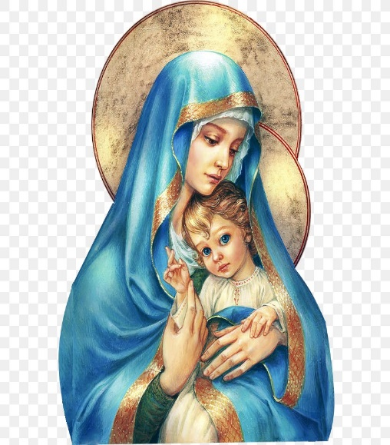
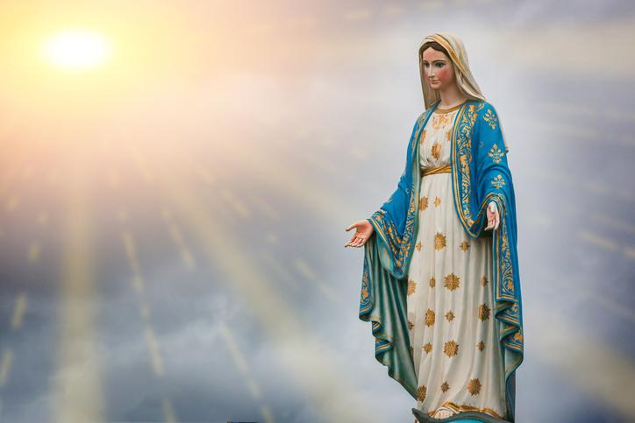
Hail Mary, Full of Grace
The Lord is with Thee
Blessed are Thou amongst women
And Blessed is the fruit of Thy womb, Jesus
Holy Mary , Mother of God
Pray for us sinners
Now and in the hour of our death
Amen

Slide 4
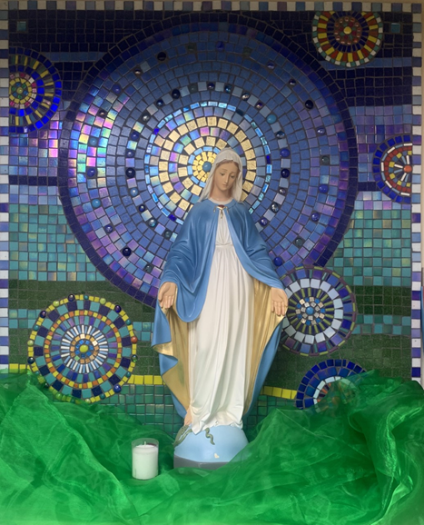
St Mary’s School Prayer
O Holy Mary,
Mother and Patron of our school,
Turn your eyes of mercy towards us,
that we may love God
With all our hearts!
May we imitate the tenderness
of your Son, Jesus,
showing love and respect
For each person
and ourselves as children of God.
Guided by the Holy Spirit,
May we create the school,
where Mercy and Compassion
Is the centre of our lives.
Amen

Slide 5
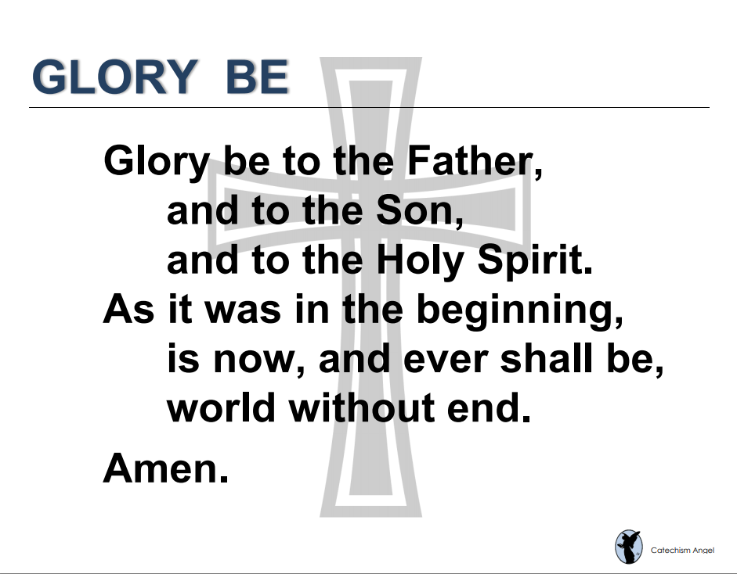

Slide 6
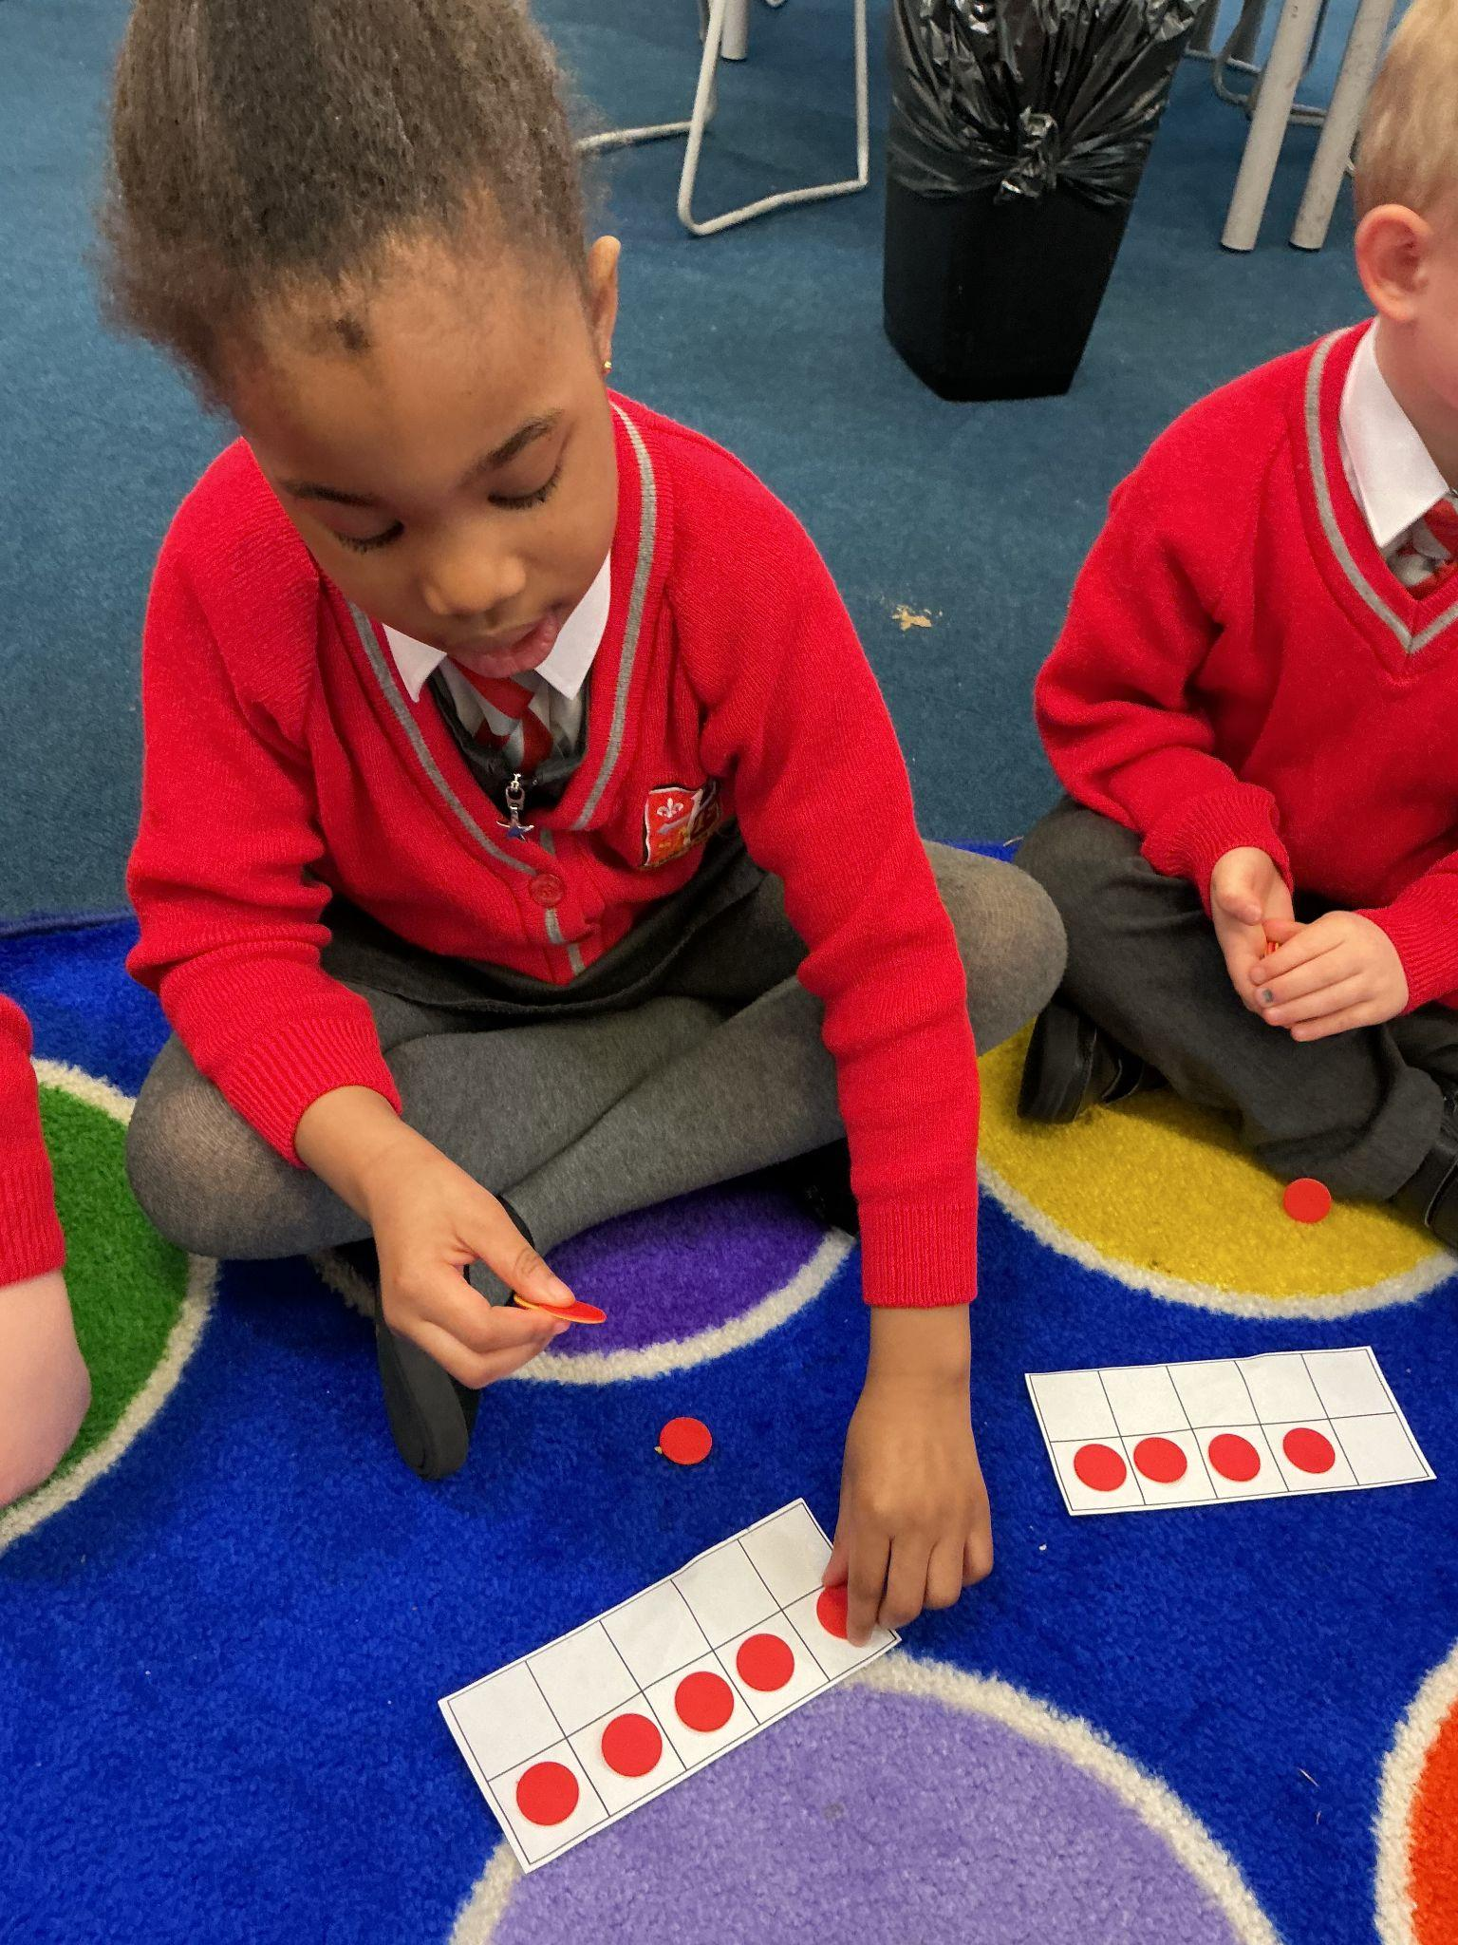
EYFS
Reception
For a wonderful attitude to her learning, asking questions and testing out her ideas especially building a house for the three pigs.
Miss Barker

Slide 7
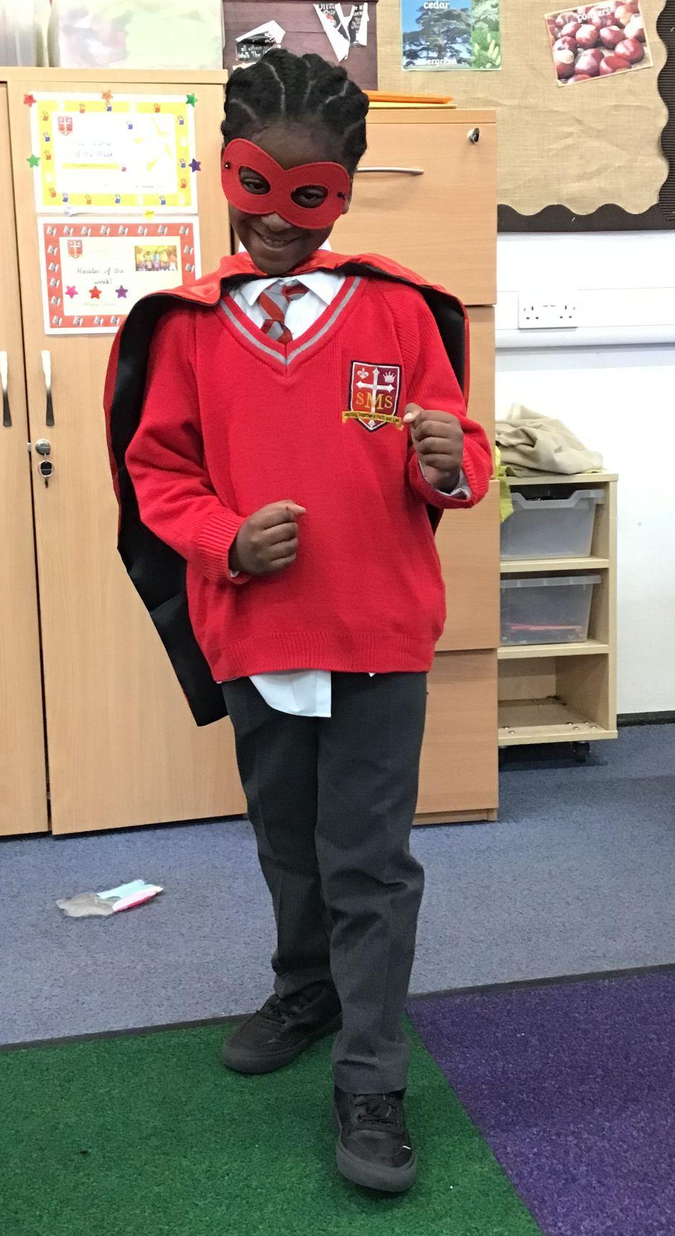
Year 1
For consistently showing focus, responsibility, and a real desire to learn. It’s wonderful to see your confidence growing, Joshua – amazing job!
Miss Flashman

Slide 8
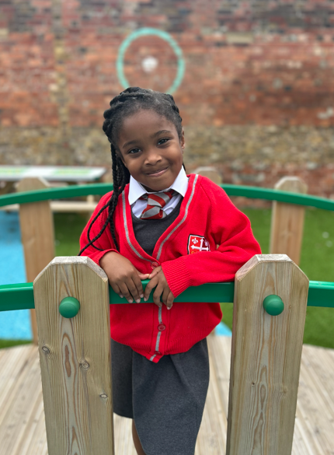
Year 2
For her infectious enthusiasm for learning!
Miss Sweet

Slide 9
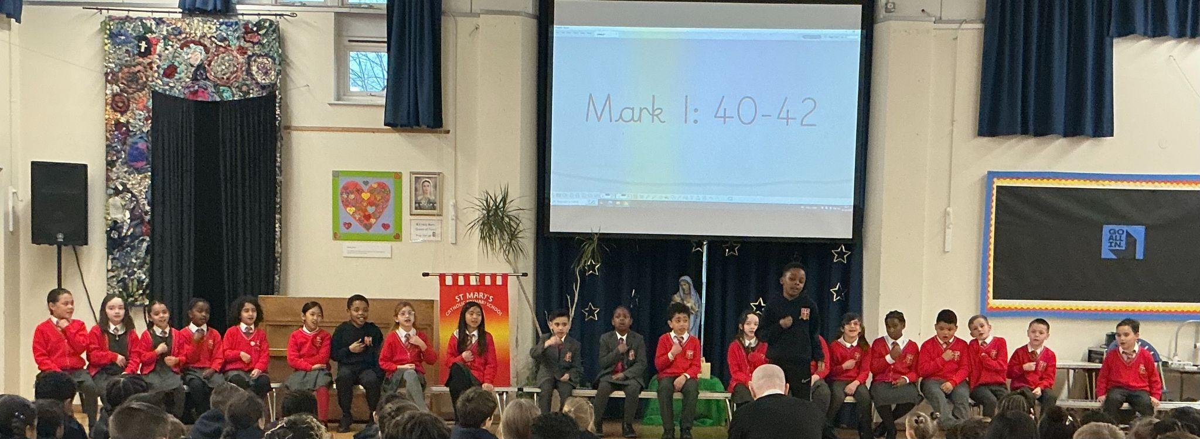
Year 3
Whole Class
For an a amazing class assembly
Mr. Larke

Slide 10
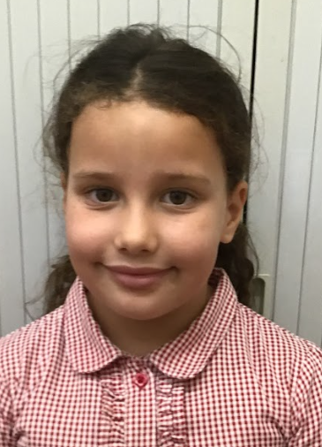
Year 3
For having a really positive week (for the second time in a row)
Mr. Larke

Slide 11
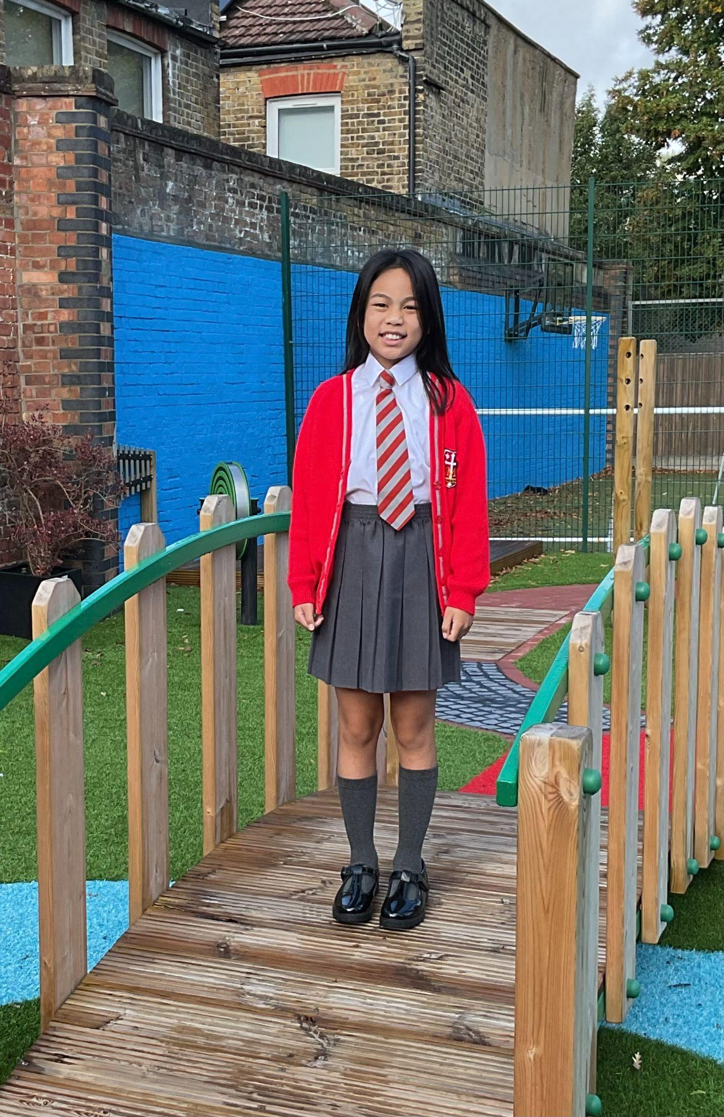
Year 4
For listening to, and implementing, feedback and so producing a superb piece of writing.
Mr Whear

Slide 12
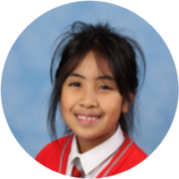
Year 5
O has a brilliant and positive attitude to learning. She has demonstrated our school core values throughout our learning journey this week and has proved
to be a positive role model in Year 5. Well done Olivia!
Mrs.Bakali

Slide 13
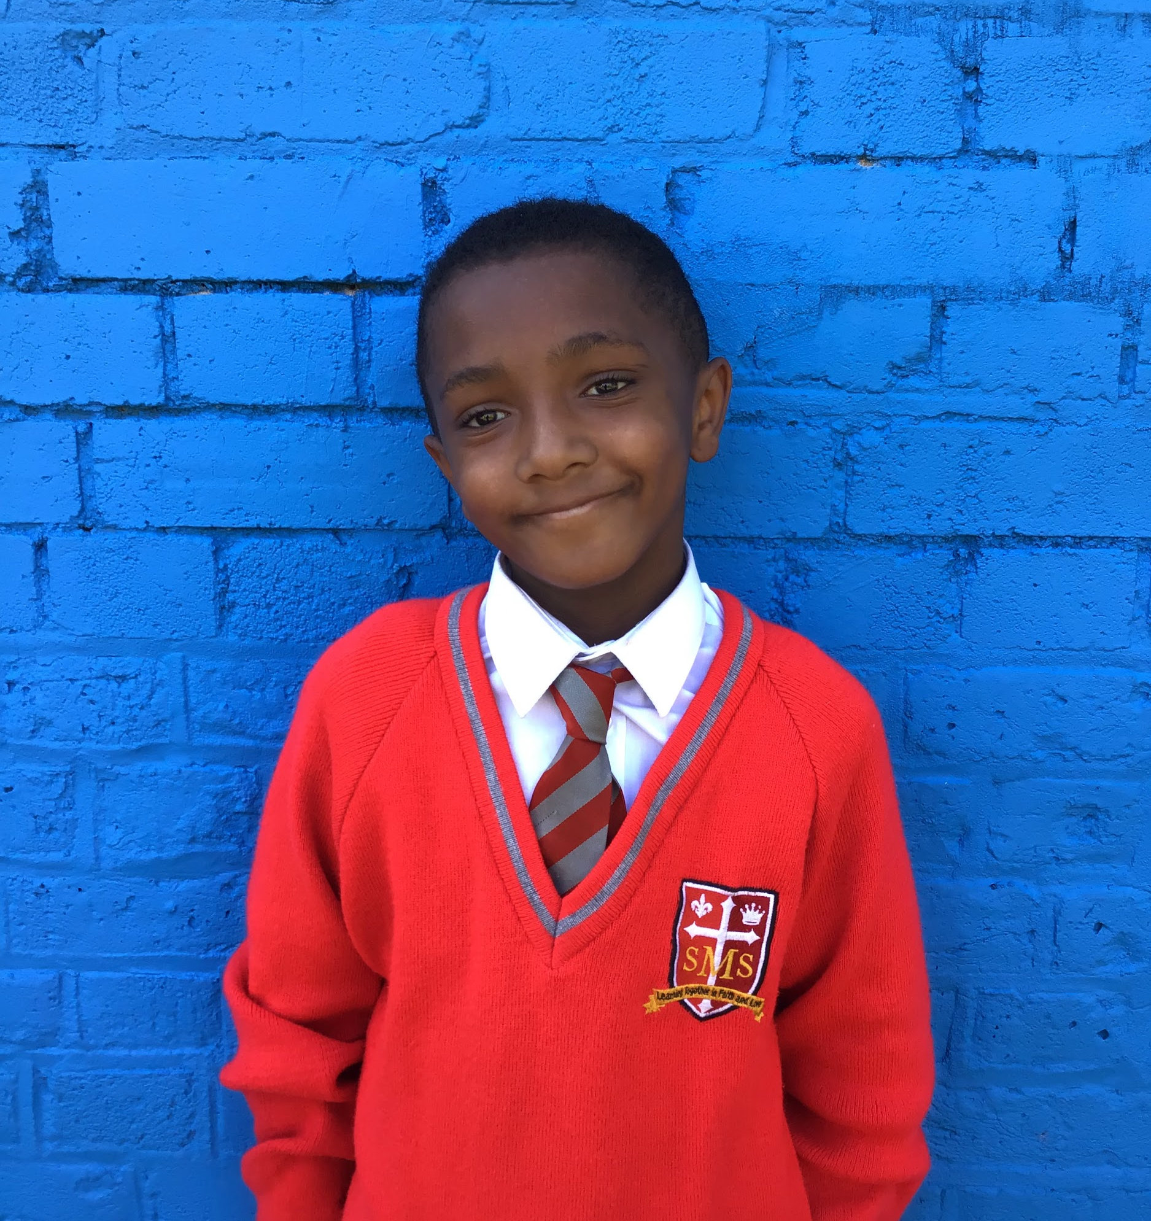
Year 6
For excellent behaviour and approach to learning. His commitment to improving his oracy and answering in clear, full sentences is exemplary.
Mr Cherfi

Slide 14



Star Readers
Y1 - Jahmiel
Y2 - Ethan
Y3 - Kadie
Y4 - Fatima
Y5 - Nathaniel
Y6 - Ana-Clara

Slide 15

Matthew Year 4
Mr Larke Y3

Slide 16
Whole School
Star of the Week
Friday 6th February 2026

