Slide 1
Whole School
Star of the Week
Friday 6th June 2025

Slide 2
Our Father who art in Heaven
Hallowed be Thy Name
Thy Kingdom come
Thy will be done on Earth as it is in Heaven
Give us this day our daily bread
And forgive us our trespasses
As we forgive those who trespass against us
And lead us not into temptation
But deliver us from evil
Amen

Slide 3
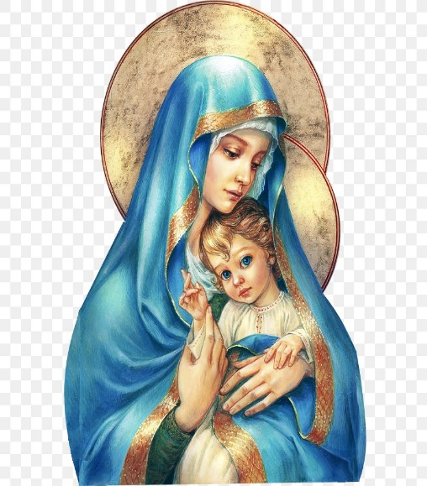
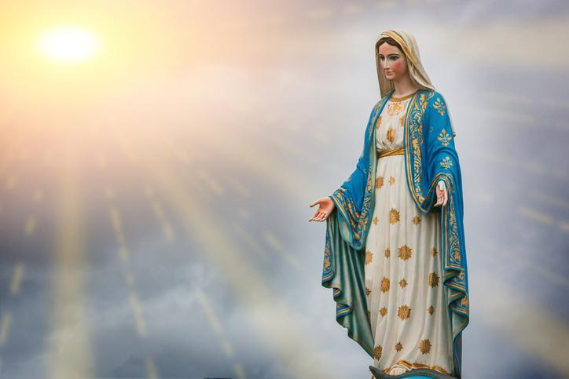
Hail Mary, Full of Grace
The Lord is with Thee
Blessed are Thou amongst women
And Blessed is the fruit of Thy womb, Jesus
Holy Mary , Mother of God
Pray for us sinners
Now and in the hour of our death
Amen

Slide 4
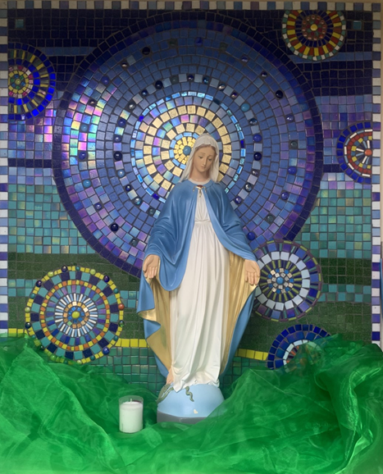
St Mary’s School Prayer
O Holy Mary,
Mother and Patron of our school,
Turn your eyes of mercy towards us,
that we may love God
With all our hearts!
May we imitate the tenderness
of your Son, Jesus,
showing love and respect
For each person
and ourselves as children of God.
Guided by the Holy Spirit,
May we create the school,
where Mercy and Compassion
Is the centre of our lives.
Amen

Slide 6
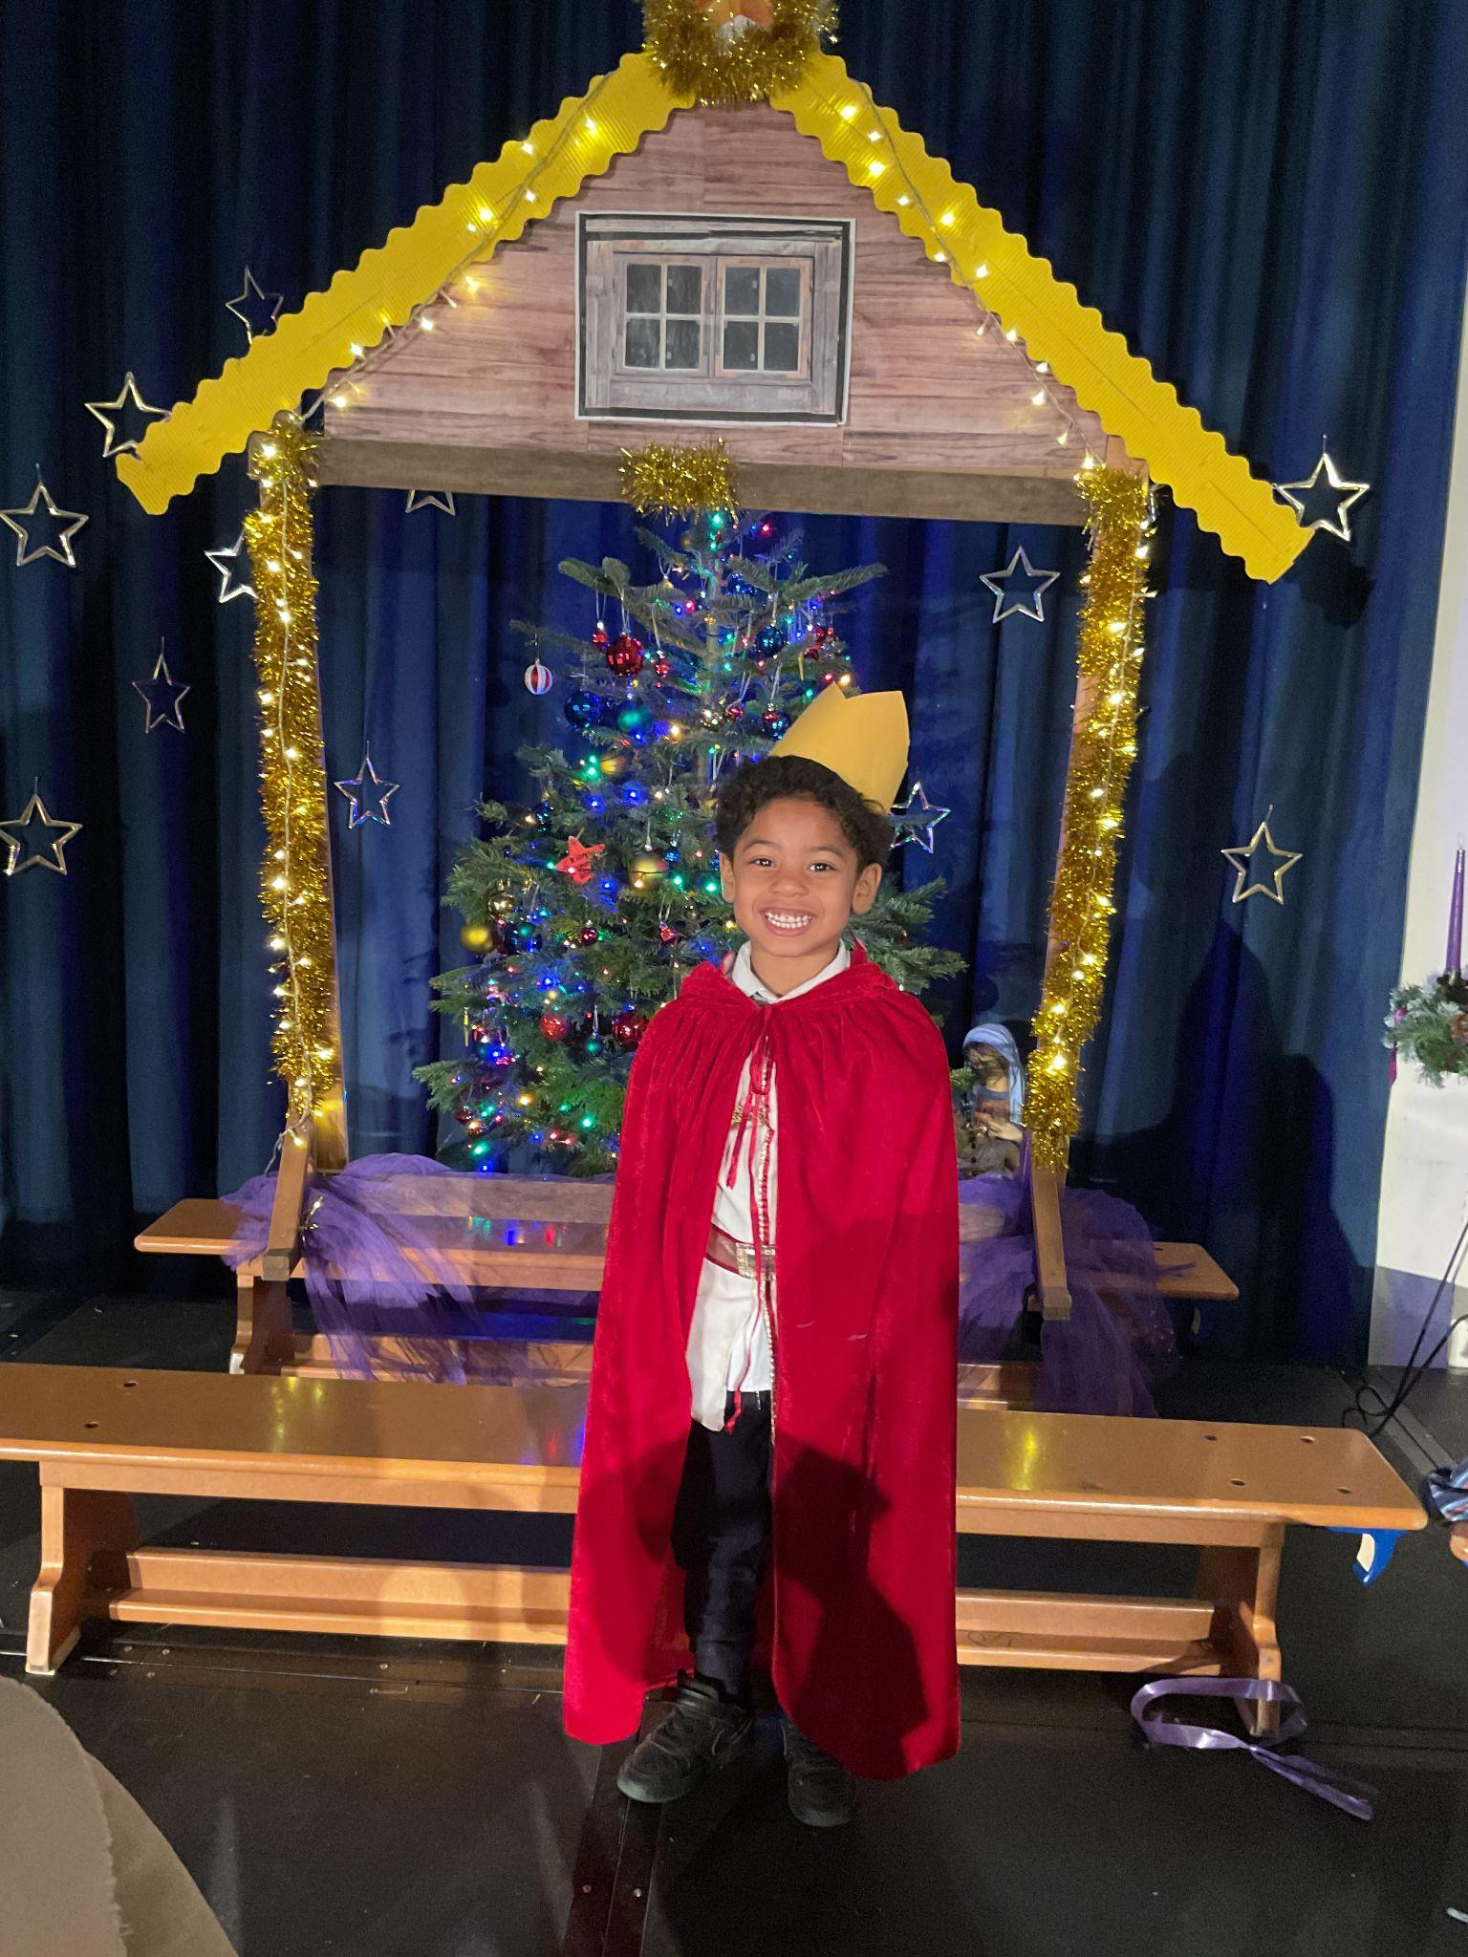
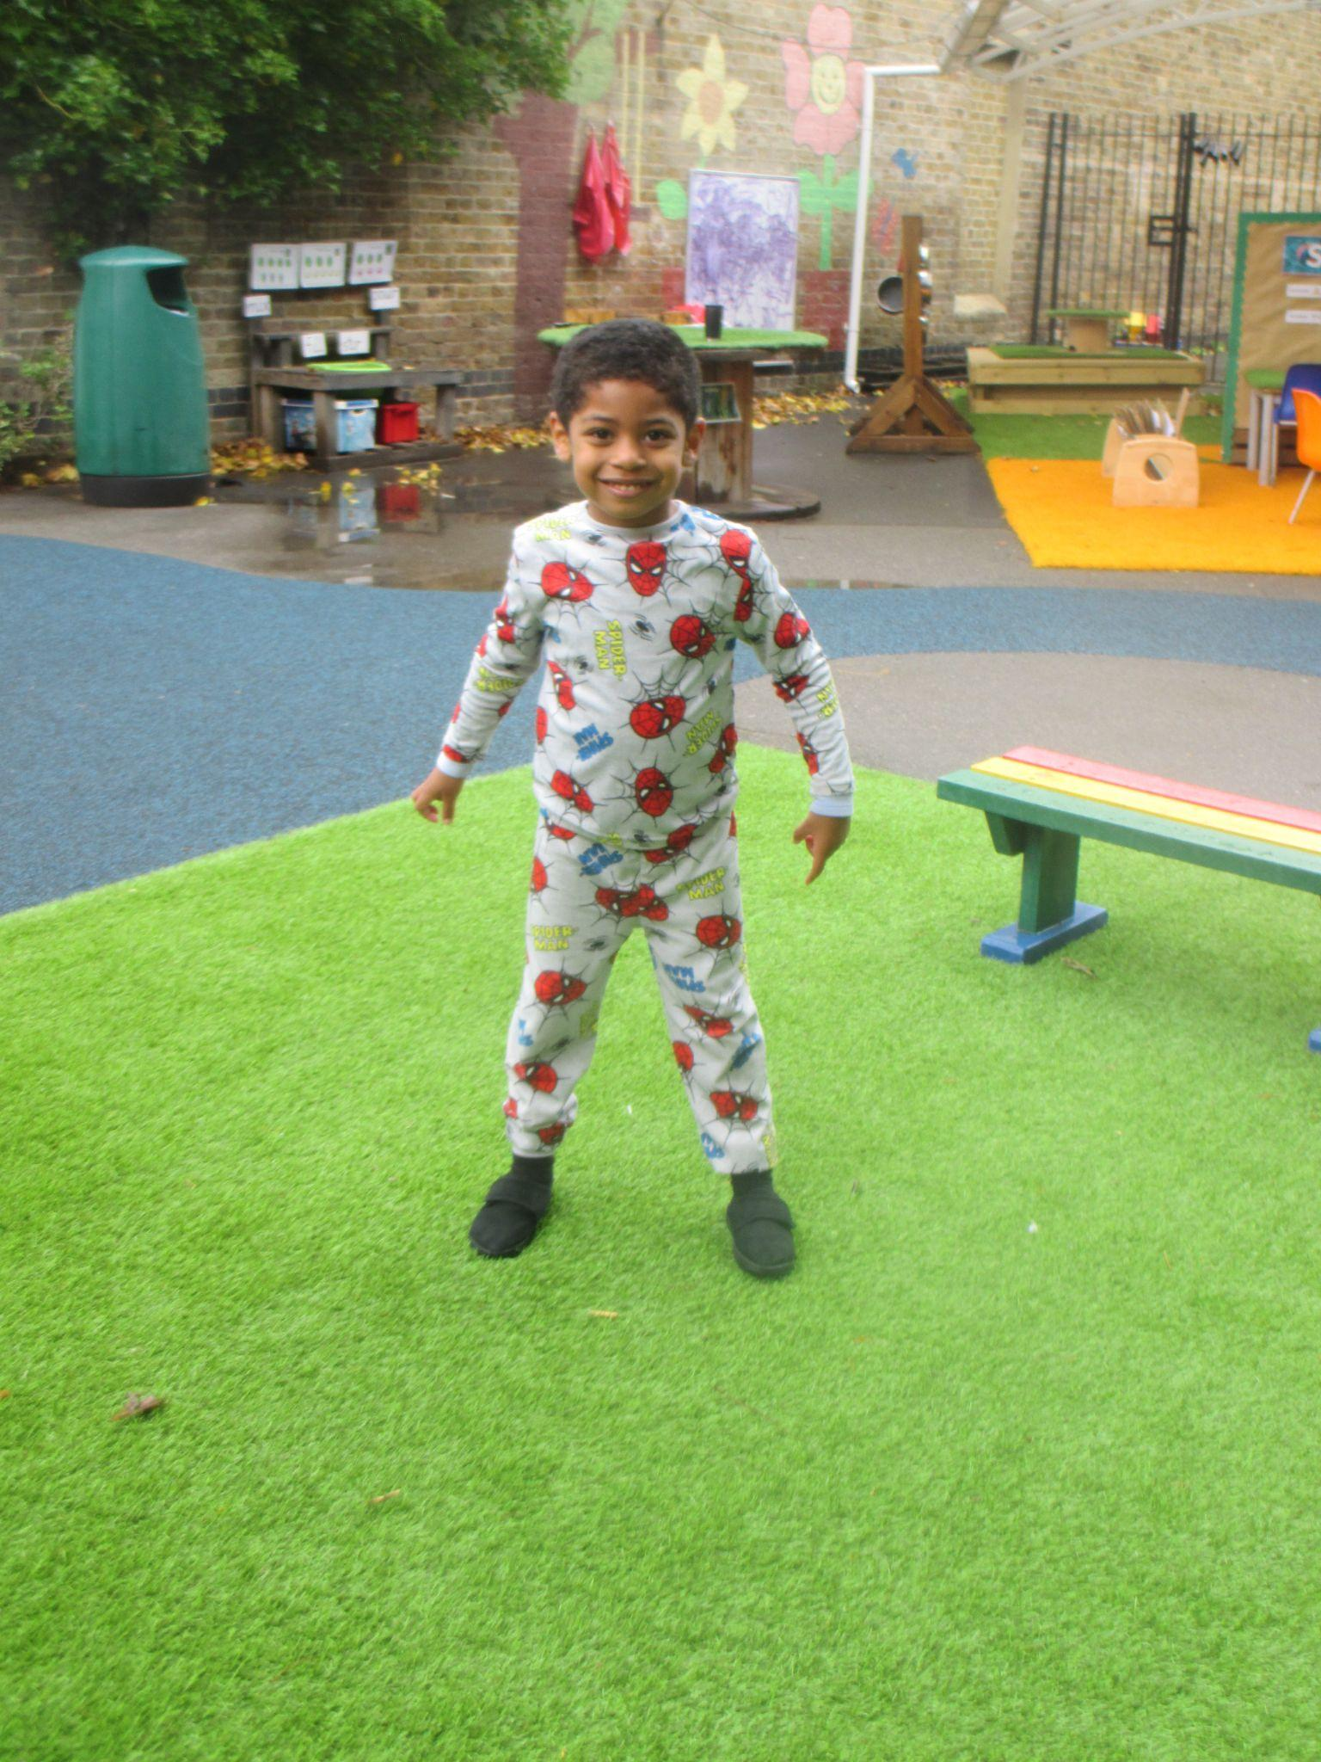
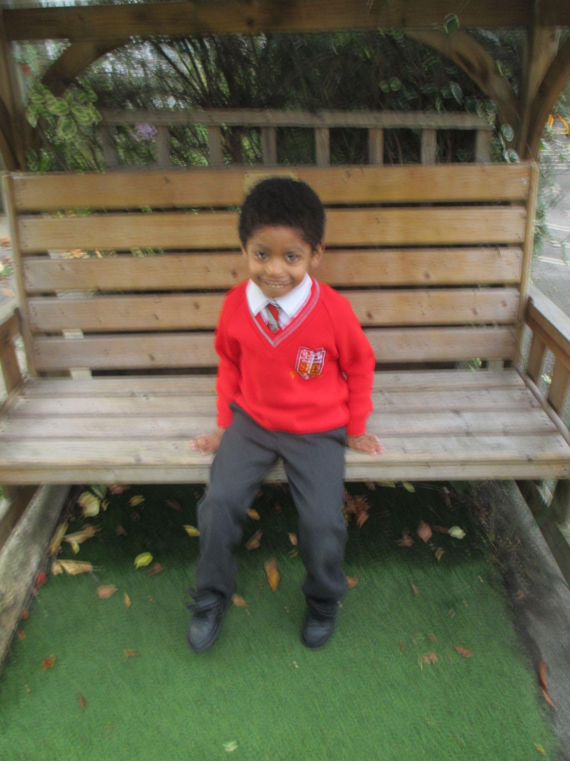
Early Years
Reception
For having a fantastic week and trying his best to stay focused in all lessons.
Miss Barker

Slide 7
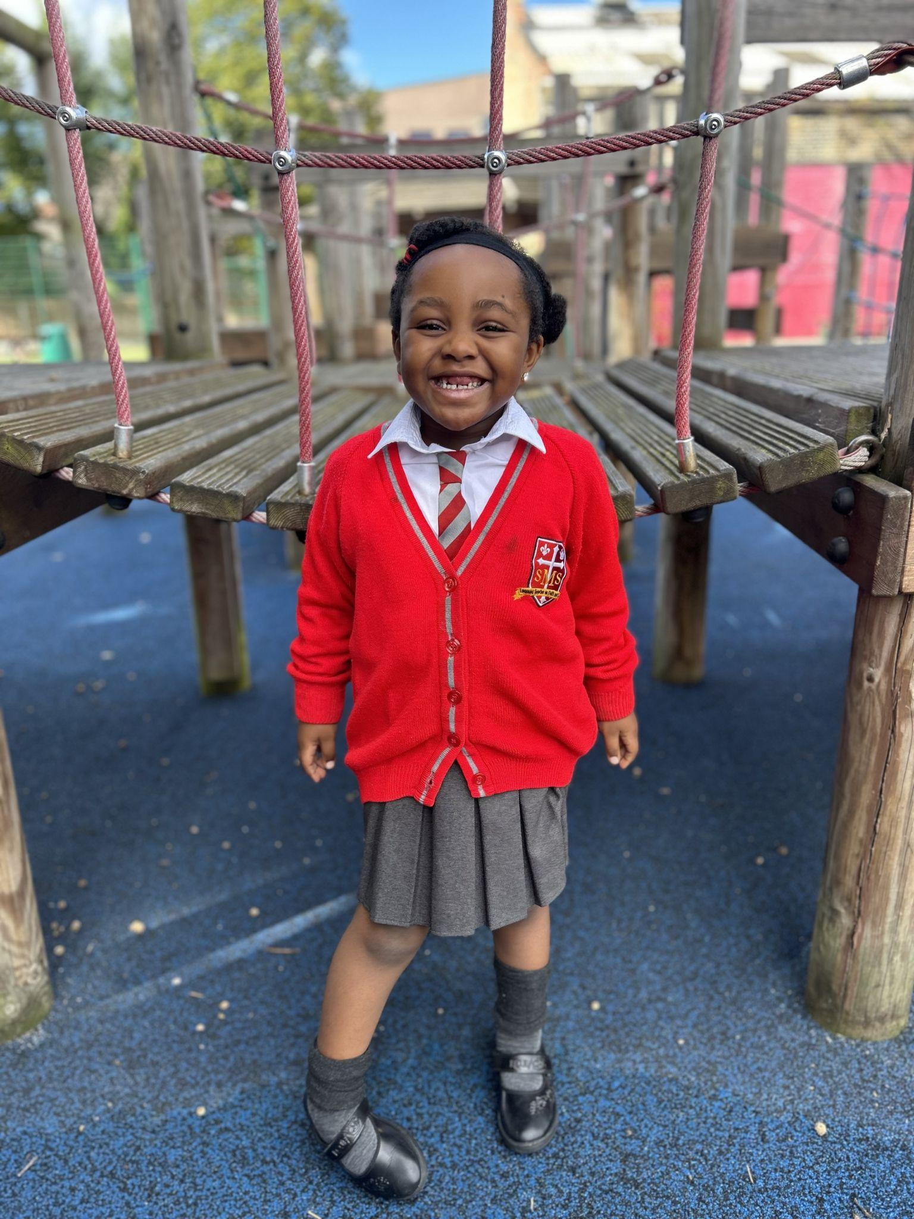
Year 1
For being a role model to her peers by always following the Golden Rules.
Miss Sweet

Slide 8
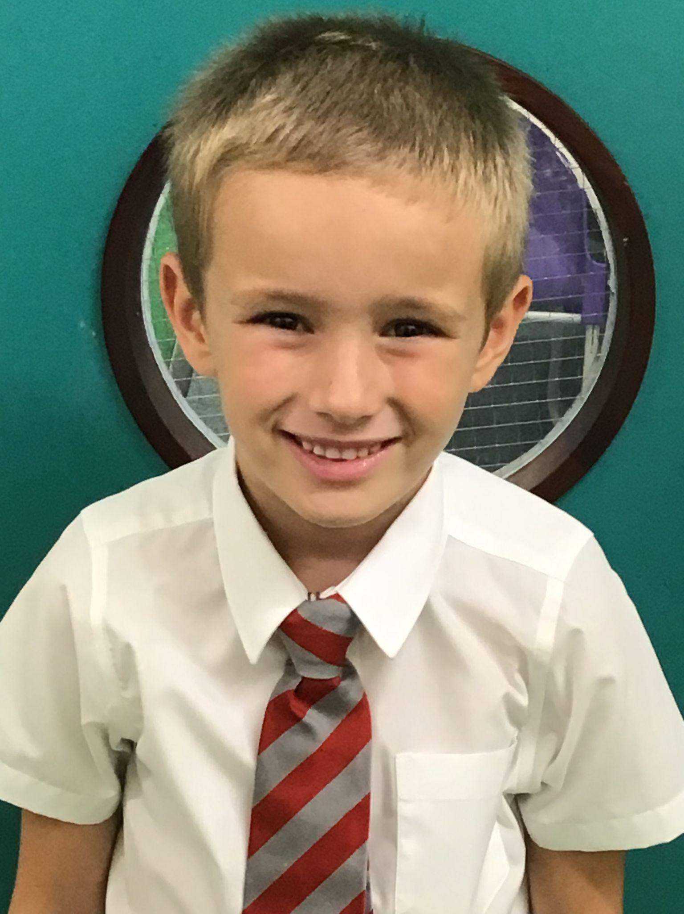
Year 2
For working so hard at his listening skills and then applying his learning in his independent work - in all subjects.
Mr Whear

Slide 9
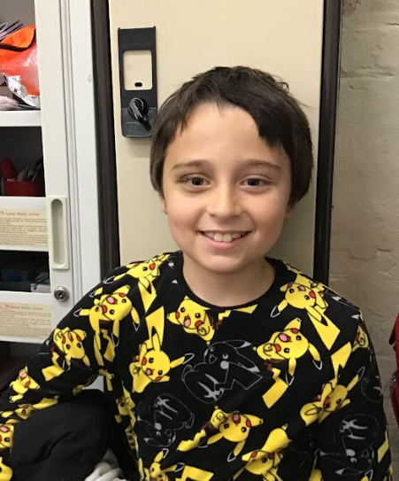
Year 3
Miss Medioli

Slide 10
Year 4
For his consistent hard work and responsible attitude throughout the whole year.
Miss Forrest

Slide 11
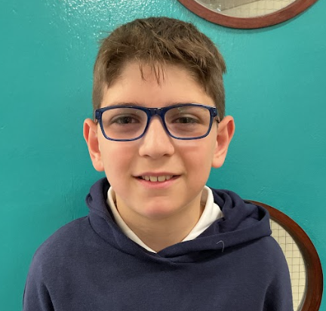
Year 5
For a fantastic and positive start to Year 5 at St. Mary’s
Mr Larke

Slide 12
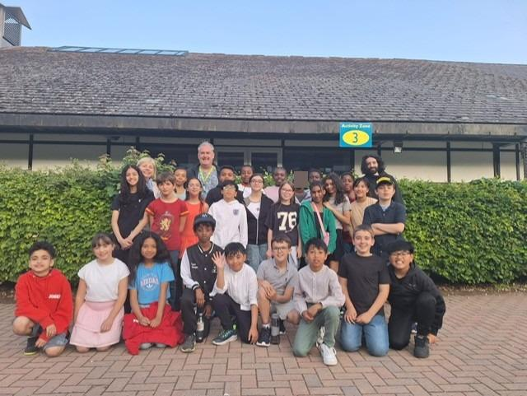
Year 6
PGL Group
Well done to all the class members who took part in the PGL residential! Your energy, resilience, and team spirit made the trip truly special. From the thrill of the giant swing and the challenge of the vertical climb, to teamwork in canoeing and the bravery shown on the trapeze—you demonstrated outstanding courage, determination, and support for one another. You should be extremely proud of everything you achieved!
Mr Cherfi, Mr Fowle & Miss Tusting

Slide 13
Star Readers
Y1 - Kavarnie
Y2 - Ricardo
Y3 - Noah
Y4 - Julia
Y5 - Zamarah

Slide 14
Olly Y1
Caleb Y4
Ms Barker
Ms Cummings

Slide 15
Whole School
Star of the Week
Friday 6th June 2025

