Slide 1




Whole School
Star of the Week
Friday 6th March 2026

Slide 2


Our Father who art in Heaven
Hallowed be Thy Name
Thy Kingdom come
Thy will be done on Earth as it is in Heaven
Give us this day our daily bread
And forgive us our trespasses
As we forgive those who trespass against us
And lead us not into temptation
But deliver us from evil
Amen

Slide 3
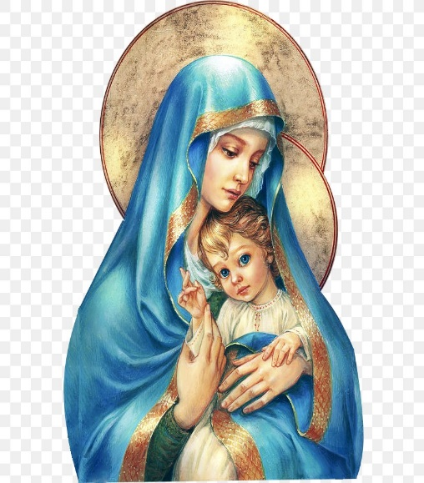
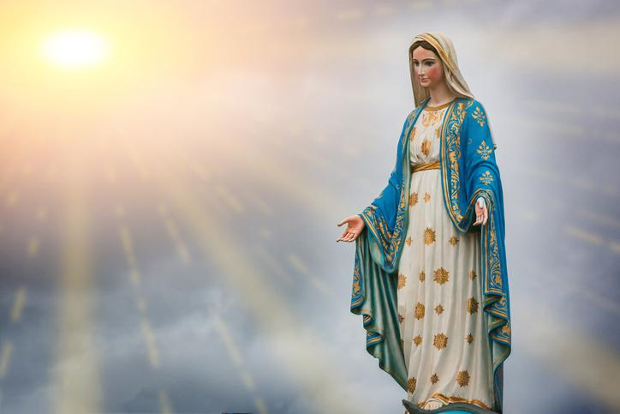
Hail Mary, Full of Grace
The Lord is with Thee
Blessed are Thou amongst women
And Blessed is the fruit of Thy womb, Jesus
Holy Mary , Mother of God
Pray for us sinners
Now and in the hour of our death
Amen

Slide 4
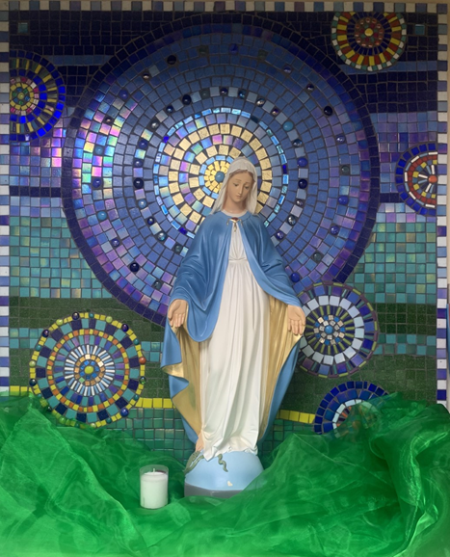
St Mary’s School Prayer
O Holy Mary,
Mother and Patron of our school,
Turn your eyes of mercy towards us,
that we may love God
With all our hearts!
May we imitate the tenderness
of your Son, Jesus,
showing love and respect
For each person
and ourselves as children of God.
Guided by the Holy Spirit,
May we create the school,
where Mercy and Compassion
Is the centre of our lives.
Amen

Slide 5


Slide 6
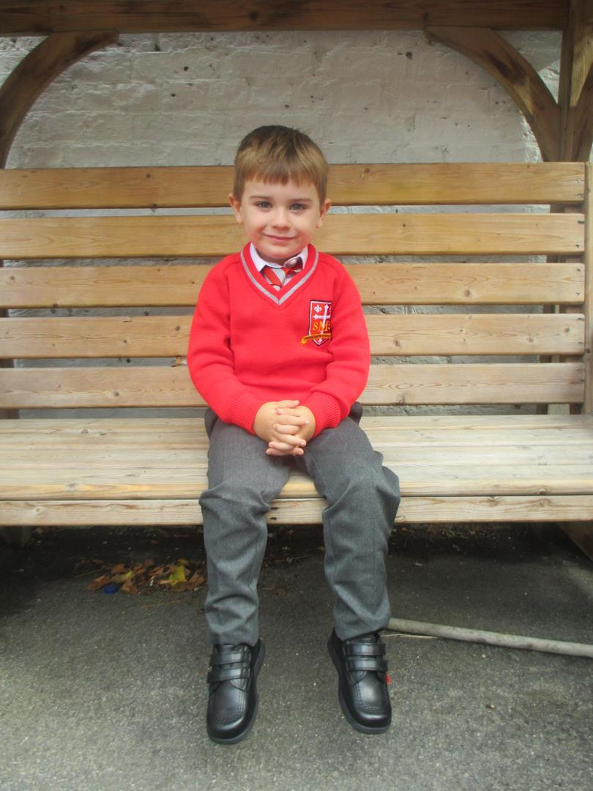
Reception
For having the best week ever in class!!!! He has tried so hard with every piece of learning this week and we are all so proud of him. Huge effort!
Miss Barker

Slide 7
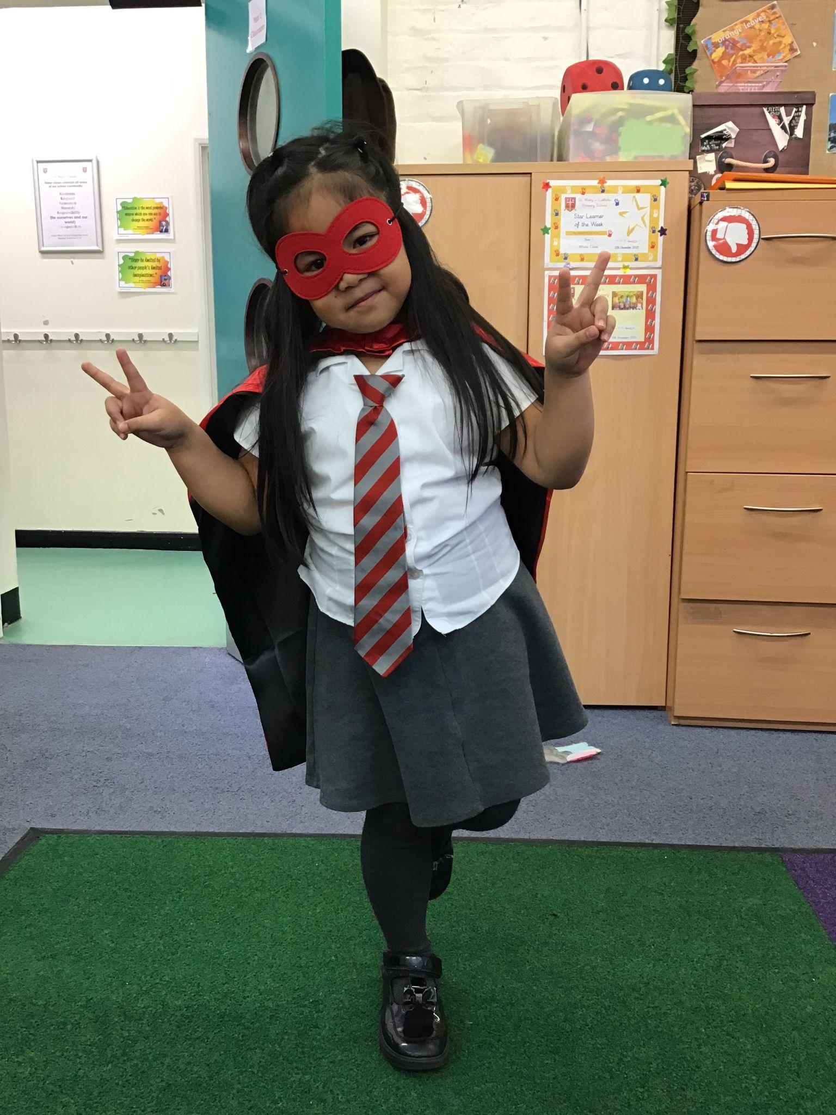
Year 1
For growing in independence to complete her work and working so hard to do the best she can!
Miss Flashman

Slide 8
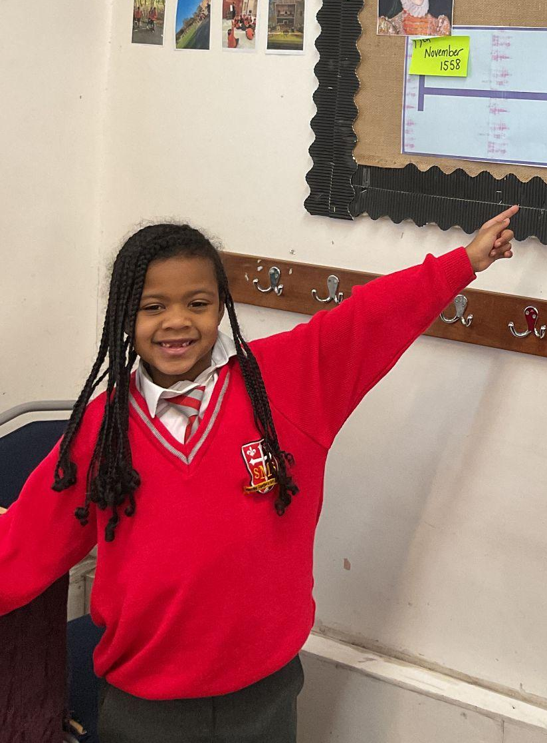
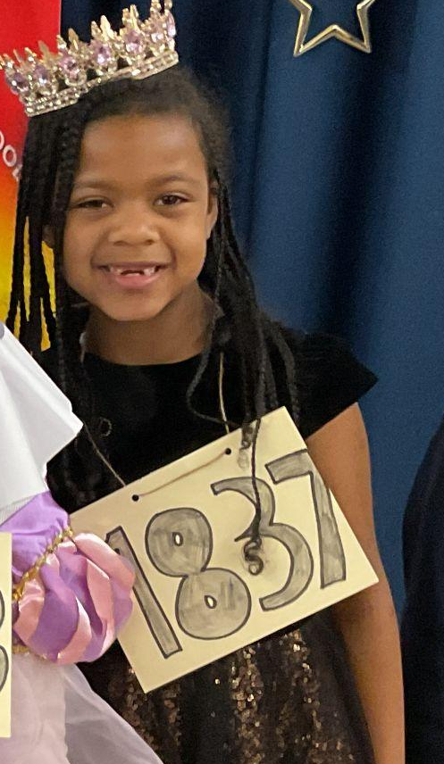
Year 2
For her perseverance during assessment week and impressing our visitors with her oracy skills!
Miss Sweet

Slide 9
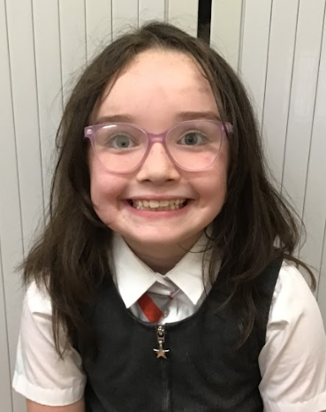
Year 3
For application and effort, reflected in assessment scores!
Mr. Larke

Slide 10
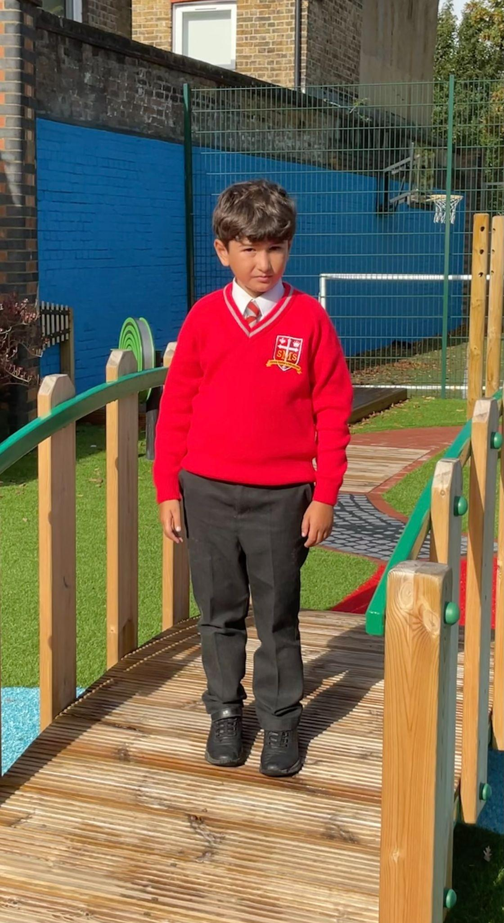
Year 4
For working extremely hard on all aspects of his life at school
Mr Whear

Slide 11
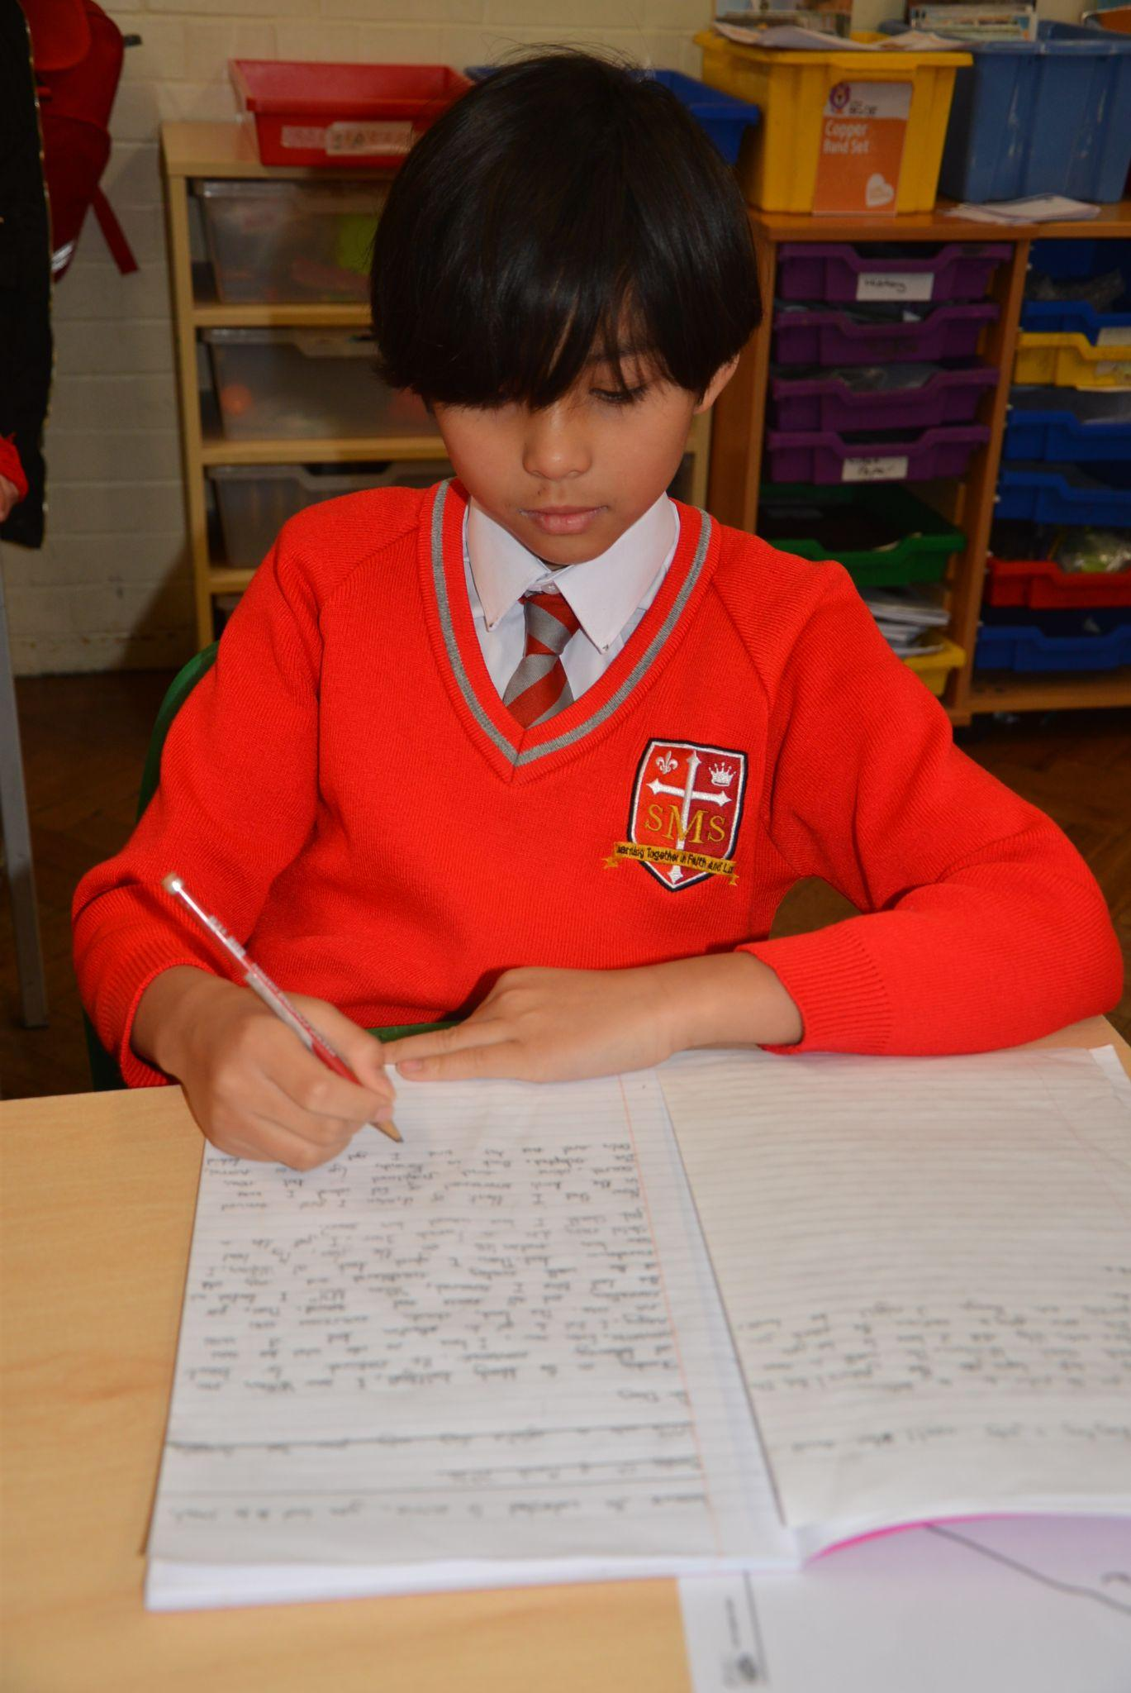
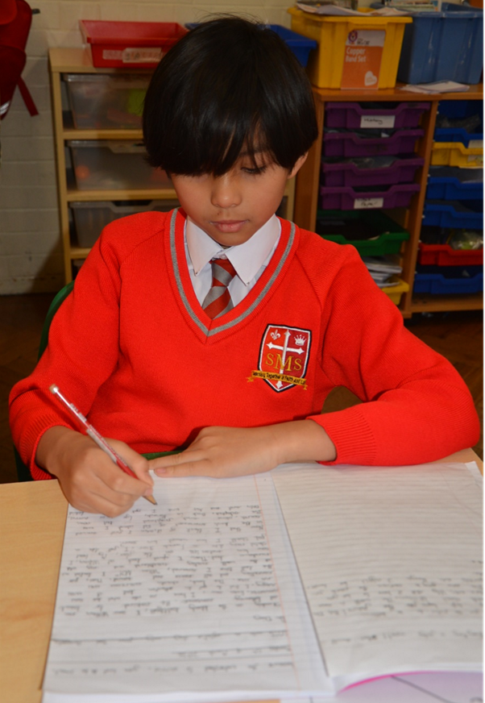
Year 5
For a positive attitude to his learning especially in English. This was demonstrated
through editing and drafting his work and was able to up-level his writing and produced a well written
Diary Entry.
Fantastic! Keep up the good work!
Ms Bakali

Slide 12
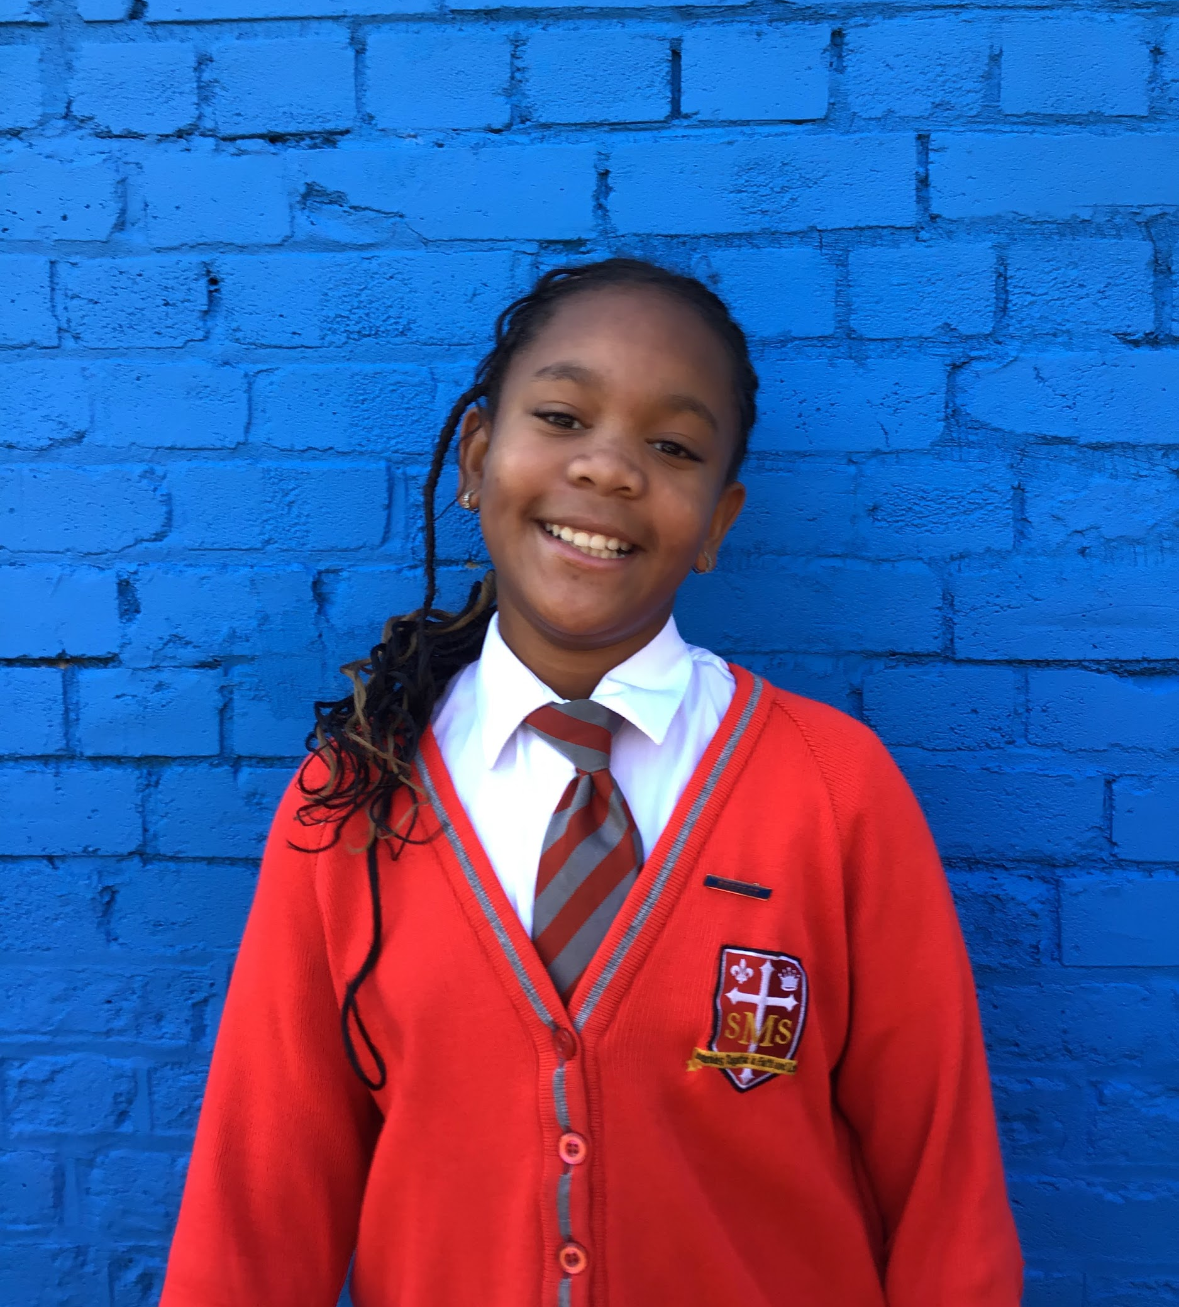
Year 6
For a great level of engagement and a phenomenal improvement across all assessments
Mr Cherfi

Slide 13



Star Readers
Y1 - Joshua
Y2 - Noel
Y3 - Mia
Y4 - Andre
Y5 - Arthur
Y6 - Layla

Slide 14

Sienna-Mae - Rec

Slide 15
Whole School
Star of the Week
Friday 6th March 2026

