Slide 1



Whole School
Star of the Week
Friday 8th May 2026

Slide 2


Our Father who art in Heaven
Hallowed be Thy Name
Thy Kingdom come
Thy will be done on Earth as it is in Heaven
Give us this day our daily bread
And forgive us our trespasses
As we forgive those who trespass against us
And lead us not into temptation
But deliver us from evil
Amen

Slide 3
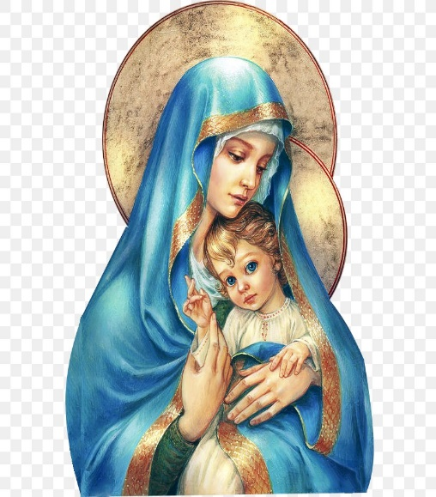
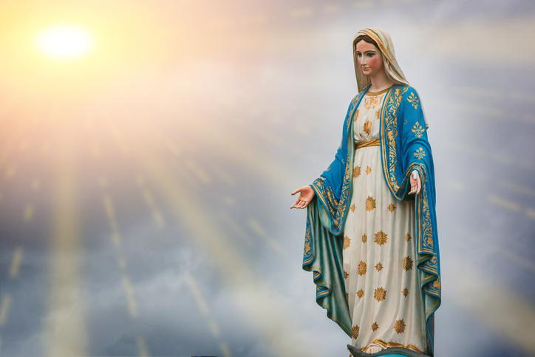
Hail Mary, Full of Grace
The Lord is with Thee
Blessed are Thou amongst women
And Blessed is the fruit of Thy womb, Jesus
Holy Mary , Mother of God
Pray for us sinners
Now and in the hour of our death
Amen

Slide 4
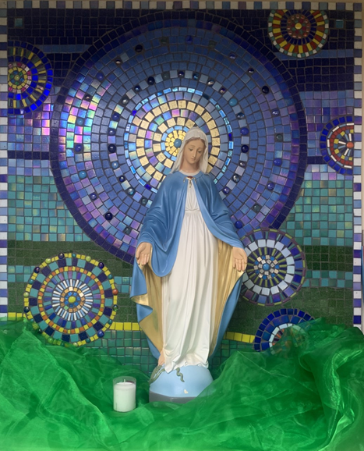
St Mary’s School Prayer
O Holy Mary,
Mother and Patron of our school,
Turn your eyes of mercy towards us,
that we may love God
With all our hearts!
May we imitate the tenderness
of your Son, Jesus,
showing love and respect
For each person
and ourselves as children of God.
Guided by the Holy Spirit,
May we create the school,
where Mercy and Compassion
Is the centre of our lives.
Amen

Slide 5
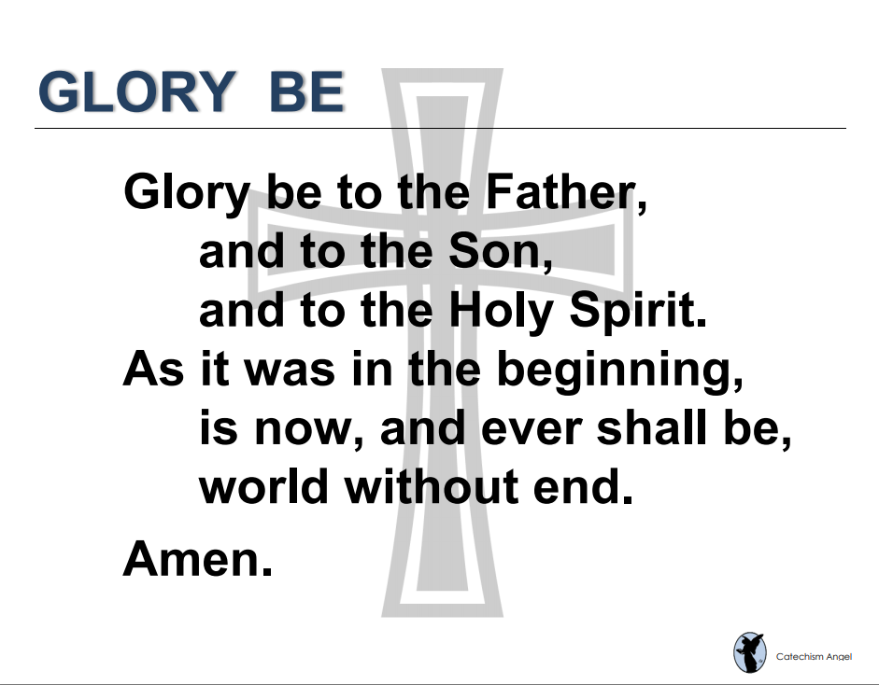

Slide 6
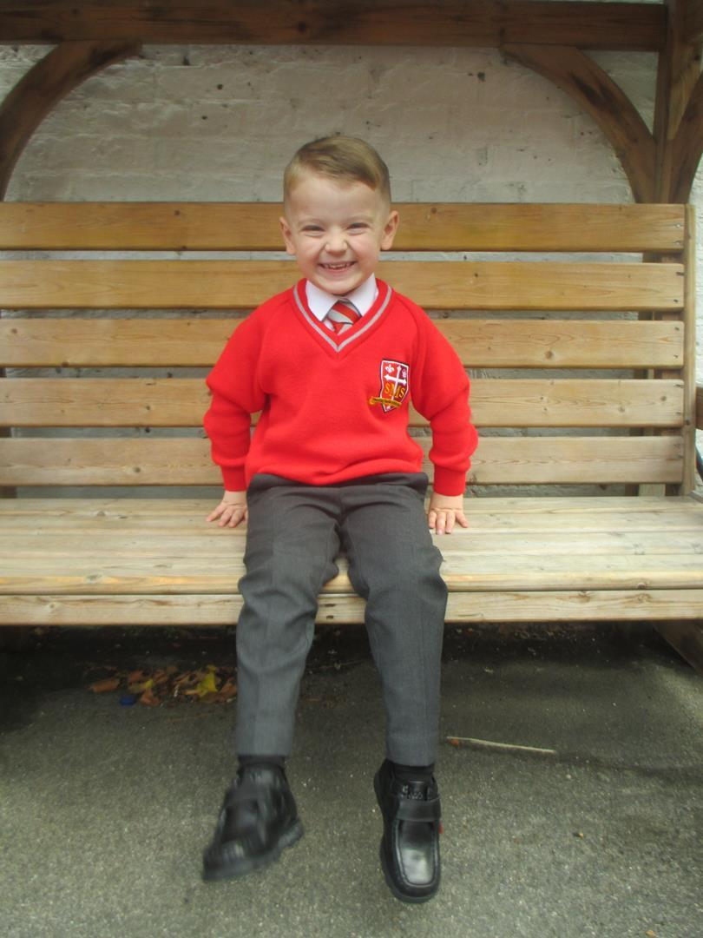
Reception
For his amazing effort this week in writing and trying to be a role model in class.
Miss Barker

Slide 7
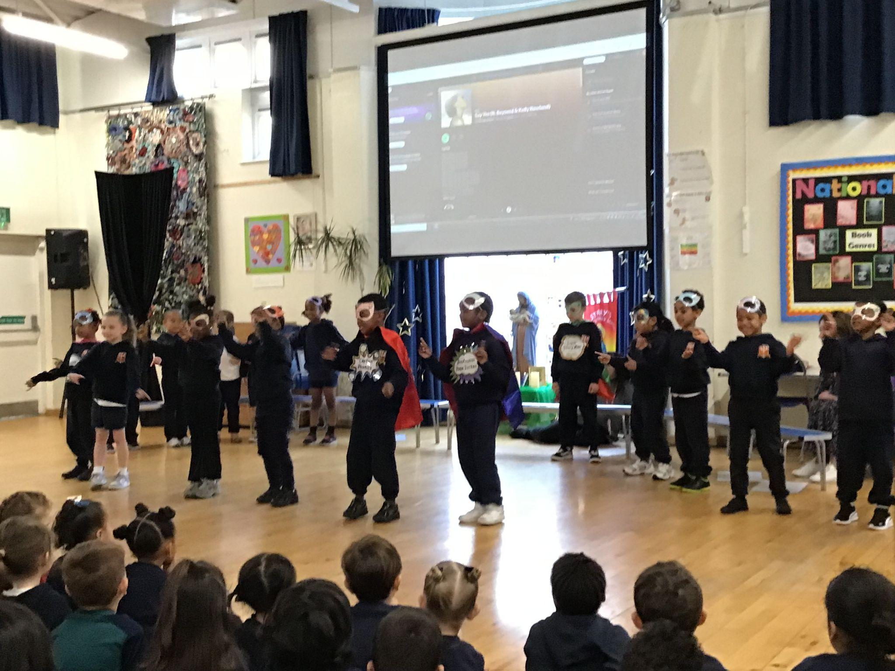
Year 1
Whole Class
For their class assembly and retelling the importance of reading.
Miss Flashman

Slide 8
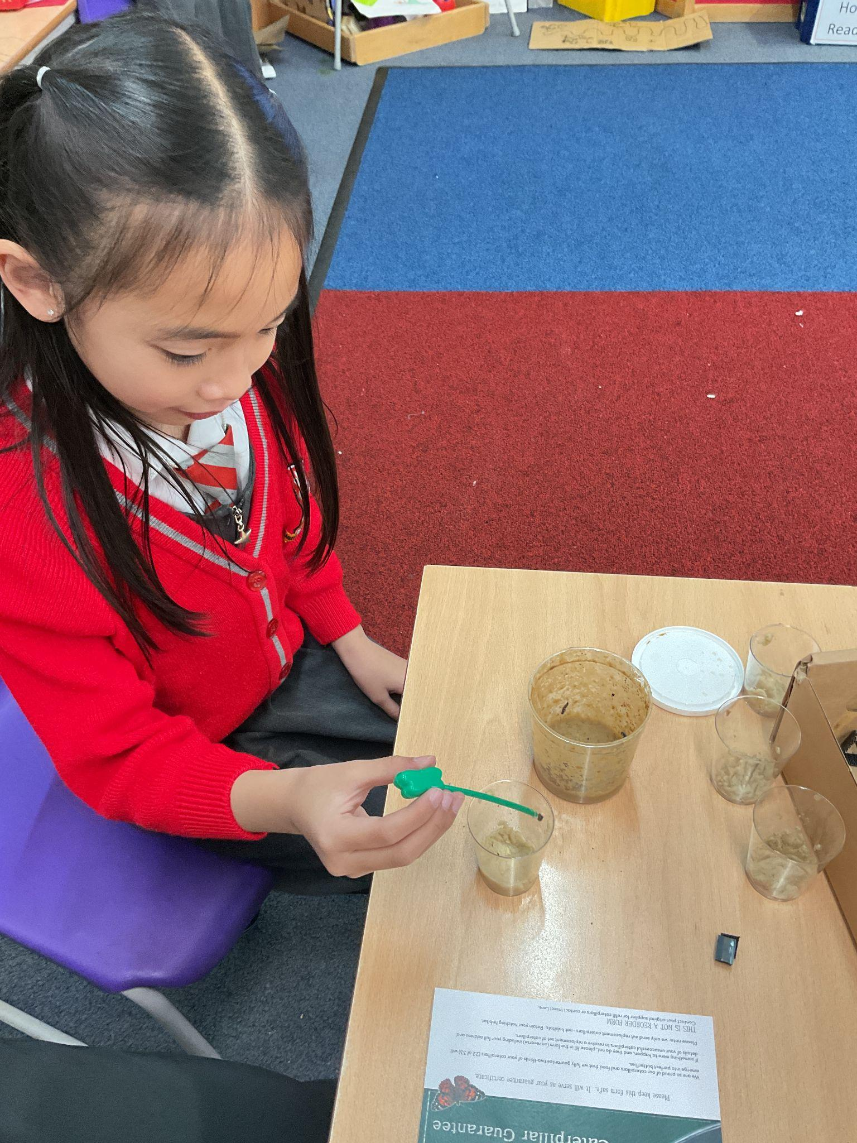
Year 2
For being a role model and always showing our school values as voted by her class.
Miss Sweet

Slide 9
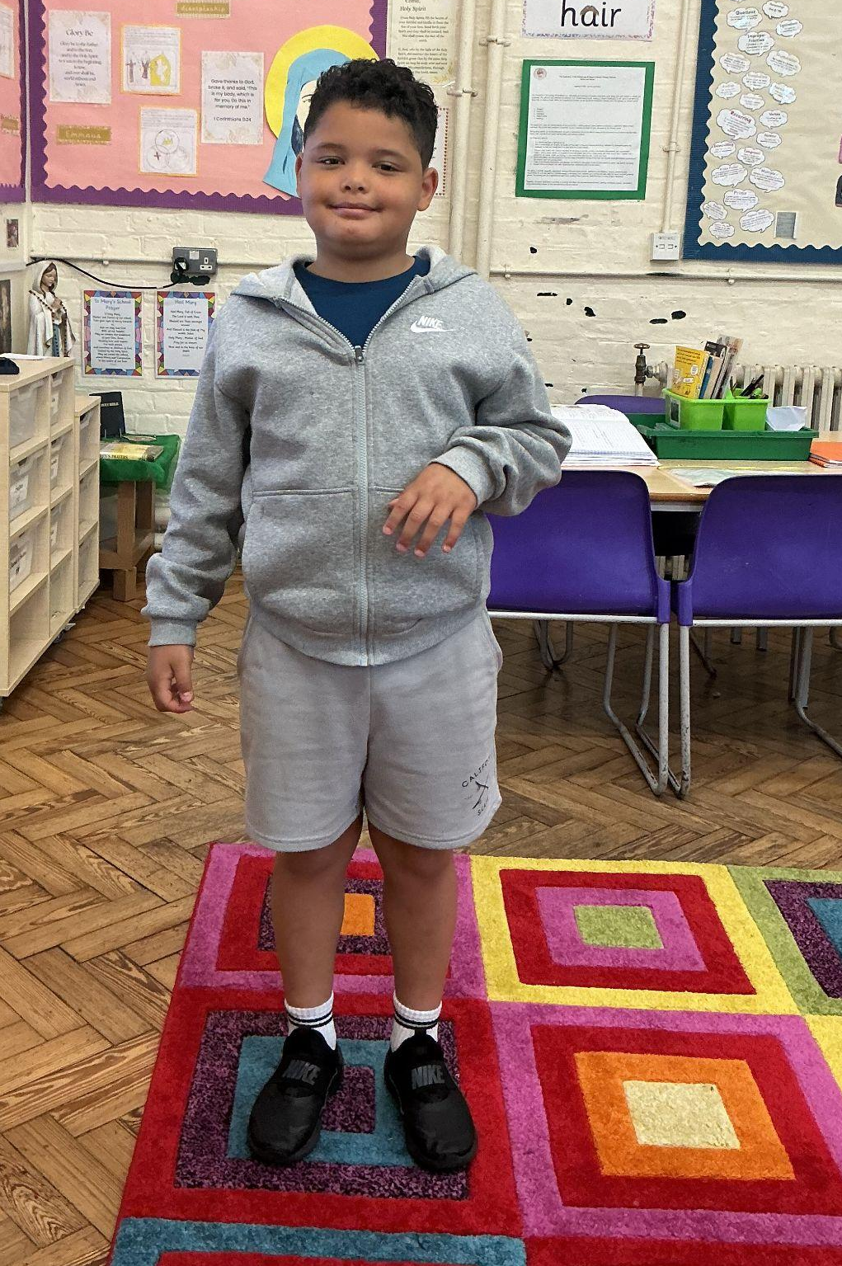
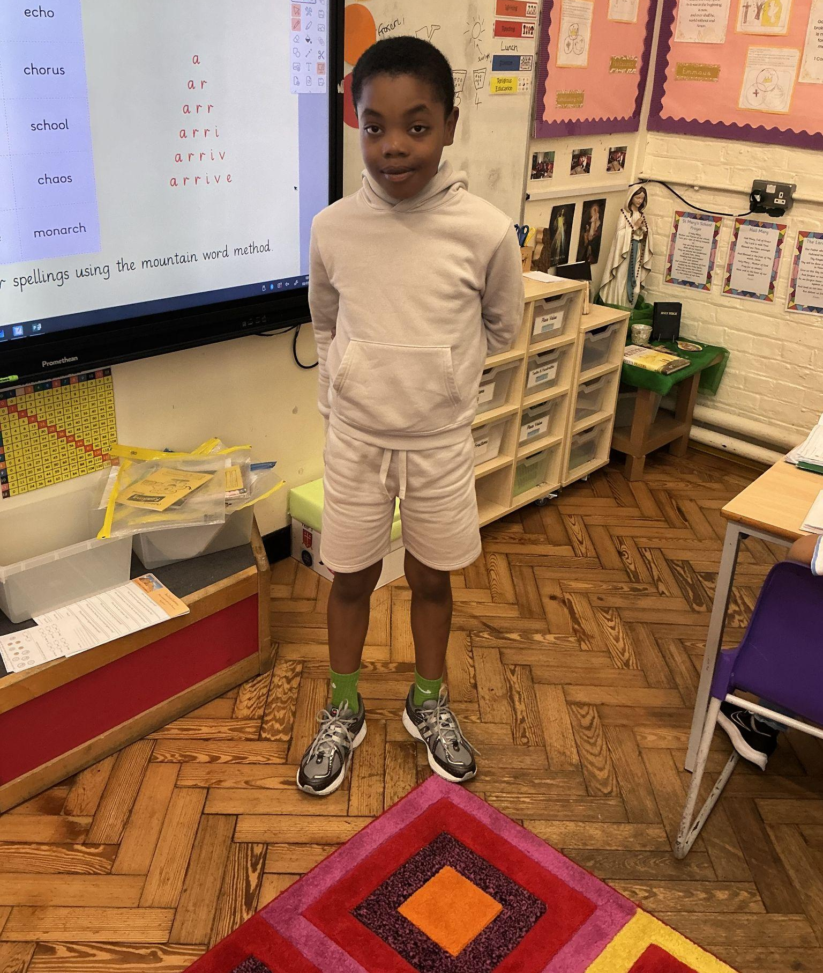
Year 3
You’ve made great progress this week and I’m super proud of you! You’ve worked hard to hit your targets and I’ve noticed the extra effort your putting into all of your learning!
Miss Hickey
Year 3
I have been really impressed with your contributions during carpet time and you’re putting much more effort into your learning. Well done!
Miss Hickey

Slide 10
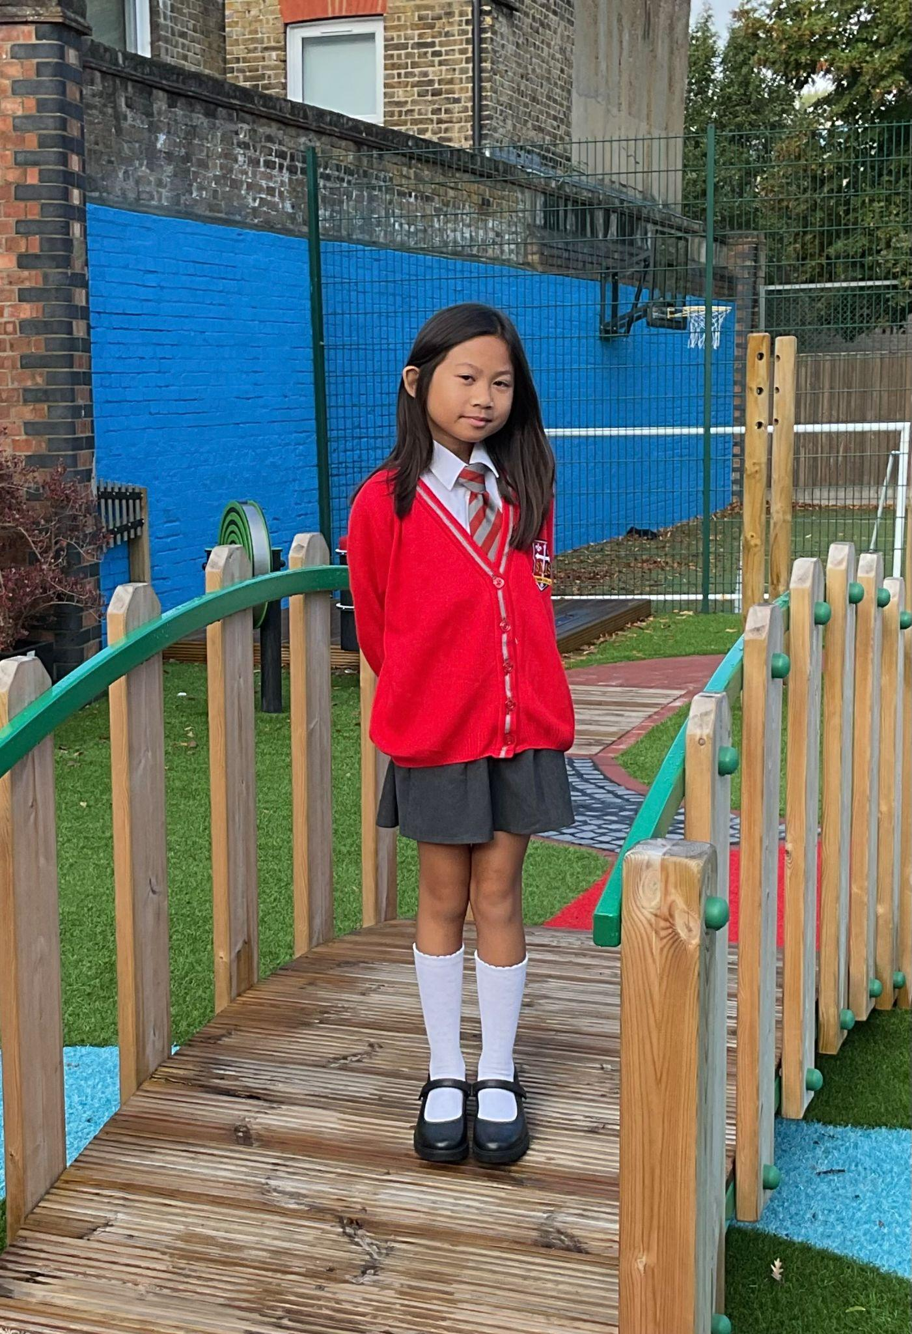
Year 4
For exemplifying our school values and challenging herself in class
Mr Whear

Slide 11
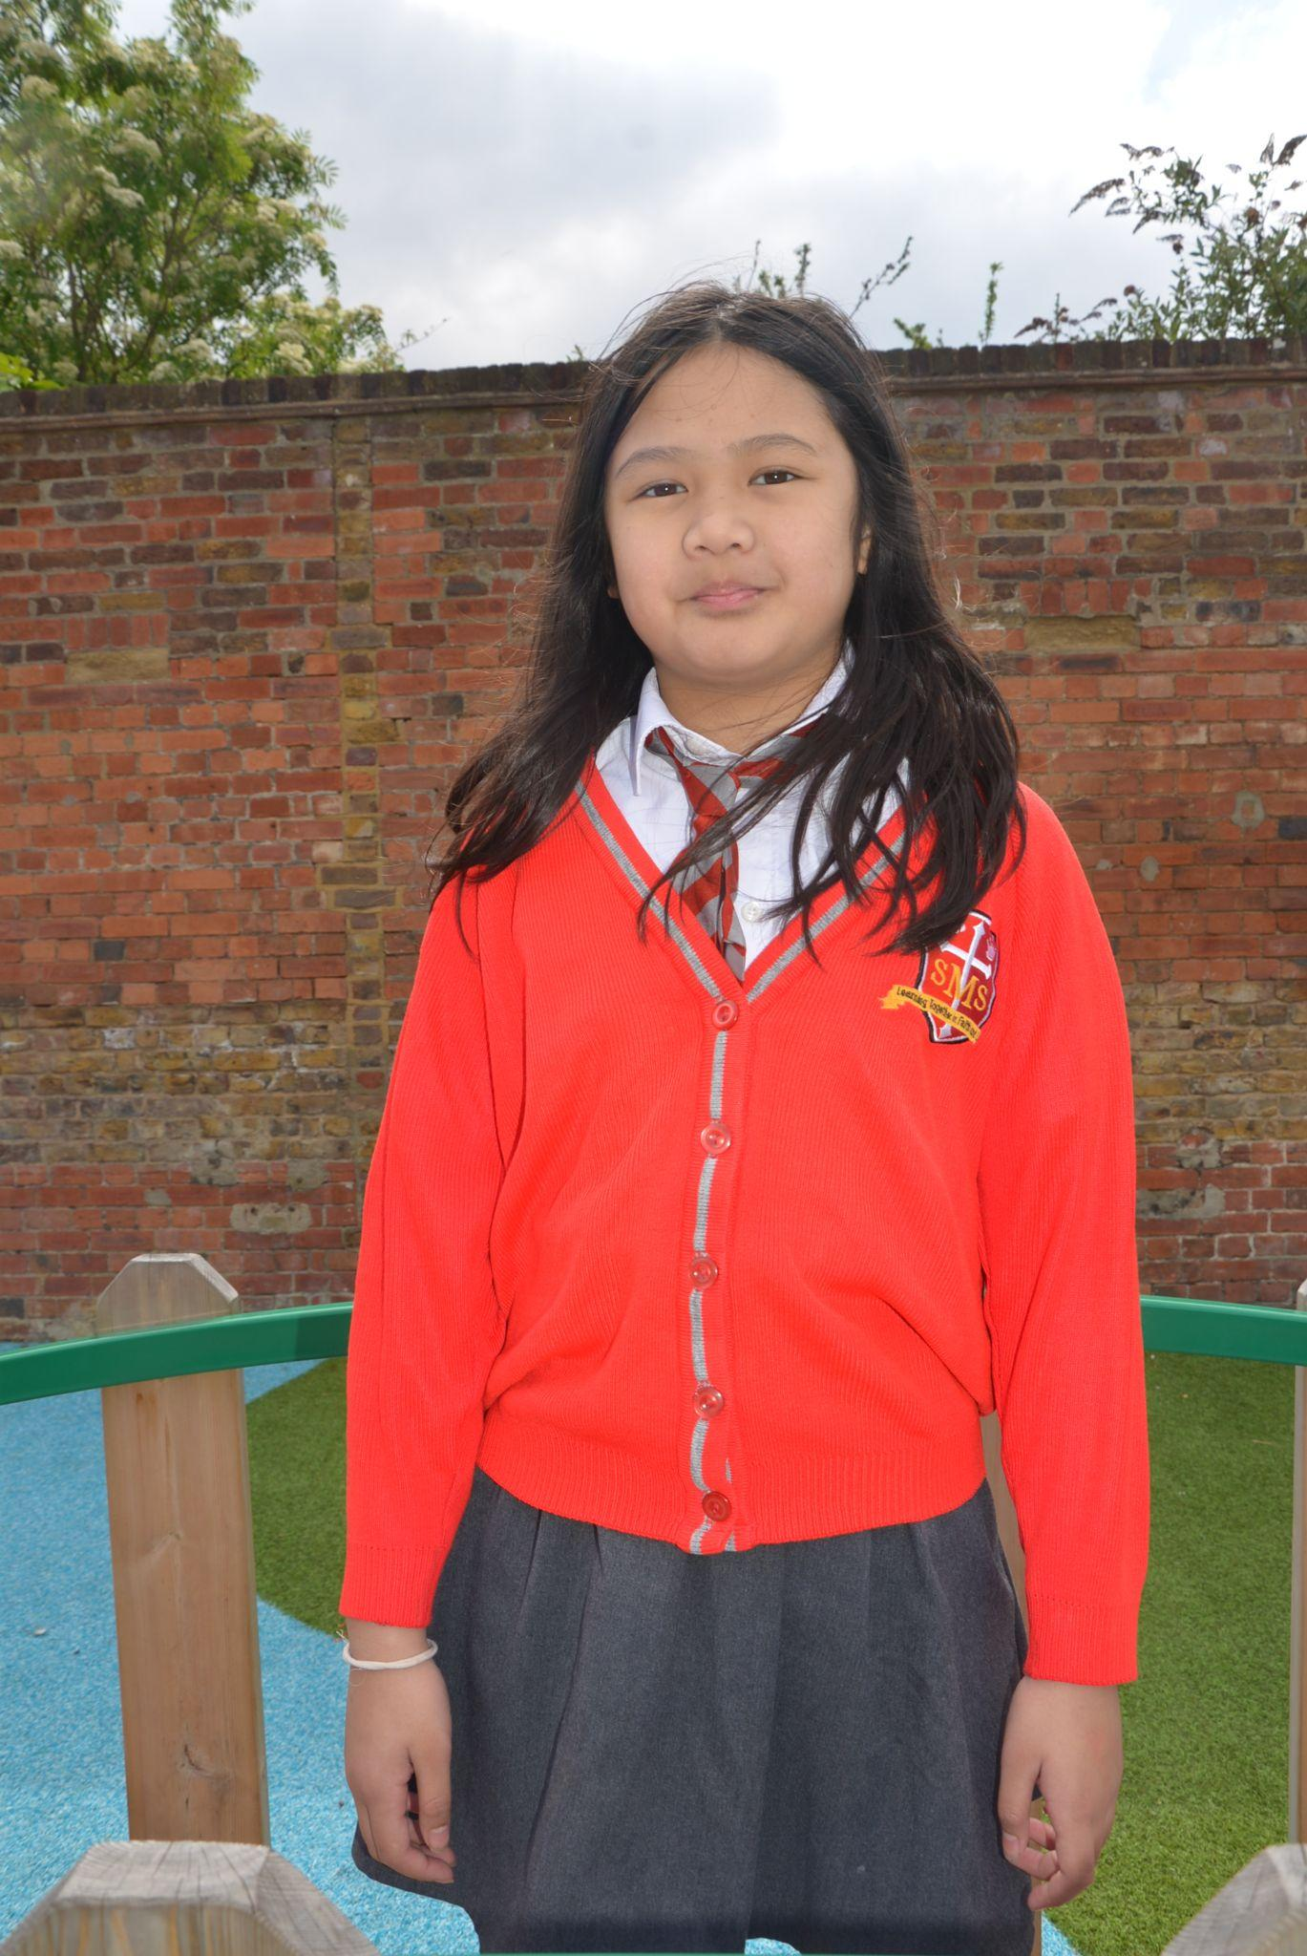
Year 5
"Our Star of the Week is being recognised for her incredible work ethic. She is a quiet leader who leads by example and she is a brilliant role model for everyone around her; showing us all what it looks like to strive for excellence. She has a fantastic attitude toward every single lesson. Her I 'can-do' attitude is infectious, and because she gives 100% to everything whether it’s a tricky task or something new, she always tries her absolute best. A huge well done
Mrs Bakali

Slide 12
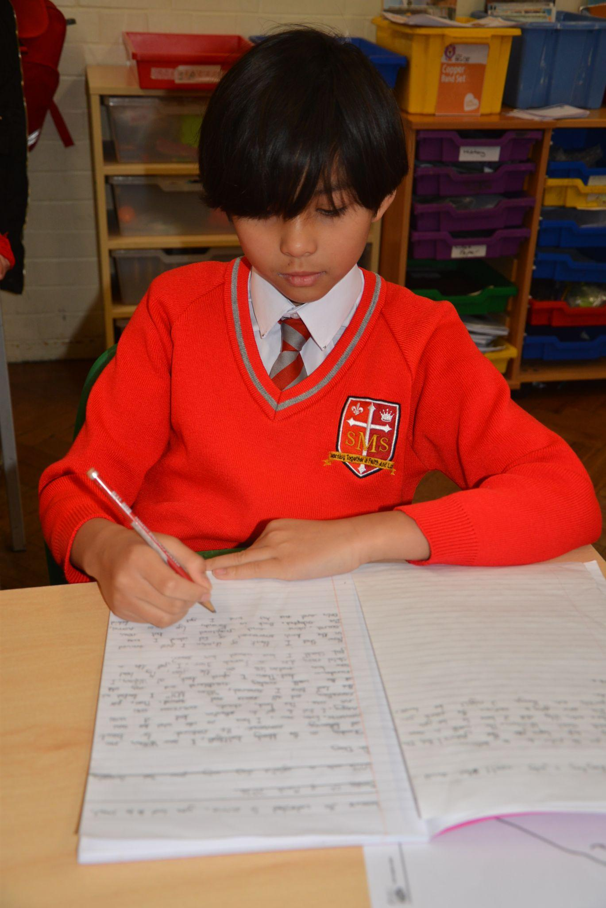
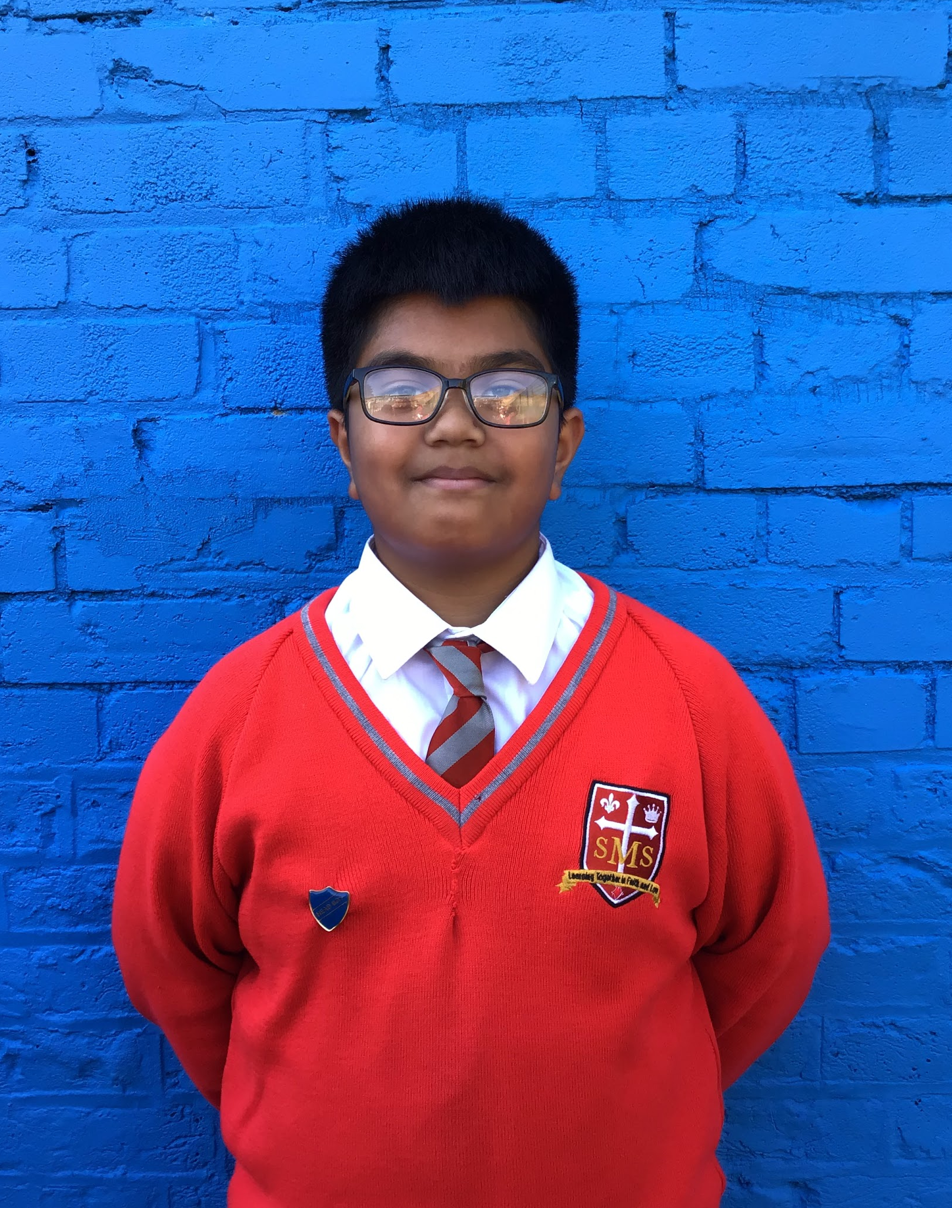
Year 6
For being an exemplary role model, unwaveringly polite, diligent and dependable.
Mr Cherfi

Slide 13



Star Readers
Y1 -
Y2 - Pippa
Y3 - Maria
Y4 - Sheraii
Y5 - Sofia
Y6 - Ana Clara

Slide 14

Amy - Y6
Delilah - Y4

Slide 15
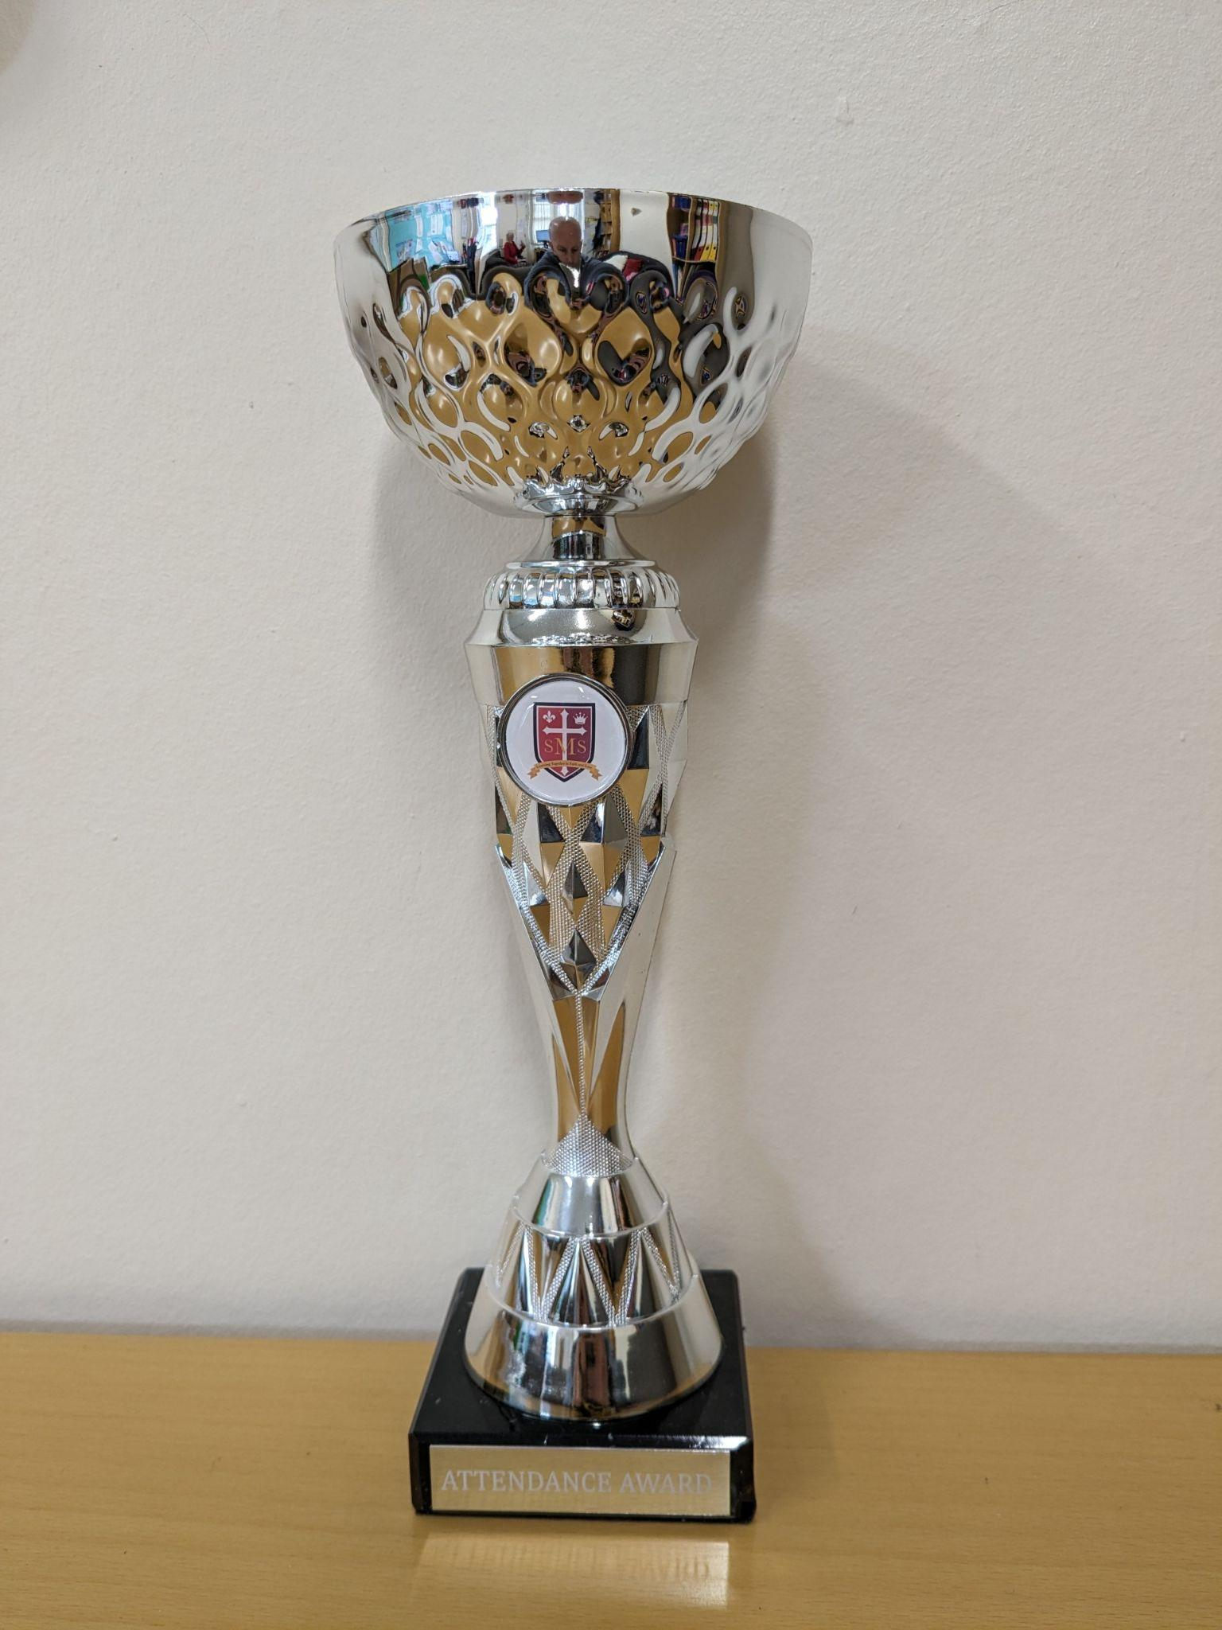
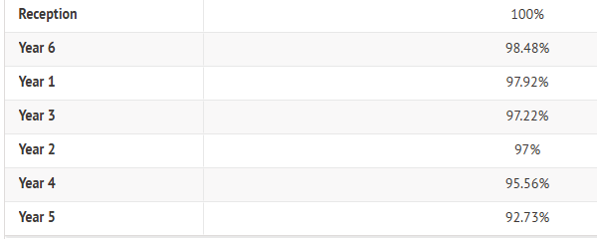
Attendance Weekly Leaders Summer Term:
Winners of the Pitch on Friday - Reception and Year 6

Slide 16
Whole School
Star of the Week
Friday 1st May 2026

