Slide 1




Whole School
Star of the Week
Friday 9th January 2026

Slide 2


Our Father who art in Heaven
Hallowed be Thy Name
Thy Kingdom come
Thy will be done on Earth as it is in Heaven
Give us this day our daily bread
And forgive us our trespasses
As we forgive those who trespass against us
And lead us not into temptation
But deliver us from evil
Amen

Slide 3
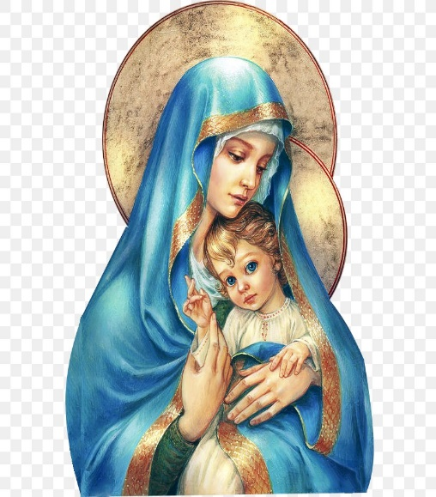
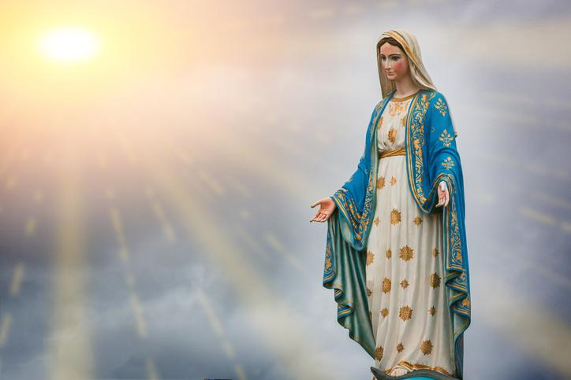
Hail Mary, Full of Grace
The Lord is with Thee
Blessed are Thou amongst women
And Blessed is the fruit of Thy womb, Jesus
Holy Mary , Mother of God
Pray for us sinners
Now and in the hour of our death
Amen

Slide 4
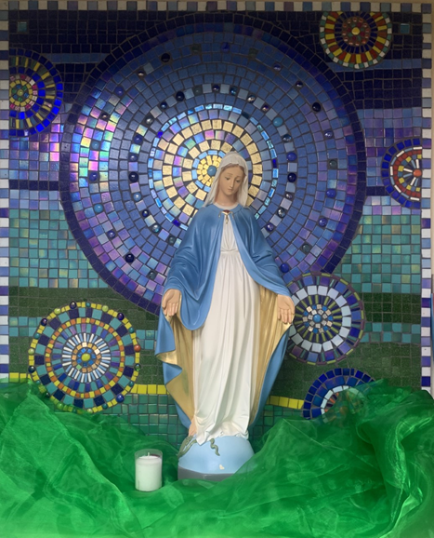
St Mary’s School Prayer
O Holy Mary,
Mother and Patron of our school,
Turn your eyes of mercy towards us,
that we may love God
With all our hearts!
May we imitate the tenderness
of your Son, Jesus,
showing love and respect
For each person
and ourselves as children of God.
Guided by the Holy Spirit,
May we create the school,
where Mercy and Compassion
Is the centre of our lives.
Amen

Slide 5
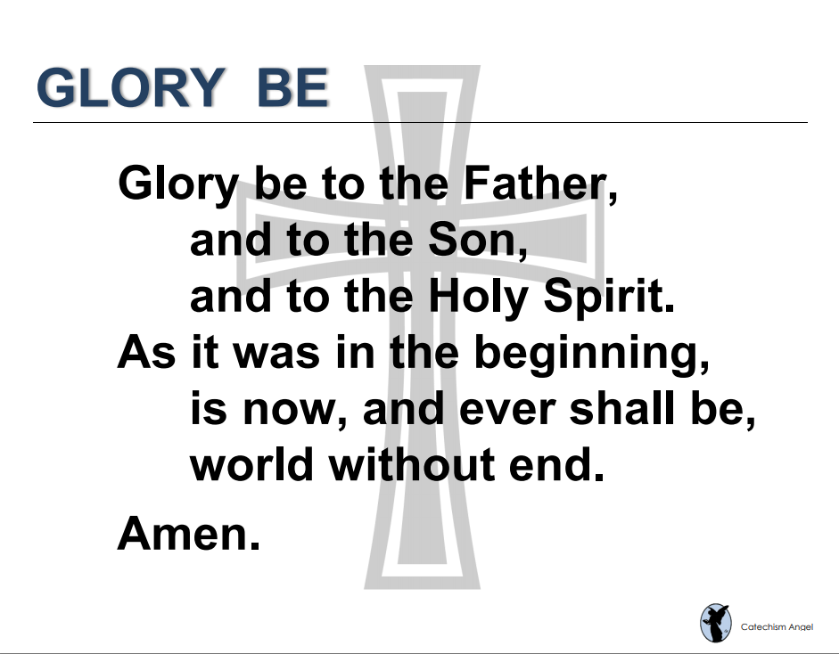

Slide 6
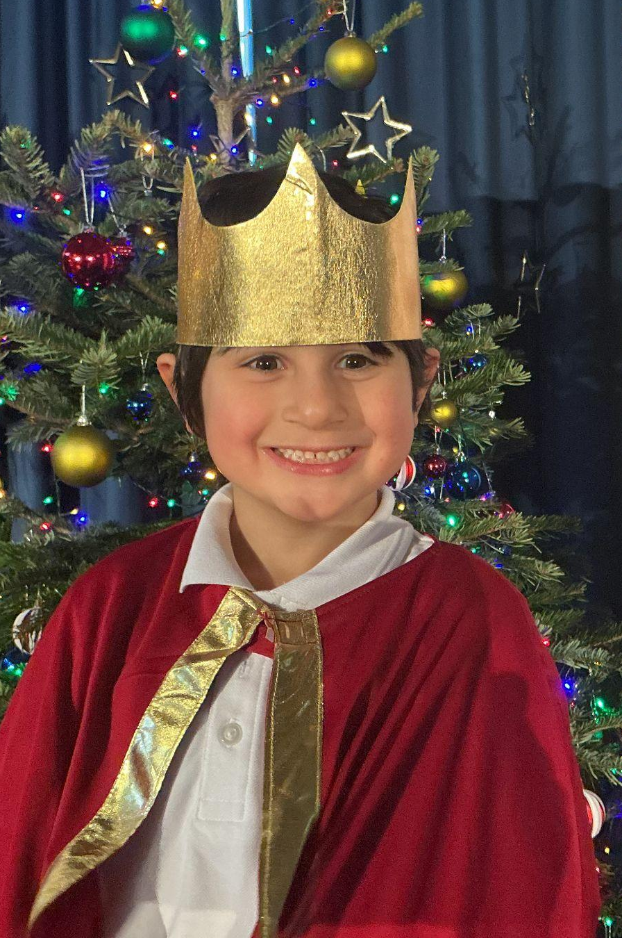
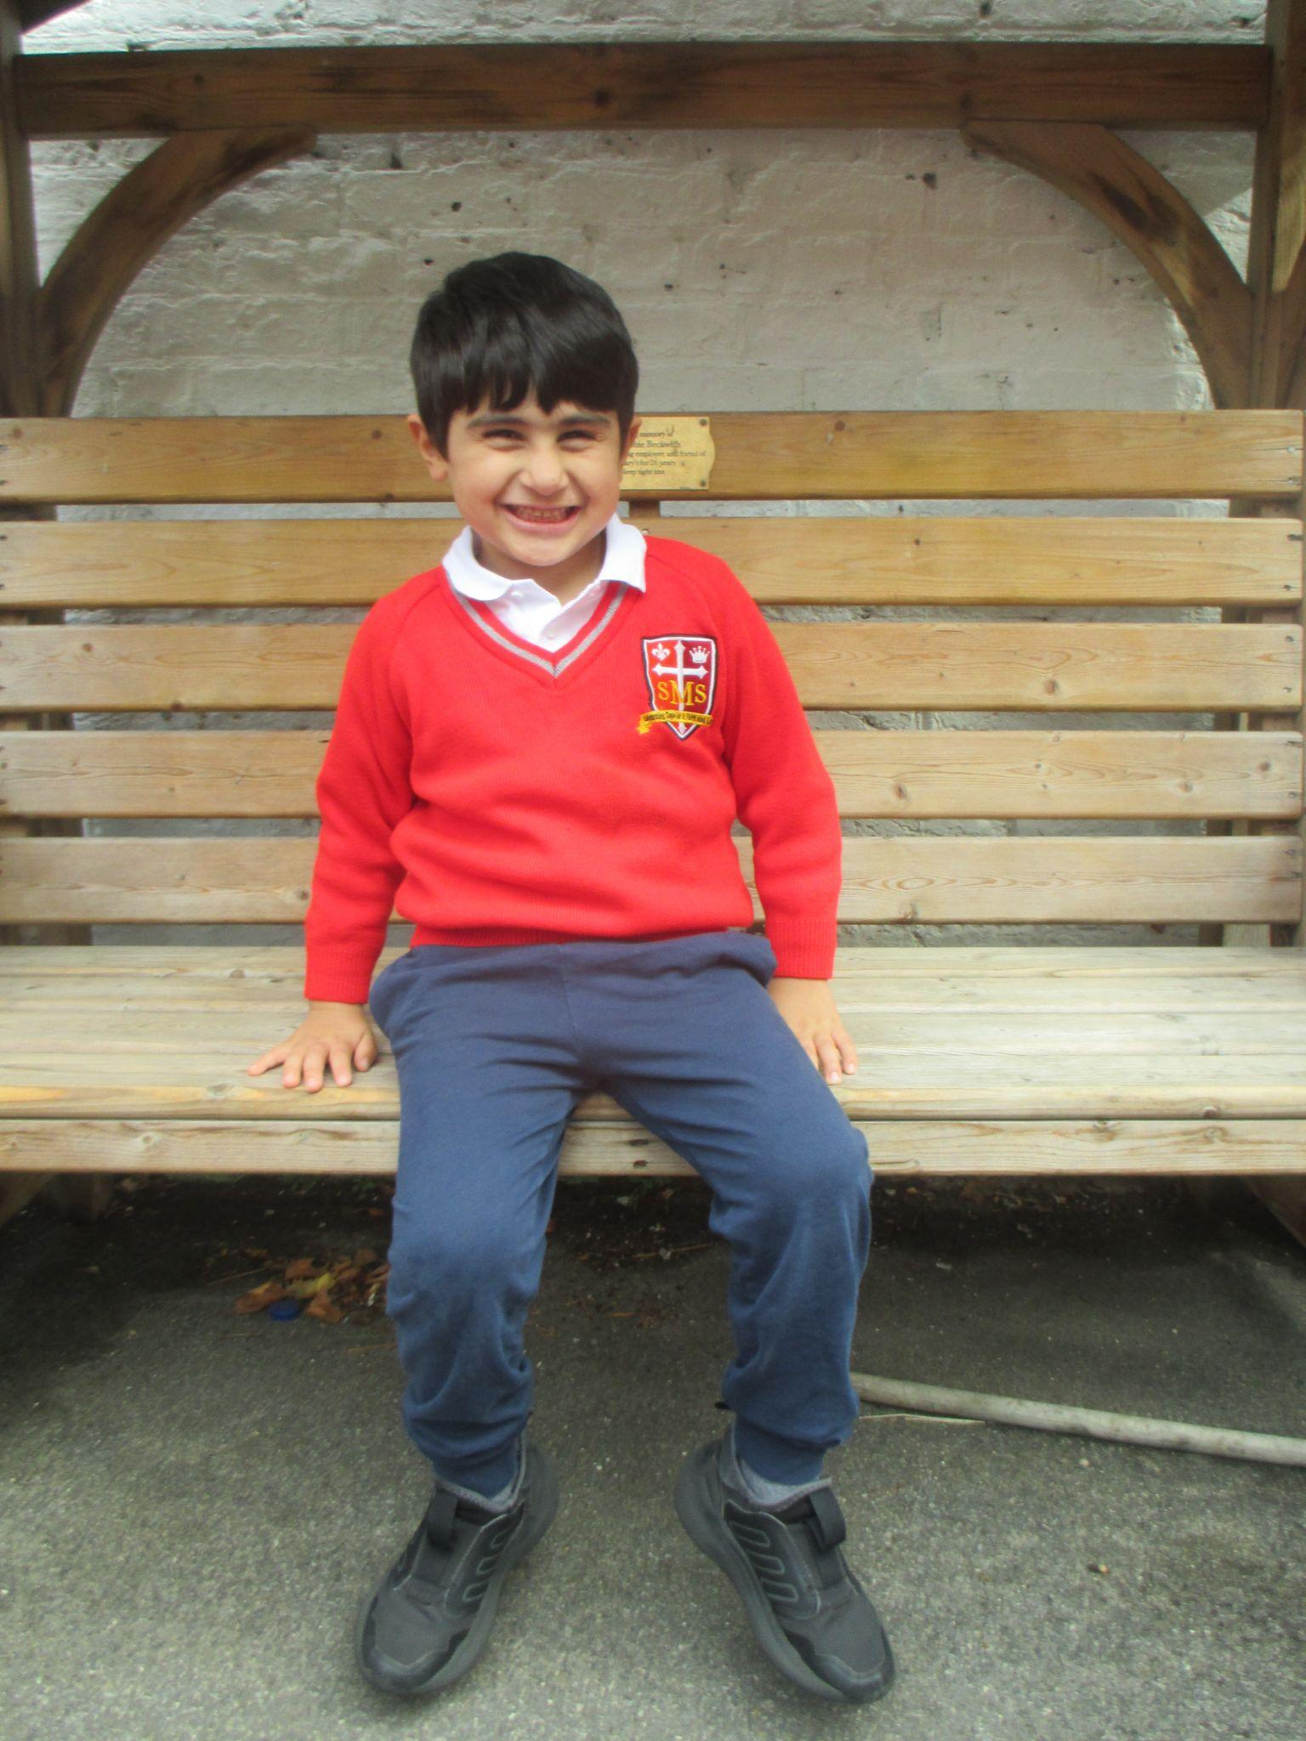
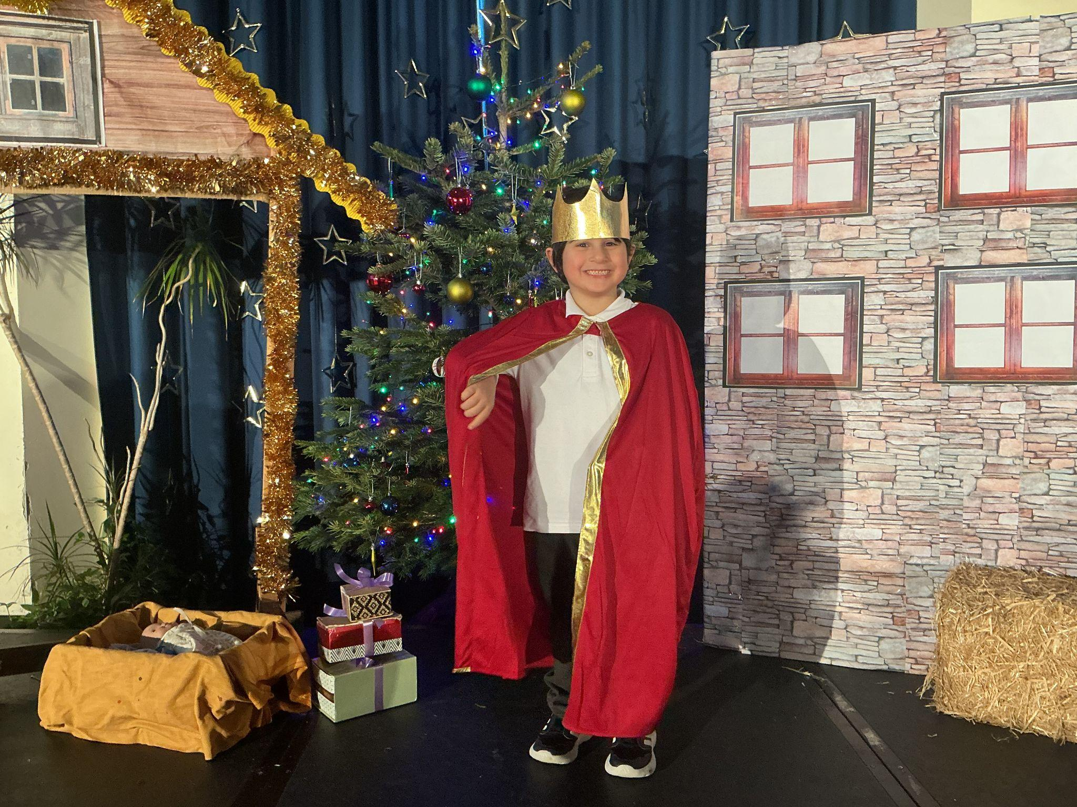
EYFS
Reception
For having a fantastic week and listening to instructions all with a big smiley face! Well done we are so proud of you.
Miss Barker

Slide 7
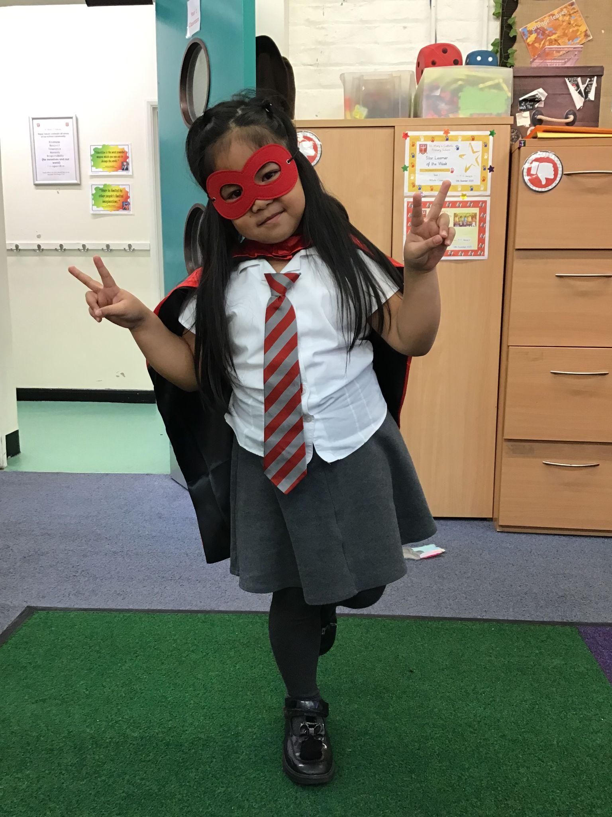
Year 1
For contributing such thoughtful and out of the box ideas to our class discussions!
Miss Flashman

Slide 8
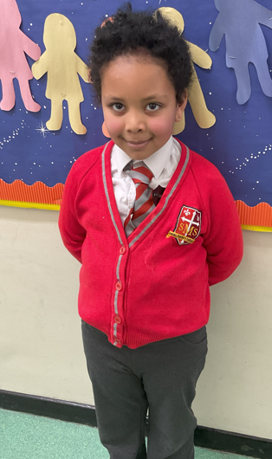
Year 2
For becoming an independent learner!
Miss Sweet

Slide 9
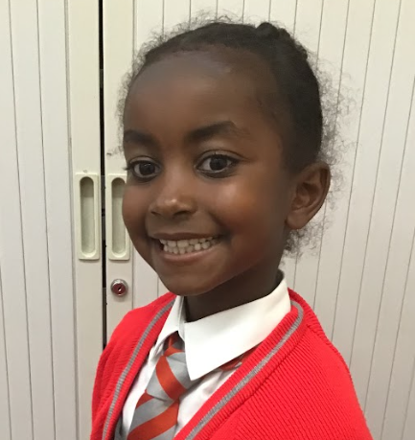
Year 3
For a focused, positive start to the New Year and showing what she is capable of!
Mr. Larke

Slide 10

Asia
For her diligence and positive attitude to work and self-betterment, both at home and in school, and for exemplifying our School Values.
Mr Whear

Slide 11
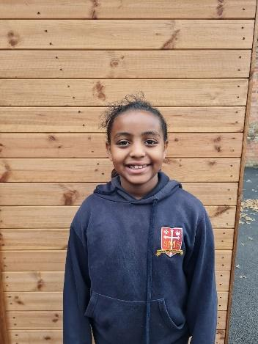
Year 5
For being an excellent role model and living out the school values in all areas of the school life.
Ms Alvarez

Slide 12
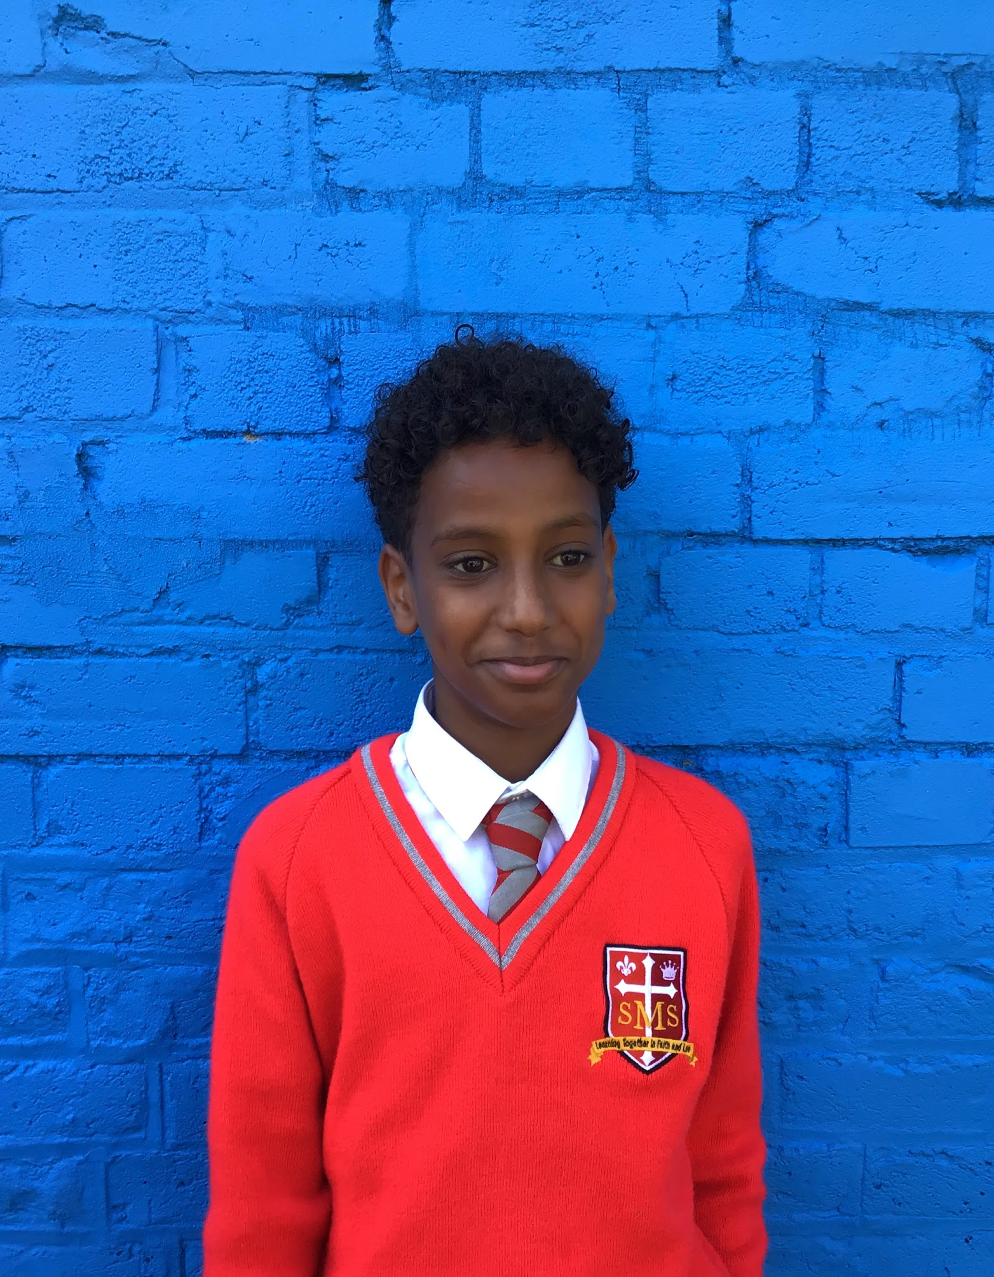
Year 6 For excellent participation and taking real ownership of his learning across multiple subjects.
Mr Cherfi & Mr Quinlan

Slide 13



Star Readers
Y1 - Brianna
Y2 - Olly
Y3 - Victor
Y4 - Thirdy
Y5 - Arthur
Y6 - Kessiah

Slide 14
Whole School
Star of the Week
Friday 9th January 2026

