Slide 1
Whole School
Star of the Week
Friday 9th May 2025

Slide 2
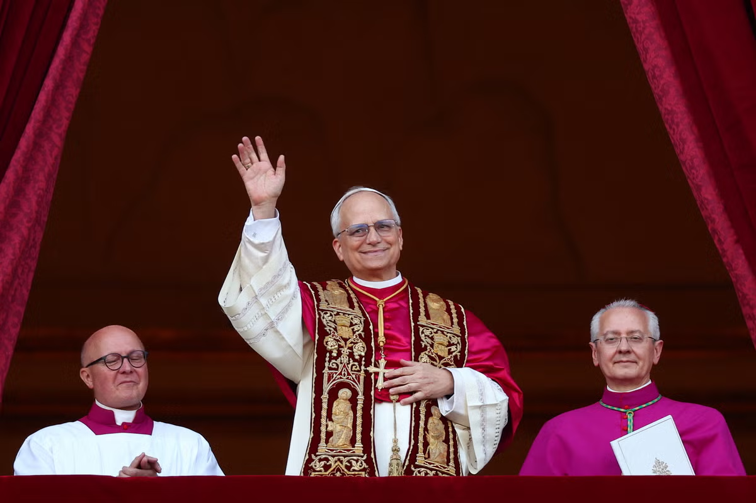
Habemus Papem
We have a new Pope
Cardinal Robert Provost who took the name Leo XIV

Slide 3
Our Father who art in Heaven
Hallowed be Thy Name
Thy Kingdom come
Thy will be done on Earth as it is in Heaven
Give us this day our daily bread
And forgive us our trespasses
As we forgive those who trespass against us
And lead us not into temptation
But deliver us from evil
Amen

Slide 4
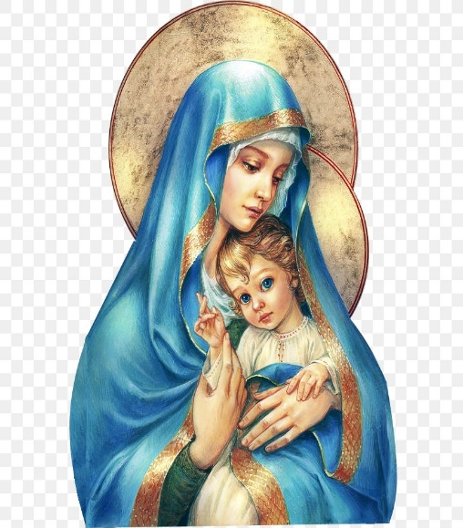
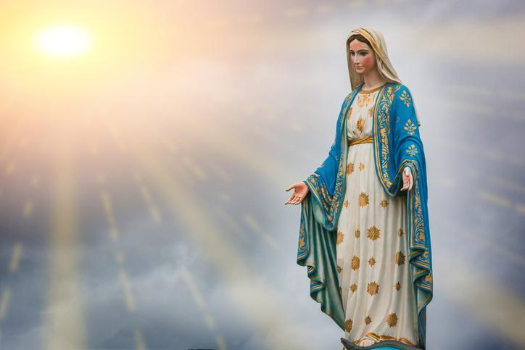
Hail Mary, Full of Grace
The Lord is with Thee
Blessed are Thou amongst women
And Blessed is the fruit of Thy womb, Jesus
Holy Mary , Mother of God
Pray for us sinners
Now and in the hour of our death
Amen

Slide 5
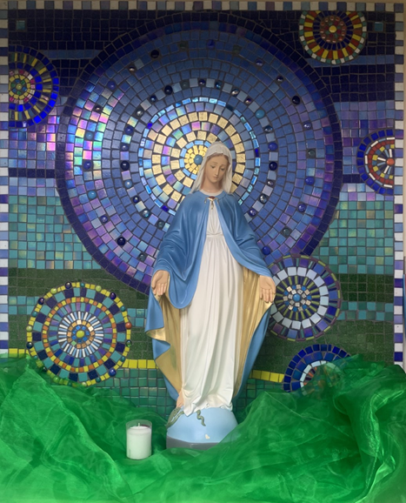
St Mary’s School Prayer
O Holy Mary,
Mother and Patron of our school,
Turn your eyes of mercy towards us,
that we may love God
With all our hearts!
May we imitate the tenderness
of your Son, Jesus,
showing love and respect
For each person
and ourselves as children of God.
Guided by the Holy Spirit,
May we create the school,
where Mercy and Compassion
Is the centre of our lives.
Amen

Slide 7
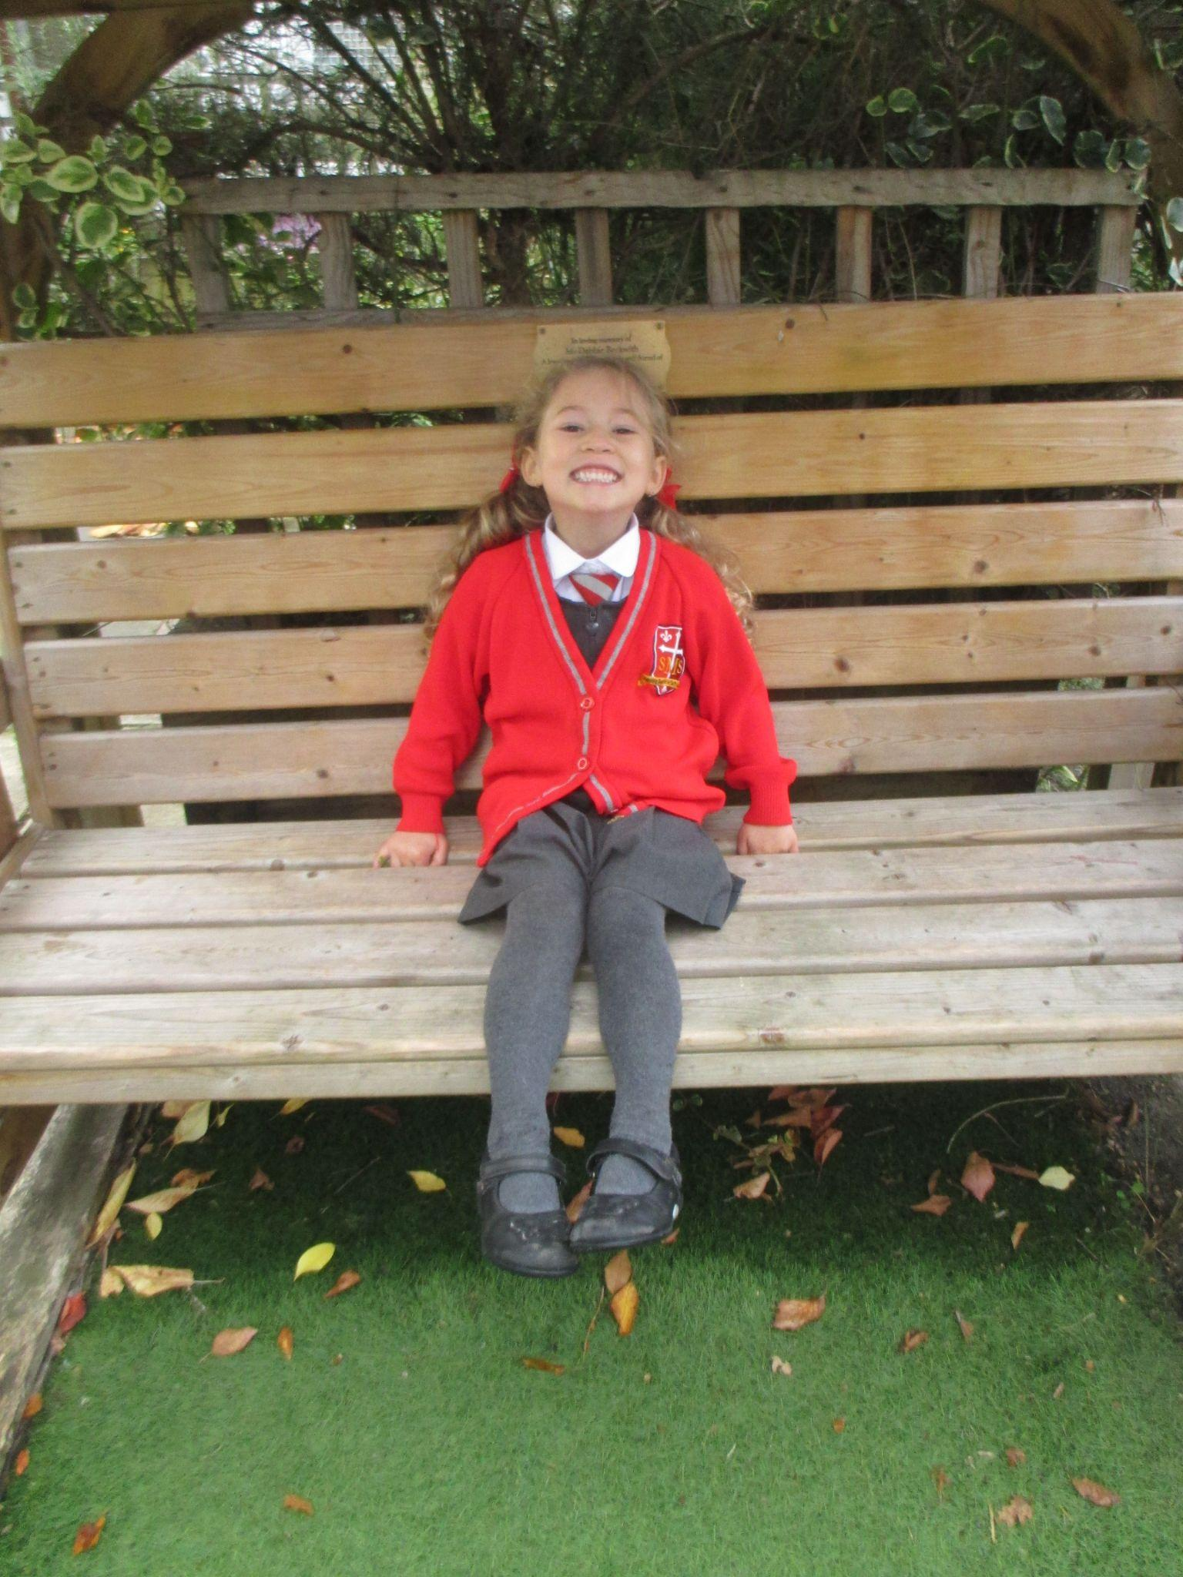
Early Years
Reception
For great learning the past few weeks and showing a real engagement in RE lessons.
Miss Barker

Slide 8
Year 1
For being a role model to her peers always ready and eager to learn!
Miss Sweet

Slide 9
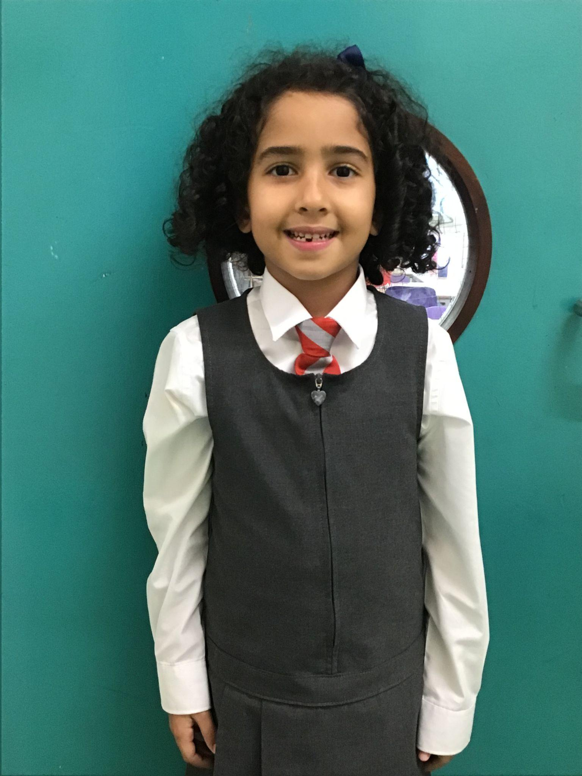
Year 2
For her outstanding attitude to learning, in every lesson on every day!
Mr Whear

Slide 10
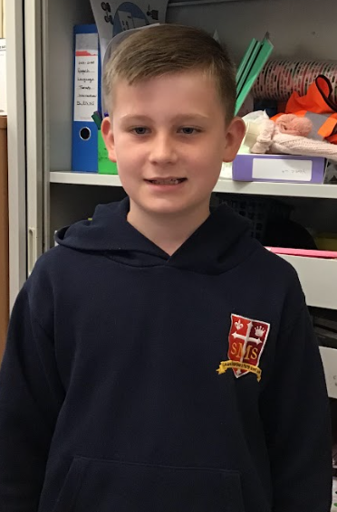
Year 3
For consistently building confidence throughout the school year and making an exemplary effort to contribute in lesson and help his friends if they are struggling to understand something.
Miss Medioli

Slide 11
Year 4
For her higher level thinking and mature attitude towards all of her learning so far this term.
Miss Forrest

Slide 12
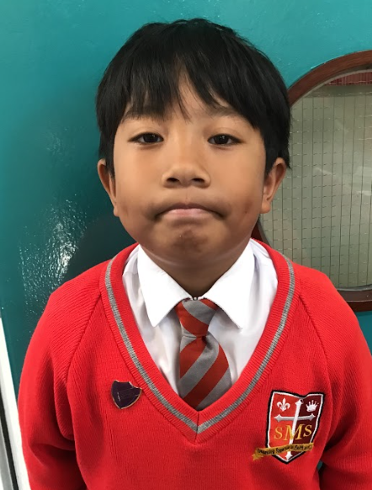
Year 5
For being a great role model this week, especially on our trip.
Mr Larke

Slide 13
Star Readers
Y1 - Olly
Y2 - Major
Y3 - Delilah
Y4 - Lola
Y5 - Gideon

Slide 14
Olivia - Y4
Mrs Ferguson
Amy - Y5

Slide 15
Whole School
Star of the Week
Friday 9th May 2025

