Slide 1



Whole School
Star of the Week
Friday 9th October, 2026

Slide 2
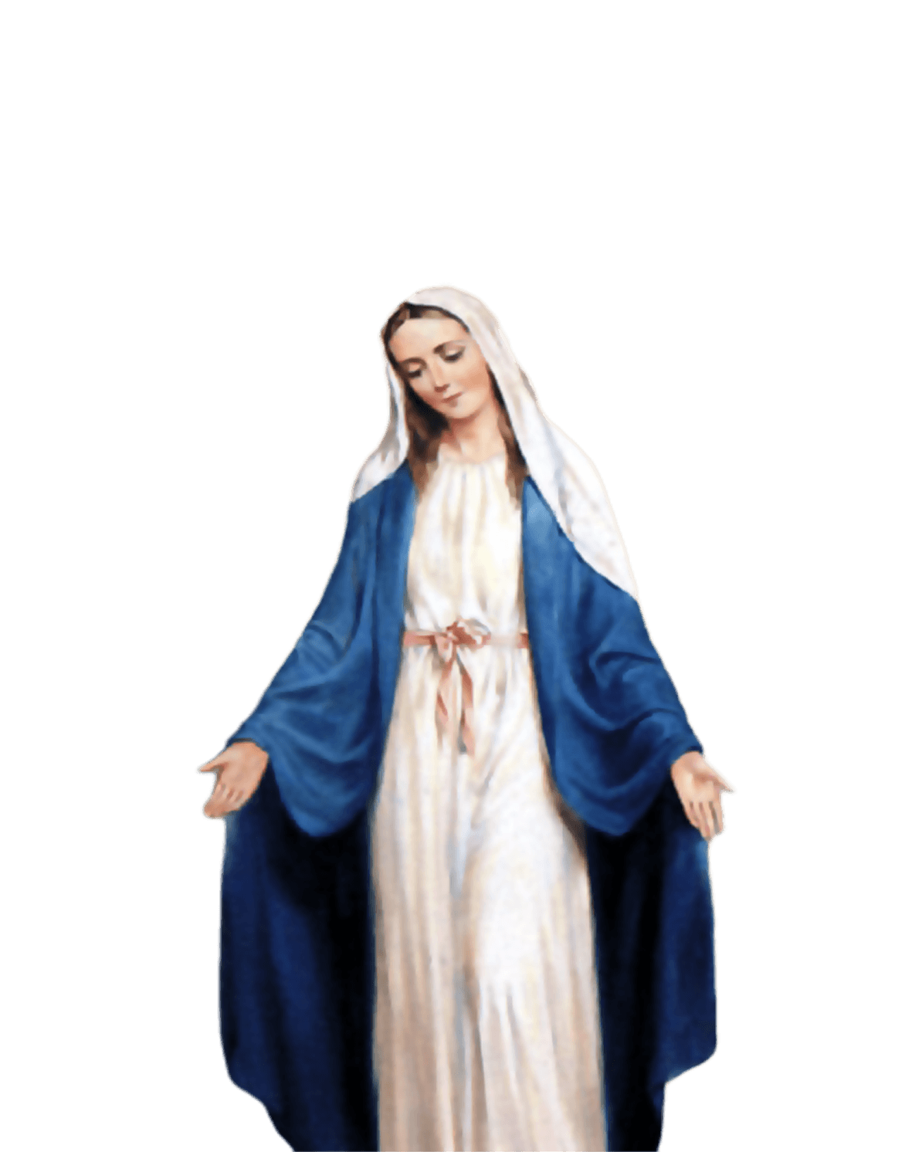
ST MARY’S SCHOOL PRAYER
O Holy Mary,
Mother and Patron of our school,
Turn your eyes of mercy towards us,
that we may love God
With all our hearts!
May we imitate the tenderness
of your Son, Jesus,
showing love and respect
For each person
and ourselves as children of God.
Guided by the Holy Spirit,
May we create the school,
where Mercy and Compassion
Is the centre of our lives.
Amen

Slide 3
EYFS
Louie
For his amazing attention and listening this week and fantastic effort in Literacy. We are beaming with pride over his progress.
Miss Barker

Slide 4
Year 1/2
Gio
Gio has done fantastic learning this week by always being polite and following our school rules. They are a brilliant ambassador for our school! A true star! ⭐
Miss Sweet and Mrs Bakali
Isadora
Isadora has had a fantastic week, showing an excellent attitude and always trying her absolute best in everything she does. Her wonderful effort and super enthusiasm make her a true star! ⭐
Miss Sweet and Mrs Bakali

Slide 5
Year 3
Mai-Mariam
For her fantastic work ethic, determination to do her best and commitment to continually improving her learning!
Miss Flashman

Slide 6
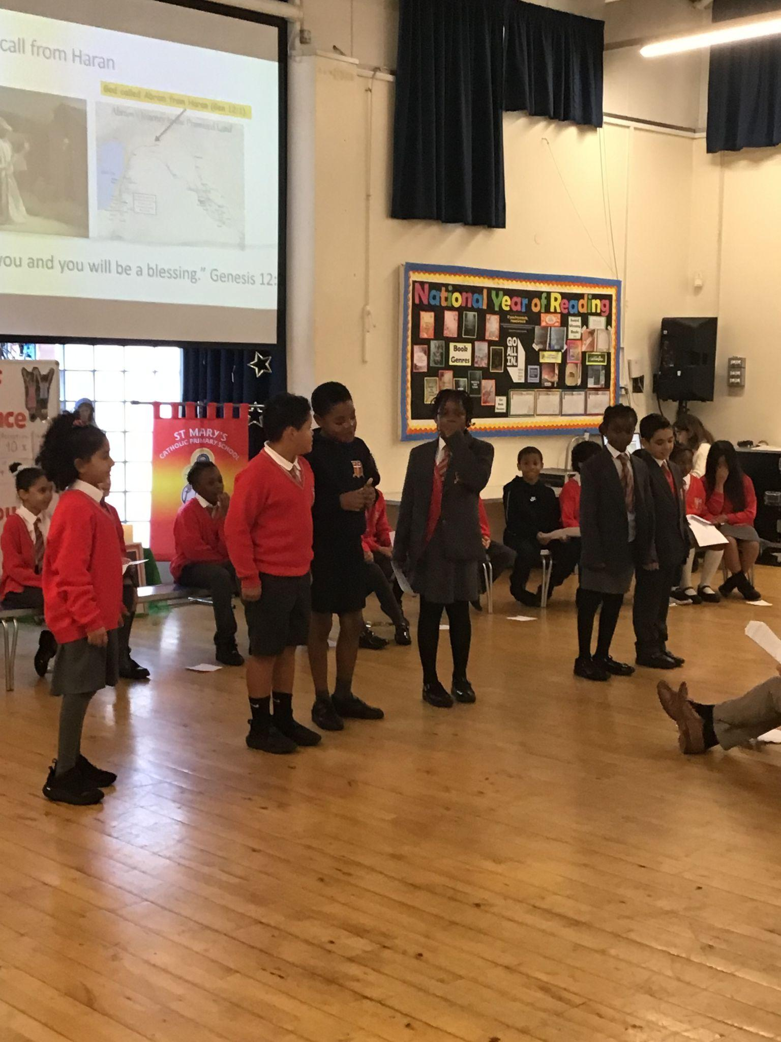
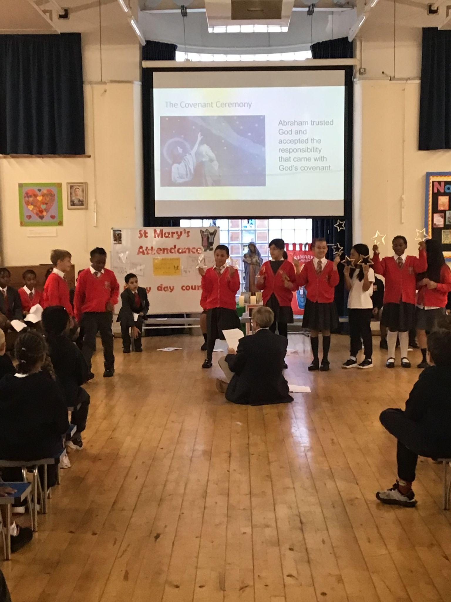
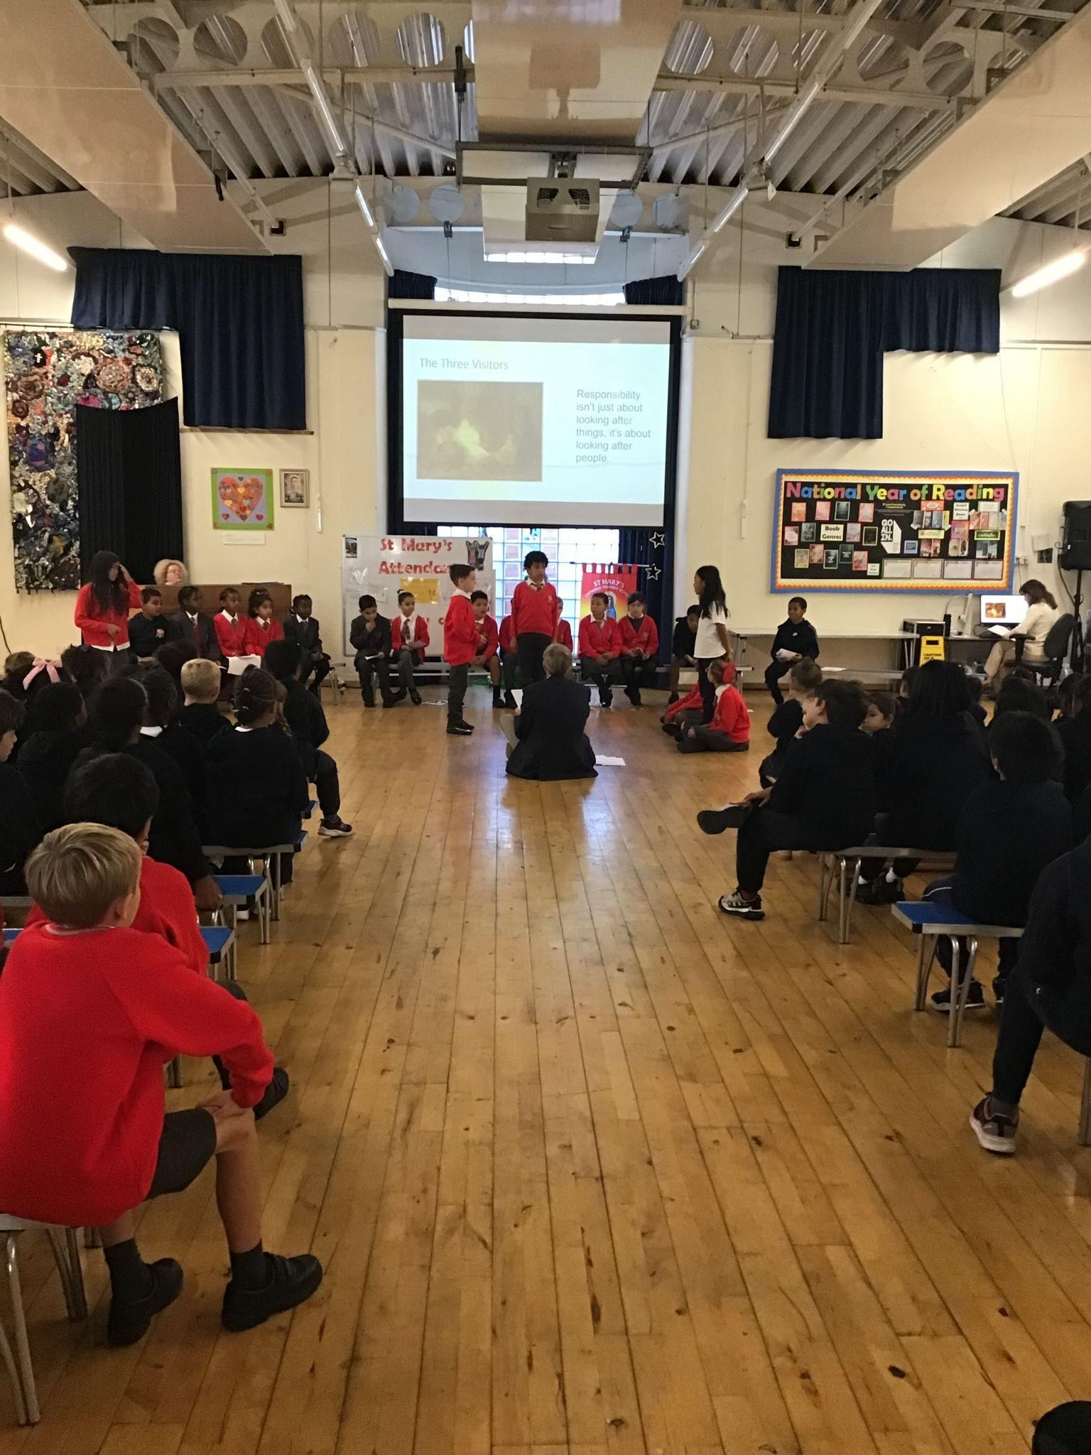
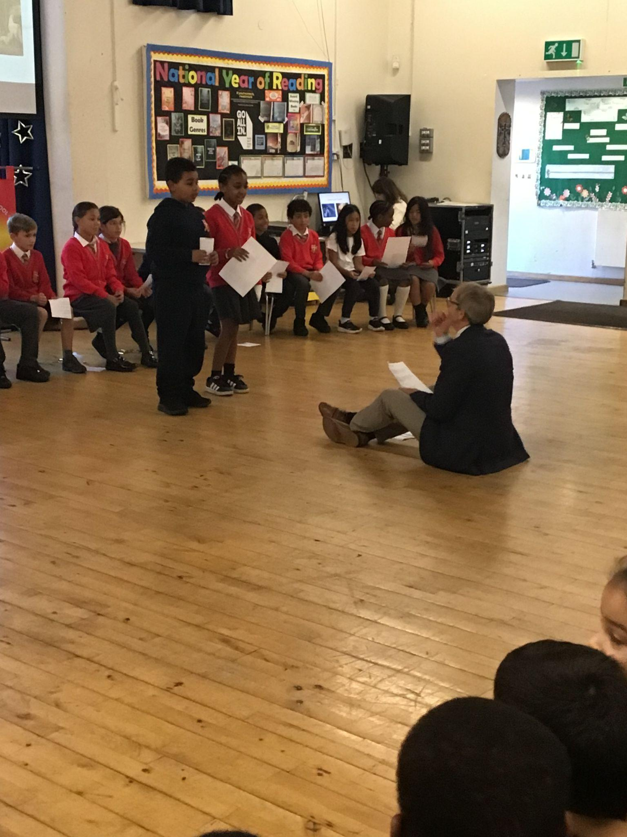
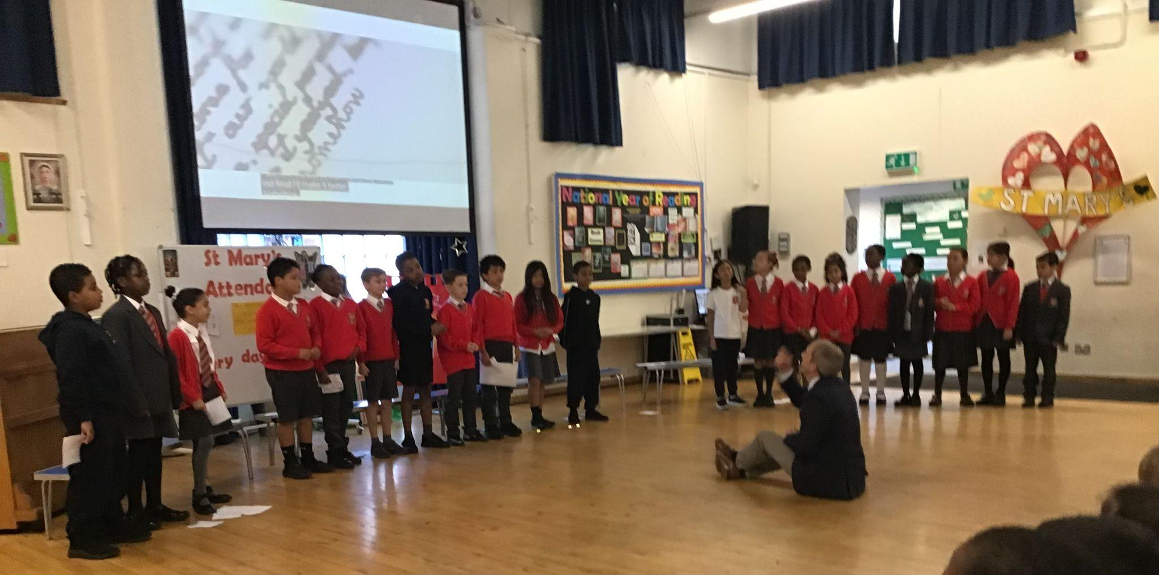
Year 4
The Whole Class
For working hard to learn our lines and roles, putting on a terrific singing performance and generally pulling it out of the bag!
Mr Whear

Slide 7
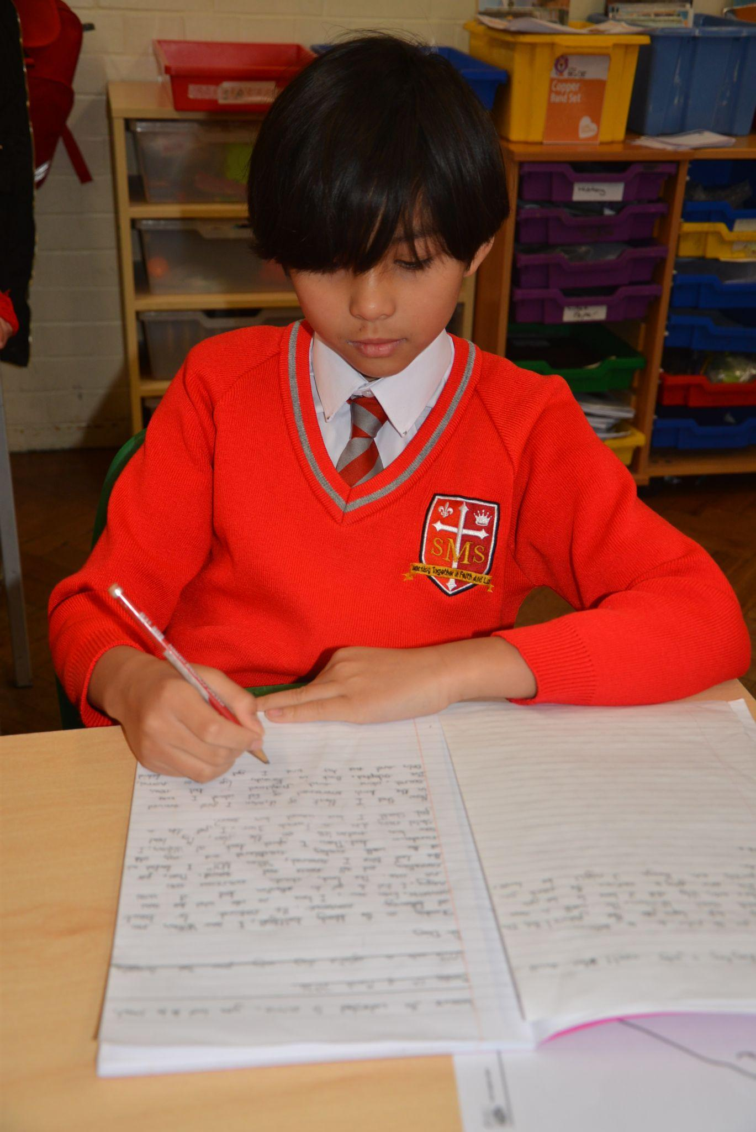
Year 5
Noah
For fantastic effort, positive attitude and willingness to always have a go. His enthusiasm and positivity brighten our classroom every day.
Keep spreading your Noah magic!
Miss O’Mara

Slide 8
Year 6
Sofia
For incredible effort and resilience. Sofia has been really pushing herself this week and it is showing in the improved quality of her understanding in lessons.
Mr Cherfi

Slide 9



STAR READER
Y1/2 - Ayda
Y3 - Noel
Y4 - Victor
Y5 - Not this week.
Y6 - Cali

Slide 10
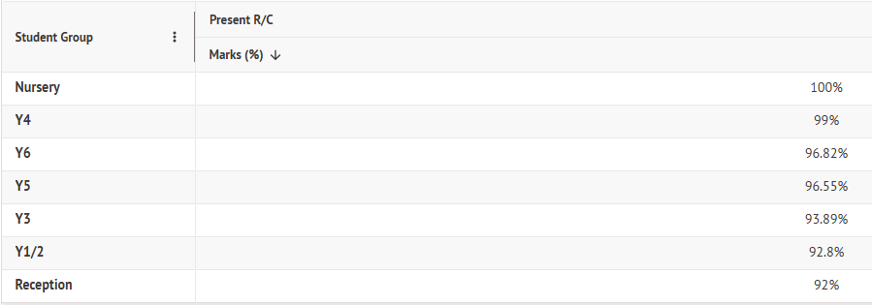
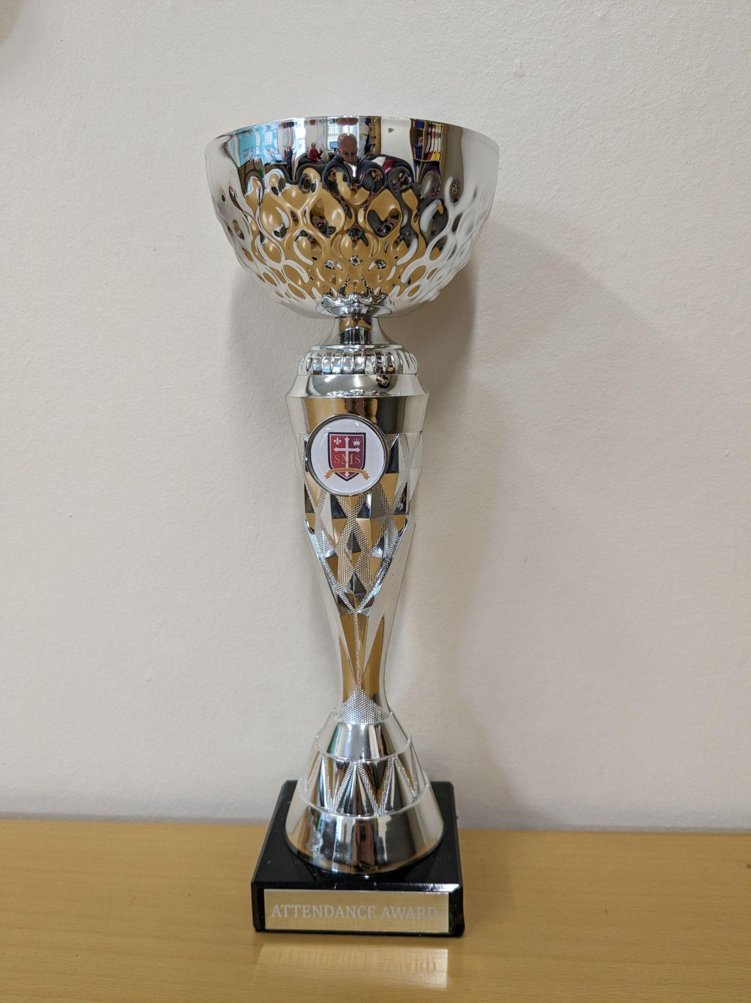
Attendance Weekly Leader:

Slide 11
Attendance Weekly Leader:
Attendance Winners for this week:
Nursery
With 100% attendance

Slide 12

Mr Spencer

Slide 13
Whole School
Star of the Week
Friday 9th October 2026

Slide 14
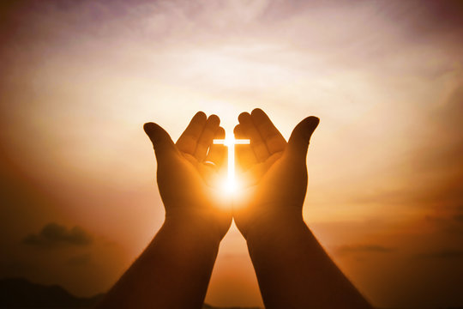
Let us pray.
"Dear God, thank you for loving us and forgiving us when we make mistakes. Forgiveness can be very hard for us to do on our own. Please give us big hearts full of your love, and help us to choose to forgive others just like you forgive us. Amen."

