Slide 1




Whole School
Star of the Week
Friday 12th September 2025

Slide 2


Our Father who art in Heaven
Hallowed be Thy Name
Thy Kingdom come
Thy will be done on Earth as it is in Heaven
Give us this day our daily bread
And forgive us our trespasses
As we forgive those who trespass against us
And lead us not into temptation
But deliver us from evil
Amen

Slide 3
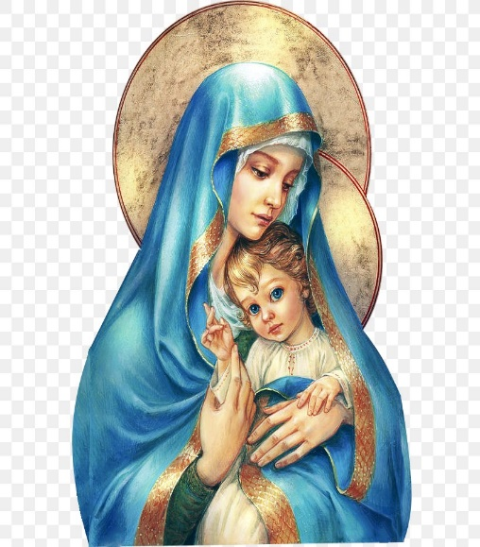
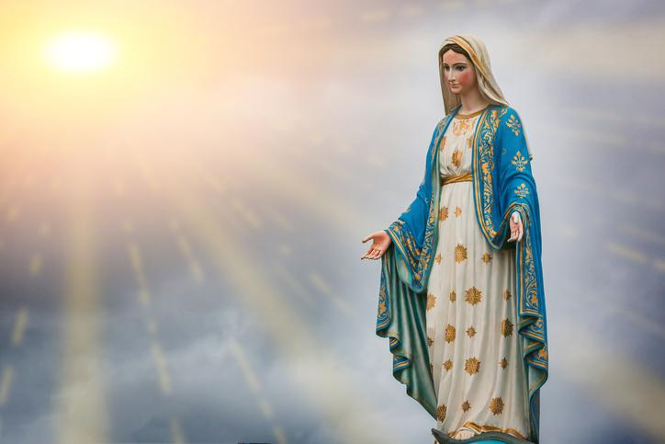
Hail Mary, Full of Grace
The Lord is with Thee
Blessed are Thou amongst women
And Blessed is the fruit of Thy womb, Jesus
Holy Mary , Mother of God
Pray for us sinners
Now and in the hour of our death
Amen

Slide 4
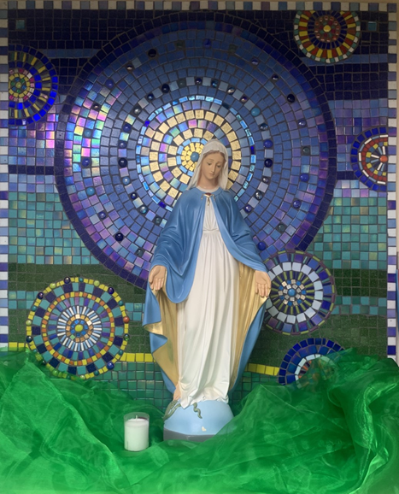
St Mary’s School Prayer
O Holy Mary,
Mother and Patron of our school,
Turn your eyes of mercy towards us,
that we may love God
With all our hearts!
May we imitate the tenderness
of your Son, Jesus,
showing love and respect
For each person
and ourselves as children of God.
Guided by the Holy Spirit,
May we create the school,
where Mercy and Compassion
Is the centre of our lives.
Amen

Slide 5
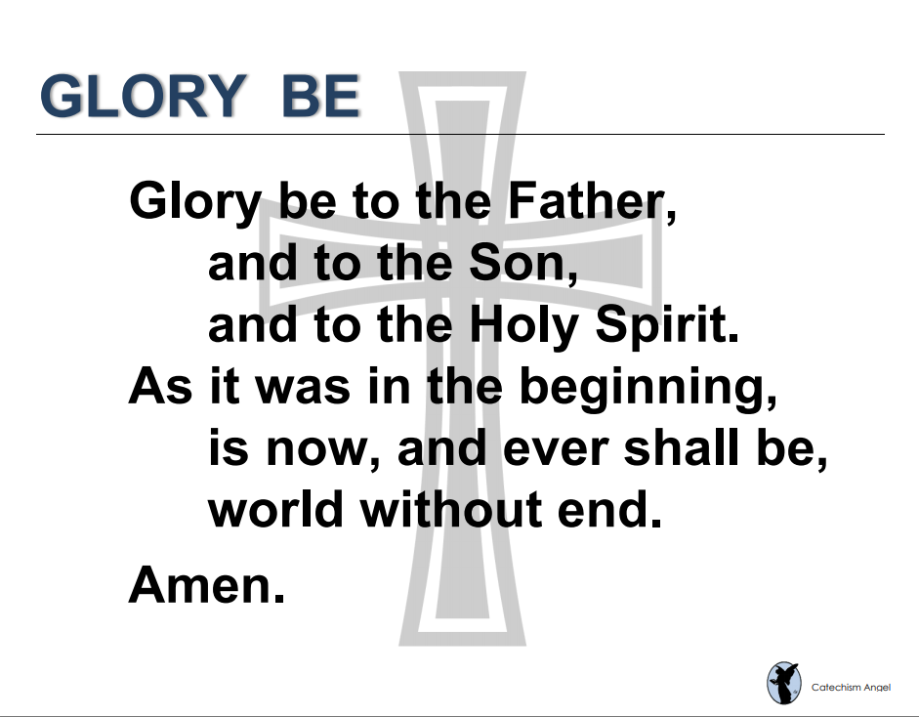

Slide 6
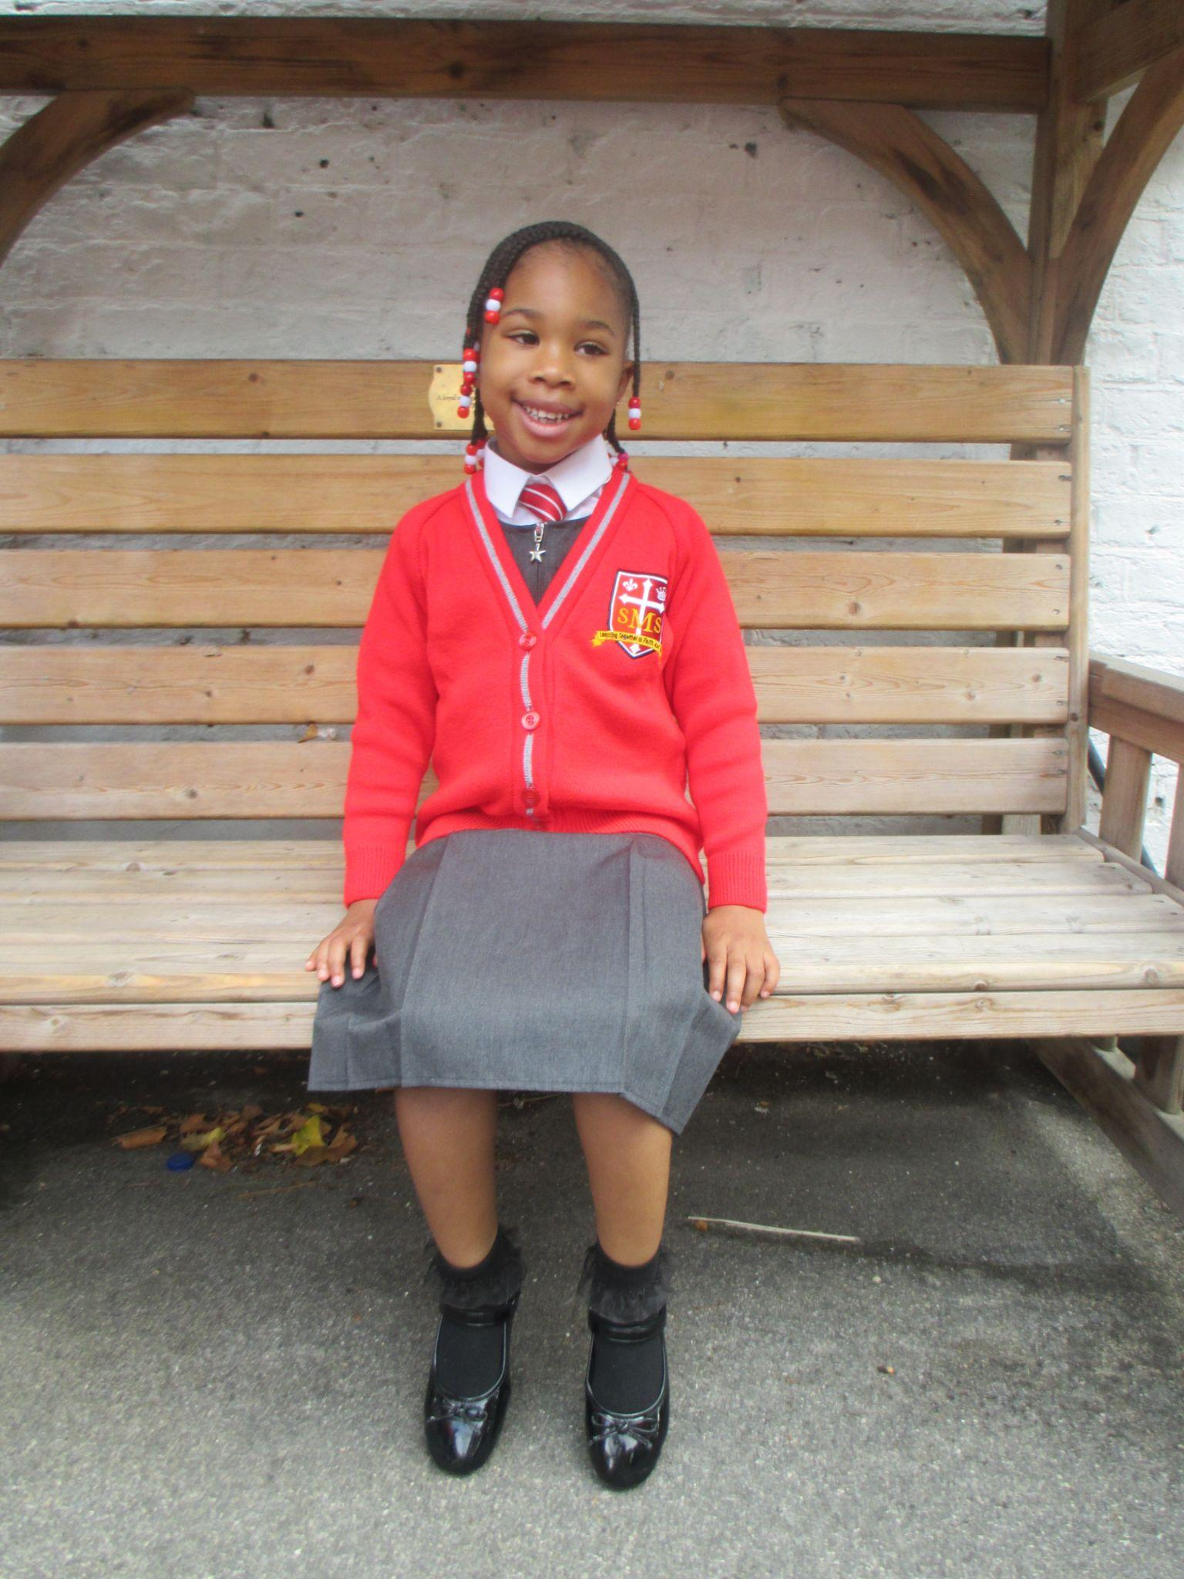
EYFS
Reception- For her amazing efforts in Reception this week and getting 100% on her phonics assessment.
Miss Barker

Slide 7
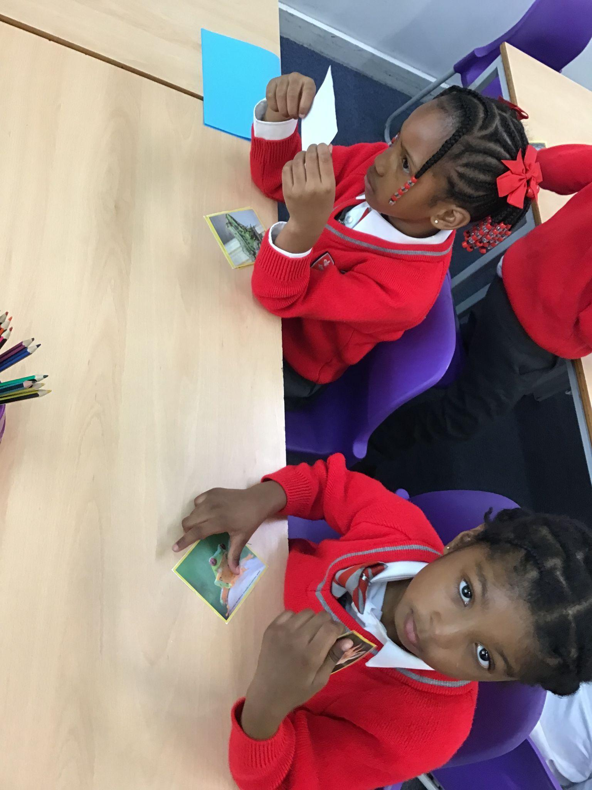
Year 1
Miss Begum

Slide 8
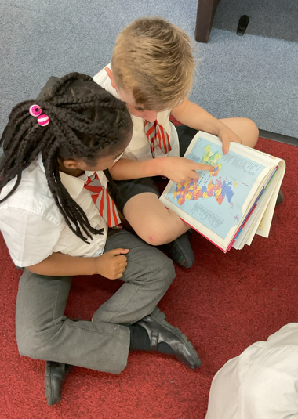
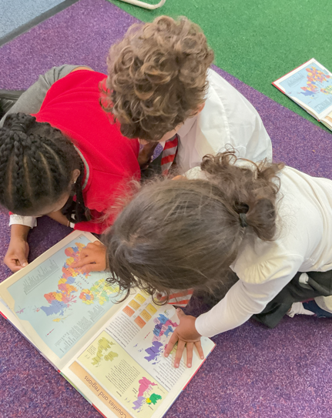
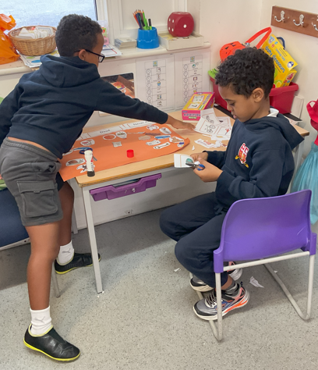
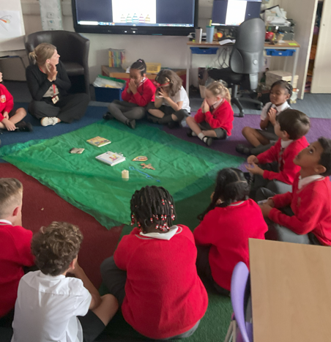
Year 2
Whole Class
For settling in so well and adapting to the new expectations of Year 2!
Miss Sweet

Slide 9
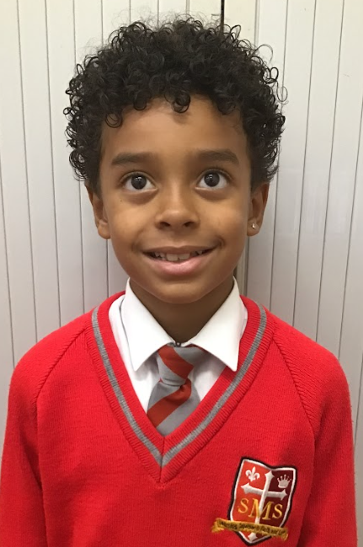
Year 3
For quietly getting on with what needs to be done.
Mr. Larke

Slide 10
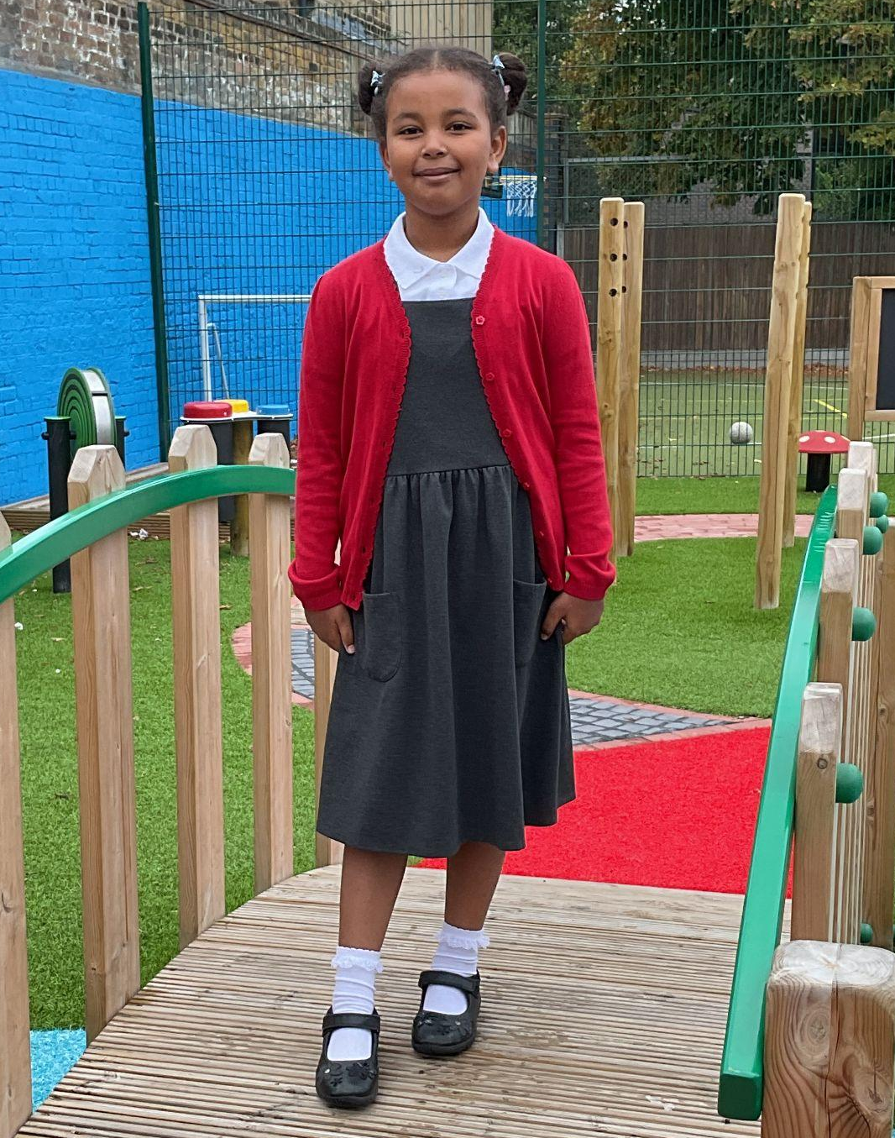
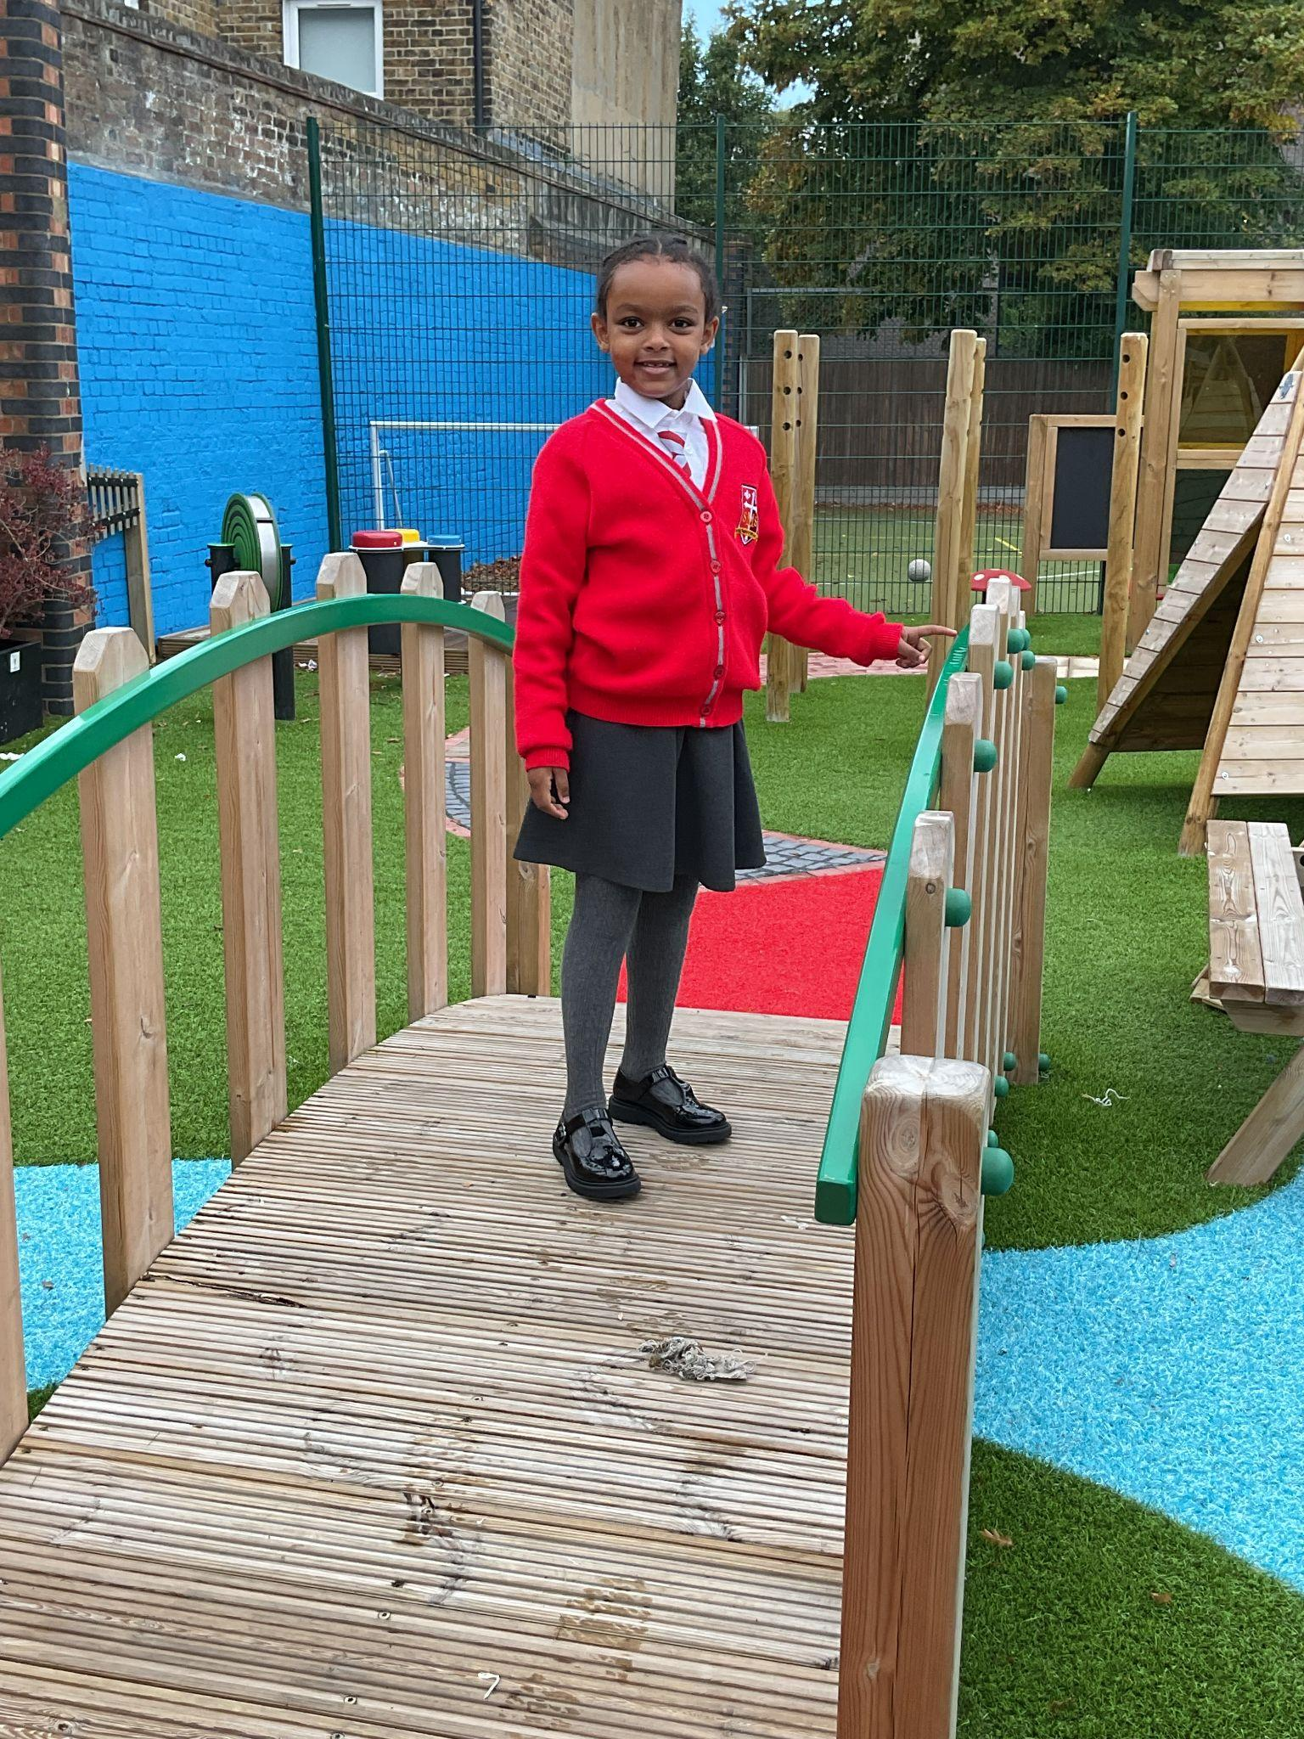
Year 4
For making wonderful starts to their time at St Mary’s.

Slide 11
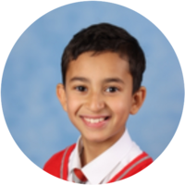
Year 5
For settling into the expectations of Year 5 and applying himself in alls his learning and challenging himself in his writing and Maths.
Mr. Carey

Slide 12
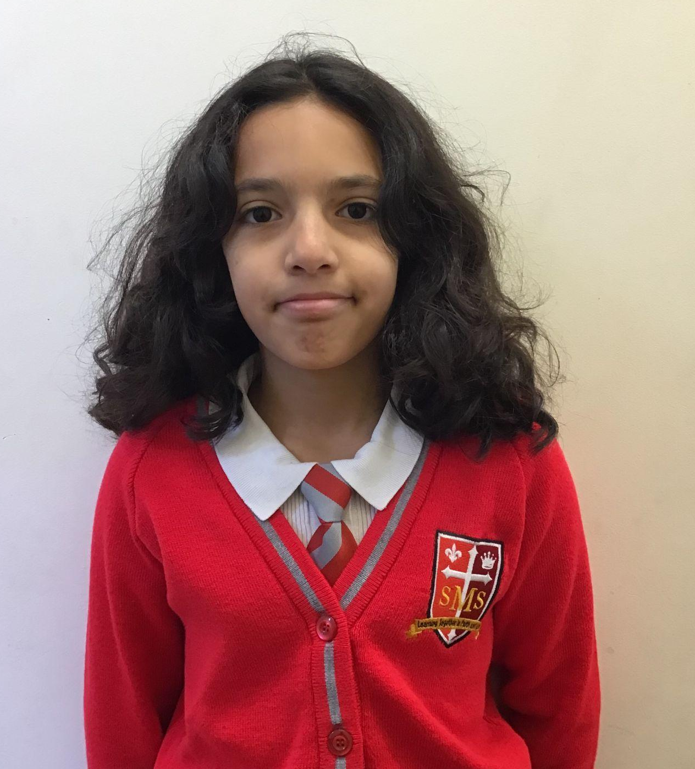
Year 6
For an exceptional start to her St. Mary’s journey. Eden’s behaviour and effort have been at an exceptional level all week and we are so pleased to have her with us.
Mr Cherfi

Slide 13



Star Readers
Y1 - Lamek
Y2 - Kai and Pippa
Y3 - Harry
Y4 - Talia and Rakeb
Y5 - Elly and Esey
Y6 - Zyann

Slide 14
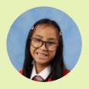

Head Girl & Boy
Deputy Head Girl & Boy
Prefects
Yael & Carlos
Layla Gideon Eden Jericho Amarah

Slide 15

Y6 - Nicholas
Y4 - Kareema
Y6 - Layla
Y -

Slide 16
Whole School
Star of the Week
Friday 12th September 2025

