Slide 1




Whole School
Star of the Week
Friday 16th January 2026

Slide 2

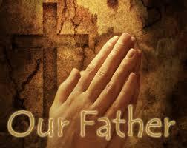
Our Father who art in Heaven
Hallowed be Thy Name
Thy Kingdom come
Thy will be done on Earth as it is in Heaven
Give us this day our daily bread
And forgive us our trespasses
As we forgive those who trespass against us
And lead us not into temptation
But deliver us from evil
Amen

Slide 3
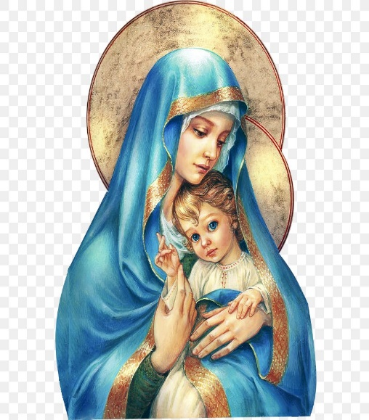
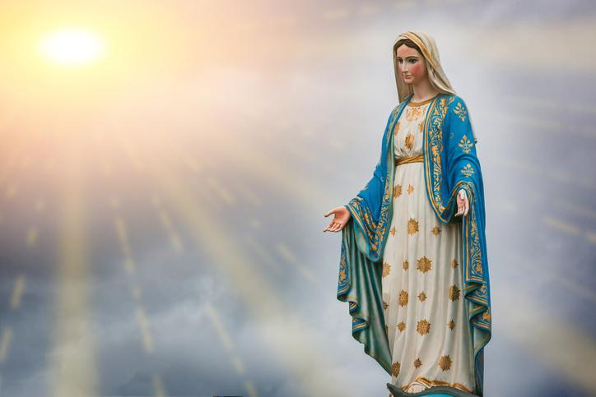
Hail Mary, Full of Grace
The Lord is with Thee
Blessed are Thou amongst women
And Blessed is the fruit of Thy womb, Jesus
Holy Mary , Mother of God
Pray for us sinners
Now and in the hour of our death
Amen

Slide 4
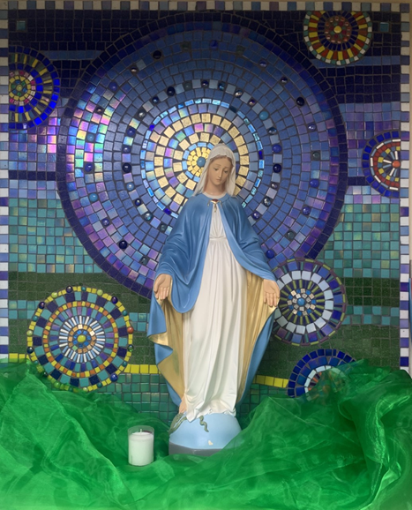
St Mary’s School Prayer
O Holy Mary,
Mother and Patron of our school,
Turn your eyes of mercy towards us,
that we may love God
With all our hearts!
May we imitate the tenderness
of your Son, Jesus,
showing love and respect
For each person
and ourselves as children of God.
Guided by the Holy Spirit,
May we create the school,
where Mercy and Compassion
Is the centre of our lives.
Amen

Slide 5
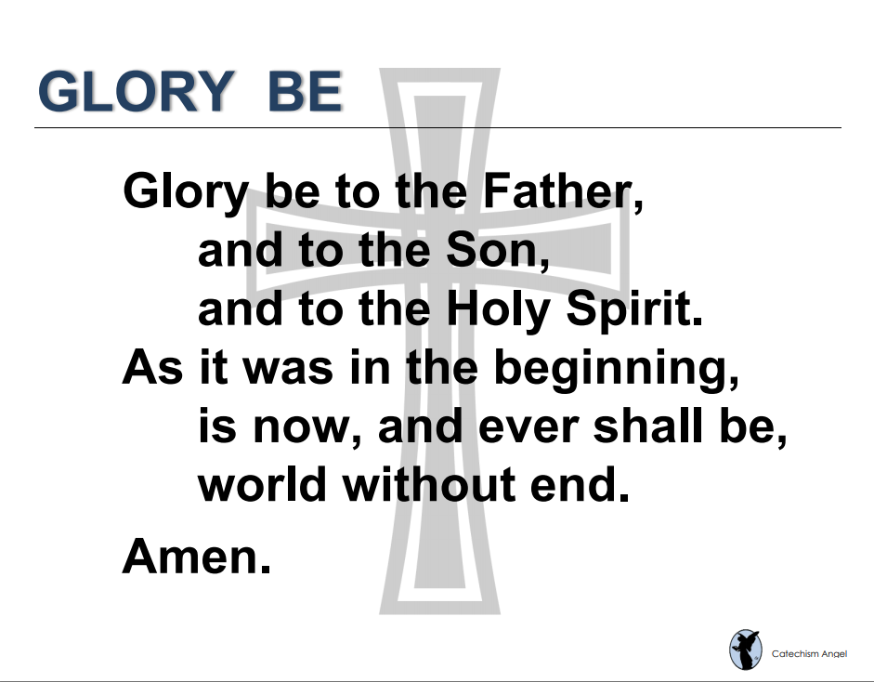

Slide 6
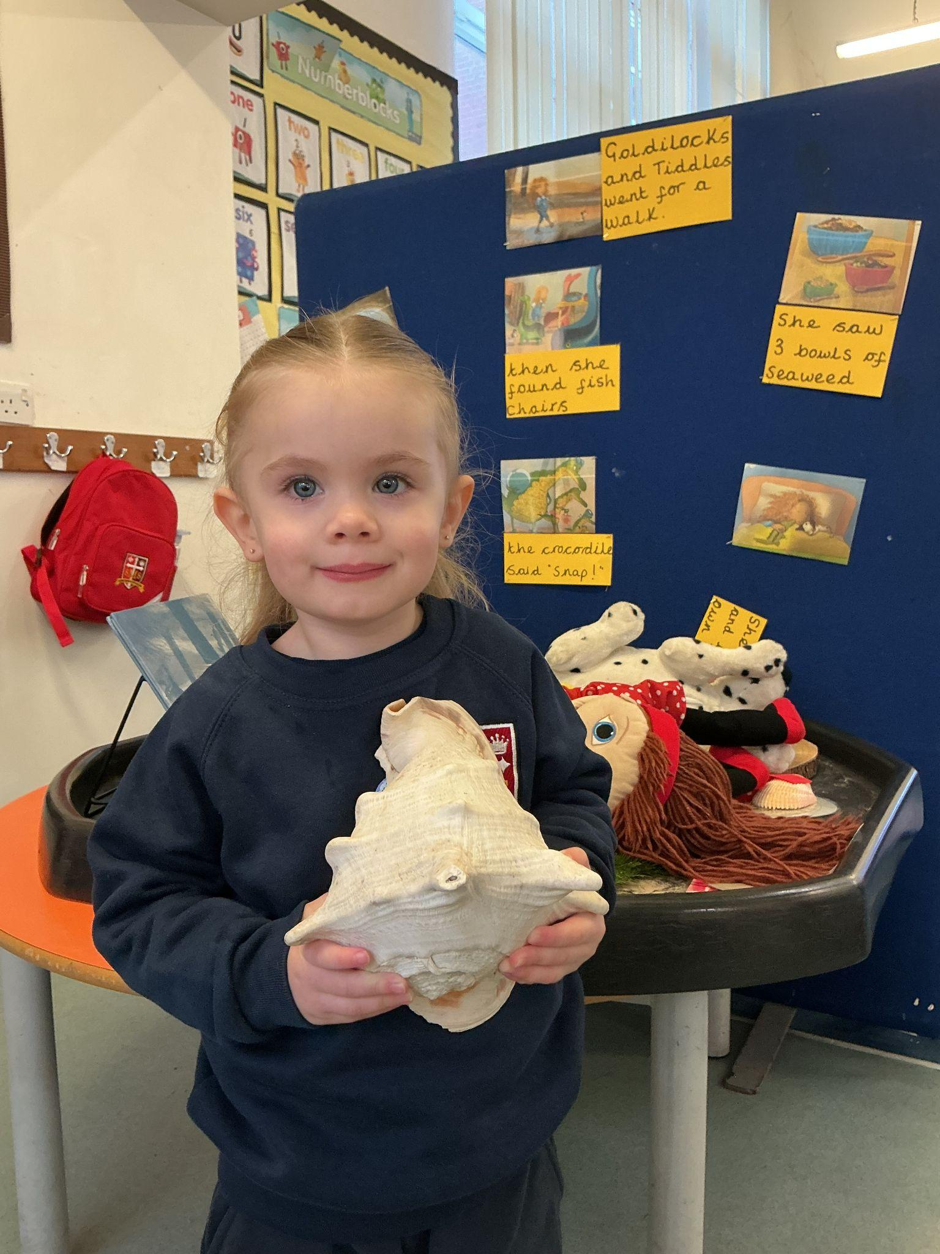
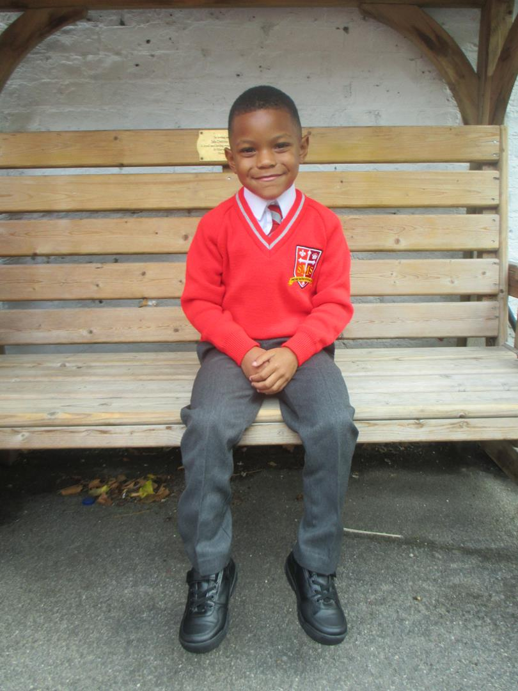
EYFS
Nursery- For settling in so well to our school, showing kindness and making lots of new friends.
Reception- For coming back after the holidays with a fantastic attitude towards his learning and trying his best in Literacy lessons.
Miss Barker

Slide 7
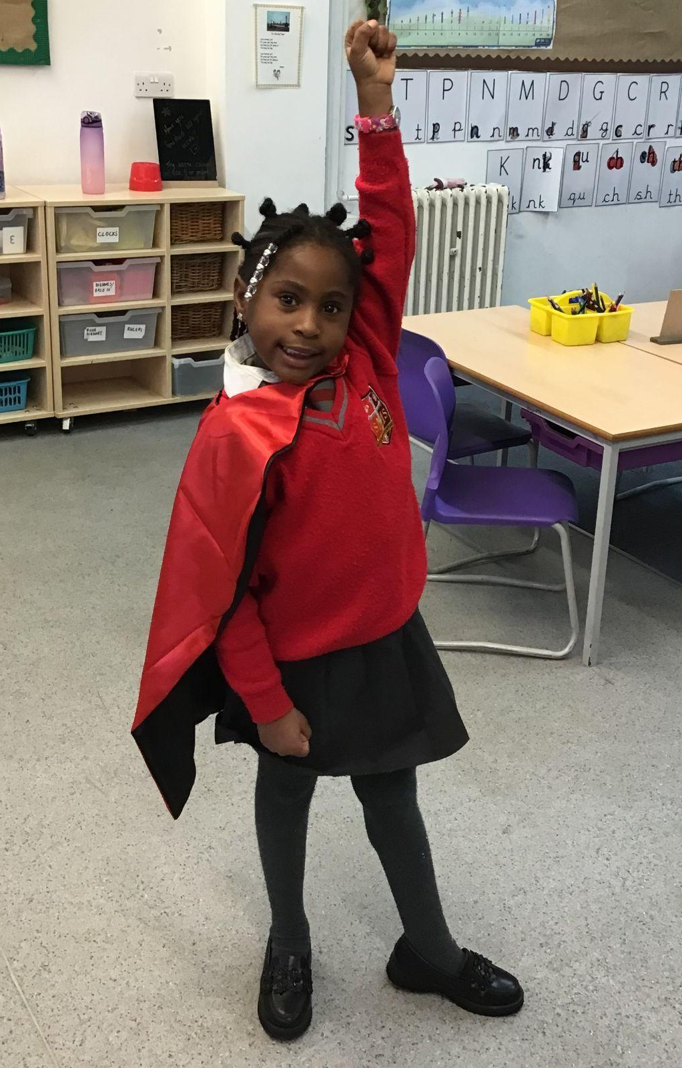
Year 1
For starting 2026 the best she can be - making good choices and putting lots of effort into her work!
Miss Flashman

Slide 8
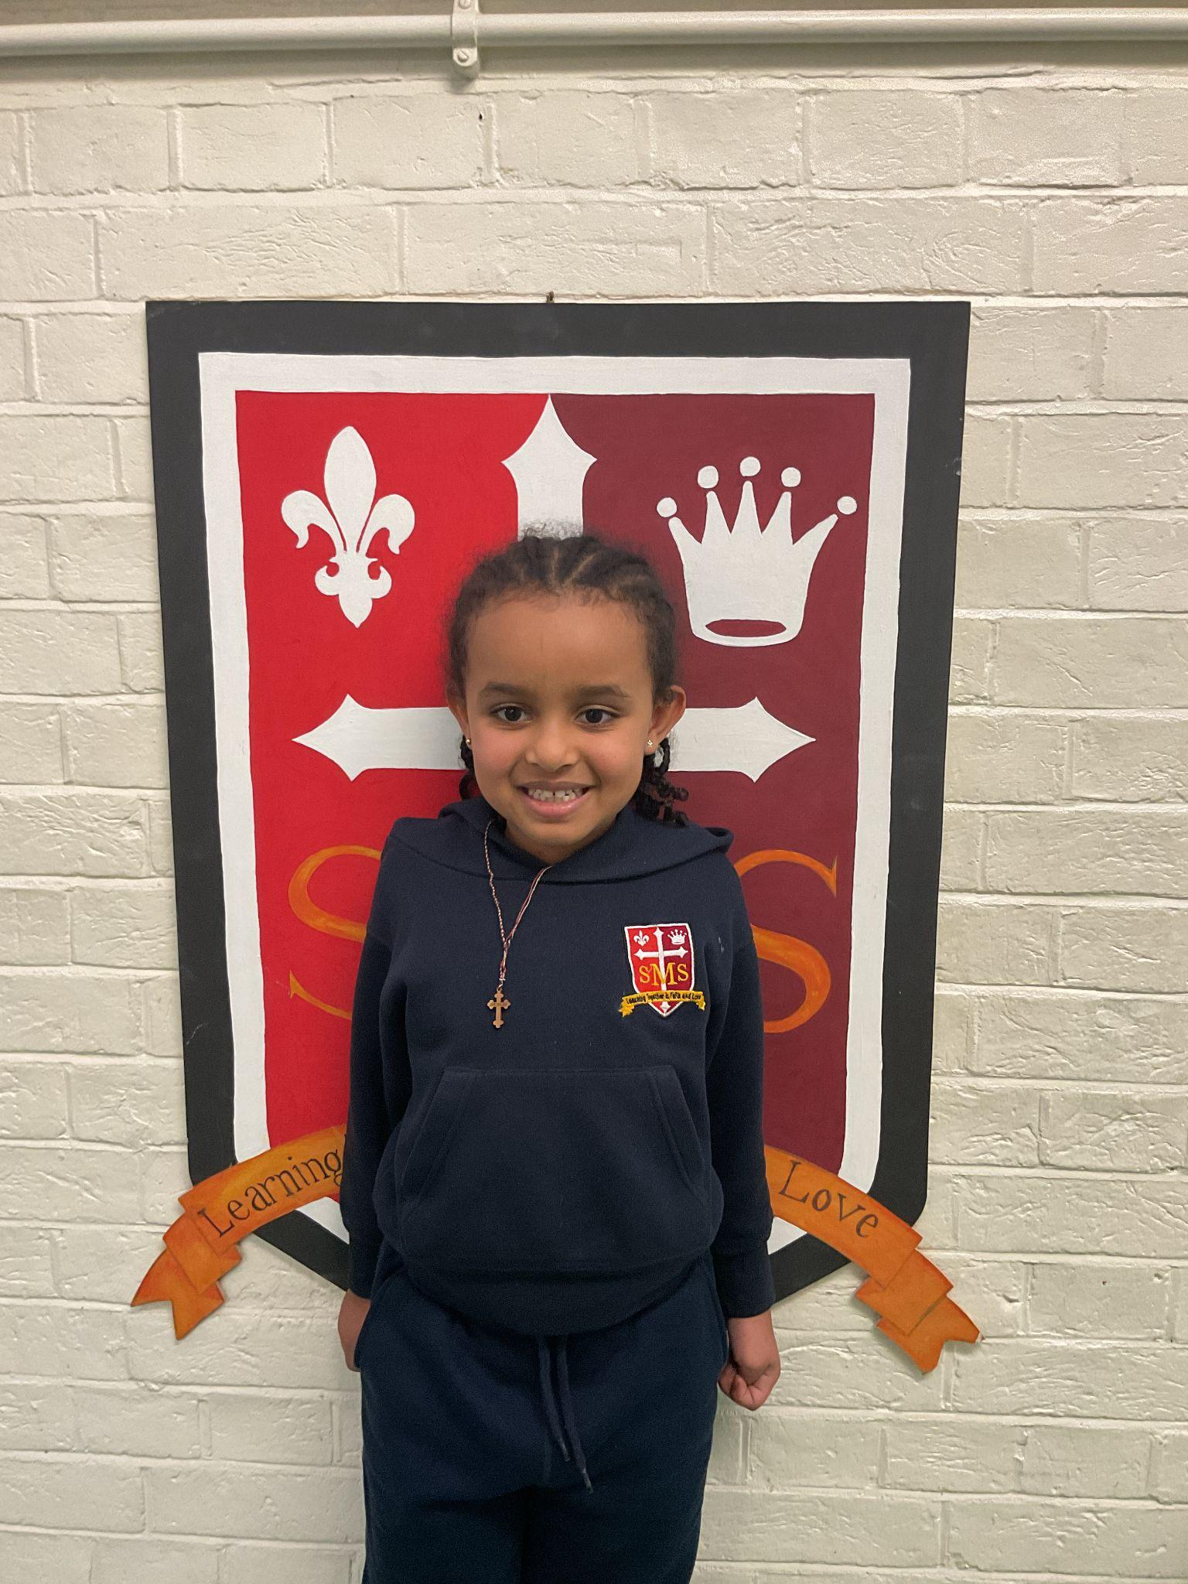
Year 2
For having a great start to Spring term and following the values of St. Mary’s
Miss Sweet and Ms Cummings

Slide 9
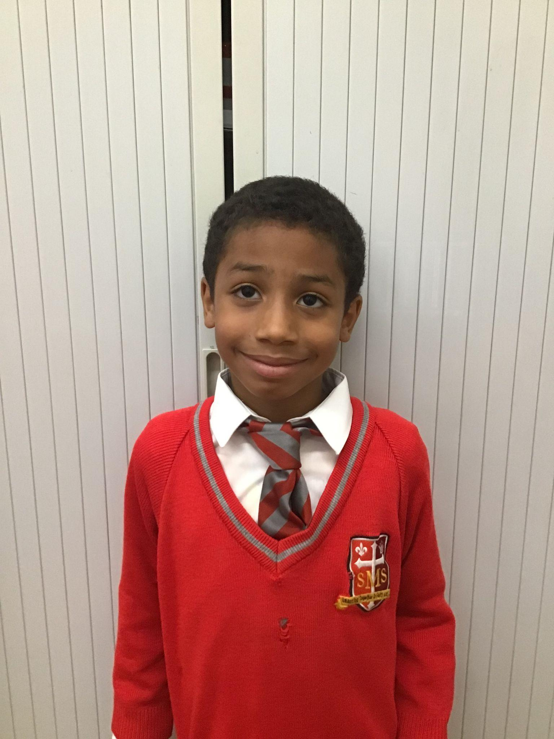
Year 3
For a superb, positive start to 2026 in all subjects.
Mr. Larke

Slide 10
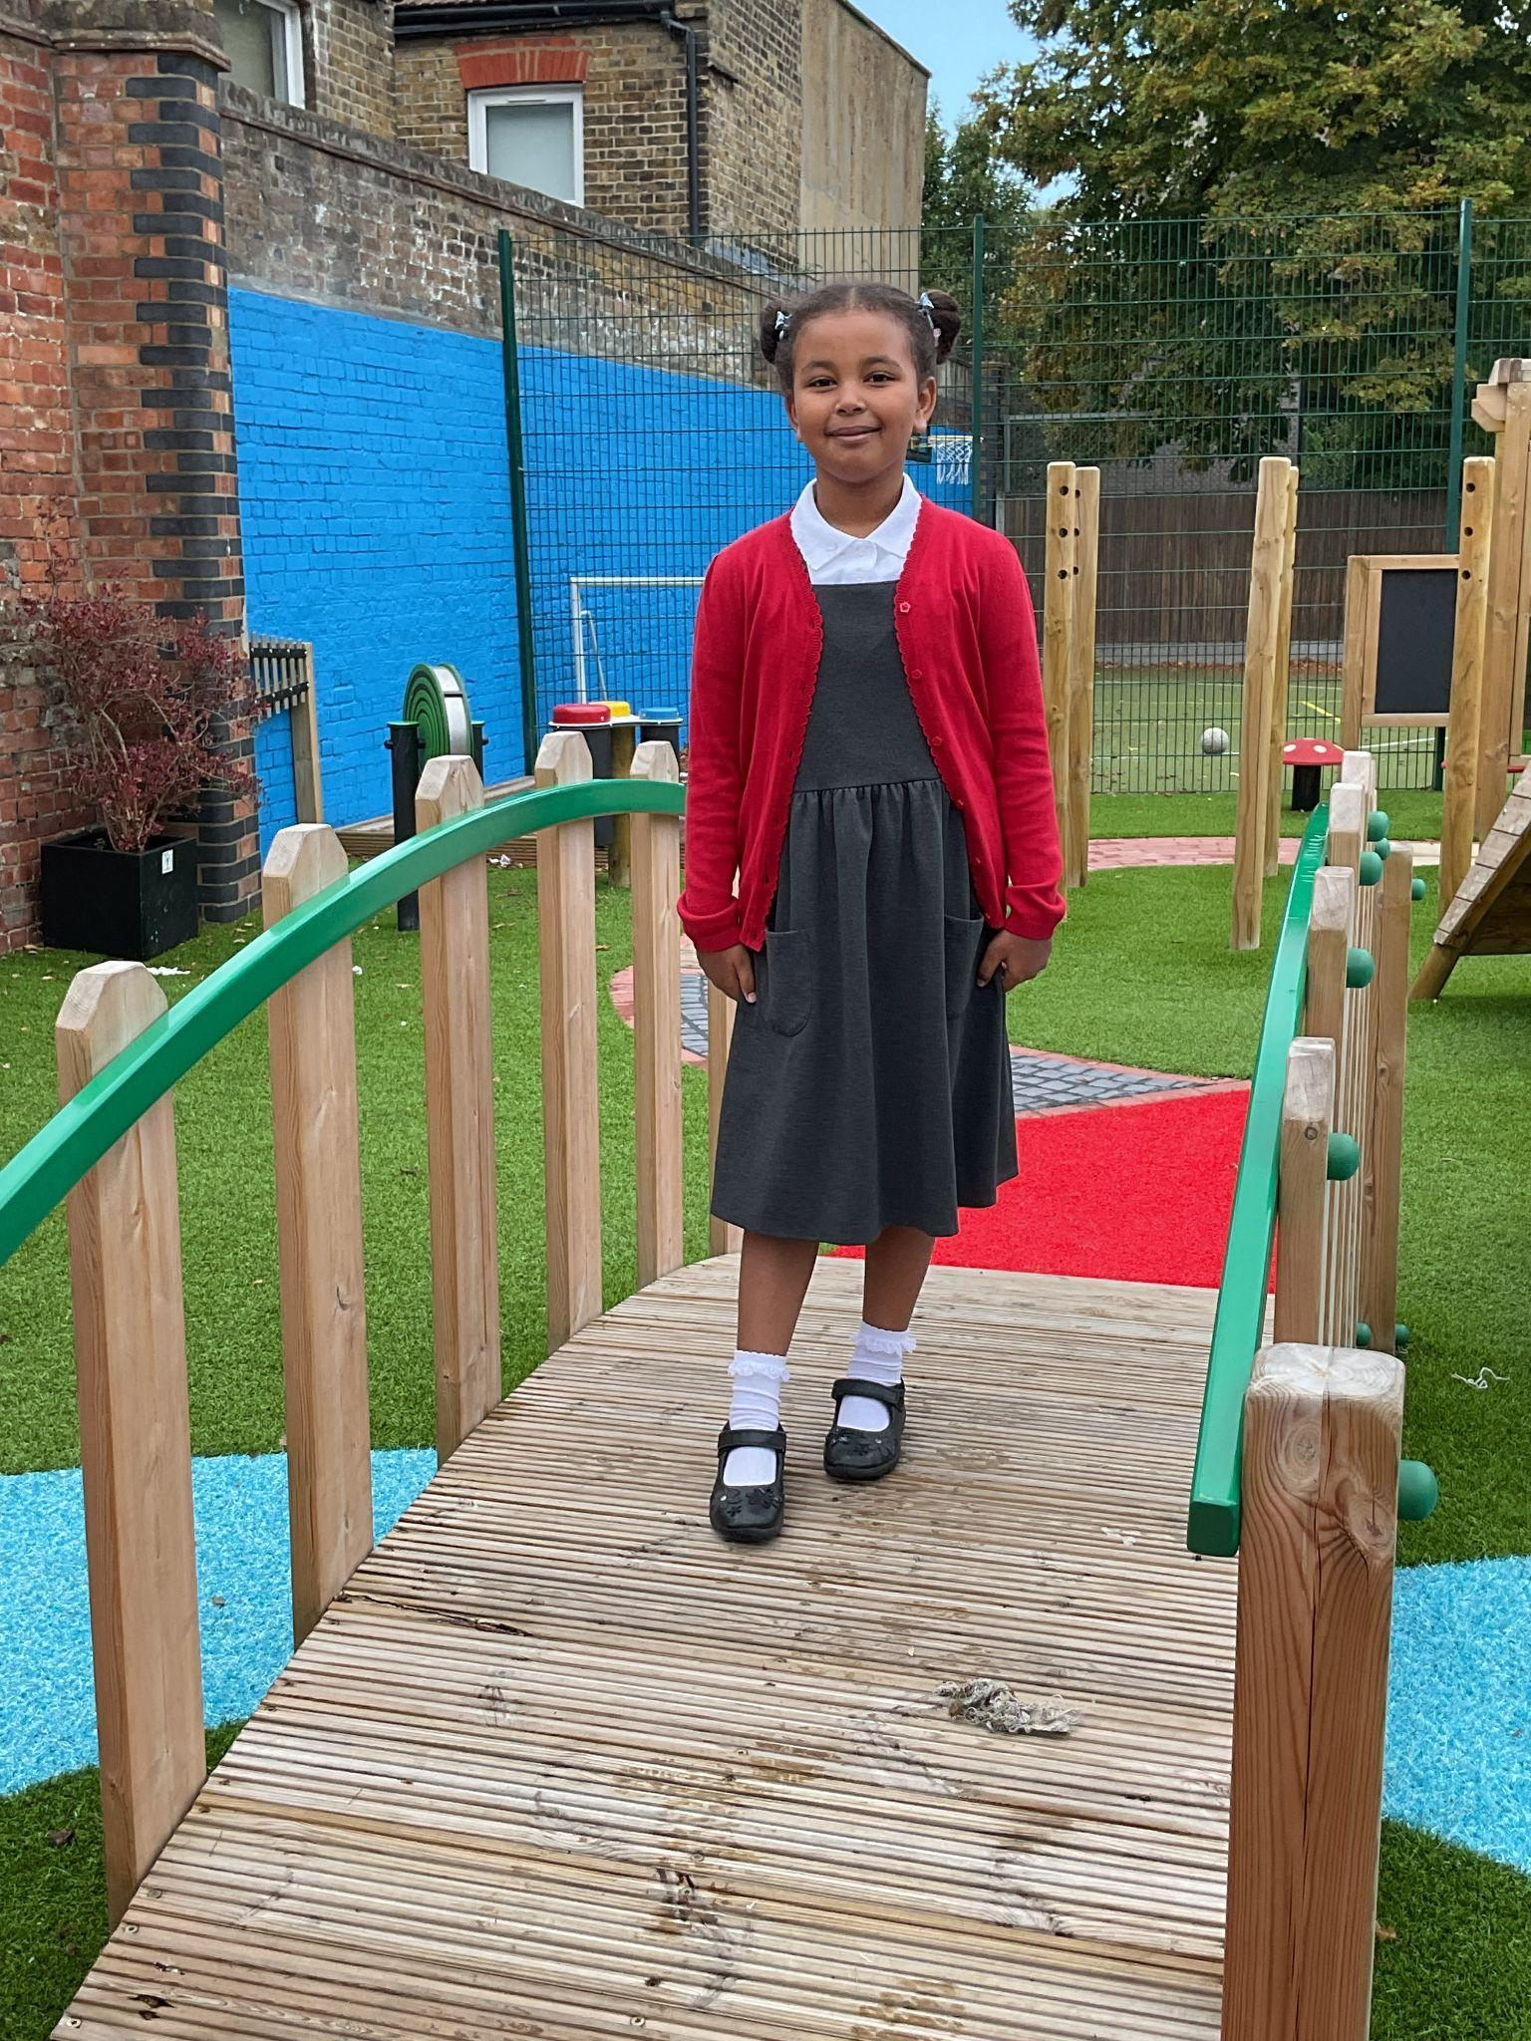
Year 4
For showing excellent attention and concentration across the curriculum, and for trying her hardest, particularly in maths.
Mr Whear

Slide 11
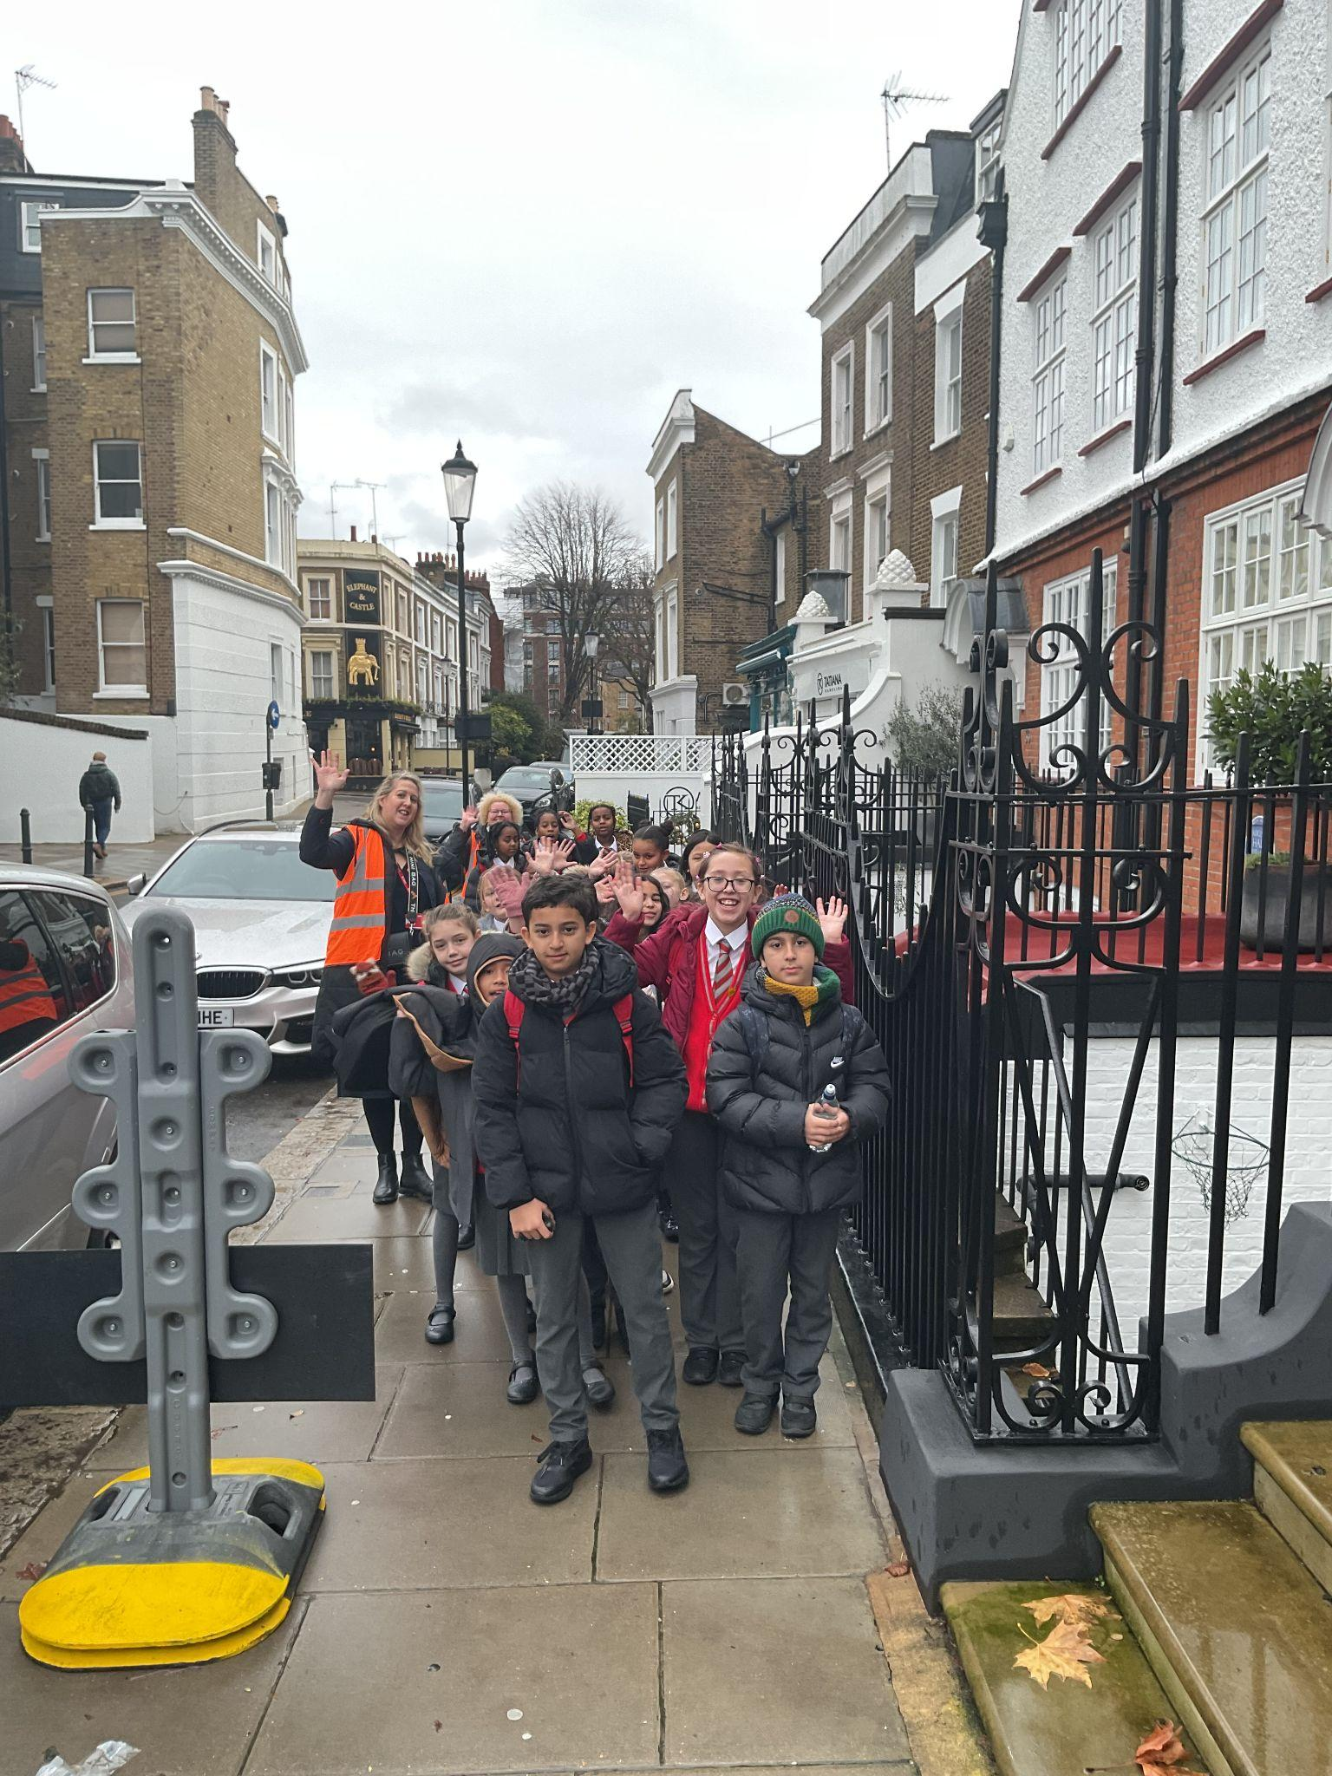
Year 5
Whole Class
For resilience and positivity.

Slide 12
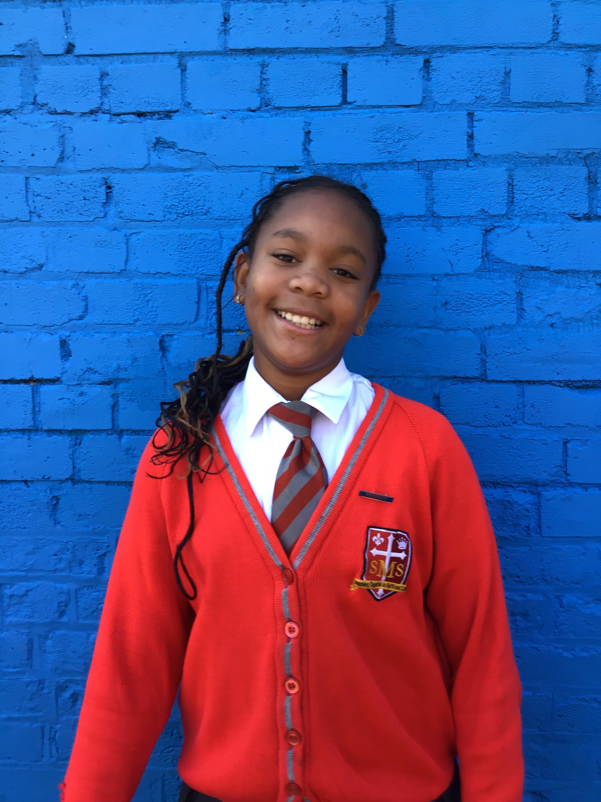
Year 6
For really pushing herself in English and producing wonderful ideas that benefitted the entire class.
Mr Cherfi & Mr Quinlan

Slide 13



Star Readers
Y1 - Tegan
Y2 - Farah
Y3 - Alana
Y4 - Aislie
Y5 -
Y6 - N/A

Slide 14
Whole School
Star of the Week
Friday 16th January 2026

