Slide 1




Whole School
Star of the Week
Friday 17th October 2025

Slide 2

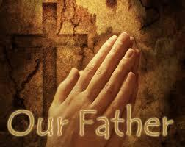
Our Father who art in Heaven
Hallowed be Thy Name
Thy Kingdom come
Thy will be done on Earth as it is in Heaven
Give us this day our daily bread
And forgive us our trespasses
As we forgive those who trespass against us
And lead us not into temptation
But deliver us from evil
Amen

Slide 3
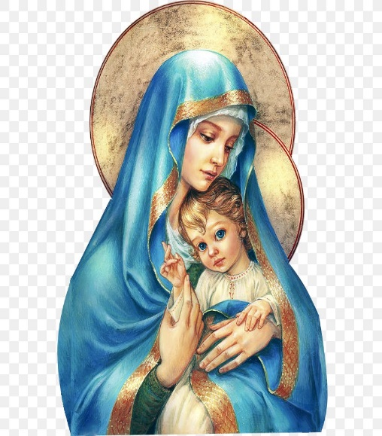
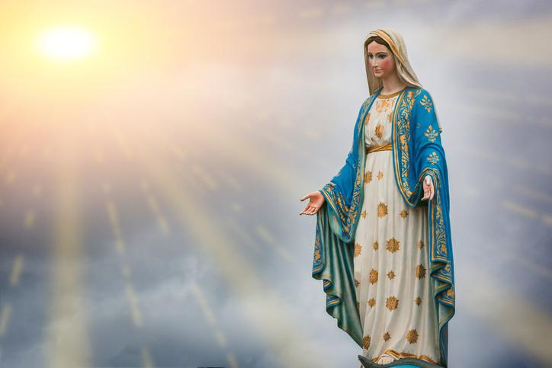
Hail Mary, Full of Grace
The Lord is with Thee
Blessed are Thou amongst women
And Blessed is the fruit of Thy womb, Jesus
Holy Mary , Mother of God
Pray for us sinners
Now and in the hour of our death
Amen

Slide 4
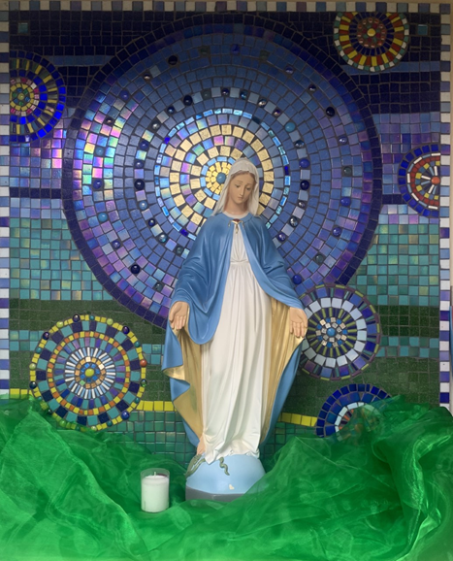
St Mary’s School Prayer
O Holy Mary,
Mother and Patron of our school,
Turn your eyes of mercy towards us,
that we may love God
With all our hearts!
May we imitate the tenderness
of your Son, Jesus,
showing love and respect
For each person
and ourselves as children of God.
Guided by the Holy Spirit,
May we create the school,
where Mercy and Compassion
Is the centre of our lives.
Amen

Slide 5
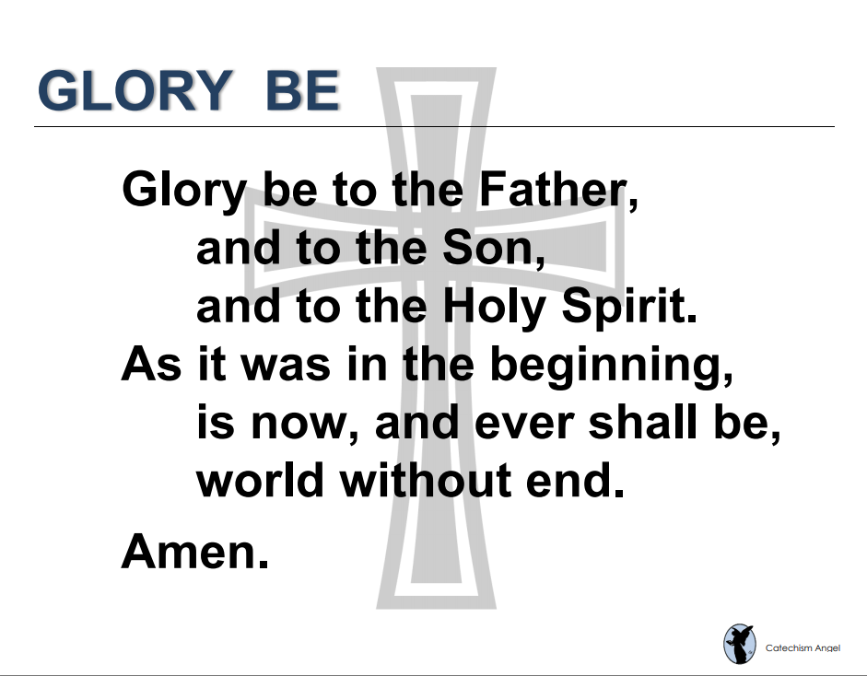

Slide 6
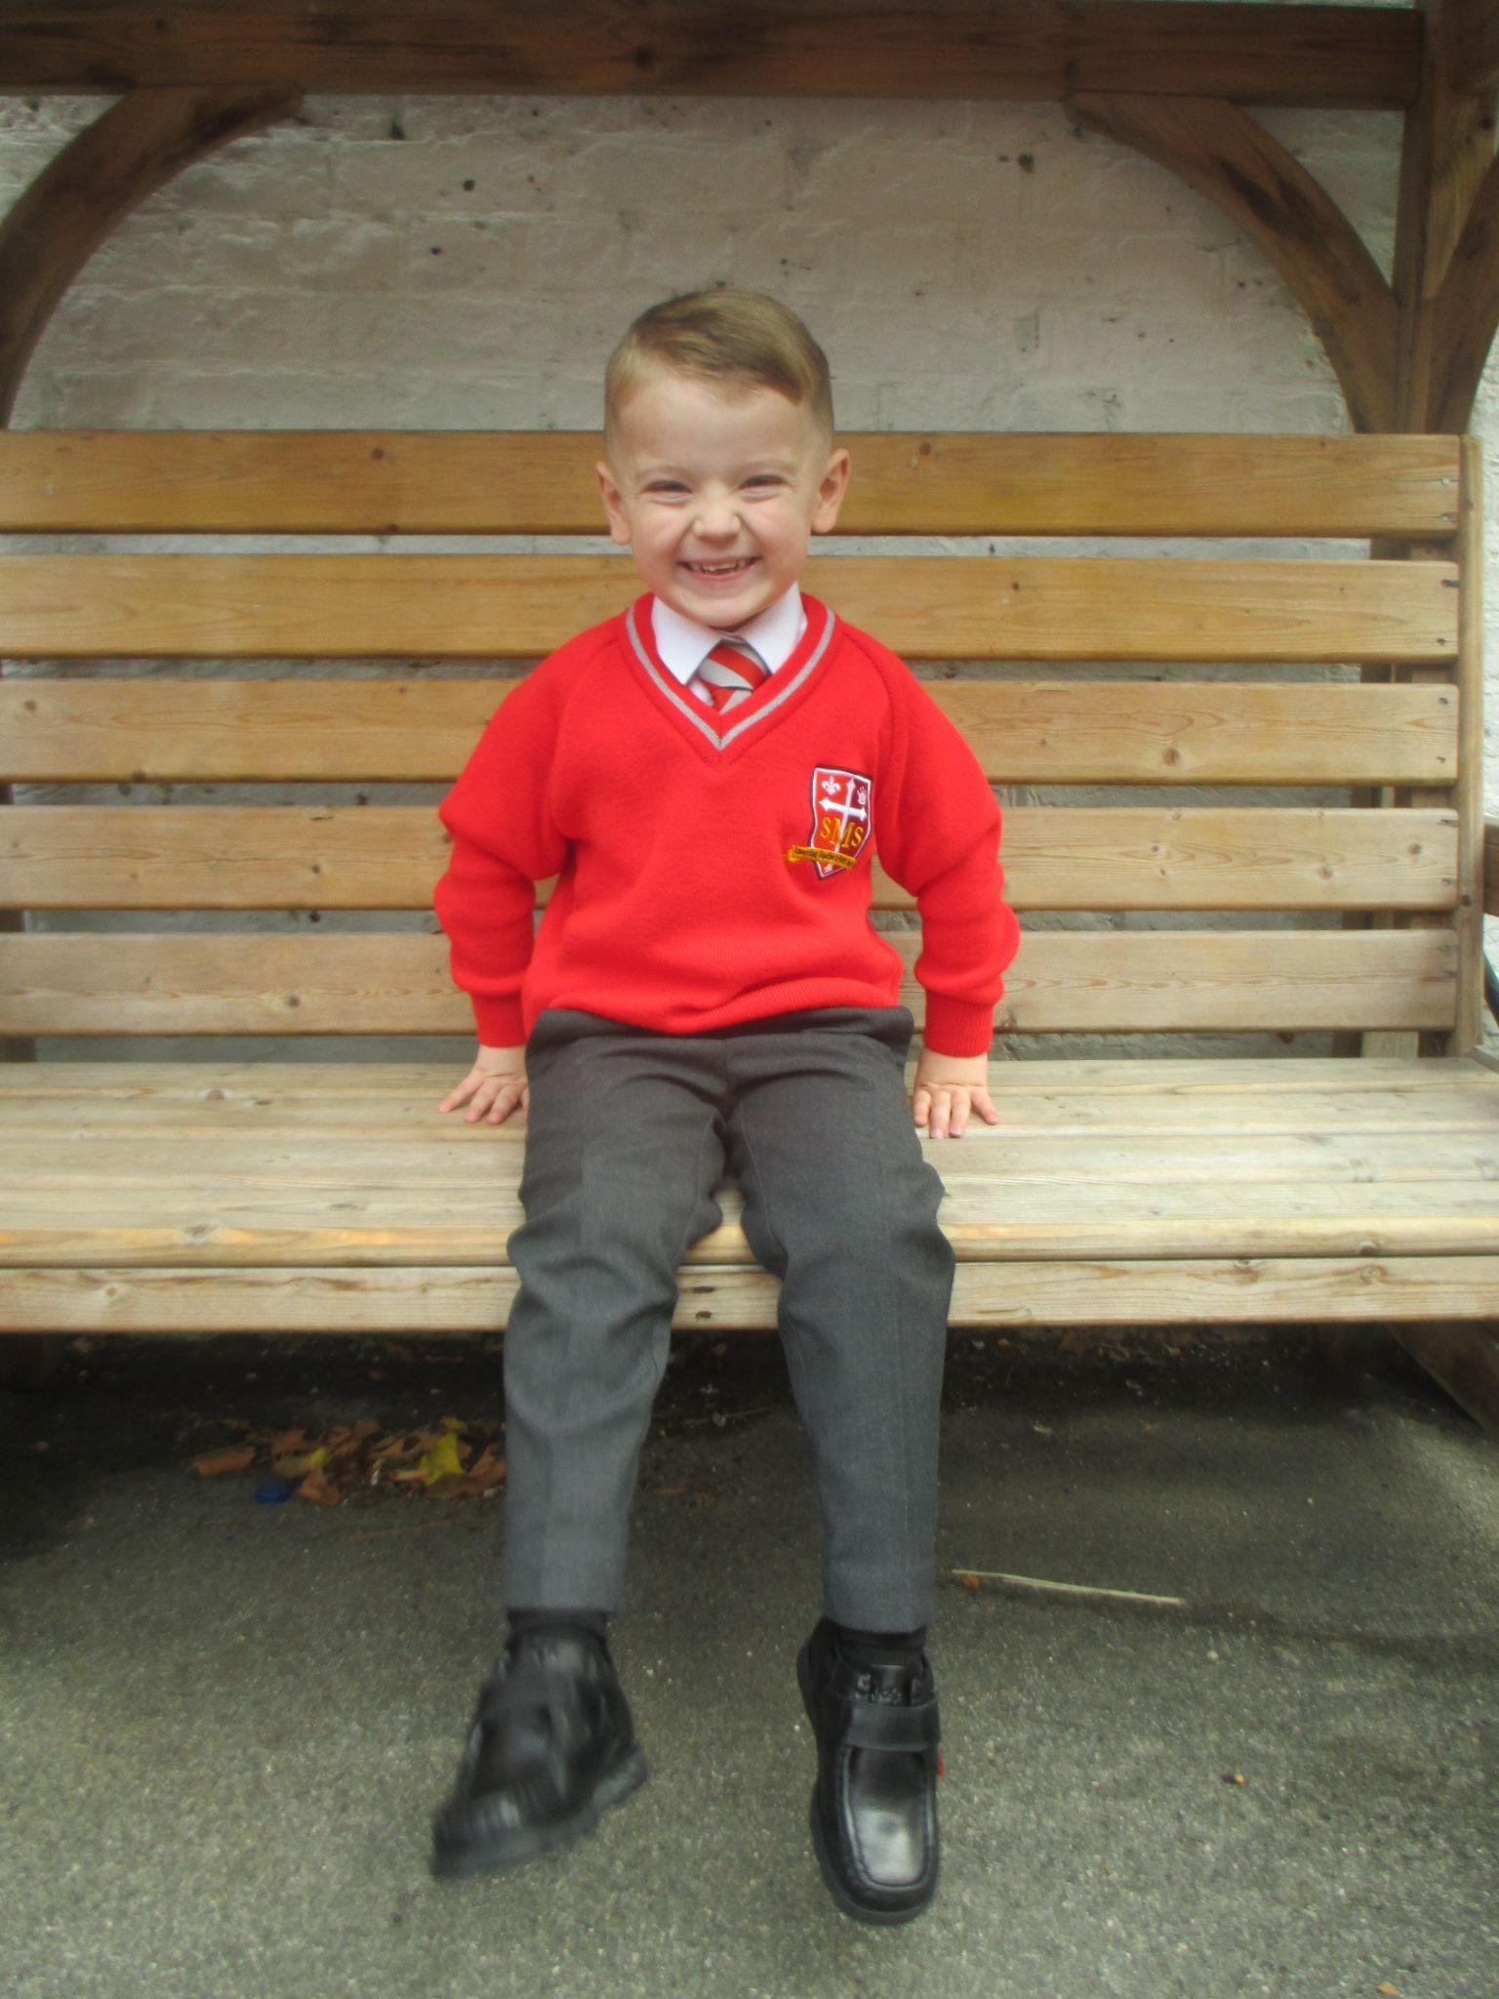
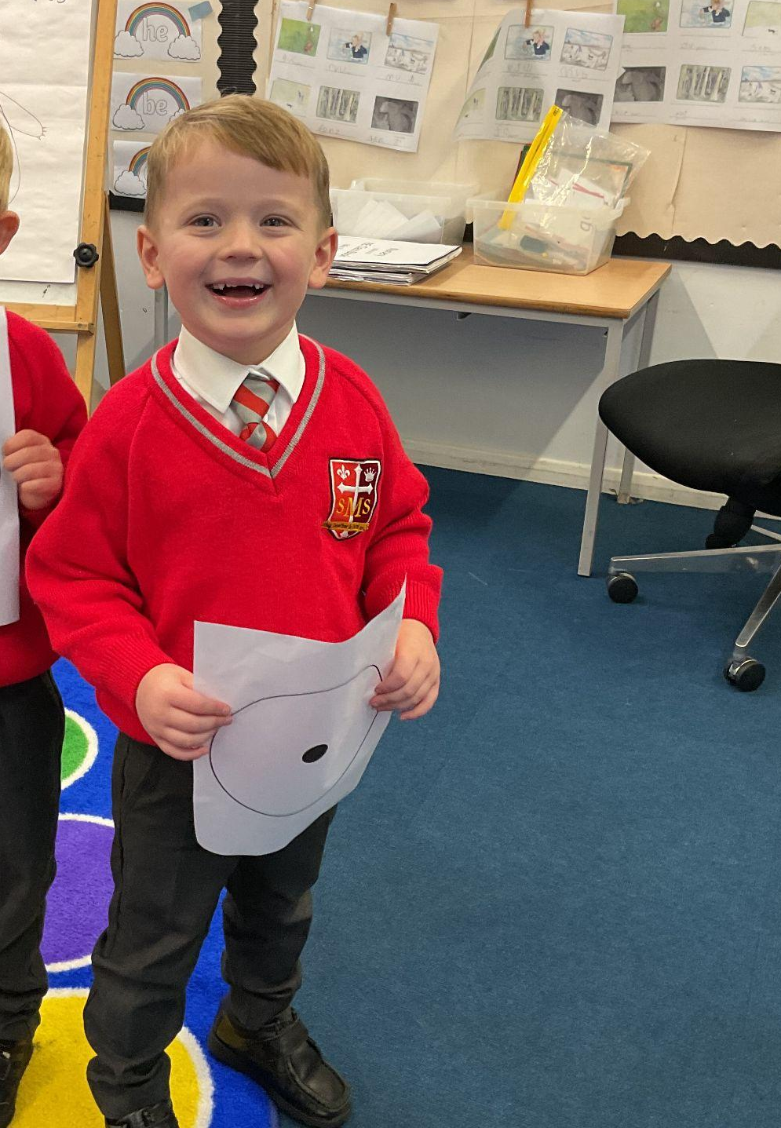
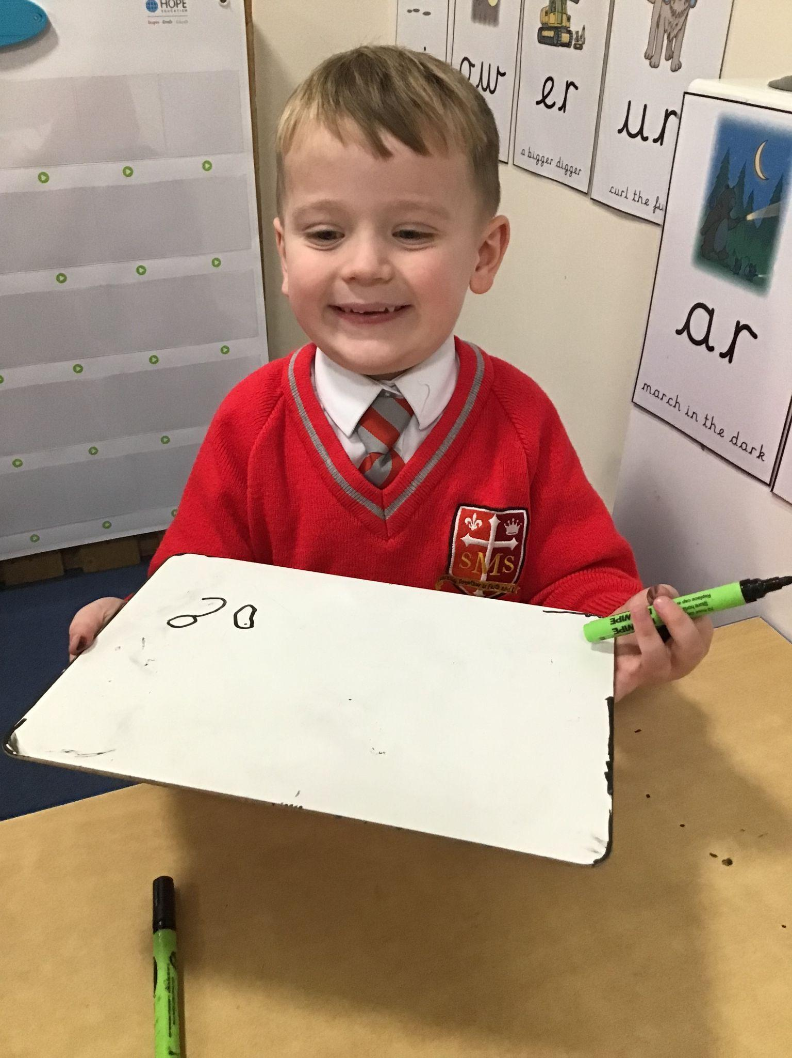
Reception
For demonstrating a real maturity in class and positive engagement in whole class lessons.
Miss Barker

Slide 7
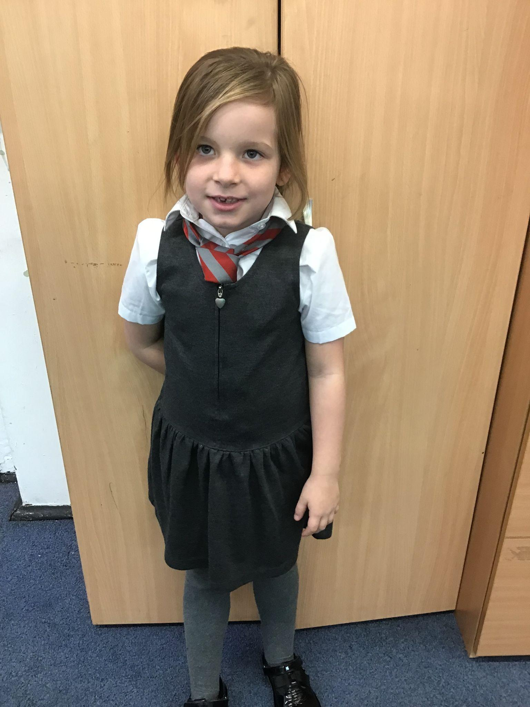
Year 1
For always listening and being focused on the carpet, ready to learn and being a role model to her peers.
Miss Begum

Slide 8
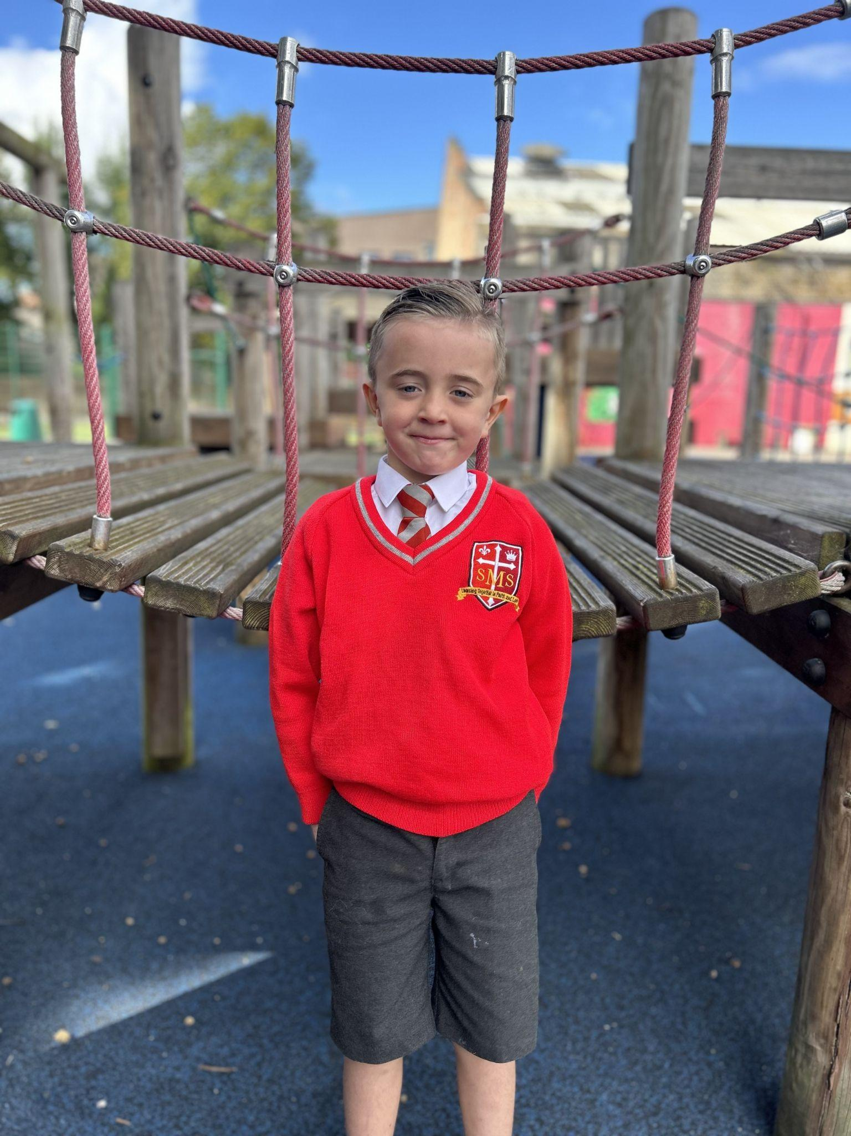
Year 2
For applying himself in his assessments this week. Working hard with Miss Jill in reading and always making sure Mrs Cummings leaves on Friday with a smile on her face! Keep up the effort George in all that you do!
Miss Sweet and Mrs Cummings

Slide 9
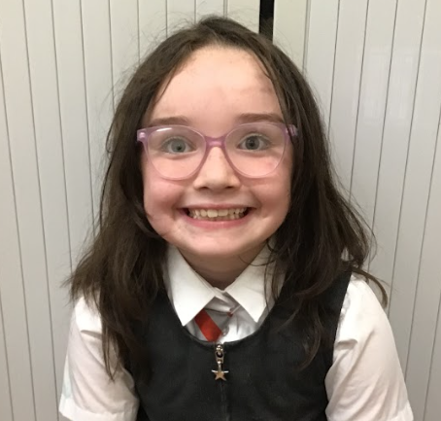
Year 3
For consistent effort and positivity in everything she does!
Mr. Larke

Slide 10
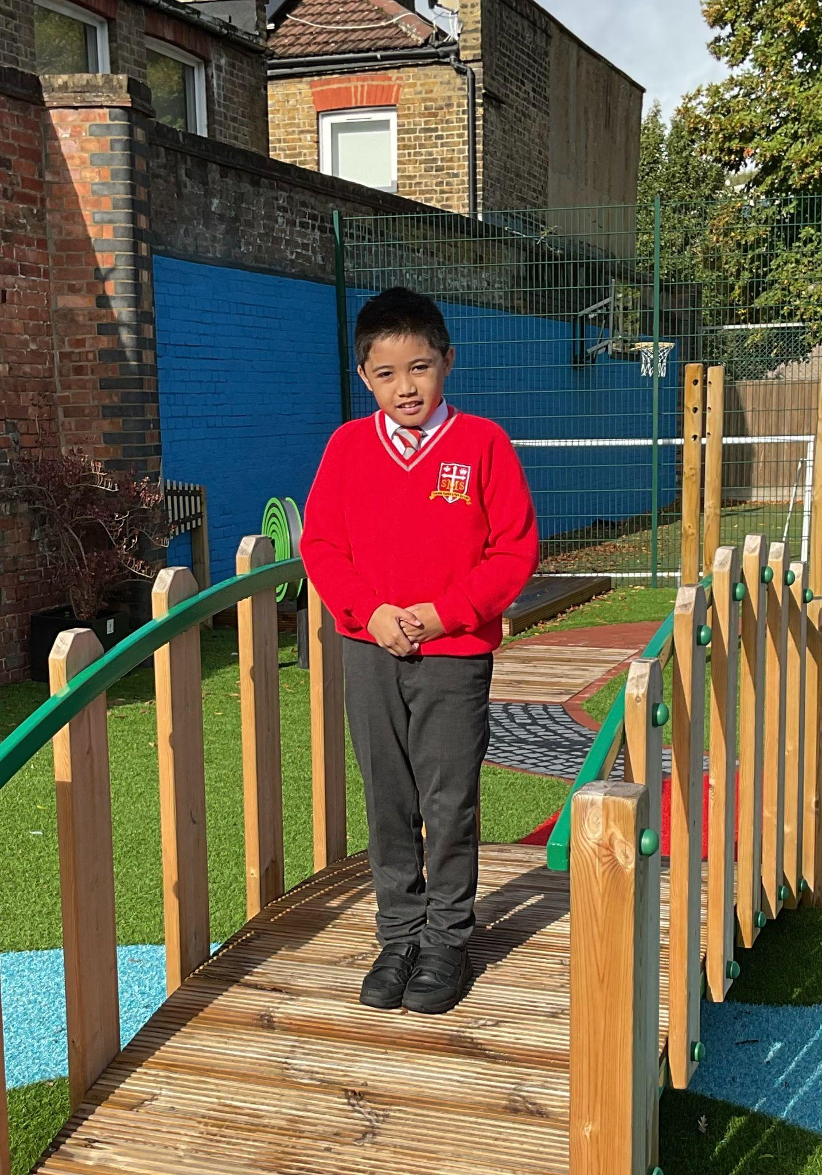
Year 4
For showing us the way through thoughtful and articulate questioning (and answers); listening to feedback and implementing it; and working hard and so performing well in his assessments
Mr Whear

Slide 11

Year 5
For her resilience in her learning and never giving up and her kindness towards everyone in class.
Mr. Carey

Slide 12
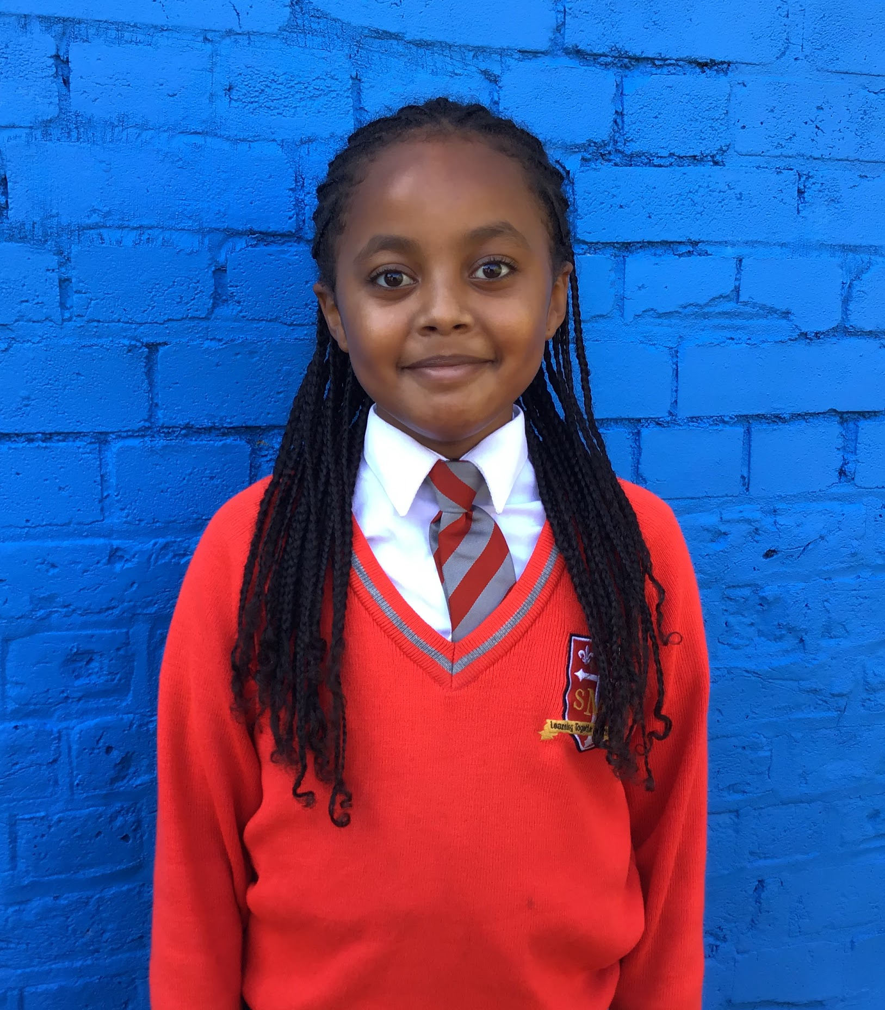
Year 6
For producing an exemplary piece of writing in English and showing great pride in her work.
Mr Cherfi & Mr Quinlan

Slide 13



Star Readers
Y1 - Isadora
Y2 - Mai-Mariam
Y3 - Victor
Y4 - Vanna
Y5 - Kian
Y6 - Kessiah

Slide 14

Noel - Y2
Mia - Y3

Slide 15
Whole School
Star of the Week
Friday 10th October 2025

