Slide 1




Whole School
Star of the Week
Friday 19th September 2025

Slide 2


Our Father who art in Heaven
Hallowed be Thy Name
Thy Kingdom come
Thy will be done on Earth as it is in Heaven
Give us this day our daily bread
And forgive us our trespasses
As we forgive those who trespass against us
And lead us not into temptation
But deliver us from evil
Amen

Slide 3
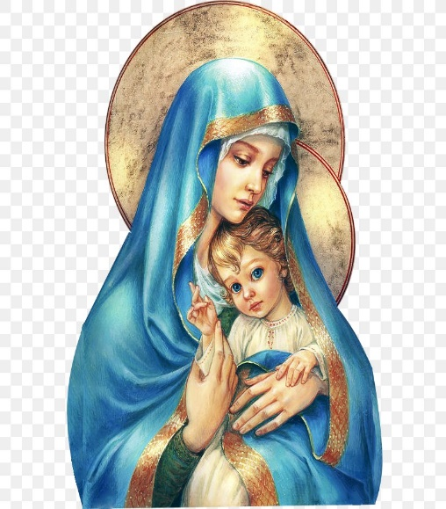
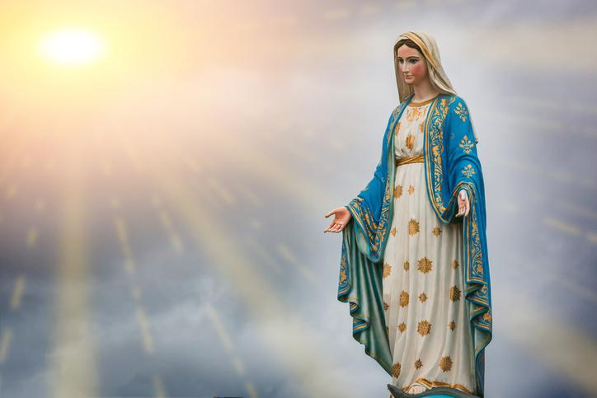
Hail Mary, Full of Grace
The Lord is with Thee
Blessed are Thou amongst women
And Blessed is the fruit of Thy womb, Jesus
Holy Mary , Mother of God
Pray for us sinners
Now and in the hour of our death
Amen

Slide 4
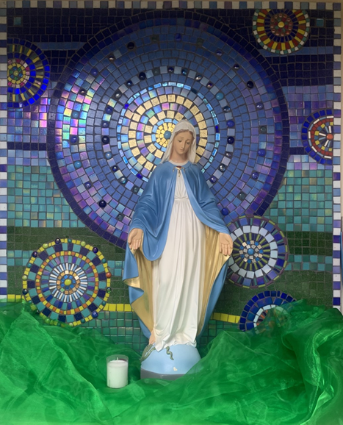
St Mary’s School Prayer
O Holy Mary,
Mother and Patron of our school,
Turn your eyes of mercy towards us,
that we may love God
With all our hearts!
May we imitate the tenderness
of your Son, Jesus,
showing love and respect
For each person
and ourselves as children of God.
Guided by the Holy Spirit,
May we create the school,
where Mercy and Compassion
Is the centre of our lives.
Amen

Slide 5
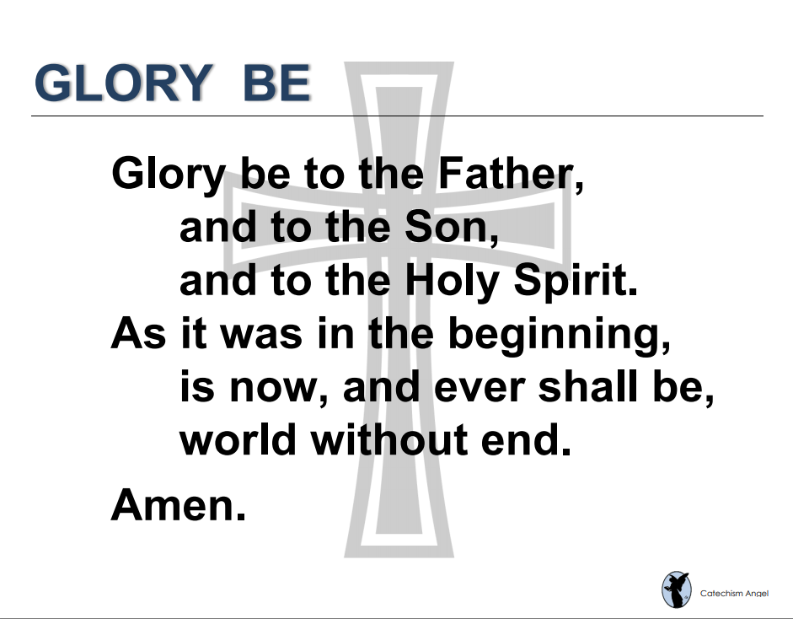

Slide 6
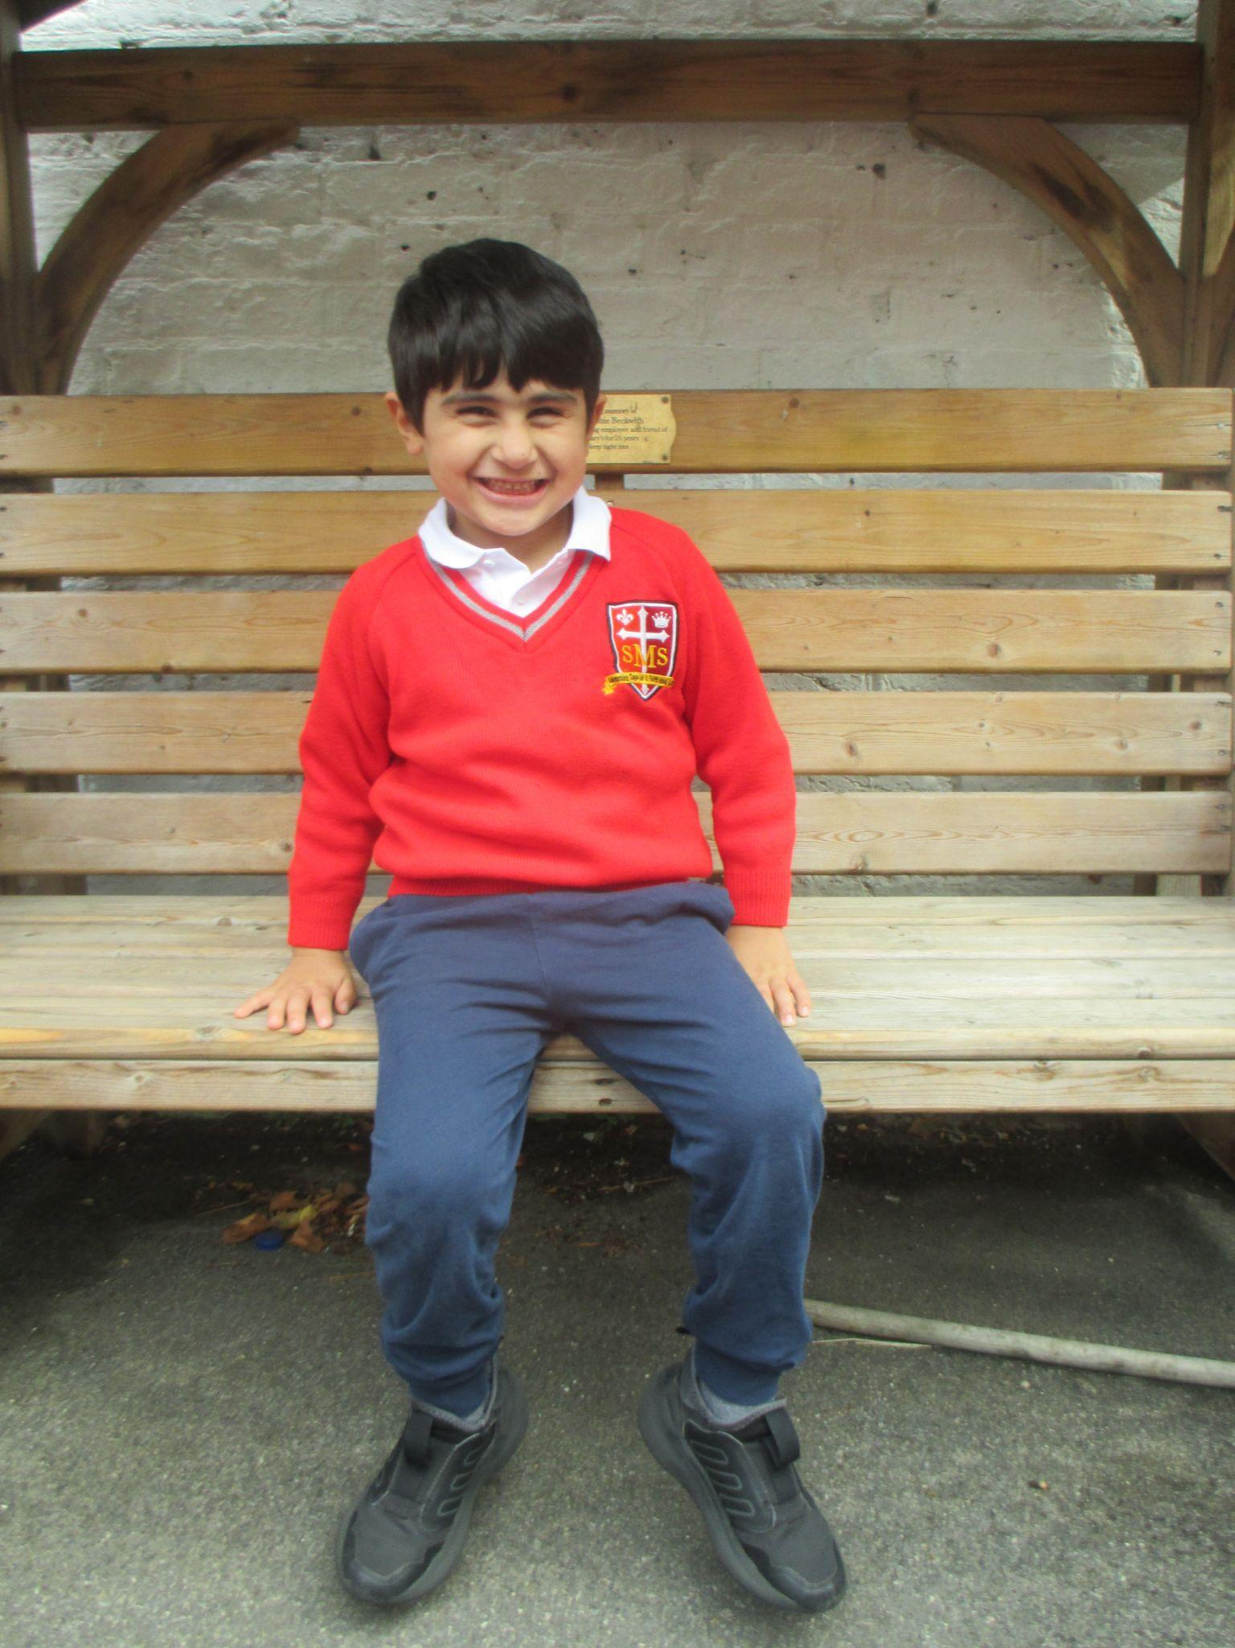
EYFS
Reception
For having a fantastic few weeks in Reception class and engaging with all learning with huge enthusiasm
Miss Barker

Slide 7
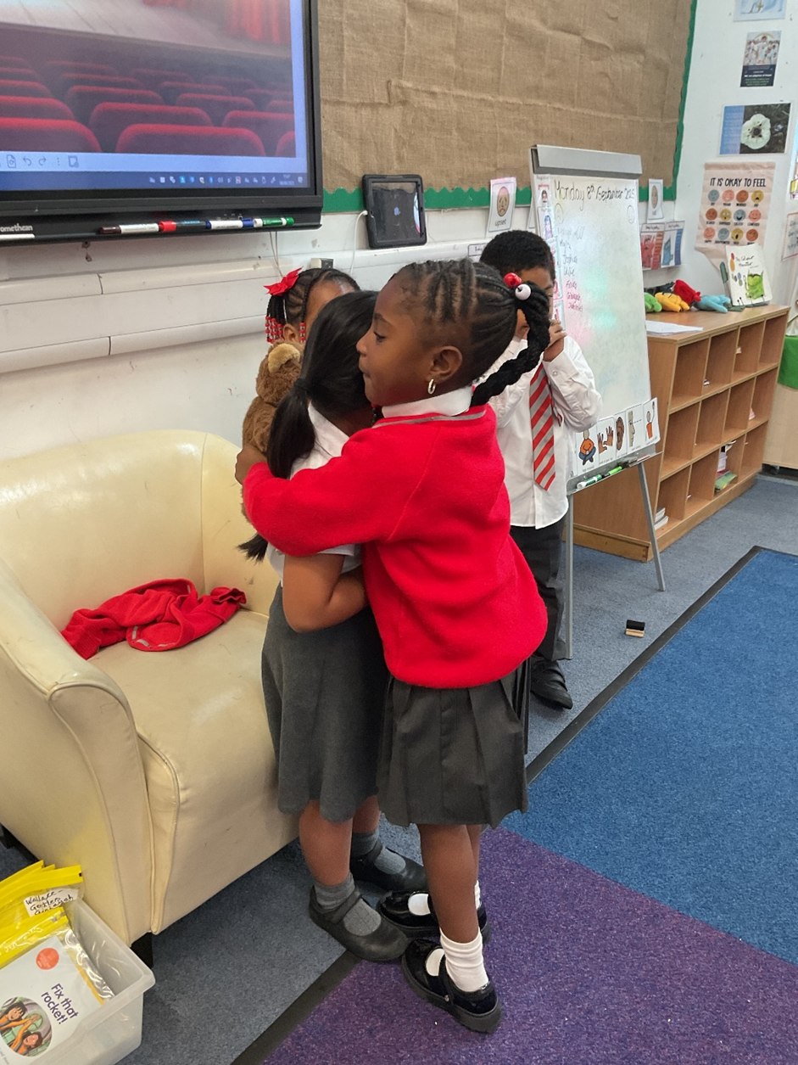
Year 1
For always being on task, and always doing the right thing when asked the first time
Miss Begum

Slide 8

Year 2
For having a fantastic start to Year 2!
Miss Sweet

Slide 9
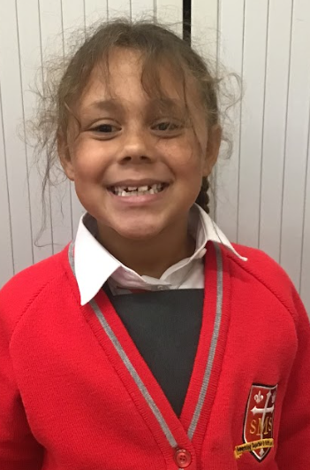
Year 3
For applying herself and giving her very best in her learning.
Mr. Larke

Slide 10
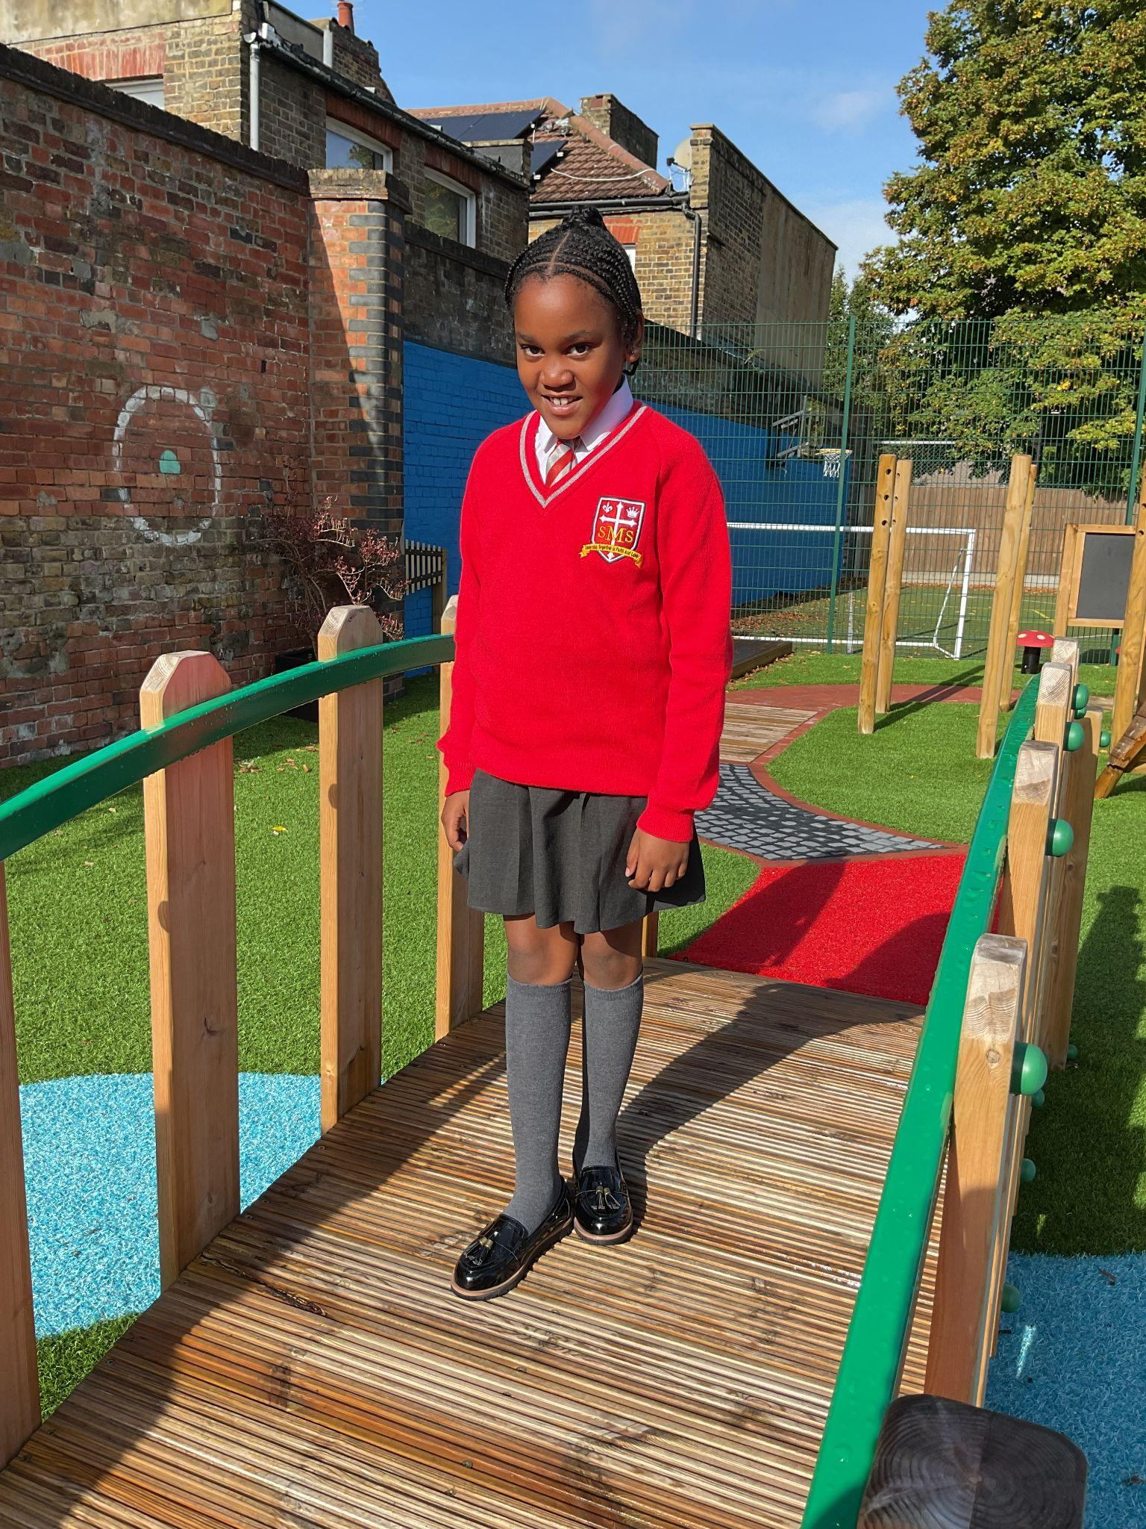
Year 4
For consistently making on-point and thoughtful contributions to our discussions with confidence and for displaying our School Values
Mr Whear

Slide 11

Year 5
For being a great role model and listening to instructions and showing our school values both in and out of school.
Mr. Carey

Slide 12

Year 6
For bringing more positivity, focus and courage to her work. This has lead to solid improvements that will put her in good stead for the upcoming year.
Mr Cherfi & Mr Quinlan

Slide 13



Star Readers
Y1 - Cecilia
Y2 - Kurtny
Y3 - Major
Y4 - Guttemberg
Y5 - Franzen
Y6 - Yael

Slide 14

Y6 - Nicholas
Y4 - Jayden
Y6 - Layla
Y1 - Cecilia
Y3 - Nicholas & Renai-Mae
Y5 - Deborah & Yusuf

Slide 15
Whole School
Star of the Week
Friday 19th September 2025

