Slide 1




Whole School
Star of the Week
Friday 26th September 2025

Slide 2


Our Father who art in Heaven
Hallowed be Thy Name
Thy Kingdom come
Thy will be done on Earth as it is in Heaven
Give us this day our daily bread
And forgive us our trespasses
As we forgive those who trespass against us
And lead us not into temptation
But deliver us from evil
Amen

Slide 3
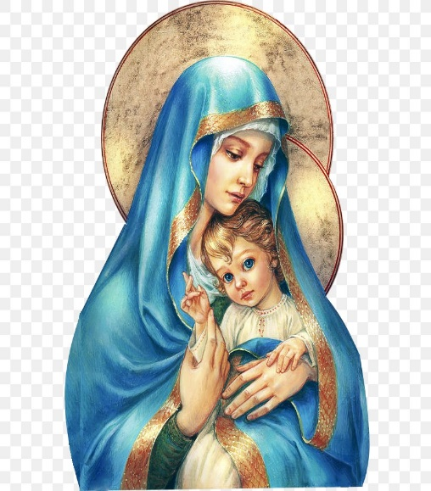
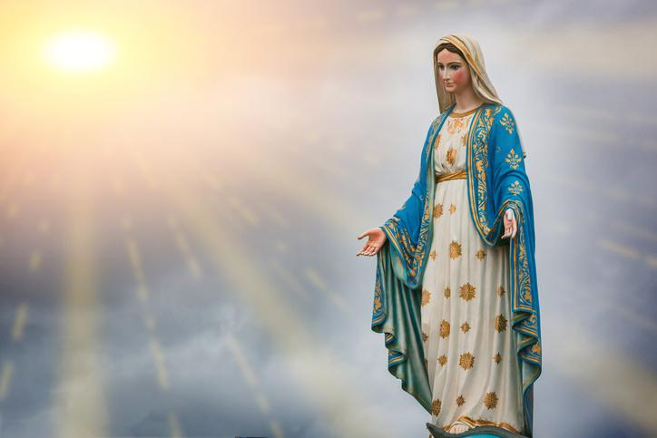
Hail Mary, Full of Grace
The Lord is with Thee
Blessed are Thou amongst women
And Blessed is the fruit of Thy womb, Jesus
Holy Mary , Mother of God
Pray for us sinners
Now and in the hour of our death
Amen

Slide 4
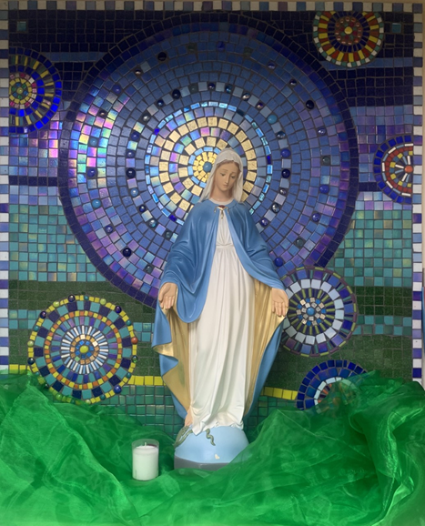
St Mary’s School Prayer
O Holy Mary,
Mother and Patron of our school,
Turn your eyes of mercy towards us,
that we may love God
With all our hearts!
May we imitate the tenderness
of your Son, Jesus,
showing love and respect
For each person
and ourselves as children of God.
Guided by the Holy Spirit,
May we create the school,
where Mercy and Compassion
Is the centre of our lives.
Amen

Slide 5
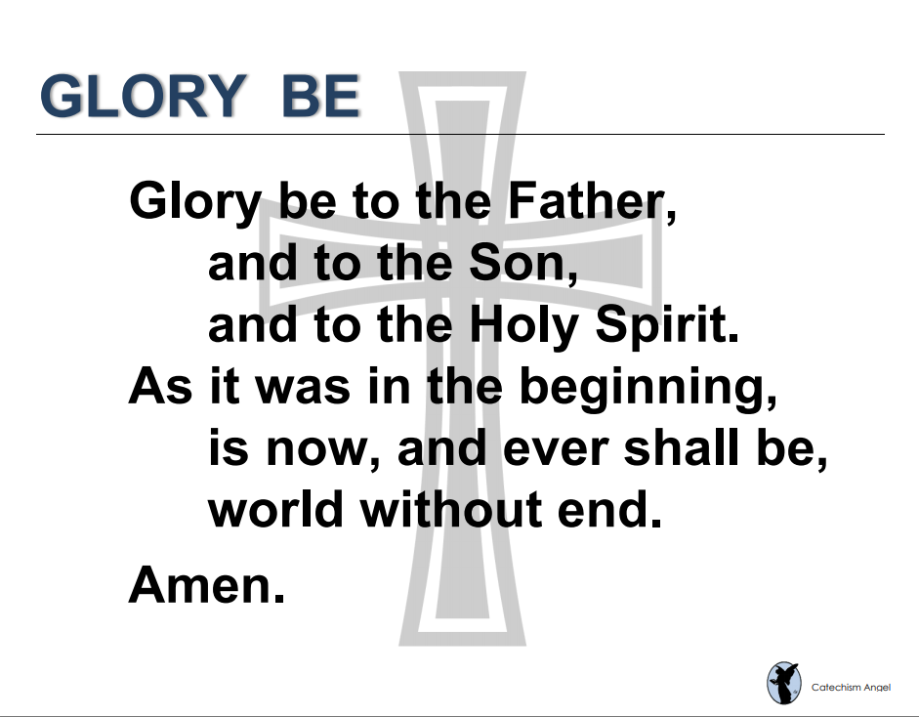

Slide 6
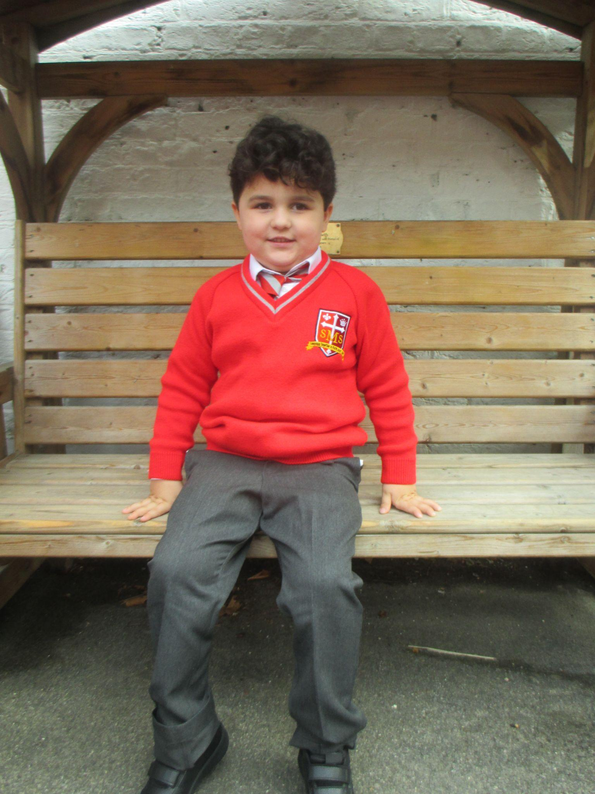
EYFS
Reception
Denis
For being the best superstar the past few weeks and 100% effort and attention during RE lessons. Well done!!!
Miss Barker

Slide 7
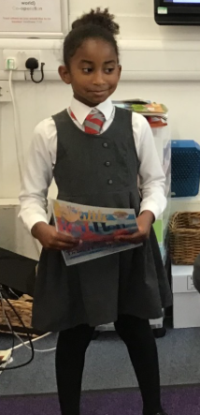
Year 1
Cecilia
For her hard work and effort in her writing, always going above and beyond.
Miss Begum

Slide 8

Year 2
Torrah-Leigh
For being a role model to her peers by always following the Golden Rules!
Miss Sweet

Slide 9

Year 3
Tay’vion
For excellent efforts all-round, especially in maths.
Mr. Larke

Slide 10
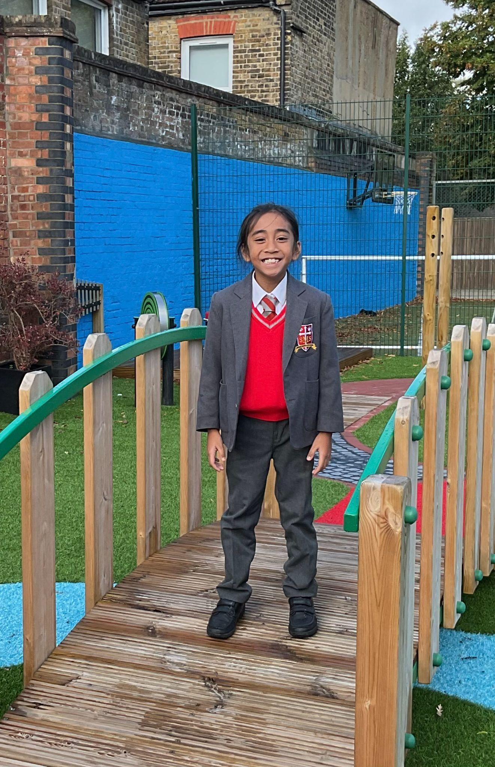
Year 4
Rhenn
For showing consistent diligence and ambition across the curriculum, but particularly in English and Maths
Mr Whear

Slide 11

Year 5
Olivia
For being diligent in all her learning and showing integrity in her behaviour at all times and showing all of the school values.
Mr. Carey

Slide 12



Star Readers
Y1 - Ayda
Y2 - George
Y3 - Sarah
Y4 - Asia
Y5 - Nathaniel
Y6 - Yael

Slide 13

Holly Year 4
Jayden Year 4

Slide 14
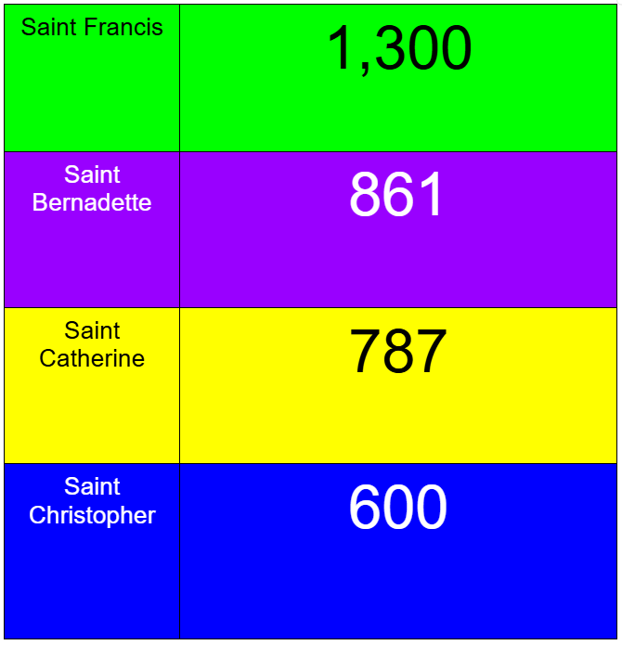
House Points

Slide 15
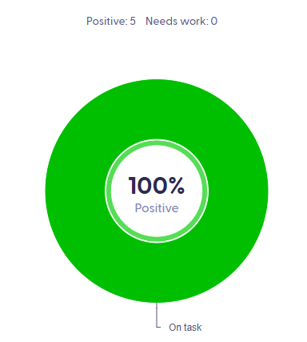
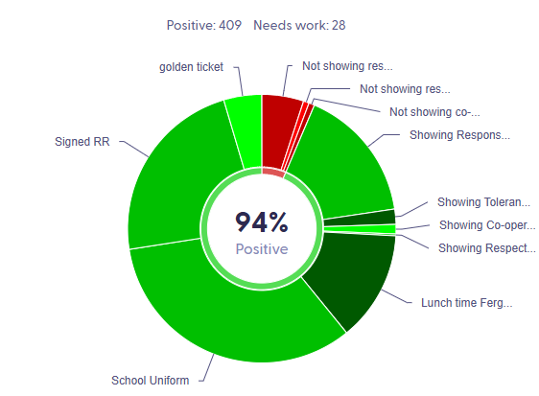
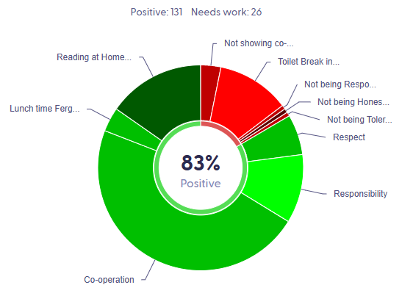
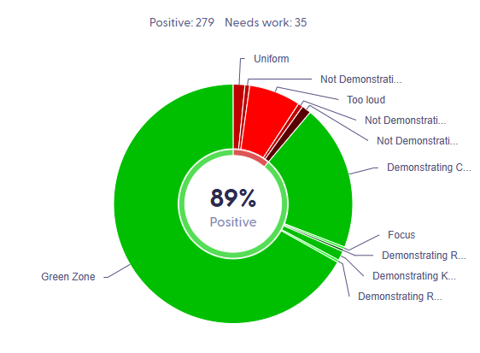
Pitch Winners KS2:

Slide 16
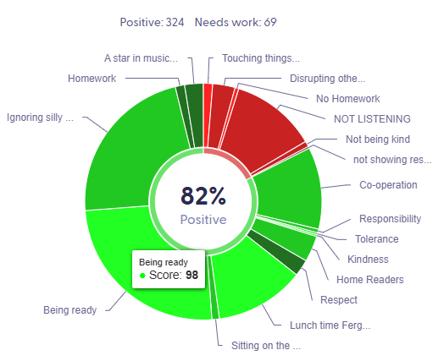
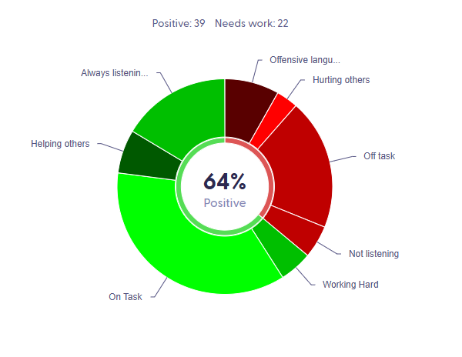
Pitch Winners KS1:

Slide 17
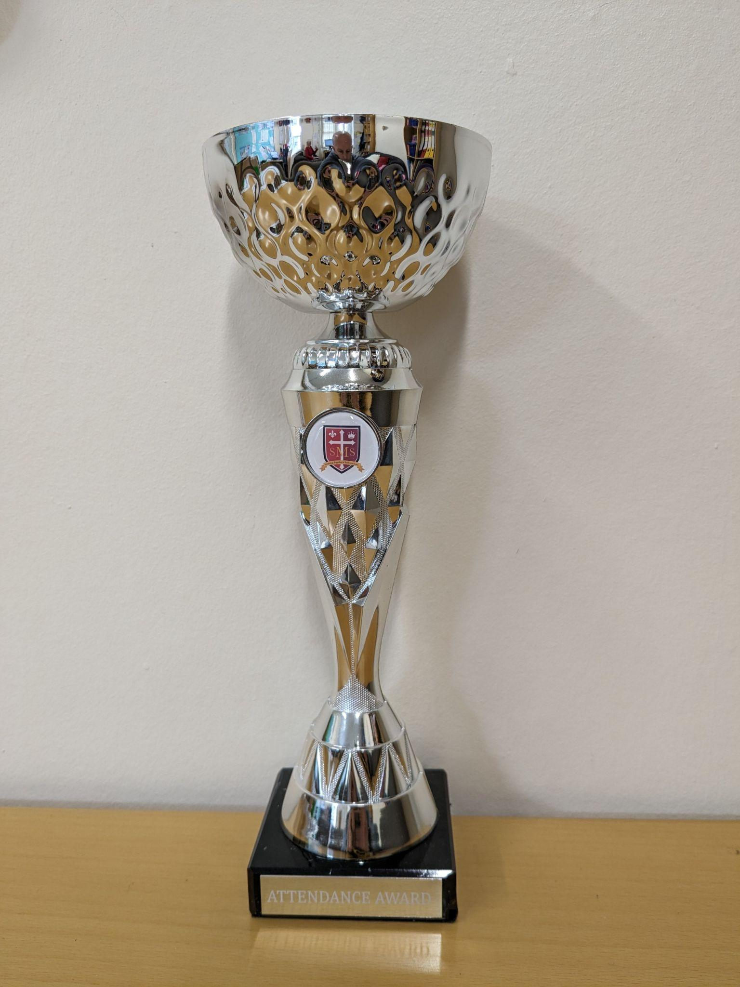
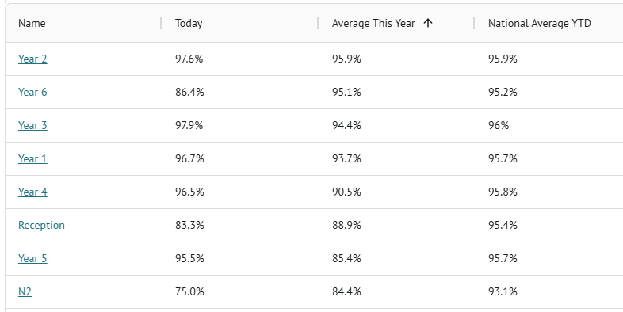
Attendance Leaders Autumn Term:

Slide 18
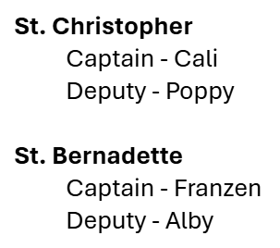
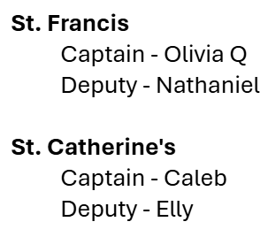

House Captains 2025-2026:

Slide 19


Today is National Support Staff Day:

Slide 20
Whole School
Star of the Week
Friday 26th September 2025

