Slide 1




Whole School
Star of the Week
Friday 30th January 2026

Slide 2


Our Father who art in Heaven
Hallowed be Thy Name
Thy Kingdom come
Thy will be done on Earth as it is in Heaven
Give us this day our daily bread
And forgive us our trespasses
As we forgive those who trespass against us
And lead us not into temptation
But deliver us from evil
Amen

Slide 3
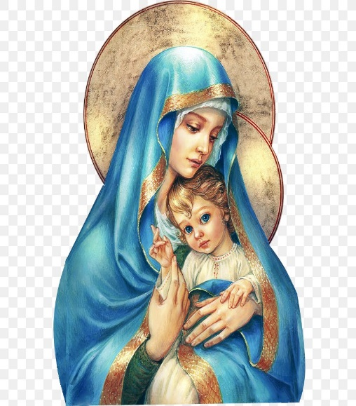
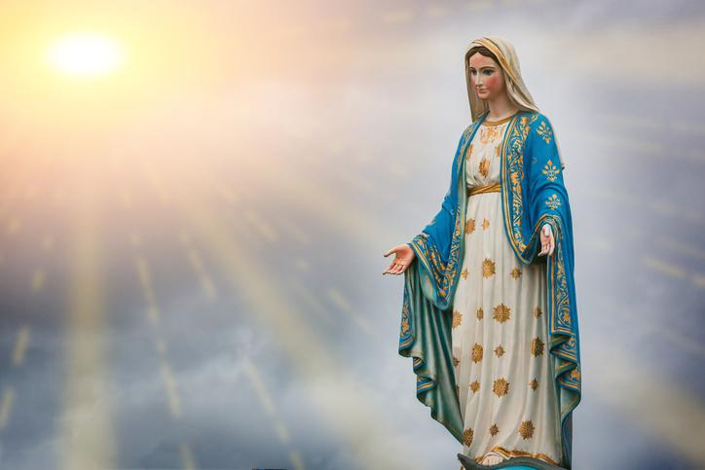
Hail Mary, Full of Grace
The Lord is with Thee
Blessed are Thou amongst women
And Blessed is the fruit of Thy womb, Jesus
Holy Mary , Mother of God
Pray for us sinners
Now and in the hour of our death
Amen

Slide 4
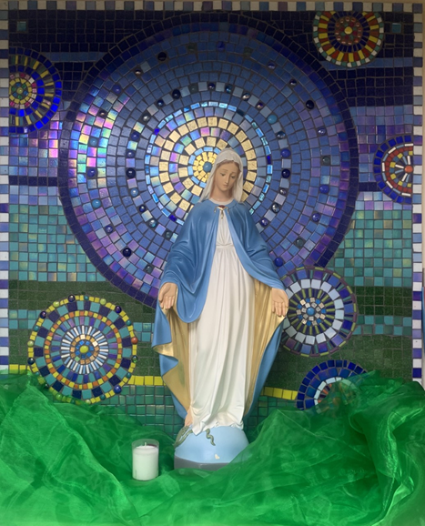
St Mary’s School Prayer
O Holy Mary,
Mother and Patron of our school,
Turn your eyes of mercy towards us,
that we may love God
With all our hearts!
May we imitate the tenderness
of your Son, Jesus,
showing love and respect
For each person
and ourselves as children of God.
Guided by the Holy Spirit,
May we create the school,
where Mercy and Compassion
Is the centre of our lives.
Amen

Slide 5
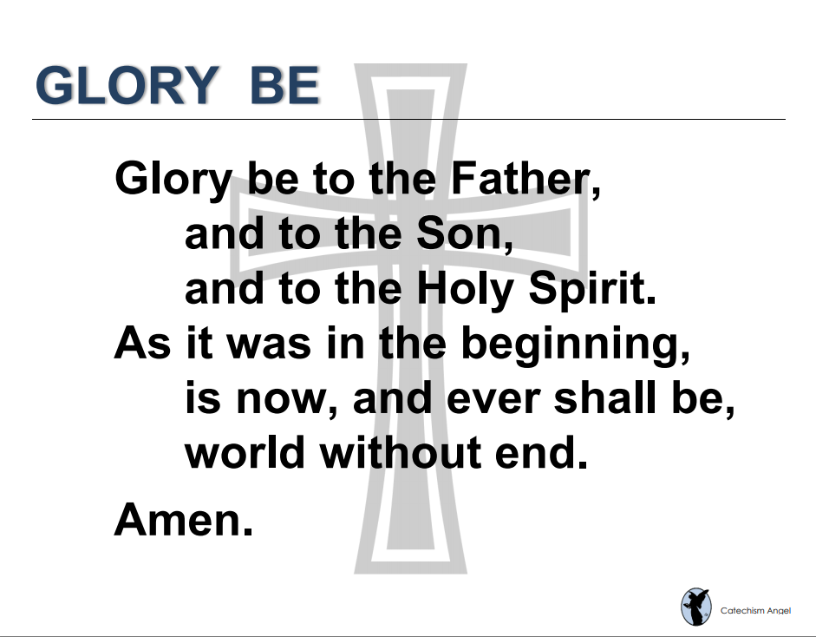

Slide 6
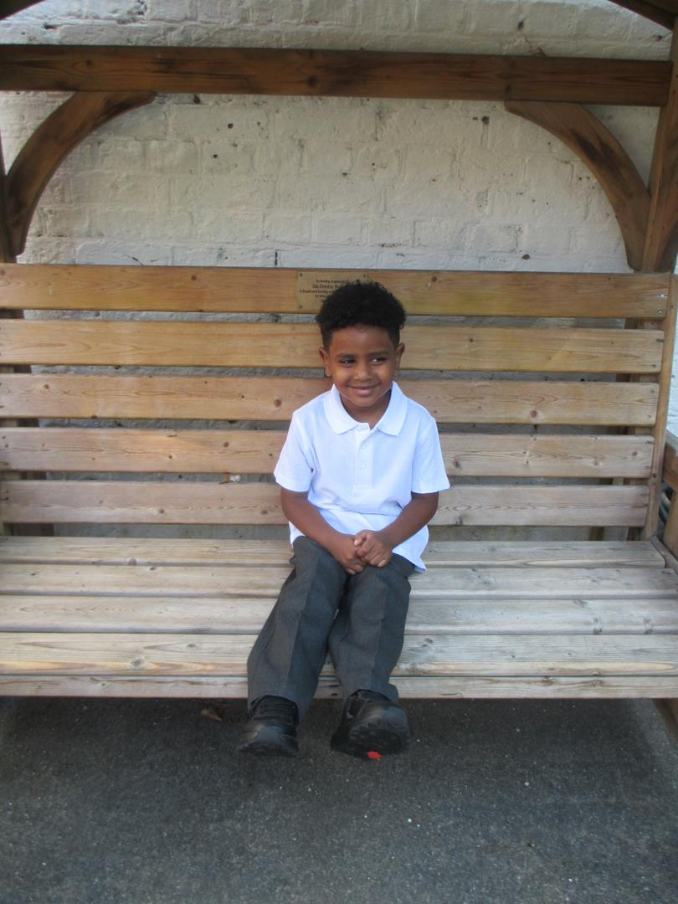
EYFS
Reception
For having a wonderful week in class and being so kind to all his friends and teachers.
Miss Barker

Slide 7
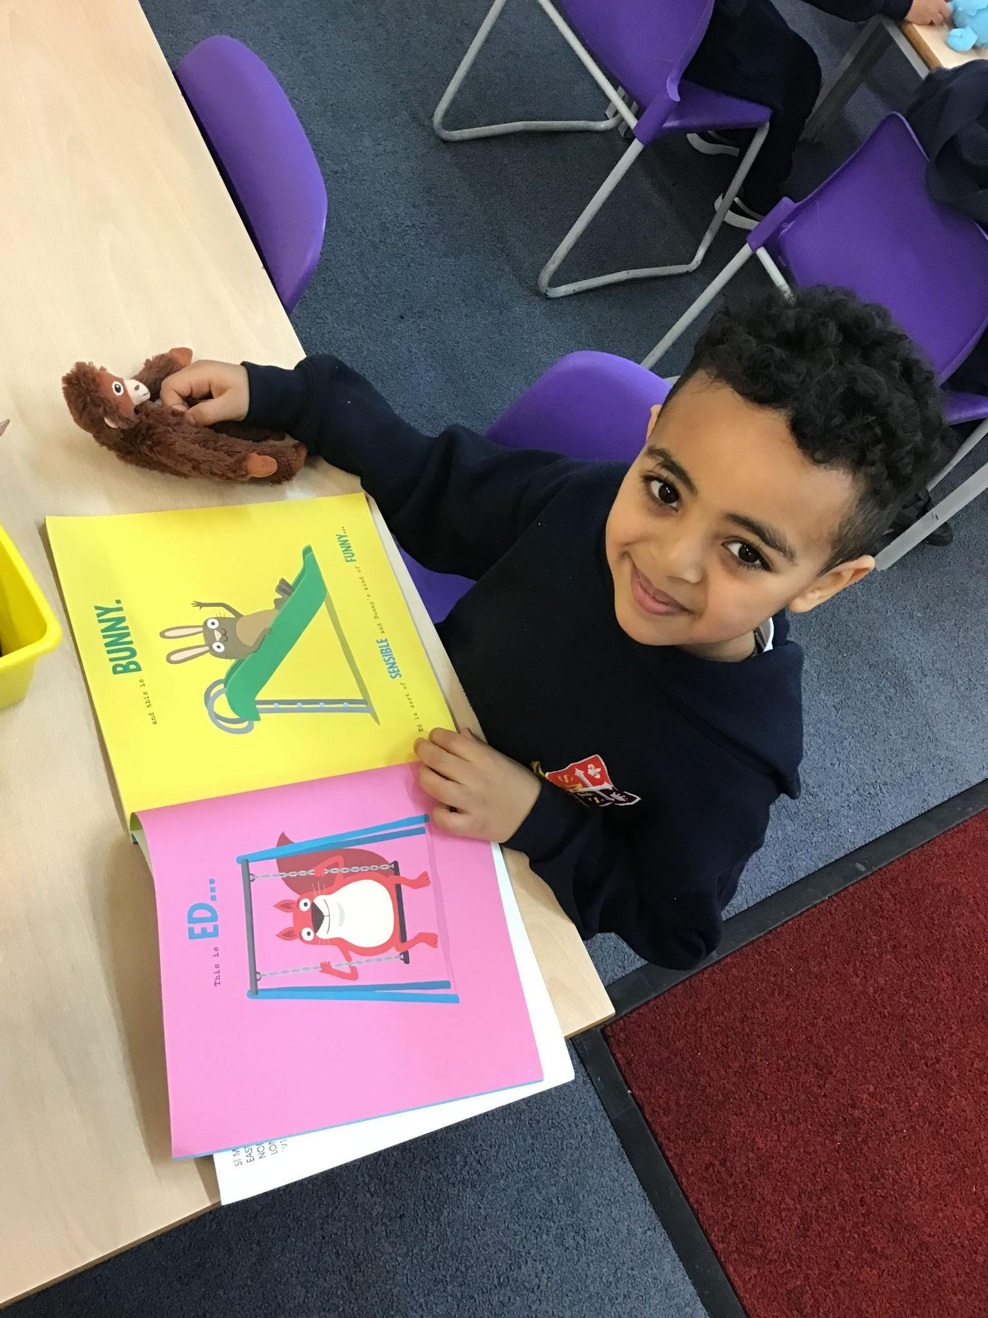
Year 1
For working super hard to listen carefully, follow instructions, and make sensible choices. What a brilliant role model you are!
Miss Flashman

Slide 8

Year 2
For his amazing efforts in his writing!
Miss Sweet and Ms Cummings

Slide 9
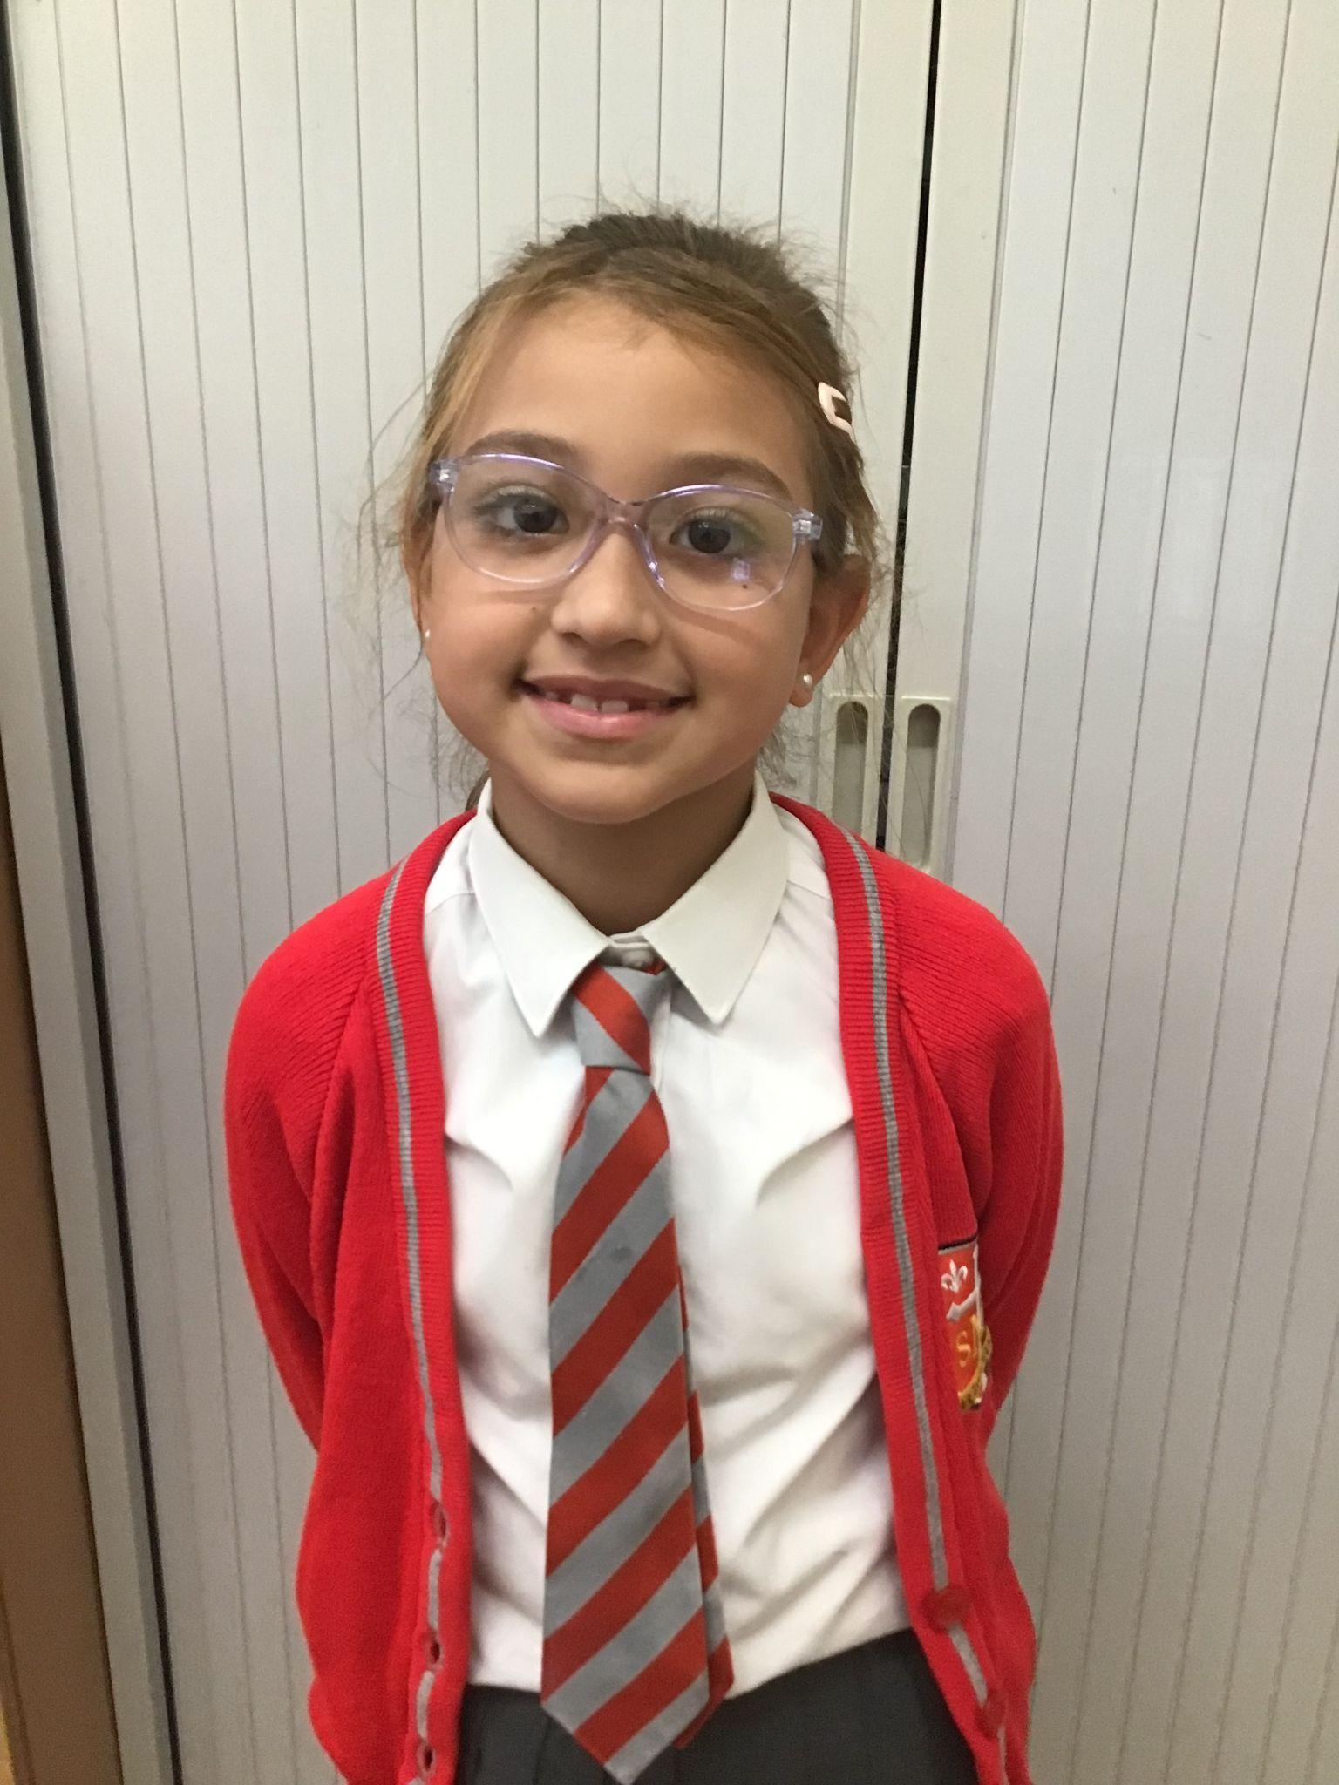
Year 3
For demonstrating The value of kindness
Mr. Larke

Slide 10

Year 4
For showing that focus and concentration brings great results and for mature behaviour in our swimming lessons.
Mr Whear

Slide 11

Year 5
For making an amazing improvement in both his attitude and approach to his learning (especially in English)
Mrs. Bakali

Slide 12
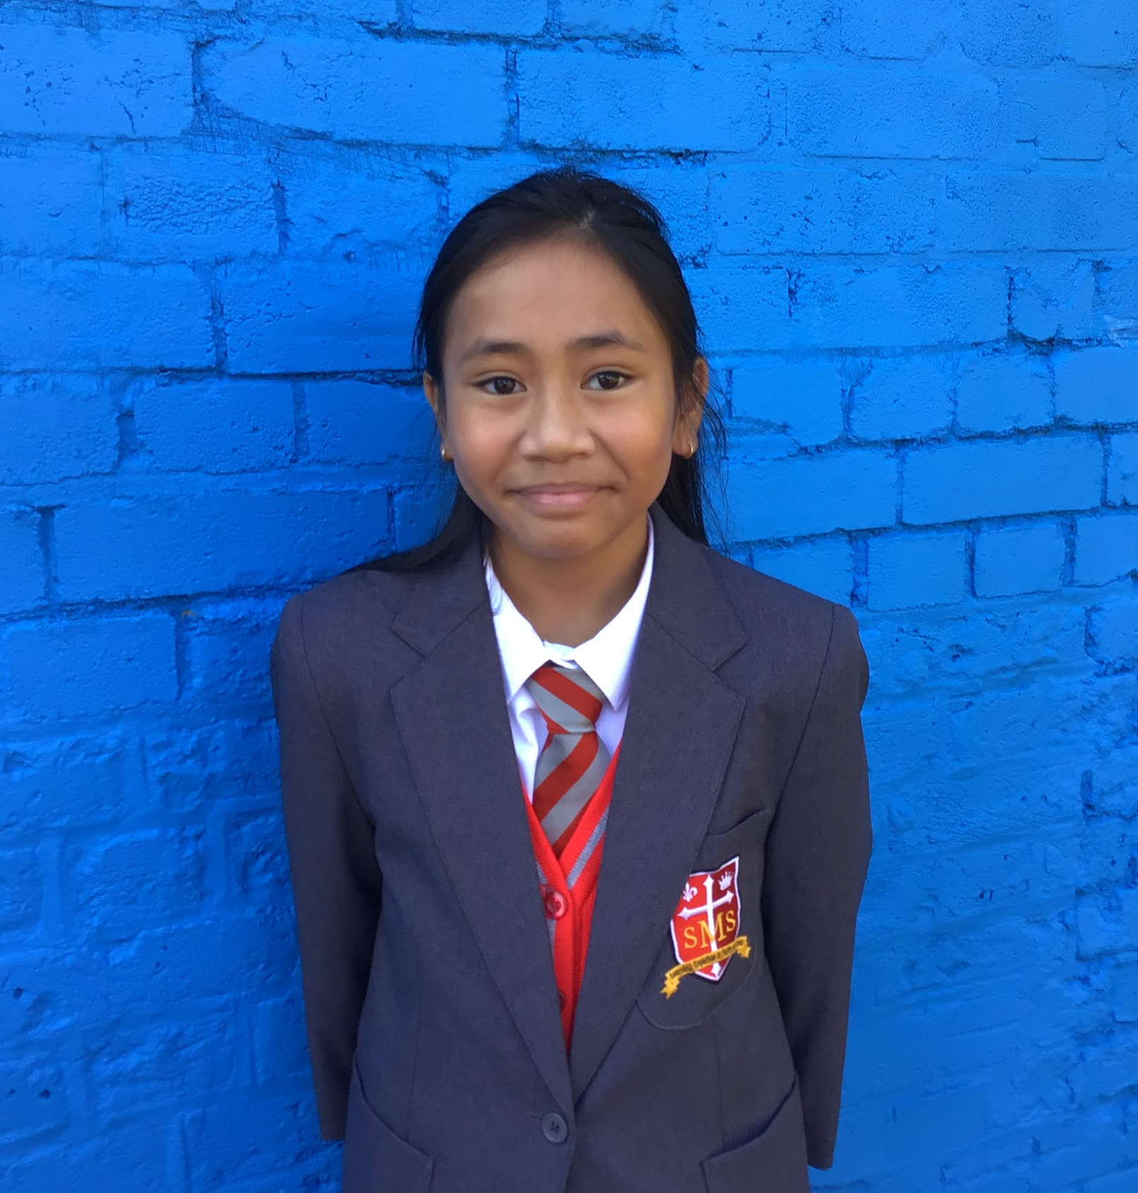
Year 6
For her resilience and excellent application across this term.
Mr Cherfi & Mr Quinlan

Slide 13



Star Readers
Y1 - Khalil
Y2 - Ineesha
Y3 - Luna B
Y4 - Jayden
Y5 - Elly
Y6 - Nazrawi

Slide 14
Whole School
Star of the Week
Friday 16th January 2026

