Slide 1


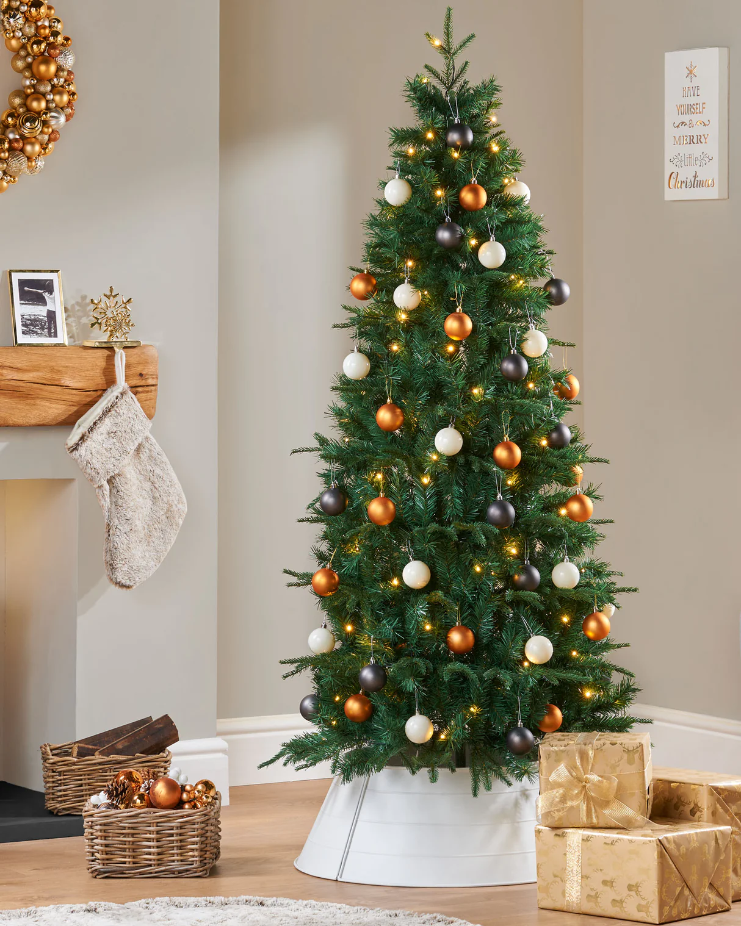

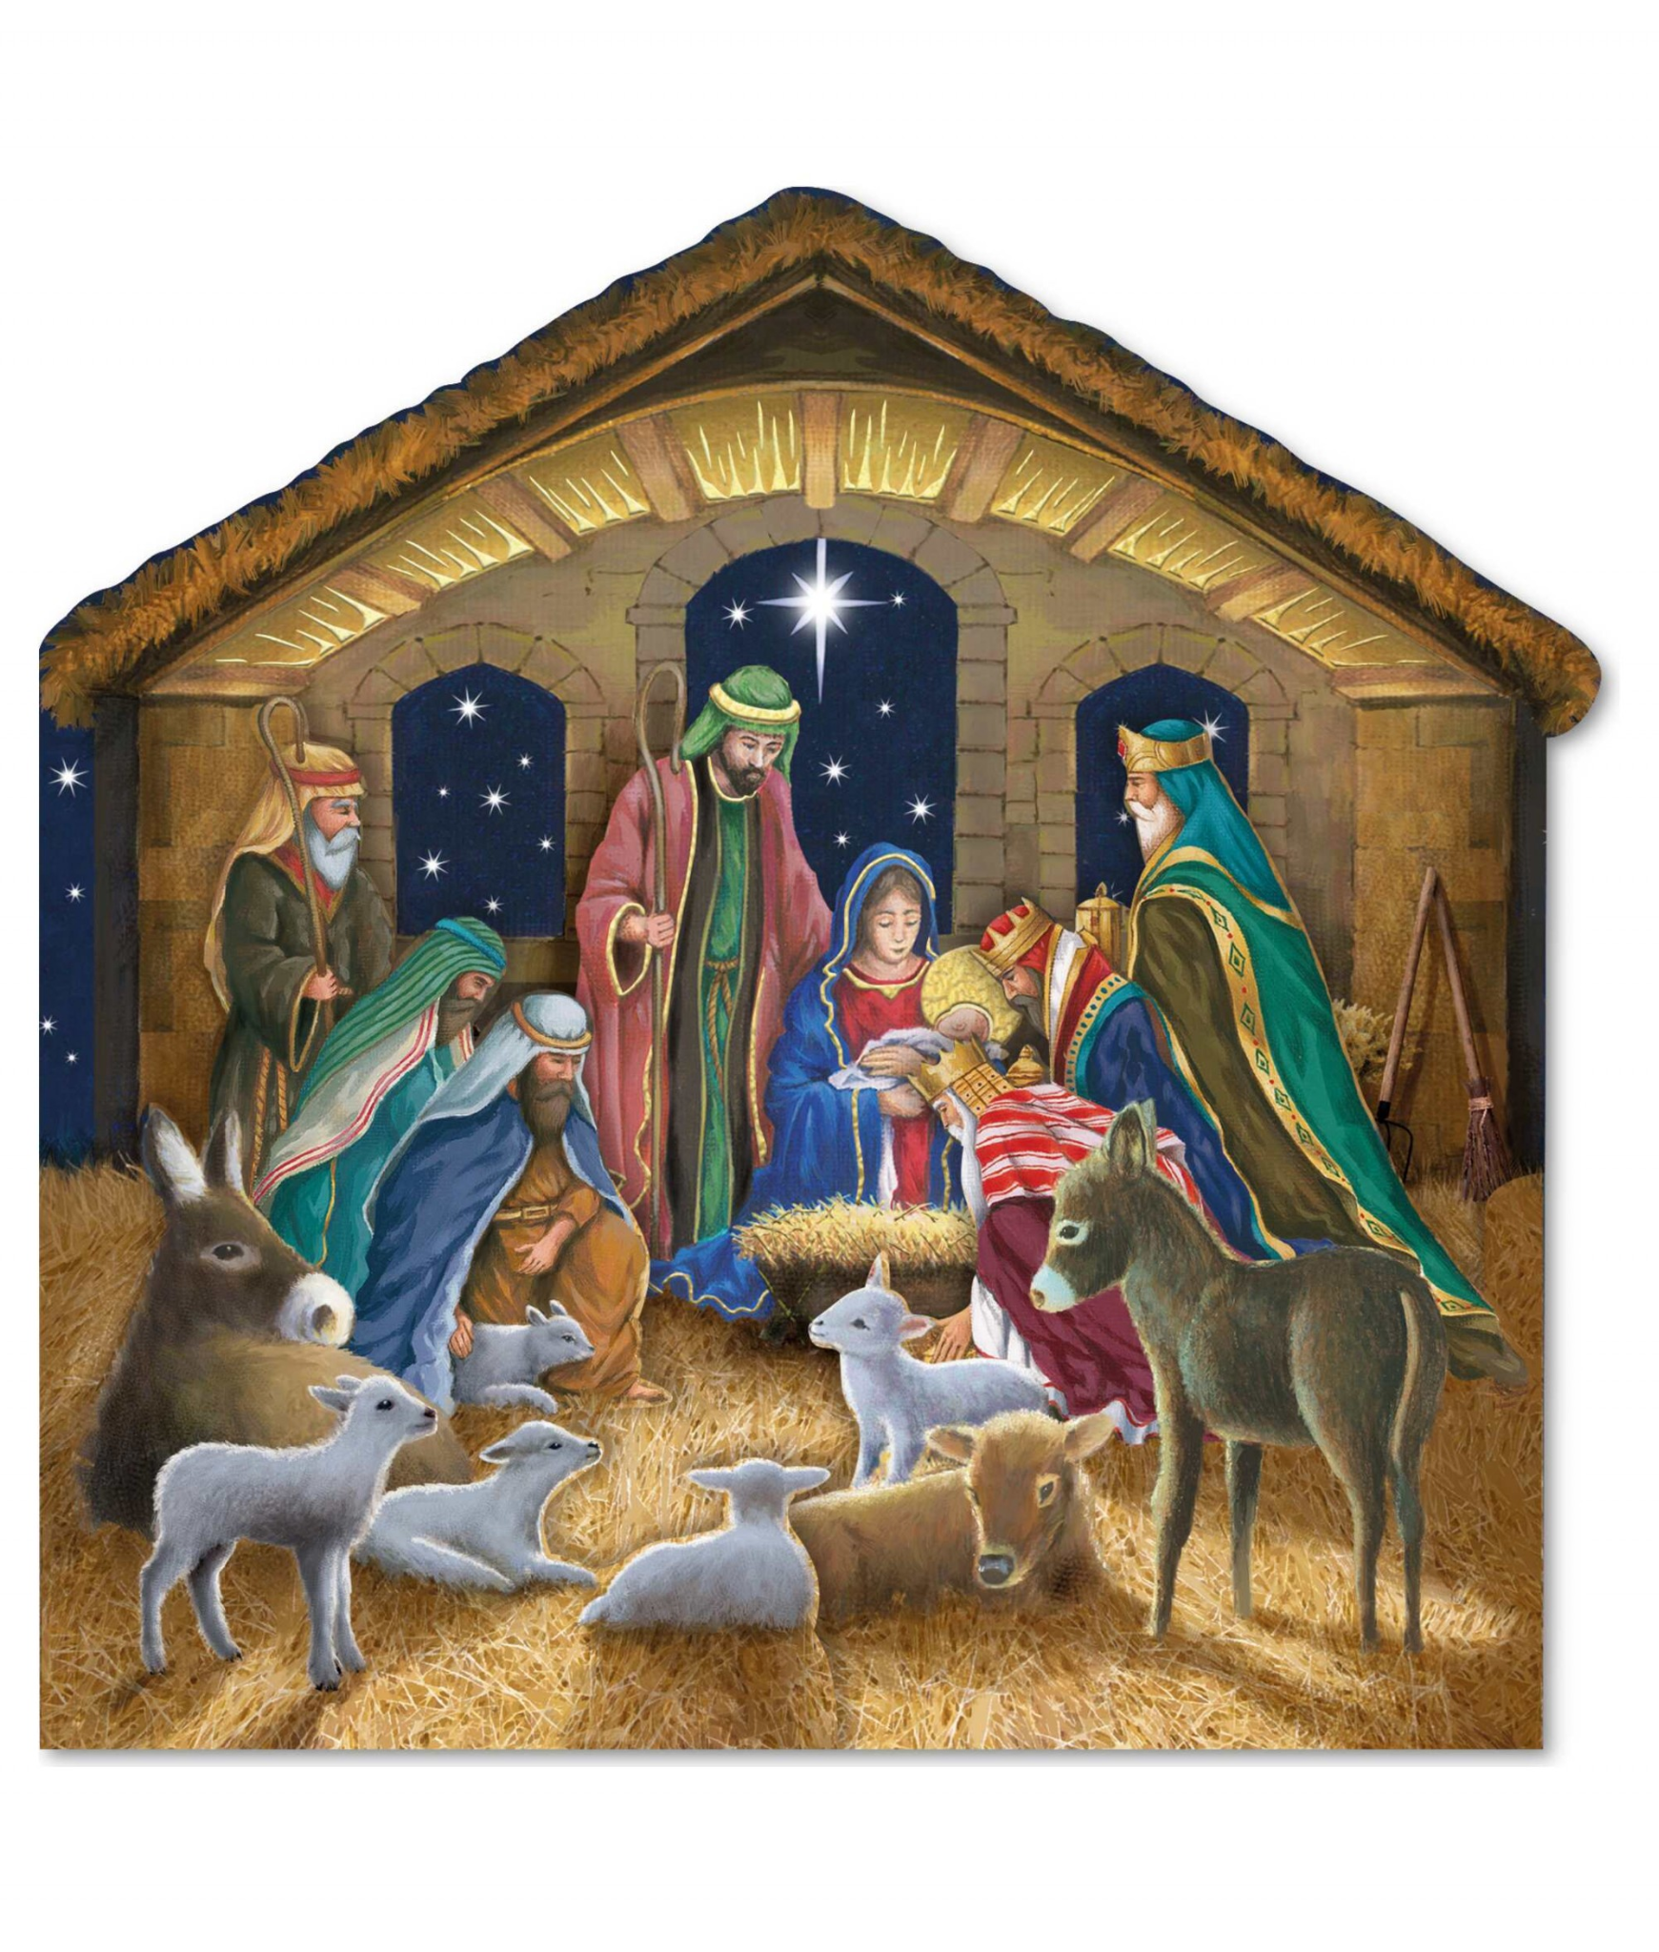

Whole School
Star of the Term
Friday 19th December 2025

Slide 2

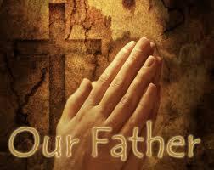
Our Father who art in Heaven
Hallowed be Thy Name
Thy Kingdom come
Thy will be done on Earth as it is in Heaven
Give us this day our daily bread
And forgive us our trespasses
As we forgive those who trespass against us
And lead us not into temptation
But deliver us from evil
Amen

Slide 3
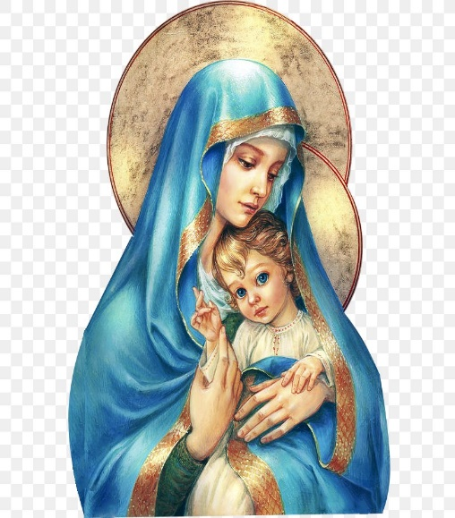
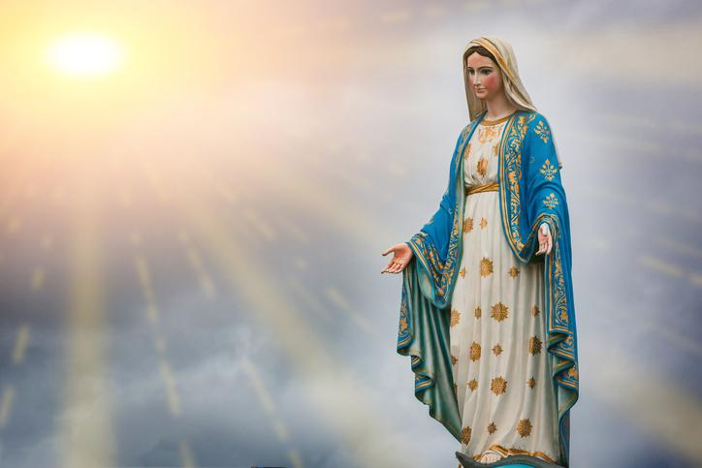
Hail Mary, Full of Grace
The Lord is with Thee
Blessed are Thou amongst women
And Blessed is the fruit of Thy womb, Jesus
Holy Mary , Mother of God
Pray for us sinners
Now and in the hour of our death
Amen

Slide 4
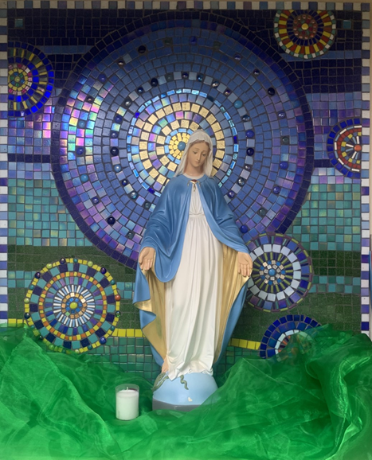
St Mary’s School Prayer
O Holy Mary,
Mother and Patron of our school,
Turn your eyes of mercy towards us,
that we may love God
With all our hearts!
May we imitate the tenderness
of your Son, Jesus,
showing love and respect
For each person
and ourselves as children of God.
Guided by the Holy Spirit,
May we create the school,
where Mercy and Compassion
Is the centre of our lives.
Amen

Slide 5
Whole School
Star of the Term
Friday 19th December 2025

Slide 6
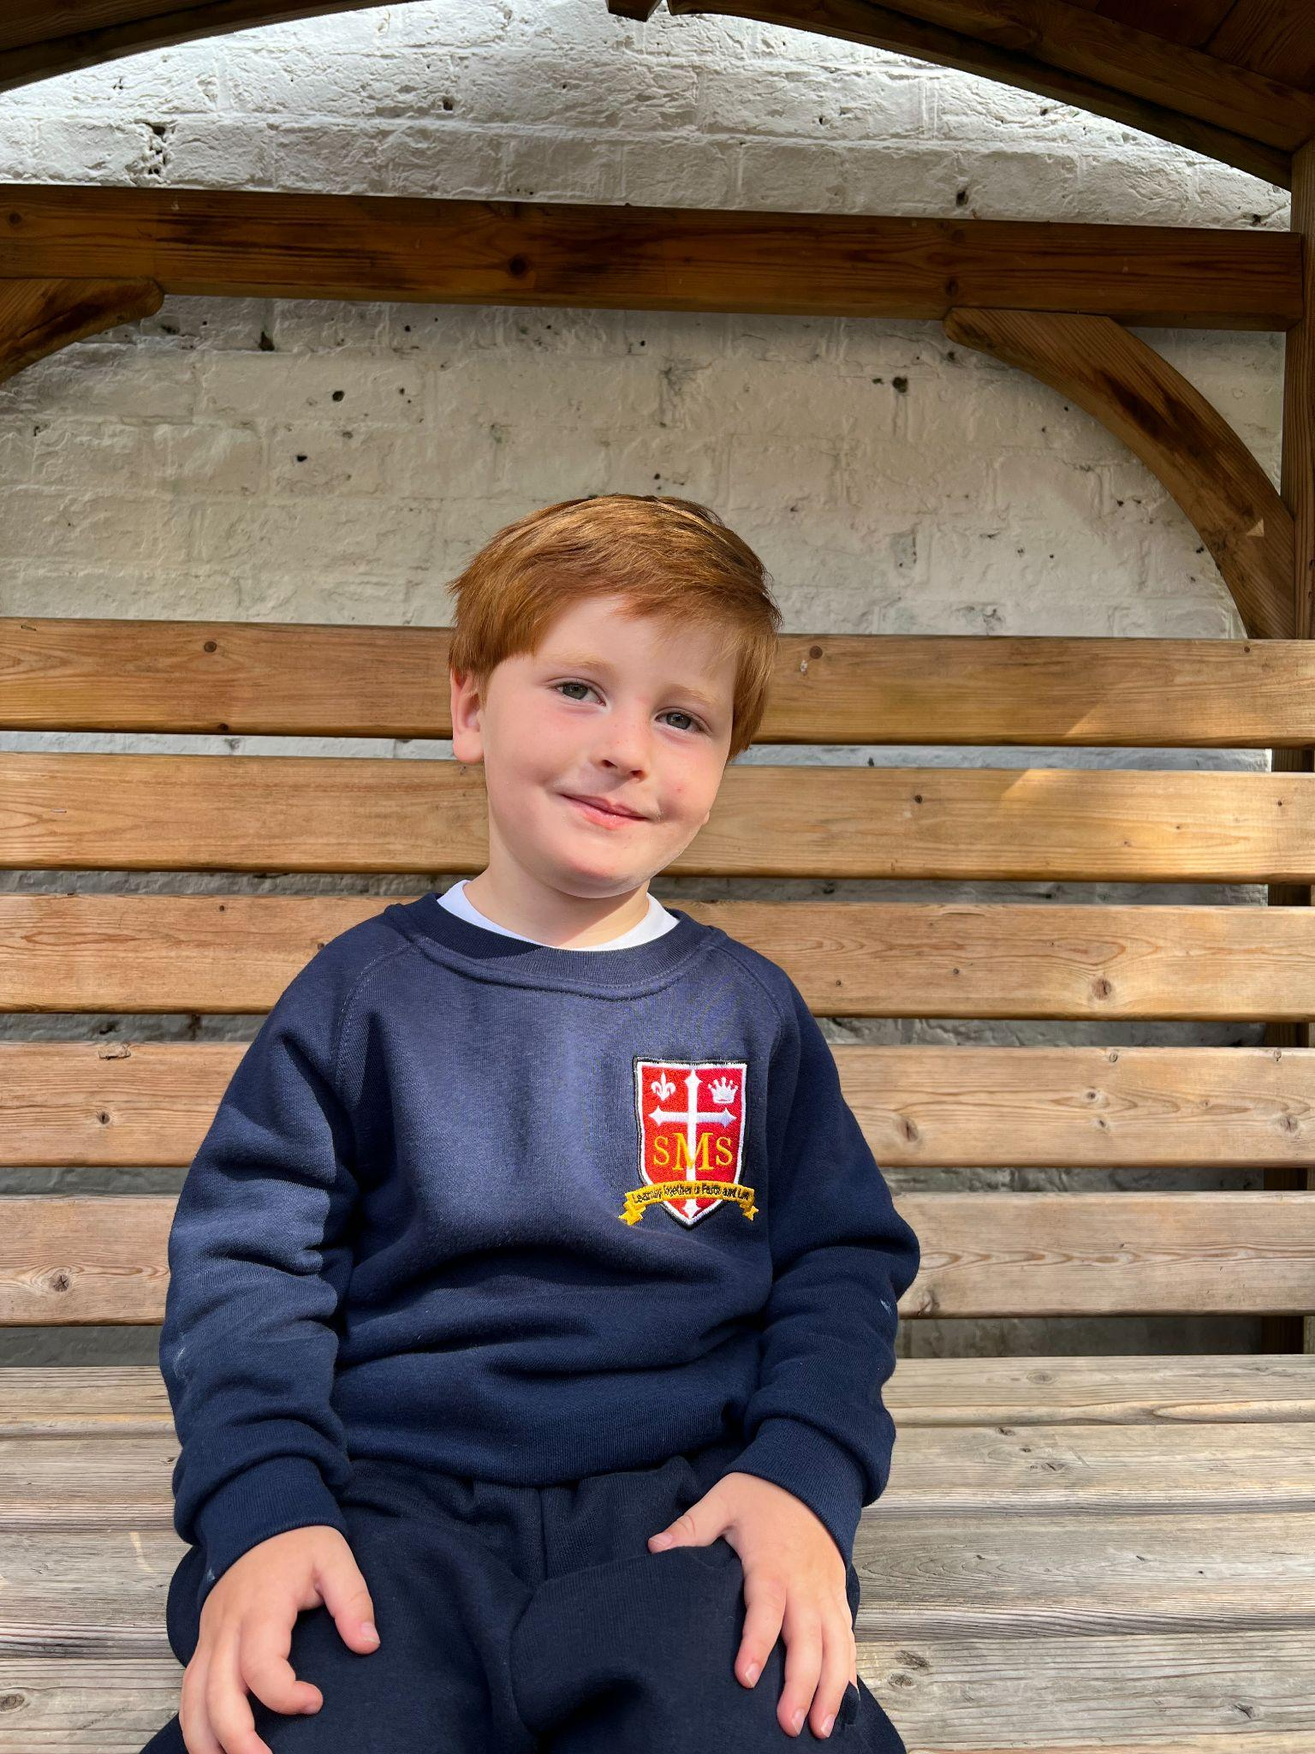
Star of the Term Winner Nursery

Slide 7
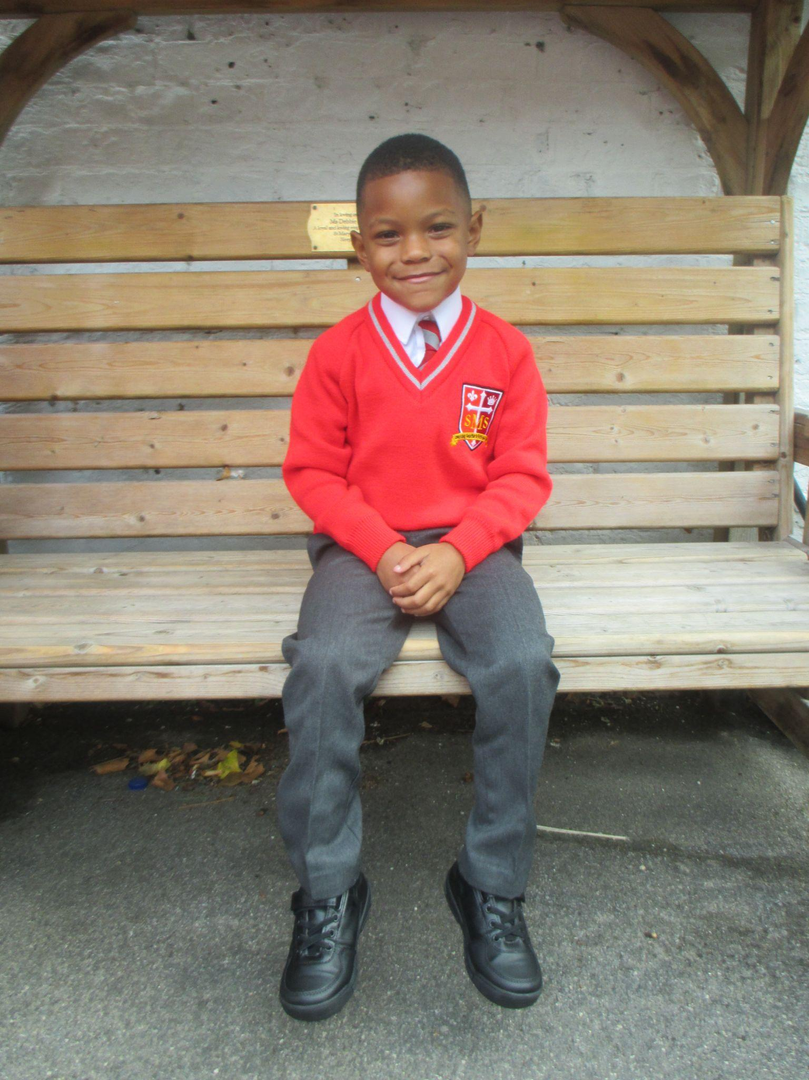
Star of the Term Winner Reception

Slide 8
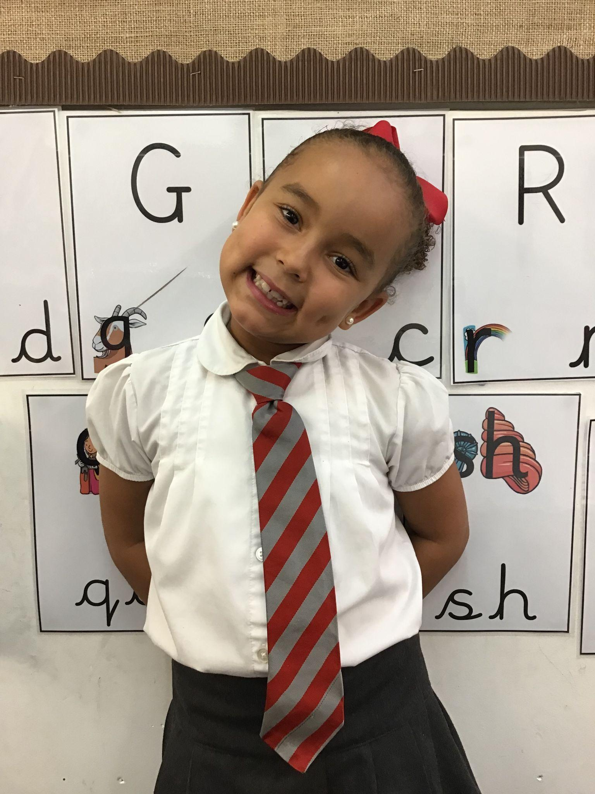
Star of the Term Winner Year 1

Slide 9
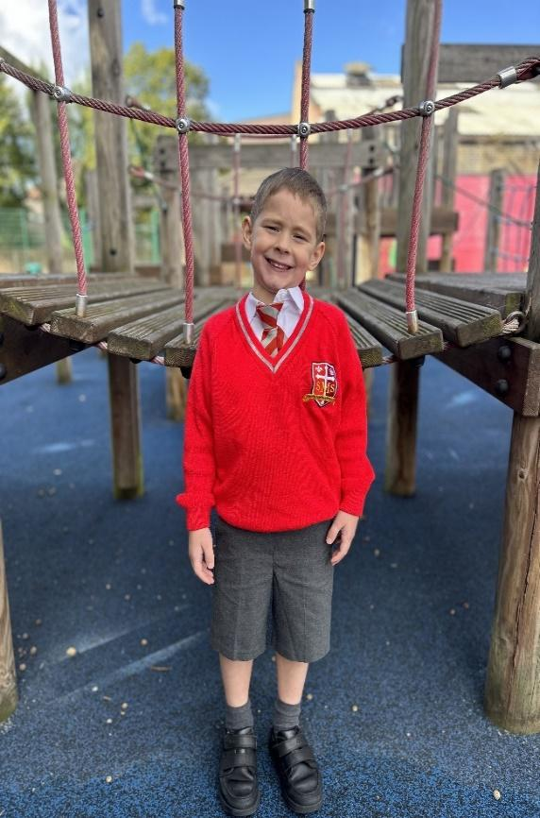
Star of the Term Winner Year 2

Slide 10
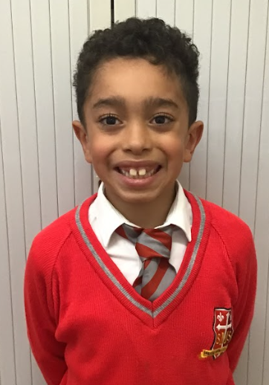
Star of the Term Winner Year 3
Nicholas

Slide 11
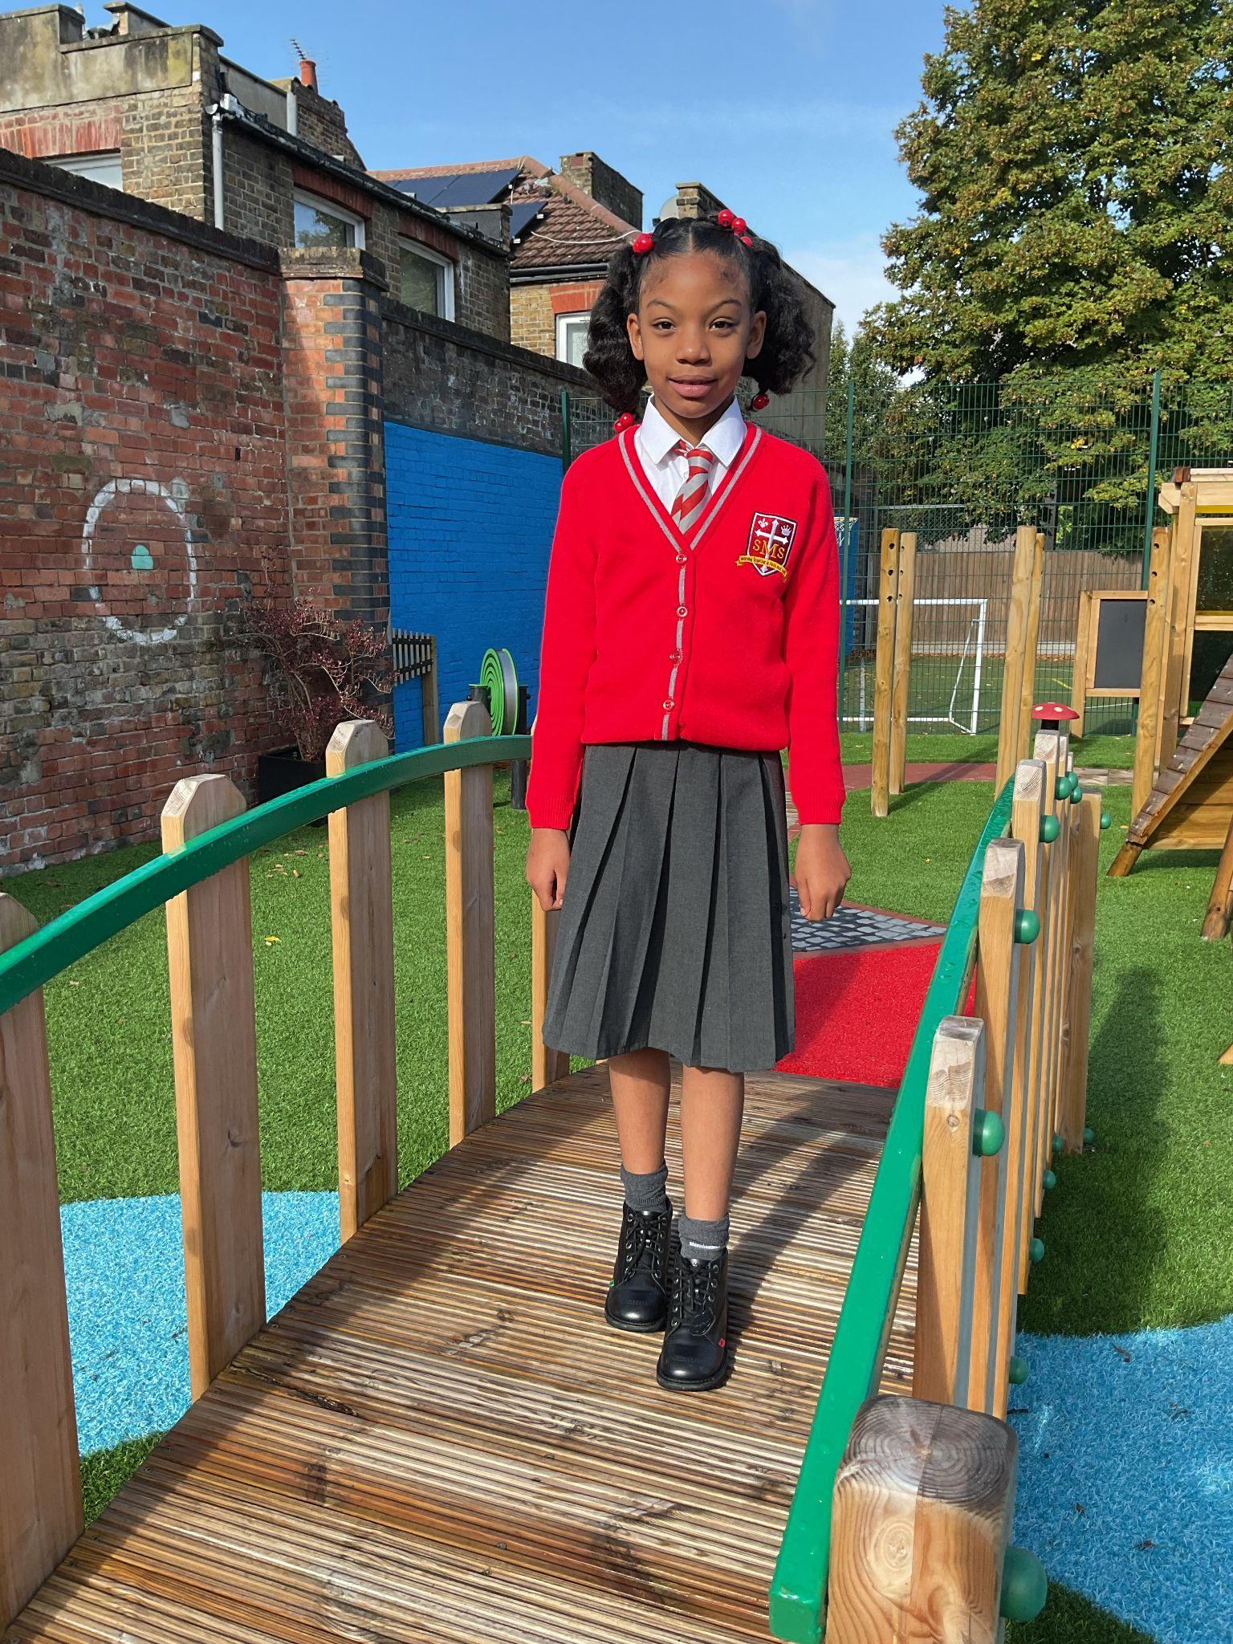
Star of the Term Winner Year 4

Slide 12
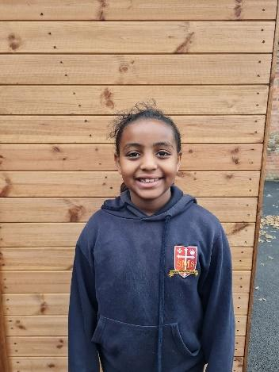
Star of the Term Winner Year 5

Slide 13
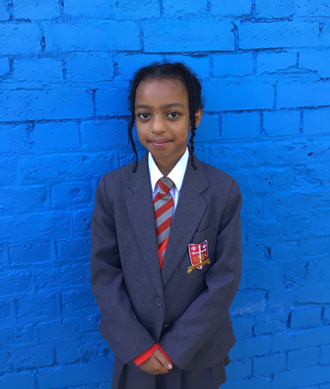
Star of the Term Winner Year 6

Slide 14
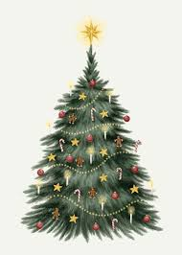
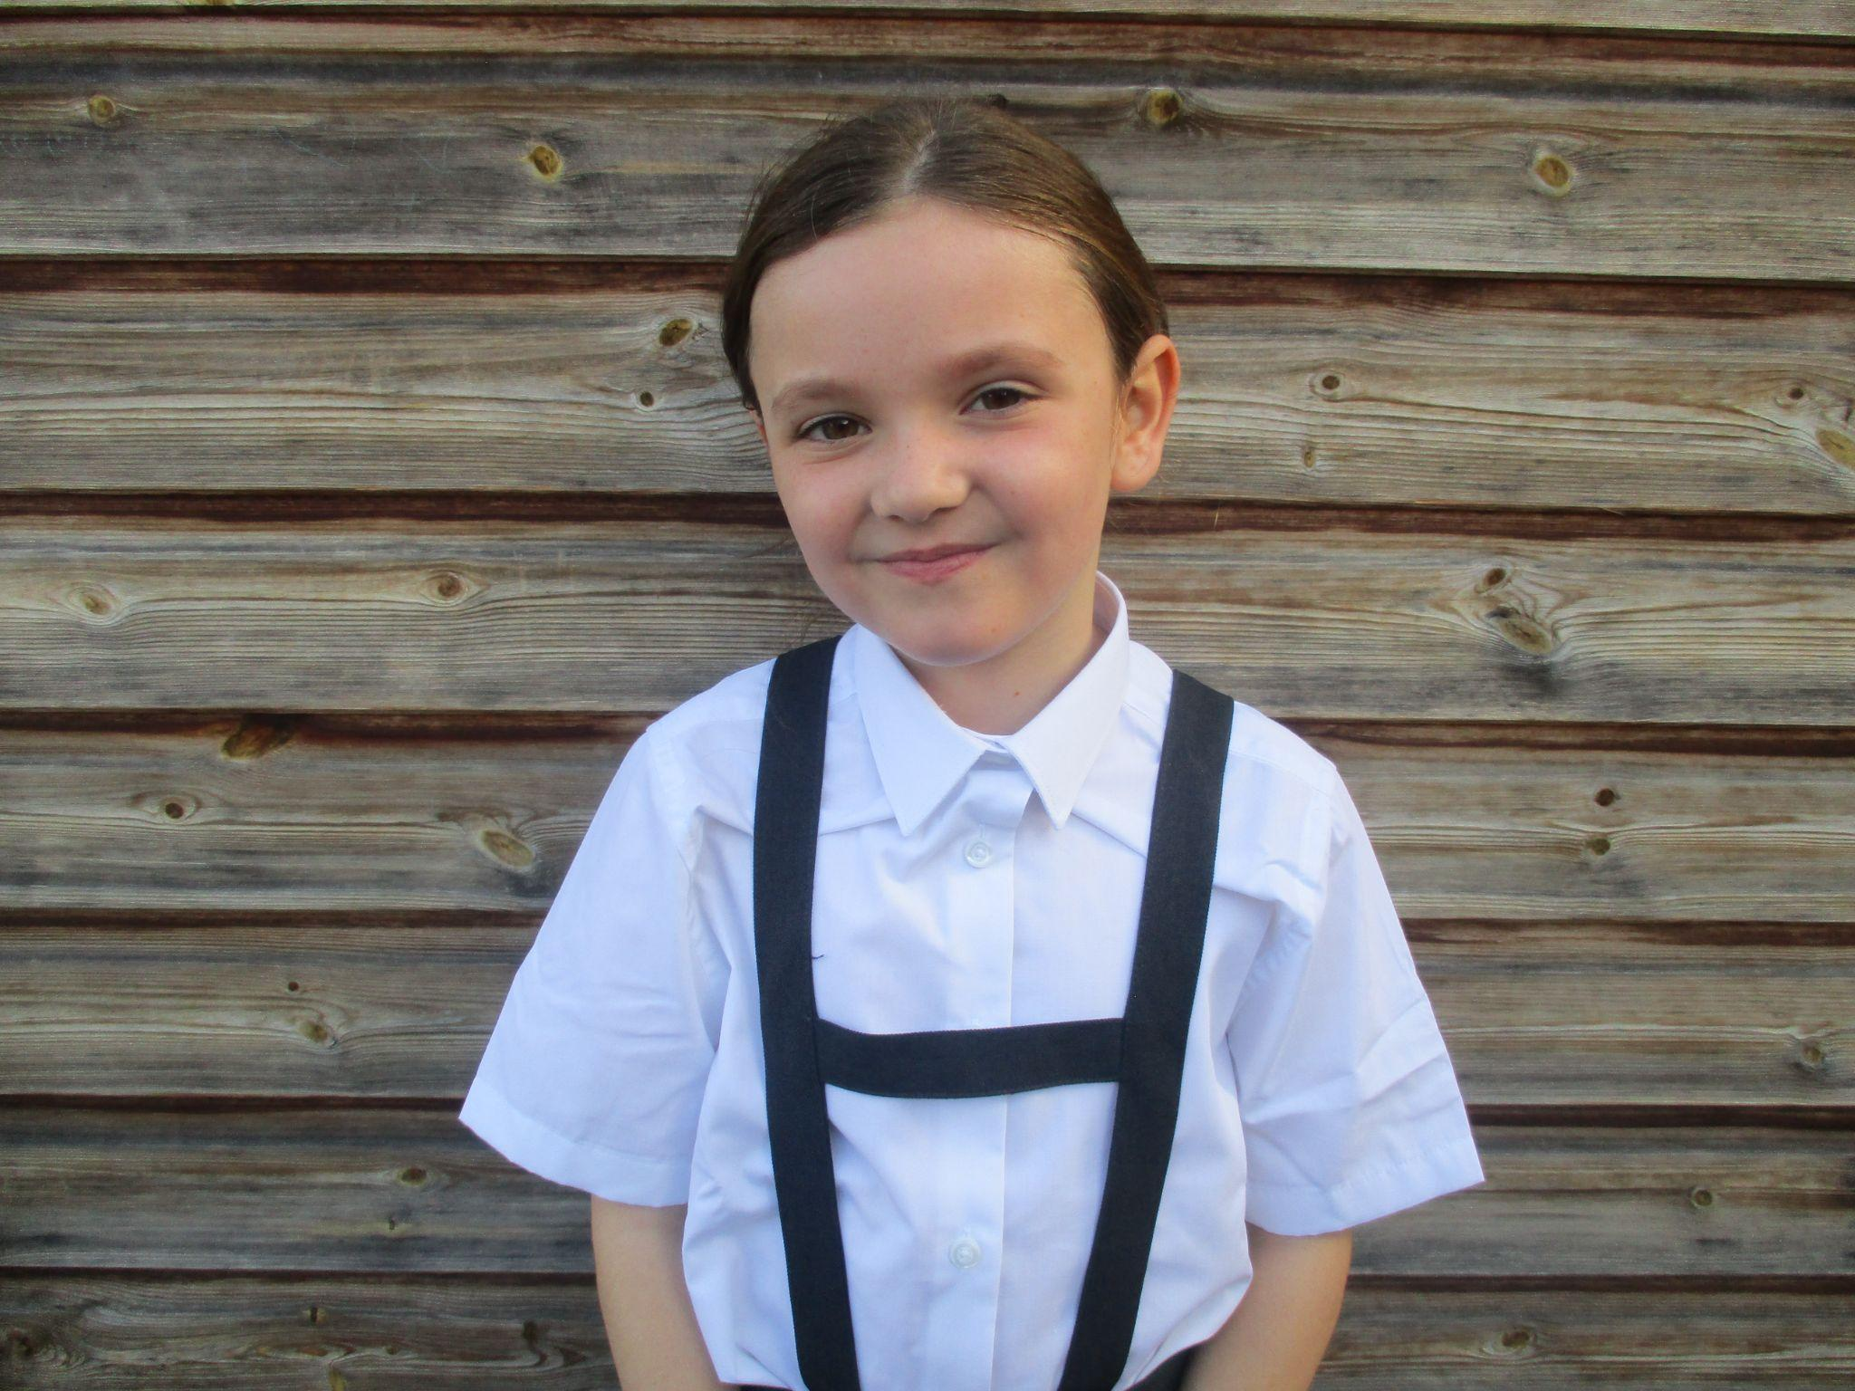
Winner of the Parish Bazaar Christmas Picture competition
Y4

Slide 15
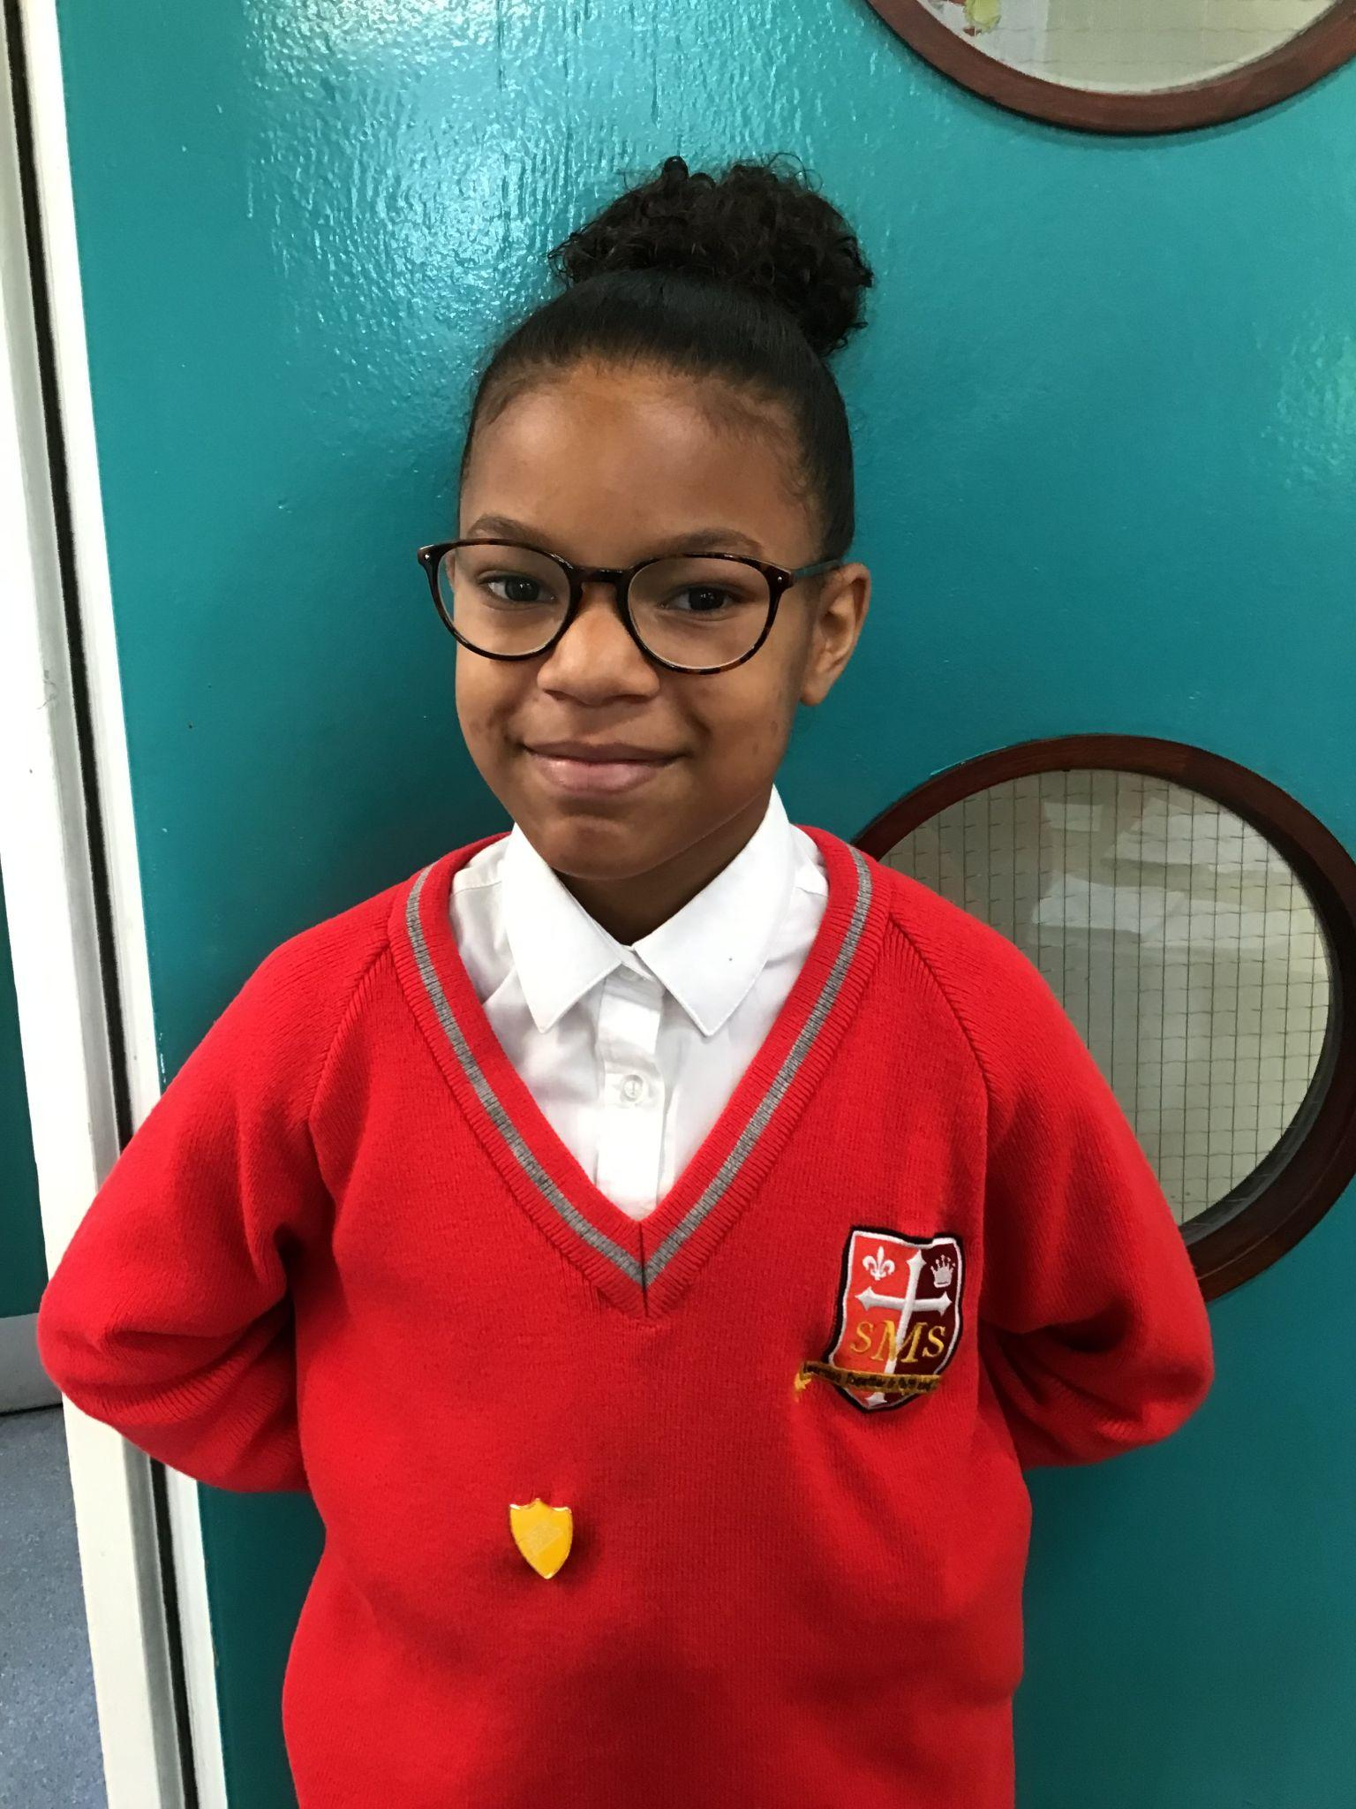
Winner of the Parish Bazaar Christmas Picture competition
Y6

Slide 16

Handwriter of the Term
Year 1 - Melaysia
Year 2 - Noel
Year 3 - Harry
Year 4 - Fatima
Year 5 - Alby
Year 6 - Eden

Slide 17


Music Awards

Slide 18

For being a fantastic musician, showing creativity, effort, and a love for music.
EYFS: Billie, Denis
Y1: Melaysia, Joshua
Y2: Kenza, Ethan
Y3: Sarah, John
Y4: Asia, Guttemberg
Y5: Poppy, Yusuf
Y6: Zamarah, Tommy
Piano Star Award: Mia Y3
Viola Star Awards: Yael Y6, Esey Y5
Choir Star Awards: Mia, Maria, Novena, Evie, Isla, Victor, John,
Vanna, Savannah, Aislie, Rhenn, Poppy, Makda,
Deborah, Cali, Elly, Franzen, Ana, Regina

Slide 19


