Slide 1
Whole School
Star of the Term
Friday 4th April 2025

Slide 2
Our Father who art in Heaven
Hallowed be Thy Name
Thy Kingdom come
Thy will be done on Earth as it is in Heaven
Give us this day our daily bread
And forgive us our trespasses
As we forgive those who trespass against us
And lead us not into temptation
But deliver us from evil
Amen

Slide 3
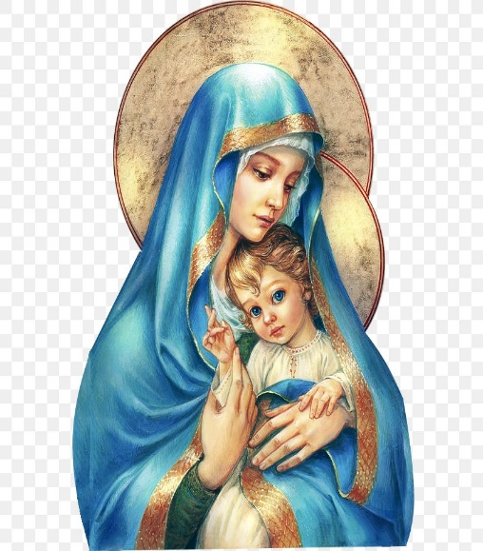
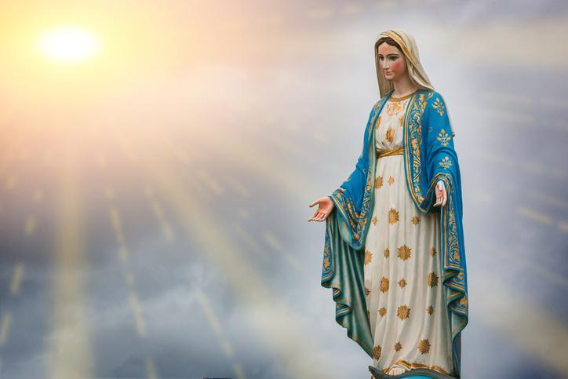
Hail Mary, Full of Grace
The Lord is with Thee
Blessed are Thou amongst women
And Blessed is the fruit of Thy womb, Jesus
Holy Mary , Mother of God
Pray for us sinners
Now and in the hour of our death
Amen

Slide 4
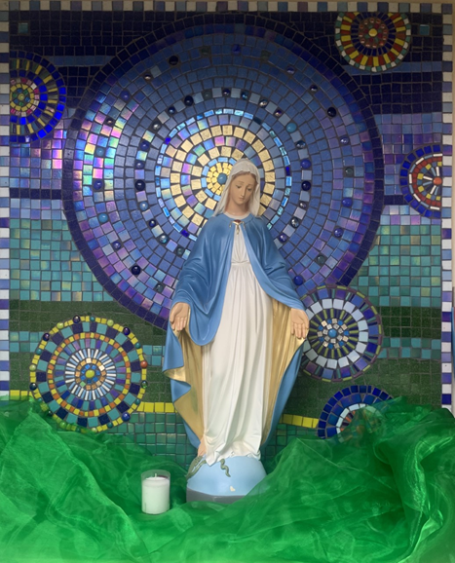
St Mary’s School Prayer
O Holy Mary,
Mother and Patron of our school,
Turn your eyes of mercy towards us,
that we may love God
With all our hearts!
May we imitate the tenderness
of your Son, Jesus,
showing love and respect
For each person
and ourselves as children of God.
Guided by the Holy Spirit,
May we create the school,
where Mercy and Compassion
Is the centre of our lives.
Amen

Slide 5
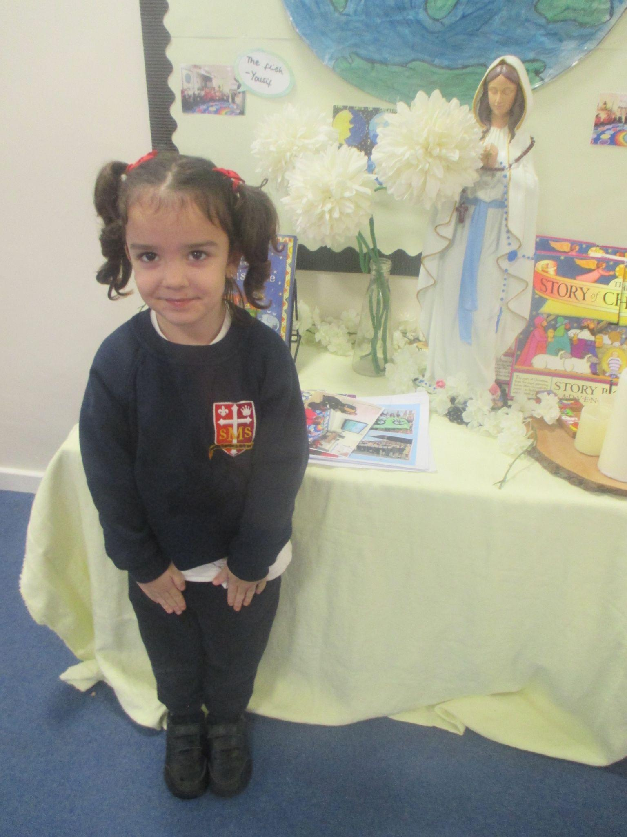
Star of the Term Winner Nursery

Slide 6
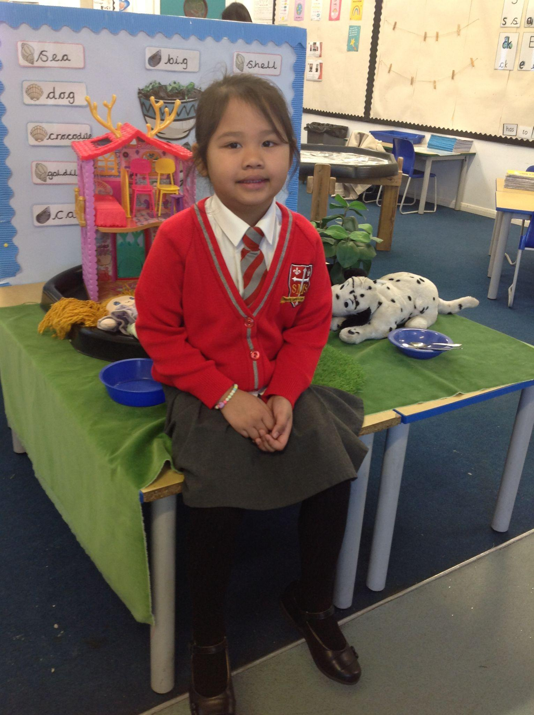
Star of the Term Winner Reception

Slide 7
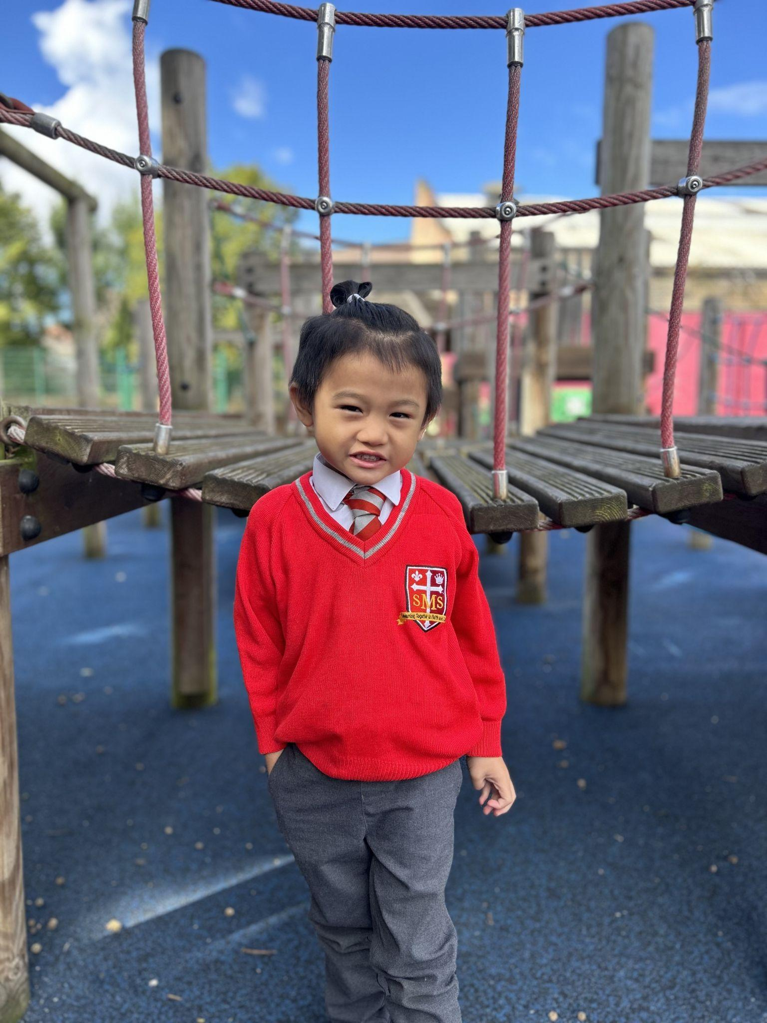
Star of the Term Winner Year 1

Slide 8
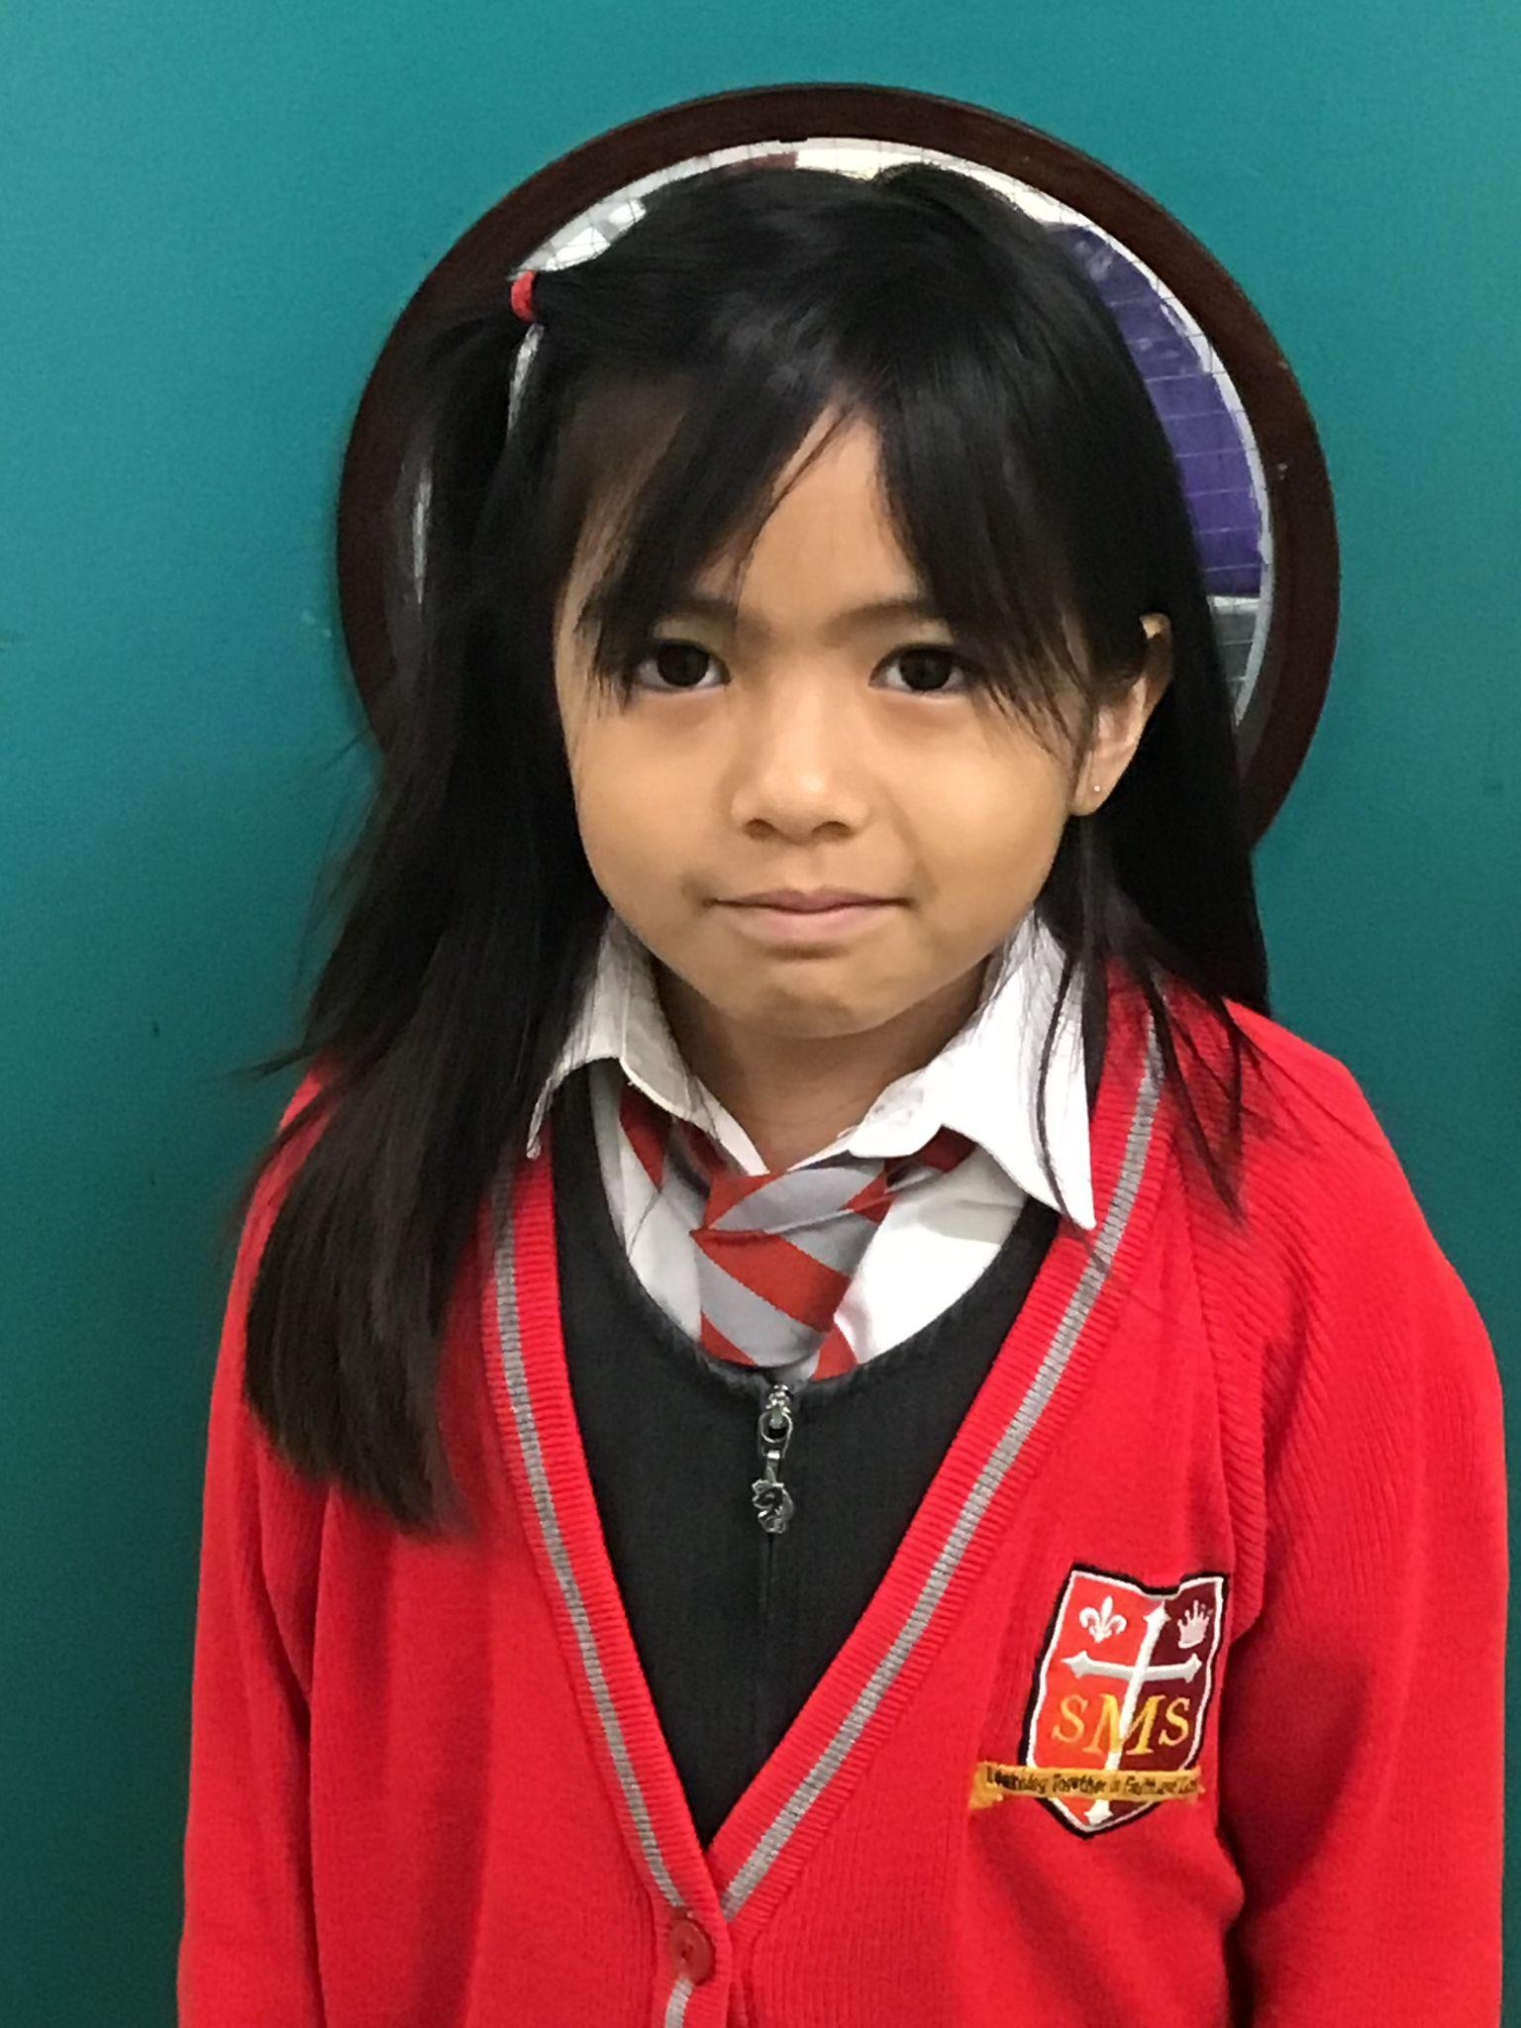
Star of the Term Winner Year 2

Slide 9
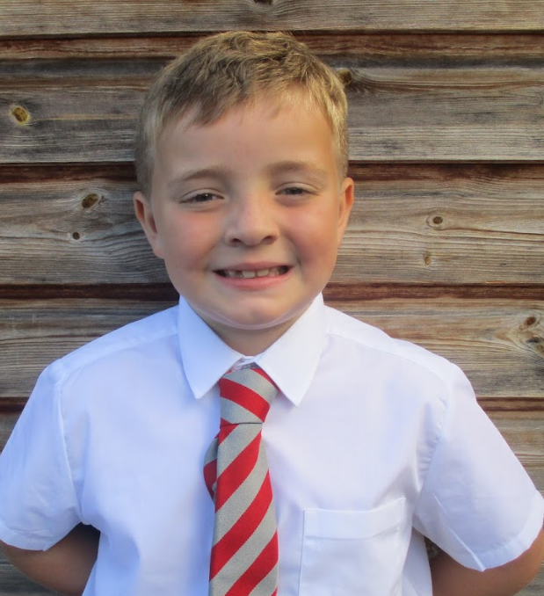
Star of the Term Winner Year 3

Slide 10
Star of the Term Winner Year 4

Slide 11
Star of the Term Winner Year 5

Slide 12
Star of the Term Winner Year 6

Slide 13
Handwriter of the term
Nursery: Kannon
Reception: Melaysia
Year 1:Aniyah
Year 2: Jose
Year 3: Grae
Year 4: Olivia Q
Year 5: Nicholas
Year 6: Stefan

Slide 14
Golden Tickets

Slide 15
Star of the Term Musicians
Nursery: Matilda and Gio
Reception: Cecelia and Lamek
Year 1: Pippa and Ethan
Year 2: Maria and Nicholas
Year 3: Savannah and Matthew
Year 4: Deborah and Nathaniel
Year 5: Yael and Nicholas
Year 6: Nina and Andrew

Slide 16
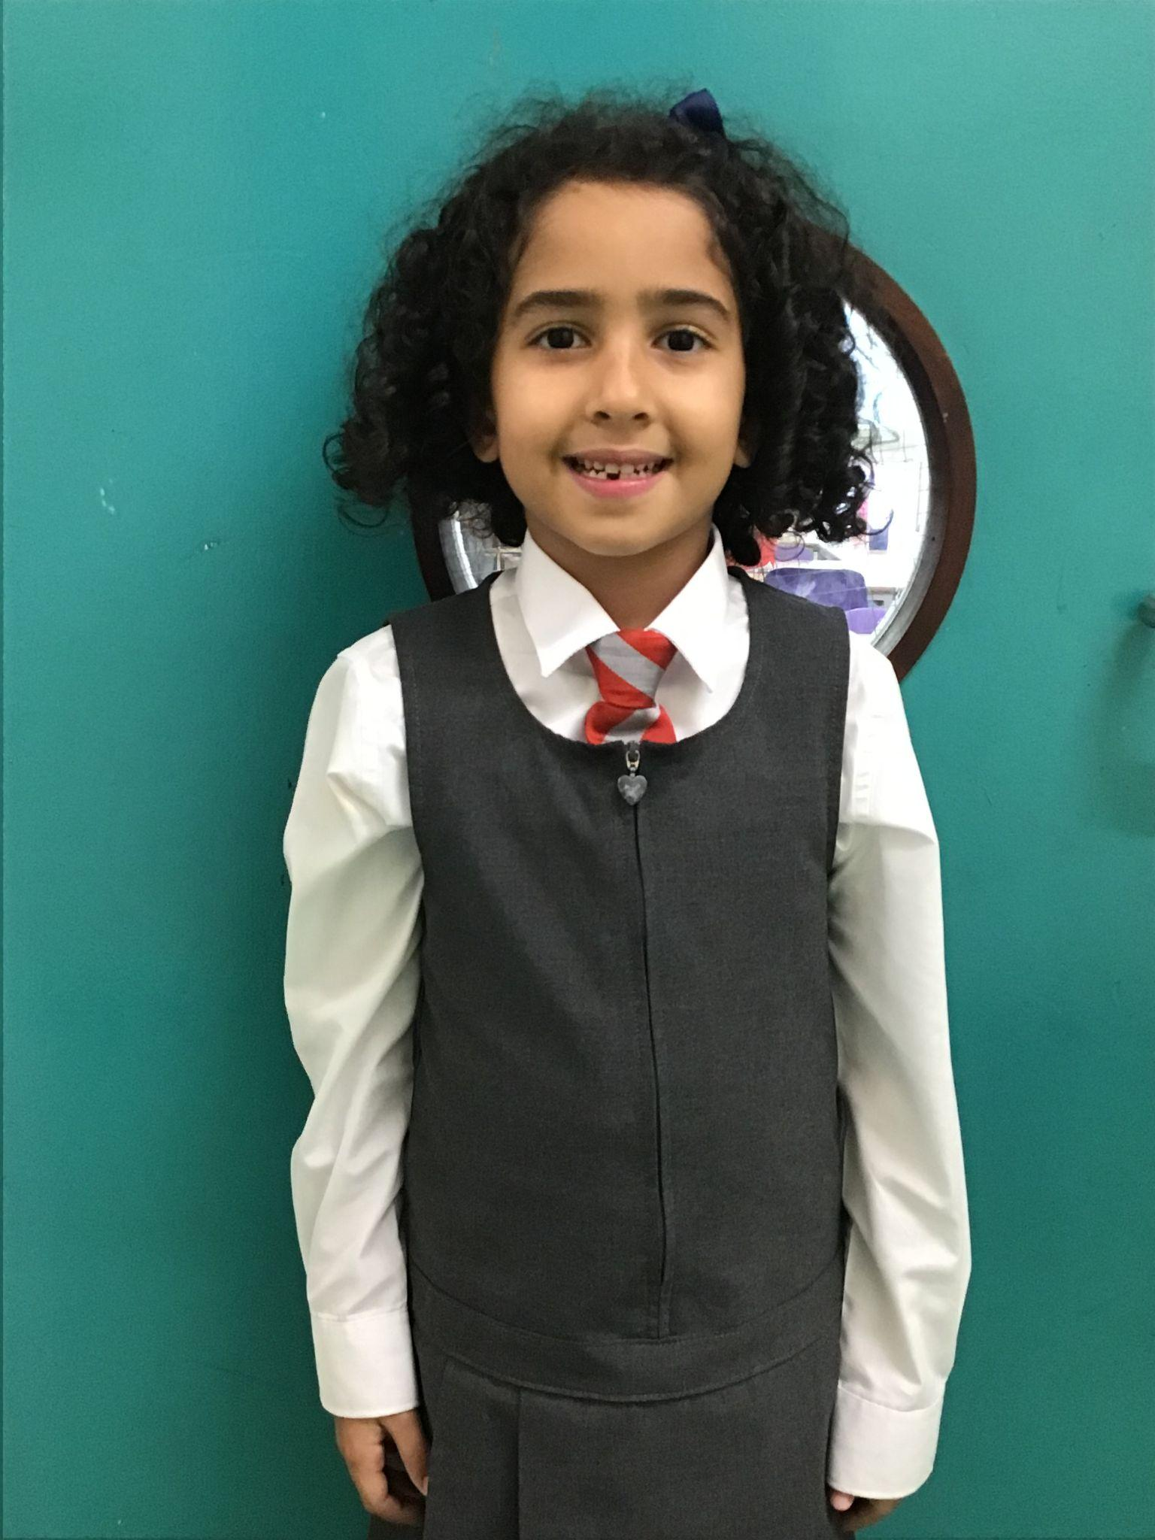
Special Star of the Term Award
Pianist of the term

