Slide 1
Whole School
Star of the Term
Thursday 17th July 2025

Slide 2
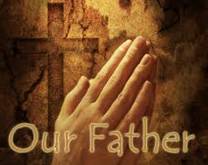
Our Father who art in Heaven
Hallowed be Thy Name
Thy Kingdom come
Thy will be done on Earth as it is in Heaven
Give us this day our daily bread
And forgive us our trespasses
As we forgive those who trespass against us
And lead us not into temptation
But deliver us from evil
Amen

Slide 3
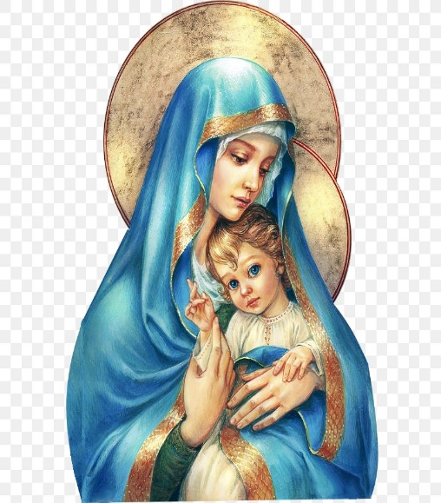
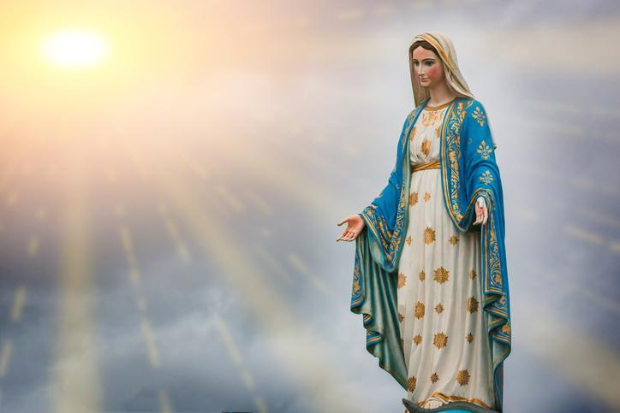
Hail Mary, Full of Grace
The Lord is with Thee
Blessed are Thou amongst women
And Blessed is the fruit of Thy womb, Jesus
Holy Mary , Mother of God
Pray for us sinners
Now and in the hour of our death
Amen

Slide 4
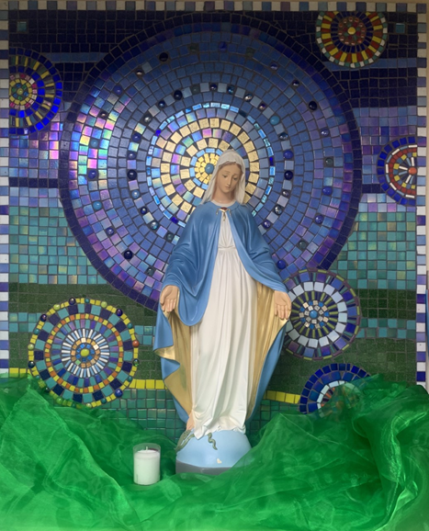
St Mary’s School Prayer
O Holy Mary,
Mother and Patron of our school,
Turn your eyes of mercy towards us,
that we may love God
With all our hearts!
May we imitate the tenderness
of your Son, Jesus,
showing love and respect
For each person
and ourselves as children of God.
Guided by the Holy Spirit,
May we create the school,
where Mercy and Compassion
Is the centre of our lives.
Amen

Slide 5
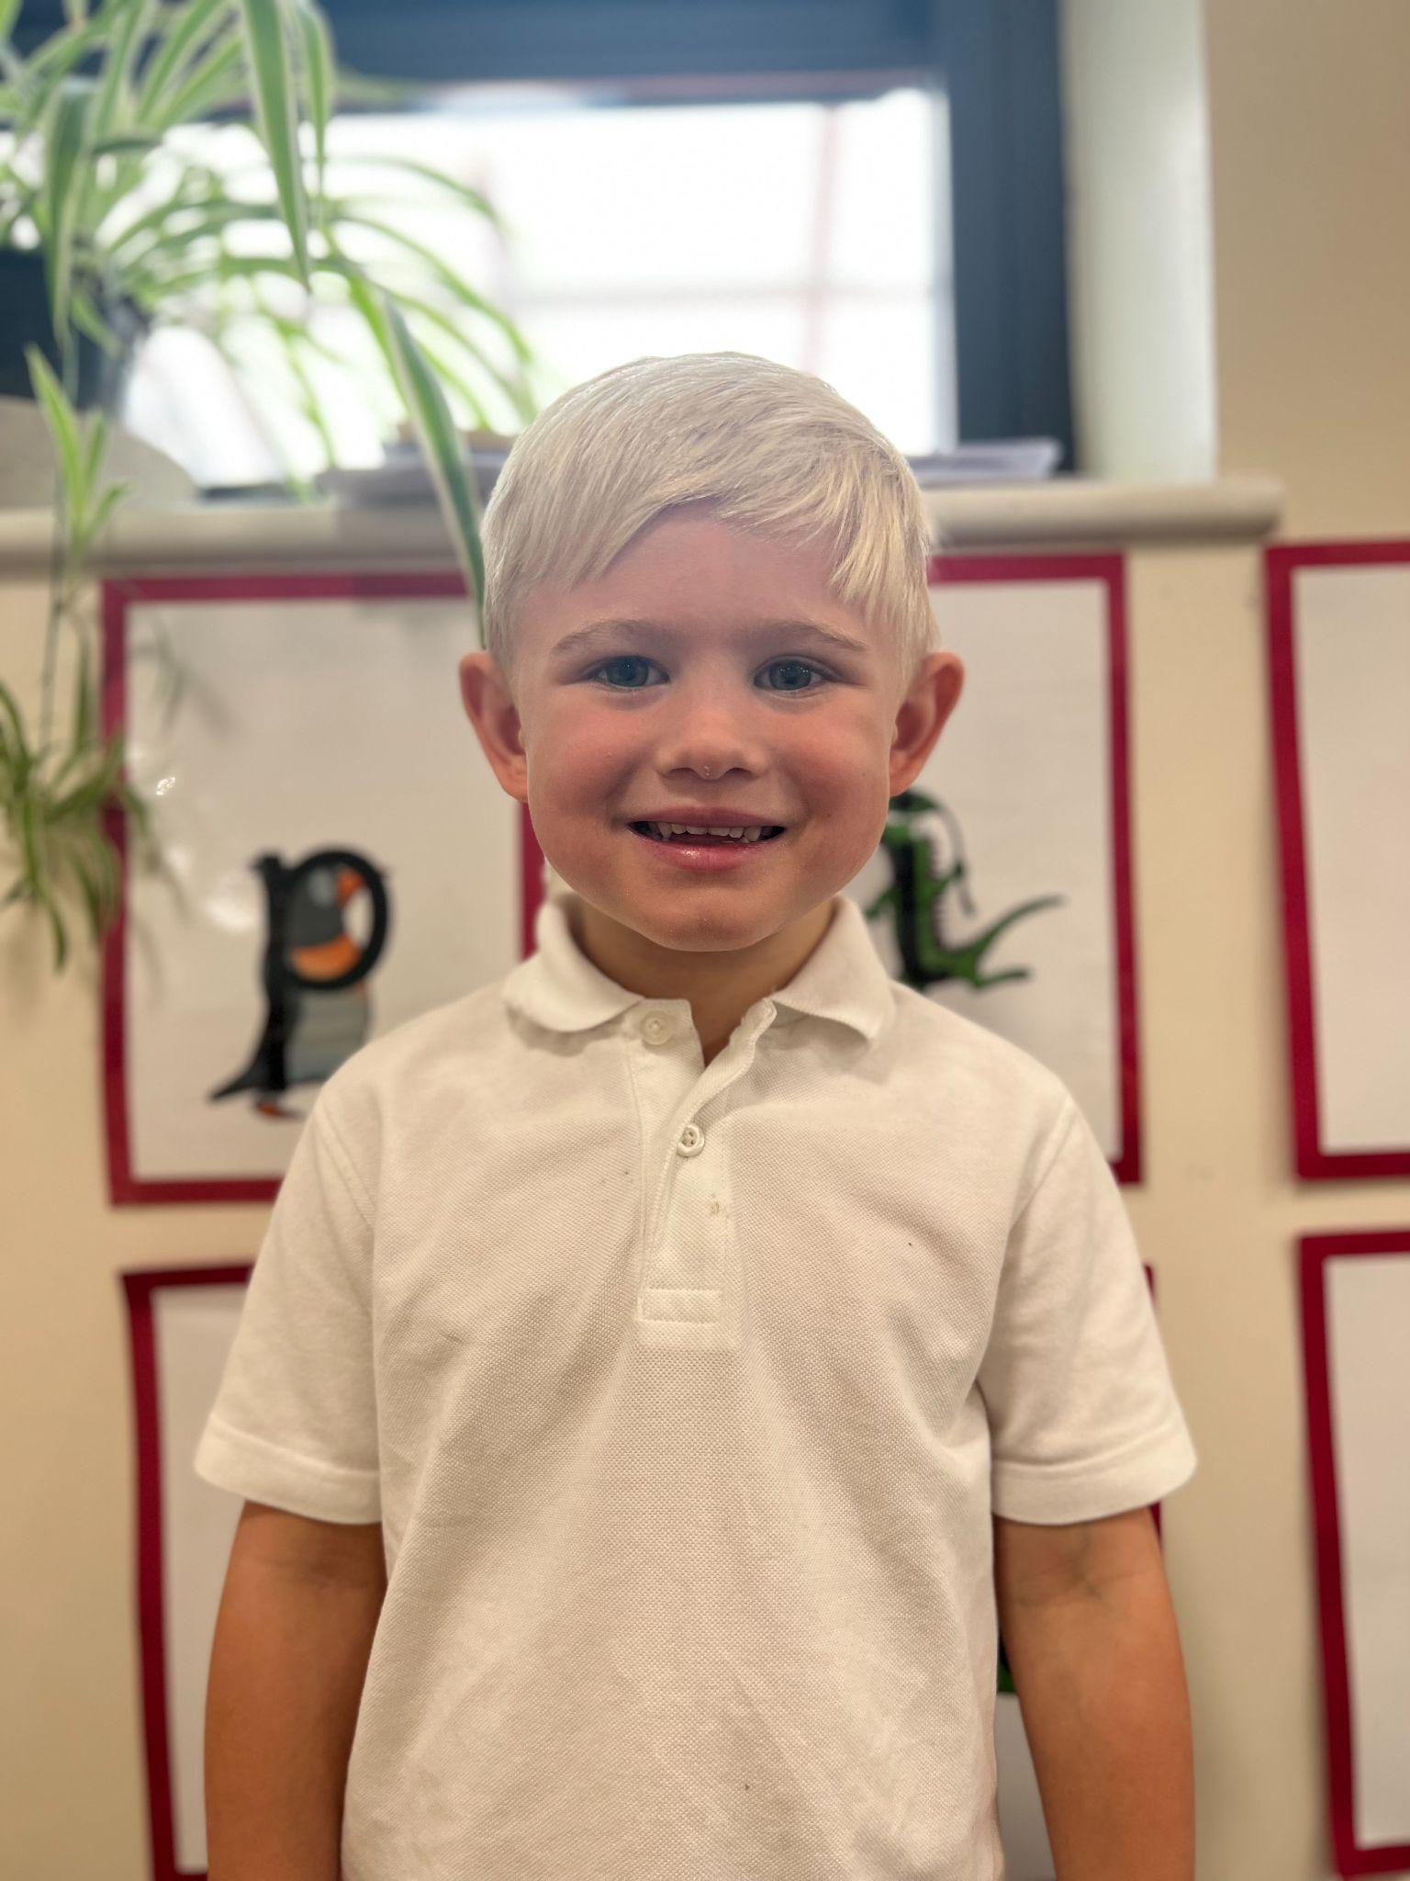
Star of the Term Winner Nursery

Slide 6
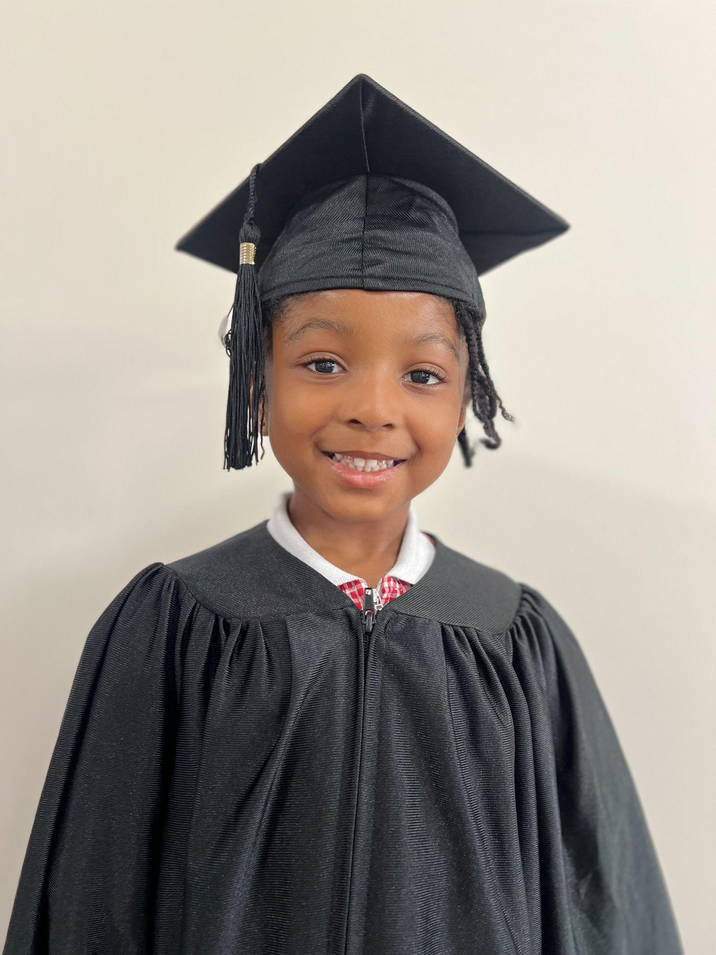
Star of the Term Winner Reception

Slide 7
Star of the Term Winner Year 1

Slide 8
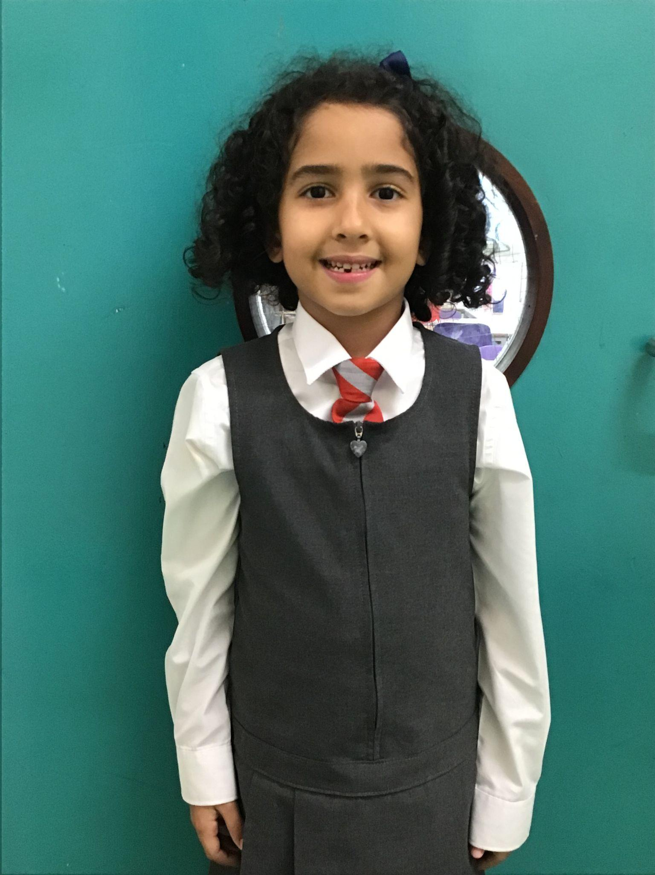
Star of the Term Winner Year 2

Slide 9
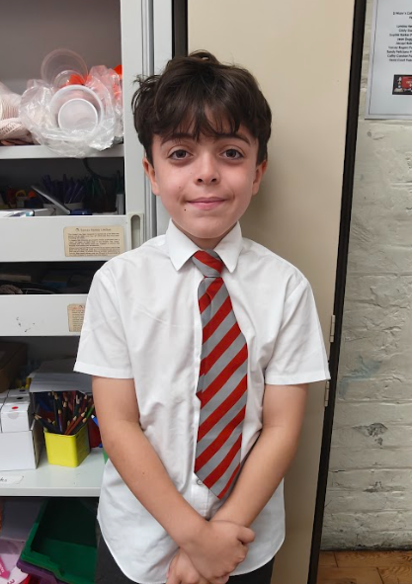
Star of the Term Winner Year 3

Slide 10
Star of the Term Winner Year 4

Slide 11
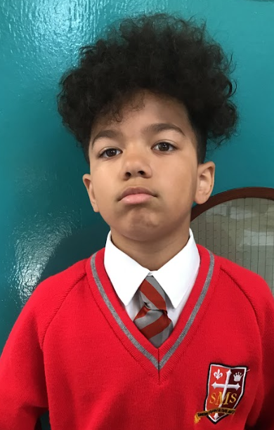
Star of the Term Winner Year 5

Slide 12
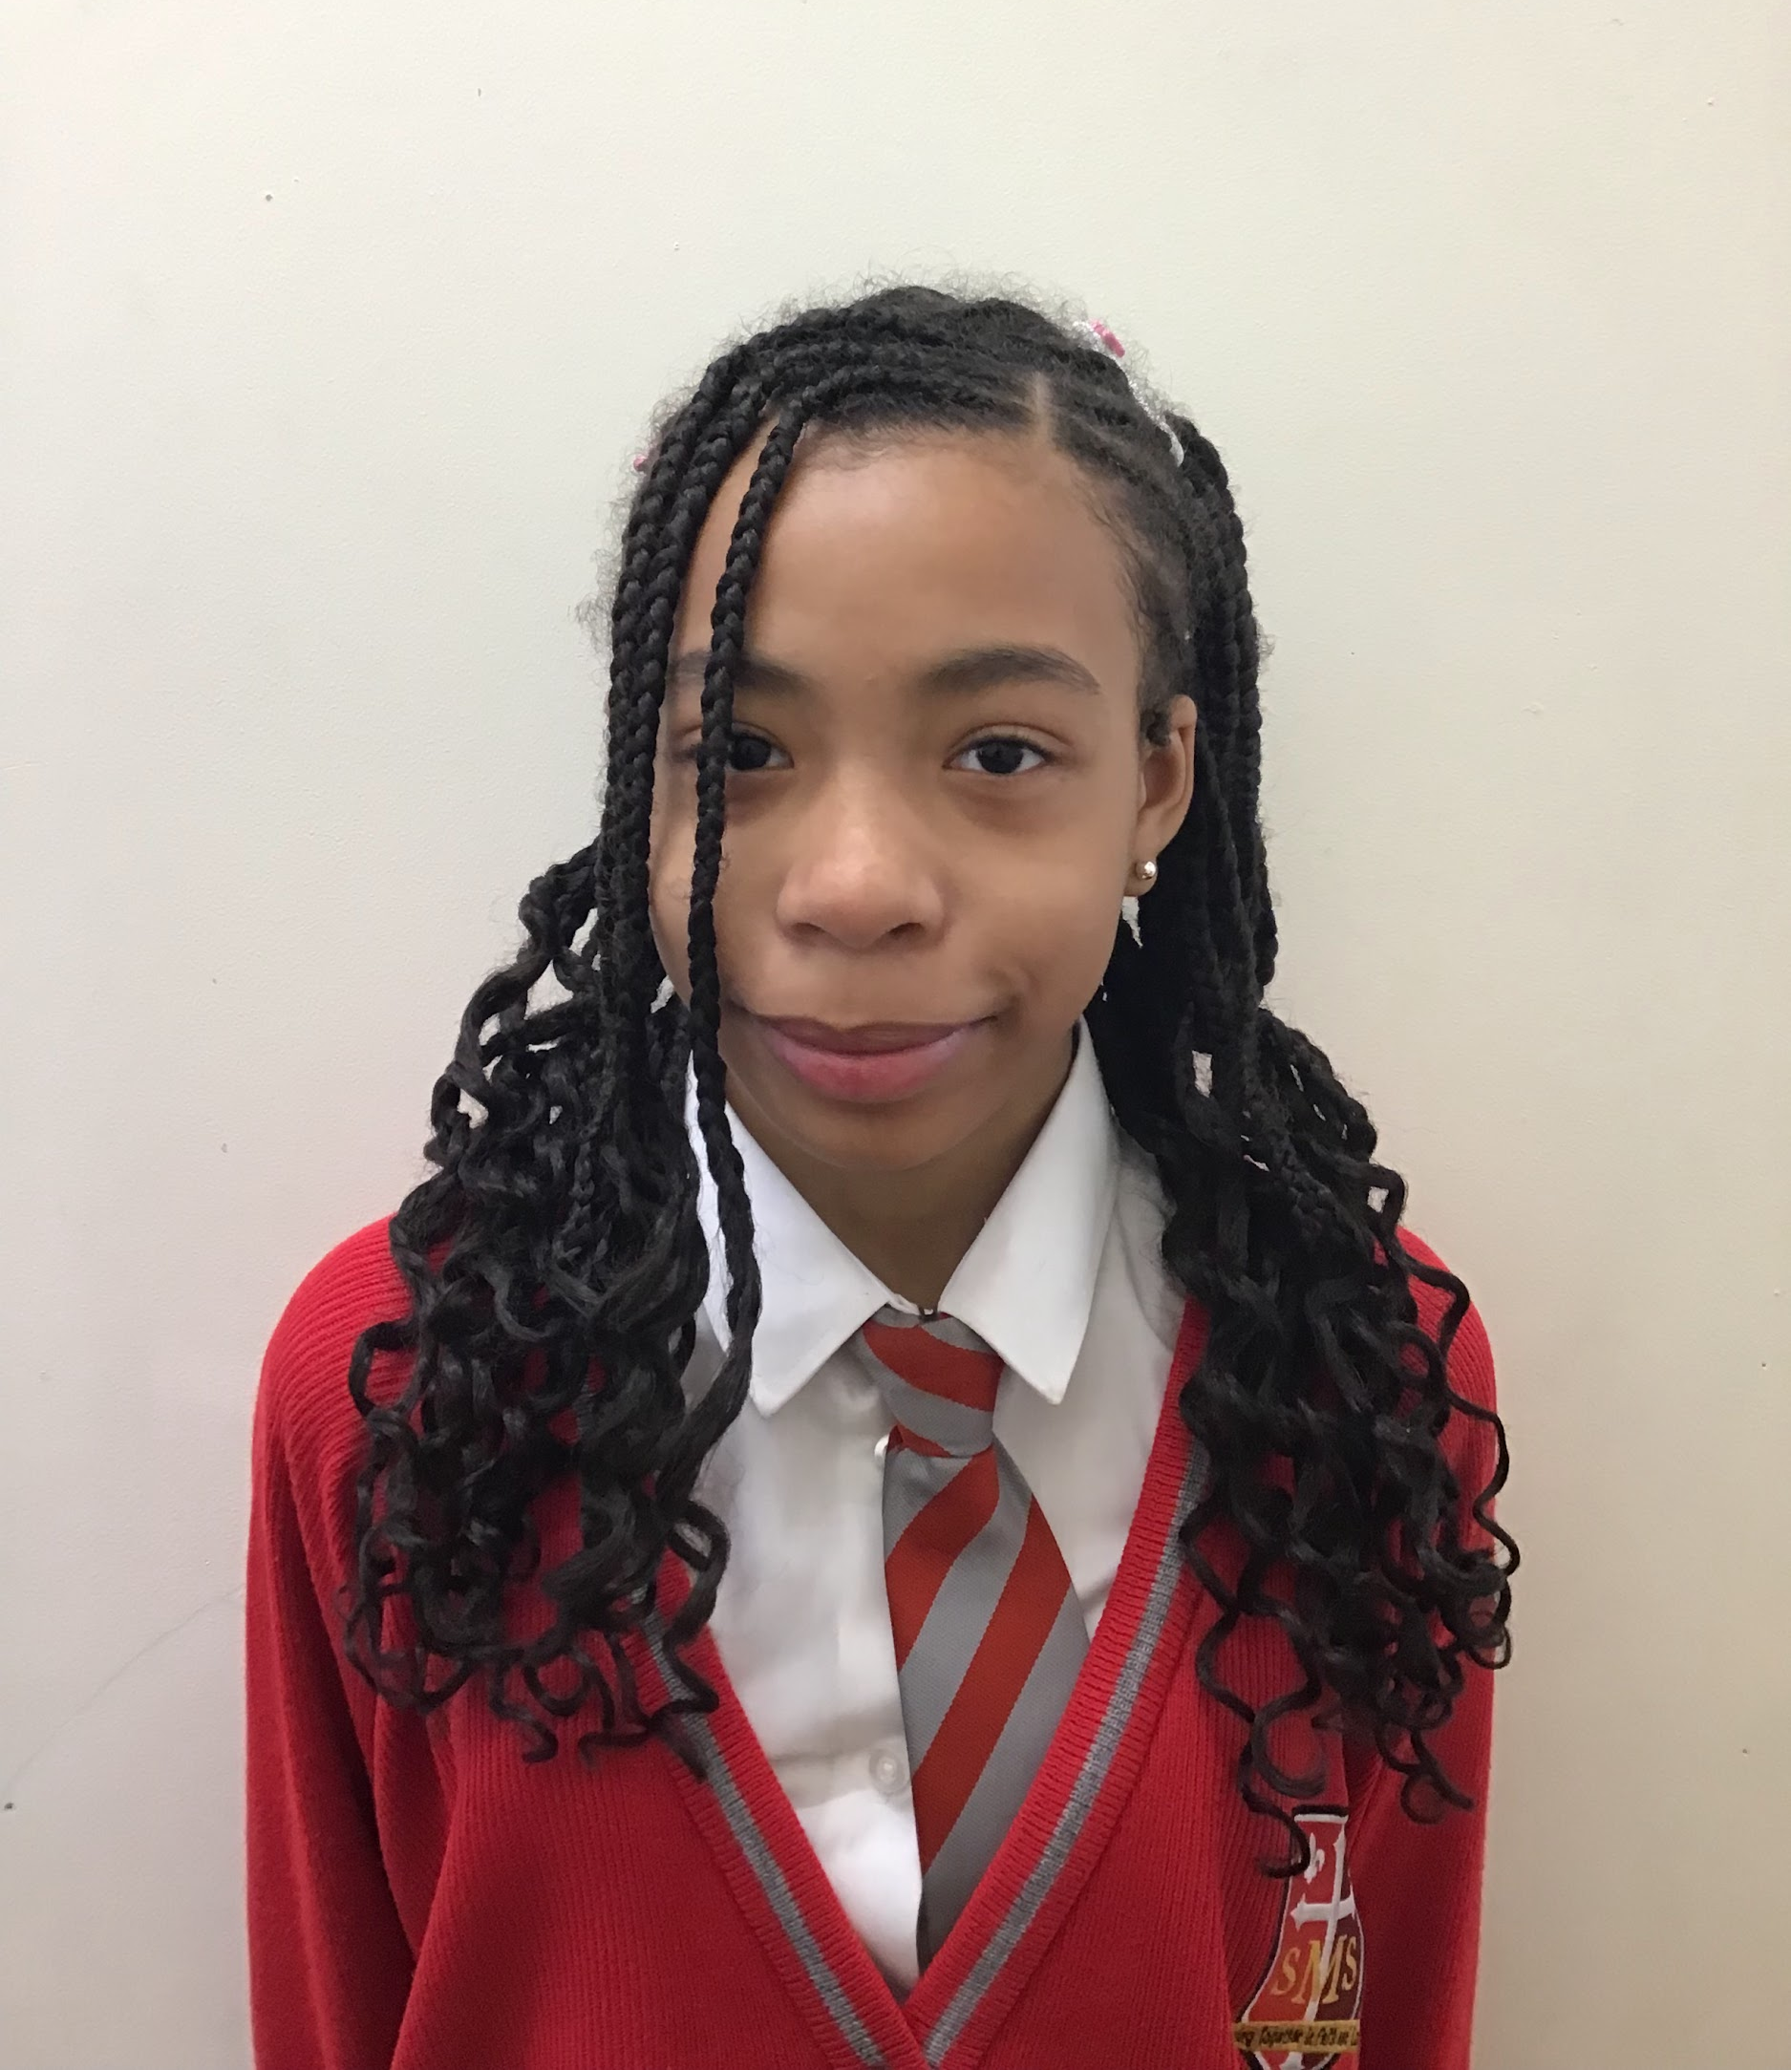
Star of the Term Winner Year 6

Slide 13
Handwriter of the term
Year 1: Aniyah
Year 2: Anya
Year 3: Asia
Year 4: Alby
Year 5: Amy
Year 6: Sienna M

Slide 14
Golden Tickets

Slide 15
Science Week Poster Competition Winners
KS1- Mia Y2
Lower KS2- Lola Year 4
Upper KS2 - Zamarah Year 5

Slide 16
Star of the Term Musicians
Nursery: George, Ivy
Reception: Hailey, Jahmiel
Year 1: Aniyah, Darius
Year 2: Mia, Azahrye
Year 3: Rhenn, Aislie
Year 4: Franzen, Caleb
Year 5: Zyann, Gideon
Year 6: Naz, Anaya

Slide 17
Special Star of the Term Award
Pianist of the term

