Slide 1
Whole School
Star of the Week
Thursday 23rd January 2025

Slide 2
Our Father who art in Heaven
Hallowed be Thy Name
Thy Kingdom come
Thy will be done on Earth as it is in Heaven
Give us this day our daily bread
And forgive us our trespasses
As we forgive those who trespass against us
And lead us not into temptation
But deliver us from evil
Amen

Slide 3
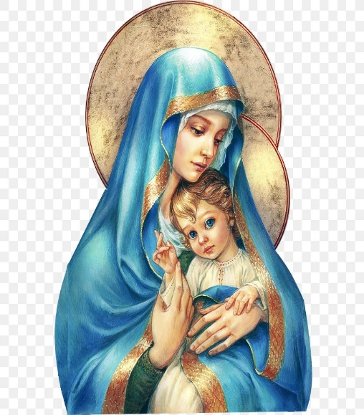
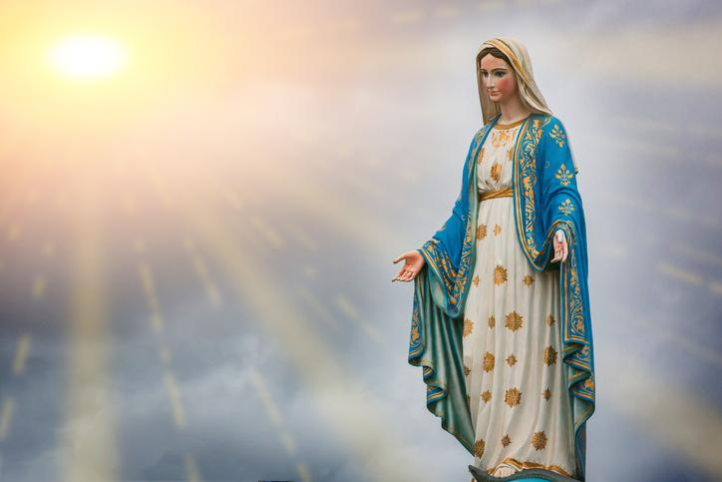
Hail Mary, Full of Grace
The Lord is with Thee
Blessed are Thou amongst women
And Blessed is the fruit of Thy womb, Jesus
Holy Mary , Mother of God
Pray for us sinners
Now and in the hour of our death
Amen

Slide 4
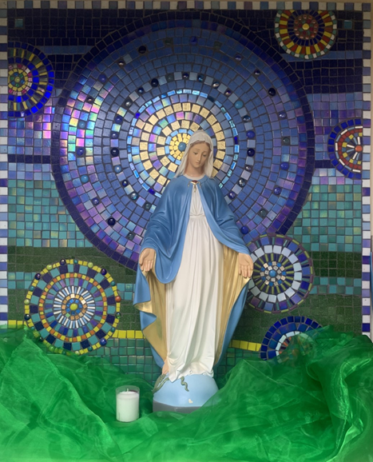
St Mary’s School Prayer
O Holy Mary,
Mother and Patron of our school,
Turn your eyes of mercy towards us,
that we may love God
With all our hearts!
May we imitate the tenderness
of your Son, Jesus,
showing love and respect
For each person
and ourselves as children of God.
Guided by the Holy Spirit,
May we create the school,
where Mercy and Compassion
Is the centre of our lives.
Amen

Slide 6
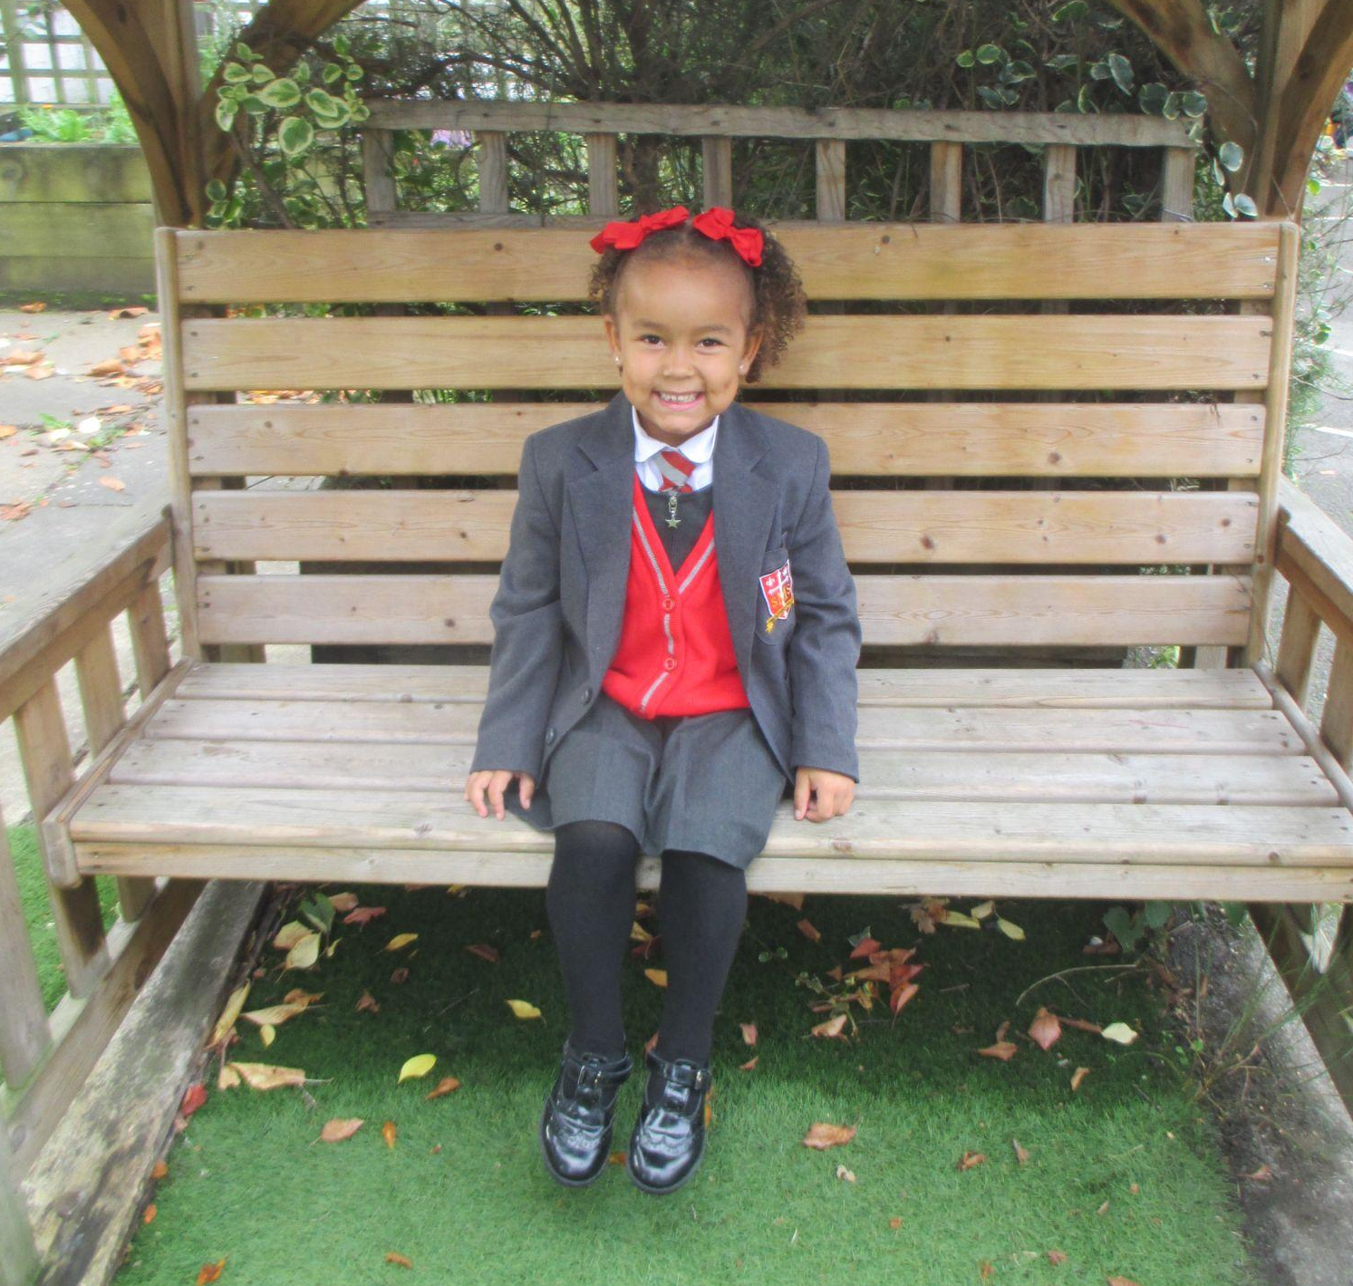
Reception-Tegan
For her positive attitude in class and for giving 100% effort in all of her learning. Well done!
Miss Barker

Slide 7
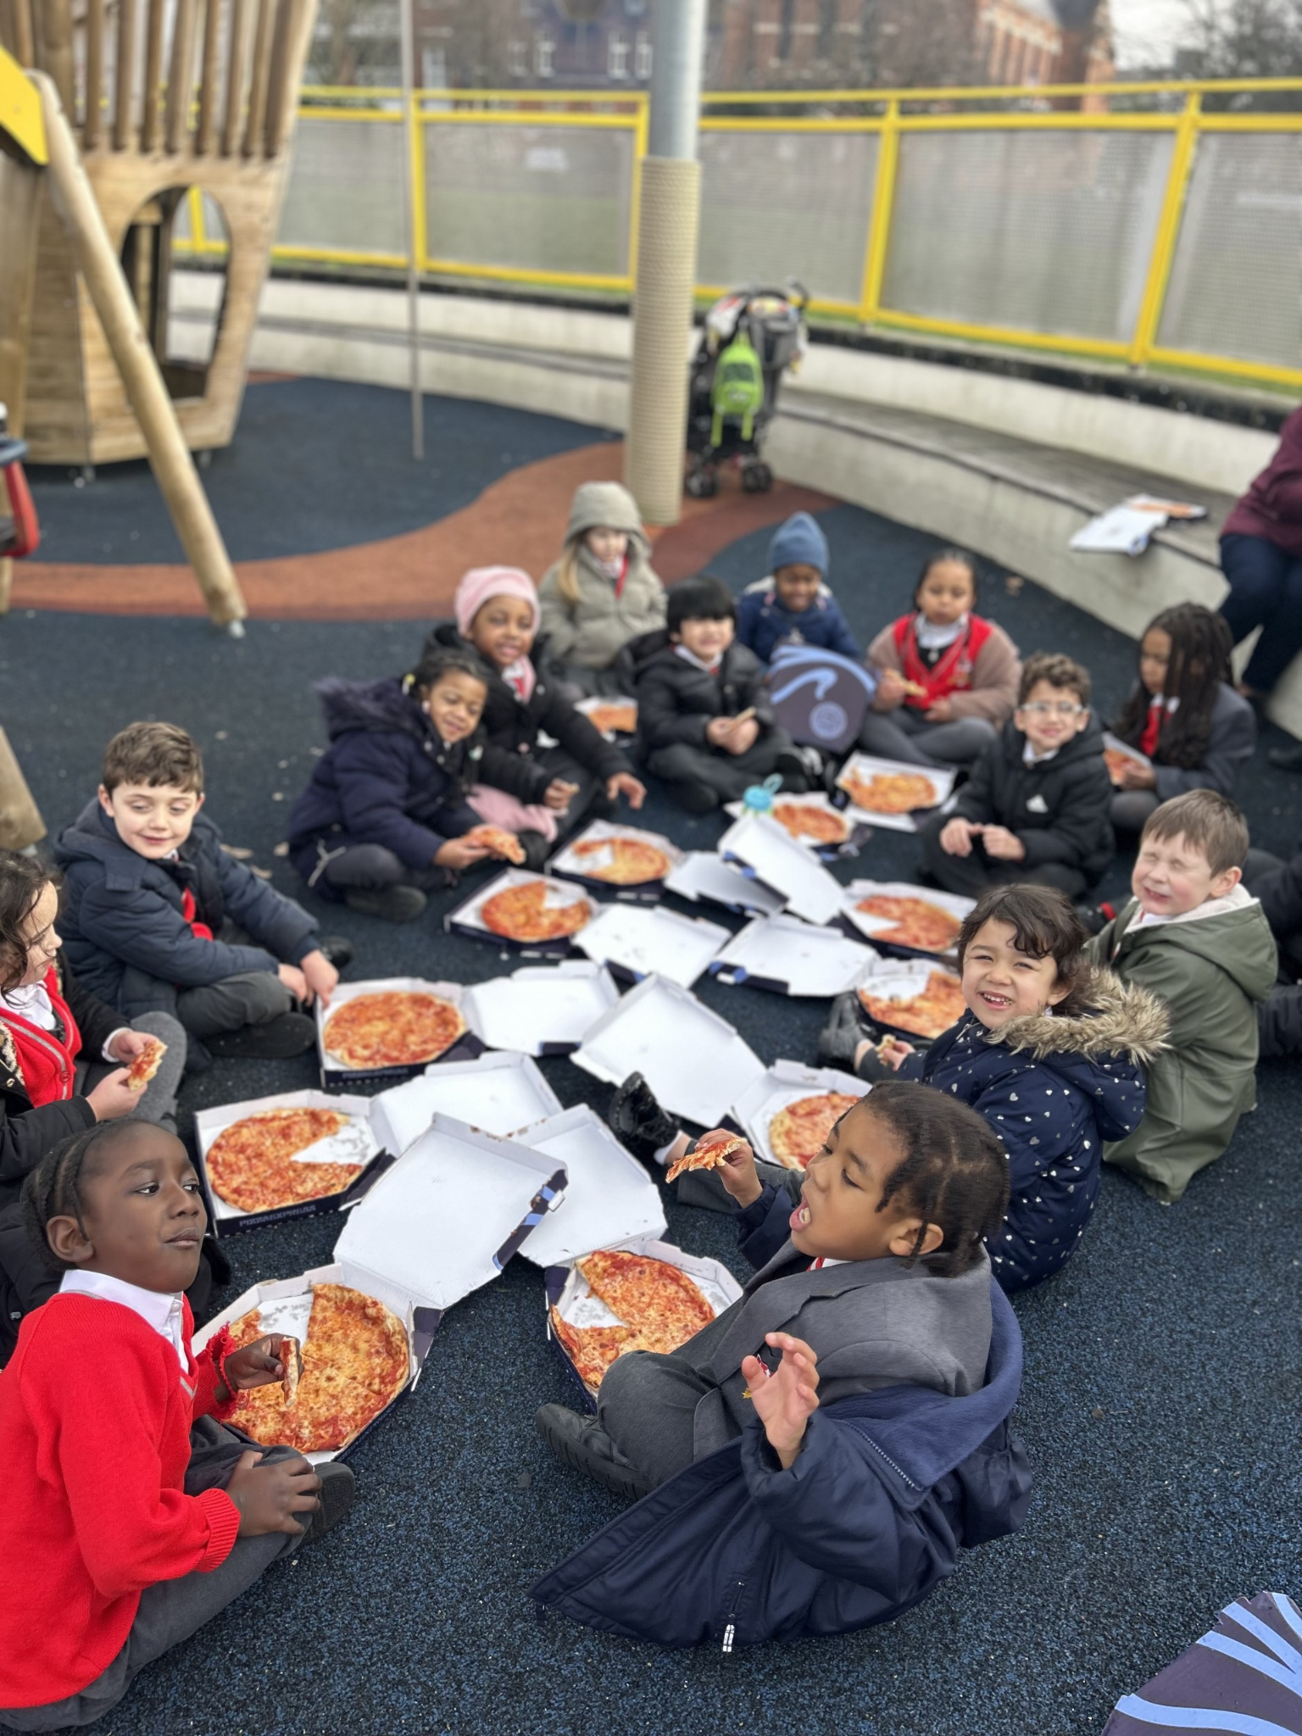
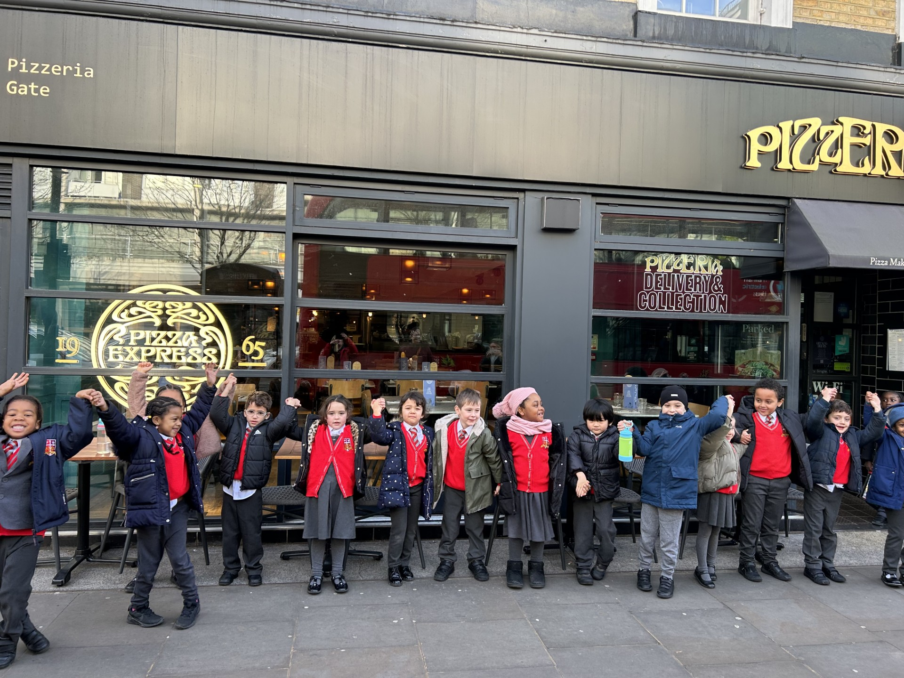
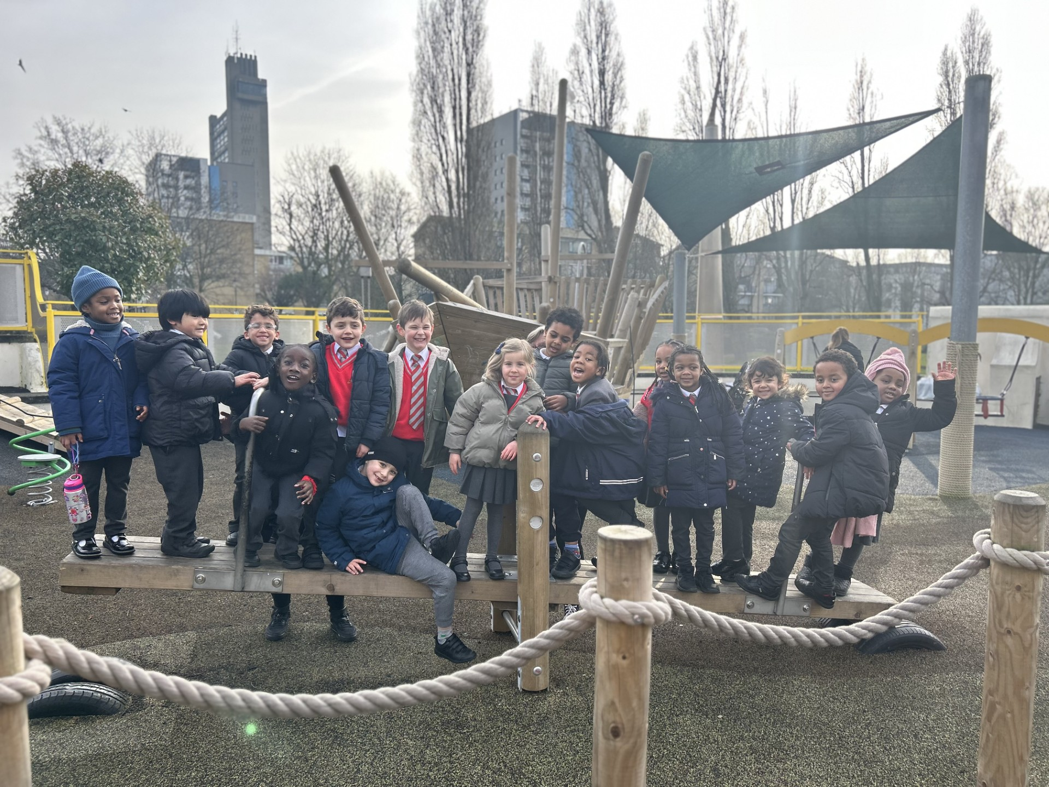
Year 1
Whole Class
For their fantastic behaviour on our trip to Pizza Express and for working hard on their information books!
Miss Sweet

Slide 8
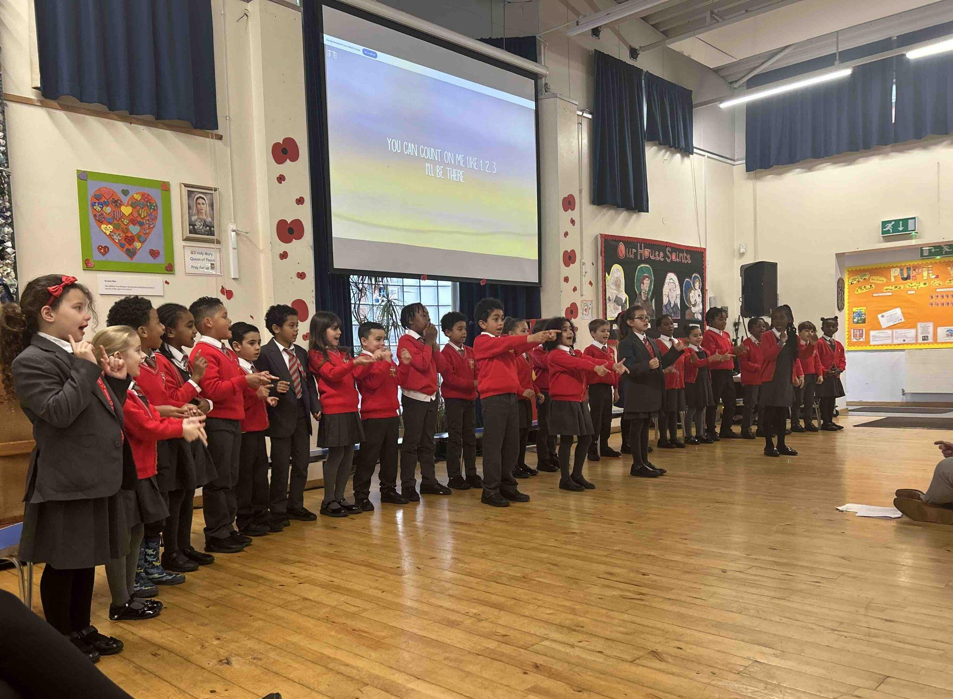
Year 2
Whole Class
For thinking and working hard this week, particularly in maths and improving our lining up so we are ready to learn.
Mr Whear

Slide 9
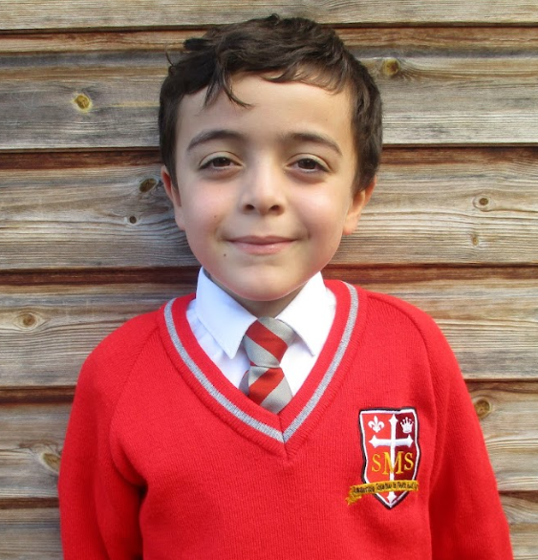
Year 3
Jayden
For having a dedicated, hard-working and sensible approach to everything he does. He is a role model for his peers on how to behave in lesson. Well done!
Miss Medioli

Slide 10
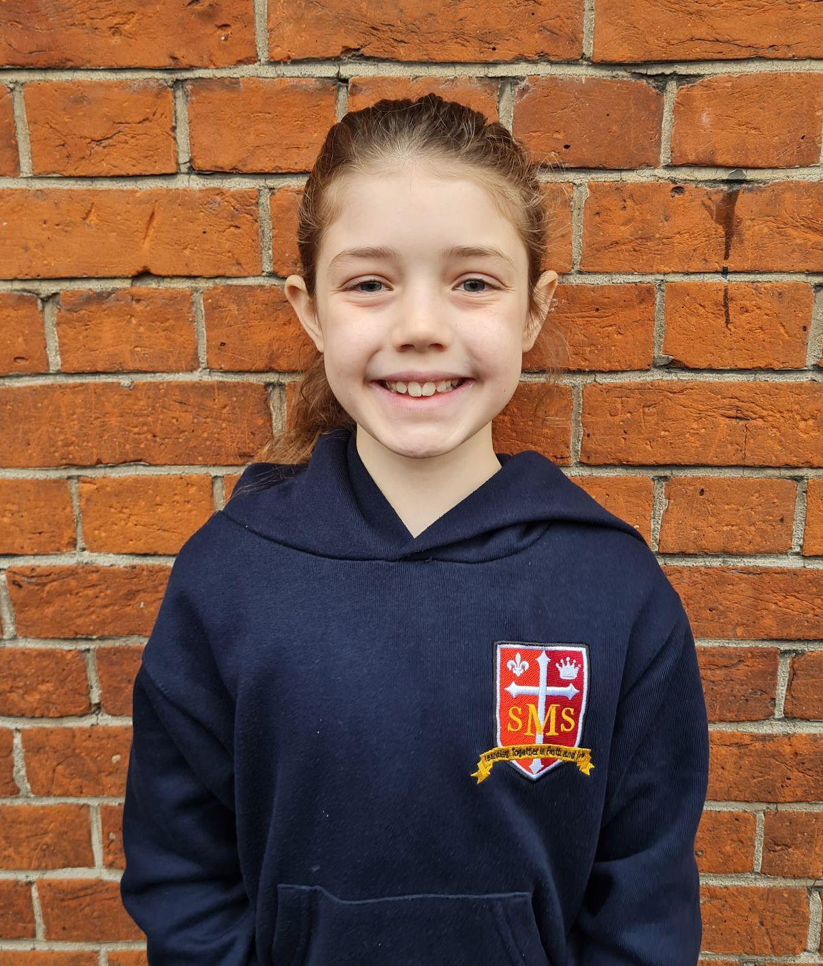
Year 4
Poppy
For her respectful behaviour and excellent effort in all subjects so far this term.
Ms Forrest

Slide 11
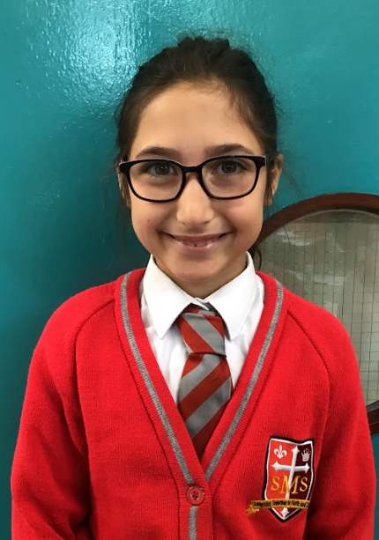
Year 5
Ana Clara
For consistent effort and positivity.
Mr Larke

Slide 12
Year 6
Agatha
For consistently showing great enthusiasm and energy. She is an example to the class and has made great strides this year.
Mr Cherfi and Mr Fowle

Slide 13
Star Readers
Y1 - Farah
Y2 - Renai-Mae
Y3 - Dilyet
Y4 - Nevaeh
Y5 - Layla
Y6 - Not this week

Slide 14
Nevaeh - Y4

Slide 15
House Points

Slide 16
Pitch Winners Years 5 and 6:

Slide 17
Pitch Winners Years 3 and 4:

Slide 18
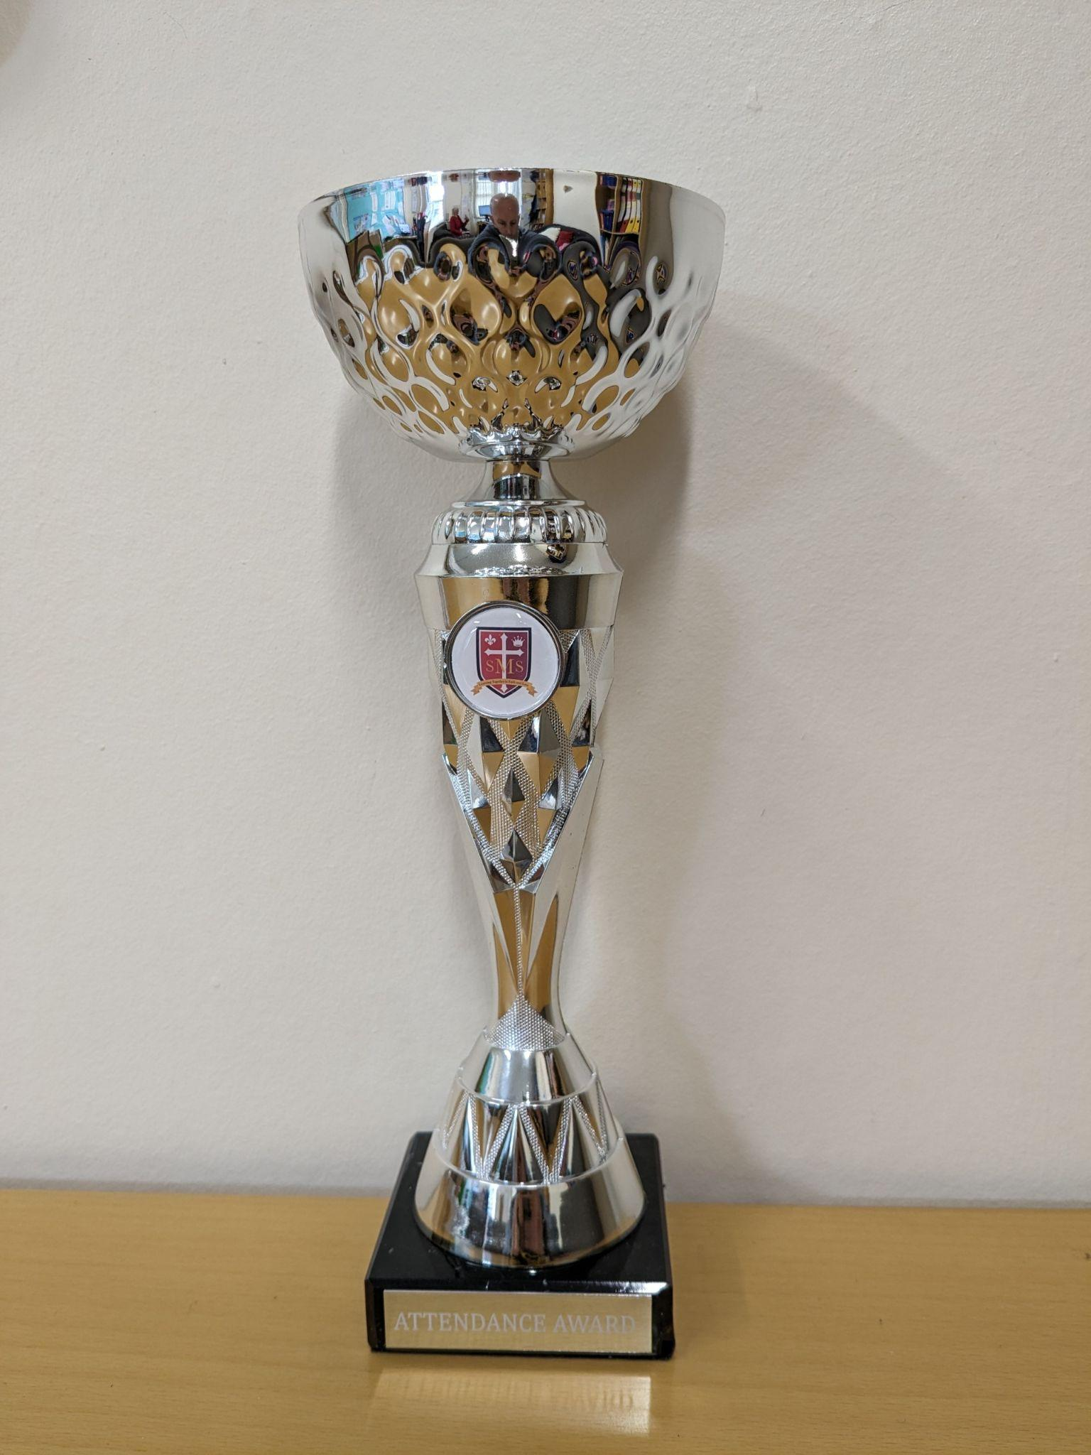
Attendance so far:

Slide 19
Whole School
Star of the Week
Friday 23rd January 2025

