Slide 1
Whole School
Star of the Week
Friday 28th February 2025

Slide 2
Our Father who art in Heaven
Hallowed be Thy Name
Thy Kingdom come
Thy will be done on Earth as it is in Heaven
Give us this day our daily bread
And forgive us our trespasses
As we forgive those who trespass against us
And lead us not into temptation
But deliver us from evil
Amen

Slide 3
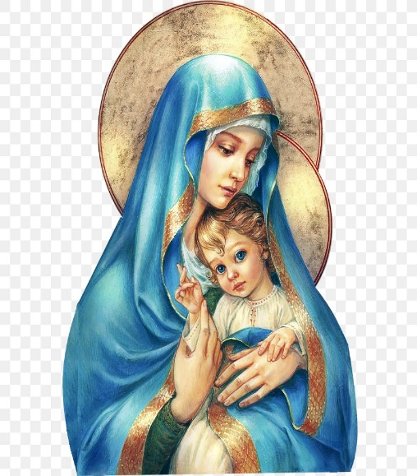
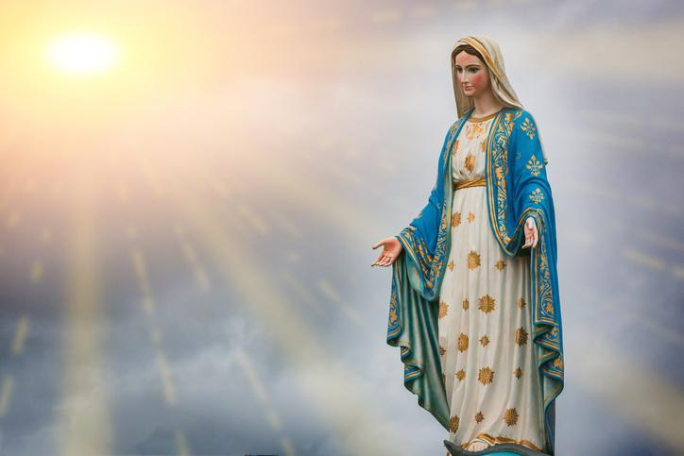
Hail Mary, Full of Grace
The Lord is with Thee
Blessed are Thou amongst women
And Blessed is the fruit of Thy womb, Jesus
Holy Mary , Mother of God
Pray for us sinners
Now and in the hour of our death
Amen

Slide 4
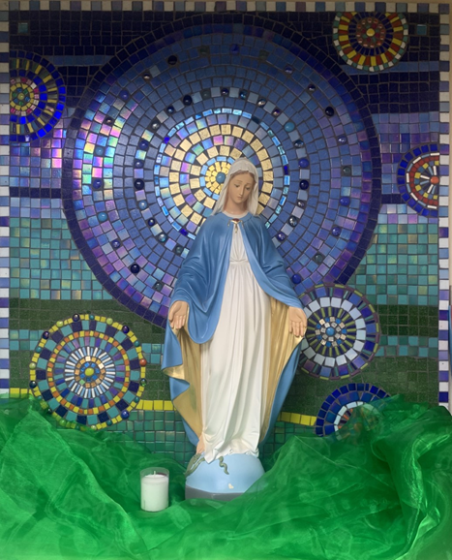
St Mary’s School Prayer
O Holy Mary,
Mother and Patron of our school,
Turn your eyes of mercy towards us,
that we may love God
With all our hearts!
May we imitate the tenderness
of your Son, Jesus,
showing love and respect
For each person
and ourselves as children of God.
Guided by the Holy Spirit,
May we create the school,
where Mercy and Compassion
Is the centre of our lives.
Amen

Slide 6
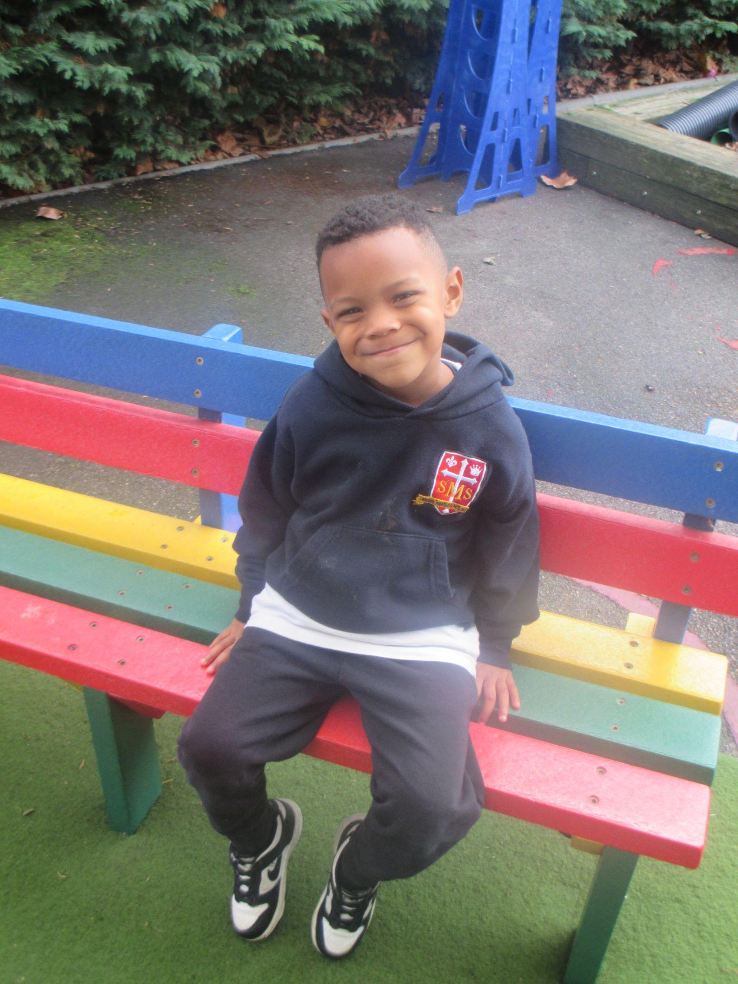
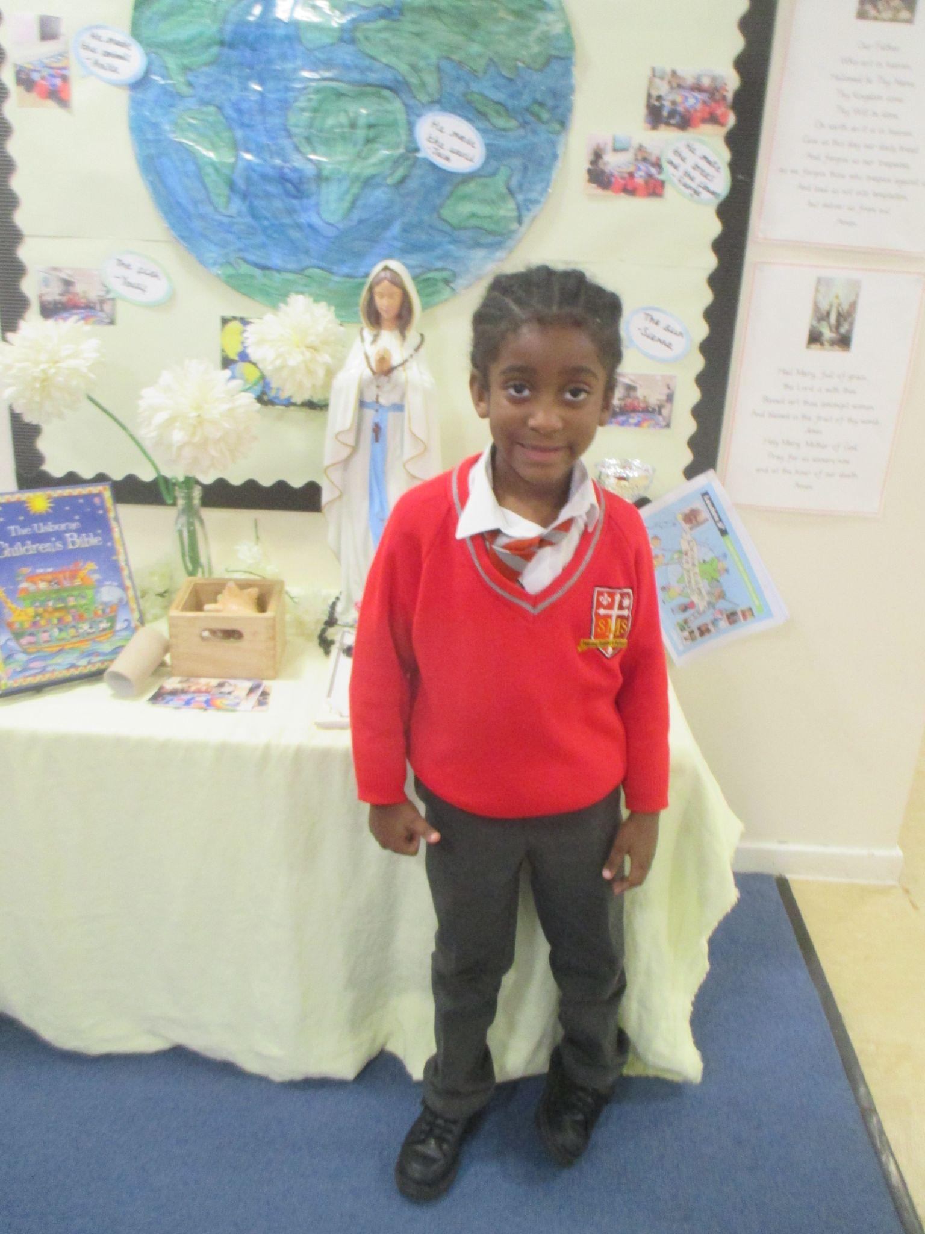
Nursery- Kannon, For having an excellent first week back to school and showing us his positive role model behaviour.
Reception- Joshua- For working extremely hard in phonics and Literacy lessons and being proud of his achievements.
Miss Barker

Slide 7
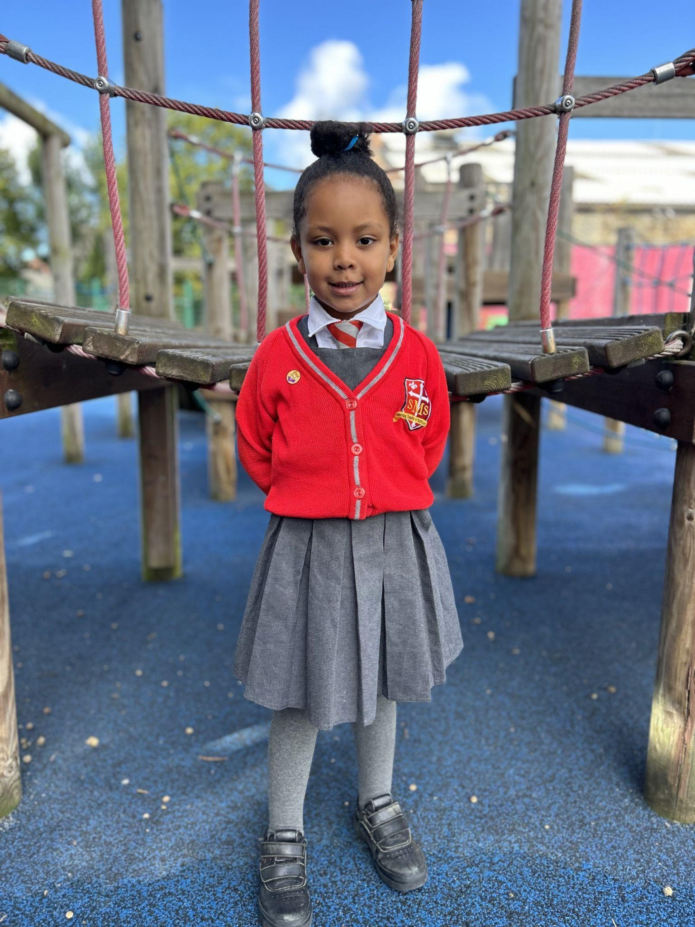
Year 1
Naomi
For trying hard in her phonics group and having a go on her own!
Miss Sweet

Slide 8
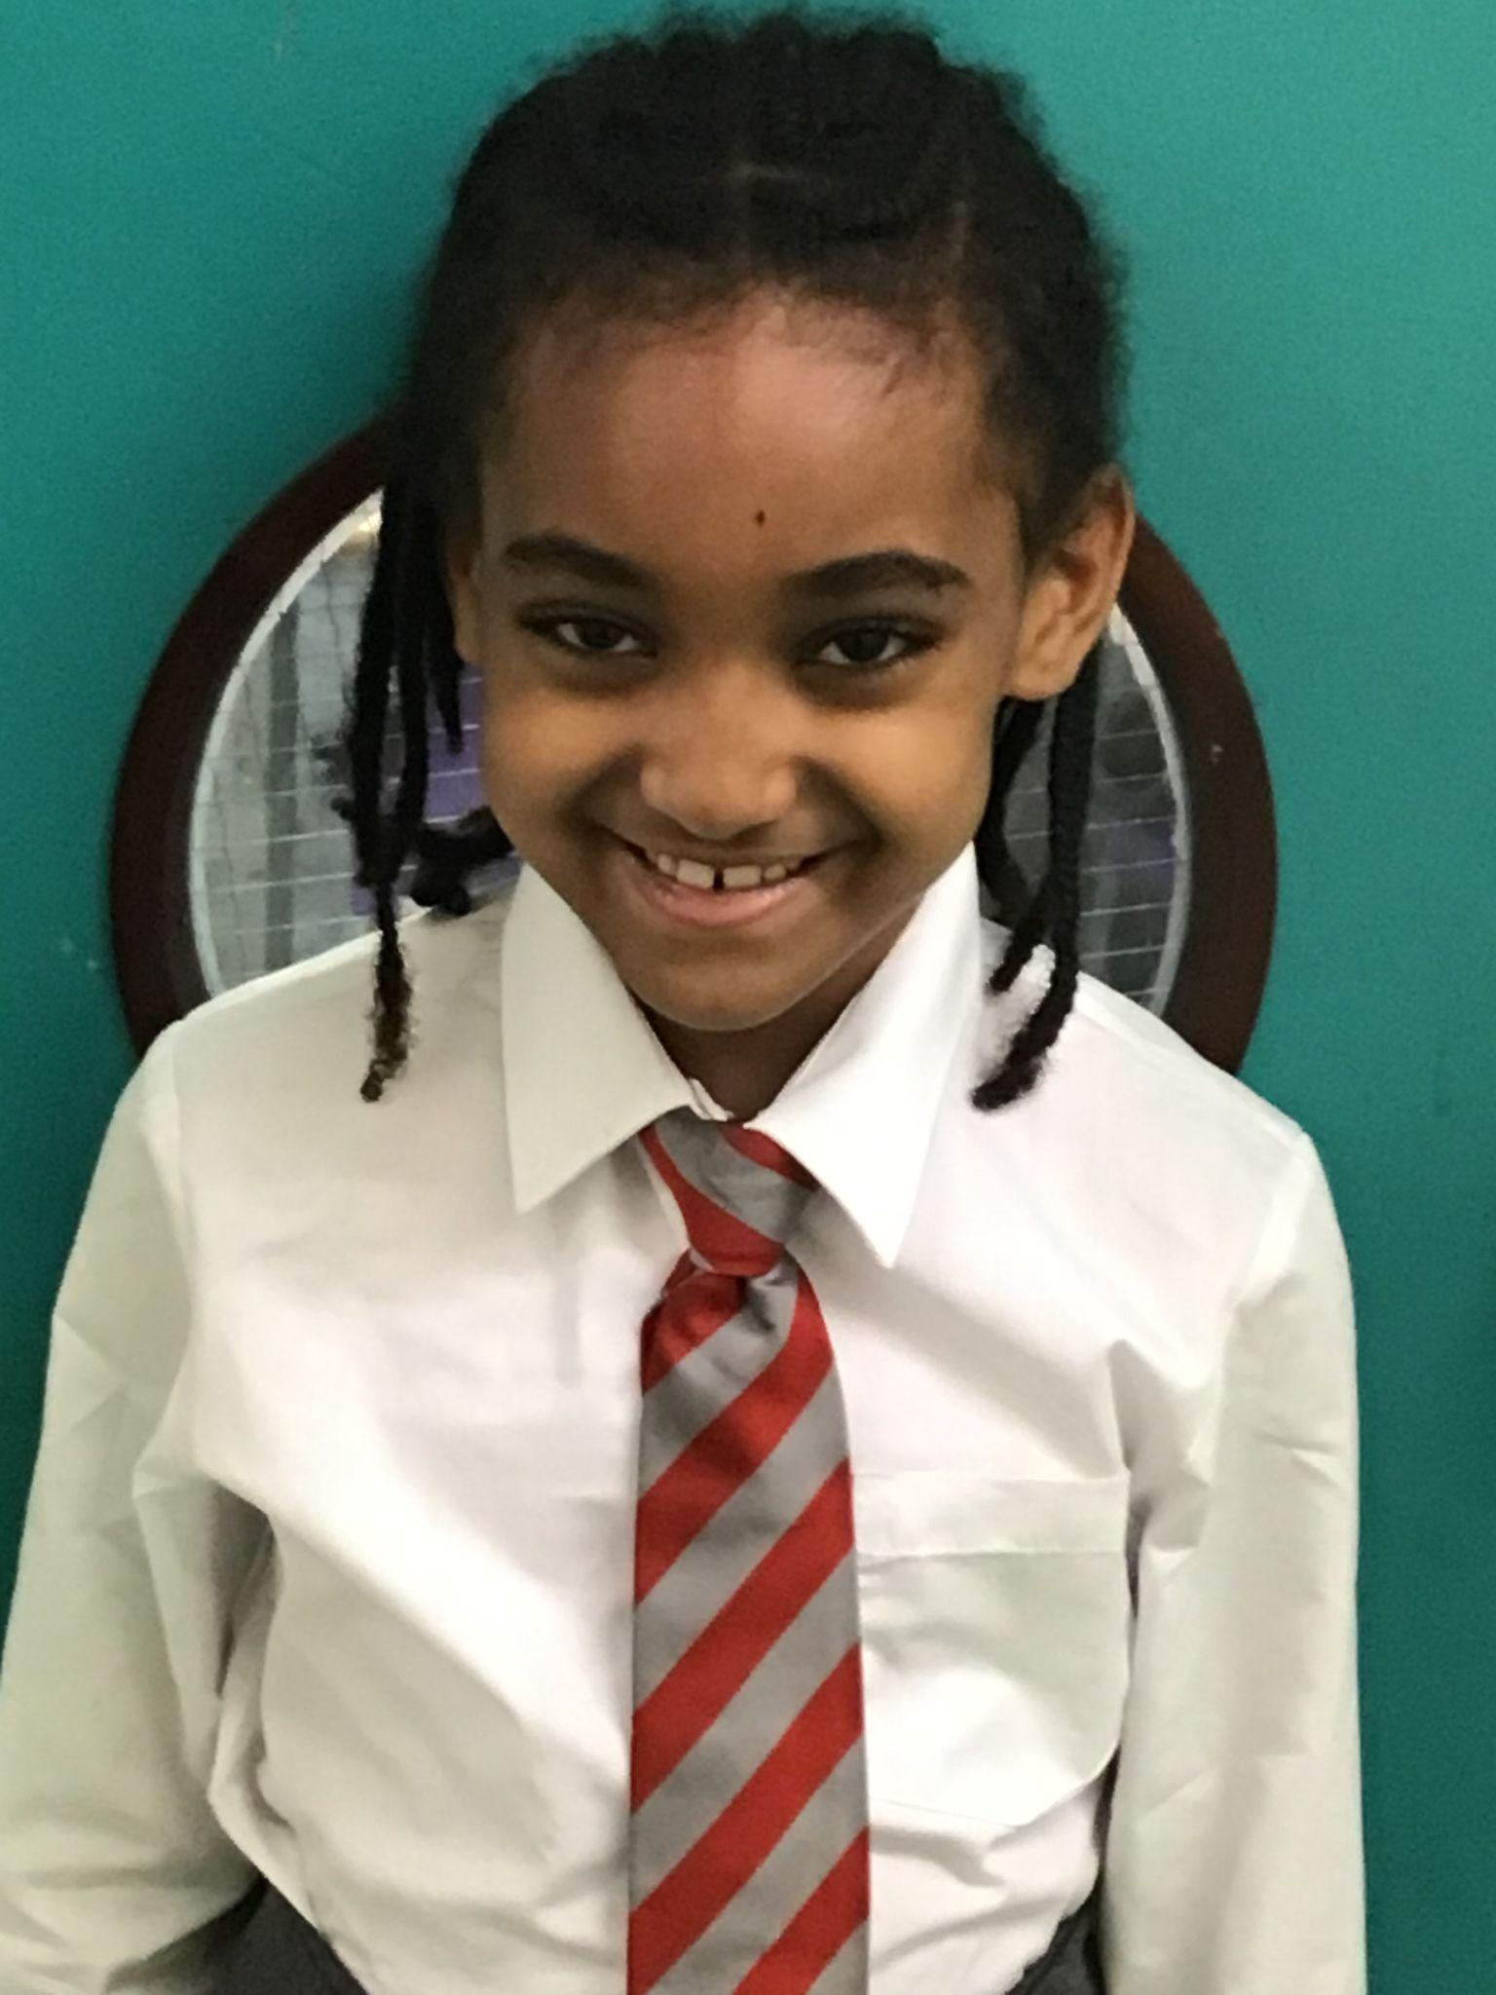
Year 2
Zeema
For consistently demonstrating our school values in her work and play.
Mr Whear

Slide 9
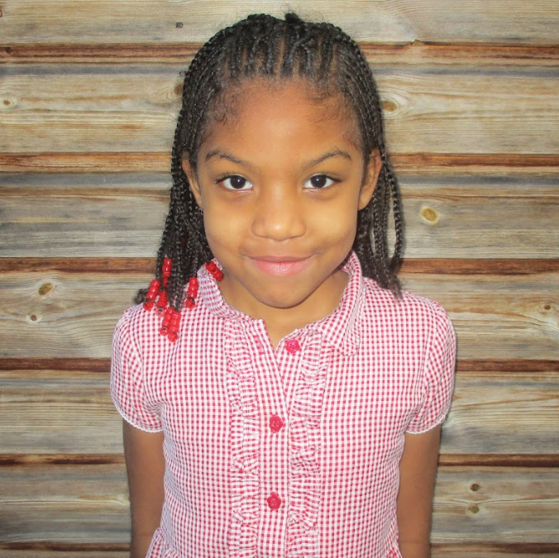
Year 3
Kareema
For making an effort to contribute more in class discussions and be more vocal about her thoughts and feelings!
Miss Medioli

Slide 10
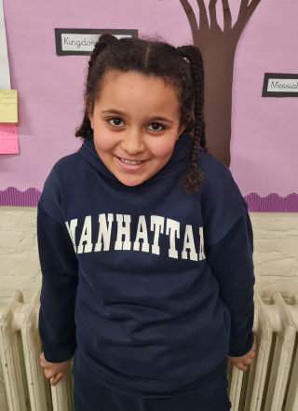
Year 4
Alessia
For being a passionate learner and giving me a very warm welcome!
Mr Choudhry

Slide 11
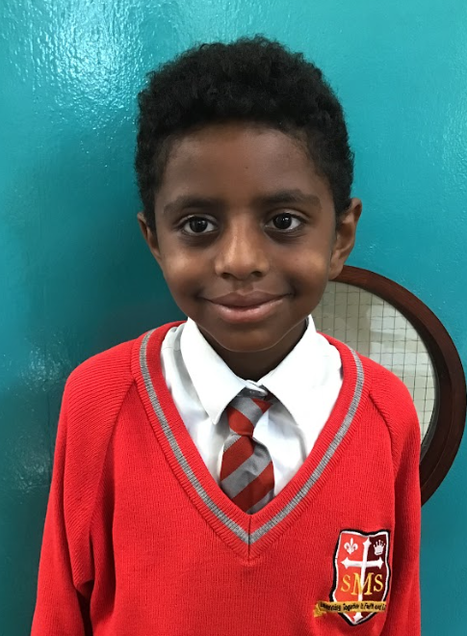
Year 5
Nazrawi
For hugely improved effort this week and showing what he can do.
Mr Larke

Slide 12
Year 6
Victoria
For incredible progress and consistency. Victoria is producing brilliant work and participating regularly in class.
Mr Cherfi and Mr Fowle

Slide 13
Star Readers
Y1 - Kai
Y2 - Victor
Y3 - Alfie
Y4 - Franzen
Y5 - Jericho
Y6 - Stefan

Slide 14
Ana-Laura - Y6
Albie - Yr1

Slide 15
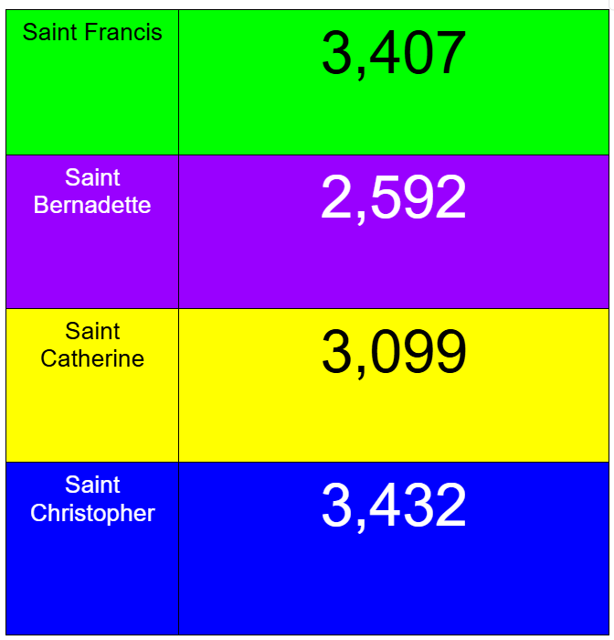
House Points

Slide 16
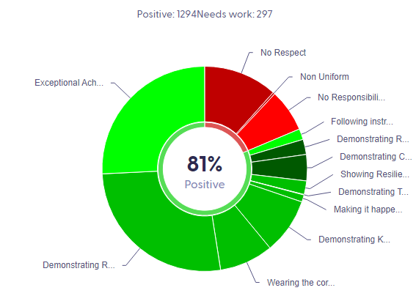
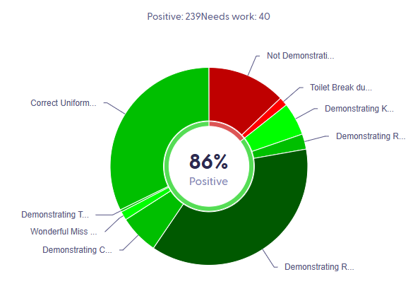
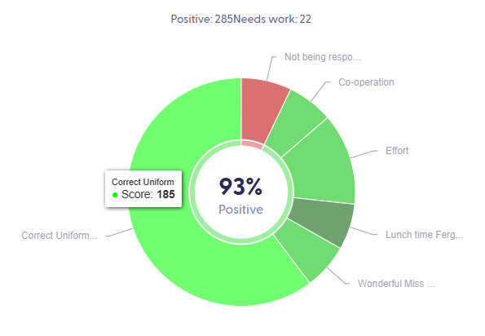
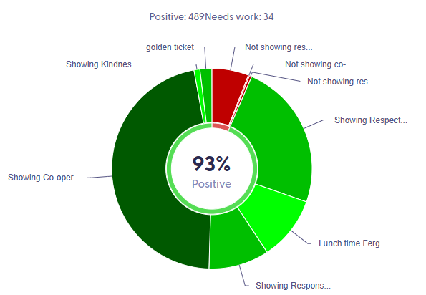
Pitch Winners KS2:

Slide 17
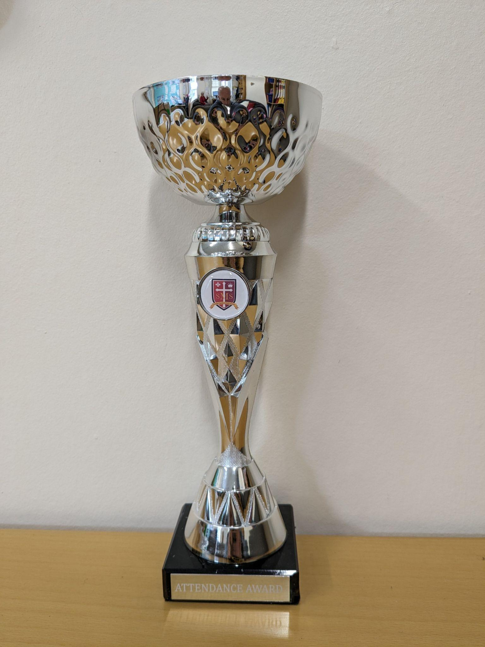
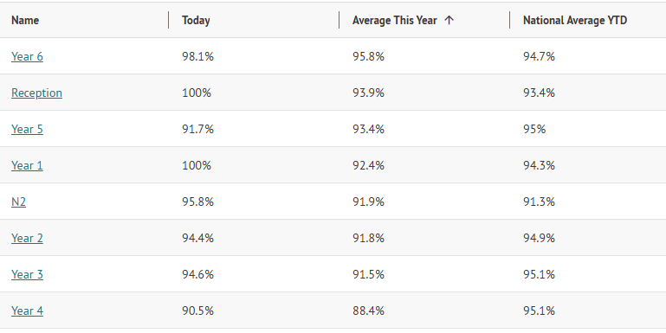
Attendance Leaders Spring Term:

Slide 18
Whole School
Star of the Week
Friday 28th February 2025

