Slide 1

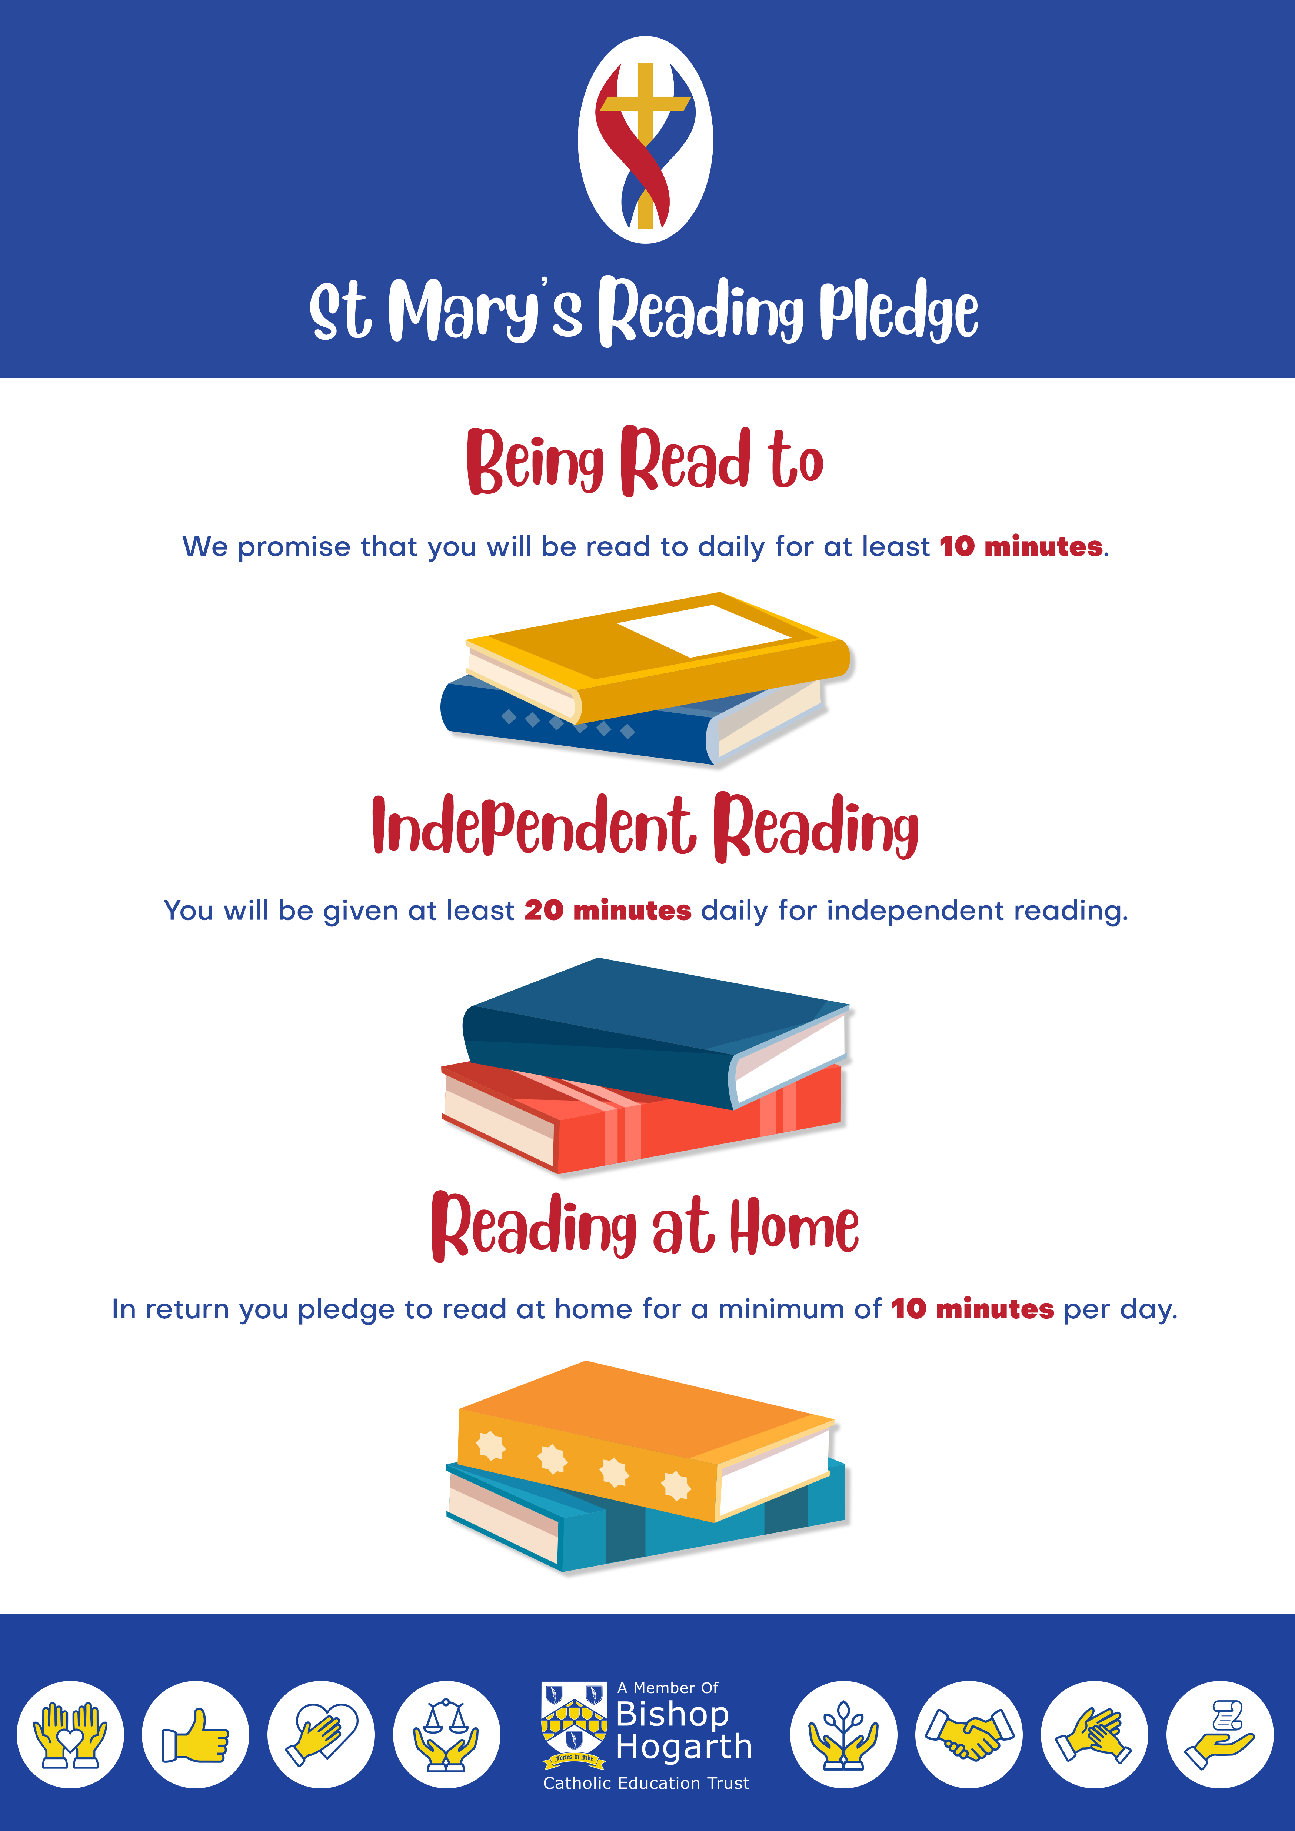

 | St Mary’s Catholic Primary School Quality of Education – Reading
The aims of the ambitious and inspiring curriculum The curriculum at St Mary’s is personalised to the unique needs of our children, our children join us with skills well below those expected, they need to make exceptional progress during their time with us to enable them to be the best that they can be. Our reading curriculum gives children the best possible opportunities to become confident, literate, successful members of society with a deep love and understanding of English language and literature. We believe the development of reading skills is central to improving a child's life chances. Teachers have high expectations for all children to achieve and enjoy reading and to be able to use the skills they have acquired in a range of contexts. Rich texts are at the heart of our teaching and a love for reading is consistently promoted throughout the school. Staff access a range of high quality CPD to ensure that they are early reading experts. This includes, yearly phonics training, regular reading strategy updates, Sounds Write Portal access, personalised and on demand training.
A genuine love of reading Our ‘St Mary’s Reading Pledge’ emphasises the dedication and priority we place on reading. Reading squad have the mission to promote a love of reading. Reading Newsletters keep all stakeholders up to date and introduce new authors and books. ‘Durham Learning Reading Boxes’ subscription boxes every term, ensuring that the library is refreshed. Children love to receive their boxes! Our Author in residence, Sam Green, is a regular visitor. Continual investment in high quality texts. Inviting library spaces used by all. Reading displays are given high priority through school. Annual Booknic’s are exceptionally well attended. Termly reading award celebrates and promotes successful readers. Weekly celebration assemblies celebrate individual and class successes. .
Reading results across school
In EY, children make rapid progress from a low starting point and leave reception class 8% above national.
Leadership and Management in Reading Curriculum Leader – Mr Nicholas Carter Steps taken to reduce work load Leaders are given non contact time to complete leadership requirements There are 3 assessment cycles per year Explicit about expectations Sequentially planned curriculum with resources available and ready to use.
Phonics We follow Sounds Write with fidelity. All staff have yearly training, with on demand training available as required through the Sounds Write online portal. From their first day, children are taught Sounds Write in Reception and are given a reading for pleasure books in the first week As soon as they can blend, they are given a RWI book. No time is lost ensuring that all children make rapid progress. Parent meetings across EYFS and KS1 inform parents about our teaching of early reading. Children who are not making expected progress are identified quickly and targeted support is provided by trained staff. If any children do not pass PSC in Year 2, phonic teaching continues by trained staff
Reading across the school
EYFS
Children have weekly story sacks to take home and share.
Learning is focussed around a ‘Book of the Week’. Children vote daily for their ‘read aloud’ book.
KS1 and KS2
3 dedicated reading Viper lessons per week, the reading domains are explicitly taught so the children have the necessary skills to comprehend texts.
Children are Star tested from Spring in Year 2, where there are set personalised goals to help them stay focused on reading for growth. Reading quizzes monitor comprehension, while literacy skills and vocabulary quizzes extend children’s learning and build skills.
3 Year Phonic Results
Monitoring and Quality Assurance There is a cycle of monitoring undertaken by the SLT, this includes TA’s. Governors and SLT regularly monitor the teaching of reading as part of their cycle of monitoring. Governing Body Reports Learning Walks Results analysis In-year data Student and parent voice Self-evaluations Appraisal reviews External Sounds Write trainer
 | 2019 | 2022 | 2023
Year 1 | 90% | 40% | 26%
Year 2 | 100% | 100% | 73%
Personal Development It is important to us that all of our children can see themselves in the stories within school. Central reading area celebrate diversity and inclusivity. These are listed on our diverse book list and address the protected characteristics too.
Curriculum
High quality texts are used to explicitly teach subject specific vocabulary and specialised instruction for how to read and understand texts in particular subjects.
SEND Children on SEN support at Y6 make better progress than their peers. Progress measure +2.55 (2023). 100% of children on SEN support achieved the expected standard compared to 77% of their peers and achieved an average scaled score of 110.7.
Disadvantaged In reception 70% DA children achieved GLD this increased from 50% the previous year.
‘Called by God’

