Slide 1
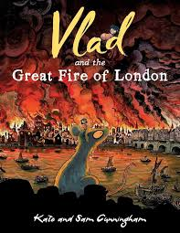
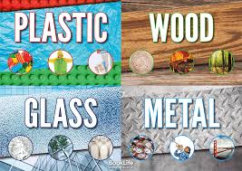
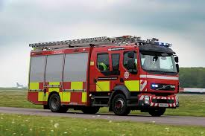
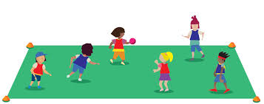


Year 2 Parent Newsletter - Spring 2
Welcome to our Spring 2 newsletter! We are excited to share with you the wonderful learning experiences planned for your children this term.
English
This term, we will be exploring the book Vlad and the Great Fire of London. The children will immerse themselves in the events of 1666 and write a diary entry from the perspective of someone who experienced the Great Fire of London.
Mathematics
In Maths, our focus will be on multiplication and division, as well as measurement. The children will learn to solve problems involving these operations and measure length, weight, and capacity using standard units.
History
Our History topic this term is the Great Fire of London. The children will learn about the events of 1666, how the fire started, and its impact on the city. They will also explore how London was rebuilt after the fire.
Science
In Science, we will be investigating materials and their properties. The children will conduct experiments to understand the different uses of materials and why certain materials are chosen for specific purposes.
Design and Technology
Our Design and Technology project will involve creating push and pull toys. The children will design and make their own emergency vehicles, learning about mechanisms and how they work.
Physical Education
PE this term will focus on invasion games. The children will develop their skills in teamwork, strategy, and coordination through a variety of fun and engaging activities.
Children must bring their reading book to school every day. Children need to read their book 3 times before they can quiz unless it is a chapter book.
We look forward to a fantastic term filled with learning and growth. Thank you for your continued support!
Best regards,
The Year 2 Team
Music
In Music this term we will be focusing on Friendship songs and learning how to use the instruments further to compose a piece of music.

