Slide 1
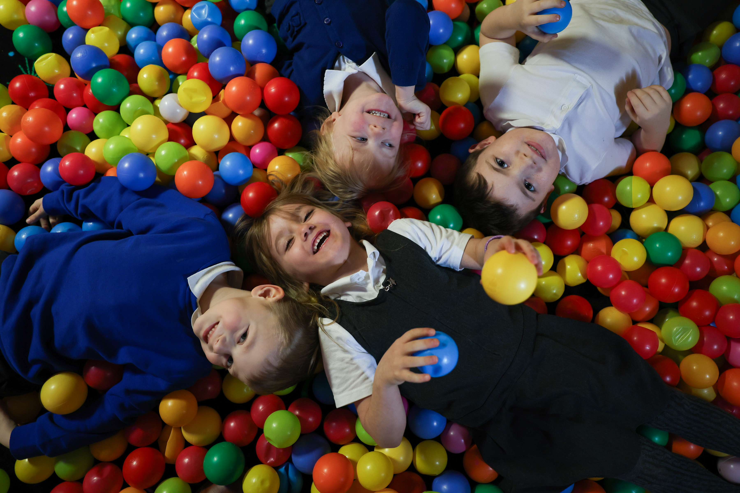
CURRICULUM & CULTURE
St. Mary’s Primary School
‘Called by God’
Notes:
FINISHED – VC 20/02/24

Slide 2
CONTENTS
SECTION
WELCOME
SAFEGUARDING CULTURE
ATTENDANCE CULTURE
BEHAVIOUR AND ATTITUDES CULTURE
OUR CURRICULUM VISION
CURRICULUM IMPLEMENTATION
CURRICULUM IMPACT
TEACHING AND LEARNING
ADAPTIVE TEACHING
CURRICULUM AND ASSESSMENT
QUALITY ASSURANCE
TIMETABLING
TERMLY PLANNING
READING, WRITING AND COMMUNICATION
MATHEMATICS AND NUMERACY
EARLY YEARS
MIXED YEARGROUP TEACHING
DEFINITION OF TERMS
WORKLOAD
ARTIFICIAL INTELLIGENCE(AI)
APPENDICES
‘Called by God’
‘Called by God’

Slide 3
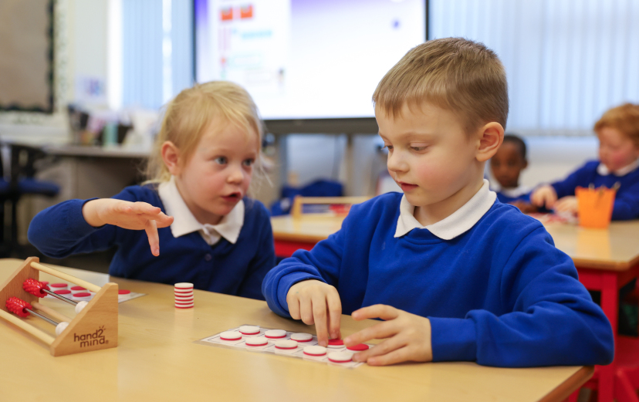
WELCOME
St. Mary's is a community where all are provided with the opportunity to achieve their full potential in a way that is rooted firmly in the values of the Gospel.
Our Catholic ethos and support for one another as a family of schools drives all that we do. Our mission is guided by a collective culture and vision where:
‘Our schools are places of excellence – providing service and witness to children, their families, and
the wider Catholic community. By adding value as a family of schools, we will enrich the learning and
experience of all our young people so they may achieve their full potential.’
“Catholic schools evangelise culture because they address the deepest questions about what it is to be human and live in society. They open pupils’ minds to the transcendent dimension of life and the reality of God revealed in Jesus Christ. The Catholic school enables each child to develop their God-given gifts in order to engage in building a better society
which is characterised by justice, truth and love.”
Hexham and Newcastle Diocese Education
The purpose of this booklet is to provide clarity on our shared position, useful documents to use and adapt. It is based upon recent and relevant research.
‘Called by God’
Notes:
FINISHED – VC 20/02/24

Slide 4
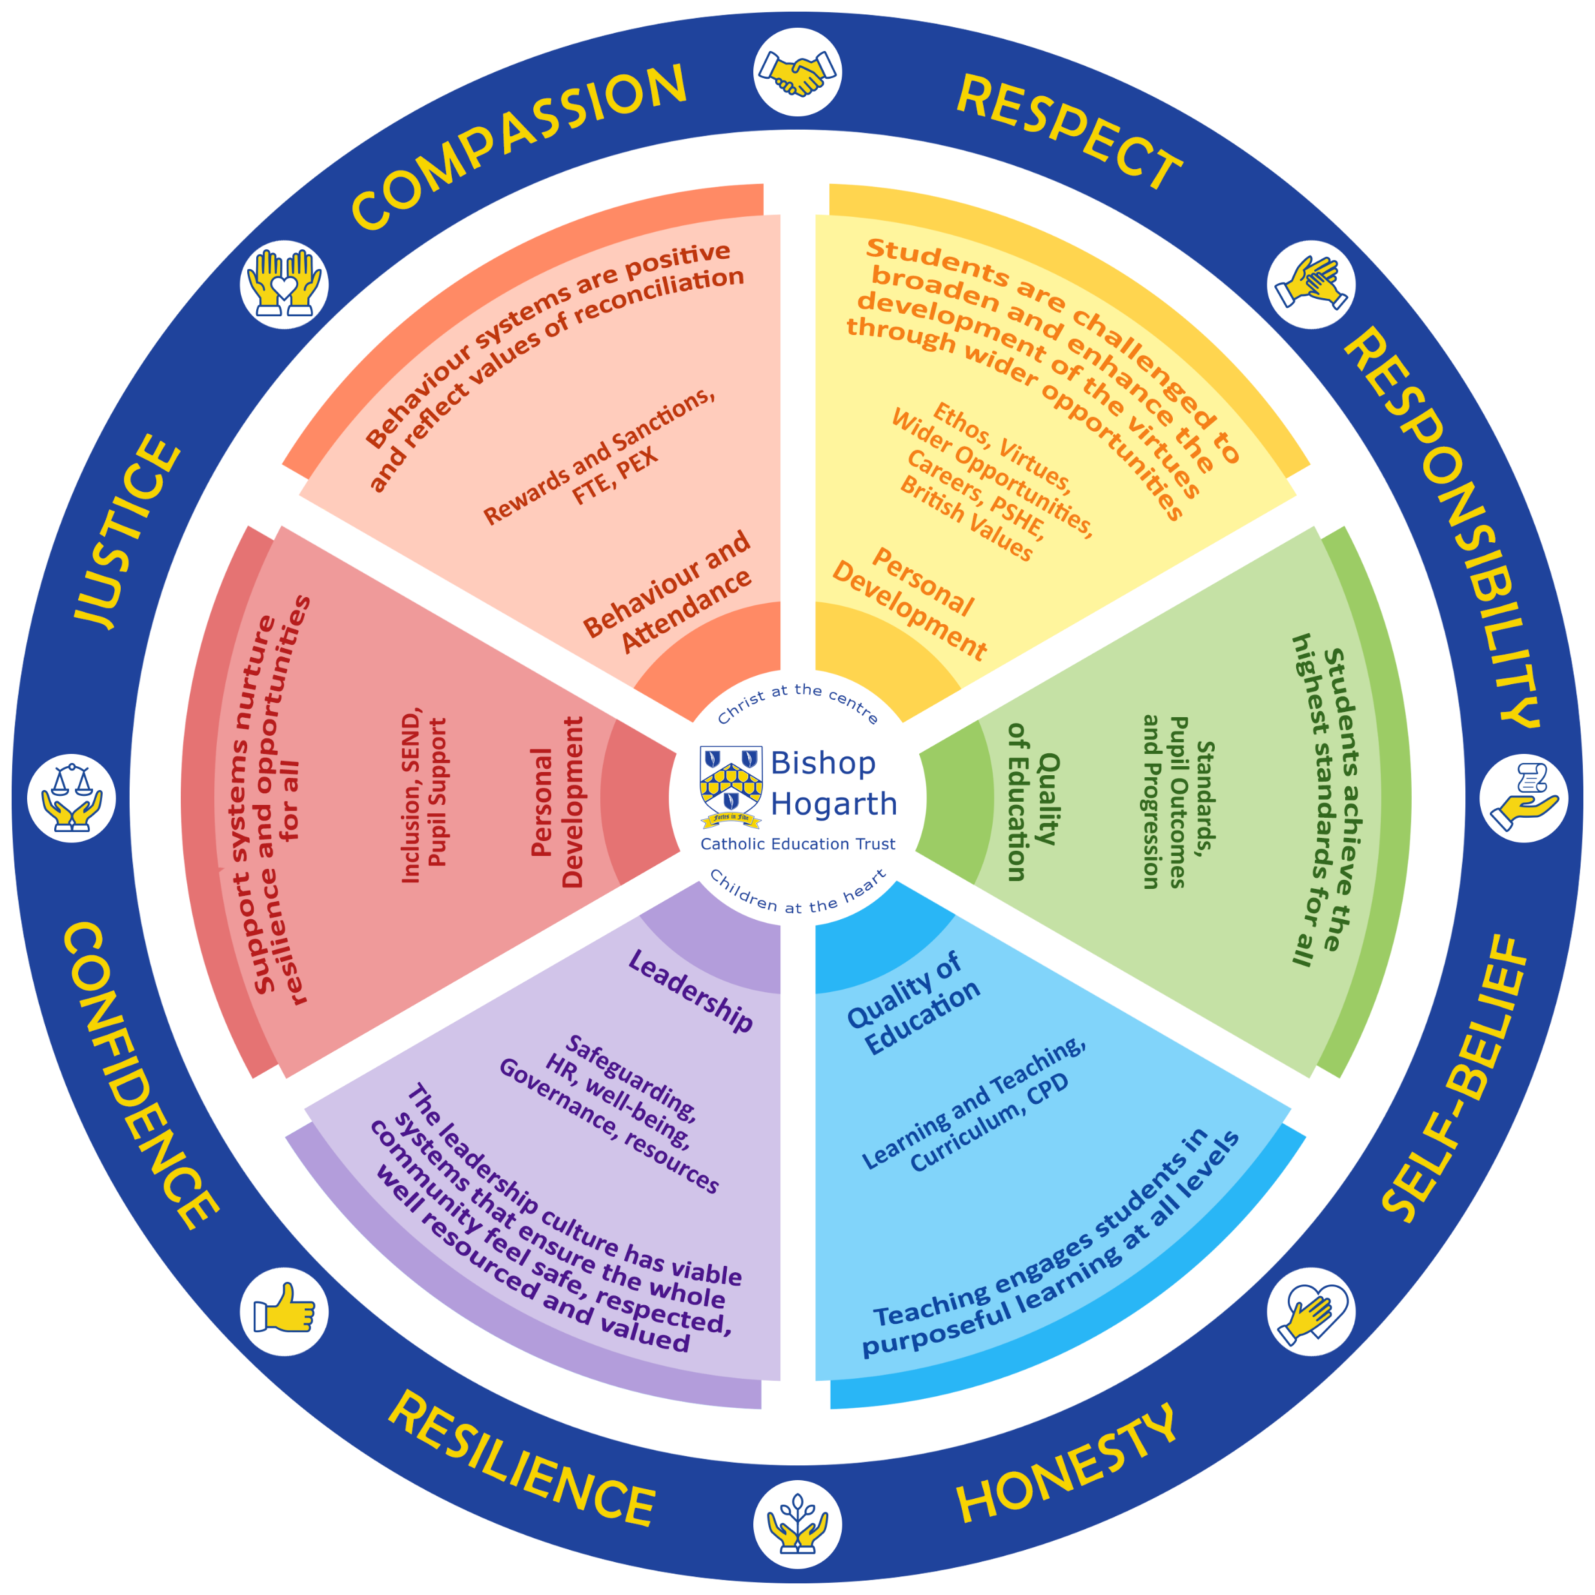
TRUST VIRTUES
We are committed to providing culture, opportunities, and high-quality experiences to our students. We develop their character by modelling, teaching and shaping the Virtues of:
• Justice and Compassion
• Honesty and Responsibility
• Respect and Self belief
• Confidence and Resilience
Through the principles of Virtue Theory, our students will nurture and develop these balanced virtues as a ‘golden mean.’ Through their interactions and experiences with staff, their peers, and the wider community, they will exercise and develop the Virtues to positively contribute to society and live a happy and fulfilled life.
“I came so that they may have life and have it to the full”
Jn 10:10
In all that we do, we are guided by our faith, committed to cultivating compassionate individuals who will make a positive impact on the world around them.
‘Called by God’
Notes:
FINISHED – VC 20/02/24

Slide 5
SAFEGUARDING CULTURE
It could happen here…
St. Mary’s will:
Be a safe environment for all
Keep one fully up to date Single Central Record (SCR)
Clearly publicise DSL/DDSL and all key contacts
Act in the best interests of the child, always
Have fully trained DSL and DDSLs
Have a nominated governor for safeguarding
Induct all new members of staff in safeguarding procedures
Ensure safer recruitment procedures are followed
Respond to the Trust online filtering and monitoring system ‘Lightspeed’
Trust Expectations at school level. Annually, leaders will ensure they:
Have a safeguarding policy – ratified by Governors by the first full week in September
Publish a safeguarding plan
Ensure DBS declaration is completed by all and quality assured by leaders
Complete the Safeguarding Audit – moderated by external consultants
All staff/governors undertake KCSIE training
Staff will:
Adhere to the Safeguarding Policy
Know who the DSL/DDSLs are in the school they are working in
Listen to and take seriously disclosures or information that a child may be at risk
What staff should do if they have a concern about a child/ risk of harm?
Clarify the information with open questions
Record only what the pupil says
Explain that we cannot keep secrets
Reassure they will be taken seriously
Listen to the child’s wishes/feelings
Explain what will happen next
Reassure those who ‘need to know’ will be told
Ensure referrals are made to the DSLs
Record the incident in accordance with policy
Concerns about staff:
If about a member of staff refer to HT
If about the HT, refer to the CEO
If about the CEO, refer to Chair of Directors
Trust Safeguarding Lead
Trust Expectations at School Improvement level:
Report to Governors and Directors with an accurate view of safeguarding
Work with individual schools where safeguarding support is needed
SAFEGUARDING IS EVERYONE’S RESPONSIBILITY
‘Called by God’
Notes:
FINISHED – VC 20/02/24
Culture (need to add in a vision for Culture) - Pastoral Behaviour Guiding Principles
Add in page for Attendance Add in page for Safeguarding Add in page for Wider Opportunities/Enrichment

Slide 6
ATTENDANCE CULTURE
Trust Expectations at School Level:
Dedicated senior leader with clearly assigned responsibilities for attendance.
Attendance evaluation to be a weekly SLT agenda item.
Pupils are prioritised for first day calls (vulnerable groups for attendance).
Weekly reports to staff across the school from attendance leaders.
Consistently reward and incentivise attendance.
Prompt action with parents where attendance is below expectations.
Stepped/ personalised approach to communication with parents.
Attendance leads monitor the impact of attendance interventions.
Forensic analysis of data to identify and act on trends and patterns.
Engage with external agencies where safeguarding or other concerns.
“Tenacity is very important ... It’s about parents knowing that we are not going to let go.”
- DfE May 2022 Improving School Attendance
Impact
Pupils have high attendance. They come to school on time and are punctual to lessons. When this is not the case, the school takes appropriate, swift and effective action.
School Expectations from Trust:
Whole Trust data analysis.
Report to Governors and Directors with accurate view of school attendance.
Work with individual schools where attendance is highlighted as low.
Media teams will highlight attendance on social media.
We listen, understand, empathise and support but we do not tolerate.
‘Called by God’
Notes:
FINISHED – VC 20/02/24

Slide 7
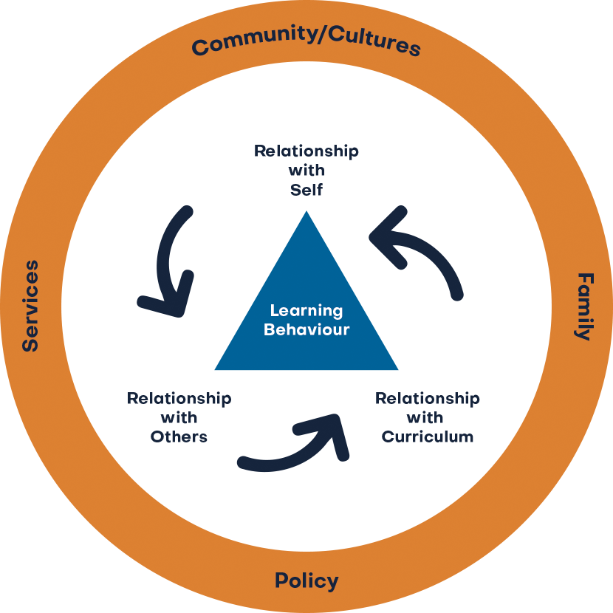
BEHAVIOUR AND
ATTITUDES CULTURE
At St. Mary's Primary School, pupils and staff flourish in an environment where they feel safe, valued, and respected. We maintain high expectations and are dedicated to fostering a positive approach to behaviour. We believe that positive praise, recognition, and restorative practices are far more effective than disciplinary measures. Behaviour in our school is intrinsically linked to academic achievement, safety, welfare, and overall well-being.
We have a behaviour culture that that frames behaviour in terms of three relationships:
Relationship with self
Relationship with others
Relationship with curriculum
Through our behaviour culture, we:
Empower our pupils to take responsibility for their actions
Foster mutual respect, clear expectations, and consistent consequences.
Encourage positive relationships for learning.
Create a foundation for effective teaching.
Nurture a supportive and positive relationship with the curriculum.
Encourage pupils to engage and find meaning in their learning.
Our school rules are as follows: Be Ready, Be Responsible, and Be Respectful. These principles are closely aligned with our mission statement and are even incorporated into our school song.
St. Mary’s has:
A Christ centred approach that ensures a calm, safe and supportive environment for all.
A culture that is free from fear, discrimination, and bullying, where all know they belong.
The highest expectations of pupil behaviour to ensure all excel.
A no tolerance approach to all bullying, where pupils accept responsibility for their actions.
An active partnership with families to encourage a shared approach to excellent behaviour.
A curriculum to develop excellent learning habits to be successful.
Independent pupils with high self-esteem.
A culture focused on attaining excellence.
Positive relationships to make all feel welcome.
‘Called by God’
Notes:
FINISHED – VC 20/02/24

Slide 8
BEHAVIOUR AND
ATTITUDES CULTURE
Implementation
Our strategies are designed to prevent undesirable behaviour.
Good relationships mean pupils want to behave.
We encourage simple, approaches and expect pupils to be known individually.
We recognise the importance of consistency and coherence when managing behaviour.
We establish the rationale for implementing behaviour strategies, then ensure it is embedded.
For pupils who find regulation difficult, we use personalised approaches.
Staff are trained in specific strategies for dealing with pupils with high behaviour needs.
Our curriculum teaches the importance of behaviour for learning.
Pupils' self-perception and confidence influences their ability to navigate challenges.
We foster a collaborative atmosphere which promotes collective learning.
Peer interactions are encouraged to influence behaviour and attitude towards learning.
Teamwork and mutual support enhance the social fabric of the classroom.
Our curriculum is adapted which will lead to the experience of success for all.
By cultivating a positive curriculum, we create an environment where behaviour for learning thrives.
Improvements to behaviour will be evidenced in pupil voice, staff voice, behaviour incidents recorded and parent feedback.
Leaders in school are expected to analyse behaviour termly to inform further actions.
Impact
We will establish a culture where relationships impact positively on behaviour for learning and attitudes.
Leaders and staff will have created a safe, calm, orderly and positive environment.
Behaviour will be exceptional because positive attitudes to learning are strong.
Pupils feel safe from bullying. If it takes place, it is dealt with quickly, consistently, effectively.
Pupils are ready to succeed in their next phase of their journey.
‘Called by God’
Notes:
FINISHED – VC 20/02/24

Slide 9
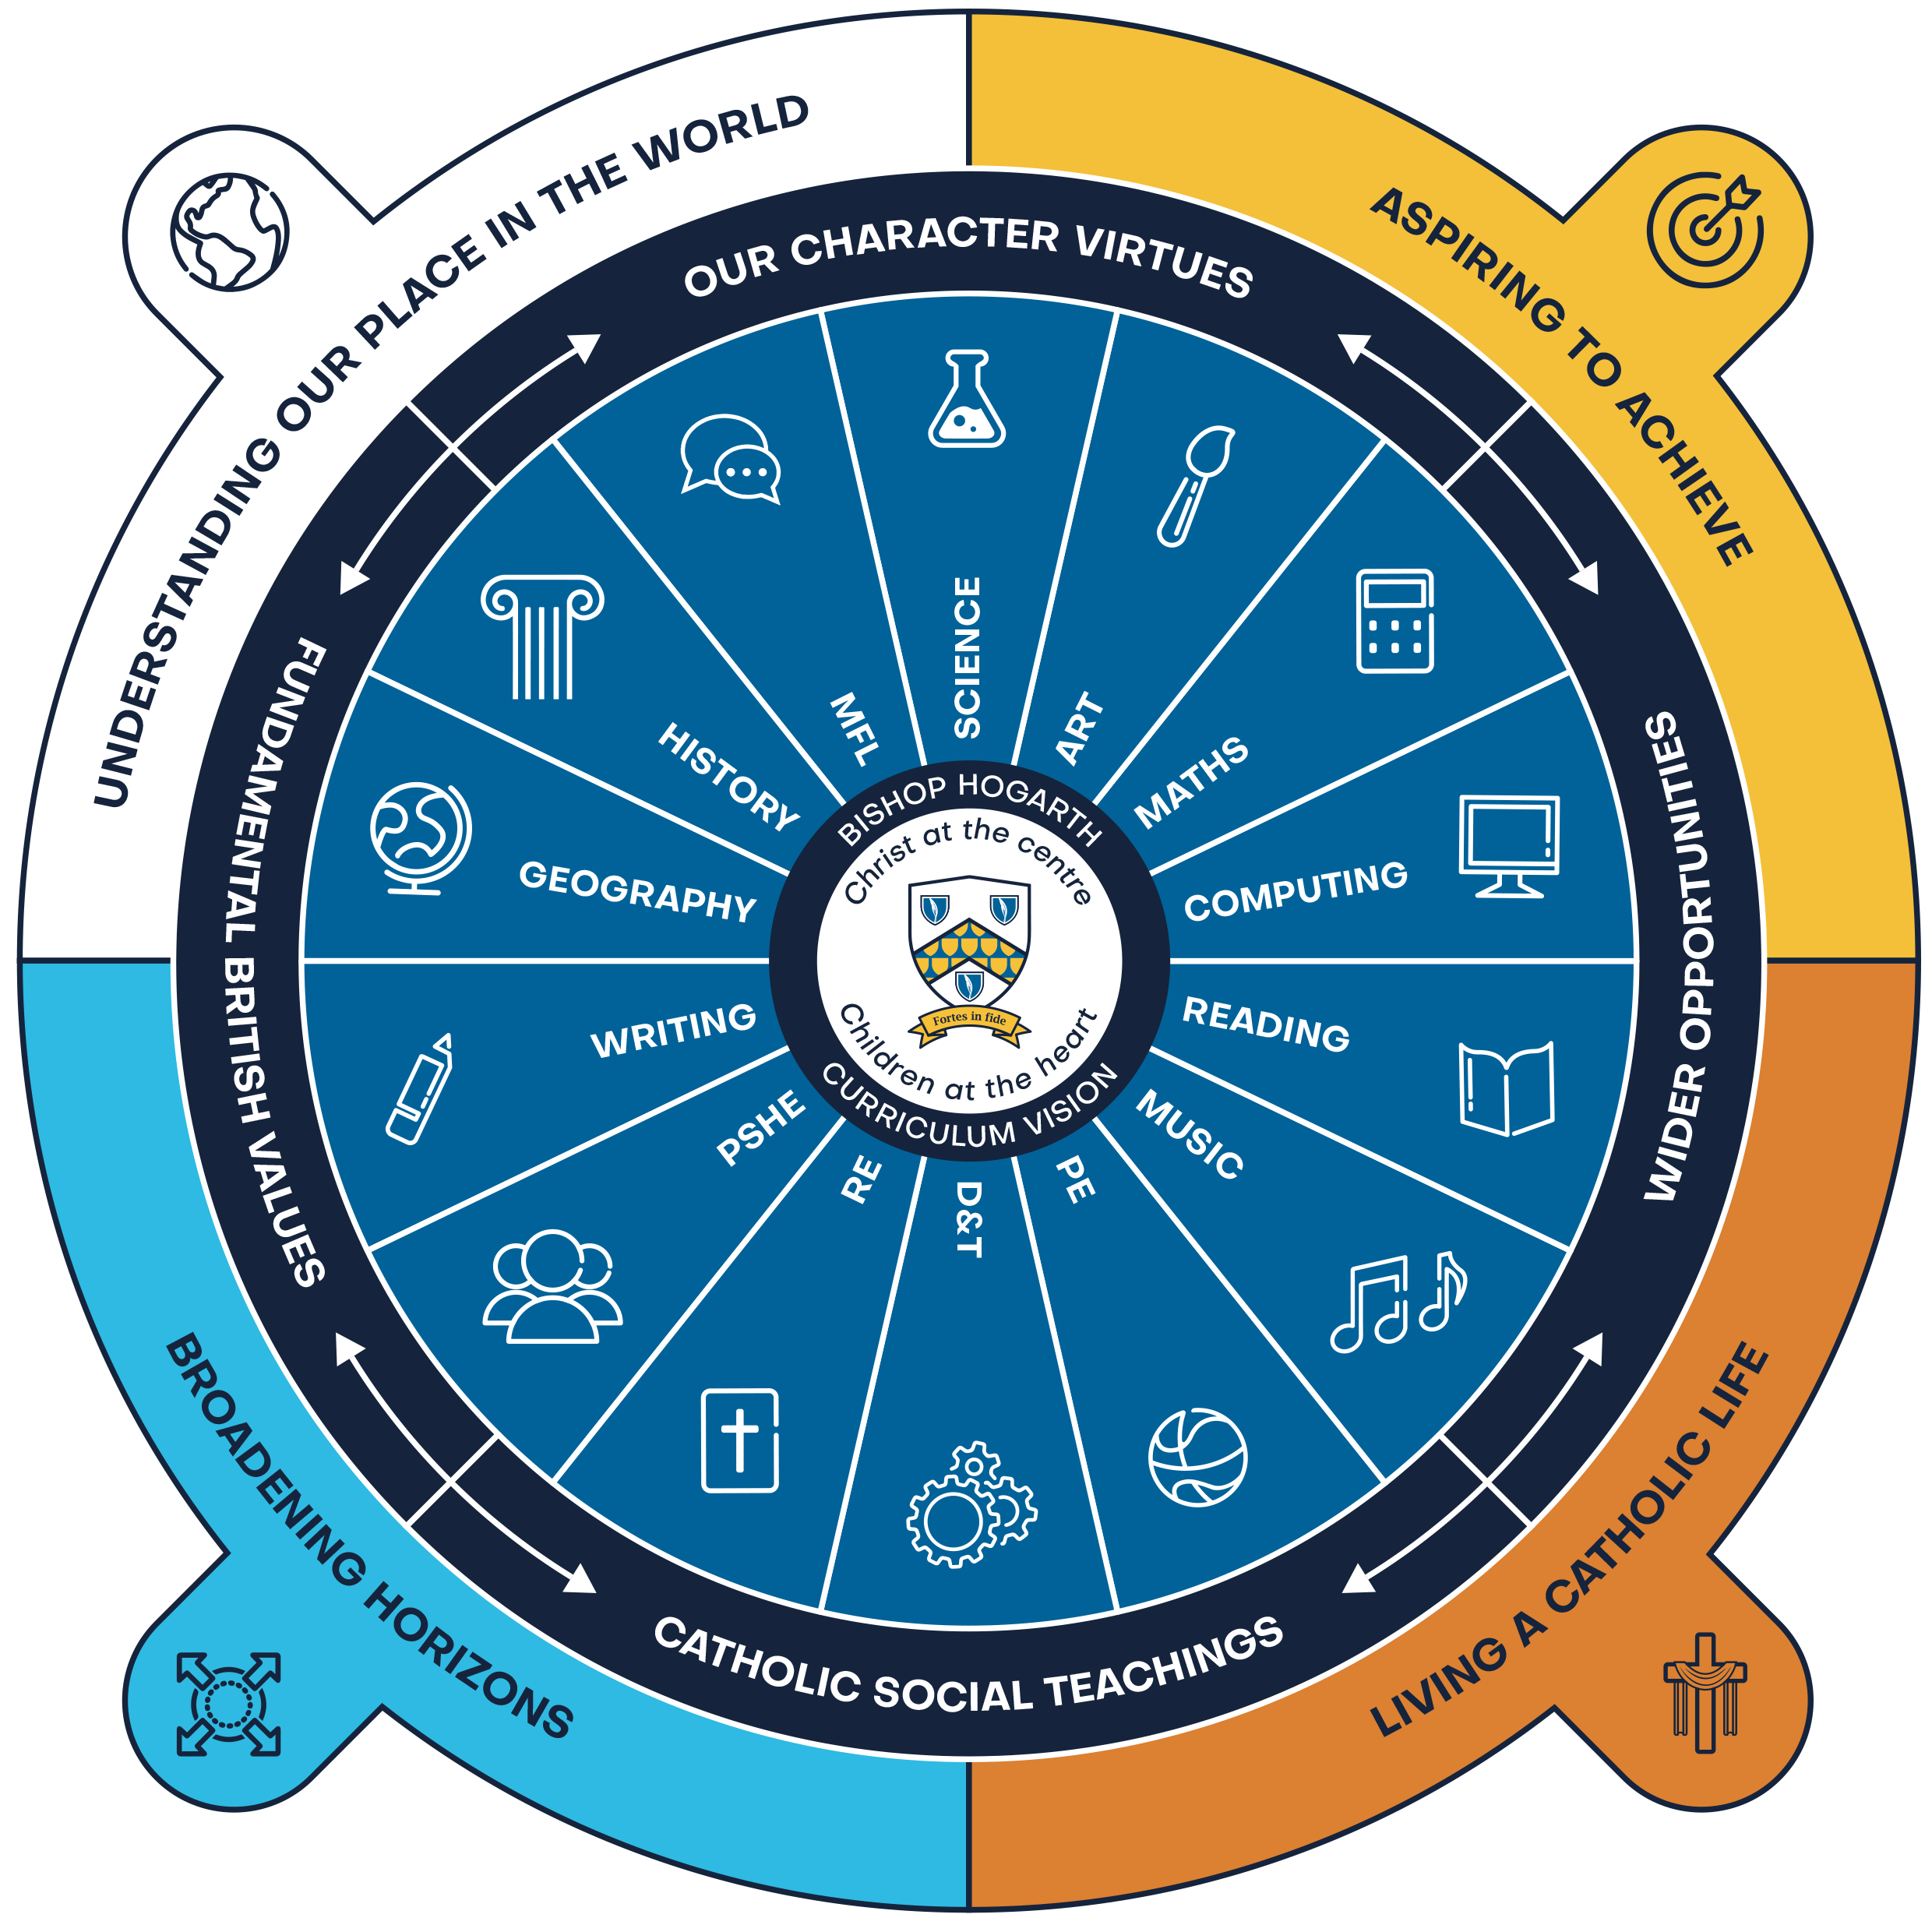
CURRICULUM VISION
‘Success through Connected Experiences’
St. Mary's Primary School, as part of Bishop Hogarth Catholic Education Trust (BHCET), provides an education firmly rooted in the values of the Gospel. Our school has uniquely adapted the Trust's curriculum to meet the specific needs and aspirations of our children. At St. Mary's, we are committed to delivering a purposeful, progressive, and inclusive curriculum with Christ at the Centre and Children at the Heart. We celebrate the diversity of experience, need, interest, and achievement among our pupils, tailoring our approach to support every child's growth.
Our curriculum not only embraces our local heritage but also enhances our pupils' understanding of the communities in which they live. It is designed to fully prepare them for the next steps in their learning journey, while also opening doors to the wider world as life-long learners.
Through these adaptations, St. Mary's ensures that each child can achieve their full potential in a supportive and nurturing environment, reflective of the distinct character and needs of our school community.
Called by God’
Notes:
FINISHED – VC 20/02/24

Slide 10
CURRICULUM VISION
Our curriculum at St. Mary's in Newton Aycliffe has been thoughtfully adapted to ensure that children achieve 'success through connected experiences' and reflects the needs of our community. By integrating interdisciplinary learning, we create a cohesive educational journey where subjects are interwoven, allowing students to see the relevance and application of their knowledge in real-world contexts. This approach fosters critical thinking, creativity, and collaboration, as students engage in projects that connect various domains of learning. Additionally, we emphasize experiential learning opportunities, such as field trips, community projects, and hands-on activities, which enrich the curriculum and provide meaningful, practical experiences. Through these connected experiences, our students develop a deeper understanding and a lifelong love for learning, equipping them with the skills and confidence to succeed in an ever-evolving world.
Called by God’
Notes:
FINISHED – VC 20/02/24

Slide 11
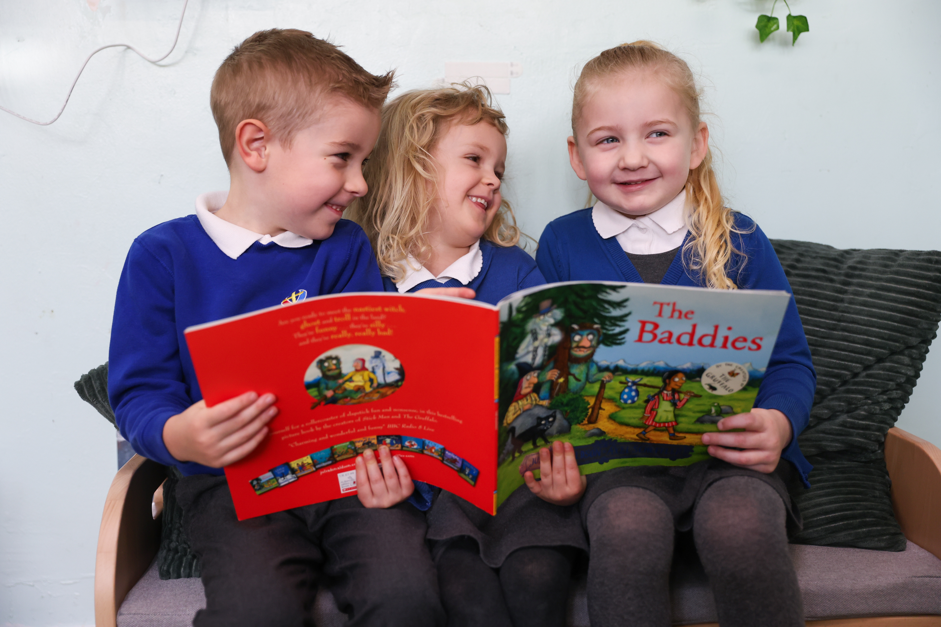
CURRICULUM VISION
“The Curriculum is not just one of the many things that Head teachers have responsibility for – it defines the purposes of a school and the journey leaders want its pupils to take.”
- Michael Young
UNDERSTANDING OUR PLACE IN THE WORLD
ASPIRING TO ACHIEVE
BROADENING HORIZONS
LIVING A CATHOLIC LIFE
At St. Mary's Primary School, our curriculum drivers are the foundation of everything we do. These principles are interwoven throughout our educational approach and reflect our shared belief in nurturing every child's understanding of their role as a global citizen. We are dedicated to fostering aspirations for achievement, broadening horizons, and promoting the Gospel of life through Catholic Social Teaching. Our aim is to provide an education that not only prepares children for academic success but also instills values that will guide them throughout their lives.
Called by God’
Notes:
FINISHED – VC 20/02/24

Slide 12
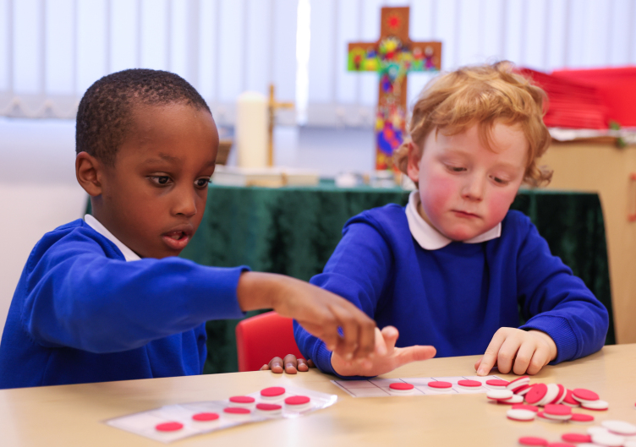
CURRICULUM VISION
‘Success through connected experiences’
Our curriculum is carefully planned and designed to provide academic, spiritual, social, and cultural, opportunities for all to develop their character through a focus on virtues and Catholic Social Teaching.
HUMAN DIGNITY
SOLIDARITY
SUBSIDIARITY
RIGHTS & RESPONSIBILITIES
PEACE
OPTION FOR THE POOR
COMMON GOOD
PARTICIPATION
STEWARDSHIP
Called by God’
Notes:
FINISHED – VC 20/02/24

Slide 13
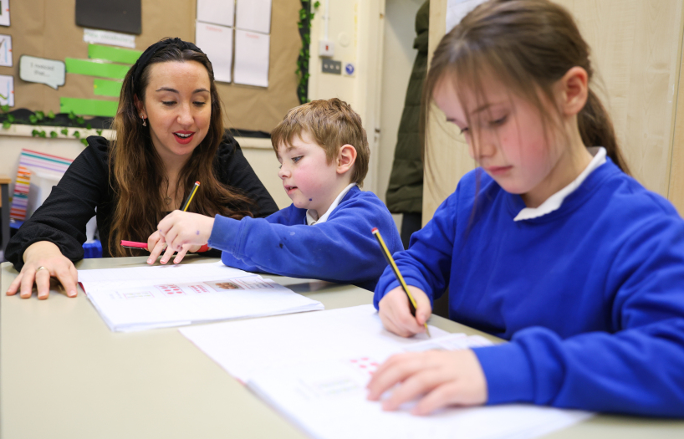
CURRICULUM VISION
‘Success through connected Experiences’
The virtues of respect and responsibility, justice and compassion, confidence and resilience, honesty and self-belief, run through our curriculum and are designed to help pupils develop their sense of self and be ready to move with confidence onto their next chapter.
COMPASSION
CONFIDENCE
HONESTY
JUSTICE
RESILIENCE
RESPECT
RESPONSIBILITY
SELF-BELIEF
Called by God’
Notes:
FINISHED – VC 20/02/24

Slide 14
CURRICULUM VISION- GOLDEN THREADS
‘Success through connected Experiences’
At St. Mary's, 'Gender and Culture' are now considered a "golden thread" woven through our history curriculum to ensure that students gain a more comprehensive and inclusive understanding of the past. This focus is particularly important in Newton Aycliffe, an area of high deprivation where children may have limited opportunities to explore diverse historical perspectives. By integrating gender and cultural narratives, we aim to break down stereotypes, promote equality, and highlight the contributions of all groups throughout history, not just the dominant or traditional ones. This approach helps students see themselves in the broader context of history, raising their aspirations and challenging the limiting beliefs they may face. It encourages critical thinking, empathy, and a sense of empowerment, enabling students to envision a future where they can make a positive impact, regardless of their background or gender.
At St. Mary's Primary School, careers education is one of the 'golden threads' seamlessly woven throughout our curriculum. From an early age, pupils are introduced to a variety of career paths through rich experiences and interactions with professionals from diverse fields. By meeting and learning from people in different professions, our pupils develop a broad understanding of the world of work and the various opportunities available to them. This approach not only inspires their aspirations but also equips them with the knowledge and skills needed to pursue their future goals with confidence.
Called by God’

Slide 15
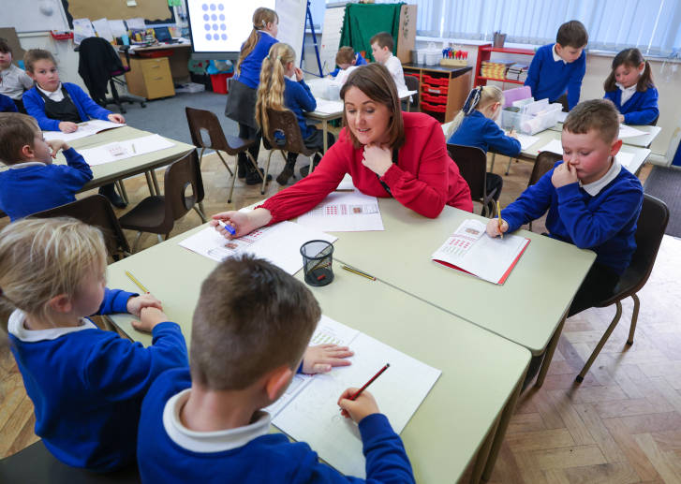
CURRICULUM VISION
‘Success through connected Experiences’
Individual subject disciplines are taught explicitly with coherent links created.
Our curriculum is sequenced to ensure that knowledge is cumulative.
At St. Mary's Primary School, substantive and disciplinary knowledge forms the core of each subject. We deliberately connect related areas of study to consolidate and embed learning, ensuring that mental models develop over time. We take pride in our evidence-informed practice and our commitment to the highest quality professional development. Recognizing that memory is central to learning, we strategically plan opportunities for pupils to recall and remember their knowledge. This approach strengthens their memories, allowing them to confidently draw on prior learning and make meaningful connections as they build on their knowledge. By fostering a robust understanding and recall of essential knowledge, we empower our pupils to achieve their full potential.
Called by God’
Notes:
FINISHED – VC 20/02/24

Slide 16
CURRICULUM VISION
“In a democratic society which prizes equality of opportunity, the curriculum should be based on the knowledge we consider all young people should have the access to and begin to acquire during their earliest years.”
- Mary Myatt
Our curriculum at St. Mary's Primary School is purposeful and responsive, designed to achieve several key aims:
Create a positive and supportive environment for all pupils without exception: We ensure every student feels safe, valued, and encouraged to reach their potential.
- Build an ongoing, holistic understanding of our pupils and their needs: We develop a comprehensive view of each child's unique strengths and areas for growth.
- Ensure all have access to high-quality teaching and all areas of the curriculum: Every pupil receives exceptional instruction across all subjects.
- Establish fundamental skills: From EYFS onwards, we rigorously develop reading, writing, oracy, listening, and numeracy skills, challenging all pupils academically.
- Expose pupils to the richness of the English language: We enable them to experience the pleasure of reading, the excitement of writing, and the joy of exploring new concepts.
- Adopt a metacognitive approach to learning: We aim to reduce cognitive load and provide opportunities across the curriculum for debate and critical thinking.
By focusing on these aims, our curriculum not only meets the diverse needs of our pupils but also prepares them for lifelong learning and success.
Called by God’
Notes:
FINISHED – VC 20/02/24

Slide 17
CURRICULUM IMPLEMENTATION
‘Success through connected Experiences’
Carefully sequenced progression documents clearly outline the knowledge and skills developed in each subject area of study. Dedicated time for revisiting key knowledge is carved into each lesson and planning builds in time to recap previous learning to then build on knowledge and understanding in new, related areas of study. Careful consideration has been given to the amount of time each subject is taught.
We value the power of authentic experience; learning is brought to life. We have built into our sequence of learning, curriculum continuity learning and peer networks with our secondary schools. These opportunities enable our pupils to achieve successful transition. Trips, excursions and in-school events, are carefully mapped to ensure a balance of coastal, urban and rural experiences.
We have outlined fundamental guiding principles, which are implemented to ensure consistency of approach. At the heart of our collective teaching pedagogy lies evidence-informed practice. We value Rosenshein’s Principles of Instruction, and these can be seen in practice throughout our curriculum.
“It doesn’t matter how great an educational idea or intervention is in principle; what really matters is how it manifests itself in the day-to-day work of people in schools.”
- Sir Kevan Collins
Called by God’
Notes:
FINISHED – VC 20/02/24

Slide 18
TEACHING AND LEARNING
Presentation & Handwriting
High expectations need to be maintained including the use of cursive writing. Where necessary, there needs to be opportunities to practice and develop fluency and speed writing in pen when they have demonstrated proficiency. Correct spelling, punctuation, and good grammar will be expected and corrected using the marking criteria. All work should be dated, titled and underlined.
Learning Environment
All spaces are kept safe, clean and ready for pupils to excel; arranged to promote learning through:
Seating layout that allows everyone to see the board and participate
Accessible resources for learning such as books, pens, pencils, rulers, manipulatives
Comfortable, well-resourced reading areas
Displays that celebrate and support pupils’ learning
Sacred prayer space
Homework
Homework must be purposeful, relevant, and designed to support learning. It should be carefully planned to consolidate understandings positively, and not overly burden pupils.
Common homework activities are reading, practice in spellings and number facts. Other effective strategies include extended activities to develop inquiry skills. The quality of the tasks is more important than the quantity of work required. Homework must relate closely to learning during school time.
Marking and Feedback
Timely and constructive feedback in the learning process is crucial. Feedback practices that are specific and actionable contribute significantly to a pupil's overall success. The primary purpose of marking and feedback is to enhance learning and progress by providing constructive guidance. Fidelity through consistent and effective practices across all phases is essential. Summative pieces of work will be marked promptly, allowing pupils to reflect on feedback and apply it to future assignments.
Formative and summative assessments will be used to evaluate pupil progress. Formative assessments provide ongoing feedback, while summative assessments measure overall achievement. A balanced approach ensures a comprehensive understanding of pupil performance. In summative pieces of work teachers will highlight strengths, identify areas for improvement, and suggest strategies for enhancement. Comments will be clear and encouraging, fostering a positive learning environment.
“The highest effects are associated with rote learning, practice or rehearsal of subject matter.”
-Tom Sherrington and John Hattie
Called by God’
Notes:
FINISHED – VC 20/02/24

Slide 19
ADAPTIVE TEACHING
EEF’s Five-a-Day principles:
At St. Mary's Primary School, our curriculum is designed to be delivered to the whole class. However, class teachers adapt tasks to meet the needs of individual children. To ensure pupils with SEND achieve well, they are exposed to the same learning as their peers, with adaptations in the way they evidence their learning.
Through scaffolding, tasks are adjusted so all pupils can access and demonstrate the same threshold concepts and learning objectives as their non-SEND counterparts. Scaffolding strategies include providing sentence starters, writing frames, vocabulary banks, sorting and matching cards, or visual prompts.
Both reactive and proactive adaptations make our curriculum accessible and achievable for all. By responding to pupils' needs and strengths, we ensure that every child can reach the ambitious curriculum end points, ultimately knowing more and remembering more.
Scaffolding
A metaphor for temporary support that is removed when it is no longer required. This requires effective assessment to gain a precise understanding of the pupil’s current capabilities.
Examples: support can be visual, verbal, or written; writing frames, partially completed examples, knowledge organisers, sentence starters; reminders of what equipment is needed and classroom routines. Scaffolding discussion: promoting prediction, questioning, clarification and summarising.
Use of Technology
Can assist teacher modelling. Technology, as a method to provide feedback to pupils and/ or parents can be effective, especially when the pupil can act on this feedback.
Examples: use a visualizer to model worked examples. Technology applications, such as online quizzes; speech generating apps to enable note-taking and extended writing can be helpful.
Cognitive and Metacognitive Strategies
Skills like memorisation techniques or subject specific strategies like methods to solve problems in maths. Metacognitive strategies help pupils plan, monitor and evaluate their learning
Examples: chunking the task will support pupils with additional needs – this may be through provision of checklists, instructions on a whiteboard or providing one question at a time. This helps reduce distractions to avoid overloading working memory. Prompt sheets that help pupils to evaluate their progress, with ideas for further support.
Explicit Instruction
A range of teacher-led approaches, focused on teacher demonstration followed by guided then independent practice, for example, Rosenshine’s ‘Principles of Instruction’.
Examples: worked examples with the teacher modelling self-regulation and thought processes is helpful; a teacher might teach a strategy for summarising a paragraph by initially ‘thinking aloud’ while identifying the topic of the paragraph to model this process to the pupil. They would then give the pupil the opportunity to practise this skill; using visual aids and concrete examples promotes discussion and links in learning.
Flexible Grouping
When pupils are allocated to smaller groups based on individual needs that they currently share with others. Such groups are formed for an explicit purpose/disbanded when that purpose is met
Examples: allocating temporary groups can allow teachers to set up opportunities for collaborative learning, for example to read and analyse source texts, complete graphic organisers, independently carry out a skill, remember a fact, or understand a concept. Pre-teaching key vocabulary, is a useful technique.
Called by God’
Notes:
FINISHED – VC 20/02/24

Slide 20
CURRICULUM & ASSESSMENT
We consider the greatest impact of the curriculum to be high rates of pupil achievement as evidenced by pupils’ classroom work, their ability to articulate their learning, balanced with performance data.
Our Curriculum Aims To Develop And Instil In Pupils:
Values, motivation, aspirations, and the moral imperatives in line with Gospel values and Catholic Social Teaching that inform their choices and actions.
The development of knowledge; progress in knowing more and remembering more.
The ability to apply; progress in knowledge applied in more challenging, relevant, and engaging ways, evidenced through pupils’ classroom work.
The acquisition of 21st century skills to translate knowledge into actions for success.
An understanding of how well they are doing and what they have to do to improve.
A love of reading for pleasure and the ability to read well.
Knowledge of, and the confidence to, articulate their learning.
Readiness and motivation to succeed in their next phase of learning.
The ability to write confidently in all subjects for a range of audiences, drawing upon a range of high-quality texts.
Monitoring Progress:
Formative Assessment:
All formative assessment must inform planning and ensure adaptive teaching. Assessment must provide a measure of where pupils are in their learning, their knowledge and skill gaps, and provide detailed feedback to pupils on how to close those gaps. Feedback must cause thinking. A grade or score should not be provided to the pupil.
Summative Assessment:
Summative assessments must be graded using examination board / DfE objectives and grade criteria. In primary schools, this includes standardised testing against age related outcomes.
Data will be collected at 3 key points across the academic year as agreed at whole Trust level.
In the secondary phase of education, KS2 scaled scores in Maths, English Reading, Writing and Grammar will be used to determine pupils’ KS4 aspirational targets.
Called by God’
Notes:
FINISHED – VC 20/02/24
Finished

Slide 21
QUALITY ASSURANCE Summary
We are committed to continuous improvement inspired by the best evidence.
We expect leaders have a consistent approach to the quality assurance so they set appropriate, actionable feedback to ensure quality outcomes for all pupils.
Great teaching is the most important lever to improve pupil attainment. Ensuring all staff are supported to deliver great teaching is essential to achieving the best outcomes, particularly the disadvantaged, EEF
Quality Assurance activities
Curriculum planning adapted to meet individual needs
Attainment and progress data analysis
Pupil voice
Work sampling
Lesson visits
“True intuitive expertise is learned from prolonged experience with good feedback.”
- Daniel Kahneman
To evaluate teaching and inform professional development.
PROFESSIONAL DEVELOPMENT
Staff are entitled to be celebrated and have areas for development clearly identified, then be provided with access to relevant exceptional professional development.
A professional development programme that will provide opportunities for staff to participate in a variety of learning opportunities building whole school and Trust capacity.
Calendared quality assurance opportunities; two each term. Once per term it will include five key activities, one to four visited a second time each term.
An additional strand to quality assurance process is moderation involving all staff, it is focused on professional development. It takes place at a school and Trust level. The process is designed to allow staff a voice in sharing opinions on pupil work from across the curriculum.
“Professional learning happens when we think hard about our practice
and take full ownership of it.”
- Dr Tristian Stobie
Called by God’
Notes:
FINISHED – VC 20/02/24

Slide 22
READING, WRITING & COMMUNICATION SUMMARY
Reading is one of the most vital life skills we cultivate at St. Mary's Primary School. It enables us to access, understand, and apply information. Through reading, both spoken and silent, we develop our communication, writing, and presentation skills. It also expands our imagination and creative thinking.
Reading teaches us how to listen and be empathetic, improving our overall well-being. Teaching children to read is fundamental to their educational achievement. We are committed to ensuring that disadvantaged pupils have the same sense of entitlement and opportunity to read for both academic purposes and pleasure, just like their peers.
At St. Mary's, we recognize the profound impact reading has on a child's development and future success, and we strive to foster a love of reading in all our pupils.
“I read a book one day and my whole life was changed.”
- Orhan Pamck
We will develop academic excellence in our school through:
A love of reading for pleasure, with a rigorous approach to develop confidence and enjoyment of literacy.
A language-rich environment, in relation to the different tiers of vocabulary.
All staff to confidently model excellent habits in reading, writing and communication.
A highly targeted support programme for pupils who have gaps in reading, writing and communication.
Access to high quality stimulating and challenging reading materials for pupils.
Regular opportunities to develop writing across the sequenced curriculum, linked to quality books.
Seamless transition between key phases.
Pupils encouraged to reason, discuss, debate and present with increasing skill using varied and precise vocabulary.
Reading materials closely matched to learners’ knowledge and skills, ensuring sequential development and stretch.
“Fluent reading supports comprehension because pupils’ cognitive resources are freed from focusing on word recognition and can be redirected towards comprehending the text.”
- EEF
Reading and writing are combined. Reading helps pupils gain knowledge, developing comprehension and fluency which leads to better writing. Writing opportunities are provided in all subjects to deepen pupils’ understanding.
Called by God
Notes:
FINISHED – VC 21/02/24

Slide 23
READING, WRITING & COMMUNICATION SUMMARY
Learning to read is a highly complex undertaking that is underpinned by two fundamental processes:
Word reading through the decoding of words and recognition of words.
Comprehension of texts through a range of knowledge and skills.
It is the skilled combination of these two dimensions that facilitates all reading success (EEF).
“Reading, writing, vocabulary, speaking, listening, debate…the complex tapestry of great teaching, enacted in every lesson, in every phase and subject domain, by every teacher.”
- Alex Quigley
Teachers strive daily to secure pupils’ understanding of language comprehension and word recognition by:
Adhering to our reading pledge
Having a highly considered reading spine which aligns to the curriculum
Frequent (Tier 2) and complex (Tier 3) vocabulary is prioritised across the taught curriculum
Pupils are given opportunities to apply this vocabulary in writing, in all subjects.
Explicit and systematic teaching of phonics through a DfE validated programme (Sounds Write)
Daily phonics sessions (EYFS/KS1), pupils who require phonics intervention to enable them to keep up.
Spelling, grammar and punctuation are taught explicitly to improve reading, writing and oracy.
Parents are encouraged to help their children become confident, fluent readers and writers.
“Books expose children to more facts and to a broader vocabulary than virtually any other activity; people who read for pleasure enjoy cognitive benefits throughout their lifetime.”
- Daniel Willingham
All subjects will:
Have a range of non-fiction texts developing subject specific (disciplinary) reading and writing.
Have reading and writing opportunities integrated into sequences of learning.
Have structured questioning to develop reading comprehension and vocabulary.
“Pupils who struggle to read struggle in all subjects.”
- Nick Gibb (DFE)
Impact
Development of reading, writing and communication in relation to starting points.
Pupils’ love of reading and writing for pleasure, having the skills to confidently express themselves.
Outcomes at statutory assessment points.
Called by God
Notes:
FINISHED – VC 21/02/24

Slide 24
READING, WRITING & COMMUNICATION SUMMARY
St. Mary's Primary School Writing Process
Immerse : At St. Mary's, we believe in sparking wonder and excitement in every lesson. Our immersive approach builds a rich understanding of the topic before children begin writing. This stage focuses heavily on developing key vocabulary linked to their project. Our teachers foster a high level of conversation and debate to enhance oral skills and encourage creative thinking. Imagine students captivated by a journey through time in a history lesson or exploring the wonders of nature in science. They dive deep into the subject, enriching their knowledge and enthusiasm.
Rehearse : In this stage, pupils practice their grammar and punctuation skills in context, guided by their writing theme. At St. Mary's, we make this practice engaging and relevant, ensuring that each student refines their technical skills while staying deeply connected with the subject matter. Through interactive activities and hands-on exercises, students become confident in their abilities. Picture children eagerly writing descriptive paragraphs about their favourite animals or crafting vivid stories about their adventures.
Create : Bringing everything together, our students draft, edit, and publish their final piece of writing. At St. Mary's, we encourage children to reflect on their work and make improvements, ensuring they produce writing they are proud of. With the support of dedicated teachers, students learn the value of perseverance and attention to detail. Imagine the pride on their faces as they share their stories and essays with classmates, showcasing their hard work and creativity.

Slide 25
MATHS SUMMARY
At St. Mary's Primary School, numeracy means understanding how mathematics is used in the real world and being able to apply it to make the best possible decisions. This involves interpreting charts, data, and graphs, processing information, solving problems, understanding and explaining solutions, and making decisions based on logic and reasoning.
We believe that to thrive in life, all students need the opportunity to master their numeracy skills, not just in mathematics but across the entire curriculum. This common goal is shared by all schools in our Trust.
To achieve this, we adapt the White Rose Maths scheme to create a bespoke maths curriculum tailored specifically for our children. Using our signature lesson pedagogy, "I do, We do, You do," we ensure that each lesson is structured to gradually shift responsibility from the teacher to the pupil. This approach supports pupils in developing their independent learning and problem-solving skills.
By customizing the White Rose Maths scheme and integrating our teaching methodologies, we provide a comprehensive and engaging numeracy education that prepares our pupils for real-world applications and lifelong success.
"
Rigorous approach to develop learners’ confidence and enjoyment of numeracy.
Coherently sequenced cross-curricular maths.
Forensic approach to ensure highly targeted, adaptive teaching supported by intervention closes gaps.
Consistent approach to teaching efficient mathematical methods and language.
Careful selection of concrete and pictorial representations.
Rigorous mathematical fluency through efficient, accurate recall of number facts and procedures.
Regular opportunities to demonstrate reasoning skills, developing metacognition/ critical thinking
A seamless and aspirational transition between year groups.
Follow a coherent curriculum that builds on the knowledge and skills of the pupil’s prior learning.
Use assessment and prior data to plan for pupil progress
.Use adaptive teaching strategies to ensure that pupils can access the same challenging content.
Use consistent mathematical methods and language
Notes:
FINISHED – VC 21/02/24

Slide 26
MATHS SUMMARY
All mathematics staff and leaders should:
Provide support and advice to ensure that there is a consistent approach.
Provide information to staff with regards to common misconceptions that pupil’s experience.
Utilise opportunities to include links to mathematical content from other subjects.
Identify pupils that require numeracy intervention and any gaps in knowledge.
All staff should:
Actively participate in whole school numeracy initiatives.
Ensure that they use correct mathematical notation, vocabulary and consistency of approach.
"Mathematics is essential to everyday life, critical to science, technology and engineering and necessary for financial literacy and most forms of employment. A high-quality mathematical education therefore provides a foundation for understanding the world.”
- DfE 2022
Monitoring Progress
Pupils’ progress is monitored through the following strategies:
Calendared quality assurance opportunities.
Progress across phases through use of question level analysis.
Regular assessment resulting in data-driven interventions.
Mathematical moderation at a subject, school and trust level.
Impact:
These principles ensure that all pupils leave education with:
Knowledge and skills which have been built through a coherent curriculum from EYFS to KS2+.
The numeracy skills and confidence necessary to be a full contributor to society and the economy.
A love of numeracy and a full appreciation of its importance in everyday life.
Independence and resilience when facing life situations, particularly those involving finances.
The impact of early life numeracy disadvantage eliminated, and the numeracy gap closed.
Confidence and competency in all forms of mathematical fluency.
Ability to use their reasoning skills and problem-solving strategies in everyday situations.
Called by God
Notes:
FINISHED – VC 21/02/24

Slide 27
EYFS GUIDING PRINCIPLES
At St. Mary's Primary School, we are committed to ensuring that every child makes progress and no child is left behind. Our EYFS framework is designed to help young children achieve the five 'Every Child Matters' outcomes:
1. Staying Safe: We create a secure and nurturing environment where children feel protected and valued.
2. Being Healthy: We promote healthy lifestyles and well-being through physical activity, nutritious food, and emotional support.
3. Enjoying and Achieving: We provide engaging and stimulating activities that foster a love of learning and help children reach their full potential.
4. Making a Positive Contribution: We encourage children to develop social skills, empathy, and a sense of community, empowering them to make positive contributions.
5. Achieving Economic Well-Being: We lay the foundation for future success by developing essential skills and a positive attitude towards learning and personal development.
Through our bespoke EYFS curriculum, we ensure that each child at St. Mary's is supported in their unique journey, fostering their growth and development in a holistic and inclusive manner.
Child-Centred Approach:
EYFS curriculum is designed around the child. Every child is unique and learns at their own pace, with regular direct teaching from the adults. The curriculum should be flexible to adapt to each child’s individual needs and interests and designed to ensure all are National Curriculum ready by the end of Reception.
Play-Based Learning:
Play is essential for children’s development. The EYFS curriculum encourages learning through play, providing opportunities for children to explore, experiment, and make sense of the world around them.
Inclusive Practice:
EYFS curriculum promotes equality and diversity. It ensures that all children, regardless of have the opportunity to learn and develop to their full potential.
Partnership with Parents:
Parents and carers are recognised as children’s first and most enduring educators. We have strong partnerships with parents/carers to support children’s learning and development.
Safe and Secure Environment:
The EYFS curriculum emphasises the importance of providing a safe, secure, and supportive environment where children feel confident to learn and grow.
Holistic Development:
The EYFS curriculum supports the holistic development of children. It covers all areas of learning, including physical, social, emotional, and cognitive development.
STAFFING
Ratio for 2–3-year-olds is
1:5 (Sept 2023 Statutory Framework)
Ratio for 3+ is 1:13 (with classroom teacher/EYT/EYP)
1:8 with level 2+
Ratio for 2–3-year-olds is 1:5
(Sept 2023 Statutory Framework)
ASSESSMENT
Key worker carries out the 2-year check (around 30 months) – assessment sent to Health Visitor and LA.
Called by God
Notes:
FINISHED – VC 21/02/24

Slide 28
EYFS GUIDING PRINCIPLES
SCHOOL OFFER
Children are eligible for funding the term after their 2nd birthday.
Local Authority will provide details of children eligible through the portal.
Schools can be flexible with the hours offered 3x5 hours/ 5x3hours depending on local needs.
ASSESSMENT:
A baseline assessment will take place within first 6 weeks of entering nursery.
Ongoing Assessment: assessment should be an ongoing process that identifies children’s needs, interests, and achievements. It should inform future teaching.
Holistic Approach: assessment should cover all areas of learning and development in the EYFS. It should consider the child as a whole.
Informed by Observation: assessment should be based on practitioners’ observations of what children are doing in their play, learning, and development.
Partnership with Parents: parents should be given opportunities to contribute their knowledge and understanding of their child.
Individual Needs: assessment should take into account the individual needs and abilities of each child.
Progress Check: there should be a progress check at age two. This is a statutory requirement and involves practitioners reviewing a child’s progress and providing parents and carers with a written summary.
Early Learning Goals: at the end of the EYFS, practitioners must complete the EYFS Profile for each child.
HEALTH & WELFARE REQUIREMENTS:
Safeguarding and Welfare Requirements: The EYFS framework sets out the legal welfare requirements that everyone registered to provide early years education must follow to safeguard and promote the welfare of children under 5 years old.
Good Health: Children’s health is promoted.
Schools must have an Intimate Care Policy which includes a nappy changing procedure and provide a changing area (preferably within the classroom) with adequate storage for nappies and an appropriate changing unit.
Safe Learning Environment: Children learn best when they are healthy, safe and secure, when their individual needs are met, and when they have positive relationships with the adults caring for them.
Schools must have a Risk Assessment specifically for the EYFS classrooms including outdoors.
Called by God
Notes:
FINISHED – VC 21/02/24

Slide 29
MIXED YEAR GROUP TEACHING
Evidence-informed pedagogical strategies for teaching mixed-age classes:
Effective pedagogy requires understanding the learning needs and interests of all students in the class and being flexible and responsive in teaching approaches.
Adaptive Teaching:
This approach involves tailoring instruction to meet individual needs. Adapted instruction can be based on content, process, product, or the learning environment. Research suggests that this approach can lead to increased pupil engagement and achievement.
Cooperative Learning:
This is a teaching strategy in which small teams, each with pupils of different levels of ability, use a variety of learning activities to improve their understanding of a subject. Studies have shown that cooperative learning can enhance pupil achievement and improve relationships among pupils.
Project-Based Learning:
This is a dynamic classroom approach in which pupils actively explore real-world problems and challenges and acquire a deeper knowledge. Research has shown that project-based learning can improve pupil attitudes towards learning and increase student achievement.
Formative Assessment:
This is a range of formal and informal assessment procedures conducted by teachers during the learning process in order to modify teaching and learning activities to improve pupil attainment. Evidence suggests that formative assessment can significantly improve student learning outcomes.
Inquiry-Based Learning:
This is a form of active learning that starts by posing questions, problems or scenarios. It contrasts with traditional education, which generally relies on the teacher presenting facts and their own knowledge about the subject. Research has shown that inquiry-based learning can increase pupil engagement and foster a deeper understanding of content.
Called by God
Notes:
FINISHED – VC 21/02/24

Slide 30
GLOSSARY OF TERMS
Interleaving - a short knowledge retrieval session at the start of a lesson The knowledge revisited will have been previously been taught; allowing links between old and new learning. In some cases, interleaving is informed by assessment.
Learning objective - a brief statement that describes what pupils are expected to learn.
Modelling - the foundation of effective teaching; revealing the thought processes of an expert learner helps to develop metacognitive skills. Teachers verbalise their metacognitive thinking (‘What do I know about problems like this? What ways of solving them have I used before?’) as they approach and work through a task. Scaffolded tasks, such as worked examples, allow pupils to develop their metacognitive and cognitive skills without placing too many demands on their working memory.
Guided practice - promotes and sustains confidence once a scaffold is removed. Support is gradually withdrawn, allowing pupils to develop skills and strategies before applying them in independent practice.
Pupils will need varying amounts of guided practice.
Independent Practice - Activities should be designed, to provide adequate time to practice and embed knowledge, understanding and skills securely. This is typically shown in oracy/subject specific writing activities. Lack of challenge can lead to disengagement and conversely pitching a task to high without manageable steps can demotivate learners. Learning needs to be progressively more demanding whilst supporting those at risk of falling behind.
Self-regulated learners - are aware of their strengths, weaknesses and how to improve their learning. Learning tasks are approached with:
• knowledge of ourselves as a learner
• knowledge of strategies
• knowledge of the task
Assessment - the basis for making inferences about the learning and development of pupils.
Formative assessment,- conducted during the learning process, serves as a dynamic tool for continuous improvement. It offers timely feedback, identifies learning gaps, and guides instructional adjustments to meet individual student needs. This ongoing evaluation fosters a responsive and pupil centred environment.
Summative assessment - positioned at the conclusion of a unit or course, provides a comprehensive measure of overall achievement. It serves as a valuable indicator of students' mastery of content, contributing to accountability and grading systems. The combination of formative and summative assessments creates a balanced and effective evaluation system, promoting both real-time learning enhancement and a conclusive measure of academic proficiency. Embracing these assessment strategies ensures a holistic approach to education, catering to the diverse needs of learners while maintaining academic rigor.
Called by God
Notes:
FINISHED – VC 21/02/24

Slide 31
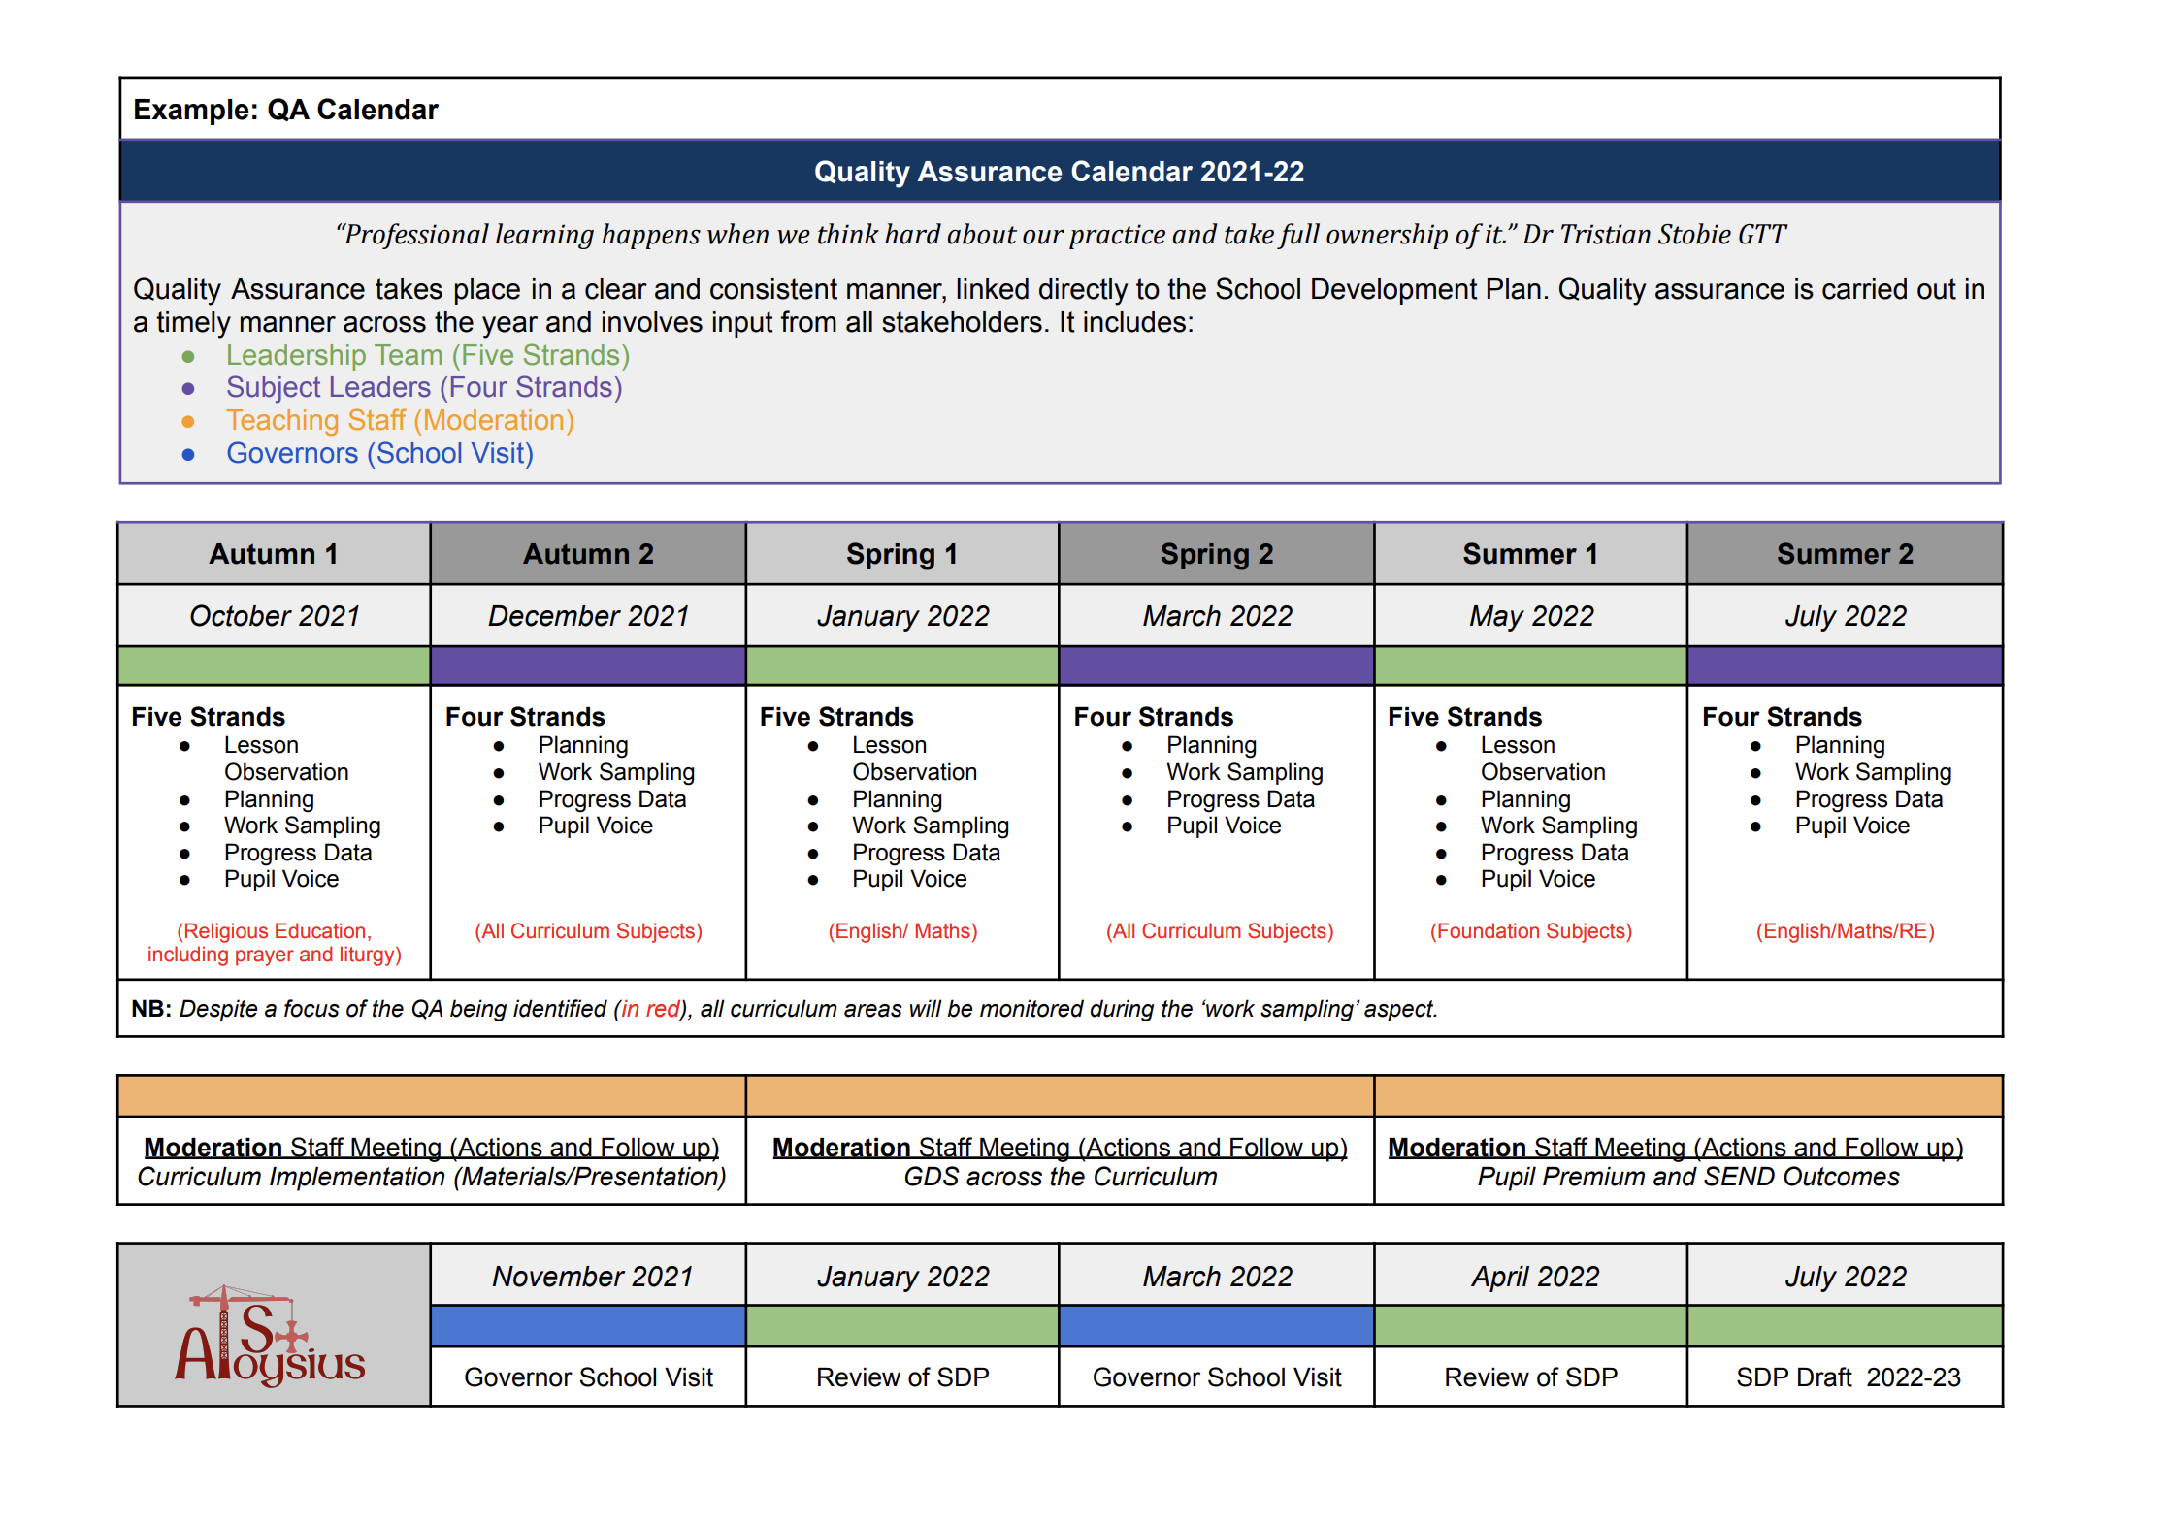
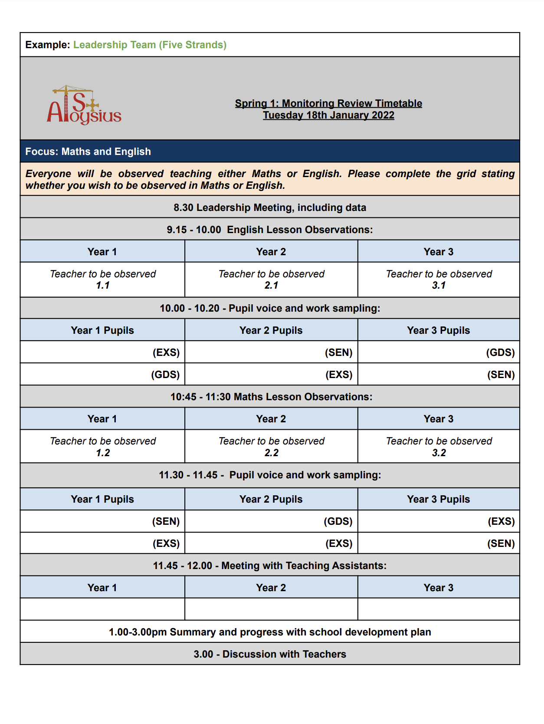
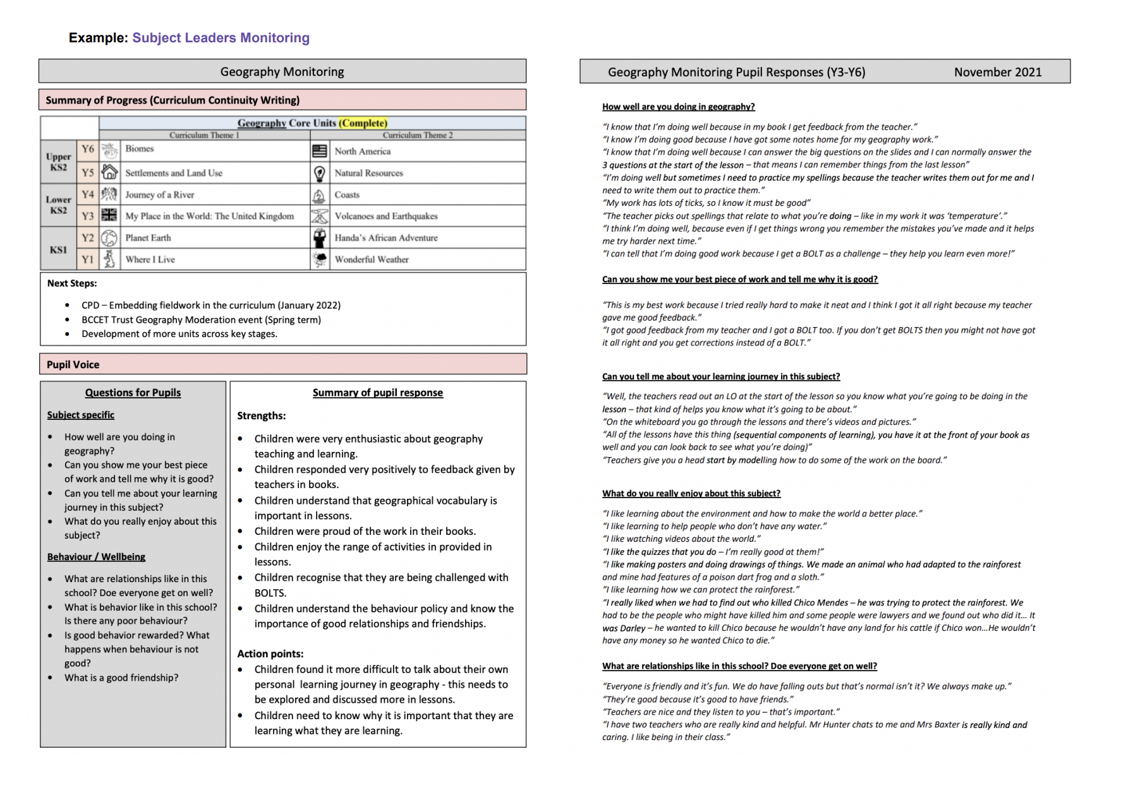
APPENDIX 1 QA CALENDAR
Called by God
Notes:
To make more visual/diagram (in line with documents Nick sent)

Slide 32
APPENDIX 2
DEVELOPING CURRICULUM
Called by God
Notes:
CAn you create a diagram for the top slide?and replace?
Can you place the original docs in?

Slide 33
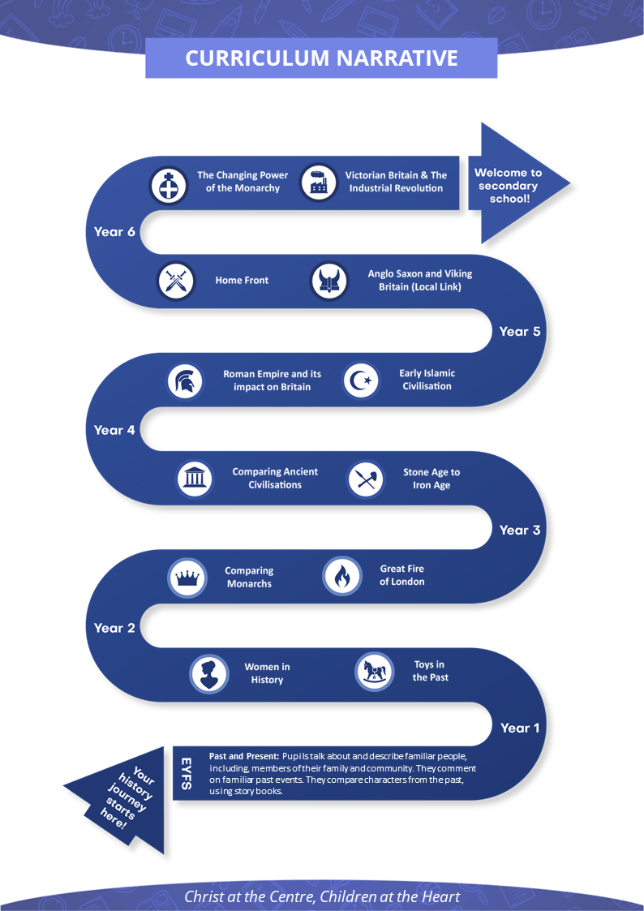
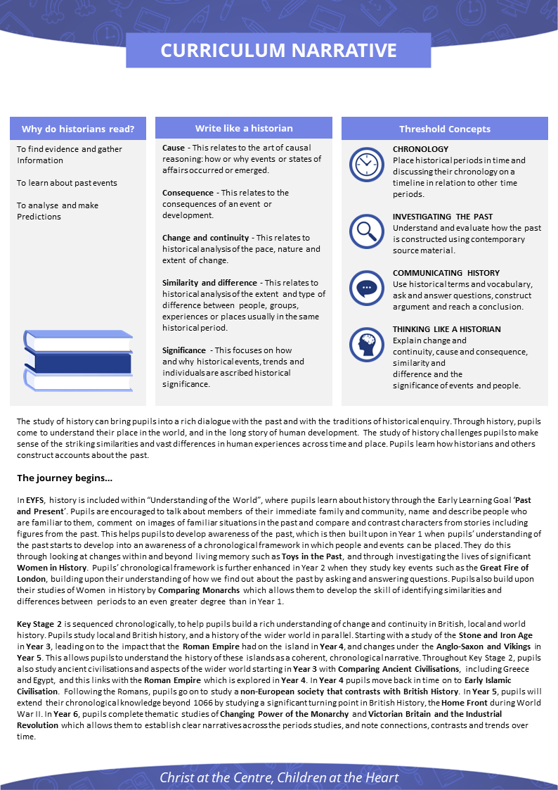
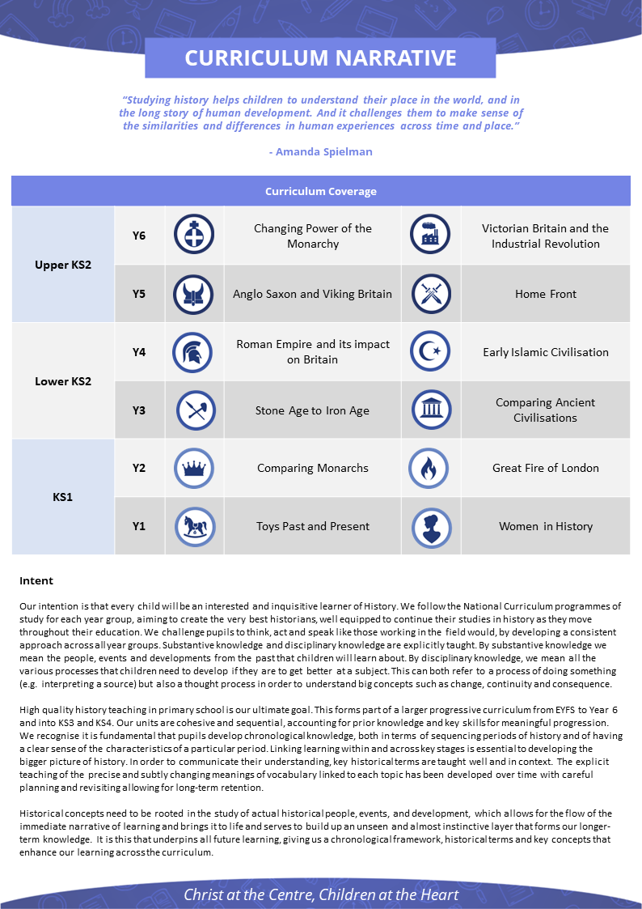
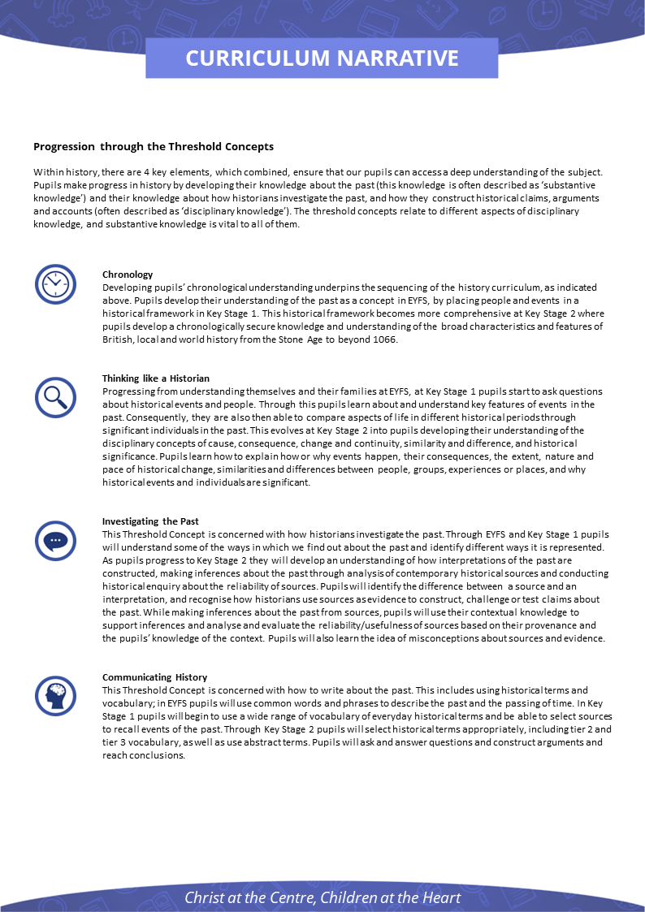
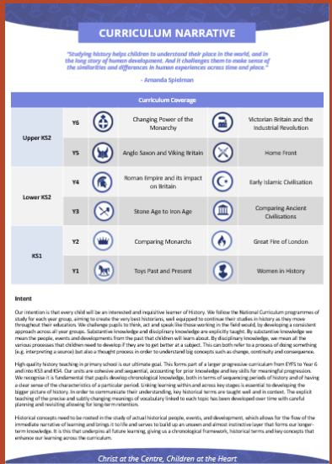
APPENDIX 2
CURRICULUM RESOURCES
Currently available for History, Geography, Science and Personal Development
Called by God
Called by God
Notes:
CAn you create a diagram for the top slide?and replace?
Can you place the original docs in?

Slide 34
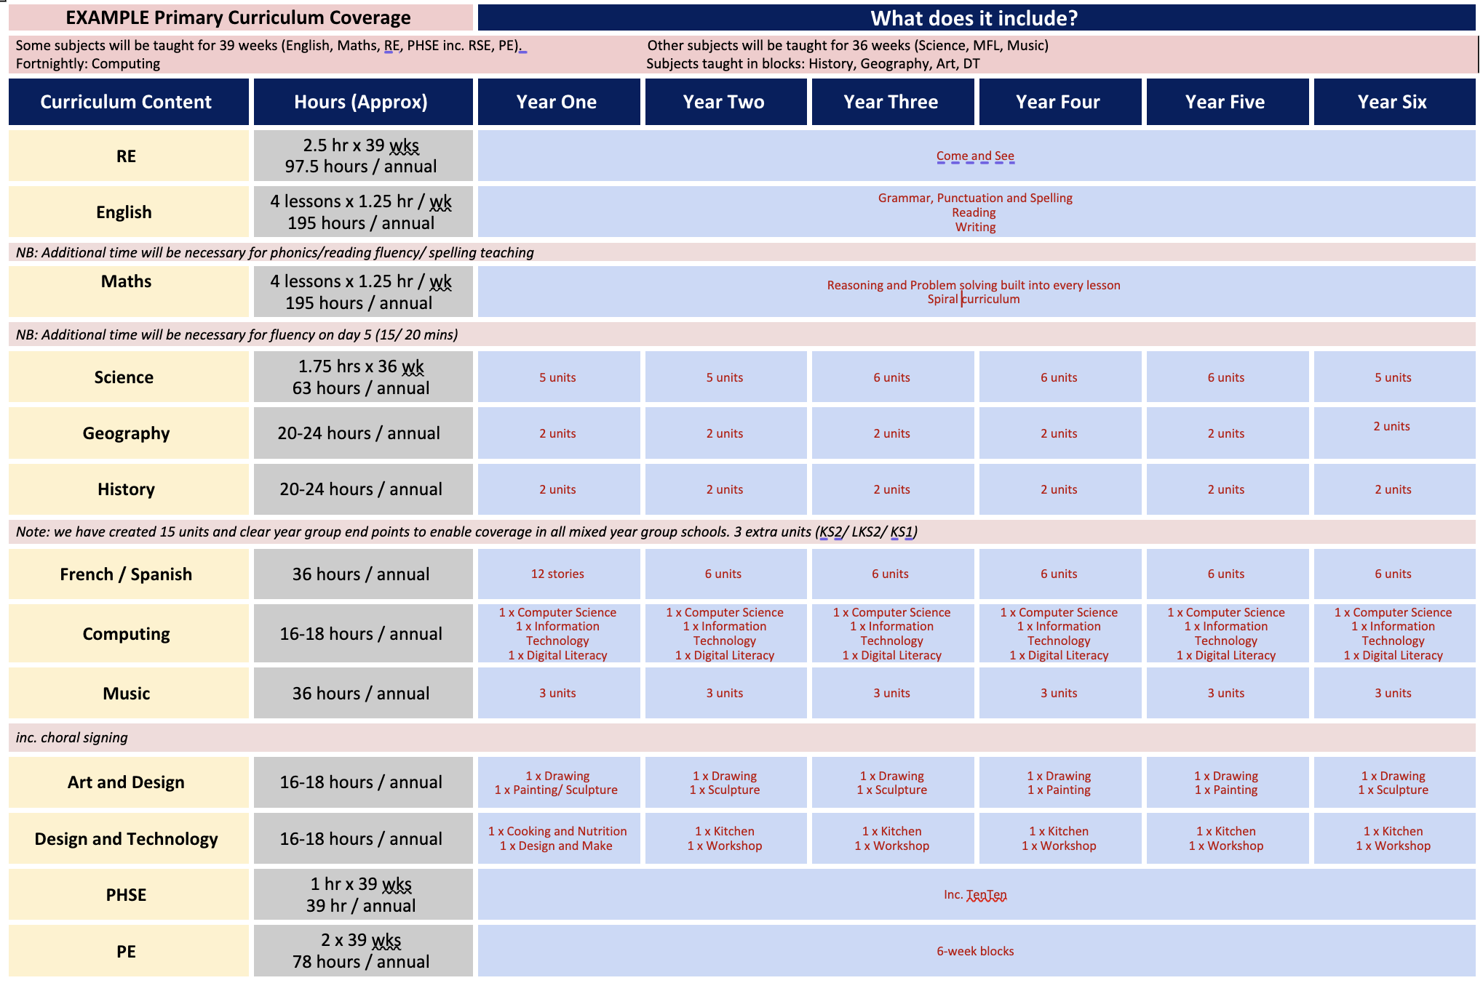
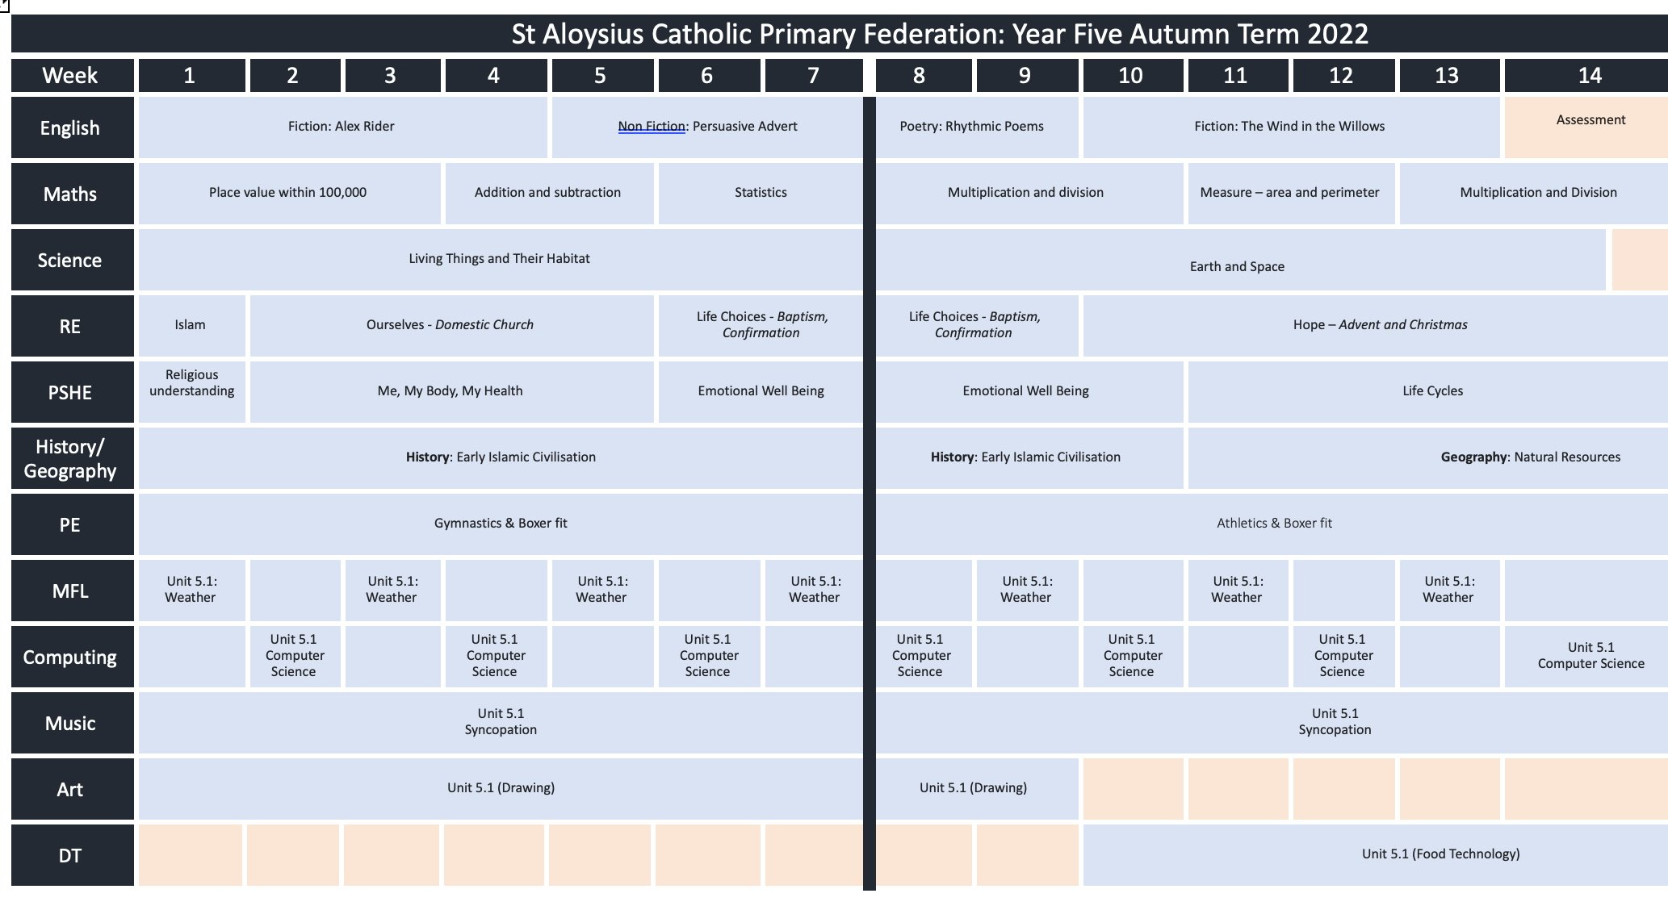
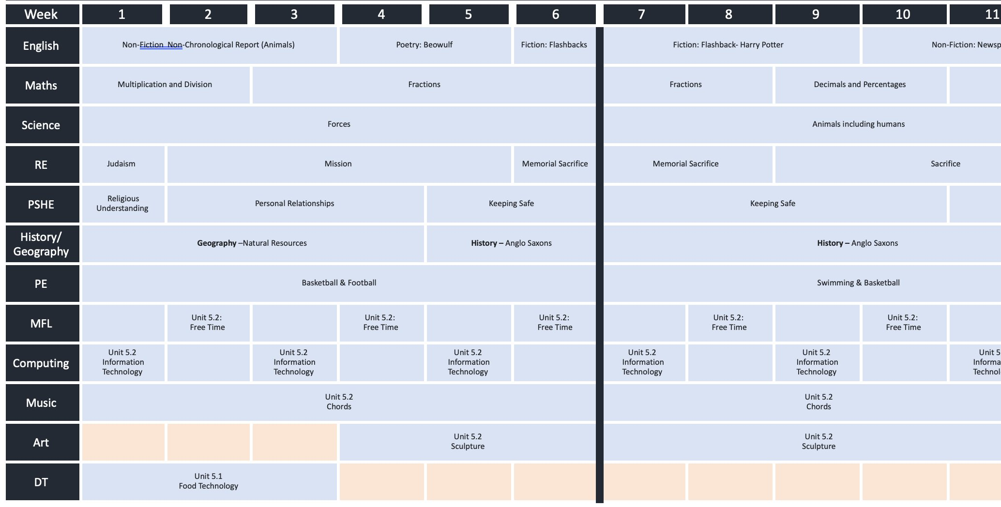
APPENDIX 3
EXAMPLE CURRICULUM DESIGN
Called by God
Notes:
Can you recreate these docs in our branding and place as sepearate appendices?Lift over from subject documents

Slide 35
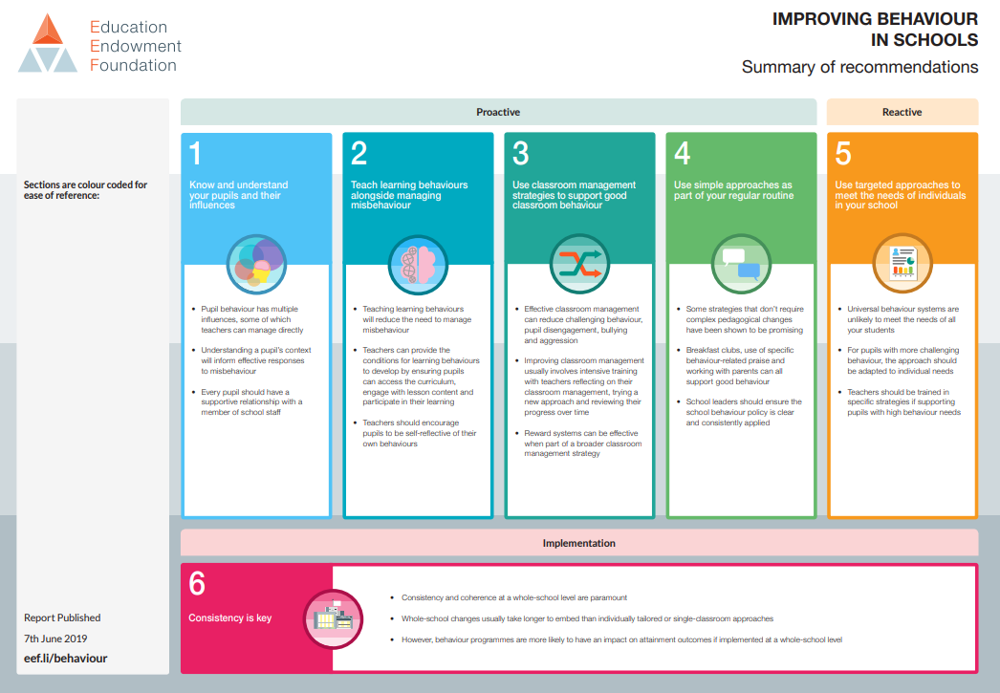
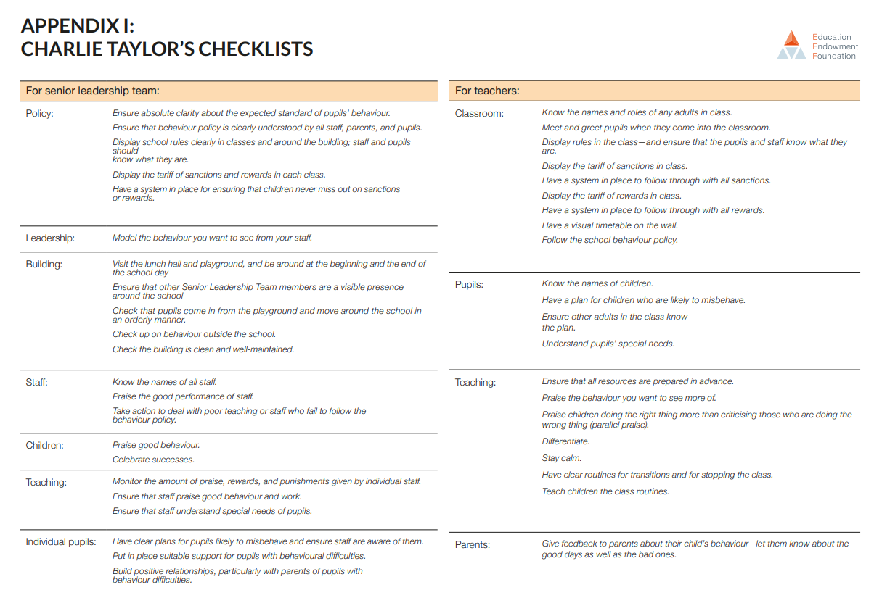
APPENDIX 4 Behaviour for learning
Called by God
Notes:
EEF_Improving_behaviour_in_schools_Summary.pdf (d2tic4wvo1iusb.cloudfront.net)
Add hyperlinks for these
Culture (need to add in a vision for Culture) - Pastoral Behaviour Guiding Principles
Add in page for Attendance Add in page for Safeguarding Add in page for Wider Opportunities/Enrichment

