Slide 1

Reception Autumn Scheme of Learning

Slide 2
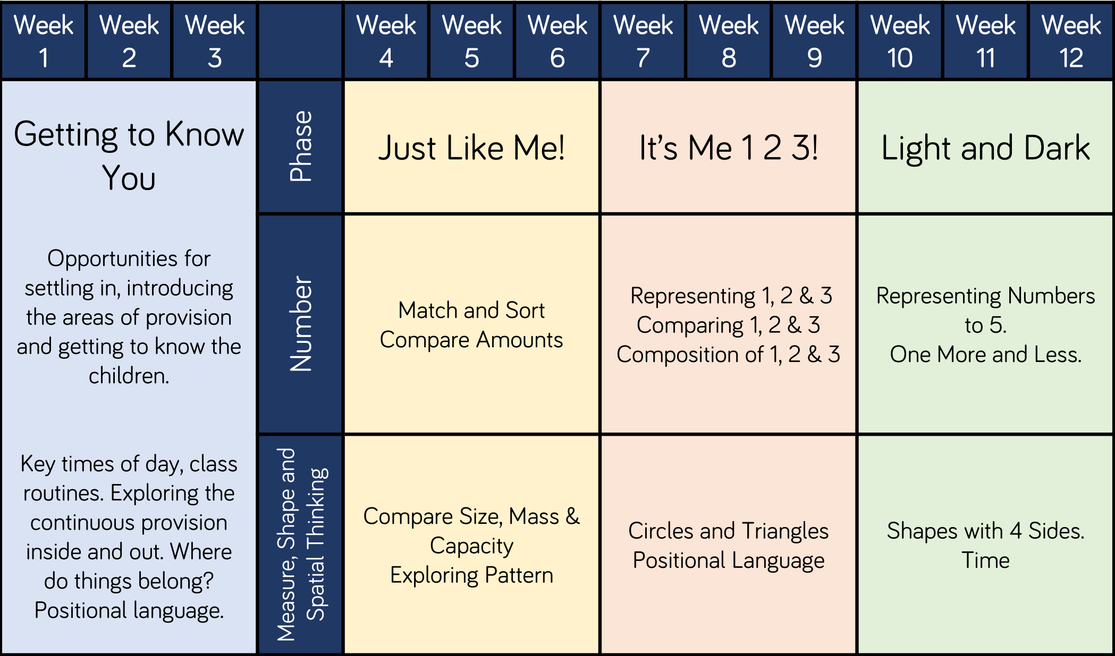
Reception

