Slide 1

Reception Spring Scheme of Learning

Slide 2
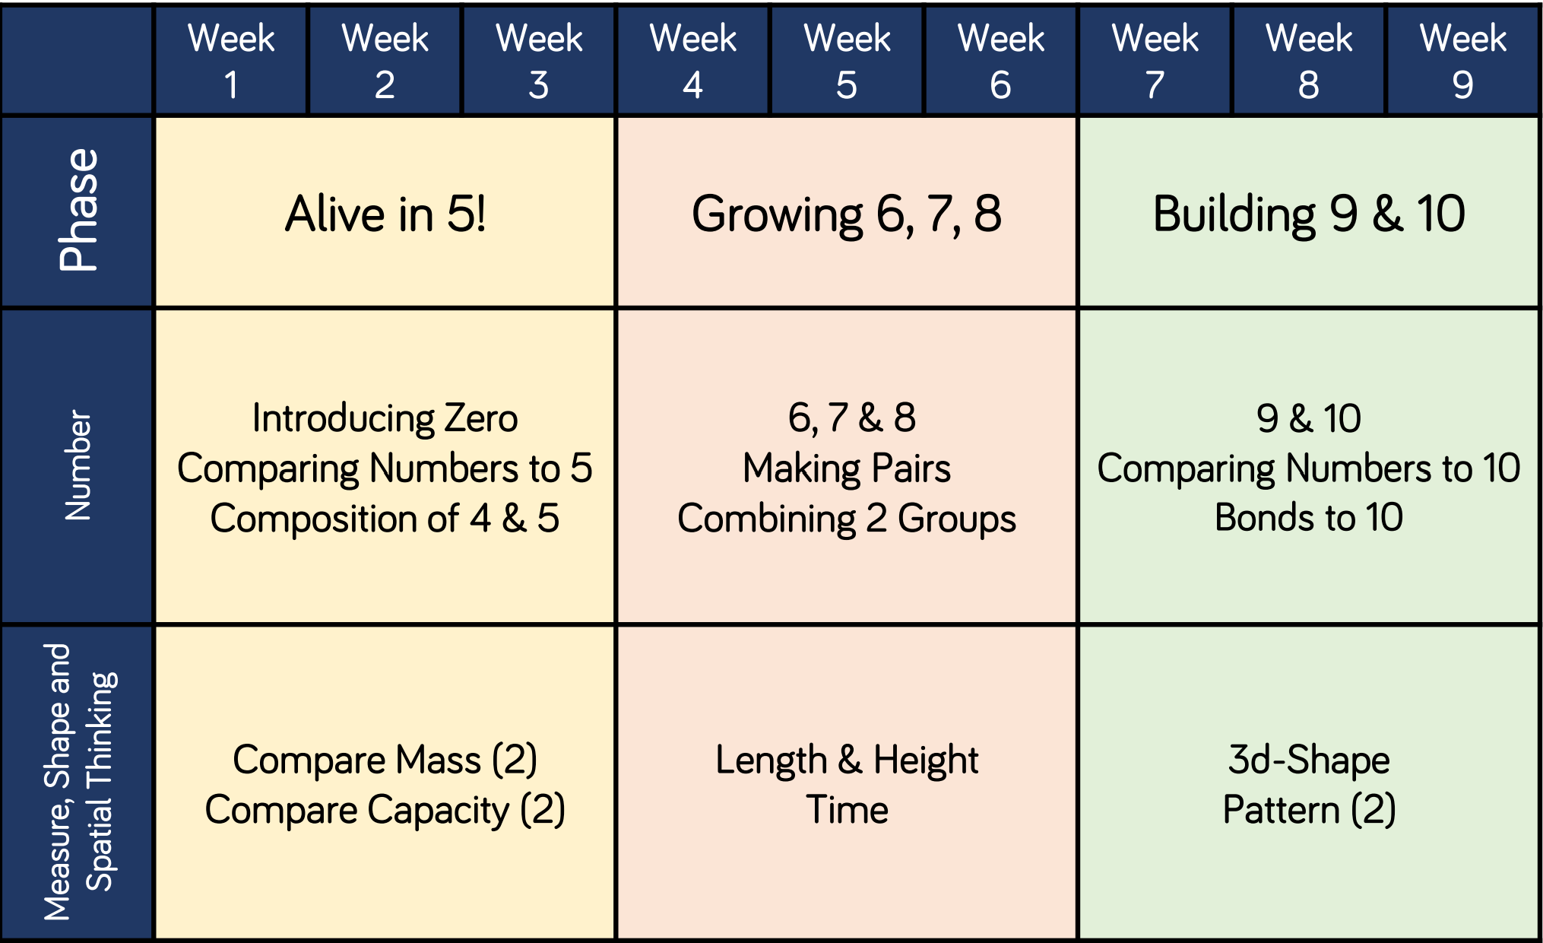
Reception

