Slide 1

Reception Summer Scheme of Learning

Slide 2
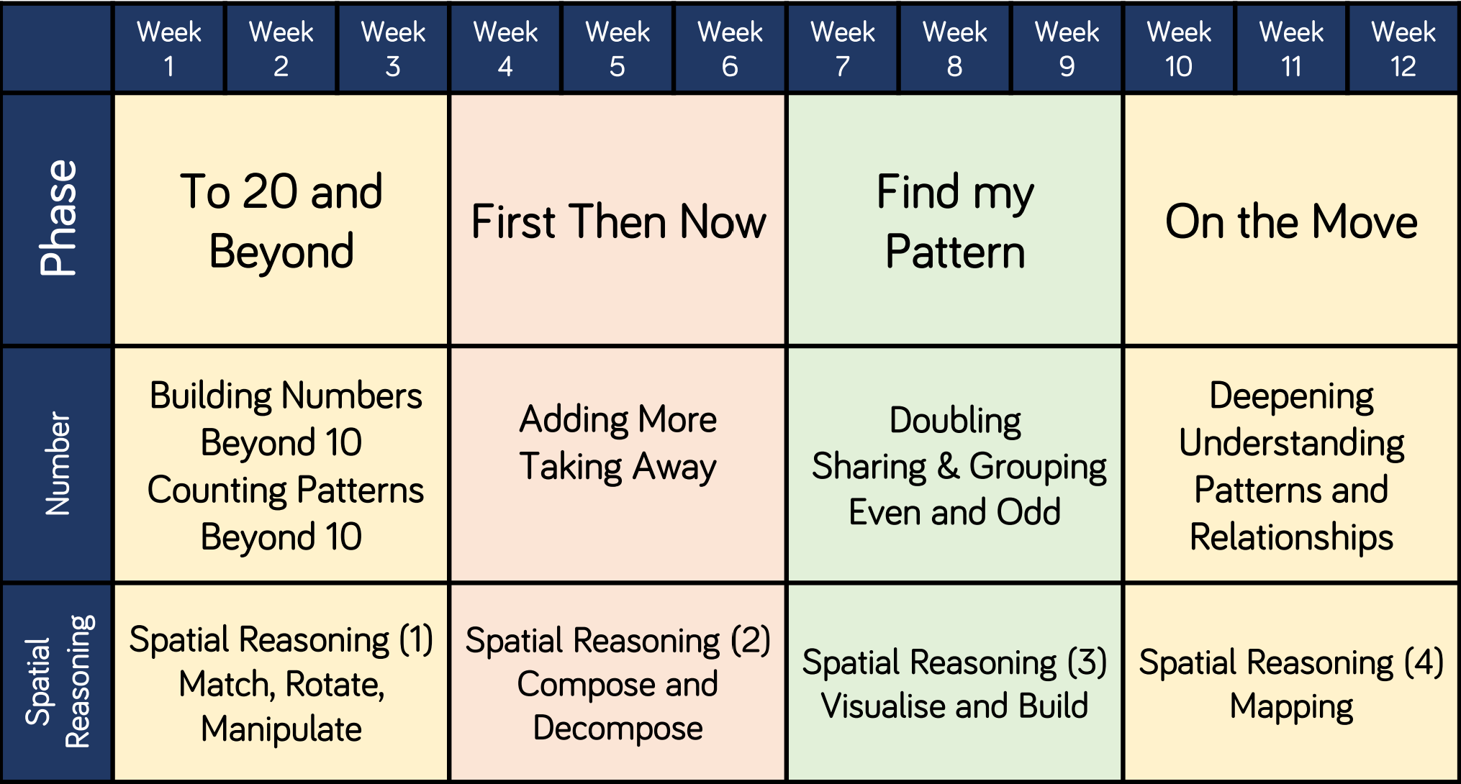
Reception

