Slide 1

Year 1 Spring Scheme of Learning

Slide 2
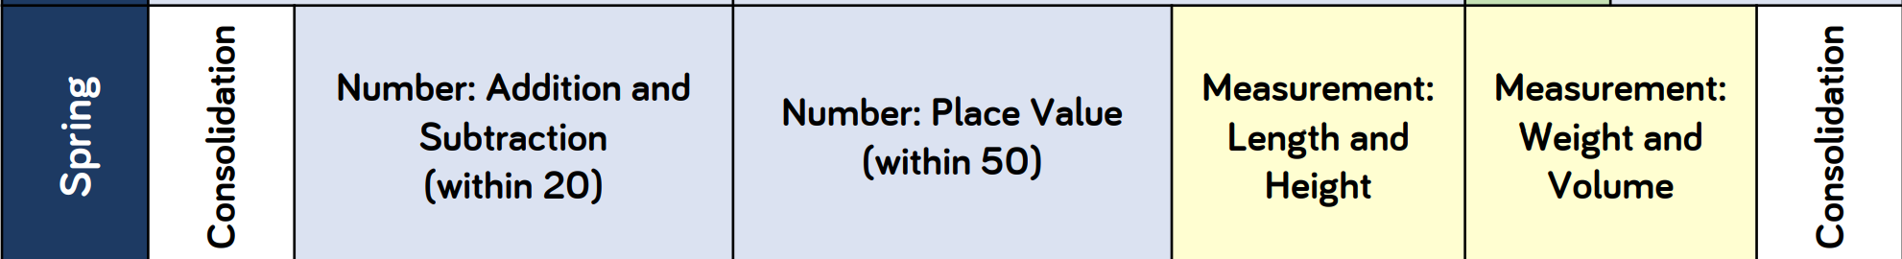
Year 1

Slide 3
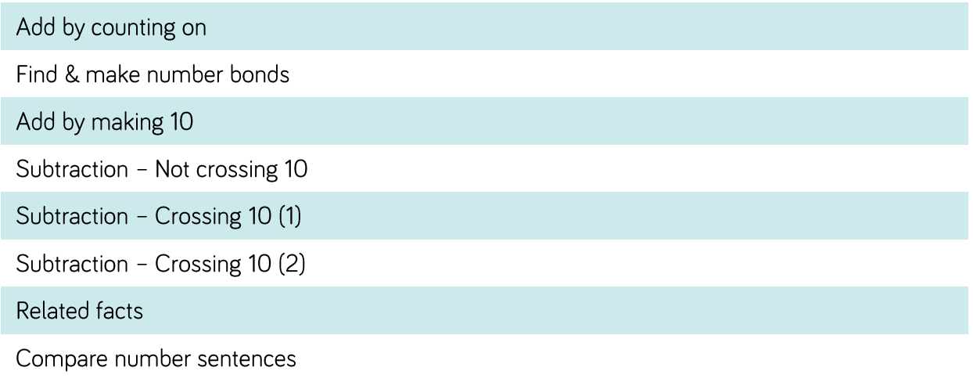
Year 1

Slide 4
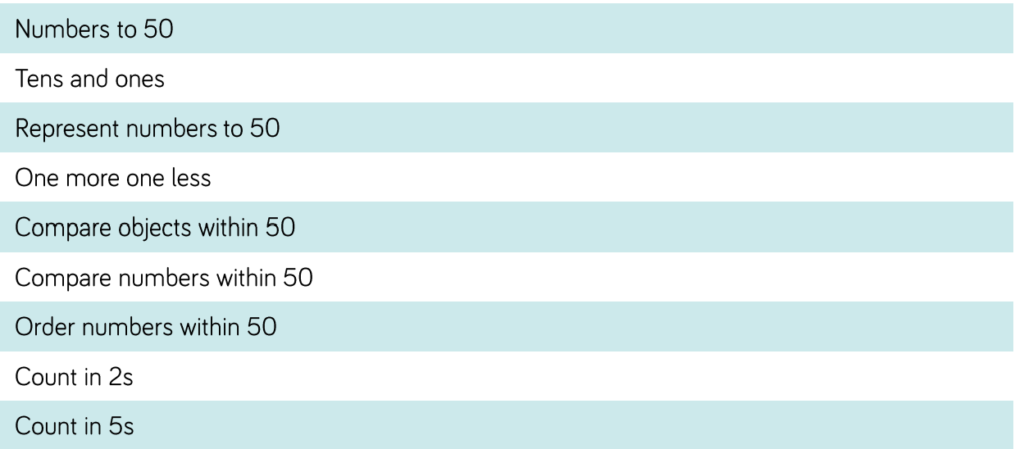
Year 1

Slide 5
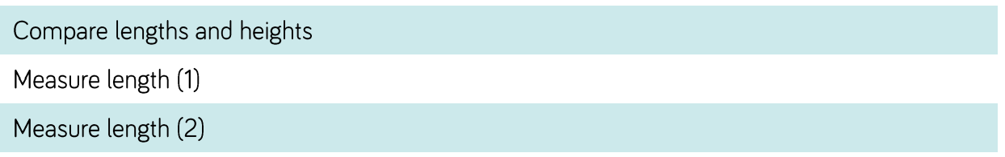
Year 1

Slide 6
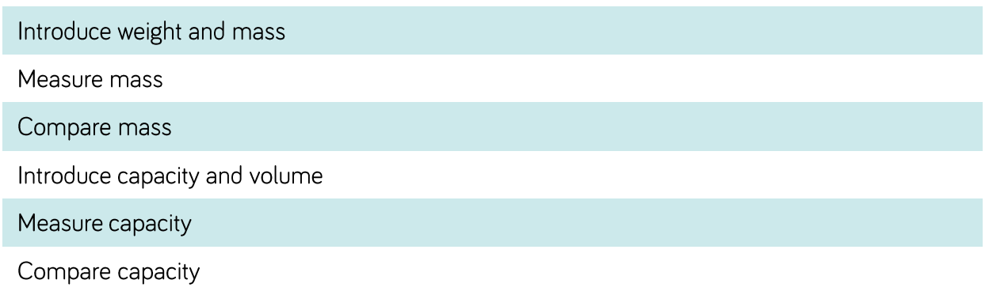
Year 1

