Slide 1

Year 2 Summer Scheme of Learning

Slide 2
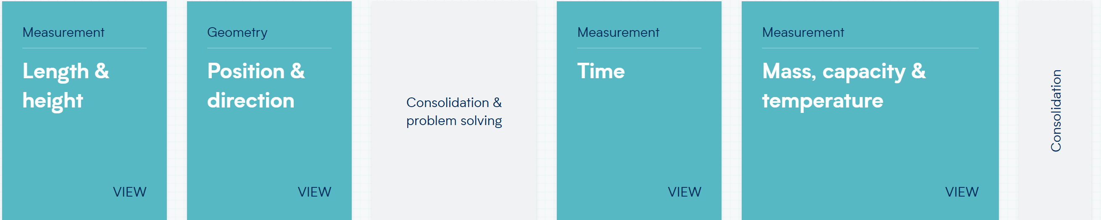
Year 2

Slide 3
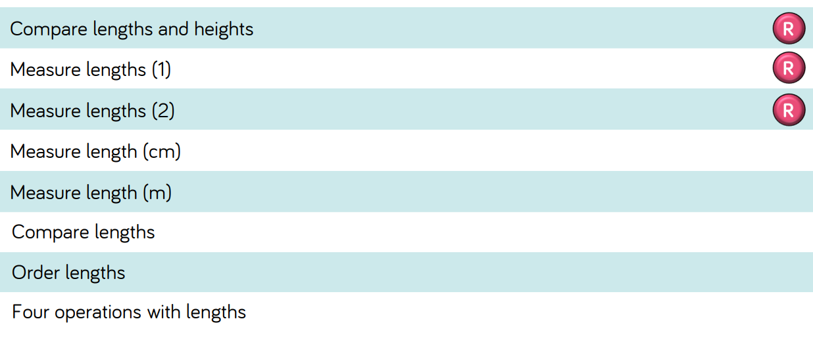
Year 2

Slide 4
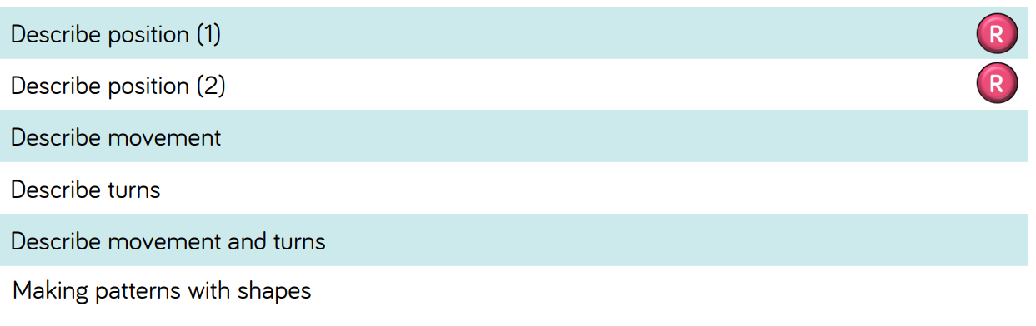
Year 2

Slide 5
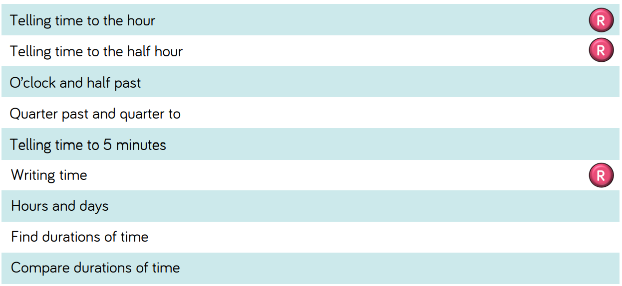
Year 2

Slide 6
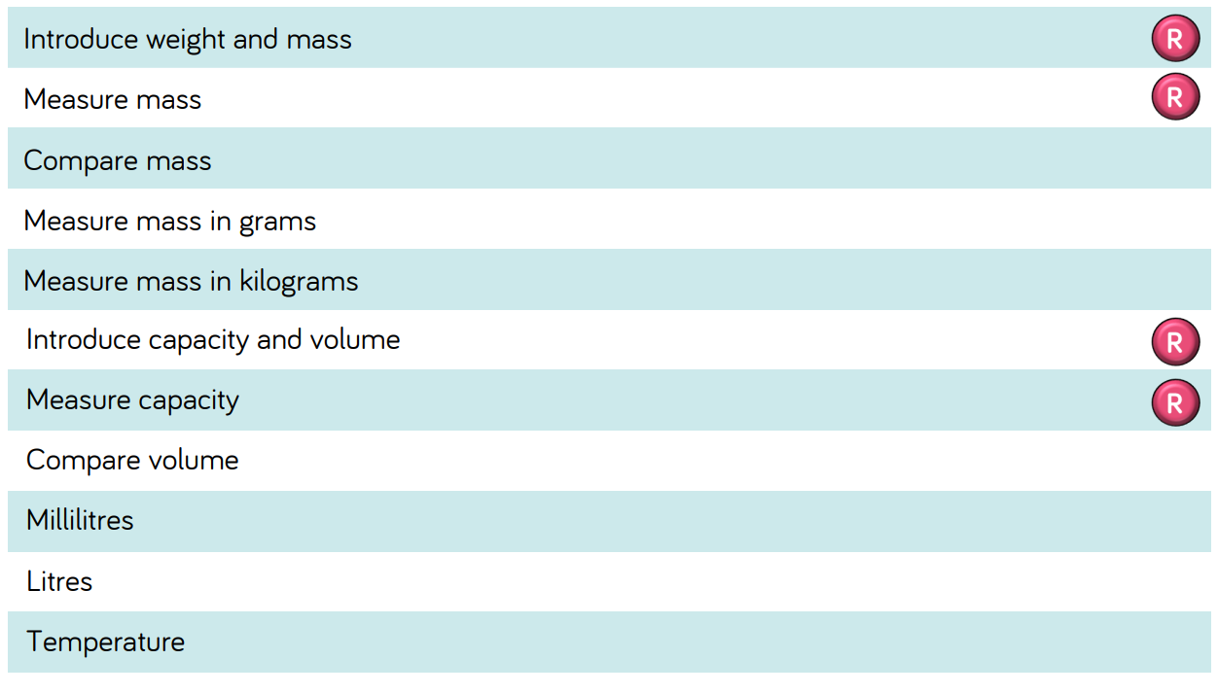
Year 2

