Slide 1

Year 3 Summer Scheme of Learning

Slide 2
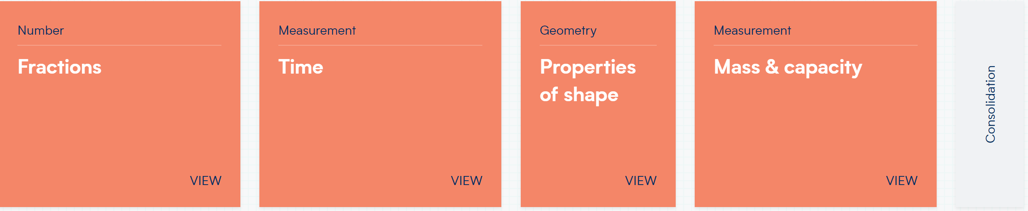
Year 3

Slide 3
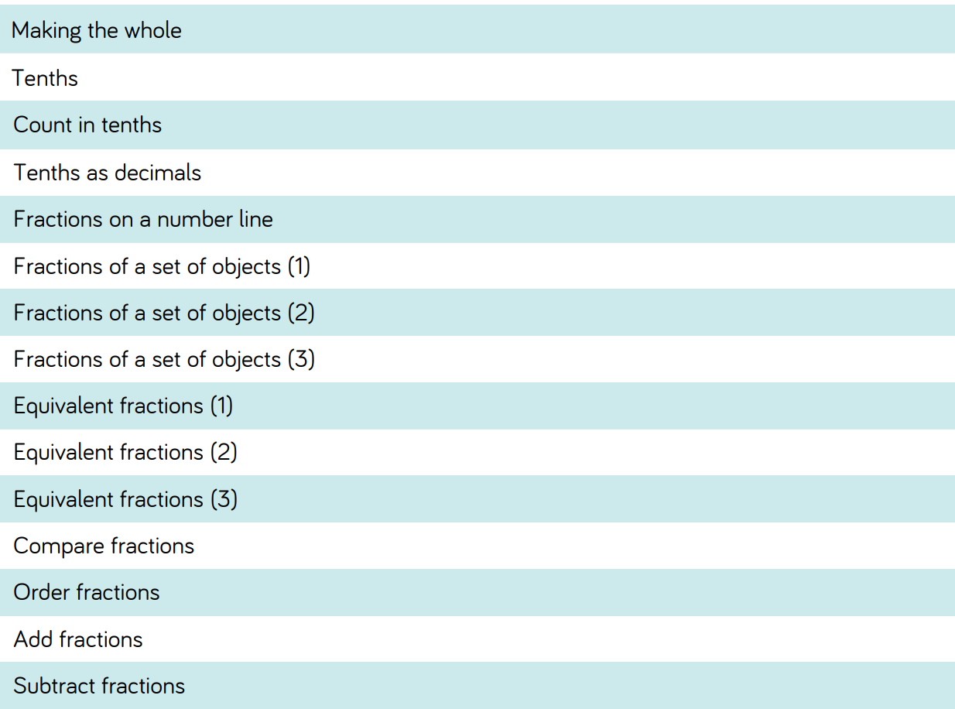
Year 3

Slide 4
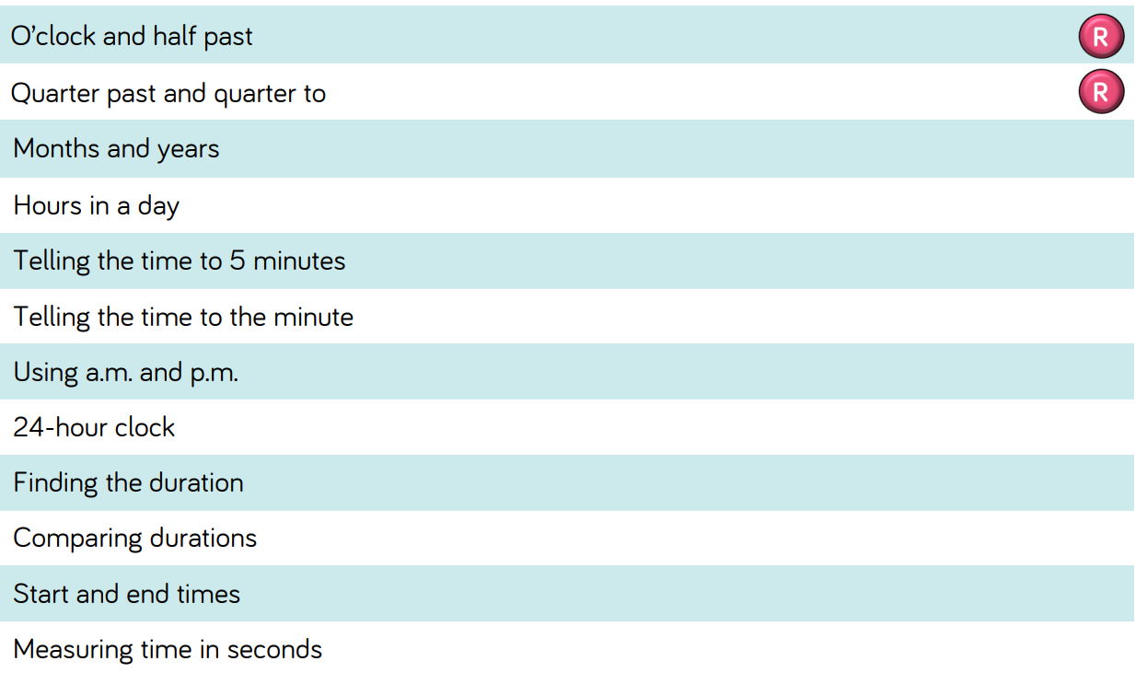
Year 3

Slide 5
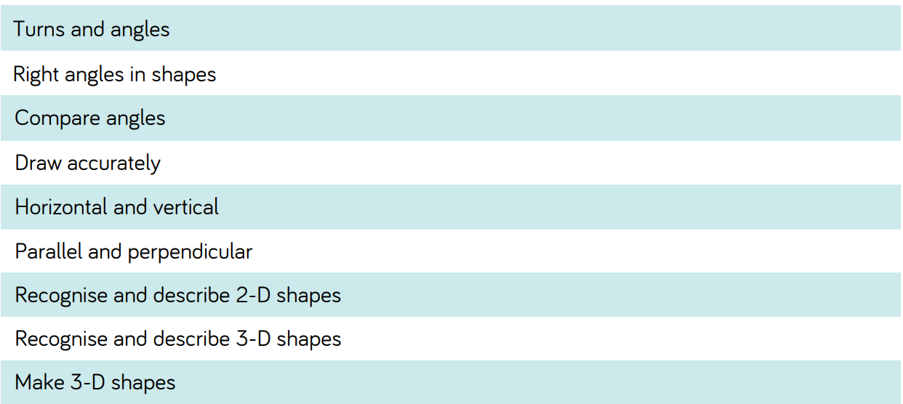
Year 3

Slide 6
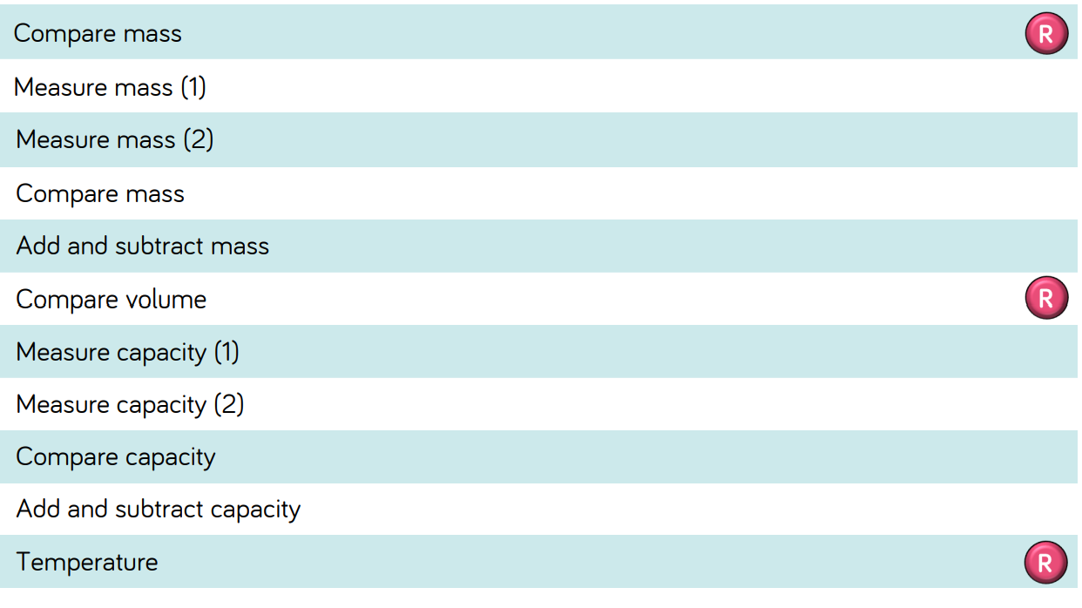
Year 3

