Slide 1

Year 4 Autumn Scheme of Learning

Slide 2
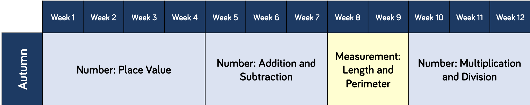
Year 4

Slide 3
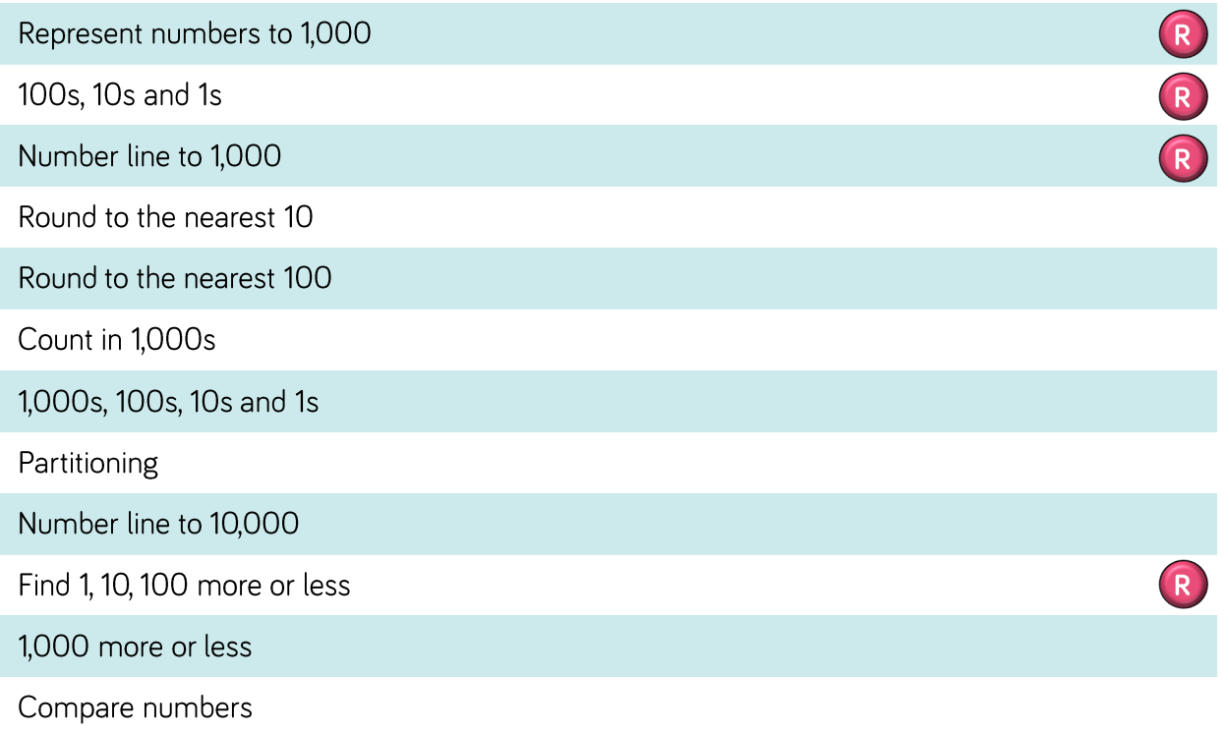
Year 4

Slide 4
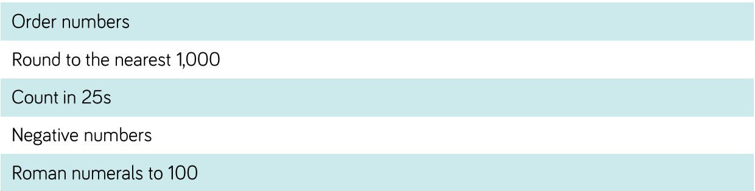
Year 4

Slide 5
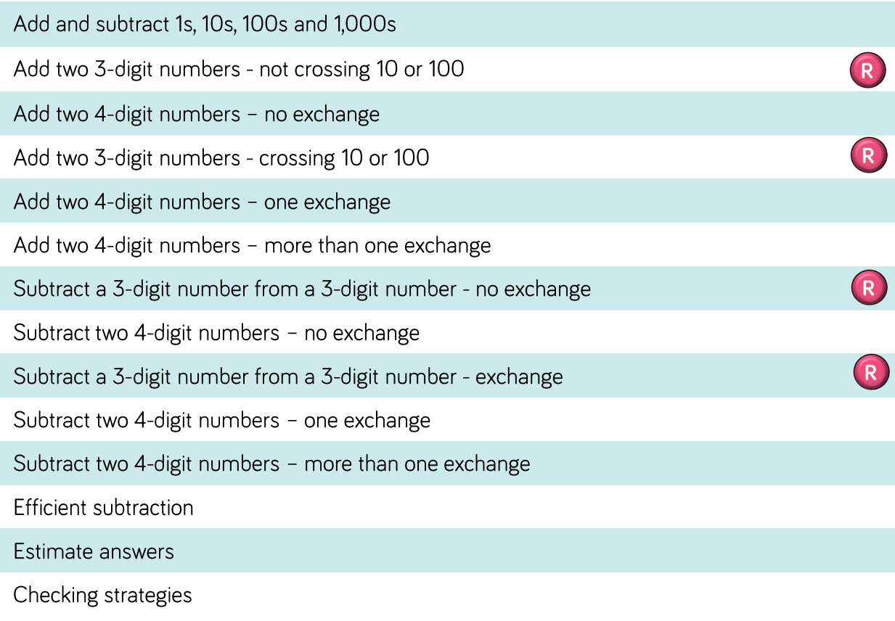
Year 4

Slide 6
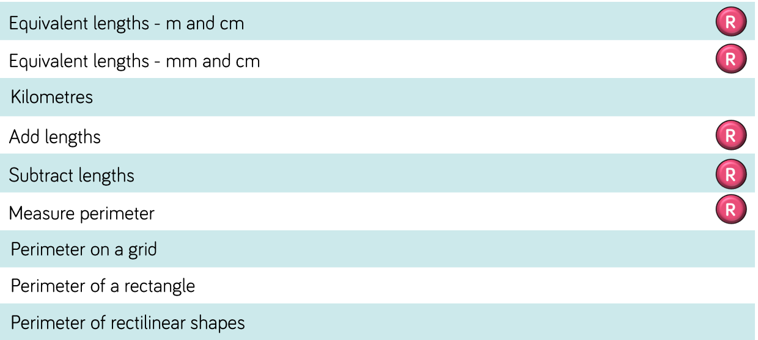
Year 4

Slide 7
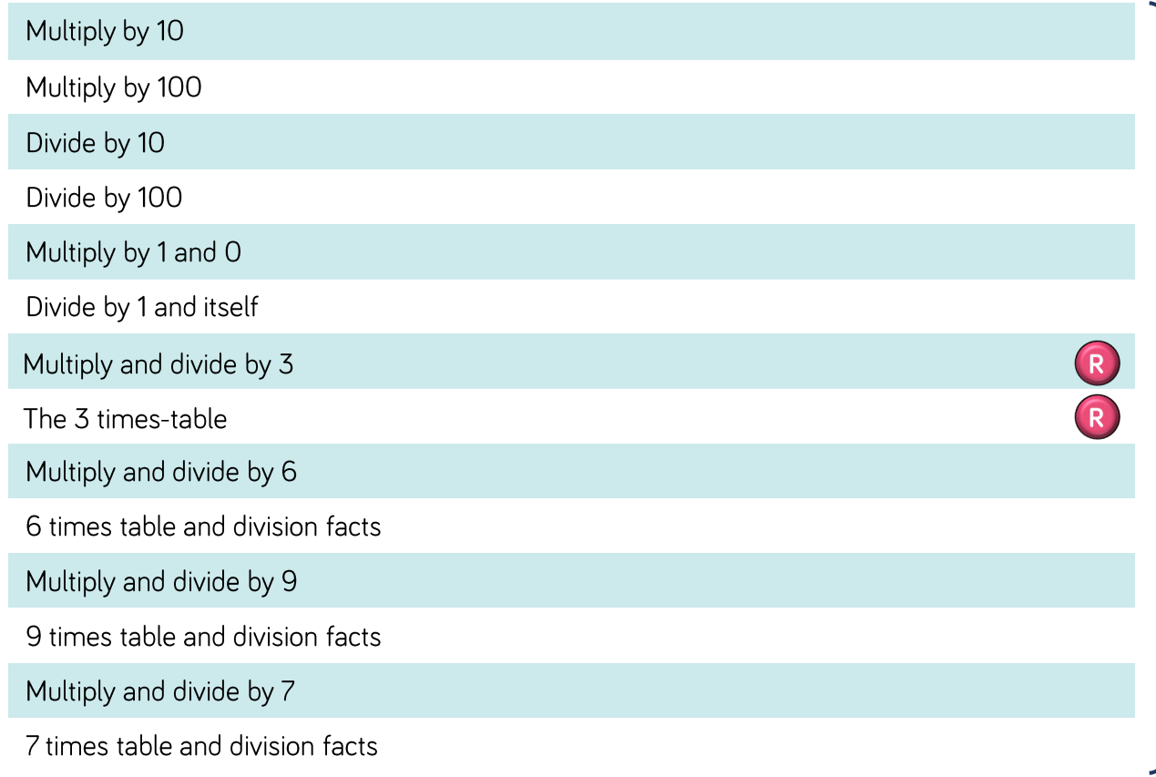
Year 4

