Slide 1

Year 6 Summer Scheme of Learning

Slide 2

Year 6

Slide 3
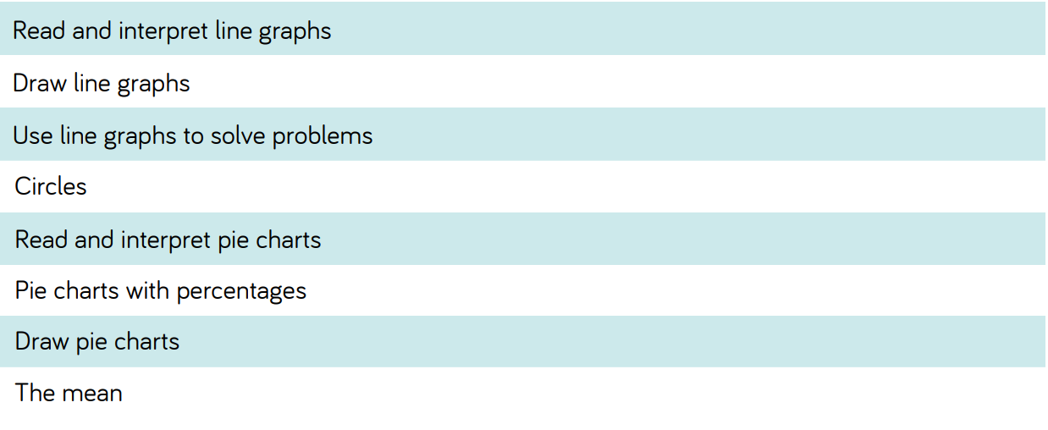
Year 6

Slide 4
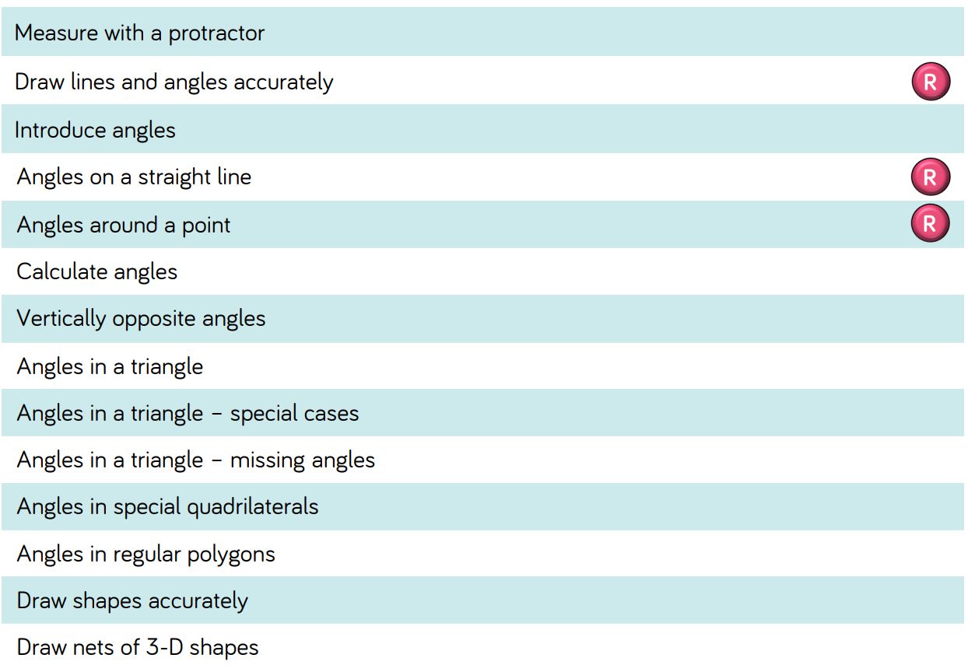
Year 6

