Slide 1

Welcome to St. Mary’s Early Years Curriculum Meeting 2024

Slide 2
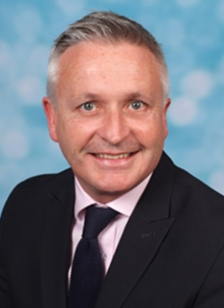
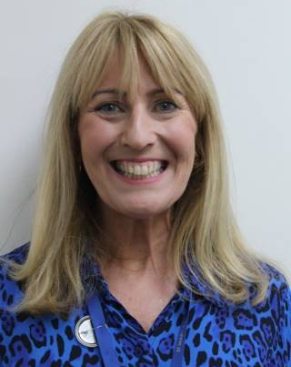
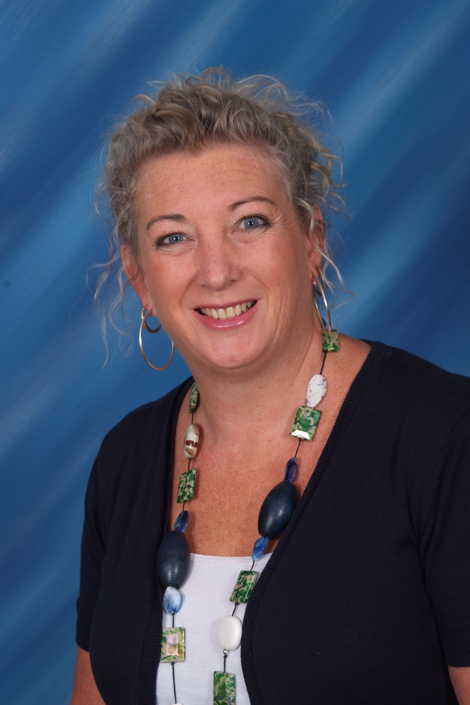
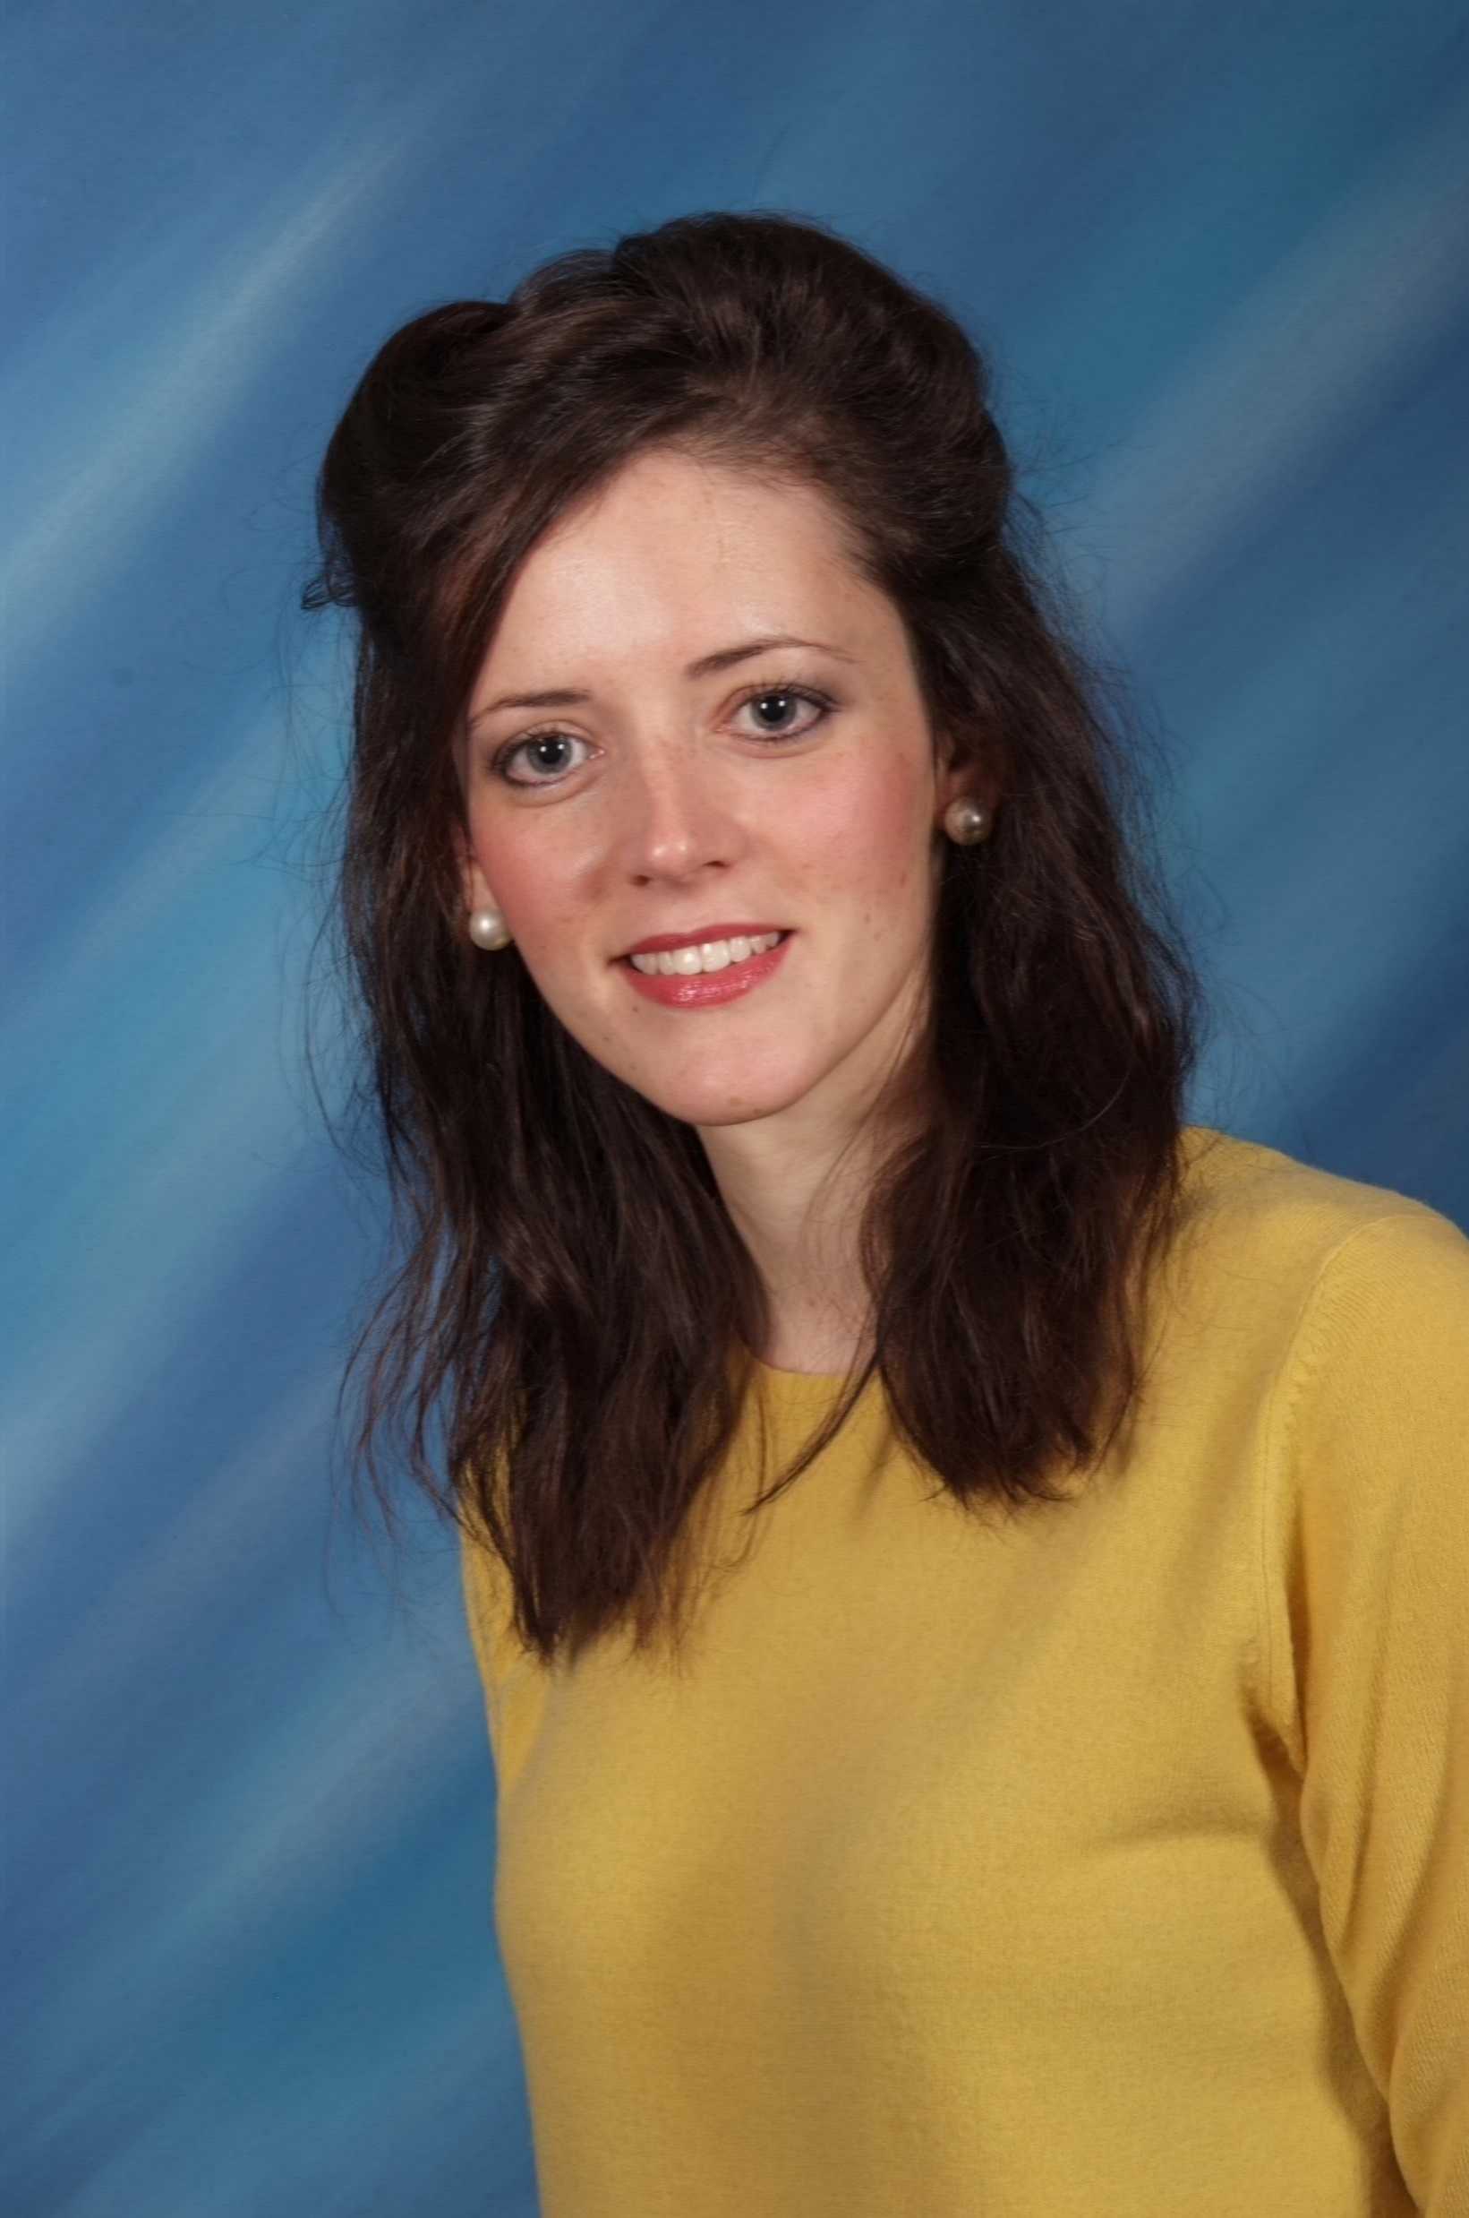
Head Teacher
Deputy Head Teacher
Mr Clephane
Mrs Clinton
Mrs Roddy
SENCO
Mrs Duffy
Assistant Head Teacher

Slide 3
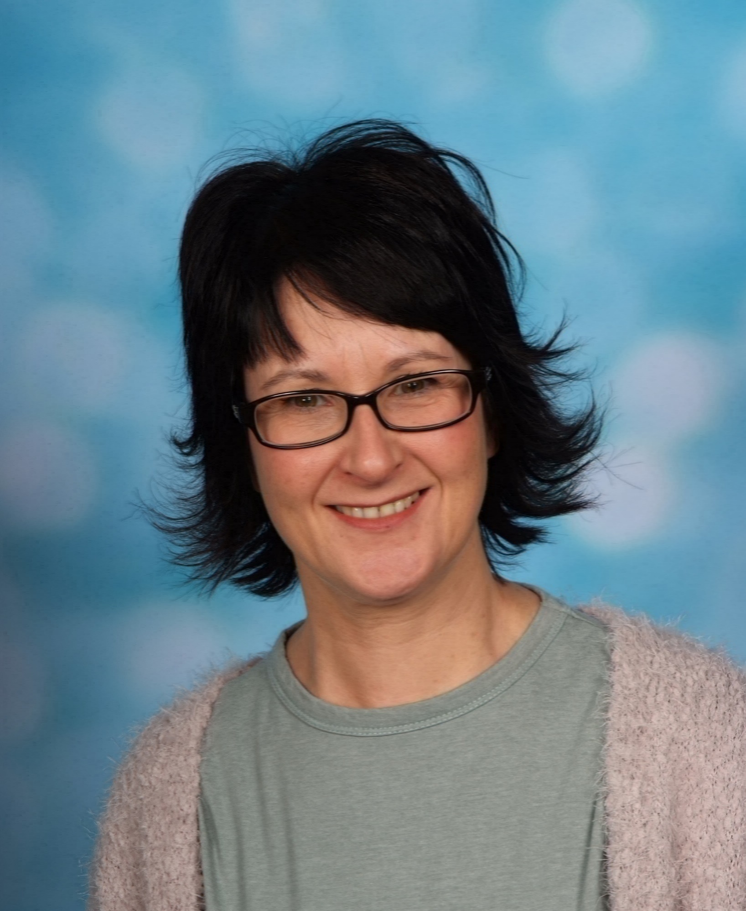
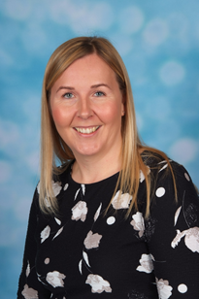
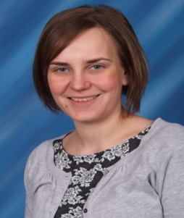
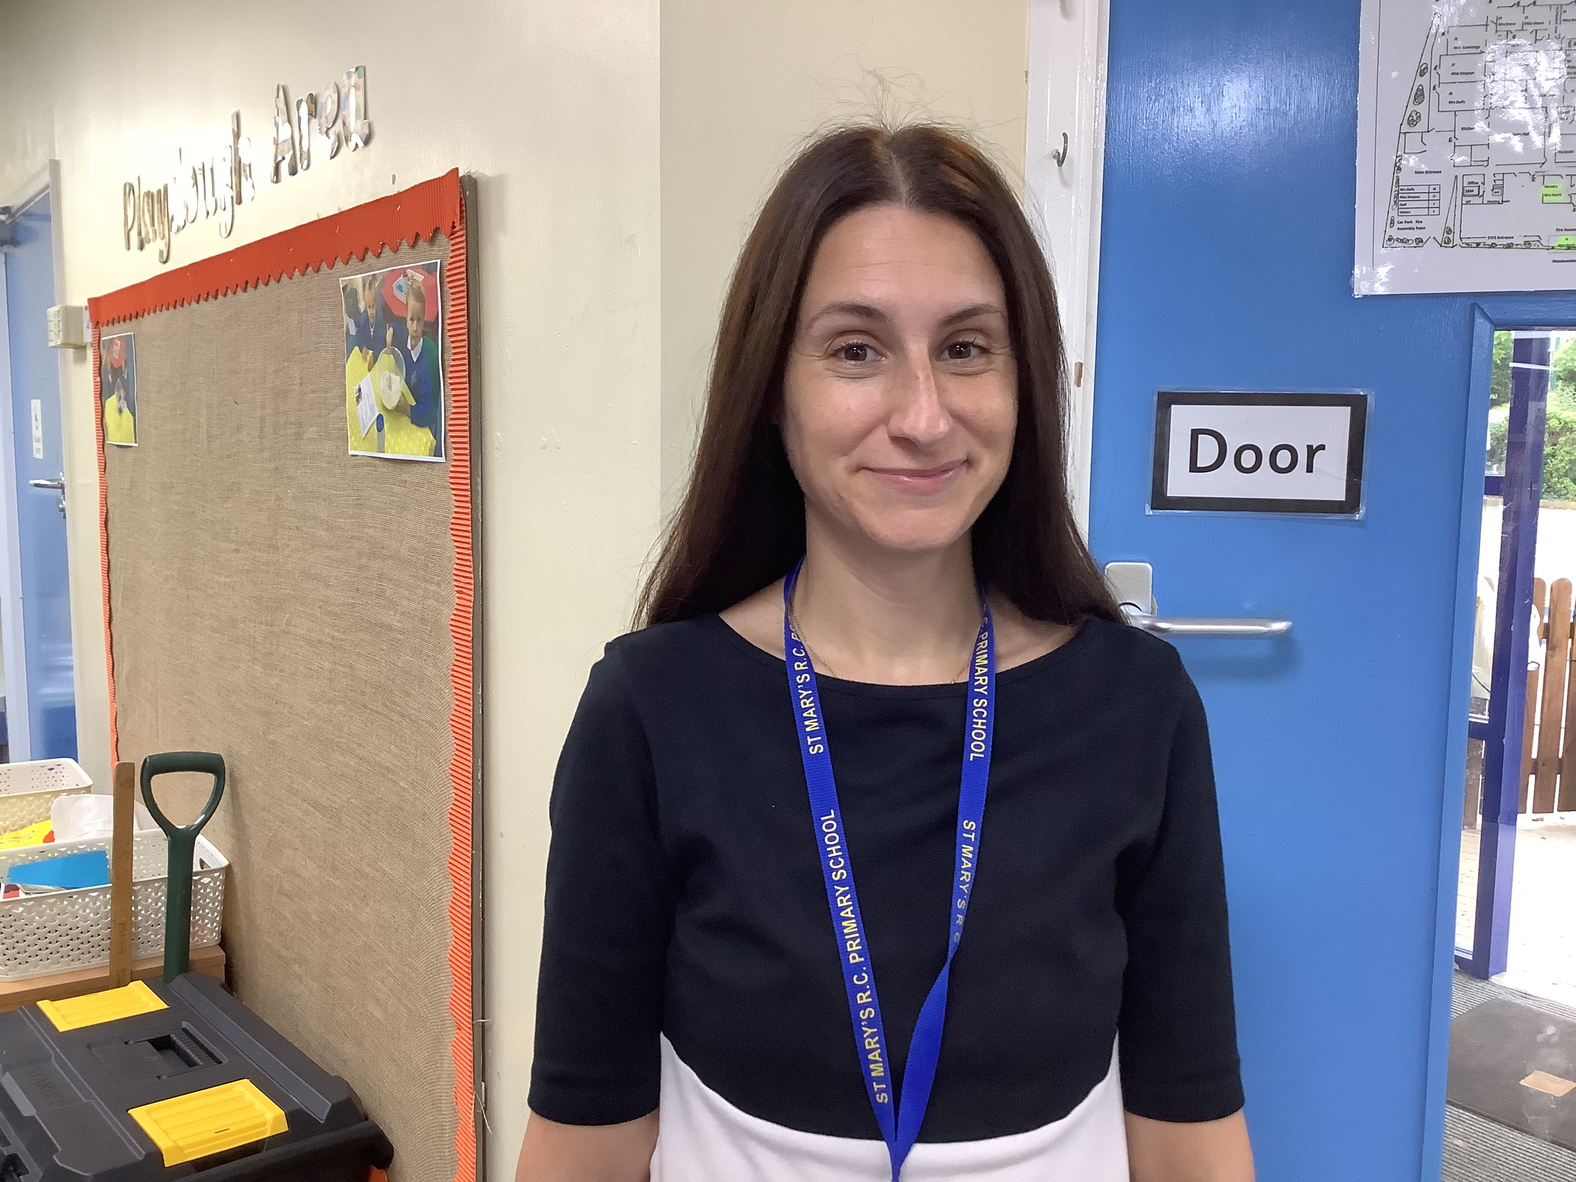
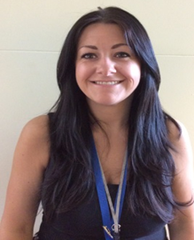
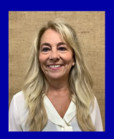
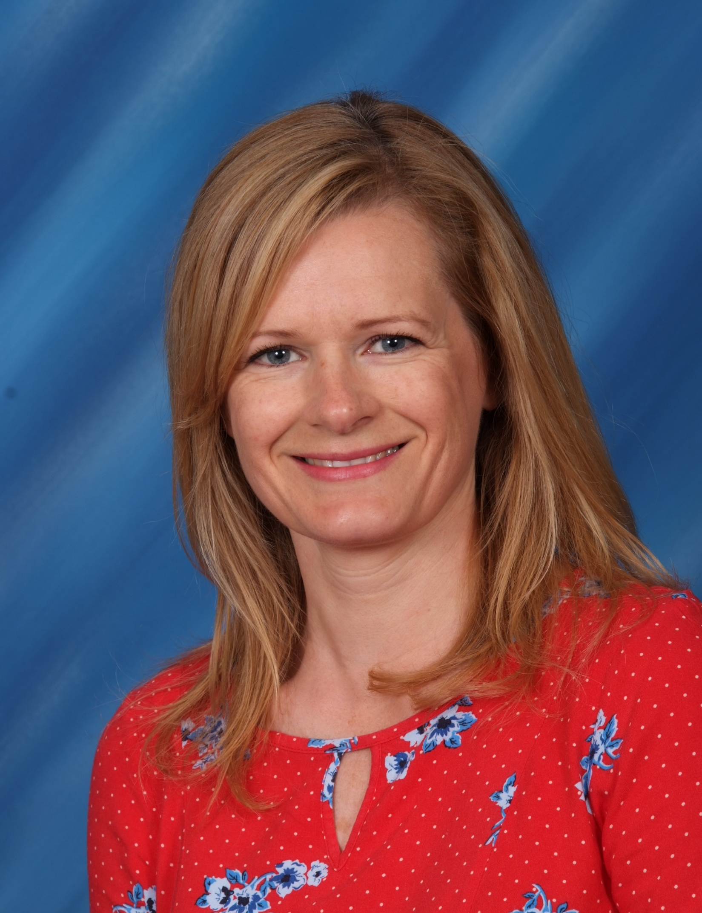
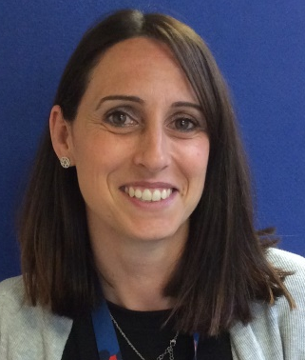
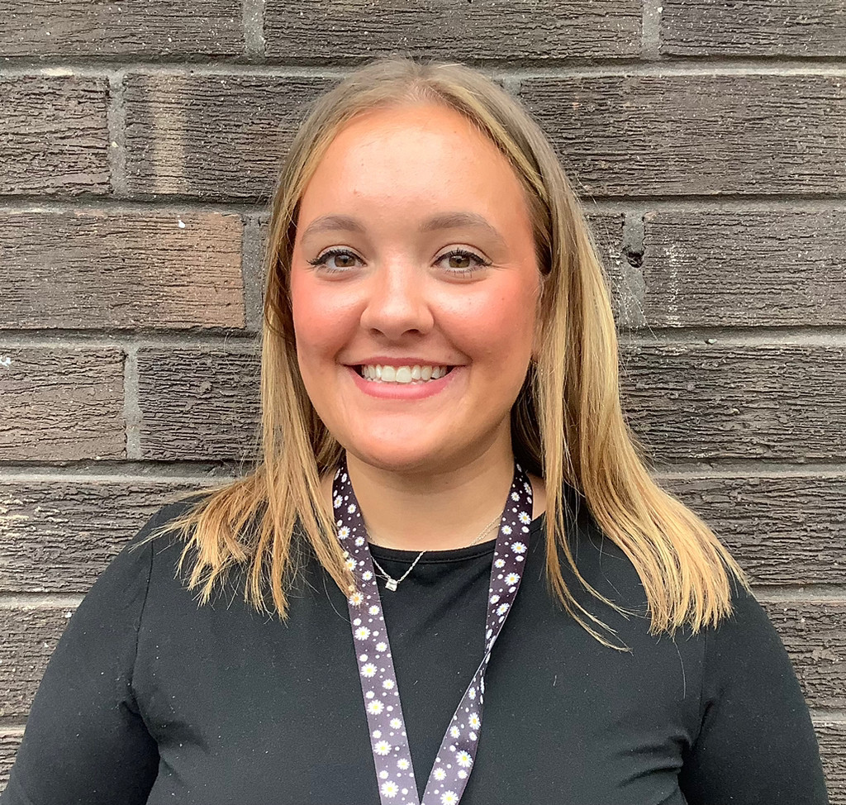
Early Years Team
Mrs Harris
Early Years Leader
Class Teacher
Nursery
Mrs Robson
Class Teacher
Reception F2
Miss Simpson
Class Teacher
Reception F1
Mrs Lagna
Teaching Assistant Nursery
Mrs Bettnardi
Teaching Assistant
Nursery
Miss Clarke
SCITT
Student
Nursery
Mrs Laws
Teaching Assistant
F1
Mrs Chapman
Teaching Assistant
EYFS
Mrs Donkin
Teaching Assistant
F2

Slide 4

Whole School Values
What is a St. Mary’s Child?

Slide 5

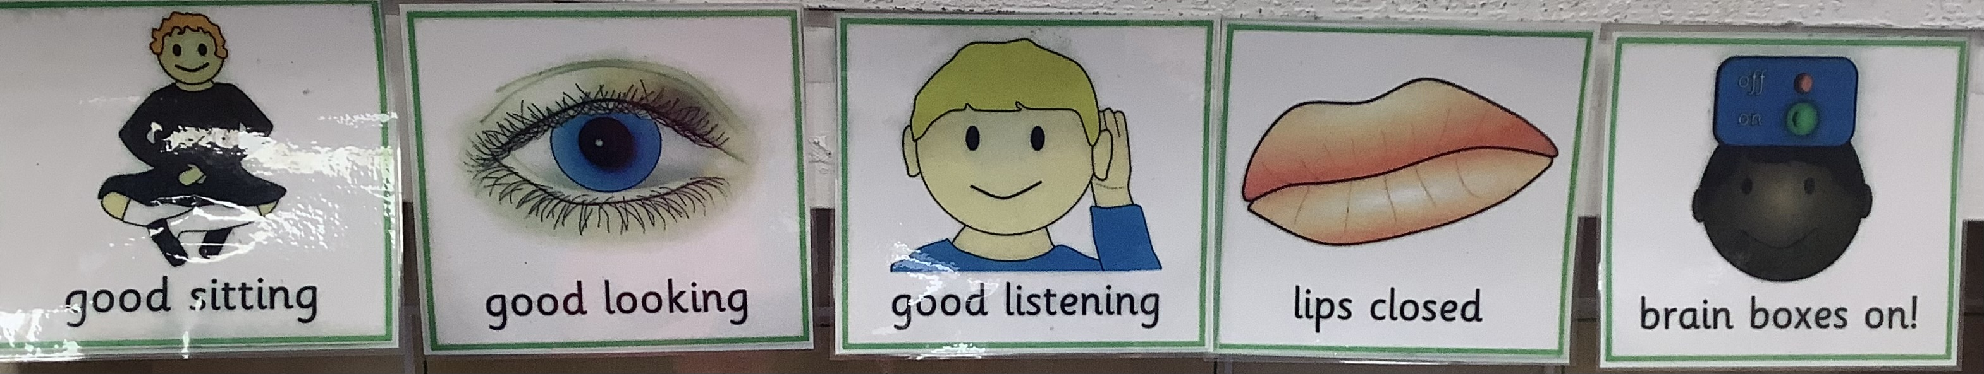
Whole School Rules
Be Safe Be Kind
Believe
Early Years Expectations

Slide 6


General
Parents Evening – Wednesday 23rd October/ Thursday 24th October 3.45- 6.00. (appointment link Reception only)
Uniform & Velcro shoes all named
No Earrings
Healthy Snack - for each child to supplement school fruit, enough for the class. (see list on Tapestry and classroom window) Examples: fresh or dried fruit, vegetables, bread sticks, crackers, cheese slices)
Careers Week
End of year report
Our Schools APP

Slide 7
What is the Early Years Foundation Stage?
It is the stage your child is in until they reach the end of their Reception year
Nursery and Reception: Children are learning all of the time.
Learning will be active, exciting and accelerated, both indoor and outdoor. This is why children need to develop independence very early on.

Slide 8
What can you expect from the Early Years Foundation Stage at St. Mary’s?
A safe environment where your child will learn through
high – quality inclusive care and education
A play curriculum which is active and fun with challenge
Highly experienced adults who understand child development and genuinely care about your child
Adults who will follow your child’s interests and abilities developing them through play and quality interactions
Open door policy to discuss any issues, at a convenient time for both.
Statutory Baseline Assessment carried out in next 6 weeks . Online assessment, no grades given. Will be used as a progress check in Year 6
Your child will develop at their own pace, not pushed or pressured

Slide 9
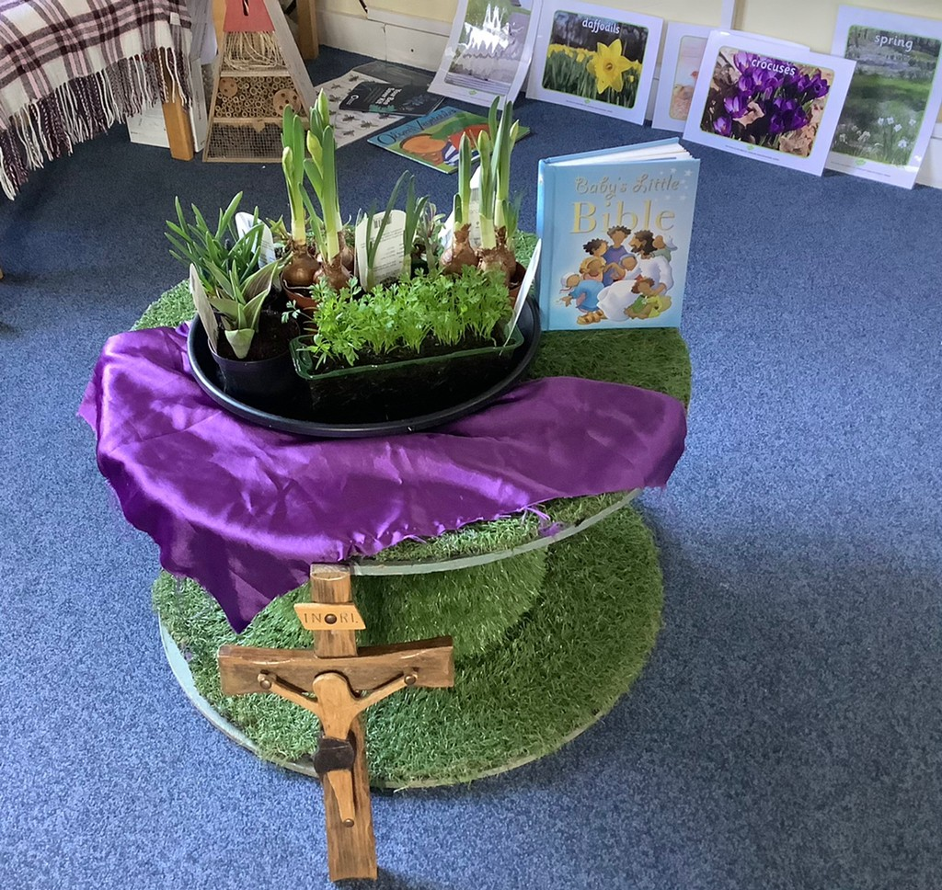
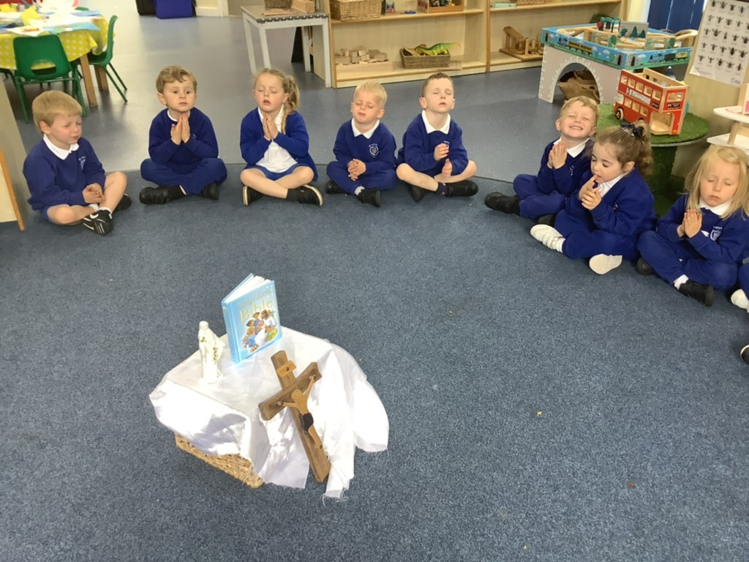
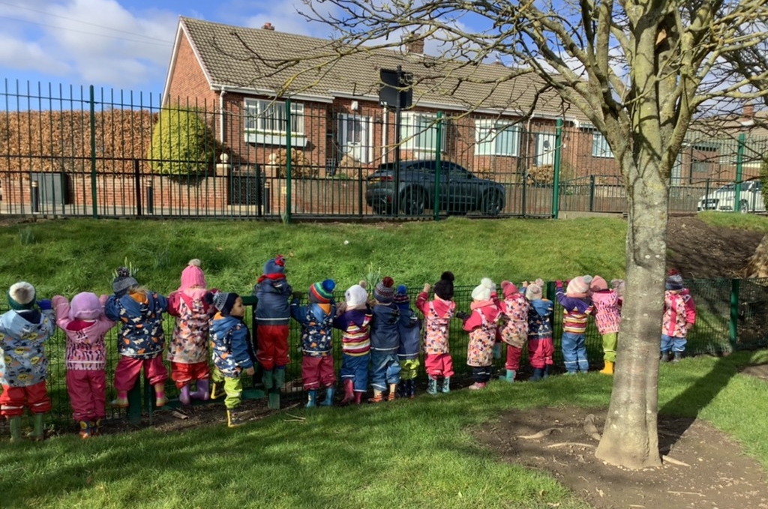
Religious Education
We are a Roman Catholic school and Jesus
is at the centre of our ethos. Daily Prayer and Liturgy and RE weekly lessons, delivered at an appropriate level. Other faiths are also part of our yearly RE curriculum.
Celebration of the word : Gospel Led

Slide 10
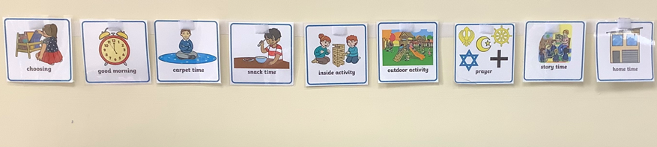
A typical day
Nursery AM session 8.30 – 11.30
PM session 12.30 – 3.30
(gates open at 11.20 and 3.15 for staggered handover)
Reception 9.00 – 3.30 (doors open 8.45 and 3.15)
Structured weekly and daily timetable
Whole class
Smaller groups - RE, Maths, Speaking & Listening
Teacher led focus – indoor and outdoor
Child led learning in the moment
Indoor and outdoor provision A.M & P.M
Notify school as soon as possible if child not attending
(48 hour rule for sickness or diarrhoea)
Reminder that it is distressing for the child if late
Ensure school office has up-to-date contact details

Slide 11
Phonics & Reading
Read Write Inc – phonics programme .
Homework will be linked to phonics in Autumn term. Teacher videos shared weekly on Tapestry DAILY FLASHING SOUNDS
Oxford Owl – when children are ready for books.
Spelling Shed – to follow
Reading Library – choosing anytime
Listen to your child read aloud
Share books
Read to your child regularly
Discuss the book your child is reading in general terms e.g. likes dislikes
READING ANYTHING IS BETTER THAN NOTHING!

Slide 12
Writing
Early writing activities
Gross and Fine motor
Funky Fingers
Read Write Inc - correct formation from the start is essential including writing names

Slide 13
Maths
White Rose for Nursery
NCETM – Maths Mastery approach Reception
Subitising – looking at an amount and know how many without counting
Maths in all areas of learning – Real life experiences.
Numbots – maths online

Slide 14
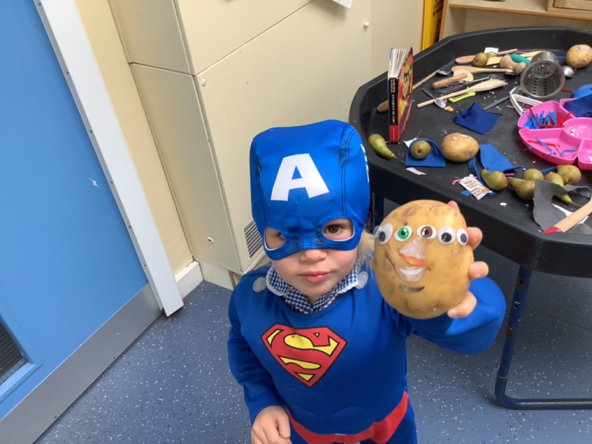
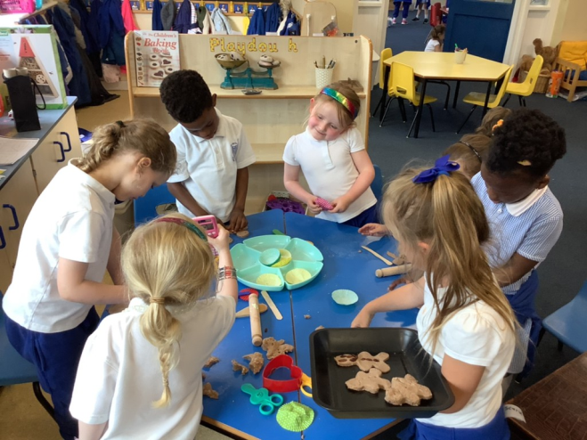
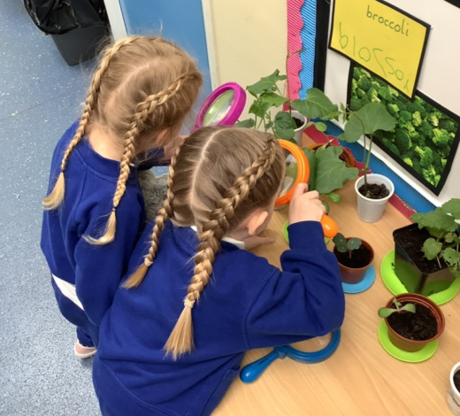
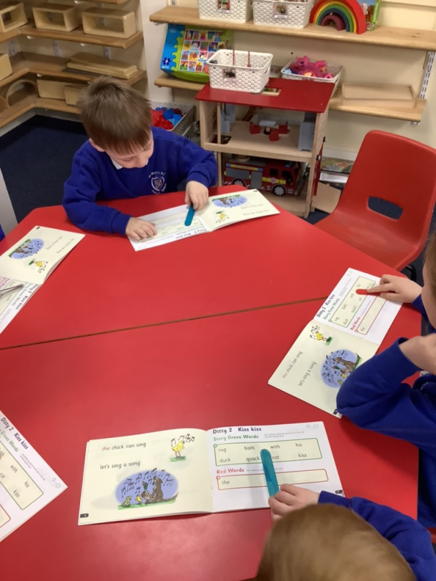
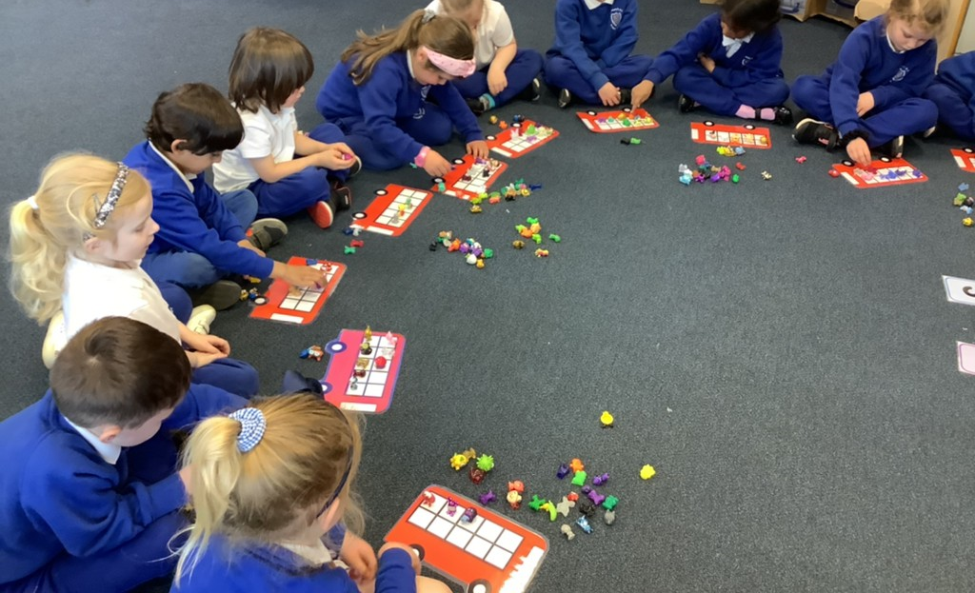
Play Indoors
Being Imaginative
Making Relationships
Understanding the World
Mathematics
Phonics

Slide 15
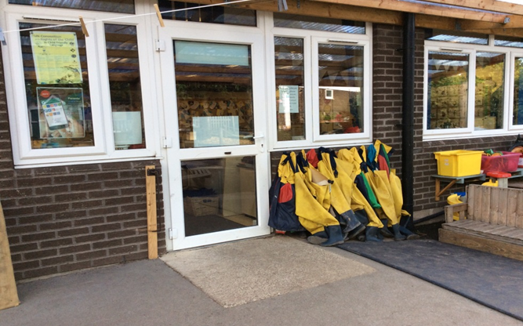
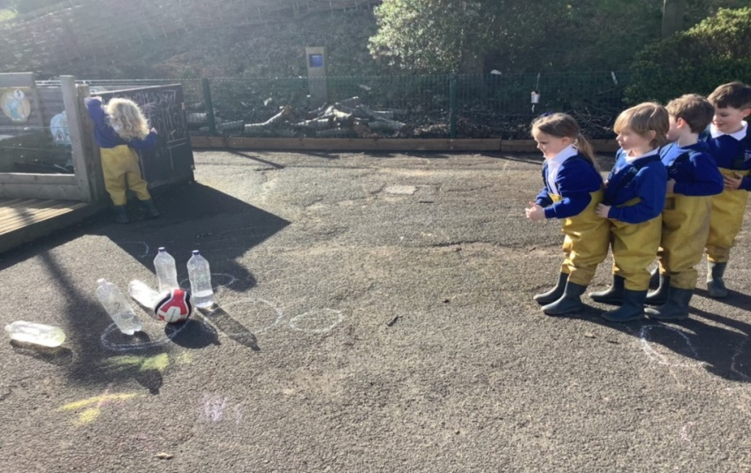
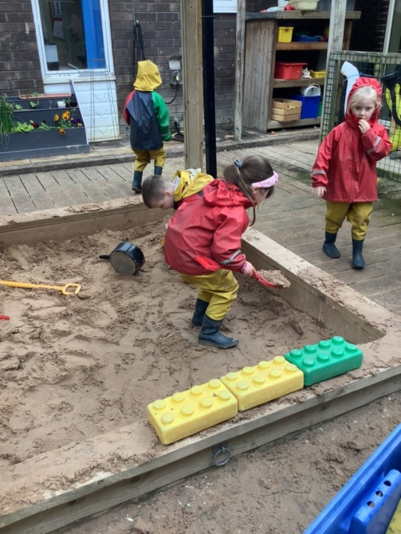
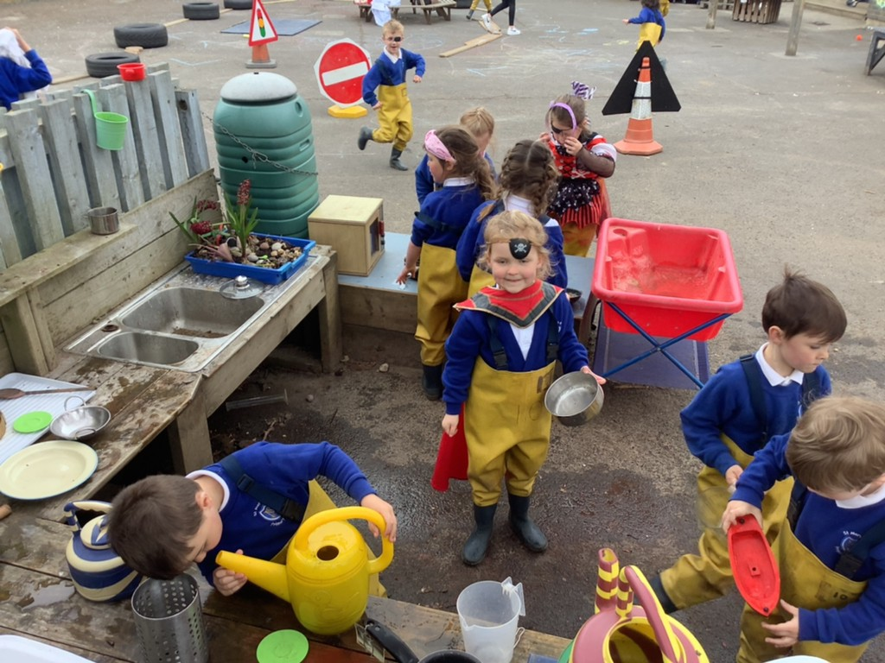
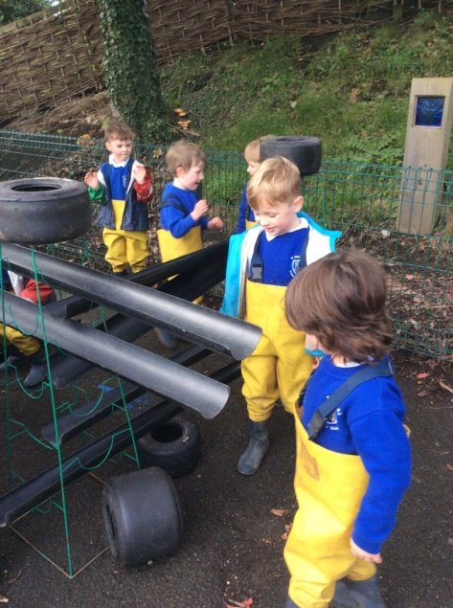
Play Outdoors
Physical development
Communication & Language
Negotiation
Sensory Regulation
Investigation

Slide 16
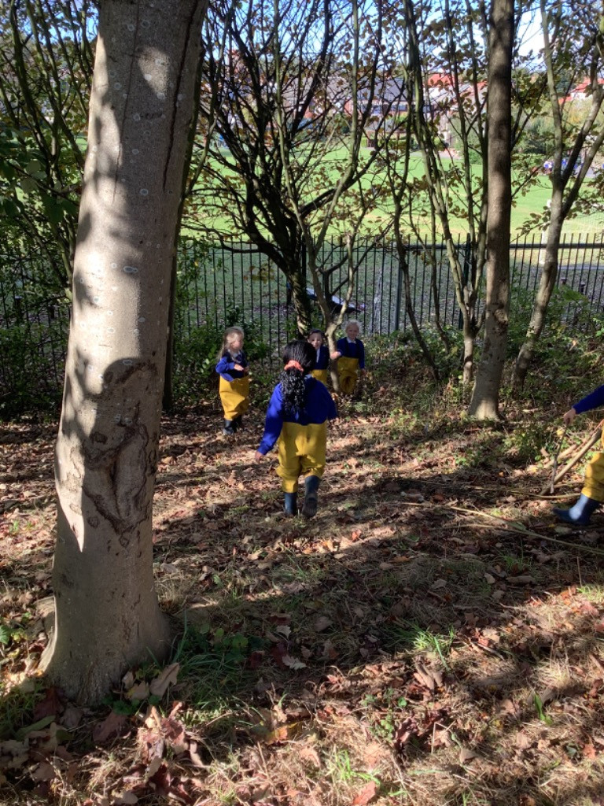
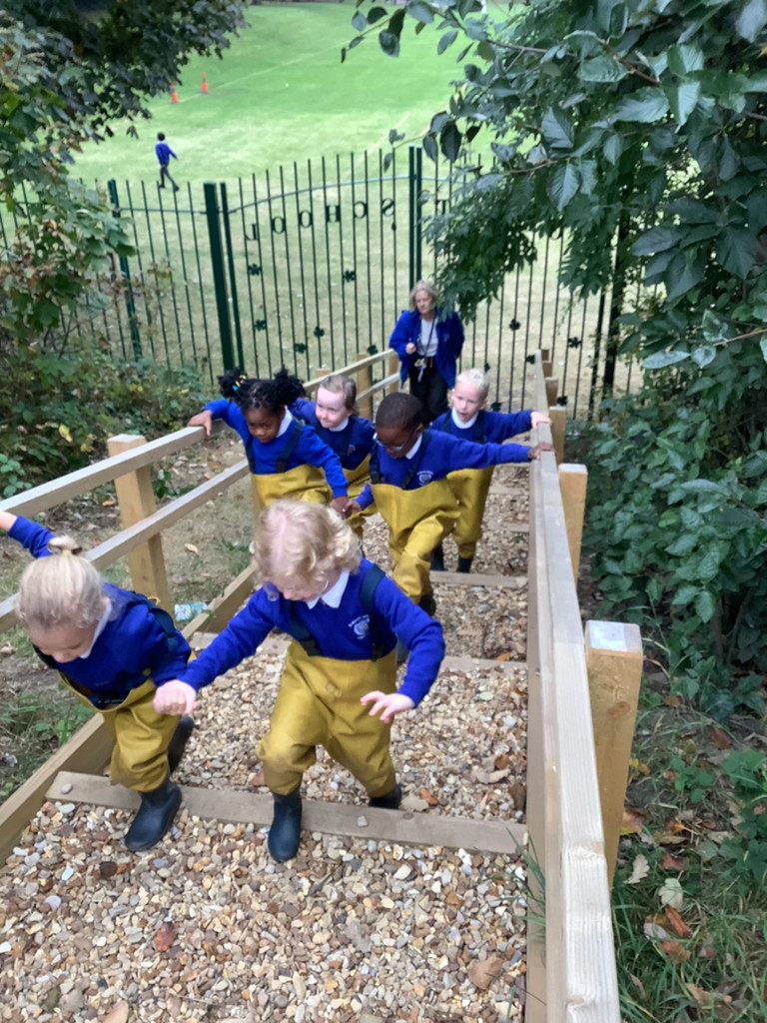
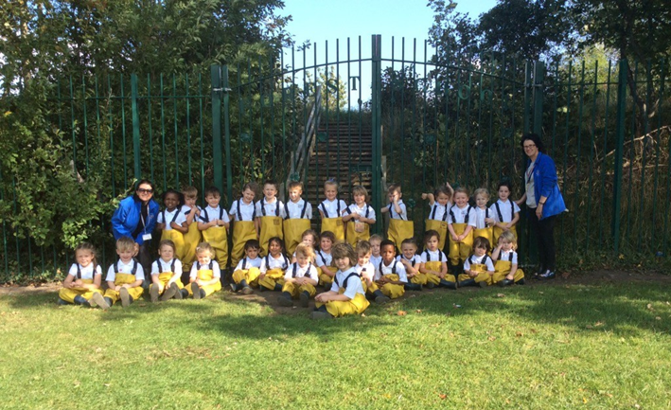
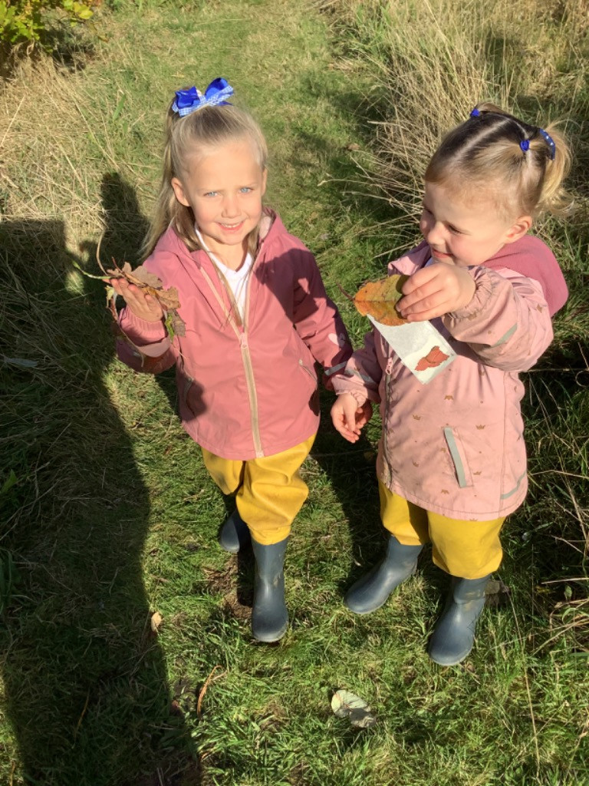
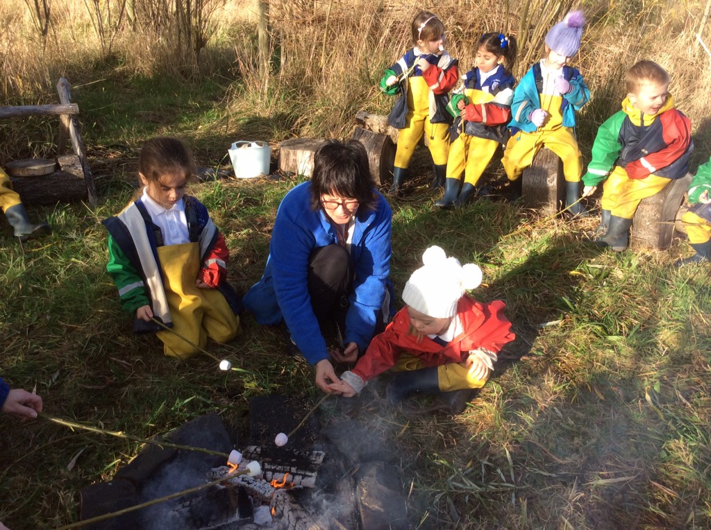
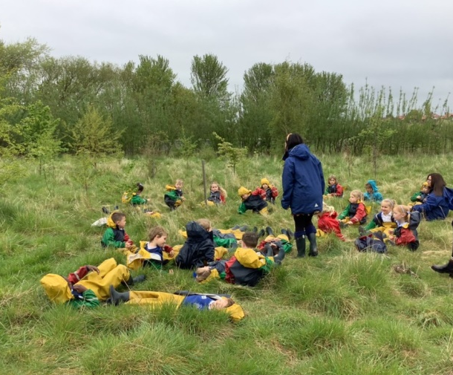
Forest School
Repeated visits to engage with the rich natural diversity of the woodland environment to help build confidence, sensitivity, resilience and curiosity.
Taking Risks
Managing Own Safety
Working Together
Real Life Experiences
Well - Being

Slide 17
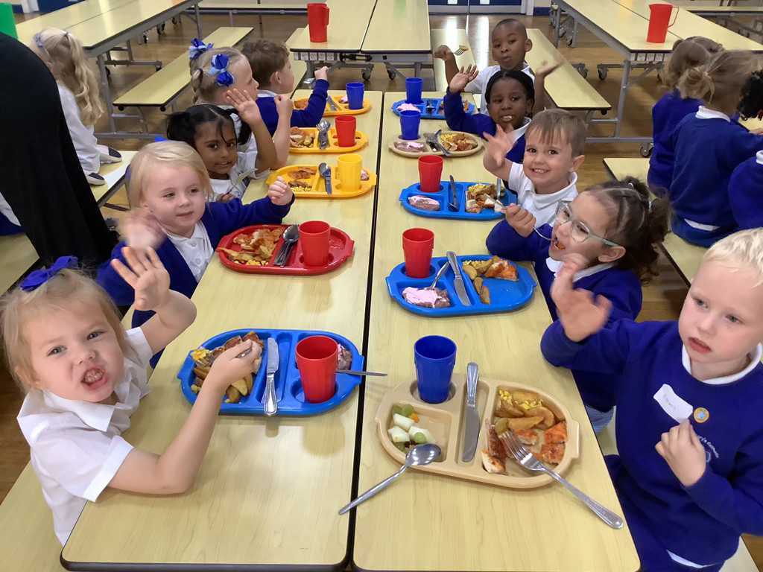
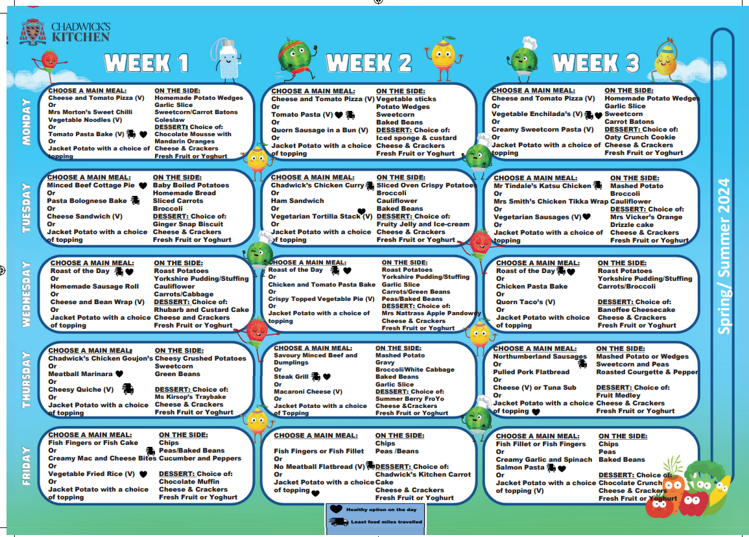
Lunchtime
Independence
Social activity
Widening tastes in food
All staff supervise while the children eat lunch
Teaching Assistants from team supervise during lunchtime play

Slide 18

Tapestry APP - online journal with observations showing your child’s development.
Link sent to parent email
Important information is shared. It must be accessed regularly
You will only be able to view your child’s journal. Others can not see anything you share from home, except staff
Sharing significant moments
Holistic view of your child
Observations will be added showing significant moments and from a range of learning experiences
Please ‘Like’ or comment on observations

Slide 19
How can you help?
Uniform- school uniform jogging bottoms, white polo top and school uniform sweatshirt
Summer uniform - shorts (girls and boys)
Black or white Velcro shoes/trainers NO LACES
Name all clothes and shoes don’t forget new uniform
Let your child dress them - putting on coat, putting on shoes
Encourage them to become more independent
In Reception we have a draw string bag for any changes. Ensure change of clothes, pants and socks. Spare uniform gratefully accepted!
Thank you for your support

Slide 20
Questions
We look forward to guiding your child along their journey at St Mary’s RC Primary School
Thank you for listening

