Slide 1




YEAR 2
CURRICULUM
MEETING

Slide 2

Meet the year 2 team:
Mrs Paget
Mrs Gregory
Mrs Collingwood
Mrs Roddy
Mrs Little
Miss Scott
Mrs Jarvis

Slide 3
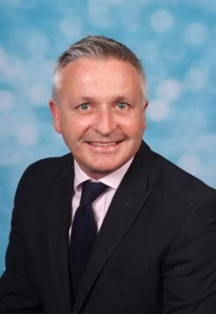
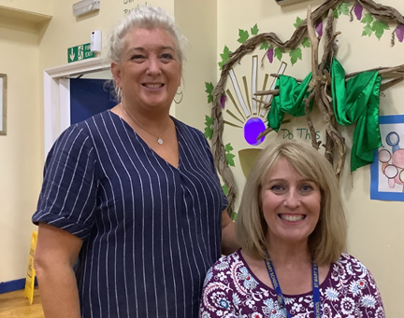
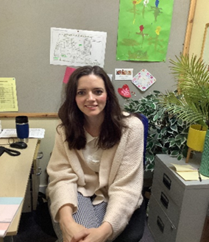
Head Teacher- Mr Clephane
Deputy Head Teacher- Mrs Clinton
Assistant Head Teacher- Mrs Duffy
SENCO- Mrs Roddy

Slide 4
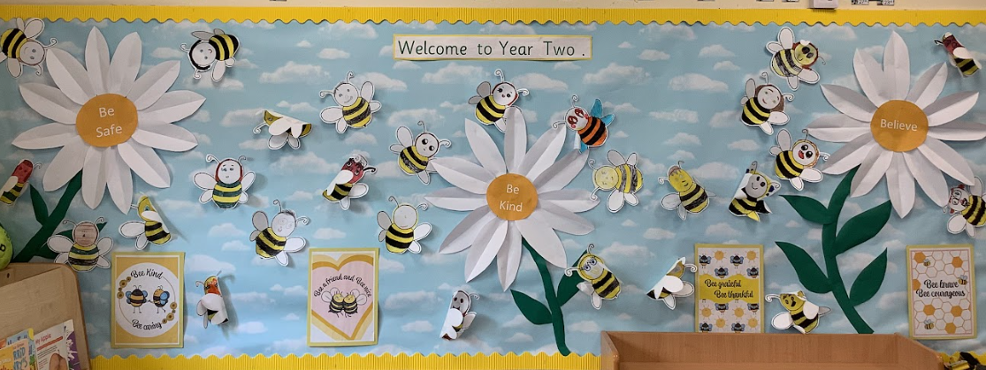
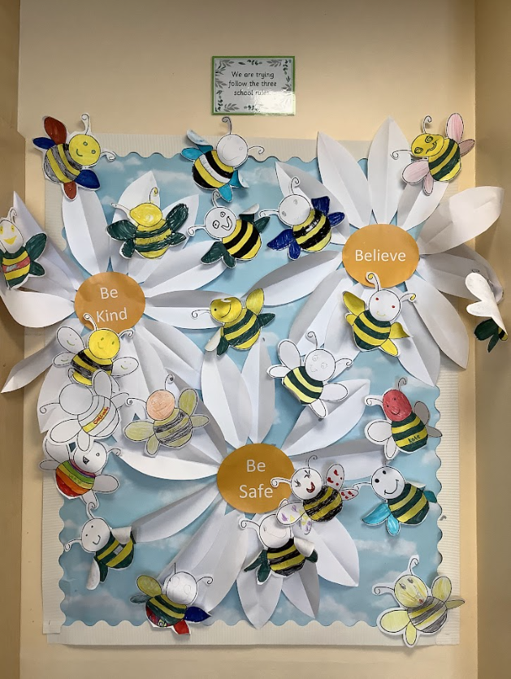
Our three school rules are:
Be kind
Be safe
Believe

Slide 5
A typical day:
Gates open 8:45 A.M.
Early bird activities
Gates close 9:00 for registration
A.M- Phonics, English, Reading and Maths
PM- Curriculum subject, RE, PE, Music and Celebration of the Word
Home Time 3:30 P.M.

Slide 6
Phonics
Year 2 Sats are no longer a statutory assessment. All assessments in year 2 will be carried out by the class teacher.
Phonics Screening Test- Children who did not achieve the required pass mark in year 1 will have another opportunity to take the test at the end of year 2.

Slide 7

RWI (Read, Write, Inc)
At St. Mary’s, we use Read Write Inc to teach children how to read, write and spell. RWI teaches children the sounds in English, the letters that represent them, and how to form the letters when writing. In year 2, your child may be taught in a RWI group, which will focus on teaching your child to read with accuracy and fluency. When your child has completed the scheme, they will then move on to other reading books, e.g. Oxford Reading Tree.

Slide 8
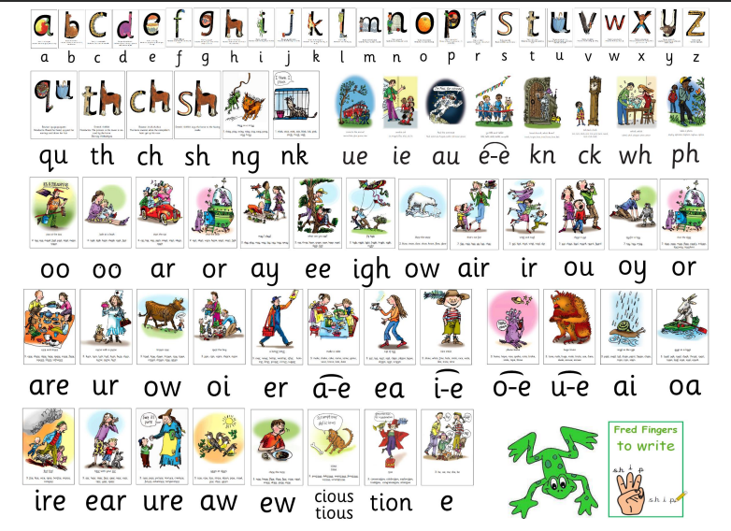
Phonics
Synthetic phonics is a method that’s used to teach pupils how to read and write in English. Through synthetic phonics, children will learn that all words can be broken down into small units of sound called phonemes, which are represented in written language using groups of letters called graphemes.
Your child will continue to learn and practice phonics to develop their reading and writing skills. Please continue to practice phonics with your child at home.

Slide 9

Maths
At St. Mary’s, we use White Rose to teach maths.
https://whiteroseeducation.com/
This is a mastery approach to teaching maths, which promotes daily problem solving activities.

Slide 10
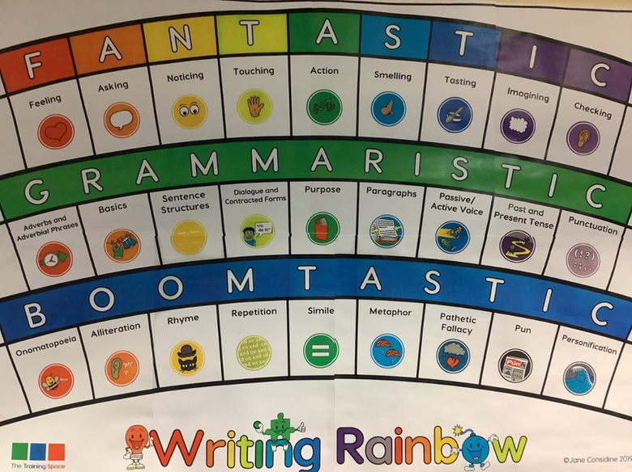
Writing
At St. Mary’s, we use the Write Stuff approach to teaching of writing. Whole school approach to writing. Systematic approach to the teaching of writing which benefits all children.
This approach encourages the use of ambitious vocabulary. The children use lenses
e.g. feeling or asking, to write sentences.

Slide 11
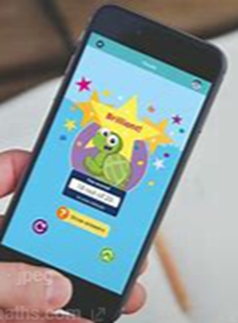

Homework
Year 2 –
Reading- Free choice book every day which children choose.
Weekly schemed book- Oxford Owl
Numbots/ White Rose 1 minute maths app
Weekly spellings to practice on
Spelling Shed- quiz on Monday morning

Slide 12

Important Dates
Tuesday 10th October
Harvest Liturgy 9:15 AM OR 2:45 PM
Wednesday 6th November- School Photographer
Christmas Nativity
Tuesday10th December
9:30 AM or 2:30 PM

Slide 13
Reminders
PE is on Wednesday for both classes. This will be taught by our specialist PE coach .
Each Wednesday the children will receive violin tuition and must bring their instrument to school each week.
Names on jumpers.
Your child must have a water bottle everyday.
Yr2 reading folders can be brought in everyday to swap for a new free choice book.
Children can bring a healthy snack however fruit is provided daily.
School Trips
Autumn Term local walk
Summer Term trip involving Parental Contribution TBC
After School Clubs:
Drama is on Wednesday and Multi-skills on Tuesdays
Careers Week: We welcome parents into school to discuss their career with our children. Volunteers are most welcome.

