Slide 1
Live Simply Award
St Mary’s Catholic Primary School
Barnard Castle
Headteacher: Lesley Ann Box

Slide 2
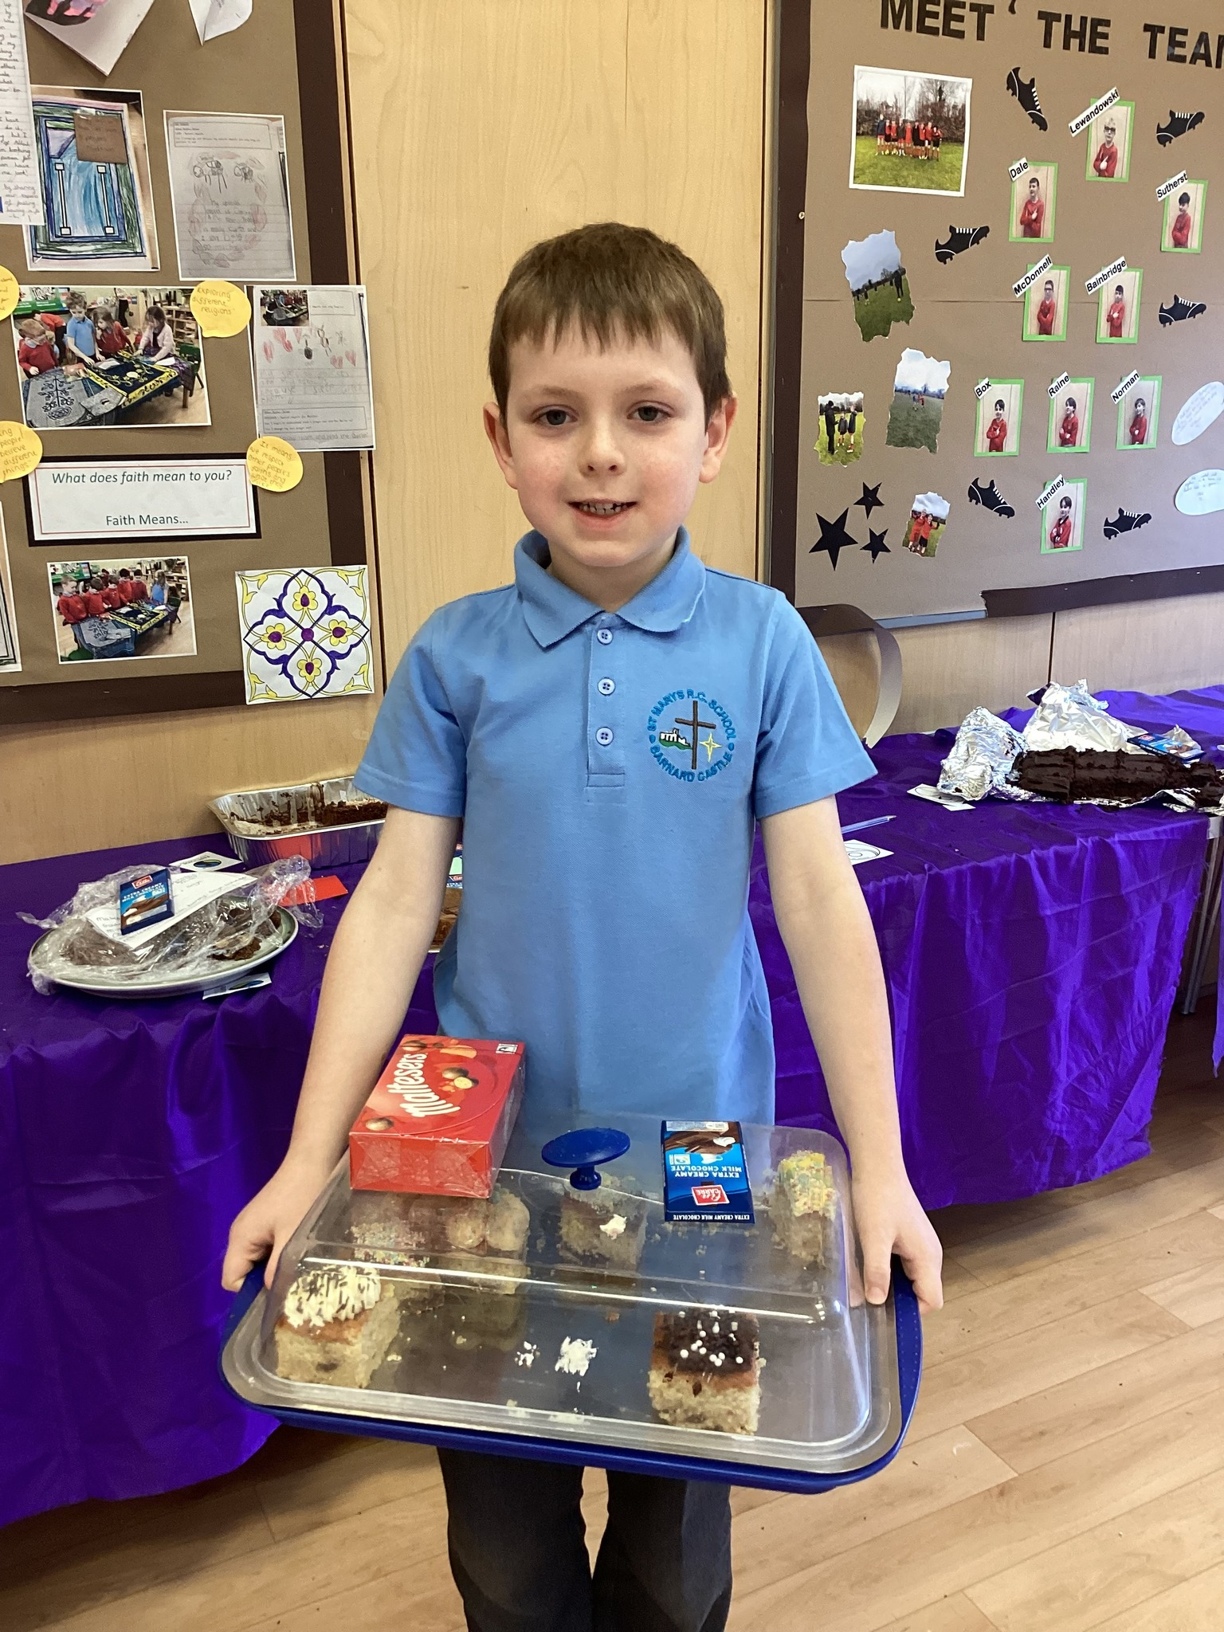
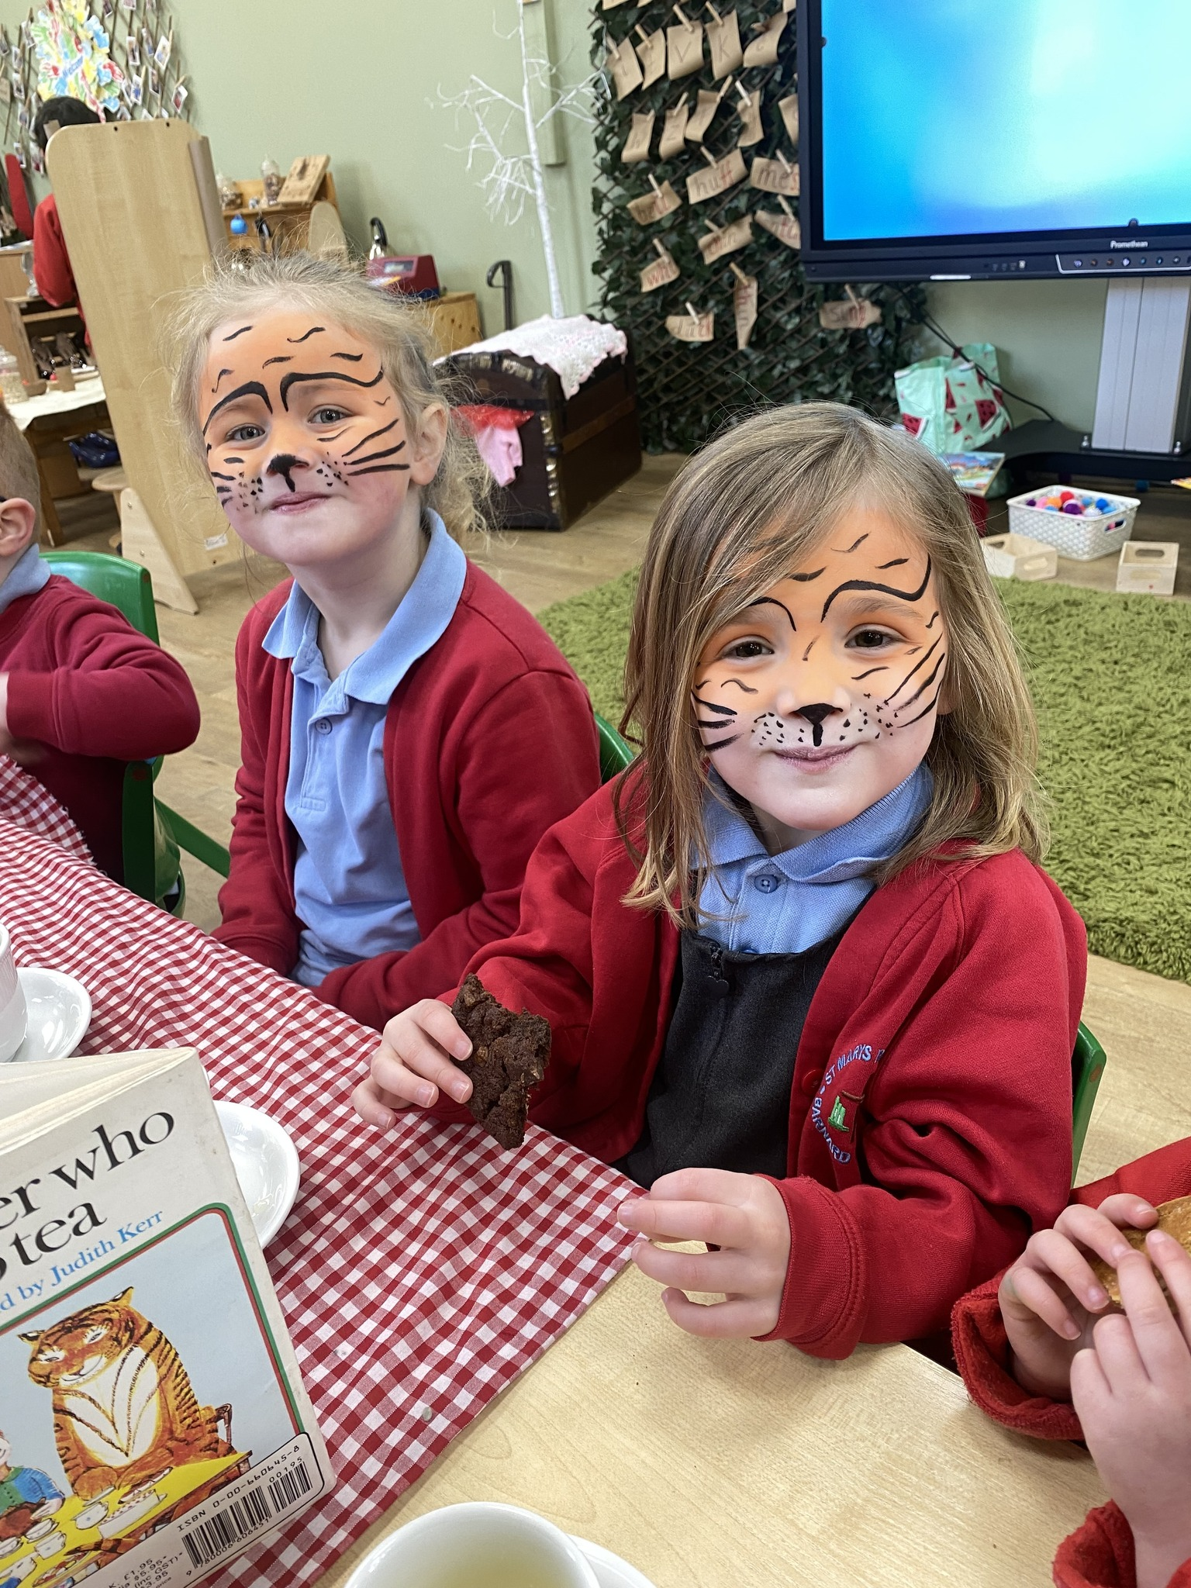
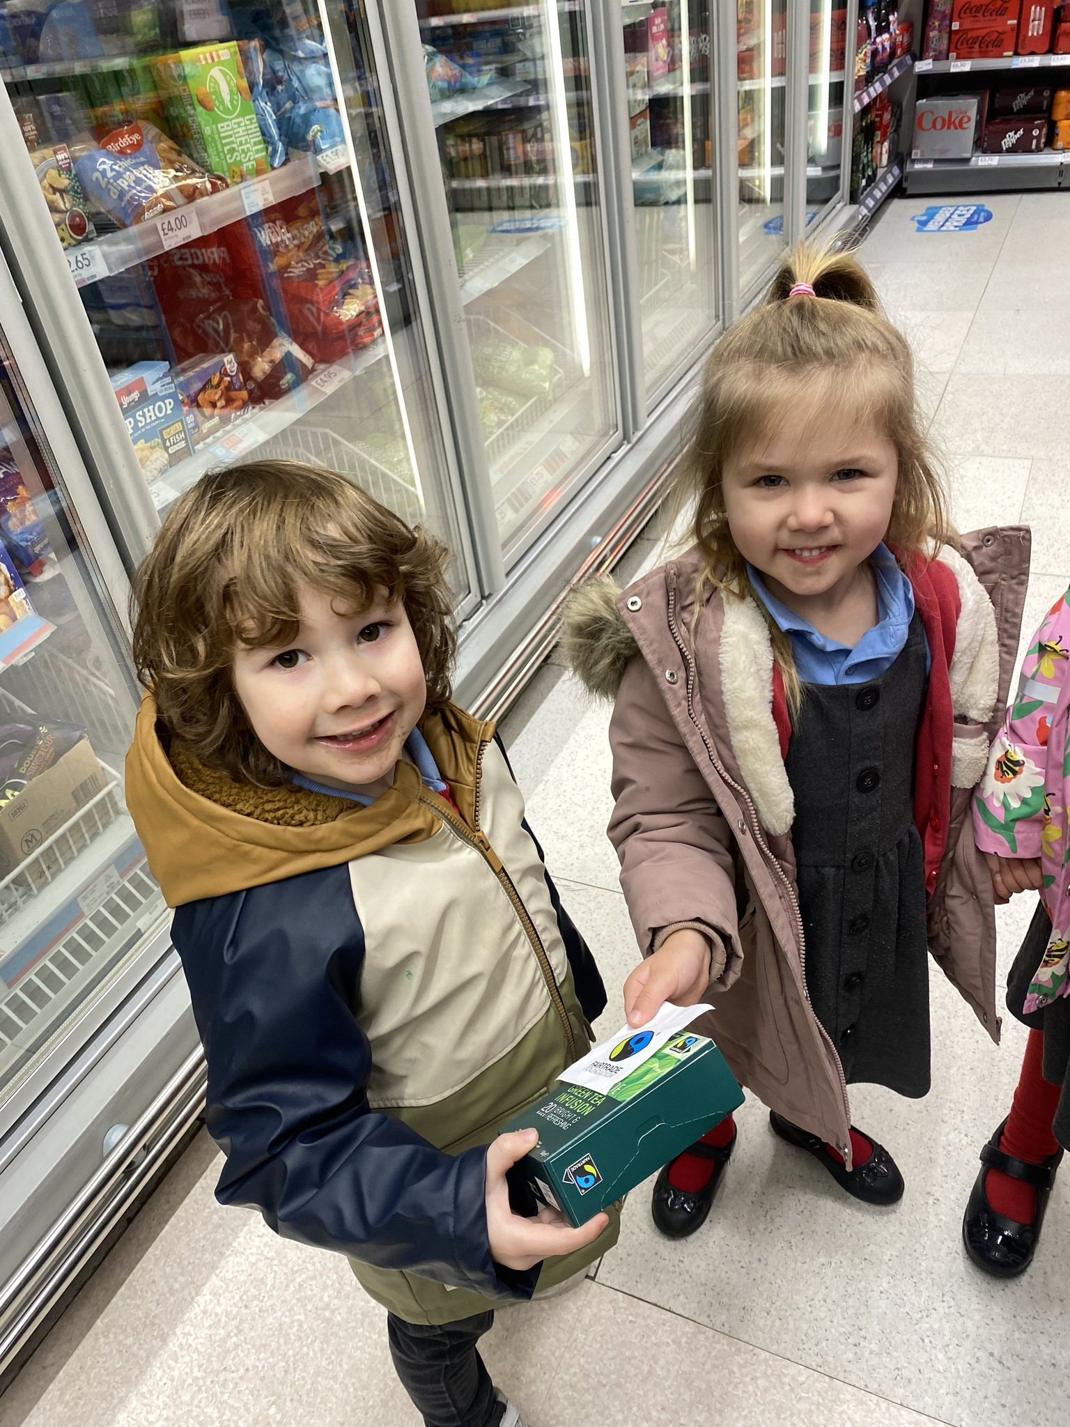
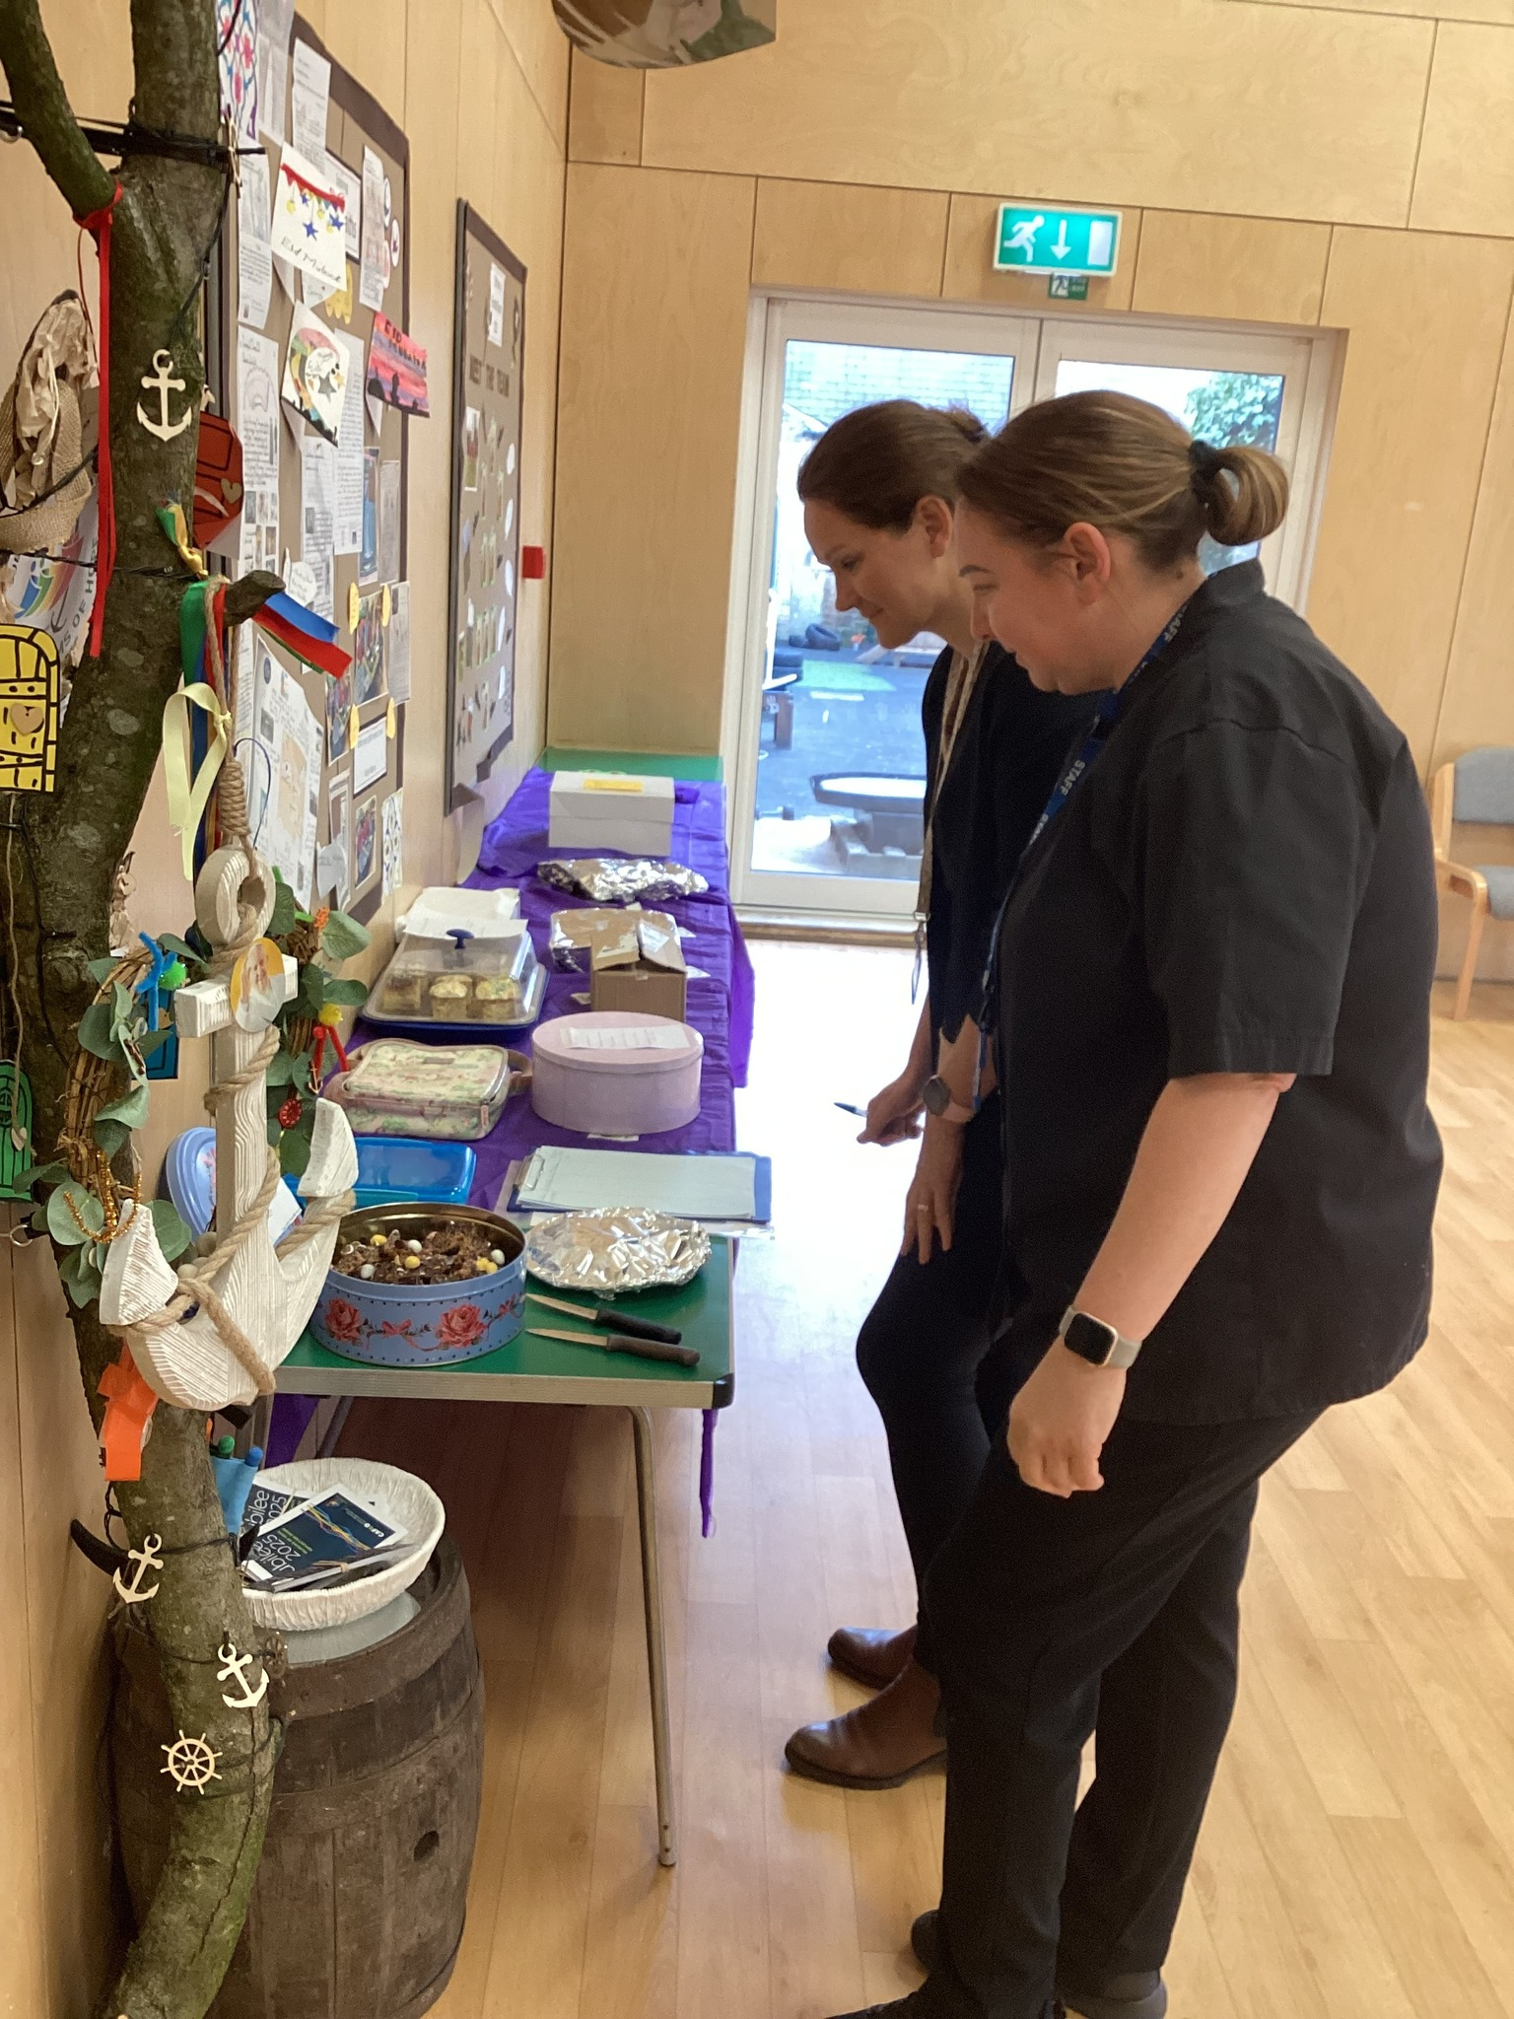
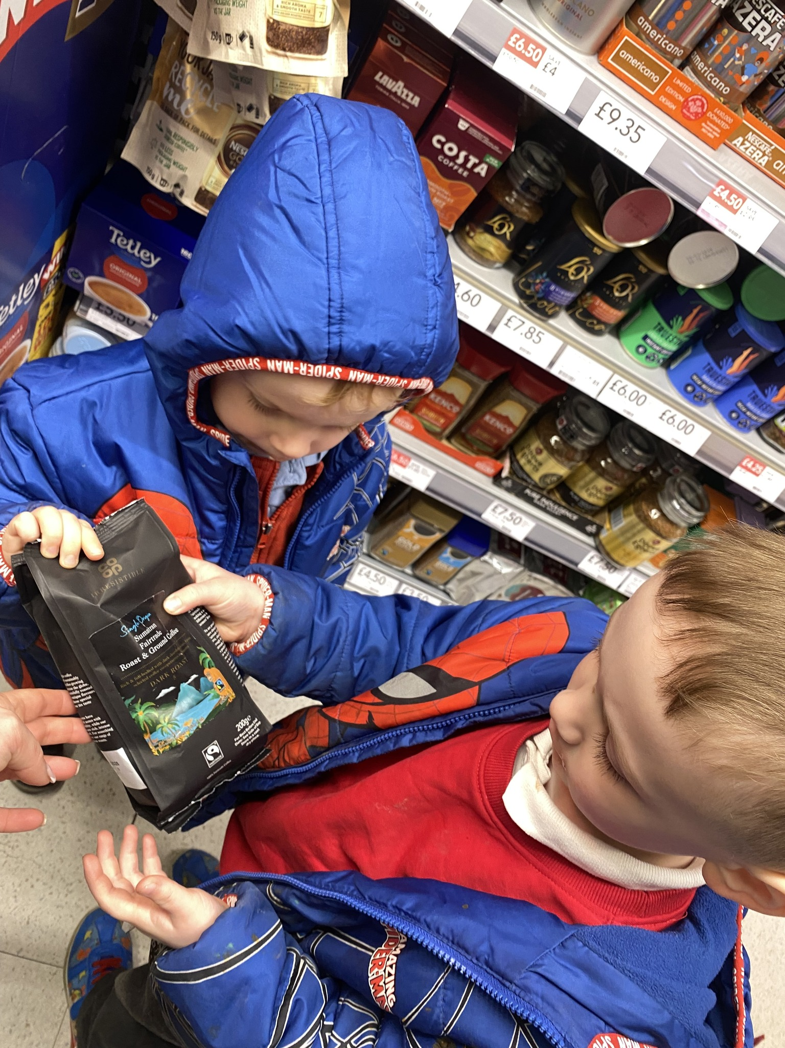
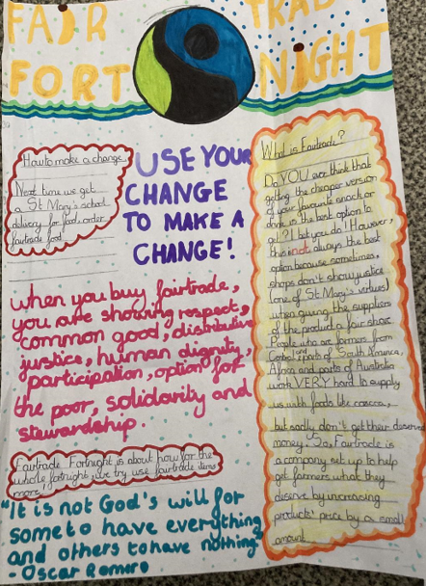
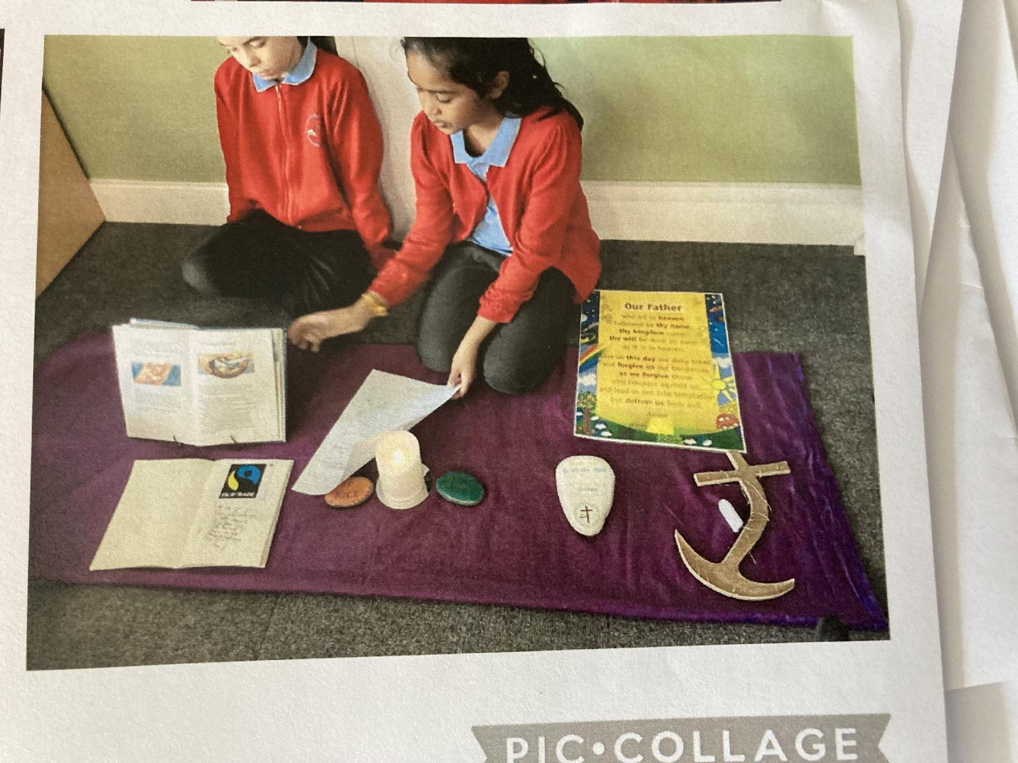
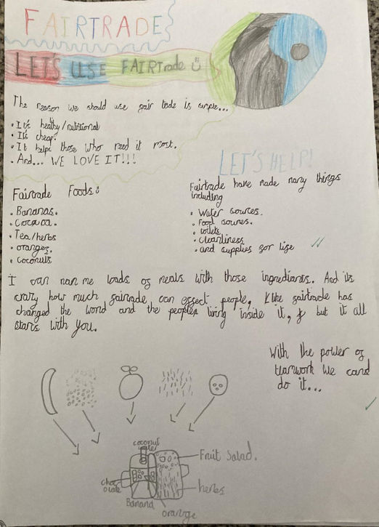
Global (1) Fairtrade Fortnight
‘Do you know Maltesers use Fairtrade chocolate? I won the bake off and that is what I won- they are very nice!’
Louie B Y3
The bake off brought the school community together- talking about Fairtrade, finding Fairtrade items and tasting Fairtrade foods.
As part of home work we saw quality pieces of work that show clear learning and understanding of what Fairtrade means and why we as Catholics need to promote it across school and home.
Fairtrade is part of our curriculum both in RE, English and wider life of school- the children wrote some very persuasive letters in English to encourage the kitchen to make changes and switch to using Fairtrade products.
‘Judging was so difficult- tasting was fun! The children were able to tell me all about their Fairtrade ingredients and how they made their bakes. Delicious!’
Miss Bunford- school cook
‘together, gladly embracing school virtues both at home and at school with our Fairtrade bake- off, developing awareness of and promoting justice, responsibility, human dignity and option for the poor.
HT St Mary’s Primary School

Slide 3
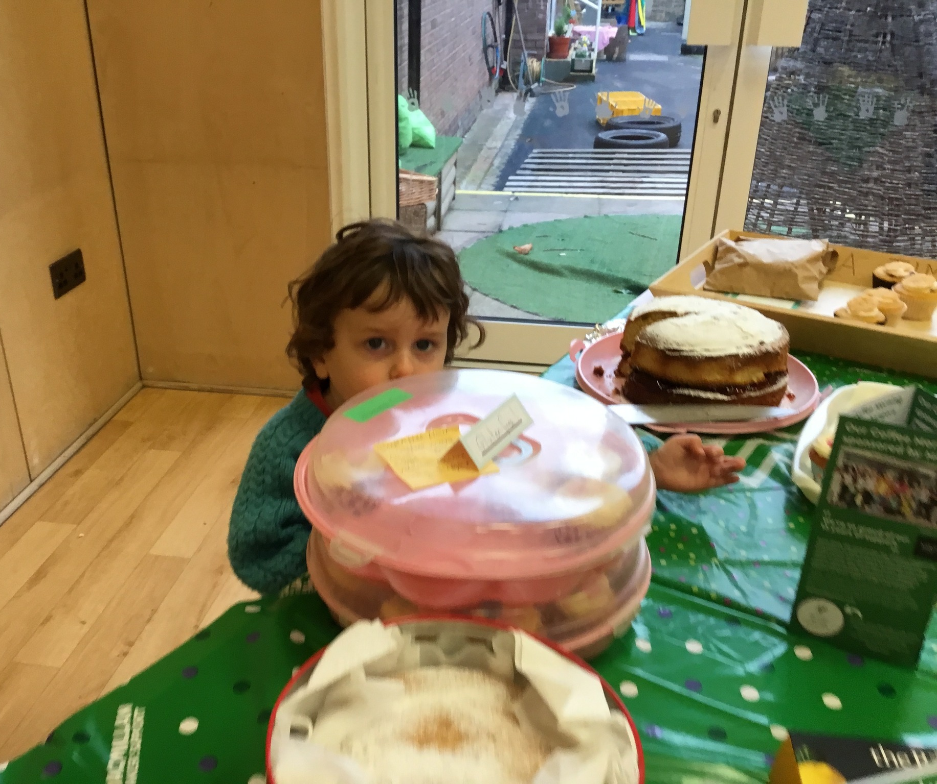
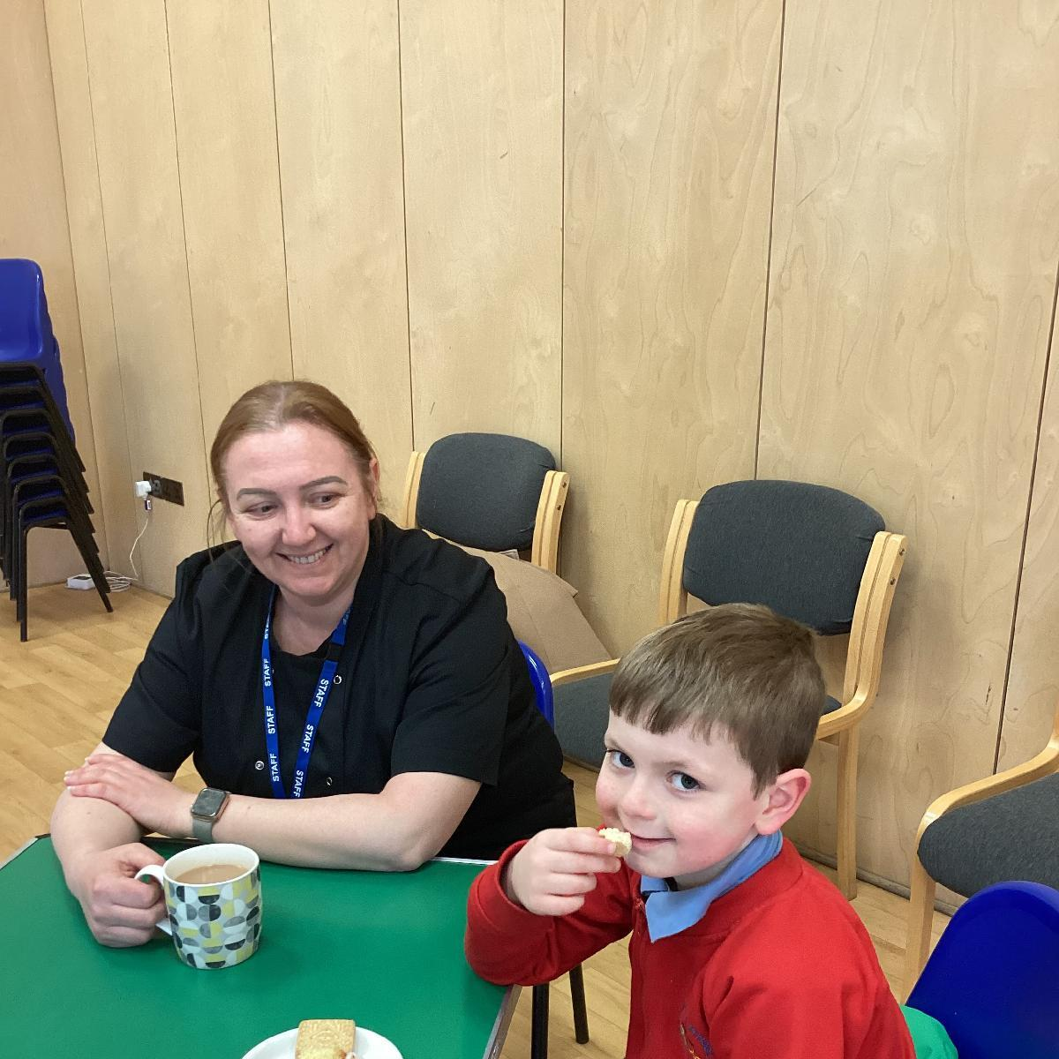
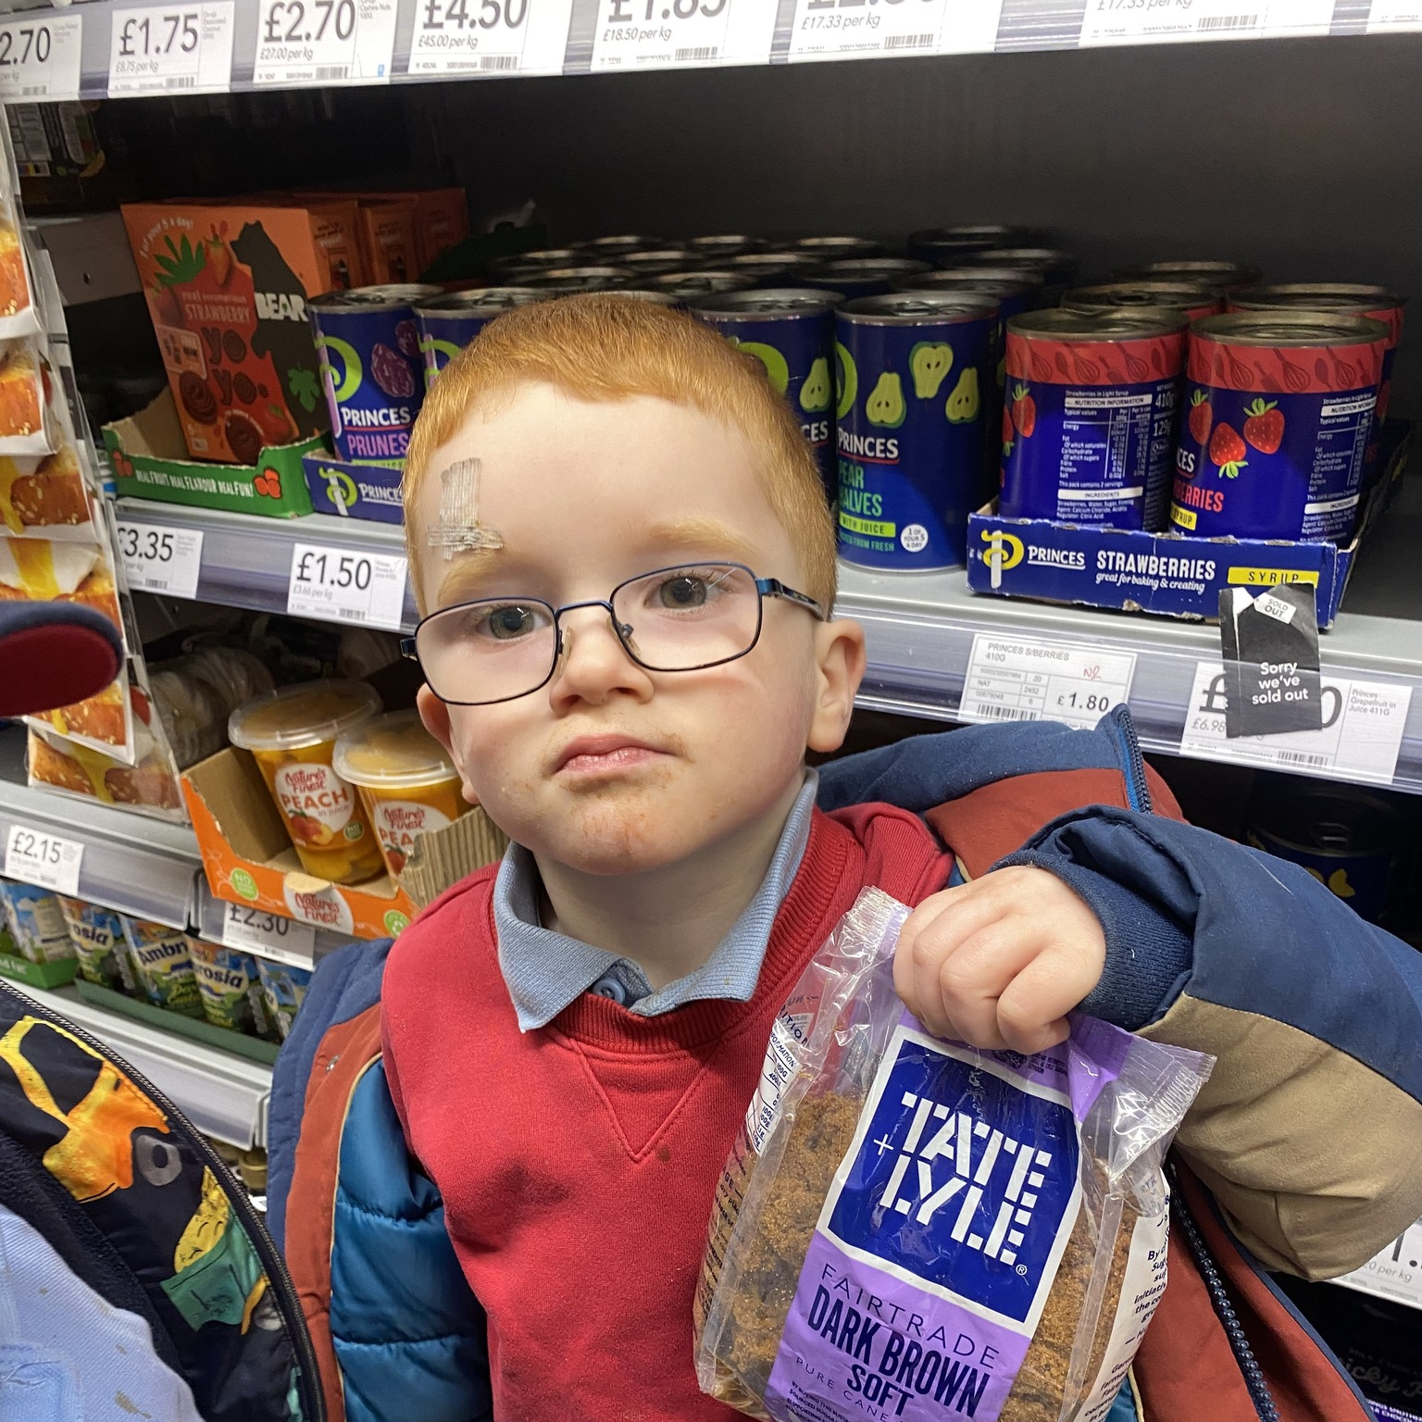
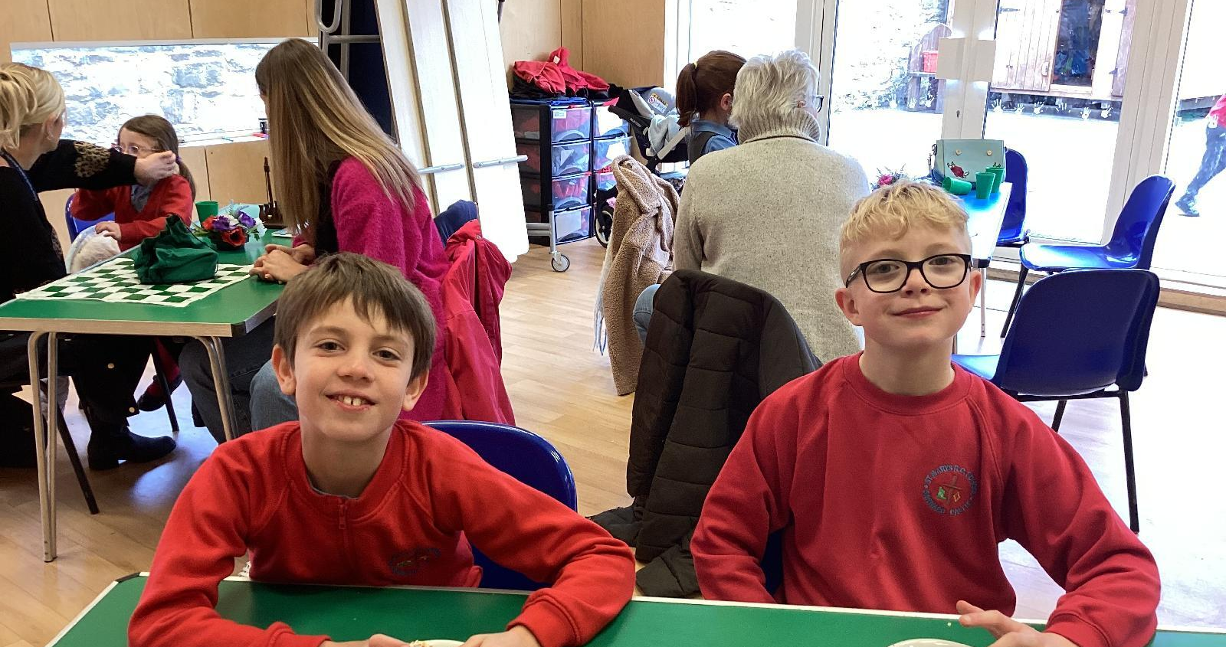
Global (1)Living in Solidarity Fairtrade Fortnight
Both at home and at school the children engaged in many activities to promote and raise awareness of Fairtrade. From Fairtrade hunting to bake offs the children and our families gladly embraced the opportunity to develop their understanding of Fairtrade and also consider changes in their own lives that will make the world a fairer place.
‘Fairtrade is just fair.That’s it!
Luna- Reception Class

Slide 4
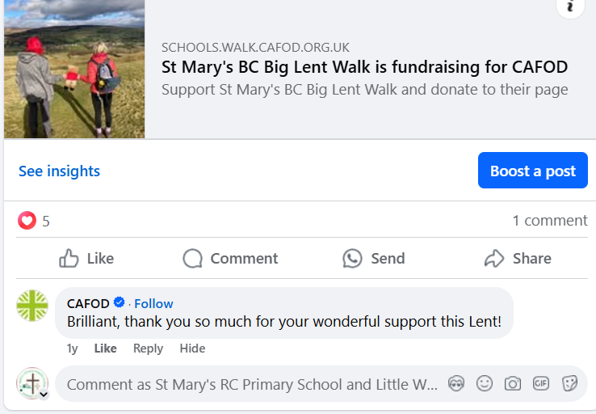
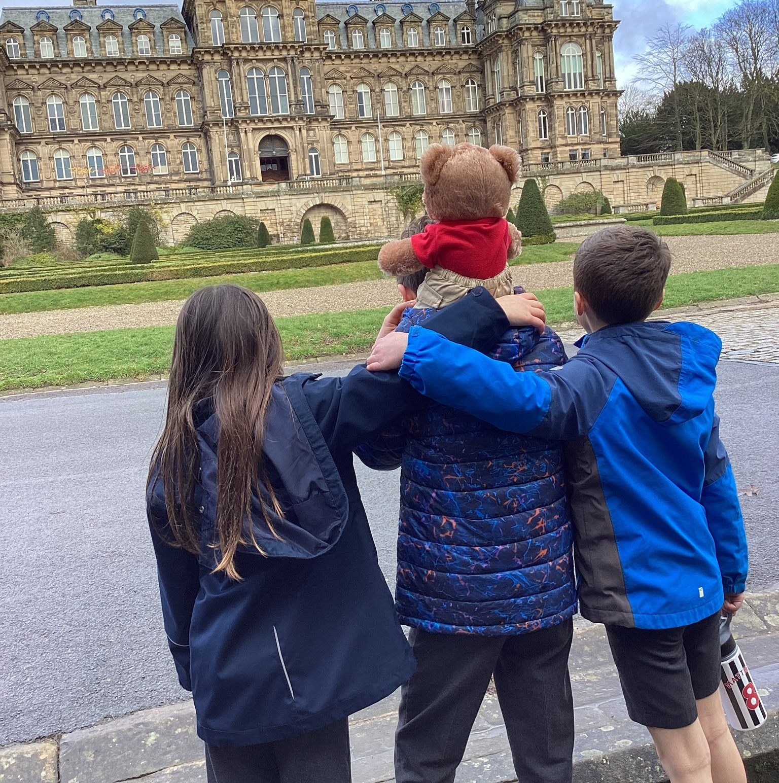
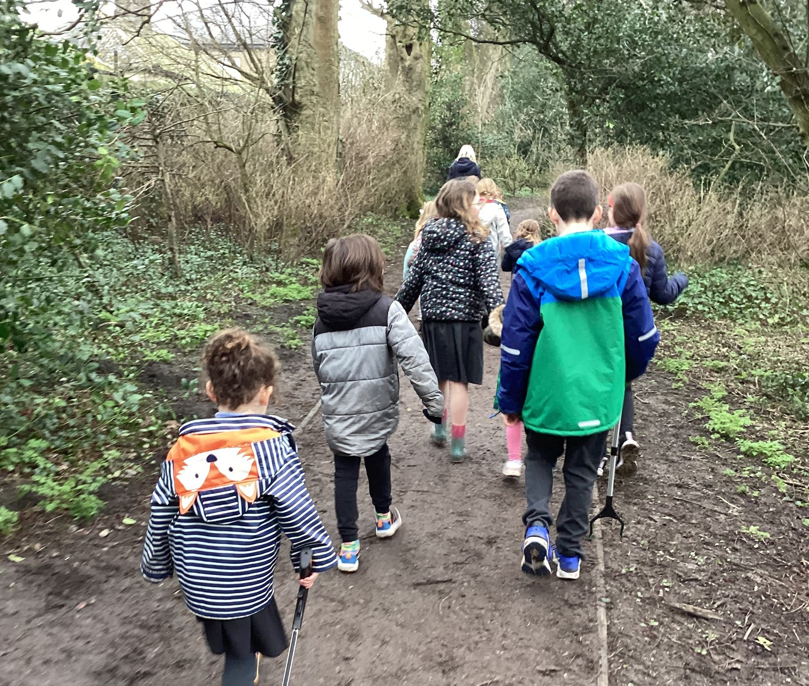
Global (2) Living in Solidarity We will take part in Cafod’s Big Lent Walk to support our Global Neighbours.
‘Solidarity means to kind of stick together! We stood together as a school family when we walked for Cafod because we are a school family and we help our global neighbours.’
Evelyn H Y5
‘A huge thankyou to the children, staff, parents and grandparents who all came along to join us this morning, for our final Big Lent Walk! As a whole school we walked along to Bowes Museum, around their beautiful grounds and back to school.
So that's 1 mile per child and adult to add to our total and we also raised a further £62.65, taking our total amount to £285.65.
St Mary's this is wonderful! Above our £200 target and also above our km target too.
Well done!
#BigLentWalk
‘A wonderful final walk to be part of as parent and governor of the school.’

Slide 5
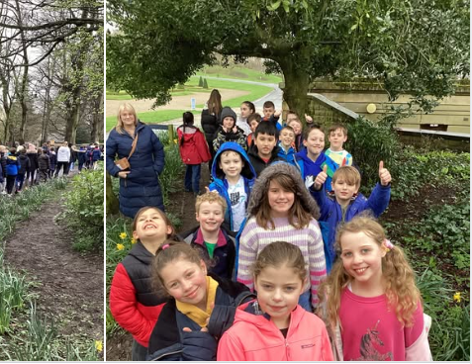
Global (2) Living in Solidarity We will take part in Cafod’s Big Lent Walk to support our Global Neighbours.
‘A huge thankyou to the children, staff, parents and grandparents who all came along to join us this morning, for our final Big Lent Walk! As a whole school we walked along to Bowes Museum, around their beautiful grounds and back to school.
So that's 1 mile per child and adult to add to our total and we also raised a further £62.65, taking our total amount to £285.65.
St Mary's this is wonderful! Above our £200 target and also above our km target too.
Well done!
#BigLentWalk

Slide 6
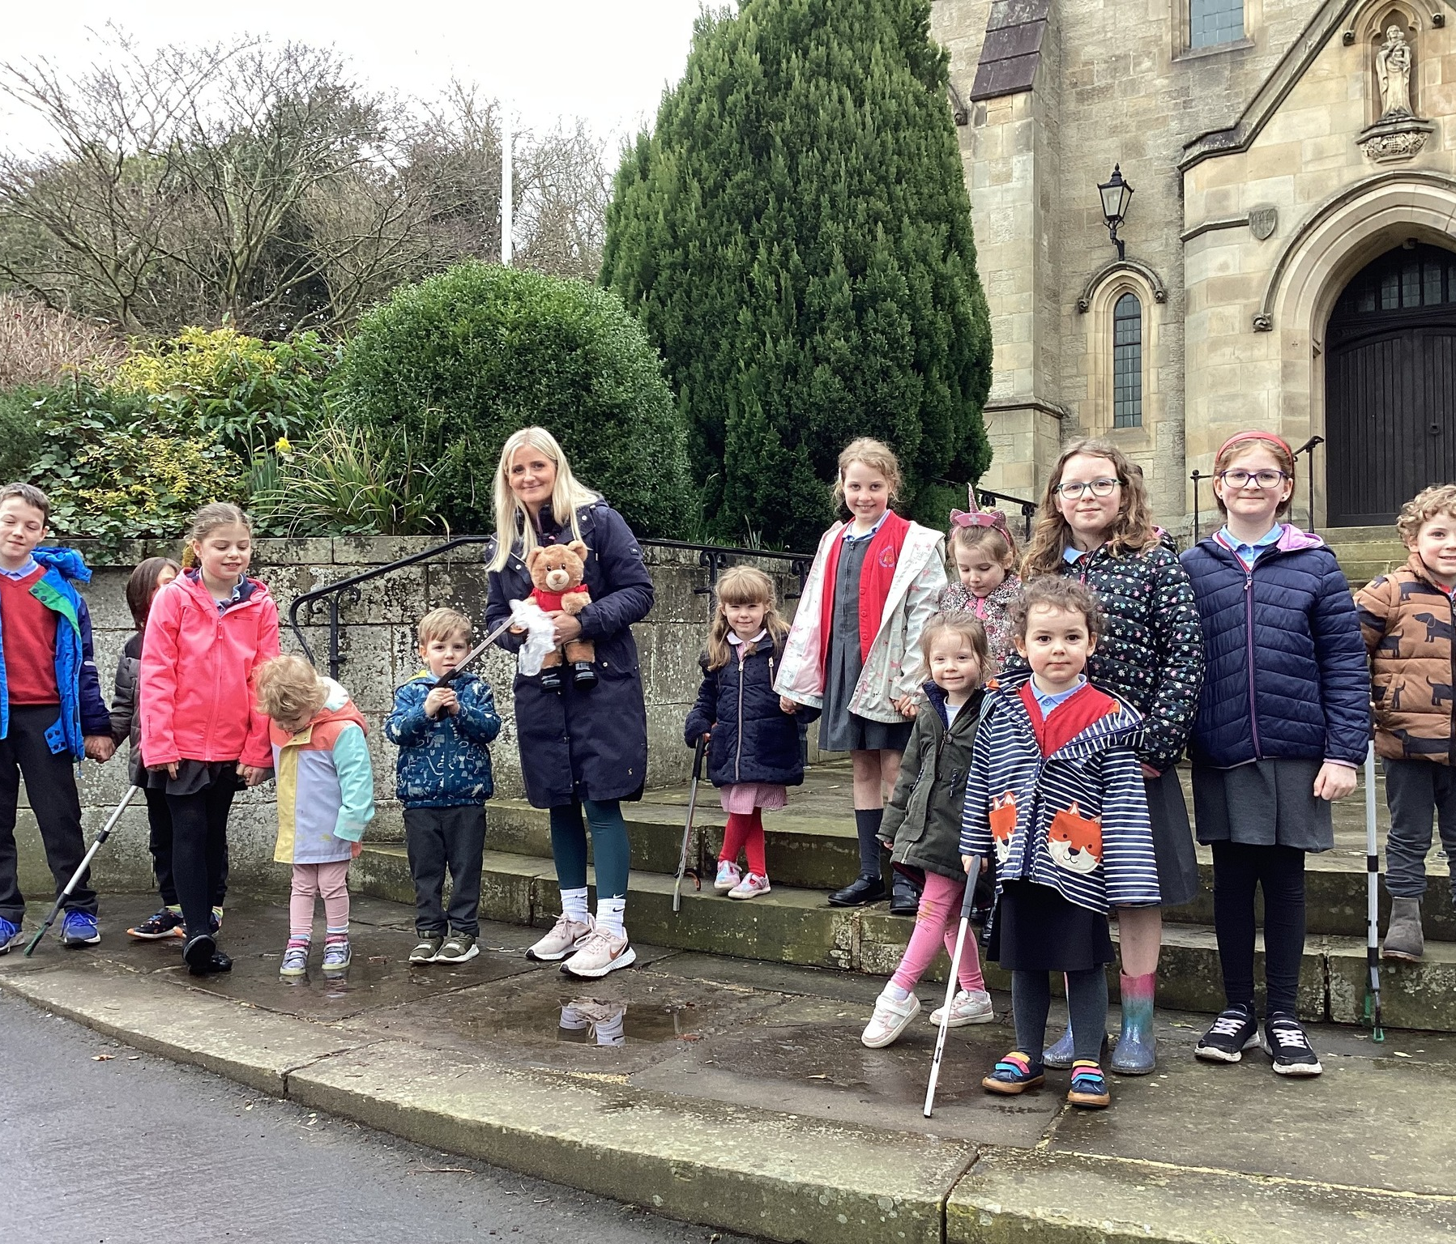
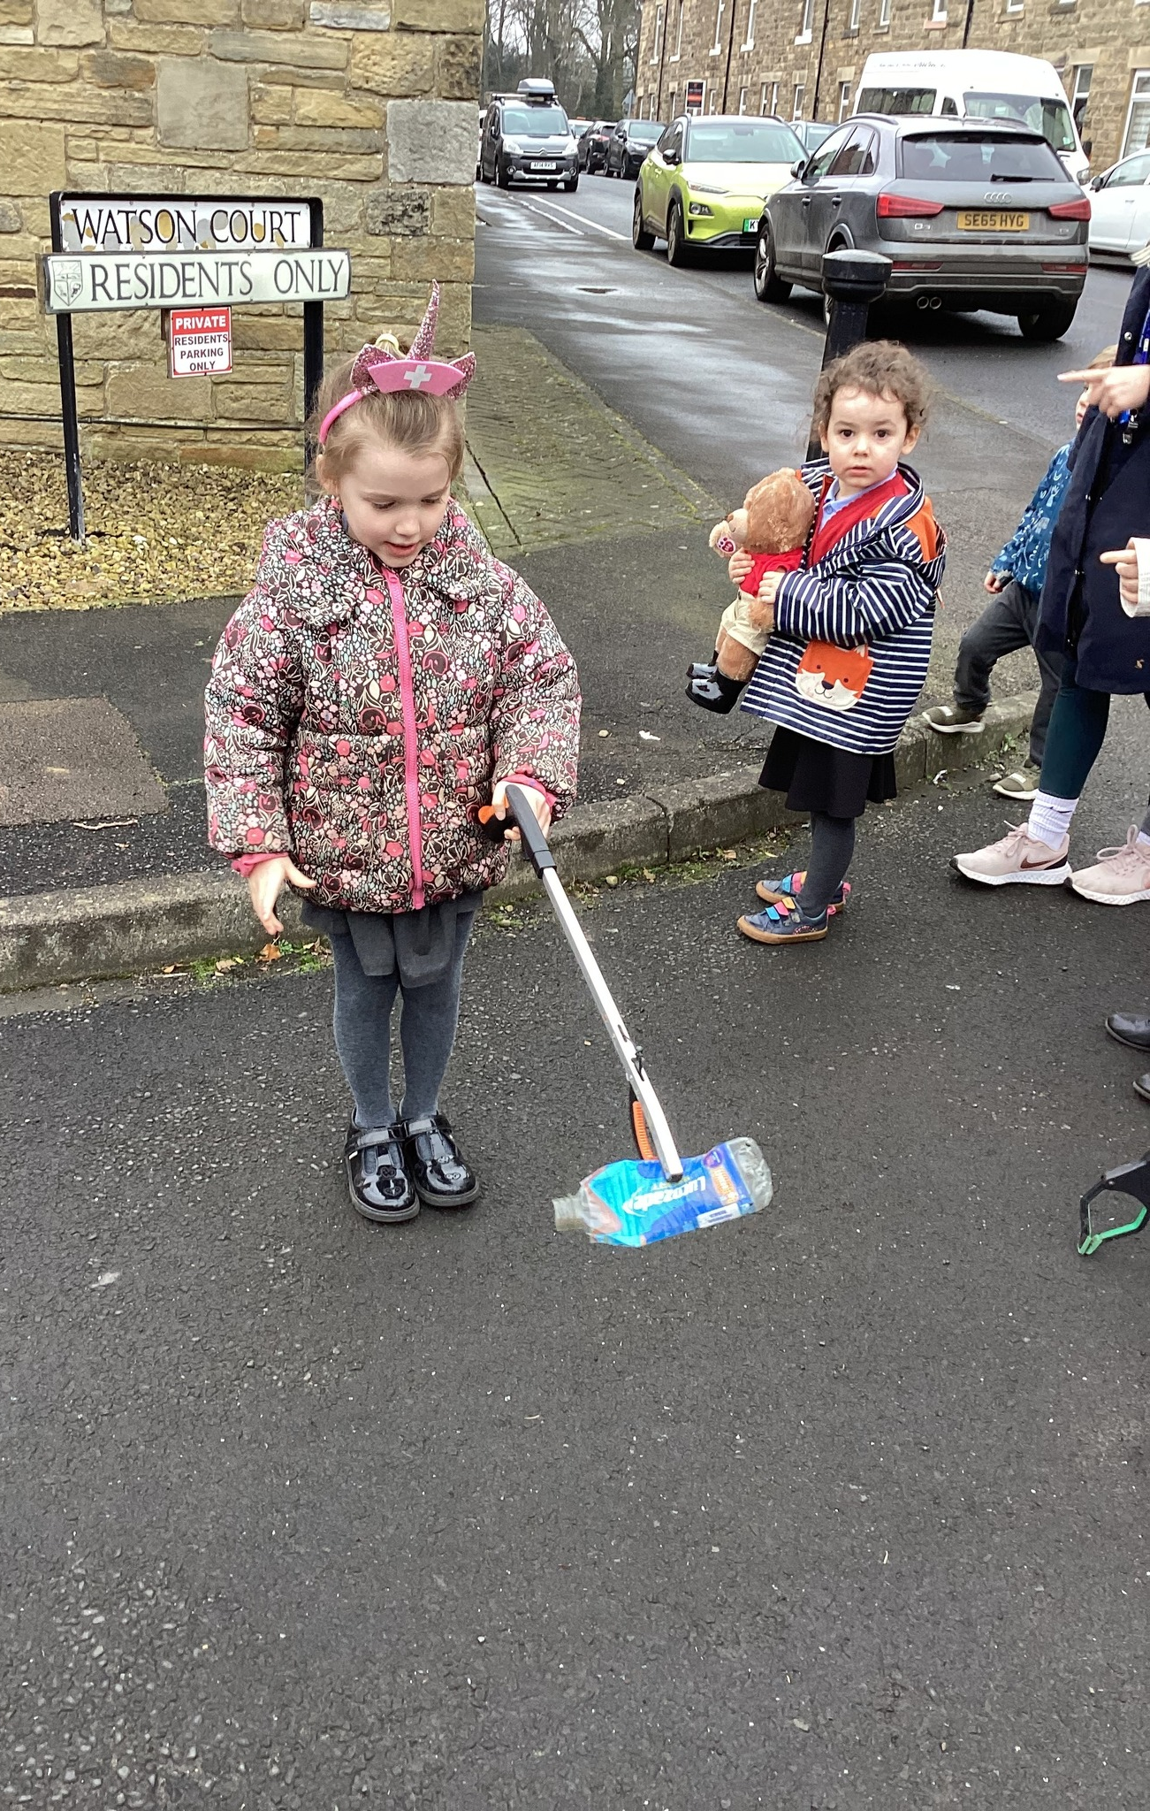
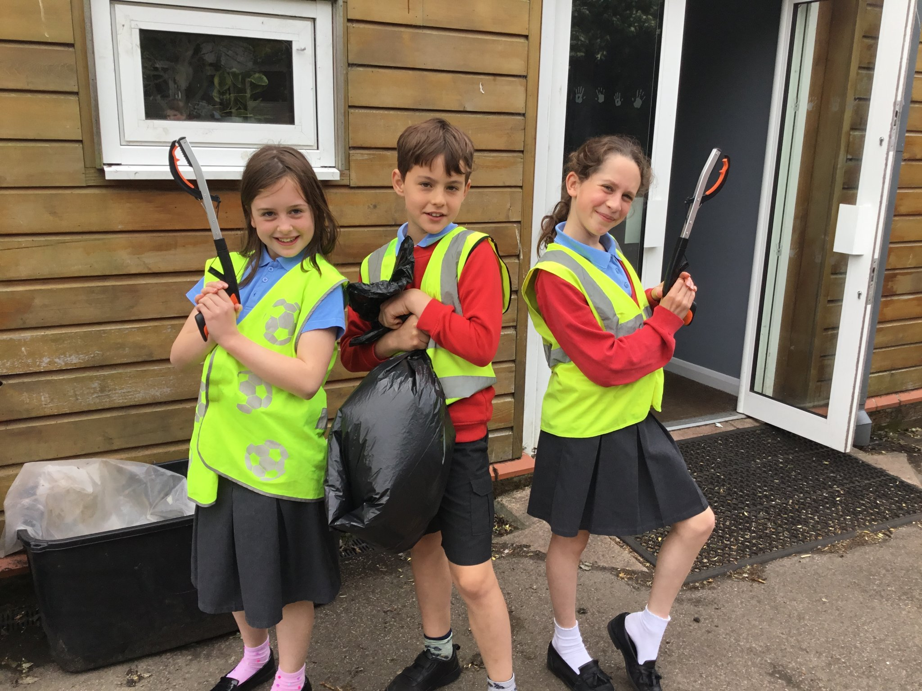

Slide 7
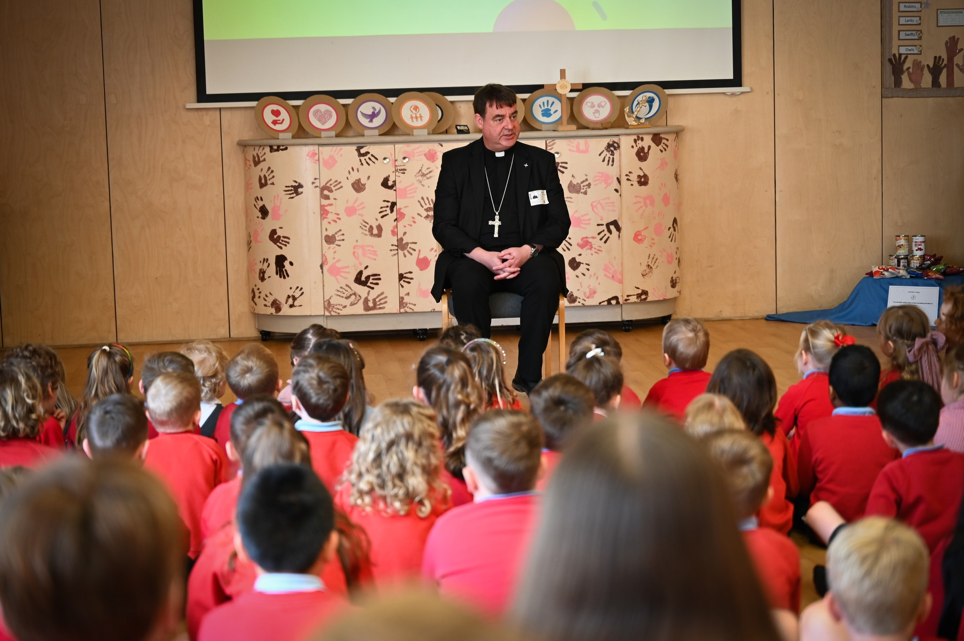
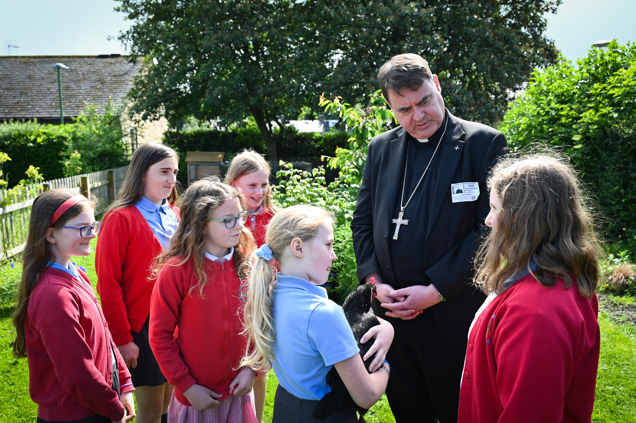
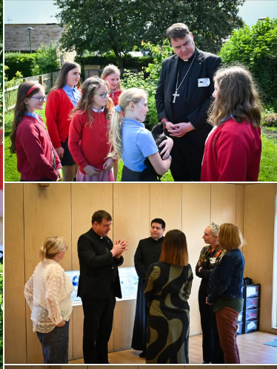
Global Action (3 ) Live Simply We will take part in World Environment Day. We will promote and raise awareness of caring for our common home We will invite parents and parishioners to come along for a planting session in our community garden Homework tasks will be used to promote further awareness outside of school
World Environment Day: 5th June 2024
Our Climate Change Champions wrote a letter to Bishop Stephen inviting him to join us for World Environment Day.
As part of our World Environment Day activities we were delighted to welcome Bishop Stephen, along with Father Thomas and school governors to school today. We gathered together as a school to remind ourselves of Laudato Si' a letter from Pope Francis to everybody, reminding us that we should care for our common home.
We shared our journey so far in taking actions and pledges to hopefully achieve the Live Simply Award this summer. Bishop Stephen thanked the Climate Change Champions, all children and staff for everything they were doing to protect, respect and look after the world we share as God's family.
The children read beautifully and they also enjoyed asking Bishop Stephen lots of their own questions at the end too- they now know his favourite colour is blue, he enjoys reading and watching football, and when he was younger he played in defence! The list goes on!
Thankyou Bishop Stephen- we hope you come back to see us soon.

Slide 8
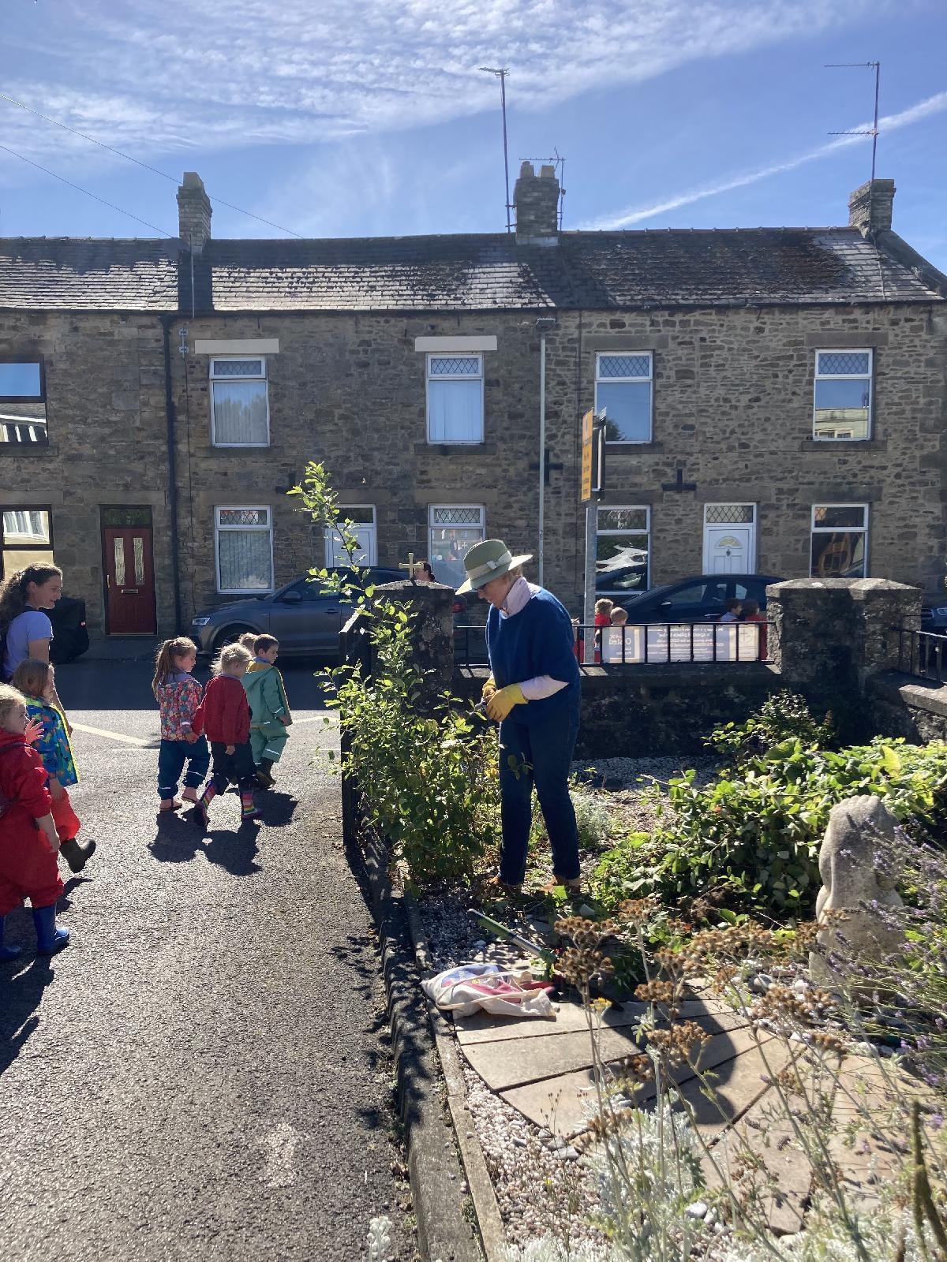
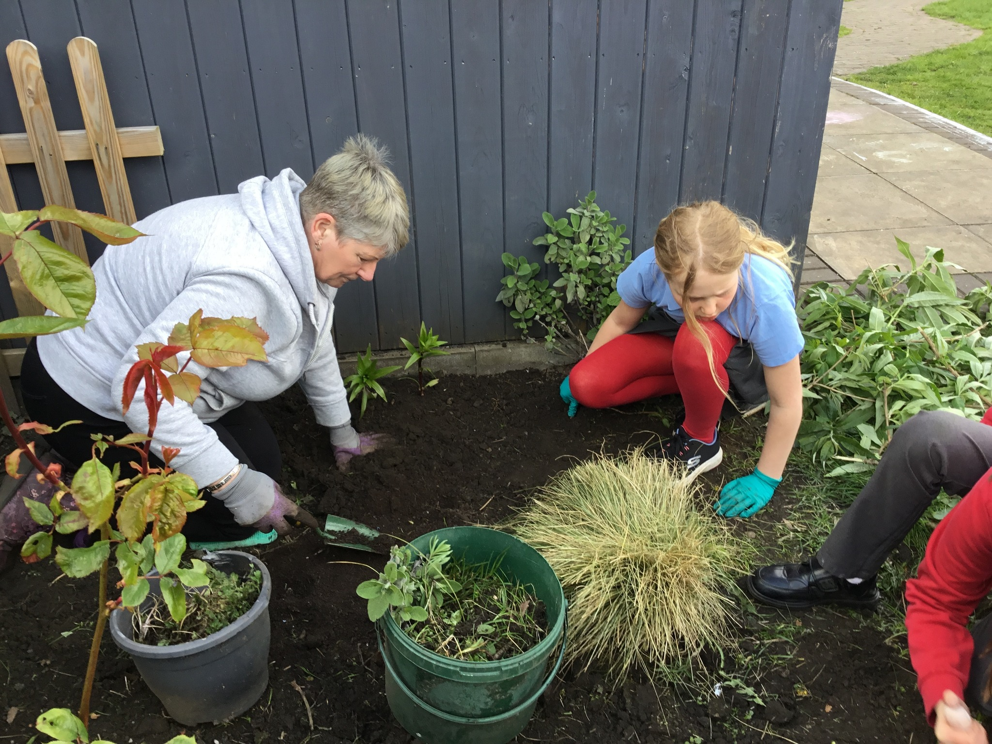
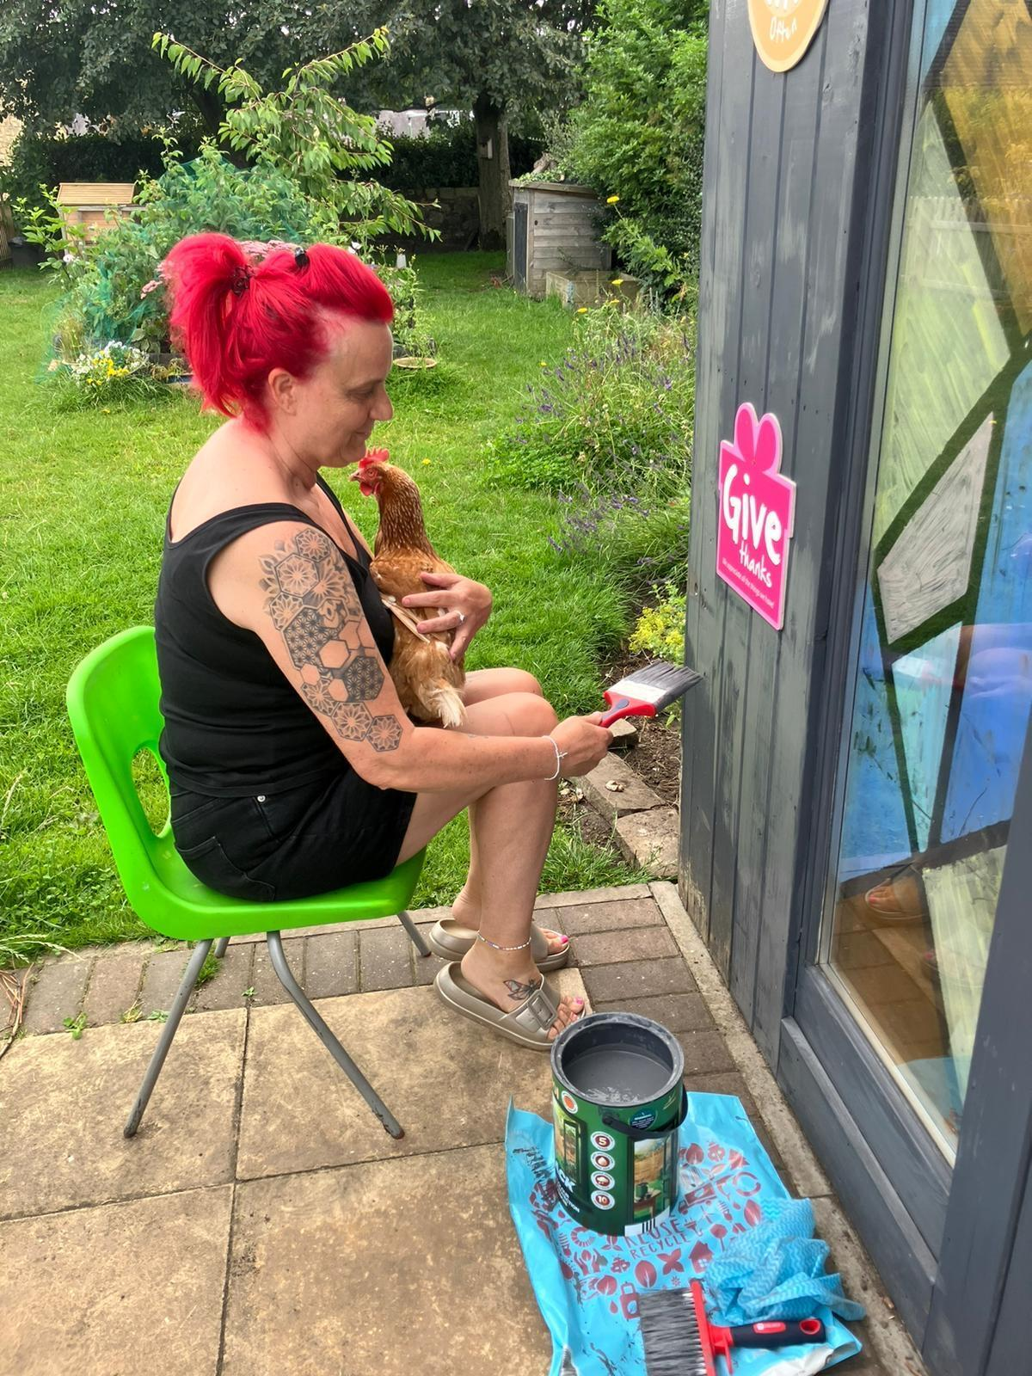
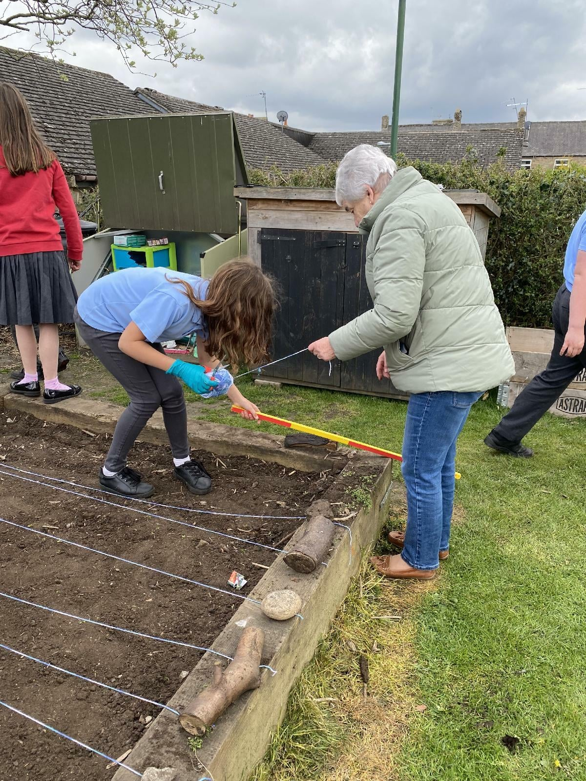
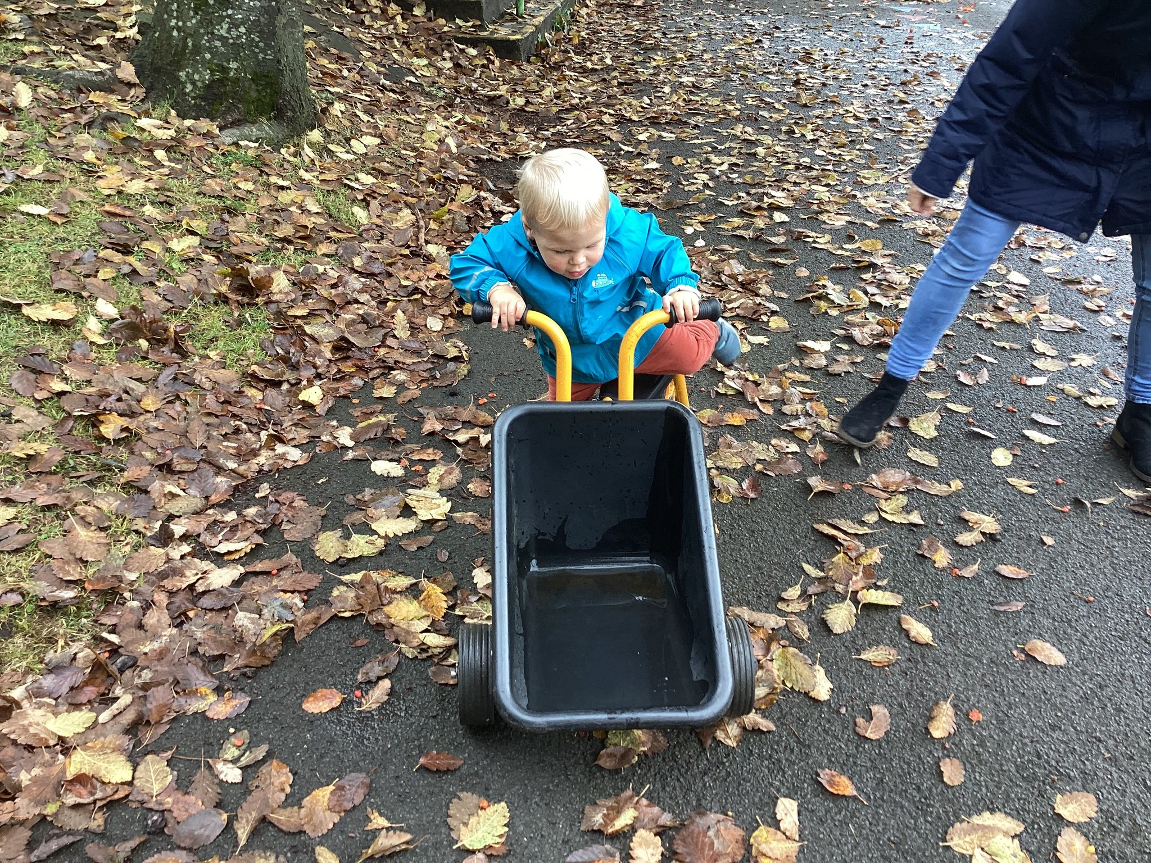
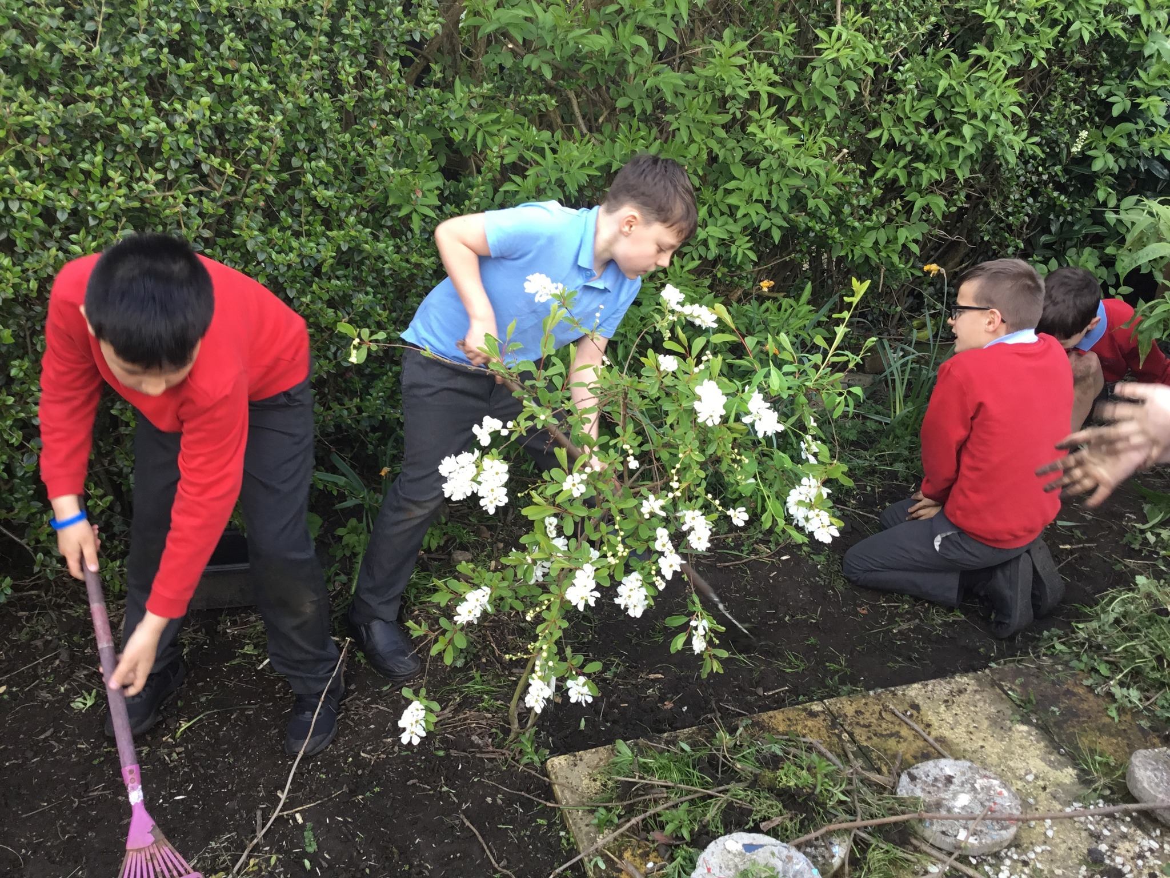
‘Global (3) Live Simply What a lovely opportunity to work with the Grandchildren and do a little bit of gardening for the school too. Thankyou!’ Grandparent Y3 pupil
The community garden session developed positive relationships across the community and an increased awareness of responsibility to look after and maintain our gardens.
There was a wonderful sense of pride from all involved including younger siblings and staff even coming in to paint the pod during half term. The children were able to see that whilst the garden belongs to us, it is for us to look after and for all to enjoy.
We worked together as a team, it was so much fun and it was hard work!
‘The climate is a common good, belonging to all and meant for all.’
Pope Francis, Laudato Si’
‘I love to garden but I do not have my own, so it is great that I get to help at school and at church too.’
Christine ( Parishioner St Mary’s Church)

Slide 9
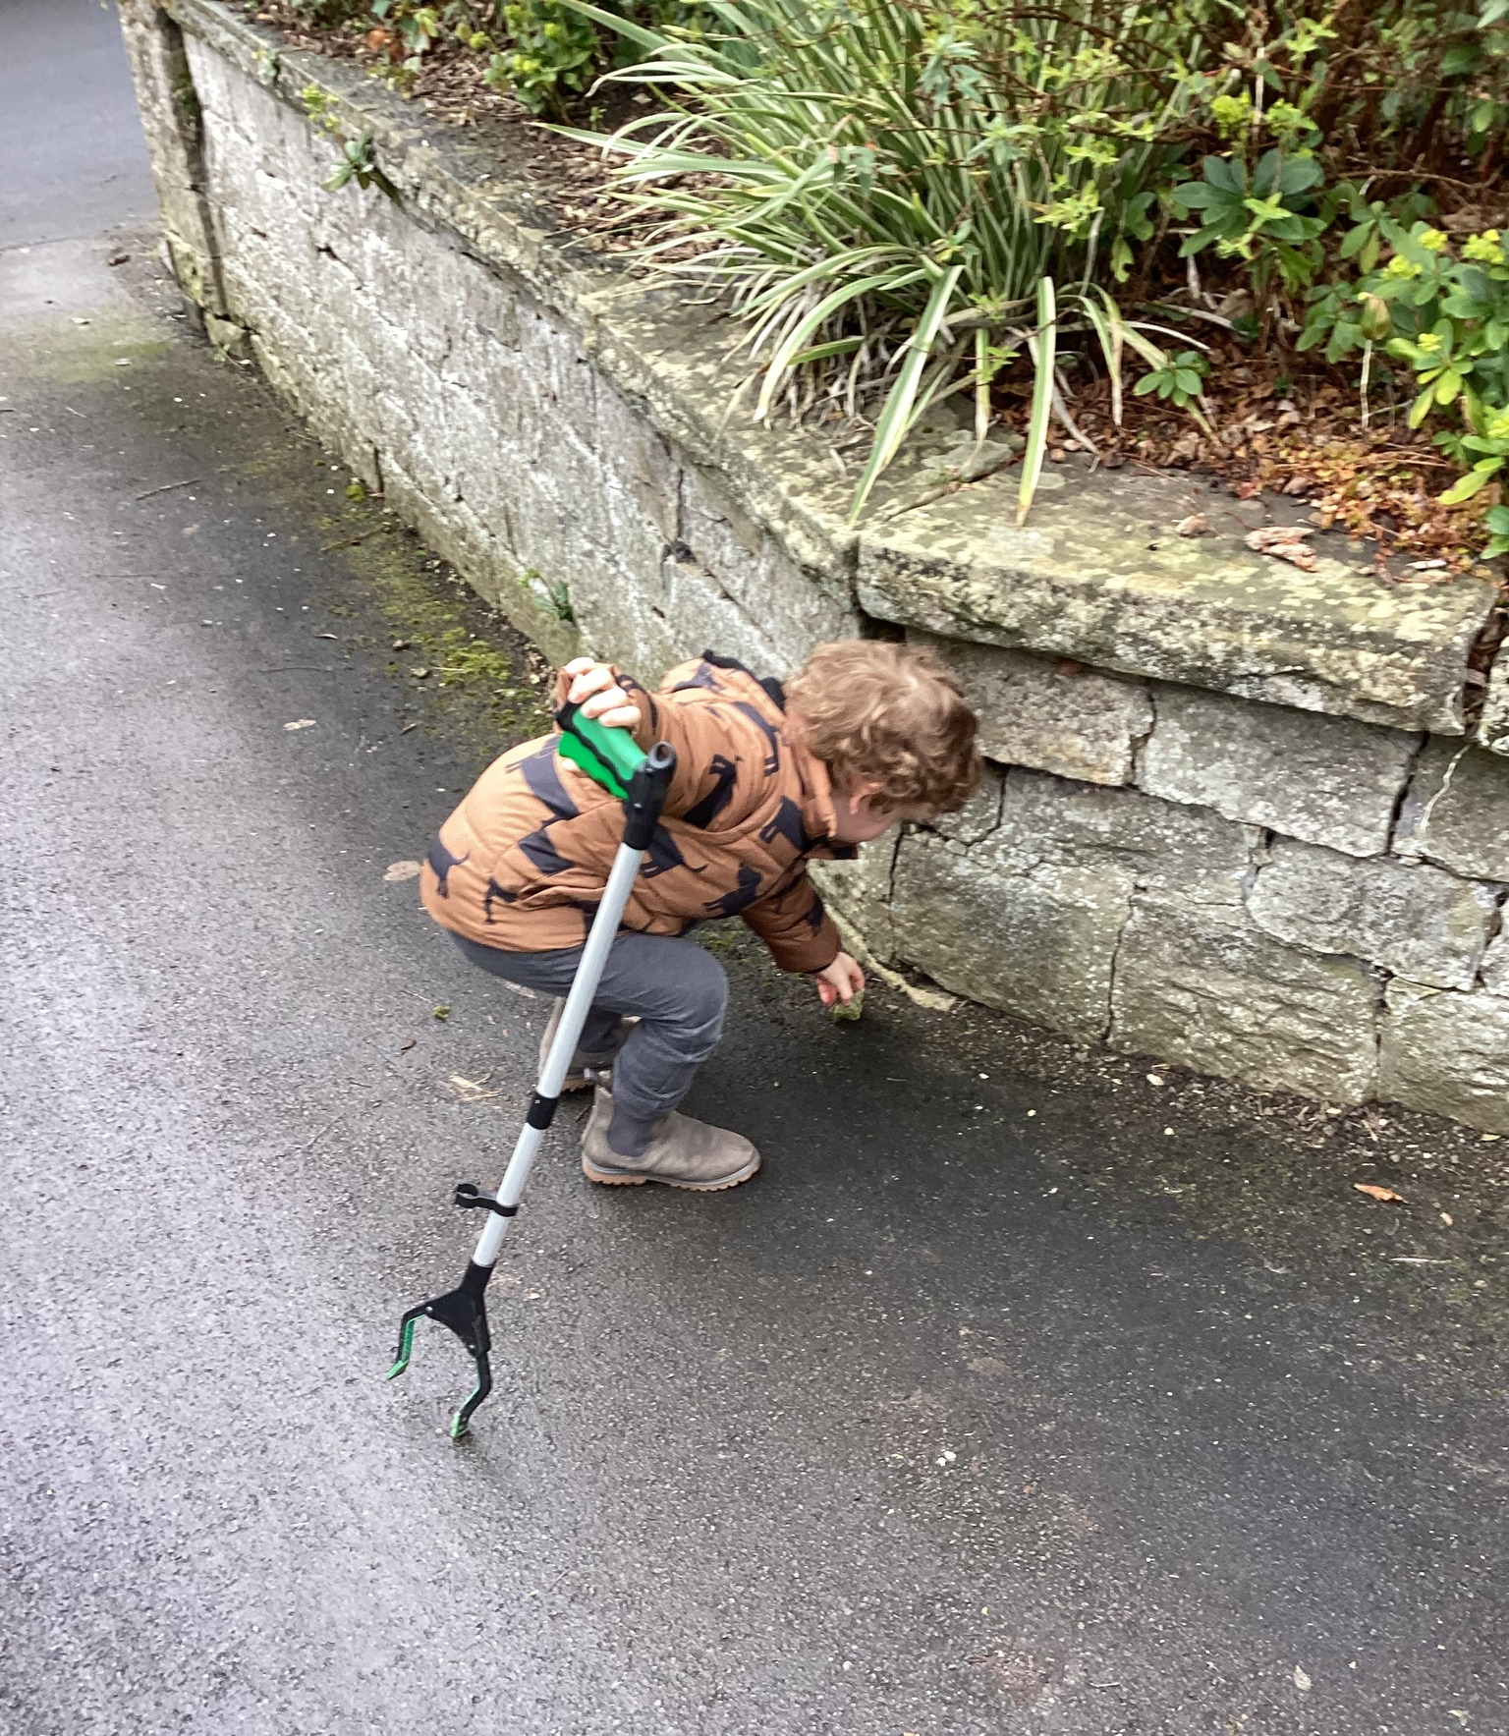
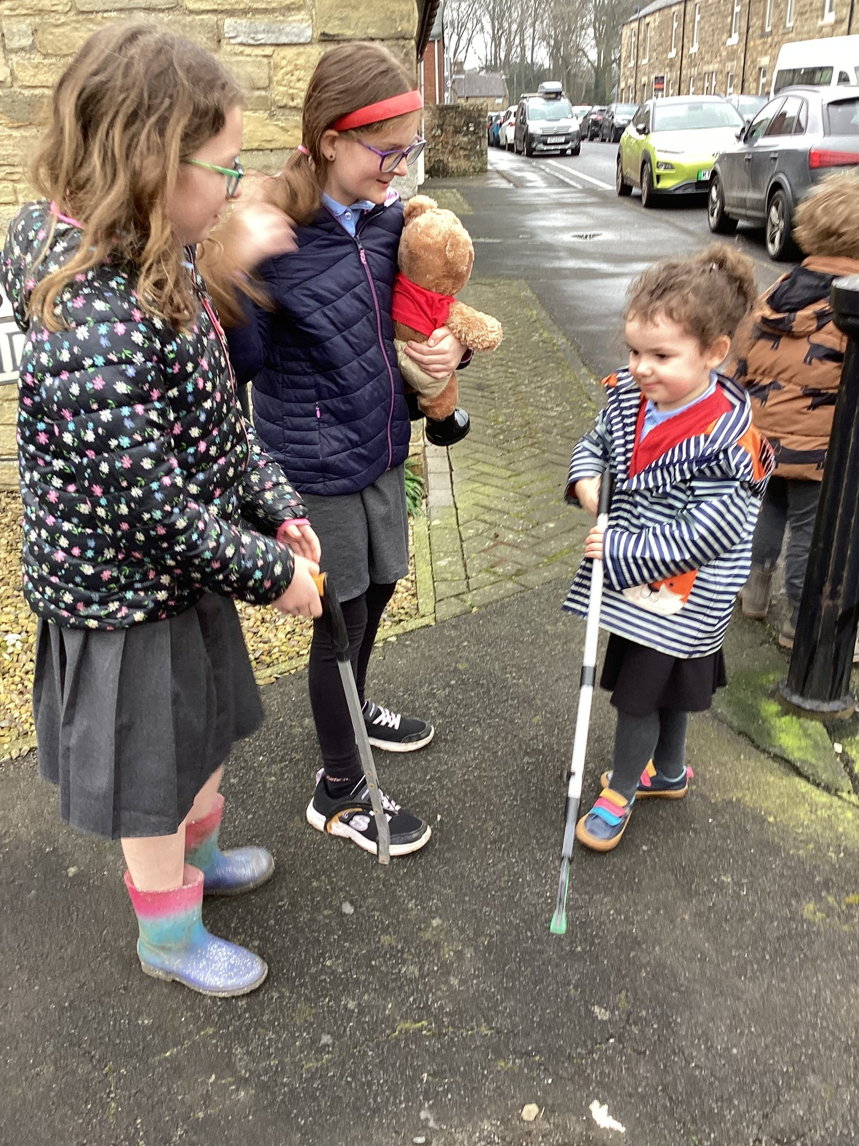
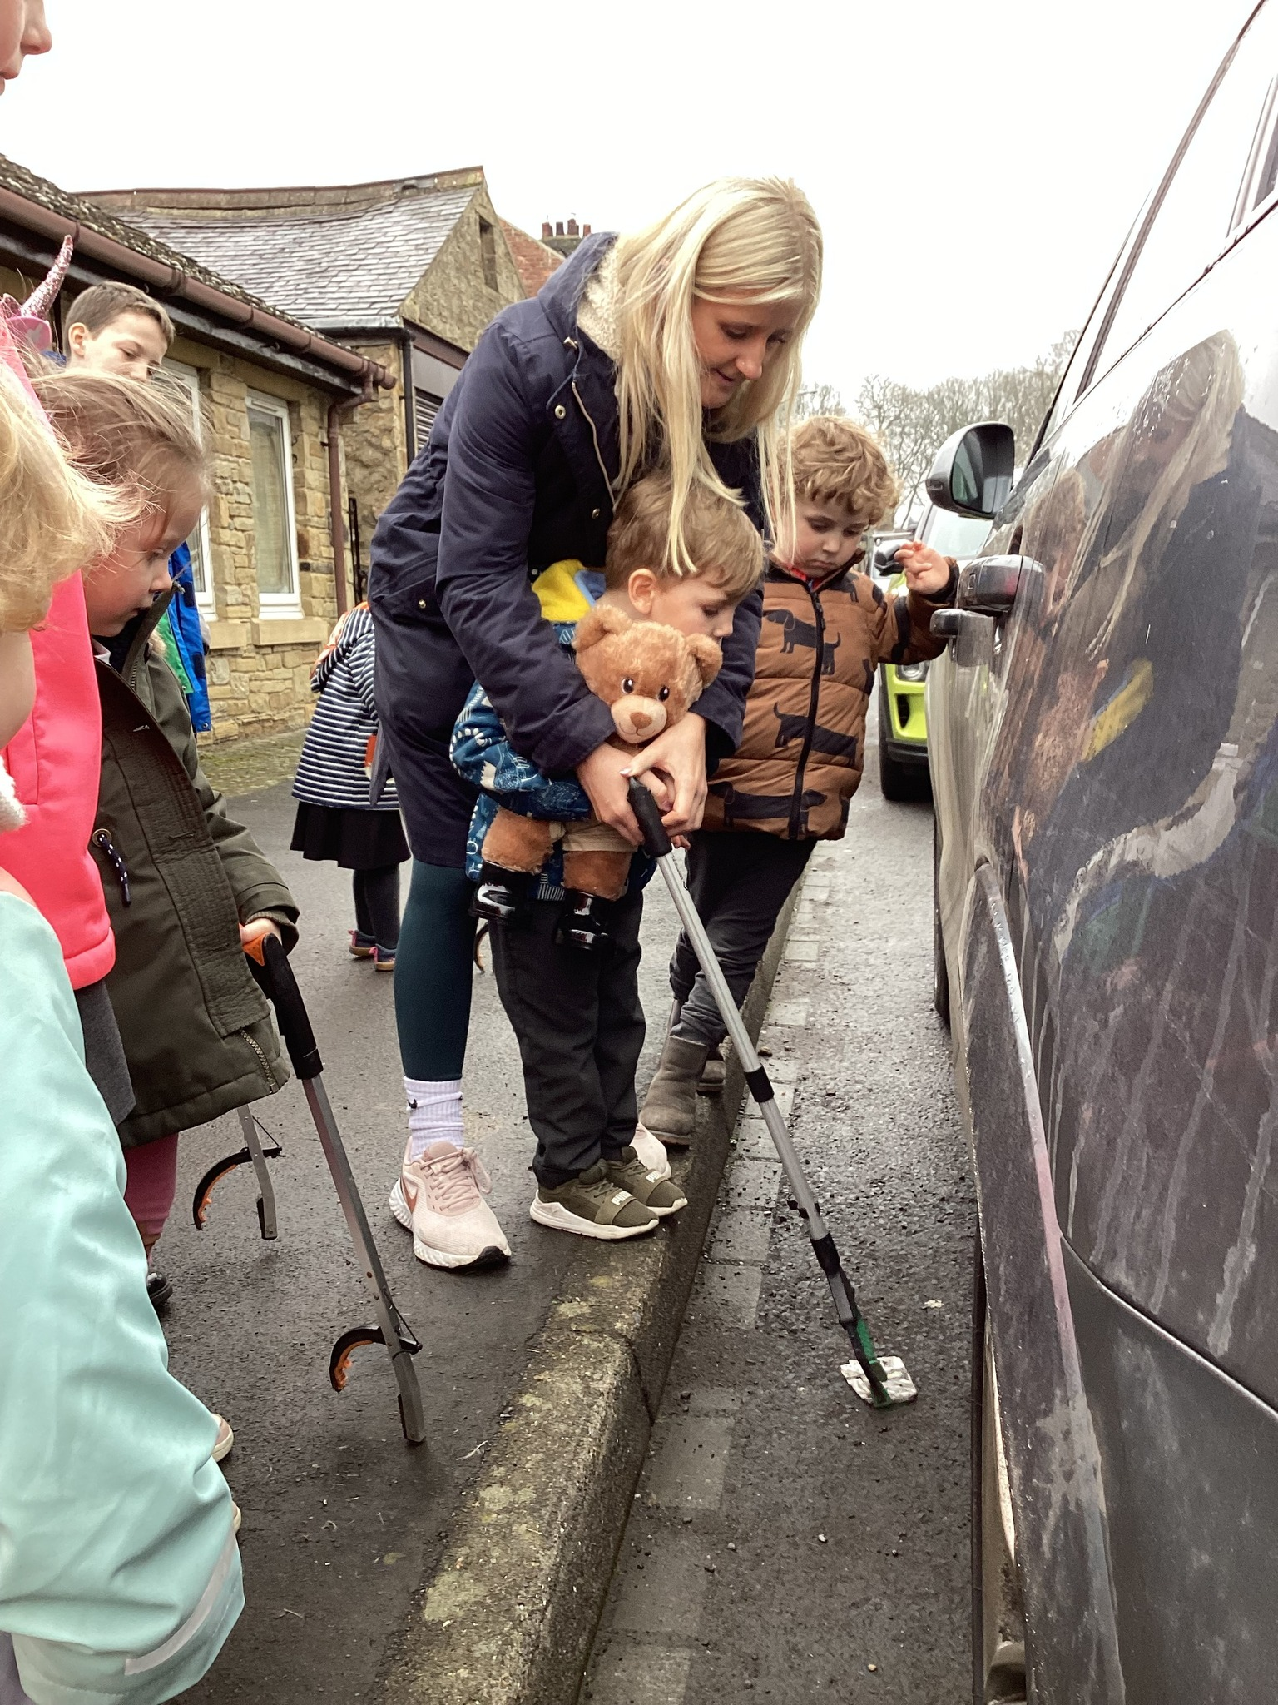
LOCAL (1) Living Sustainably Litter Picking We will organise termly litter picks in the local community so our environment is cleaner and safer for all, including wildlife. We will have a rota so that children are given opportunities to participate, take action and share the responsibility of caring for our world.
‘If you put rubbish on the floor- that is bad. If you pick it up and put it in the bin- that is good. That is what God wants us to do because it is good.’
Cassian (EYFS)
Our lunch time ramblers have combined their daily steps with local litter picks. As part of our Live Simply Award we have pledged to make an effort to keep our school grounds and local area litter free- no better time to do it than during our Big Lent Lunch Walks!
A huge thankyou to Mrs Dominick and Miss Callender for giving up some of their own lunch time to supervise the children with such worthwhile activities and opportunities.
#BigLentWalk
#livesimplyaward
‘Some people just don’t care about dropping litter but we do. We need to be the ones responsible and respect God’s world.’
Connie (Y6)

Slide 10
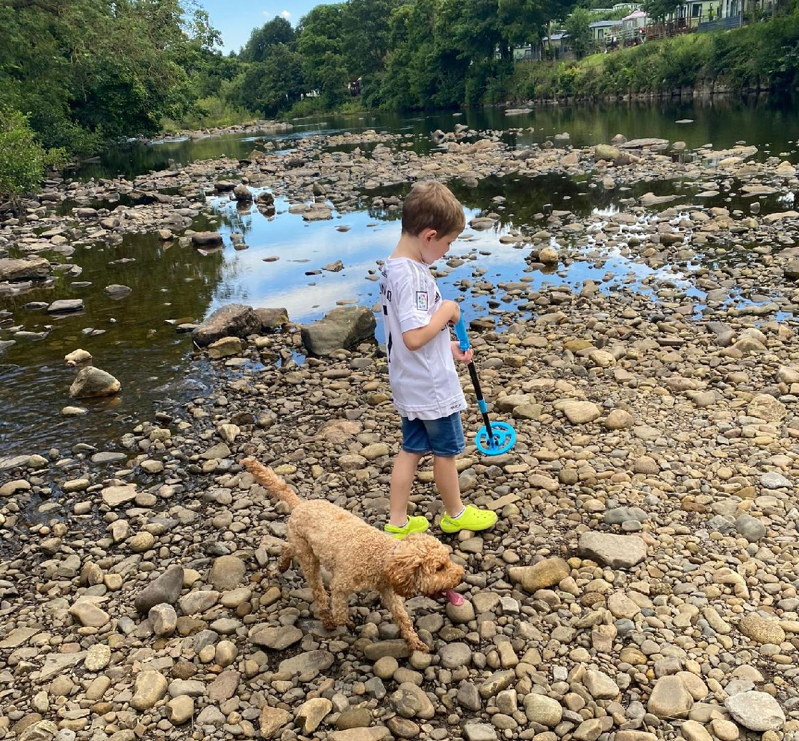
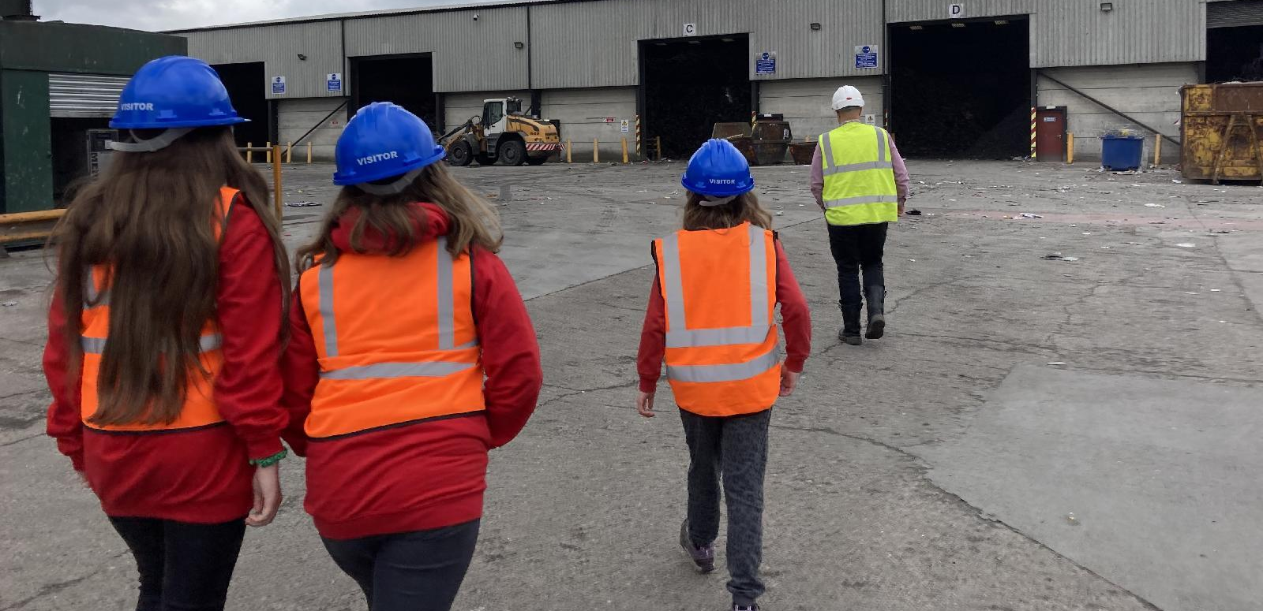
Local (1) Finding out more about what happens to our rubbish!
‘Pupils enjoy numerous extra-curricular opportunities. They take part in daily clubs including drama, sport, well-being and choir. Pupils also apply for positions in the ‘Climate Change Team’. Through these, they plan and put in place a wide variety of initiatives. For example, pupils were inspired by a trip to a recycling centre. As a result, they created a ‘litter bug’ group which picks up litter in school and in the local community. These rich opportunities contribute exceptionally well to pupils’ personal development.’ Ofsted November 2024
Some children who volunteered to be a Litter Bug leader went on to explore other local areas and carry out litter picks and also used a metal detector to find and sort litter. It is wonderful to see the children so motivated and inspired outside of school and involving parents too.
‘I can’t wait to be a Litter Bug Leader at school. We need to buy more litter pickers Mrs Box.’
Louie B
A visit to J&B Recycling
Today 3 of our Climate Champions went along to visit J& B recycling at Hartlepool. The children wanted to find out ore about what happens to our rubbish once it is emptied by the bin men.
We all learnt so much about the recycling process and were amazed by the size of the machinery, all doing different jobs to sort the rubbish before then being packed for recycling.
A big thankyou to both Mark and Claire for the guided tour- it was so interesting and I am confident that our pupils will do an excellent job in feeding back what they have learnt so that we can all ensure we are doing our bit in saving the planet and caring for our common home. They came away full of ideas and motivation to get everyone back at school involved!
The children’s pictures were shared on our social medias and the children were also asked to feed back to the school what they had learnt from their visit. They created recycling posters around school to encourage everybody to make more of an effort to recycle.
Wow! I did not think there would be this much rubbish! (Evie (Y6)

Slide 11
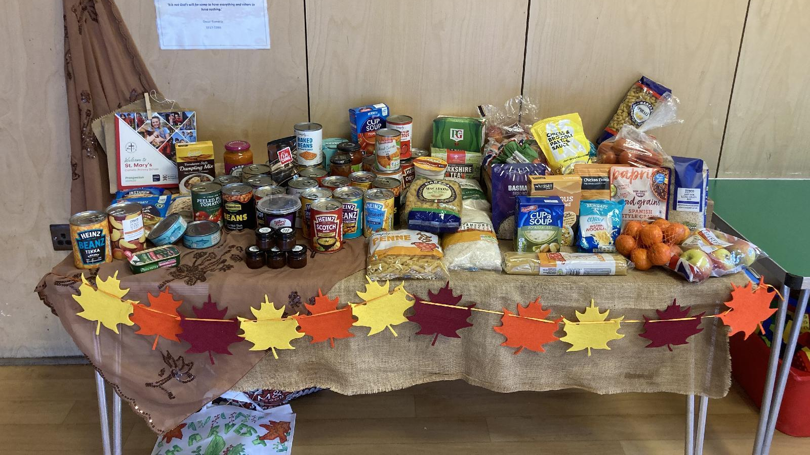
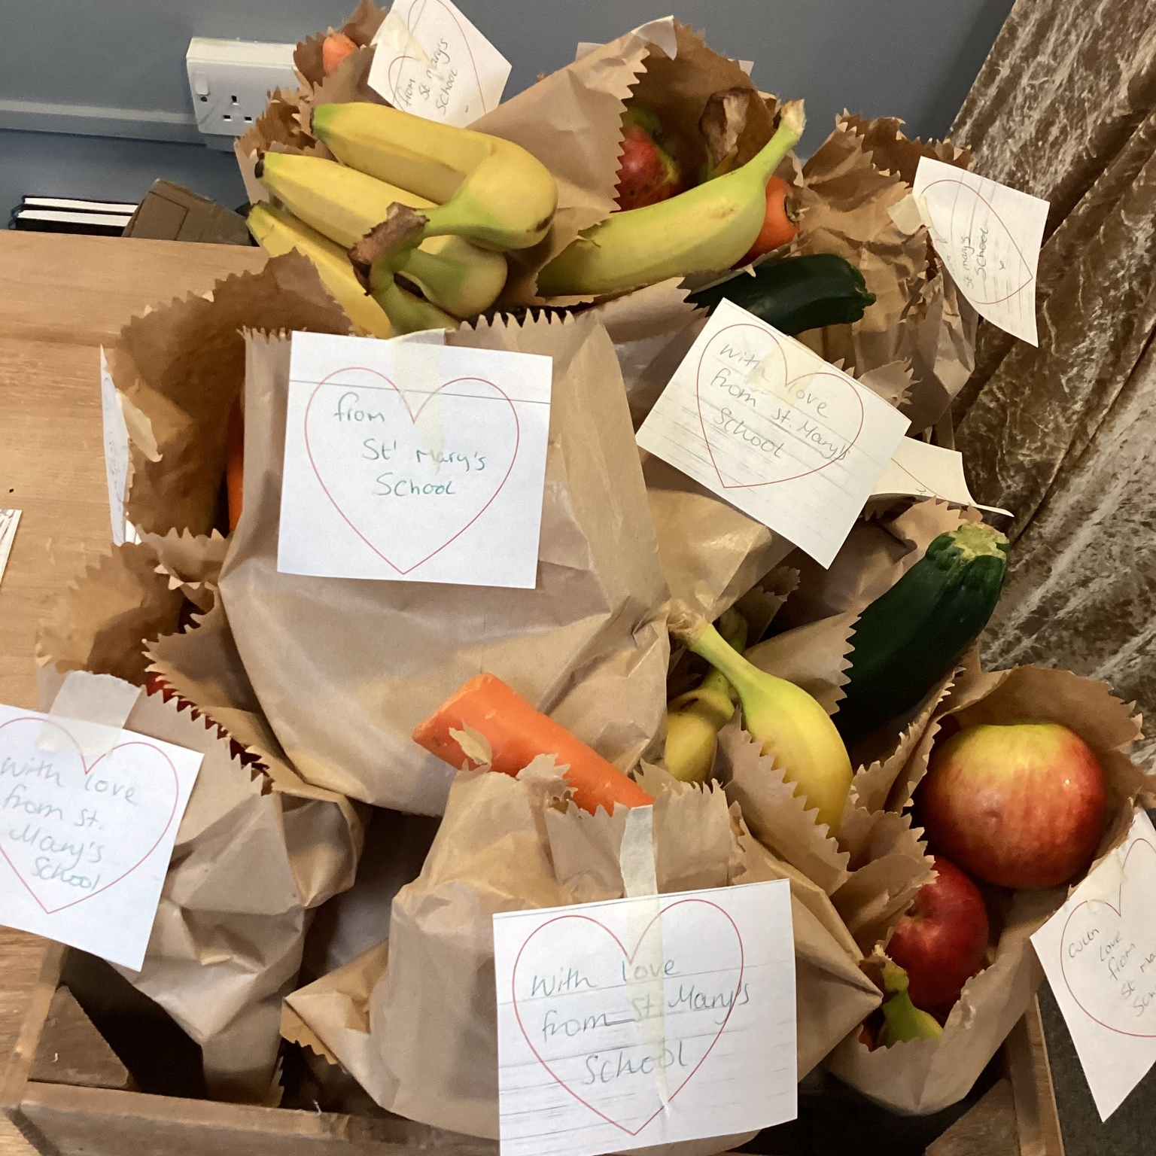
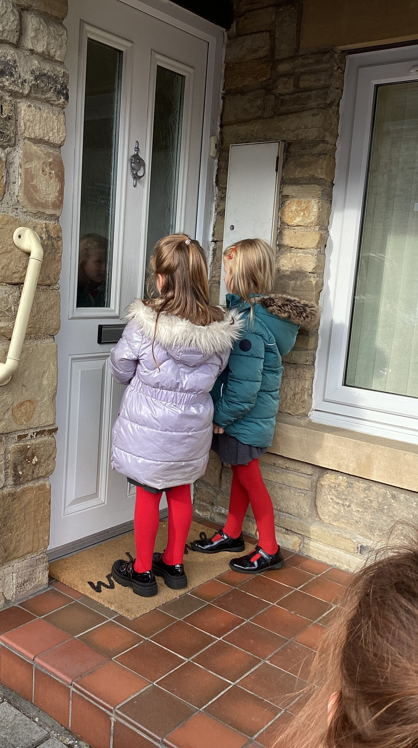
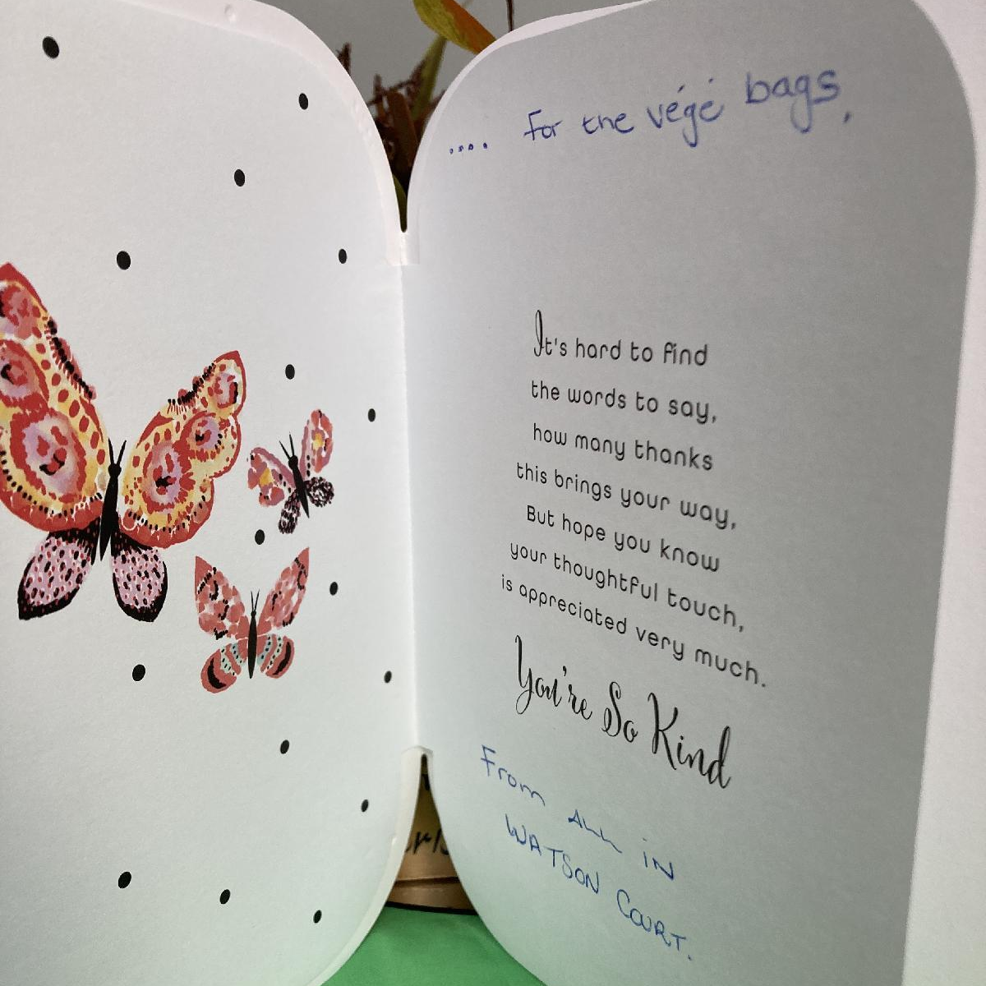
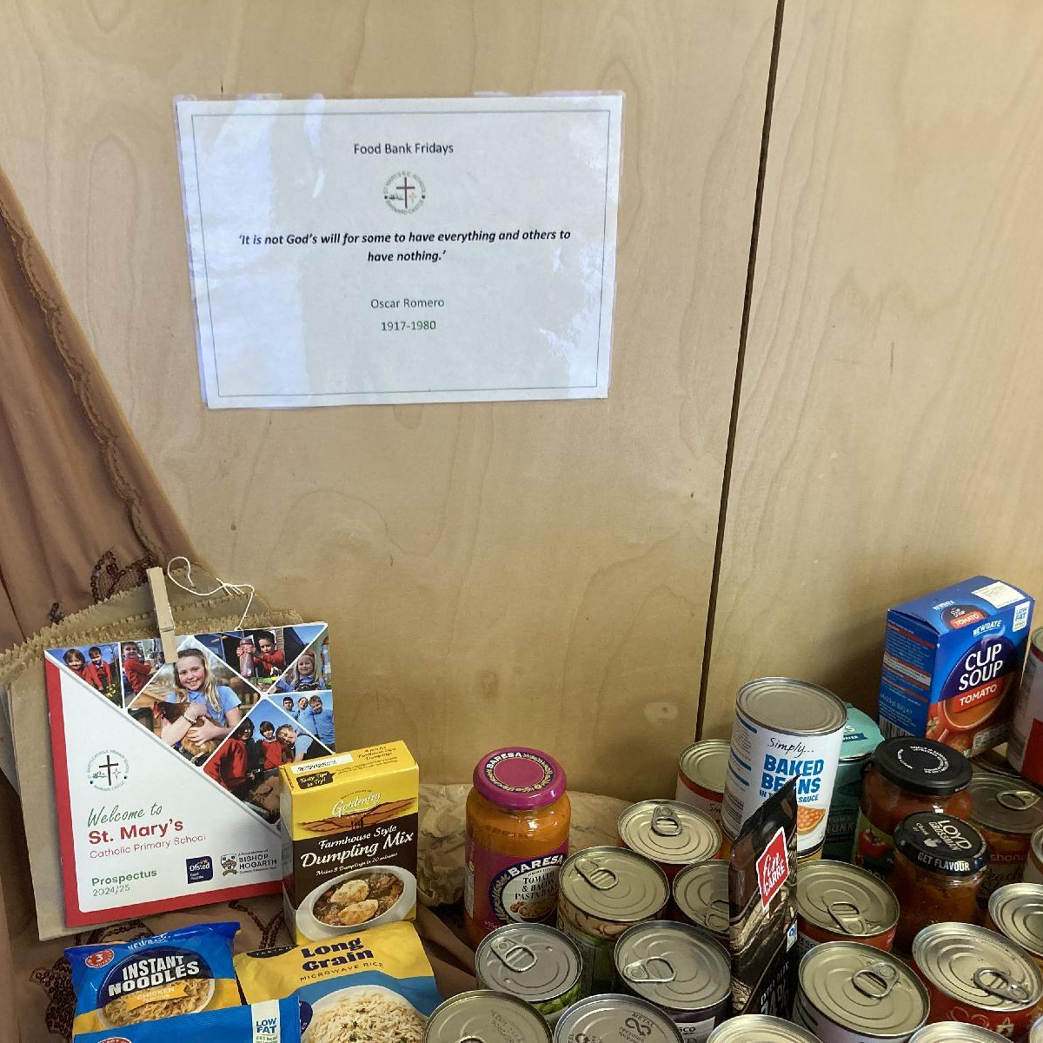
LOCAL (2) Living in Solidarity Supporting our local food banks.
‘It is not God’s will for some to have everything and others to have nothing.’
Oscar Romero
‘For I was hungry, and you gave me something to eat…’ Matthew 25:35

Slide 12
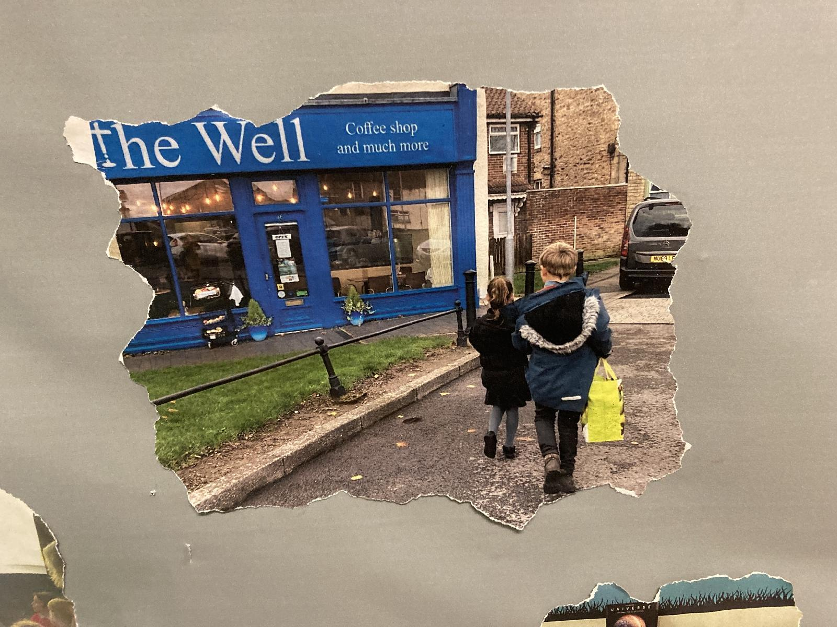
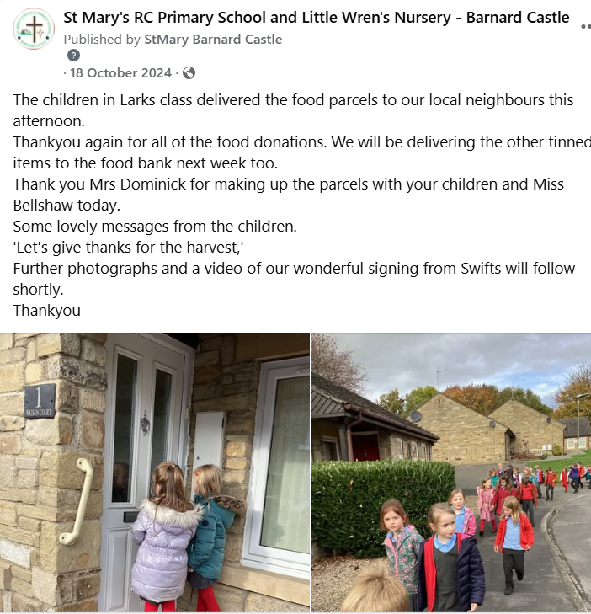
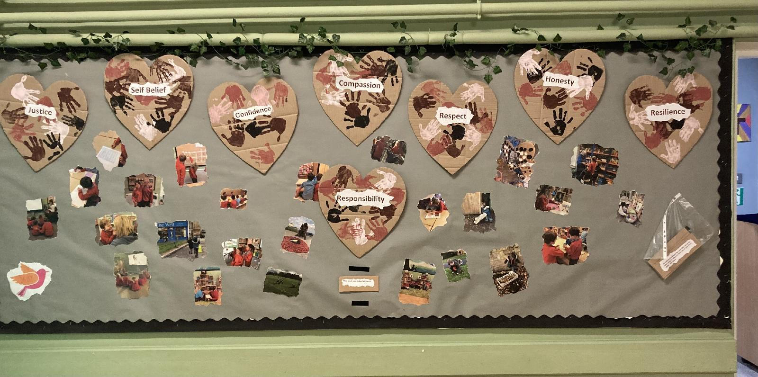
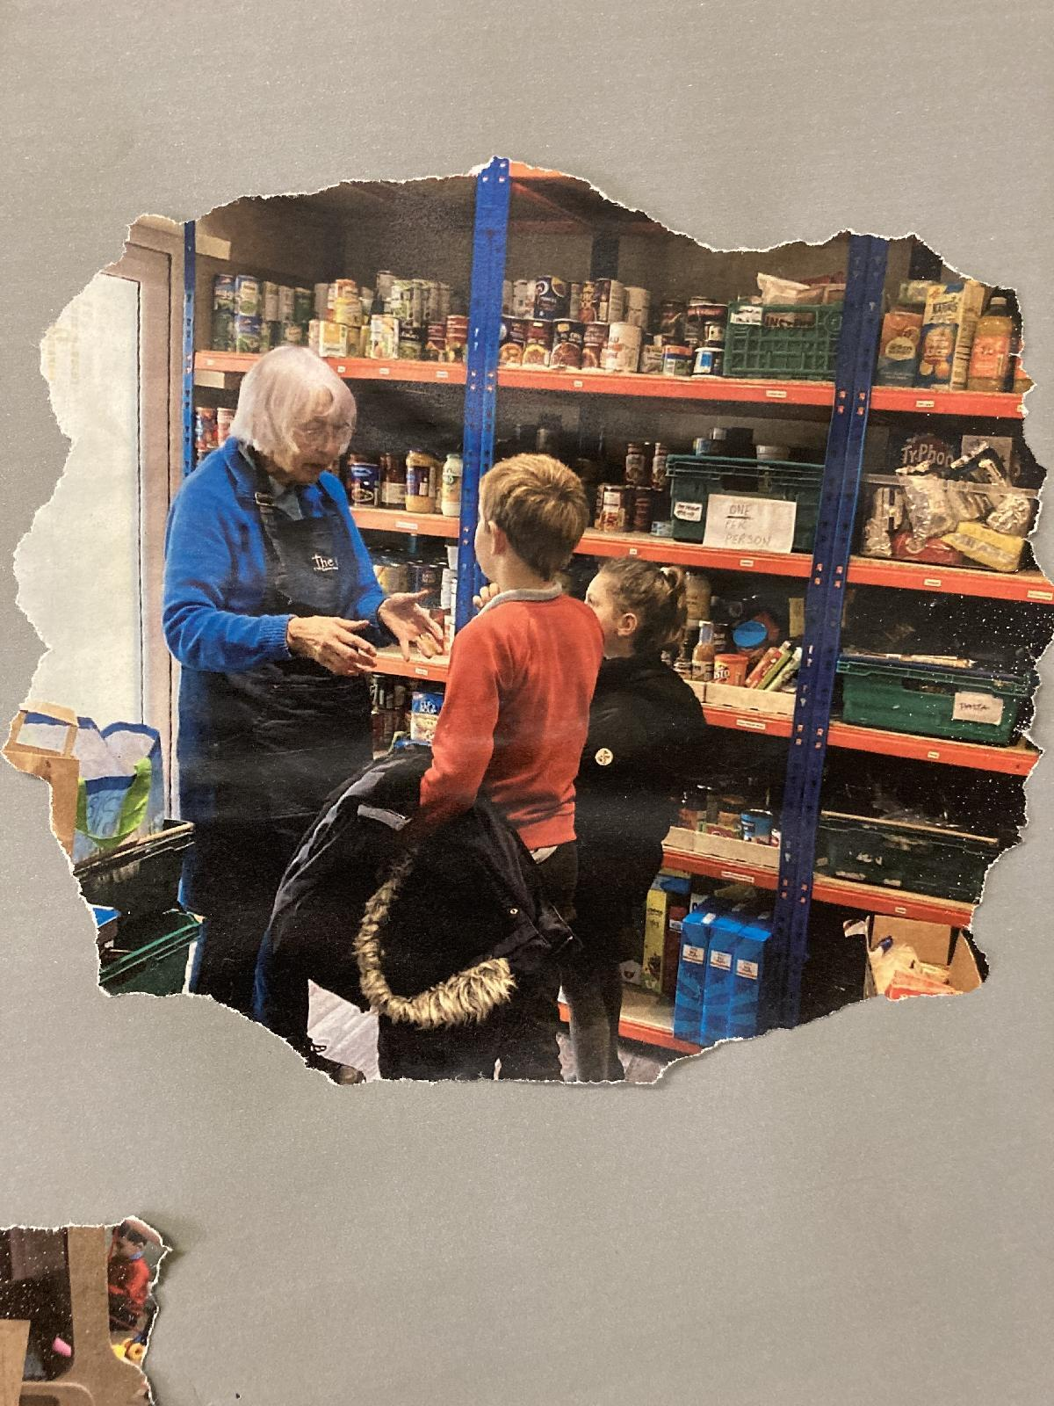
LOCAL (2) Living in Solidarity Supporting our local food banks.
Our food bank leaders are responsible for checking the dates of foods, promoting the foodbank Friday’s and coming along with Mrs Box to deliver the food we collect. Sometimes we deliver the food to The Well in Bishop Auckland and sometimes we drop the food off at church. Parents have also volunteered in the past, to deliver the food on our behalf with their own children.
‘God guides us to give to others. We follow his footsteps. God would give them some food.’
Tilly (Y1)
‘If other people have food, then we should give some to the people that don’t.’
Matilda (Y2)
‘It is not God’s will for some to have everything and others to have nothing.’
Oscar Romero
‘For I was hungry, and you gave me something to eat…’ Matthew 25:35

Slide 13
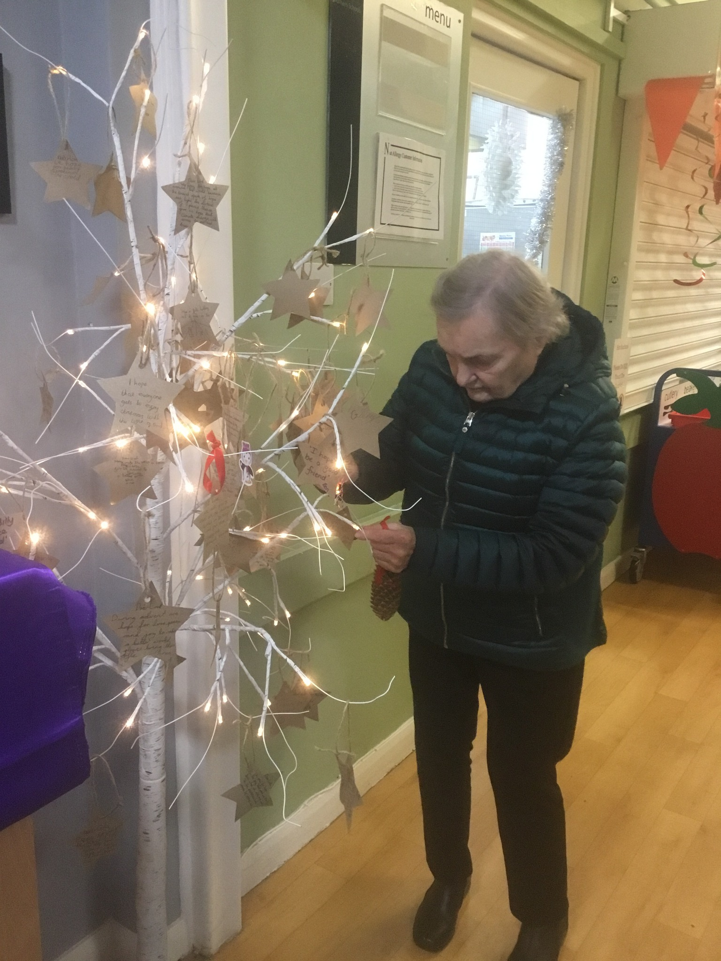
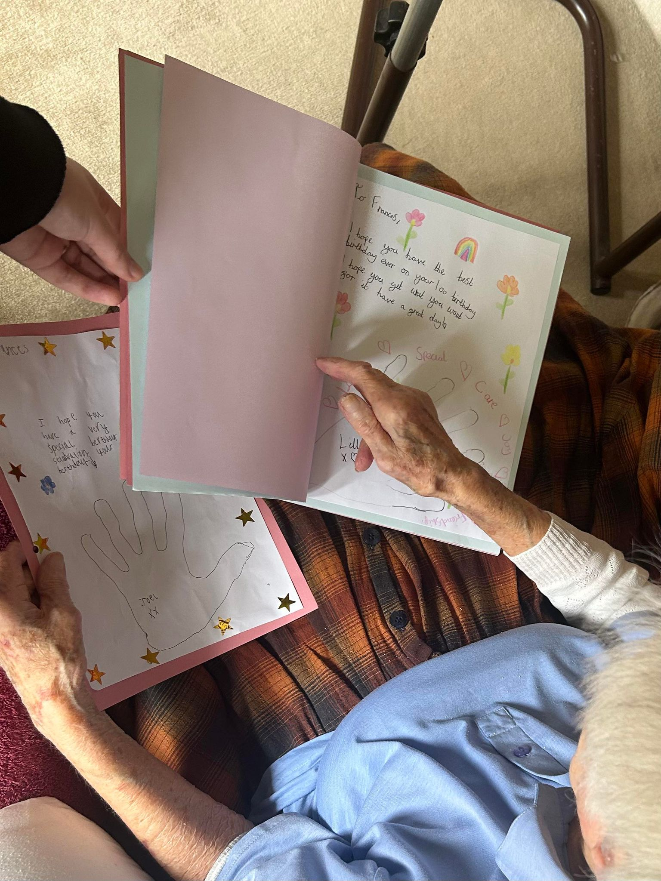
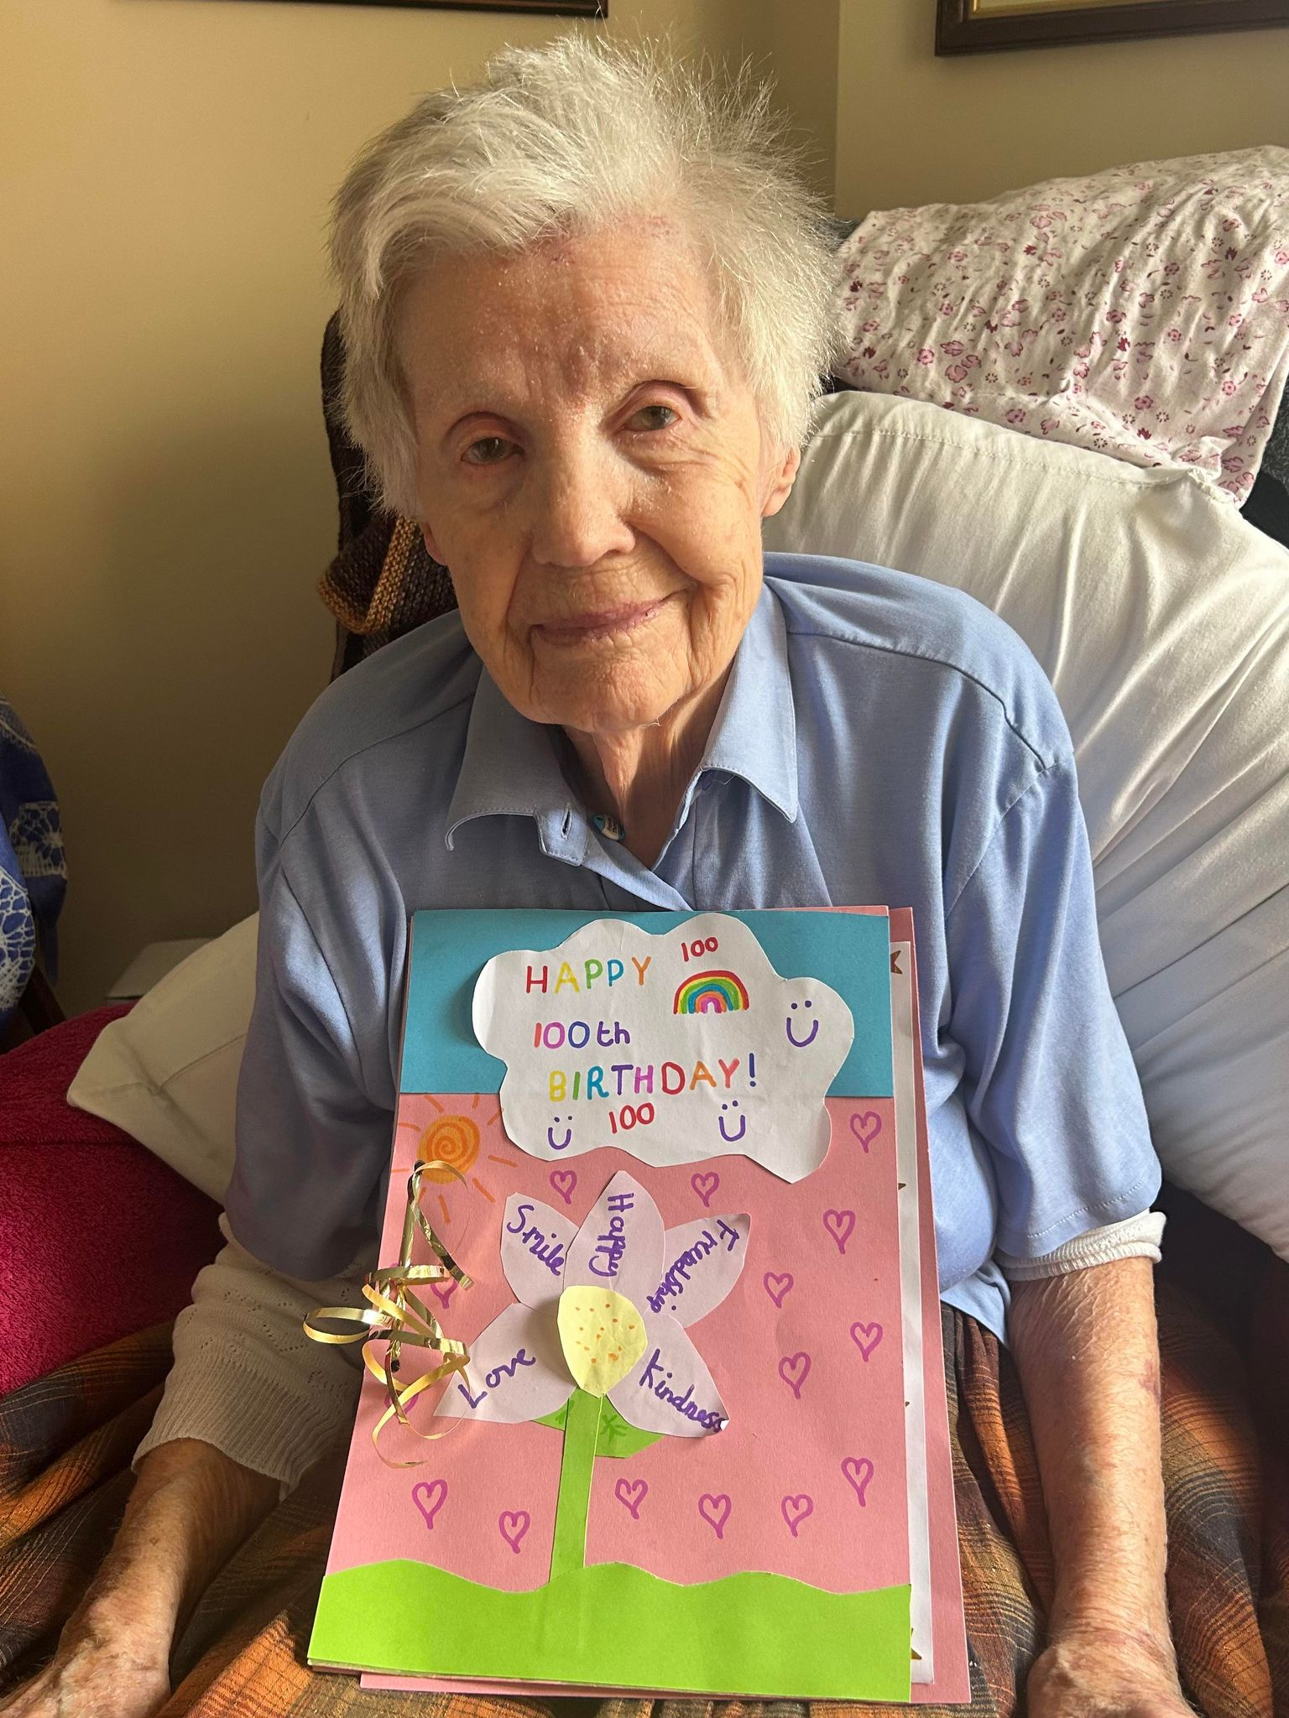
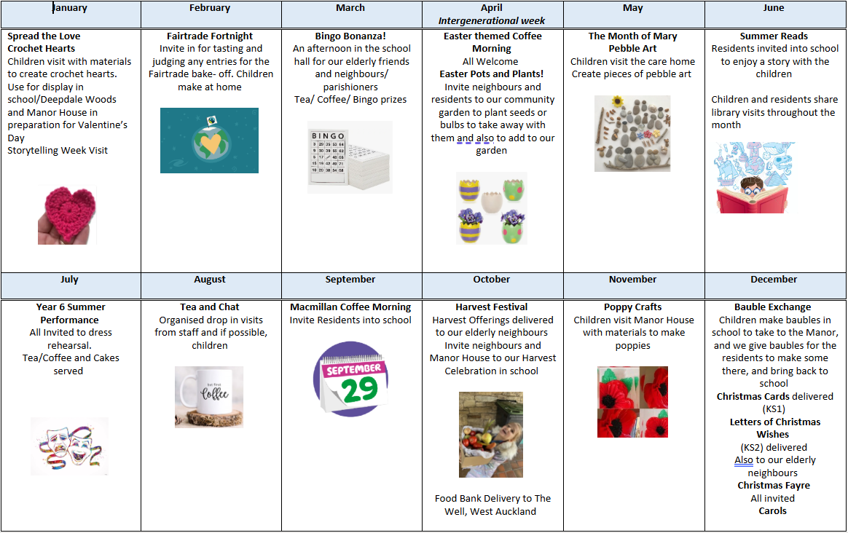
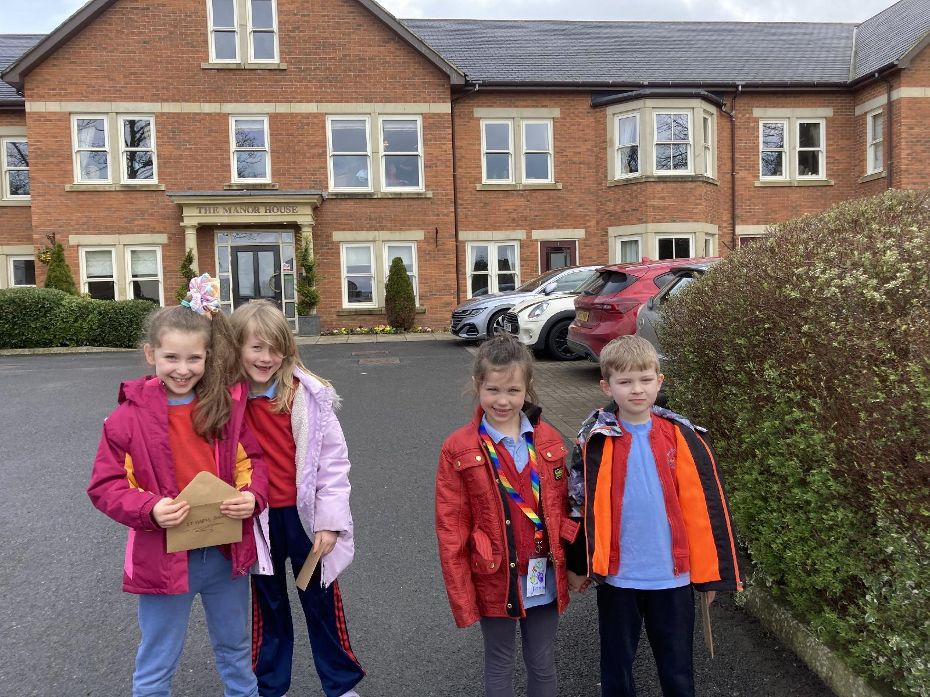
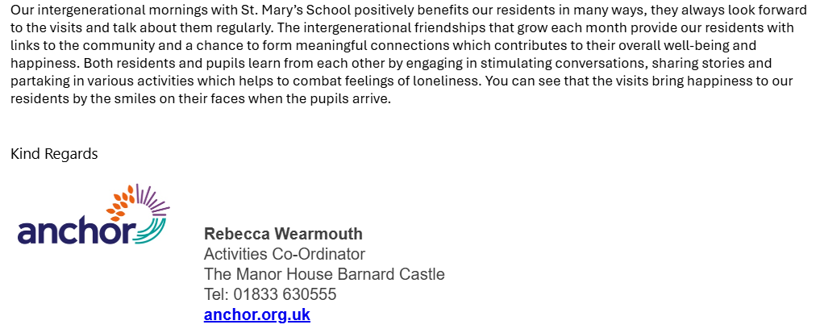
LOCAL (3) Living in Solidarity : Developing links with our Local Care Home
Residents are invited to school events such as fairs, Christmas performances and coffee mornings.
A special visit to celebrate a 100th birthday celebration! What a wonderful day to be a part of! (Lesley B HT)
‘It is so lovely to see young children. They remind me of when I was young too. It makes me happy.’
(Resident, Manor House)
‘An impressive culture of positive relationships underpins successful learning.’ Ofsted November 2024

Slide 14
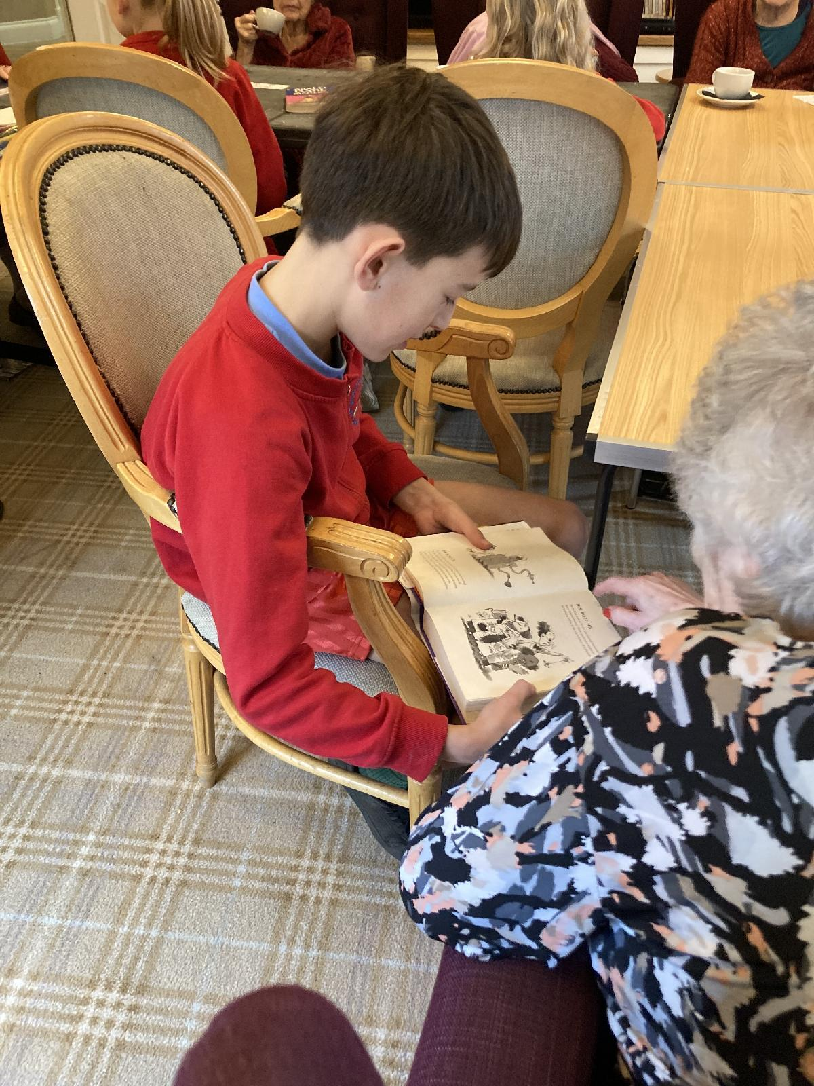
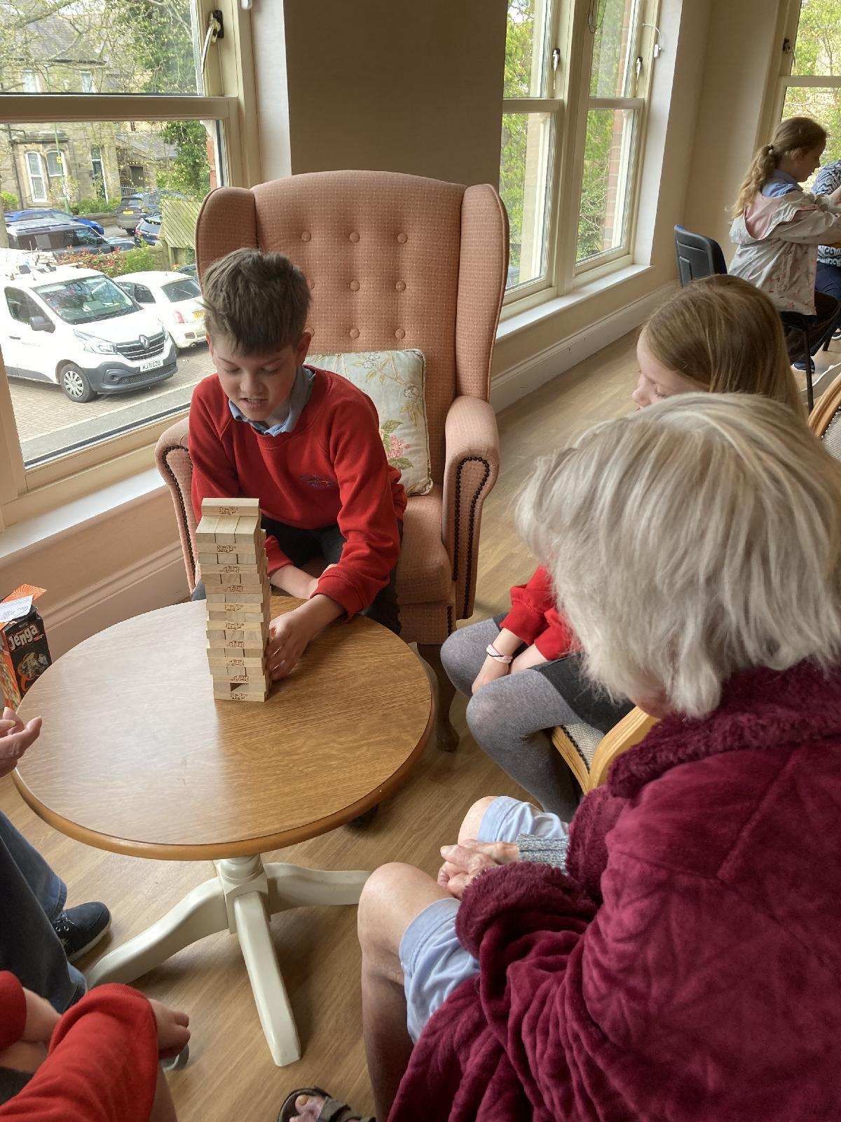
LOCAL (3): Developing links with our Local Care Home
This ongoing action has encouraged incredibly positive relationships between the children and residents as well as school staff and care workers. Pupils and staff at St Mary’s have developed adorable bonds and friendships with our elderly friends at the Manor. The children look forward to their visits and show very caring, compassionate, respectful and loving attitudes when they are there. It is a pleasure to see and something we will continue to develop as part of our community culture and mission of the school.
‘St Mary’s is a welcoming and inclusive school where pupils thrive. Pupils are happy. They enjoy positive relationships with staff and peers alike. There is a respectful warmth that spreads through the school.’. Ofsted November 2024
‘We learn so much about our friends at Manor House- they have lots of funny stories to tell us and they like to talk to us about their family and their jobs before they retired.
It is very interesting.
It is important we respect the elderly as we are all one family and need to look after the people who need the most care.
I respect the elderly- so do my friends.
I am looking forward to the next visit- I hope I get to show them how to knit!’
Layla- Mae (Y5)

Slide 15
LOCAL (3): Developing links with our Local Care Home
Our commitment to Care
In October 2023 staff used and Inset day to put together an action plan made up of 12 monthly pledges to build links with our local care home and develop relationships with residents, children and staff.
Together, we came up with our motto; Opening our hearts, Connecting to the Community.
The impact of the pledge has ensured children have made wonderful friendships with the elderly and have demonstrated incredibly respectful and compassionate attitudes during visits.
We continue to carry out the pledges each month and to ensure they are prioritised, and fulfilled they are part of our weekly agenda at each staff meeting.
‘As part of our training day across BHCET all schools gathered in the morning for CST training and sharing examples of good practice across our schools. We then spent the afternoon working within our own school teams and during this time, together we decided on what key principles we would like to further develop in school. Staff pledged to ensure that the monthly visits would take place and would be prioritised within school and local community.
St Mary’s Staff Team
‘I really hope I get to go to the Manor House again- I loved it!’
Rosalia Y3
‘I like how we get involved with the activities and suggest things like crocheting hearts. One of the ladies ( Margaret showed me what she had crocheted in her room- she is so good. She told me she use to be a teacher. Olivia ( Y6)

Slide 16
School (1) Live Simply Our commitment to pledge...

Slide 17
School (1) Live Simply Our commitment to pledge...
As part of our commitment and dedication to making our pledge to Live Simply, Sustainably and in Solidarity we:
Made pledges in school- children and staff
Stuck the pledges in our RE books and in Faith in Action books as a reminder of what we pledged to do over time and to help us reflect and evaluate how proactive we have been.
Invited parishioners and governors to make their pledge- inviting them to add their pledge to our display that we took along to church after we displayed the pledges in our school hall.

Slide 18
SCHOOL (2): Live Simply/Live Sustainably ‘Time to connect to nature’
Our broad, balanced curriculum offers a variety of opportunities that allow children the opportunity to explore, play and learn outside; in our school grounds, local area, school visits and so much more!
We are dedicated to offering our children weekly opportunities that embrace the outdoors and allow children to make connections with nature as part of their everyday learning.
The evidence on this slide shows just some of the vast activities we plan that involve our parents, the community and the great outdoors. One pupil ( Matthew Y5)) wrote to David Attenborough as part of his homework set by his class teacher and was delighted to get a reply!
Oracy is an important part of our pedagogy too and across our curriculum this is embedded to allow children the opportunity to ‘simply talk!’
I like to be outside because it makes me feel calm when I hear the bird noises and the wind.’
Tilly ( Y1)
Being outside makes me feel happy!
(Dotty (Y1)
'The weekly adventure sessions in EYFS are carefully planned so that the children can explore and learn in their local outdoor areas. It is an excellent way to build community links and develop relationships with parents who come along each week as regular volunteers. We offer children right across school many outdoor experiences, lessons and activities that allow them to develop nerw talents and interests and to appreciate our common home.' (EYFS team, St Mary's)

Slide 19
School (2) Live Simply/ Live Sustainably
'I like to go and see our chickens. They give us eggs! I like to count them... 1,2,3!'
Josh EYFS
'God created the world for us so we should all make sure we look after it. We learn how to look after the world through prayer and liturgy, our actions and our lessons. We need to respect the world.'
Charlotte ( Y2)
'The children have a rota so that they all take it in turns to be responsible for feeding, watering, cleaning and collecting eggs from the chickens. The chickens allow the children to connect with each other, with nature and to develop responsibilities so that the chickens are safe, fed and watered. The children love to collect the eggs and then either sell them on the drive to parents or give to our elderly neighbours. All money then goes back into the gardening funds.'
(Leanne P ( DH/Science and community garden lead)

Slide 20
SCHOOL (3) Live Simply
Our school 'Poppy Field' EYFS pupils re- planting clay poppies from previous years and then add new poppies to our area at the front of school for the whole of the school community to admire, access.
We will create an Oscar Romero prayer space in school that all children can access throughout the day.
We will encourage and create simple forms of prayer opportunities to promote Aspiration, Live Simply, In Solidarity and Sustainably.
Over the past 18 months we have created further prayer opportunities and spaces around school, for all children to access. Some spaces are permanently there, others are set up as part of the liturgical year, events or occasions in school. We have also invested time to gather pupil voice and invite our local artist in to school ( Lynda Nelson) so that scripture and positiv quotes are more evident around school and outside grounds too Here are a selection of just some of the spaces we have set up, including our Romero Cross and quote from Oscor Romero himself 'Aspire to be more, not to have more.'
Oscar Romero.
Signs and symbols 'Mary Hunt' around school grounds. These 3- fold displays are then taken to St Mary's Catholic Church so that our parish Priest, Father Thomas and parishioners can also enjoy seeing what we have been up to in school- building positive community links too.
Our Stars of Hope tree during Advent. Residents were invited to come and draw or write a prayer too and hang it on the tree...

Slide 21
SCHOOL (3) Live Simply Creative Prayer spaces and scripture around school
Faith In Action Group 2025
Pupil voice helped us decide as a school what scripture to have in each of the classrooms and in corridors of school. The vast majority of children voted for our school mission; 'I can do all things through Christ who strengthens me.'
Philippians 4;13
The 'Time to shine' area is also used for our fortnightly prayer group with Father Thomas over Friday morning break times. The prayer group is an invite to children, staff and governors.
'Prayer is part of everyday life at school – I am proud when I show people my school. It makes me feel relaxed, calm, not lonely, joyful, peaceful and safe.' Larks Class Y1/2

Slide 22
School (3) Live Simply
Our outdoor prayer garden is called The Mary Garden.
The colours are blue like Mary and purple for Lent. It is Lent now. William ( Y4)
Christine from church looks after our flowers so they do not die.
The garden makes me feel peaceful- I like to pray outside – like today when it is sunny. Penny and Margaret ( Y3)
'It makes me feel calm.' ( Joel (Y4)
Sometimes we have liturgies outside with Mrs Jennings William ( Y4)

