Slide 1



How to be a
At SSMM!

Slide 2
In this presentation, I hope to share with you:
how we approach reading at SSMM
why we do it that way
what you can do at home.

Slide 3


Slide 4
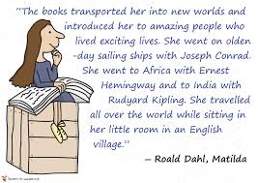

Slide 5
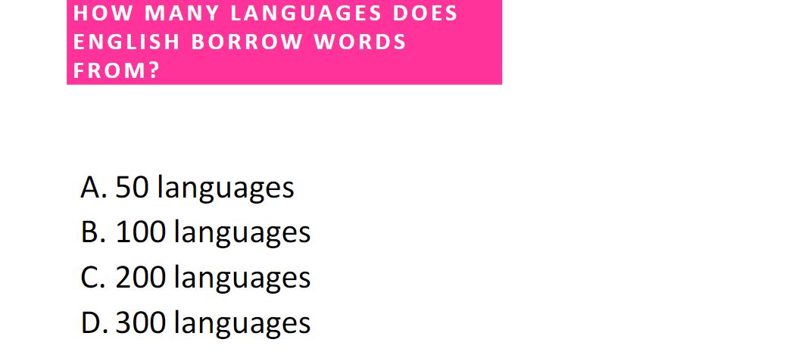

Slide 6


Slide 7
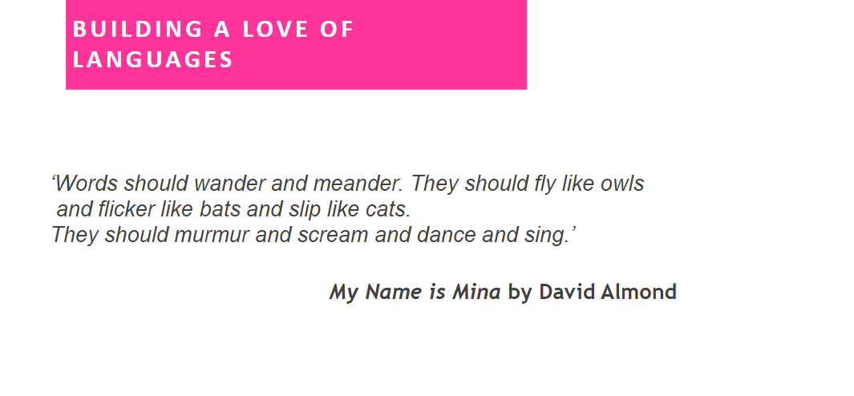

Slide 8
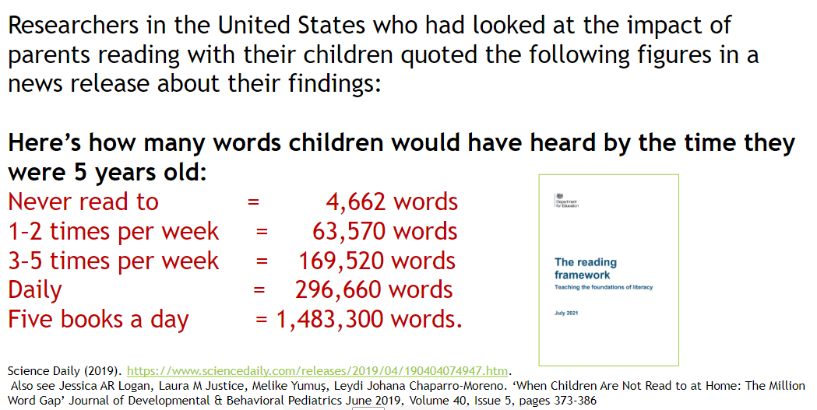

Slide 9
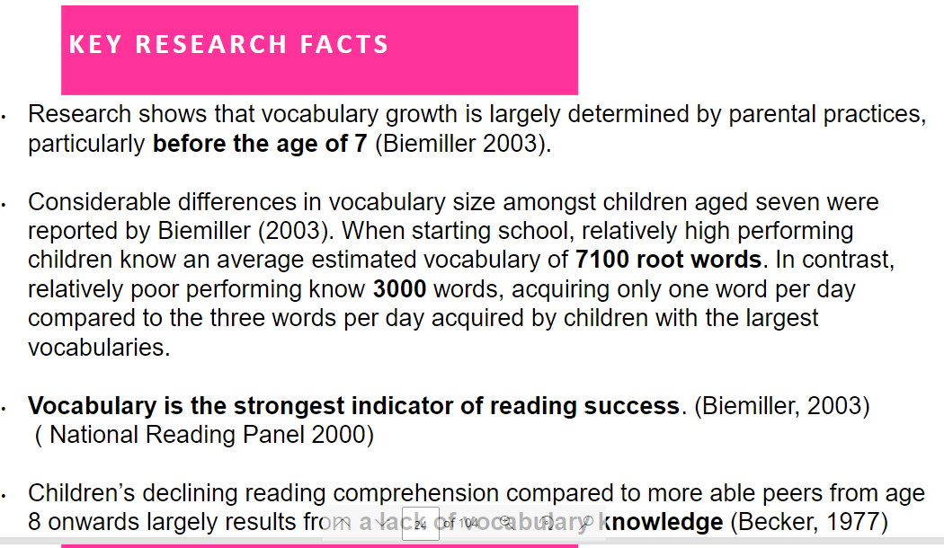

Slide 10
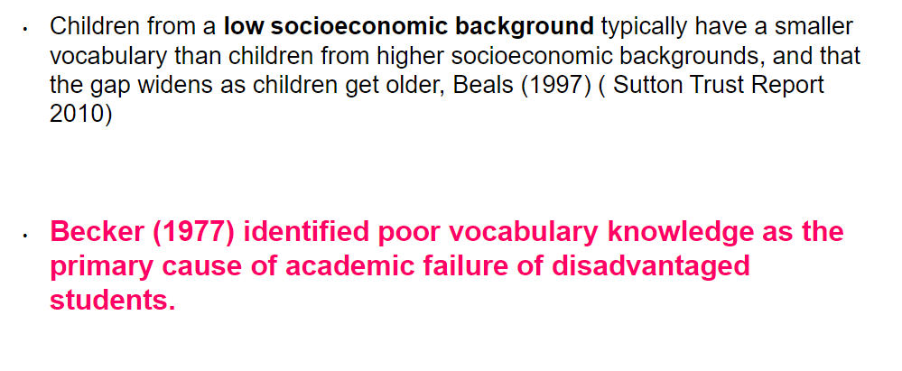

Slide 11
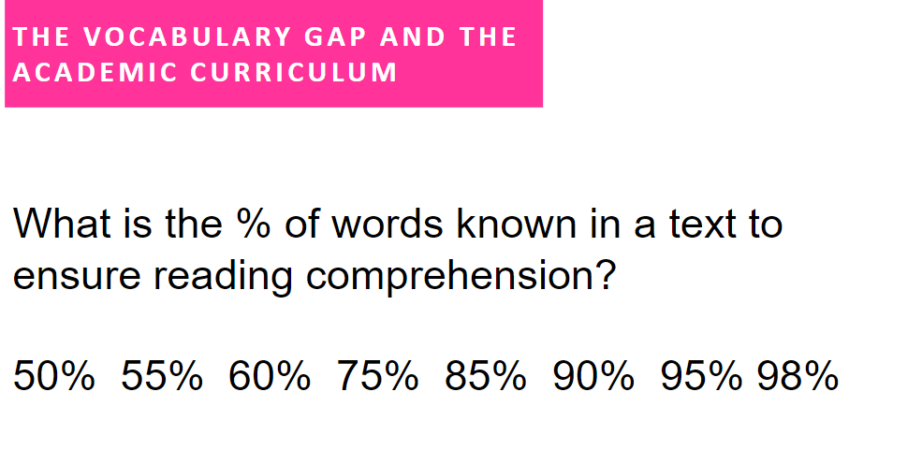

Slide 12
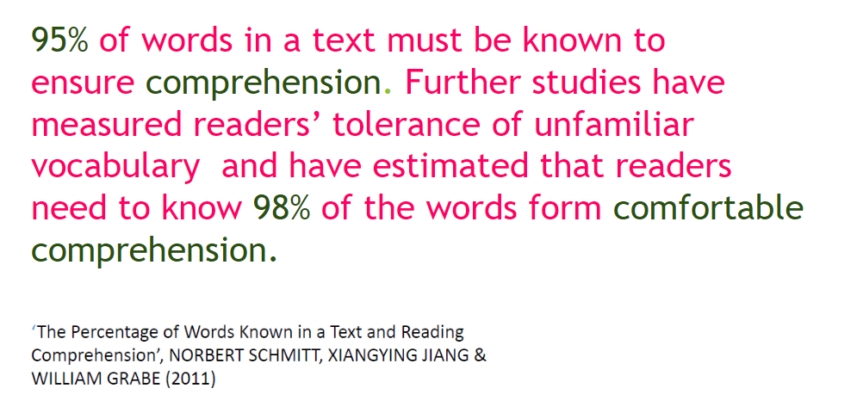

Slide 13
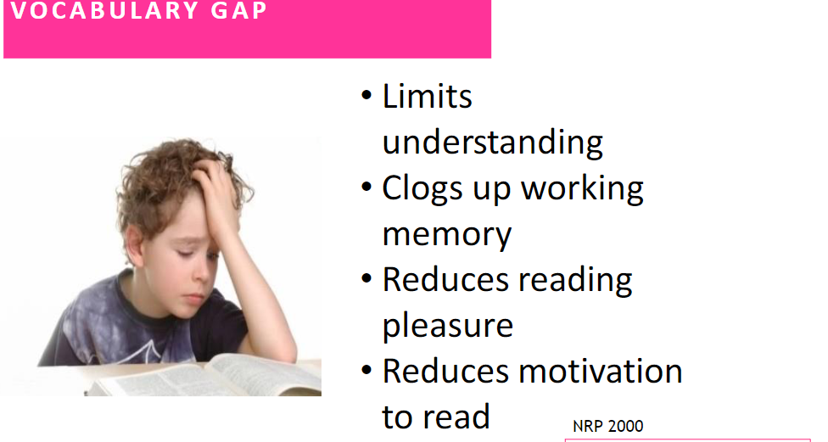

Slide 14
This is why at SSMM we start our approach with a whole text first and then unpick the vocabulary.
Once the children know the words, we can then start to work on improving their fluency.
This why we ask children to keep their books for so long:
To work out the words
To begin to improve their fluency of the text
To understand what it is saying
There is a reason behind everything we do!

Slide 15
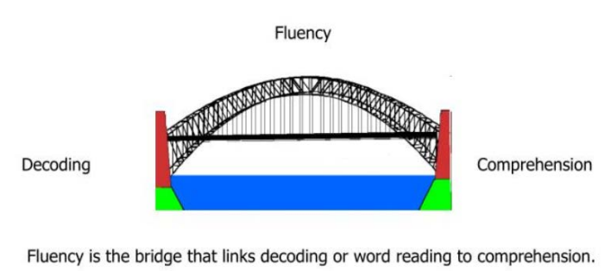
Why is fluency so important?
Notes:
Fluency is not something that will just happen.
It is a spectrum and everyone’s fluency decreases with more challenging texts so it needs to be practised even in Year 6
It needs to be modelled, encouraged and explained.

Slide 16
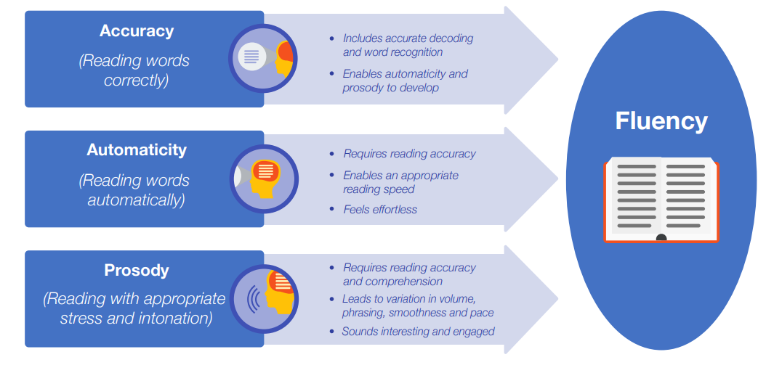
What exactly do we mean by fluency?
Notes:
Prosody- paying attention to punctuation.

Slide 17

Why Read?
Vocabulary development
Experiences/increased general knowledge
To learn
Text around us
Mental well being
Better academic attainment

Slide 18
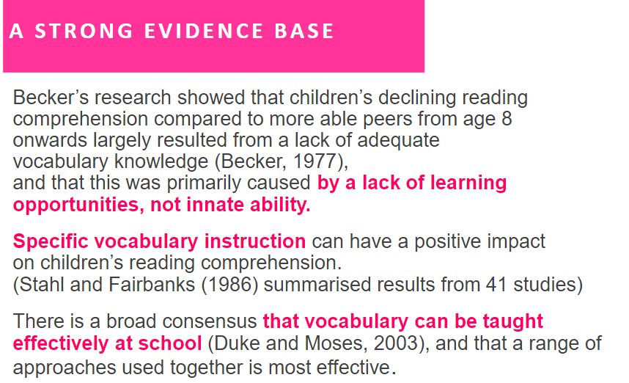

Slide 19
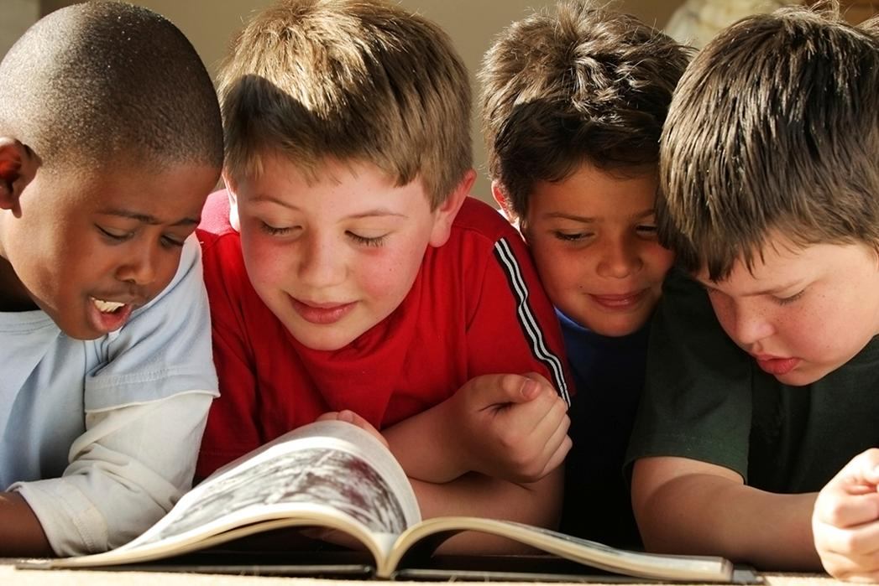
How do we teach children to read in school?
Picture books
Shared reading
Read aloud
Synthetics Phonics teaching
Guided reading
Whole class reading
Independent reading
Reading comprehension

Slide 20
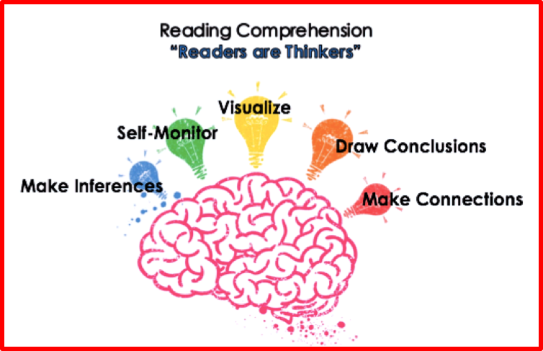
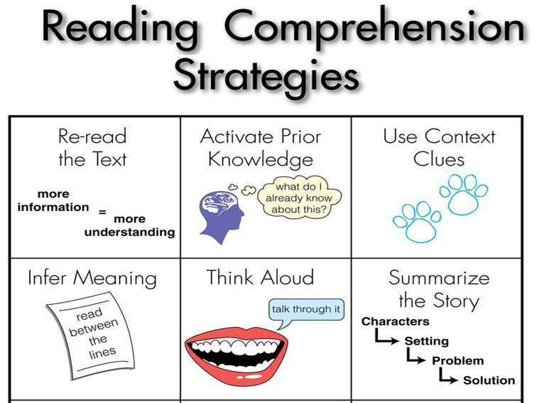


Slide 21
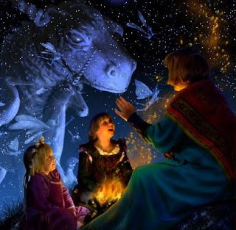
How do we help children to enjoy reading and become lifelong readers?
Book week
Incentives
Buddies
Library
Class novels
Teaching through a text
Role models
Range of books available
Parent support in and out of school

Slide 22
The next slide shows you the type of tasks the children are assessed with in KS2 …
These are the areas we have to cover according to the National Curriculum.

Slide 23
Extract from Treasure Island | Key Stage Two Task
I remember him as if it were yesterday, as he came plodding to the inn door, his sea-chest following behind him in a hand-barrow—a tall, strong, heavy, nut-brown man, his tarry pigtail falling over the shoulder of his soiled blue coat, his hands ragged and scarred, with black, broken nails, and the sabre cut across one cheek, a dirty, livid white. I remember him looking round the cover and whistling to himself as he did so, and then breaking out in that old sea-song that he sang so often afterwards: "Fifteen men on the dead man's chest— Yo-ho-ho, and a bottle of rum!" in the high, old tottering voice that seemed to have been tuned and broken at the capstan bars. Then he rapped on the door with a bit of stick like a handspike that he carried, and when my father appeared, called roughly for a glass of rum. This, when it was brought to him, he drank slowly, like a connoisseur, lingering on the taste and still looking about him at the cliffs and up at our signboard. | Vocabulary- With reference to the text, explain how the author uses language to make the reader think that the man is a sailor. Infer- Why do you think the man drank the rum slowly? Predict- What type of man do you think this visitor will turn out to be? Explain- What affect the description of the man has on the reader. Retrieval- What was in the man’s hand-barrow? Summarise the extract in 3 sentences.

Slide 24
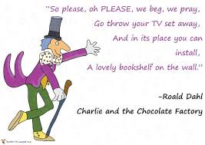

Slide 25
If your child prefers to read one genre of book, fantastic! They are reading!
If your child is willing to try something else, even better!
The next few slides might help to sign post alternative authors. →

Slide 26
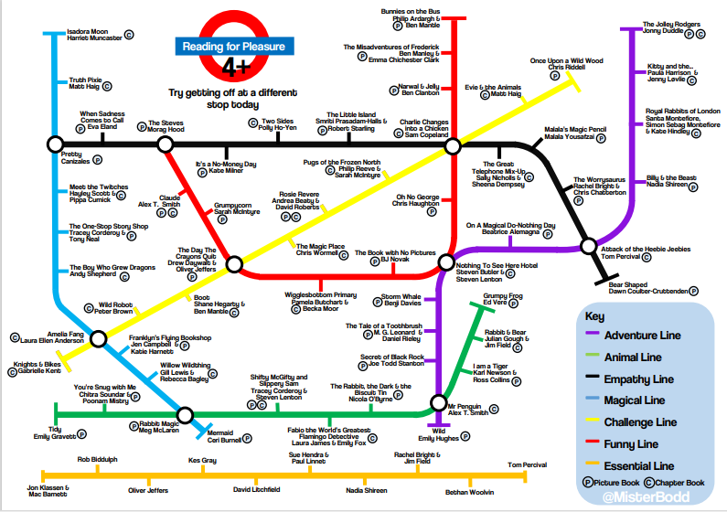

Slide 27
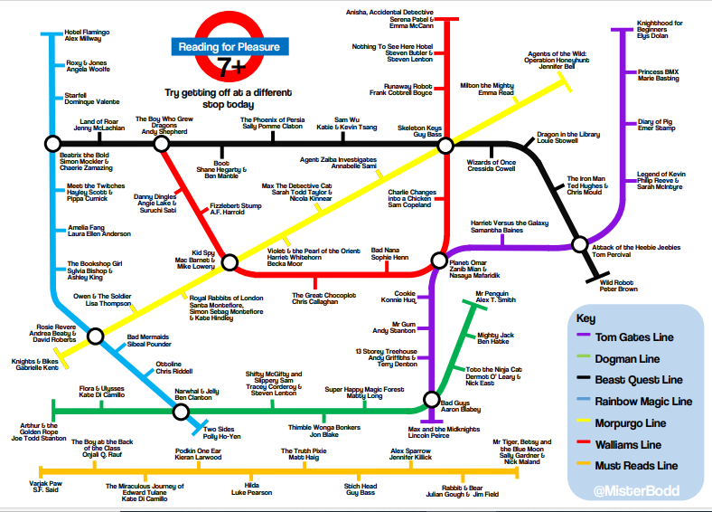

Slide 28
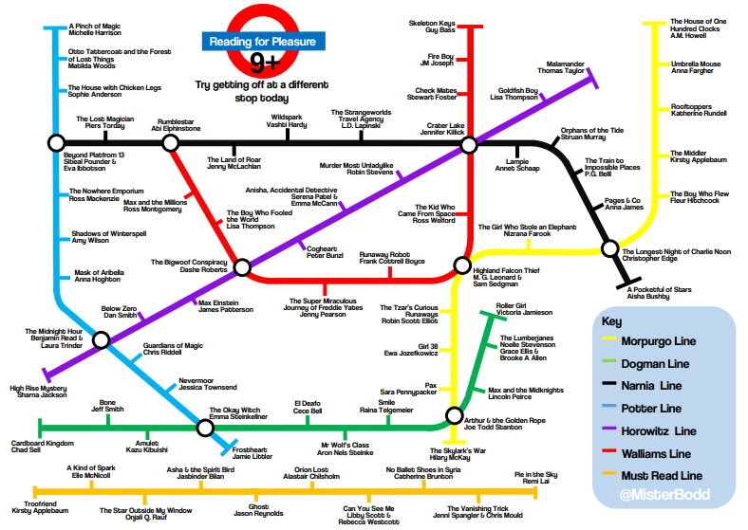

Slide 29
