Slide 2

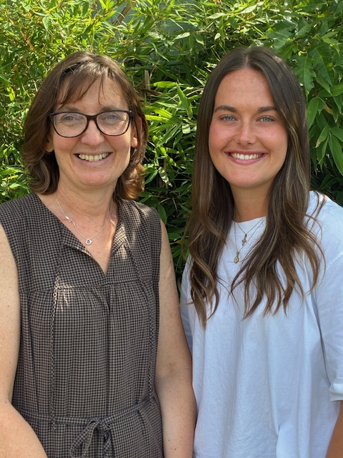
Welcome to Reception
Our names are Mrs Beirne (Class RAB) and
Miss Colyer (Class RPC) and we will be your teachers in September.
Let us tell you what a day in Reception looks like.
Why not add your own photo to each slide!

Slide 3

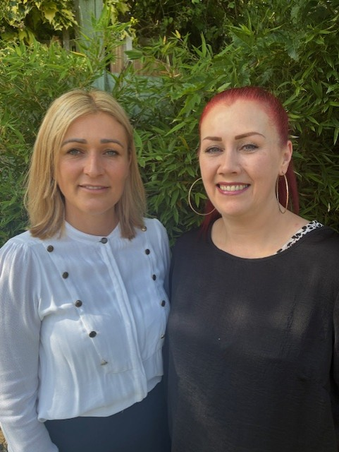
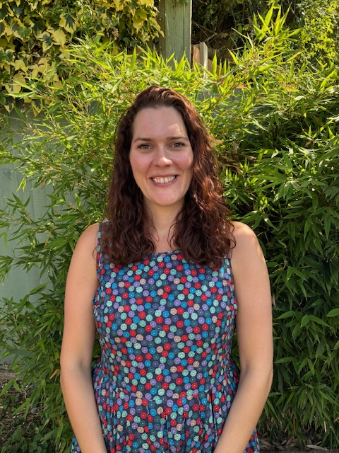
Good morning!
When you come to school in the morning, you need to walk through the playground with your grown up and find our classroom door. We will be there to meet you!
Mrs Azeez (Mon-Thurs) and Mrs Patel (Fri) will be the teaching assistants in RAB and Mrs Jackson in RPC.
Insert a photo of yourself here.

Slide 4
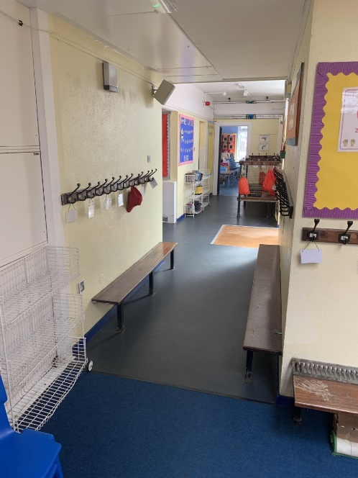
When you come into the classroom, you will need to take off your coat and hang it on your peg. Each child in your class has their own peg. You can put your PE bag on your peg too.
Insert a photo of yourself here.

Slide 5
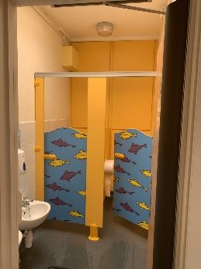
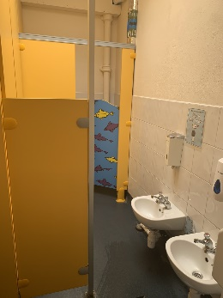
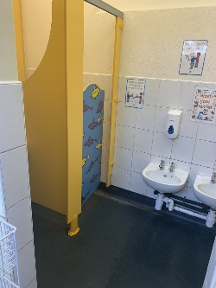
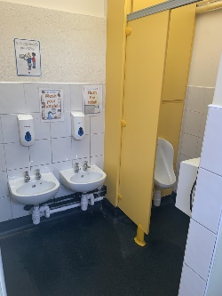
Our toilets are by your coat peg. We will show you them when you start school so that you can use them whenever you need to.
Insert a photo of yourself here.

Slide 6

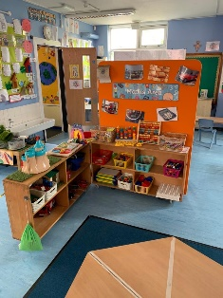
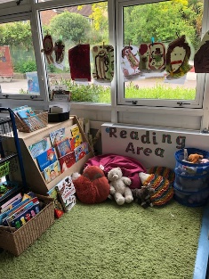
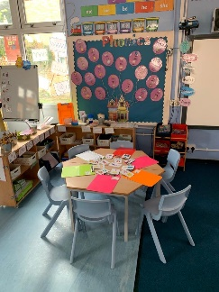
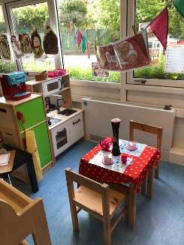
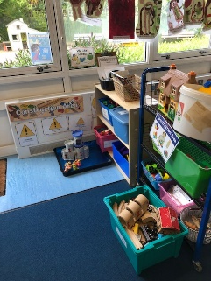
In the classroom, there are lots of things for you to explore and help you with your learning.
Insert a photo of yourself here.

Slide 7
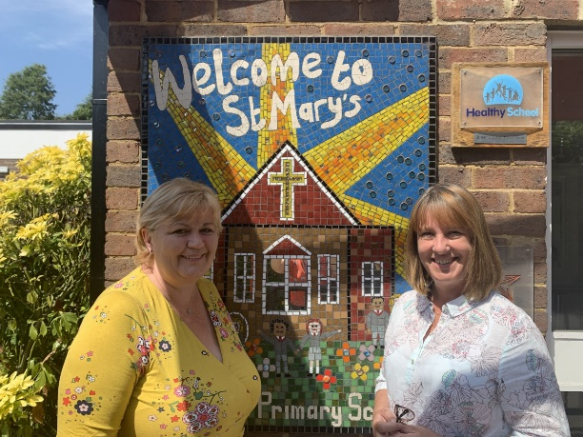
Sometimes we go to the hall for assembly.
In assembly we listen to stories and sing songs.
You might see some other teachers during assembly time, such as Mrs Vassallo and Mrs Durand.
Insert a photo of yourself here.

Slide 8
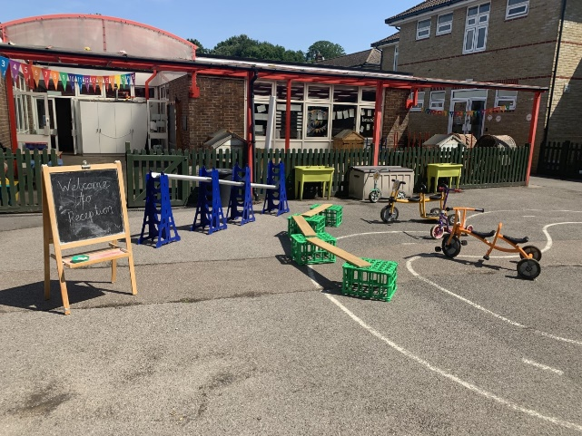
During the day, we sometimes go outside to the playground to play.
Insert a photo of yourself here.

Slide 9
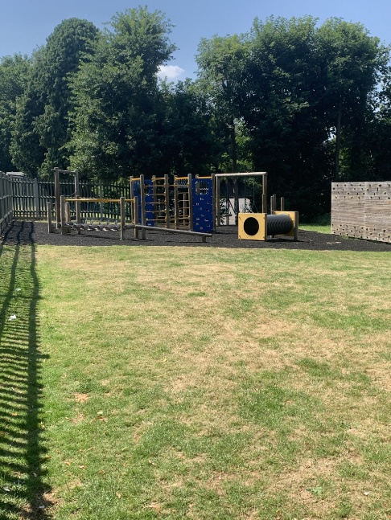
Sometimes we also go on the trim trail and have fun jumping and climbing.
Insert a photo of yourself here.
Insert a photo which shows the playground.

Slide 10
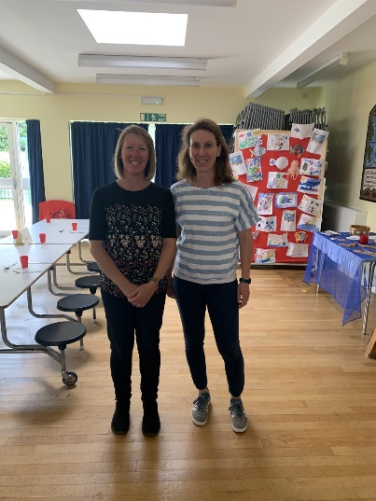
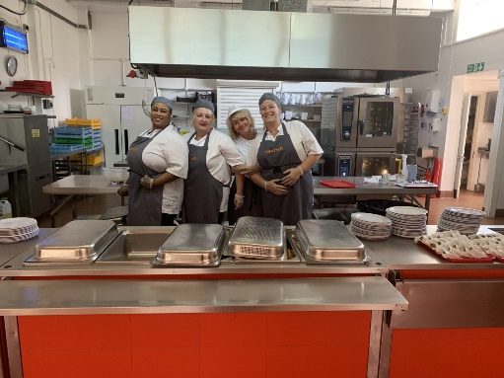
At lunchtime we go into the hall to see the cooks who have made us our delicious school dinner. Our lunchtime supervisors are Mrs Cavallo and Mrs Monaghan and they look after us at lunchtime.
Insert a photo of yourself here.
Insert a photo which shows the playground.

Slide 11
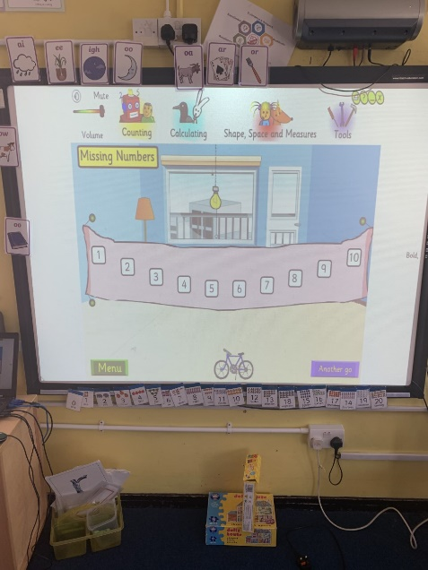
After lunch, we will do the afternoon register and do some counting together and then it’s time to do some more learning inside and outside.
Insert a photo of yourself here.

Slide 12
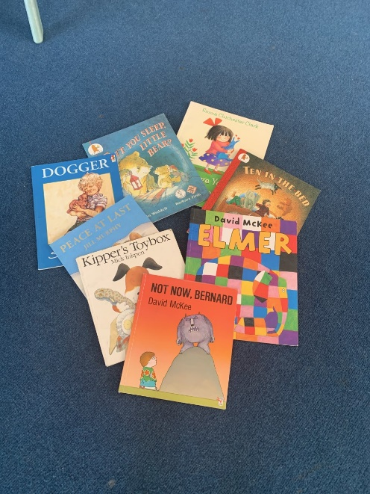
Just before it is time to go home, we sit together on the carpet and talk about all the fun things we did today.
We sometimes have a story or sing some songs too.
Insert a photo of yourself here.

Slide 13
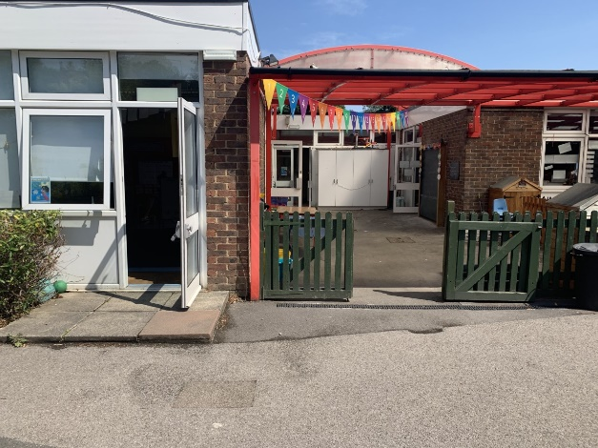
When it is home time, we put on our coats and collect the things we need to take home.
We look out for your grown-up who is coming to collect you.
Insert a photo of yourself here.

Slide 14
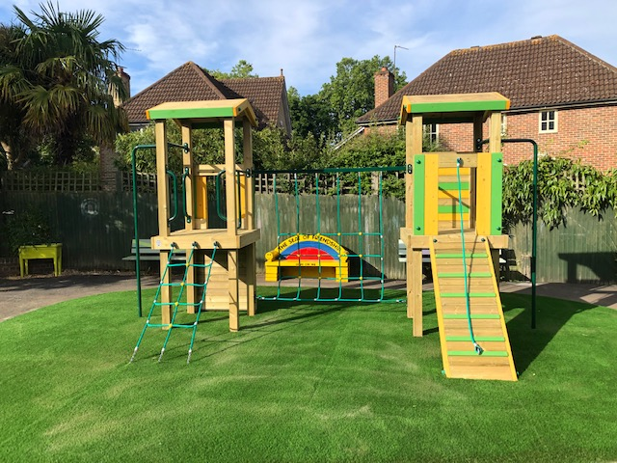
Phew! What busy days we have in Reception. I hope you are looking forward to playing on our climbing frame.
We are looking forward to seeing you soon!

