Slide 1
Class 3 Knowledge Mats
Year B – 2023 - 2024

Slide 2
Autumn 1

Slide 3
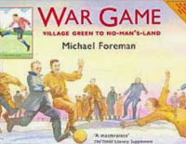
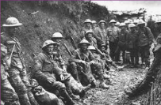
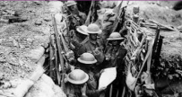
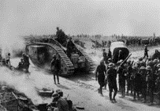
World War 1: KS2 Knowledge Mat
Subject Specific Vocabulary
trench | A long narrow ditch dug into the ground where soldiers lived
airships | Huge balloon like crafts used to carry out bombing raids in Britain.
 |  | Sticky Knowledge about World War 1
Archduke Franz Ferdinand of Austria | His assassination was believed to be the trigger to the outbreak of the WW1 war. He was heir to the Austro-Hungarian throne.
 |  | Aircraft were still very new in 1914, so when the Germans launched bombing raids on London, they were carried out from airships, known as zeppelins
Central Powers | The alliance of Germany, Austria, Hungary, Bulgaria and Turkey
 |  | In 1918 a pigeon, Cher Ami, one of about 100,000 homing pigeons used during the war, managed to save 500 US soldiers
front line | The trench closest to the enemy.
no man’s land | The area between the two sides during battle.
 |  | Tanks were developed by the British during the first world war
Battle of the Somme | The largest battle of WW1 and the bloodiest battle in history. | Before the war most women stayed at home or worked in domestic service
zeppelin | Giant German airships that carried out 52 air raids on Britain. | When the war started, British soldiers went into battle with just a cloth cap for protection
blackout | When lights from buildings, including houses, were not allowed to be seen from the sky. | Many people suffered facial injuries during the first world war
 |  | The first ever motorized ambulances were used during the first world war
Armistice Day | The day the agreement was signed between the Allies and Germany to end the war on 11th November.
 |  | Approximately 16,000 British conscientious objectors refused to fight during the war
conscription | A rule that said ALL healthy men aged 18 – 41 had to fight. | Due to food shortages, Britons were banned from throwing rice at weddings and feeding pigeons

Slide 4
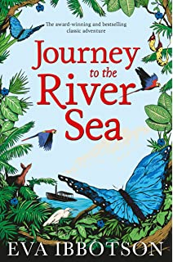
LKS2 Living things and their habitats Knowledge Mat
Subject Specific Vocabulary |  | Interesting Book | Sticky Knowledge about the living things
mammals | Warm-blooded animals that give birth to their live young and normally hair/fur.
 |  |  | All living things have certain characteristics that help to keep them healthy and alive.
reptiles | Cold-blooded animals that normally lay eggs and have scales. |  | Living things live in habitats that suit them, and which provide for their basic needs.
 |  |  | Living things depend on other living things to survive.
Amphibians | Cold-blooded animals that have moist, scaleless skin and lay eggs.
 |  |  | You can remember the features of living things by using the acronym MRS GREN (movement, respiration, sensitivity, growth, reproduction, excretion and nutrition)
Fish | Cold-blooded animals that can breathe underwater and lay eggs.
 |  | Important facts to know by the end of the living things topic:
Birds | Warm-blooded animals that have feathers wings and a beak.
 |  |  | Animals are often adapted to their habitats they live in. However, habitats can change over time which may present animals and plant life with difficulties.
 |  | Group living things in different ways Use and make classification keys to group and identify living things. Explore how environments change over time and the dangers this can pose to living things.
Insects | Insects have exoskeletons and three main body parts.
 |  |  | Global warming is impactin many habitats.
habitats | A place where animals live that is suited to their needs.
 |  |  | All around us, there are some things that are alive, some things that are dead, and some things that have never been alive.
Invertebrates | Animals that don’t have a backbone
Vertebrates | Animals that have a backbone

