Slide 1
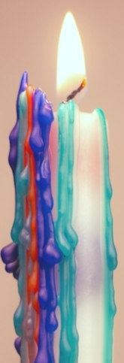
Creativity
Creativity

Slide 2
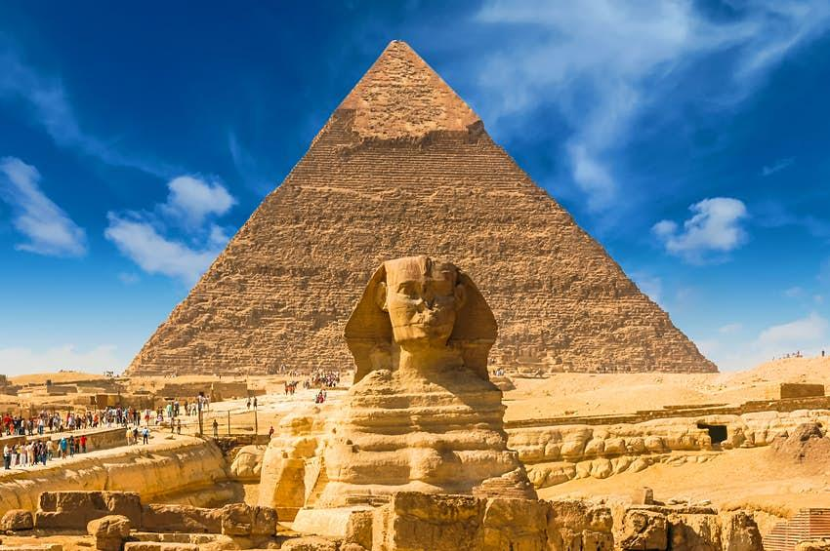

Slide 3
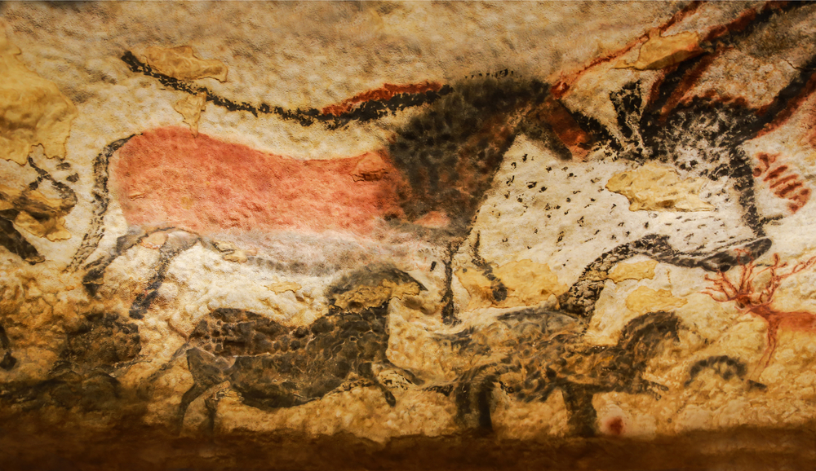

Slide 4
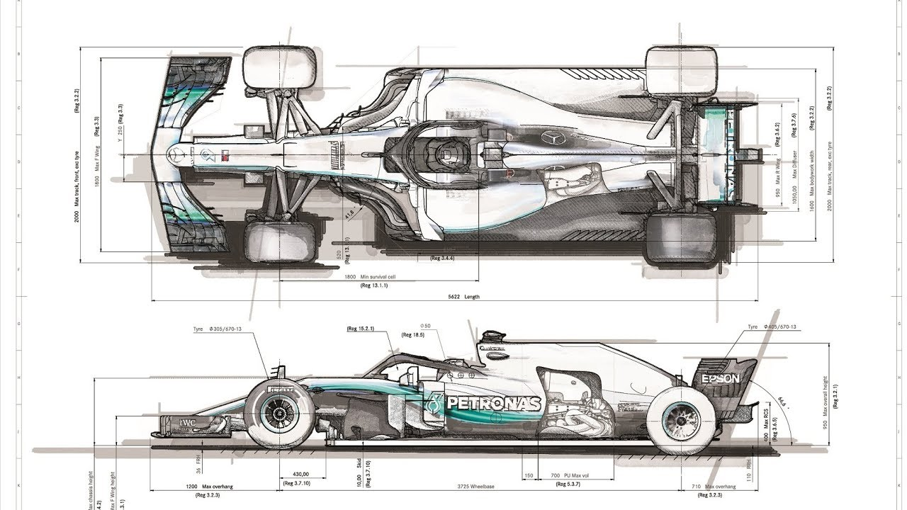

Slide 5
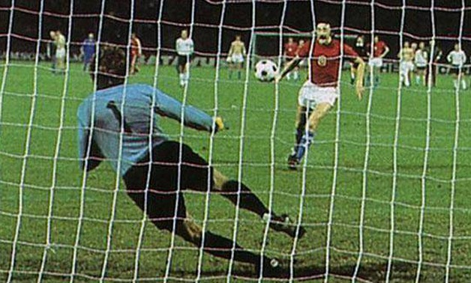

Slide 6
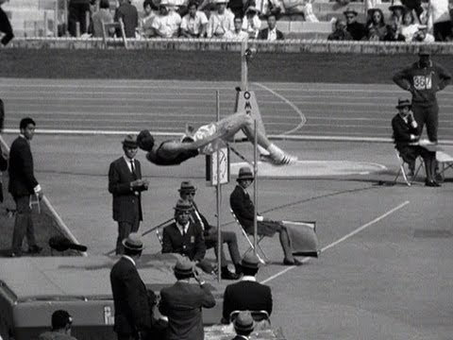

Slide 7
Each of us is creative but we all have
different gifts and abilities. Some of
us love to paint, others to cook: some
like to make music, others to build
Models…
What are your creative gifts?
Is there something you have alkways wanted to try but never got around to?
Each of us is creative but we all have
different gifts and abilities. Some of
us love to paint, others to cook: some
like to make music, others to build
Models…
What are your creative gifts?
Is there something you have always wanted to try but never got around to?

Slide 8
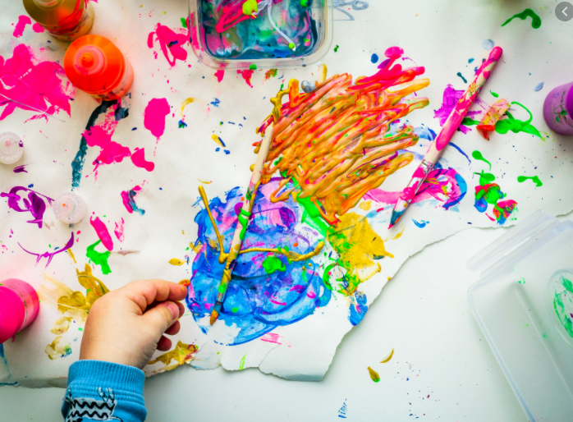
This half term….
Let’s be creative!!!

Slide 10
Creativity
Creativity

Slide 13
Creativity
Creativity

Slide 14
Then God said, "I give you every seed-bearing plant on the face of the whole earth and every tree that has fruit with seed in it. They will be yours for food.
Genesis 1:29

Slide 15
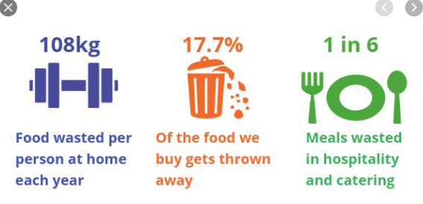

Slide 16
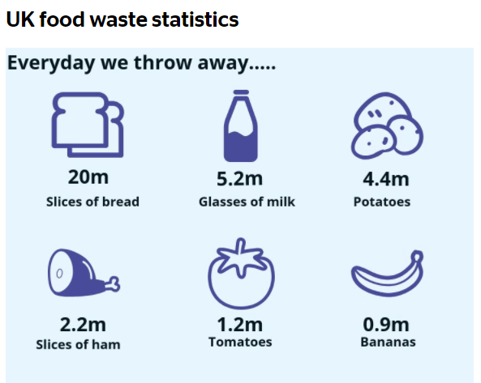

Slide 17
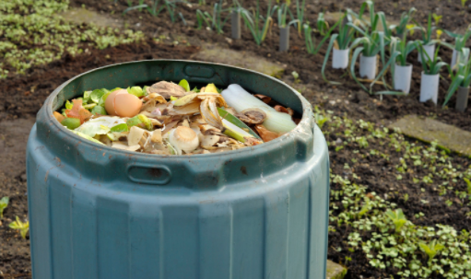

Slide 18
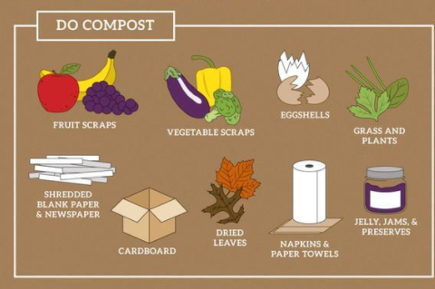

Slide 19
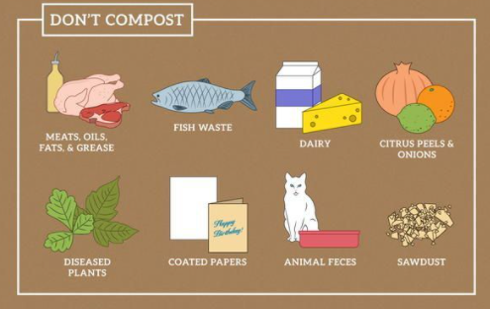

Slide 20
TIME TO REFLECT
God, I'm sorry. I took this food and didn't eat it. Please forgive me for wasting food, especially when so many people don't have enough. Starting now, make me wiser and help me take better care of the food you have given me.

