Slide 1
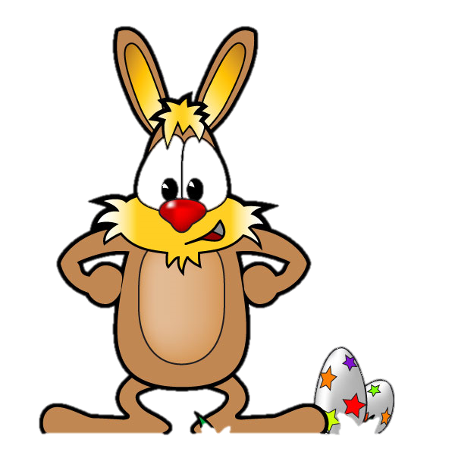
Can you help the Easter Bunny?

Slide 2
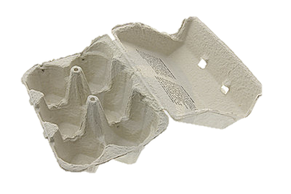
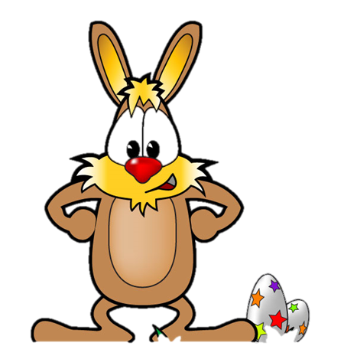
The Easter bunny has to arrange his eggs into boxes of 6.

Slide 3
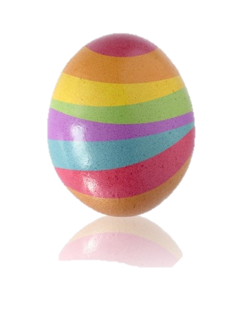
How many ways can he arrange 1 egg?

Slide 4
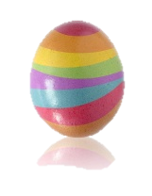

Slide 5
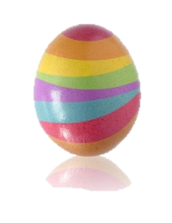
What about if he had 2 eggs?
Can you help find the different possibilities?

Slide 6
What about if he had 3 eggs?
Can you help find the different possibilities?

Slide 7
How many ways can you find to arrange eggs in the box?
Remember, they must all be different!

Slide 8
How can you make sure you find them all?
Does the person next to you have one you don’t?

Slide 9
Look at this table
Number of eggs | 0 | 1 | 2 | 3 | 4 | 5 | 6
Number of Possibilities | 1 | 6 | 15 | 20 | 15 | 6 | 1
Do you notice a pattern?
Can you explain why it is happening?
Convince a friend.

