Slide 1
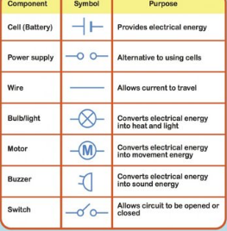
Year 6: Electricity Knowledge Mat
Subject Specific Vocabulary |  | Electrical symbols | Sticky Knowledge about Electricity
conductor | Some materials let electricity pass through them easily. These materials are known as electrical conductors.
 |  |  | Electricity travels at the speed of light. That's more than 186,000 miles per second!
insulator | Plastic, wood, glass and rubber are good electrical insulators.
 |  |  | Electricity comes from the power station, the wind, the sun, water and even an animal’s poo!
socket | A socket is a safe device to plug your electrical items into at home. Almost every room at home will have at least one socket.
 |  |  | Electricity is a type of energy that builds up in one place (static), or flows from one place to another (current electricity).
series circuits | A series circuit is one that has more than one resistor, but only one path through which the electricity (electrons) flows.
cells | An electrical cell is a device that is used to generate electricity, or one that is used to make chemical reactions possible by applying electricity.
 |  |  | Coal is the biggest source of energy for producing electricity. Coal is burned in furnaces that boil water and create steam.
volts | Voltage is an electrical potential difference, the difference in electric potential between two places. | Important facts to know by the end of the electricity topic:
 |  |  | A popular way of generating electricity is through hydropower. This is a process where electricity is made by water which spins turbines attached to generators.
 |  | Know that the brightness of a bulb is associated with the voltage. Compare and give reasons for variations in how components function. Use recognised symbols when representing a simple circuit in a diagram. Construct simple series circuits. Be able to answer questions about what happens when they try different components, for example; switches, bulbs, buzzers and motors.
generator | A machine that converts energy into electricity.
turbine | A machine that creates continuous power in which a wheel, or something similar, moves round and round by fast moving water, steam, gas or air.
 |  |  | A bolt of lightning can measure up to 3,000,000 volts, and lasts less than one second!
fuses | These are safety devices. A fuse is a strip of wire that melts and breaks an electric circuit if it goes over a safe level.
 |  |  | Electric fields work in a similar way to gravity. Whereas gravity always attracts, electric fields can either attract or repulse.
Thomas Edison | He was a great inventor that came up with a way of making the electric light bulb accessible for homes, industry and outside in the streets.

