Slide 1
Lesson four: Investigating fairtrade

Slide 2
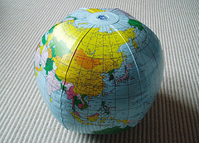
Recap: Global Trade
Trade is global: countries import and export goods to and from other countries.
Supply chains are global: manufactured goods go through stages of production that occur at different locations around the globe.
Globe © Steve Cadman, Flickr

Slide 3
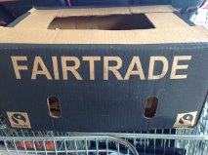
What is fairtrade?
Trade between companies in more developed countries and producers in less developed countries in which fair prices are paid to the producers.
Watch the video on fairtrade

Slide 4
Fairtrade: What is it all about?
“Fairtrade is about better prices, decent working conditions and fair terms of trade for farmers and workers.
It’s about supporting the development of thriving farming and worker communities that have more control over their futures and protecting the environment in which they live and work”.
- The Fairtrade Foundation
Source: Wikipedia

Slide 5
Protects workers’ rights and working conditions, keeping them safe and healthy.
Helps producers help themselves out of poverty through global trade: selling their products to large companies and other countries at fair prices.
FAIRTRADE
Benefits and empowers marginalized communities in developing countries.
Fairtrade Premium: Money given to producers which they choose to invest in business or community projects such as schools, transport and healthcare.
Ensures workers receive a fair price for their work and product that is stable.

Slide 6
Where are fairtrade producers located?
Go to the Fairtrade Foundation website to explore the world map of fairtrade producers

Slide 7
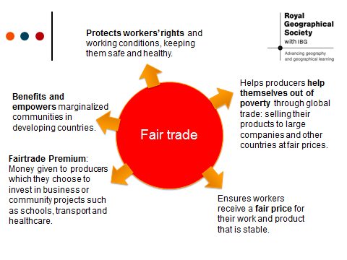
Main Activity: Why Pay More?
Why pay more?
Create a poster explaining
why it might be worth paying a
Little bit more for fairtrade
products.
Illustrate your poster with fairtrade products and link their source to the correct location on the map using the information on the next slide.

