Slide 1
CLASS 4
The Lord is Here

Slide 5
A - Z

Slide 7
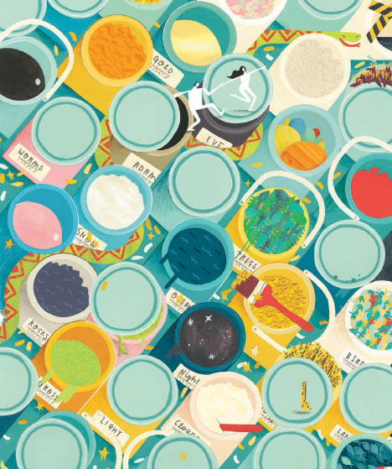
God is generous He gives us amazing gifts He gave us the sun, the moon, the planets and the animals

Slide 8
ARE YOU GENEROUS?
HOW DO YOU SHOW IT?
DO YOU HAVE TO BE RICH TO BE GENEROUS?
WHO IS GENEROUS TO YOU?
HOW IS GOD GENEROUS?

Slide 9
Dear God Thank you for your generosity For all you have given us Help us to be thankful for these gifts and to give generously to others Amen

