Slide 2
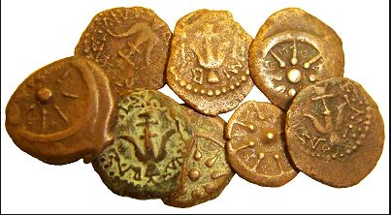
The Widow’s Mite

Slide 3
Jesus had been teaching in the Temple

Slide 4
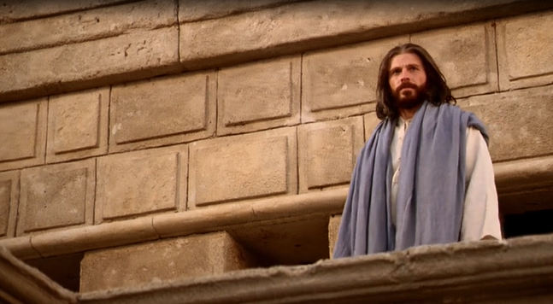
But now he sat down near the treasury and watched as the many visitors to the Temple passed by and dropped money into the collecting box to help with God’s work

Slide 5
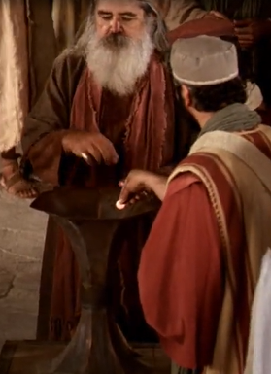
The rich men dressed in fine robes threw in handfuls of coins as they
passed, without a thought.

Slide 6
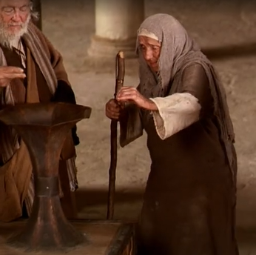
But then a poor widow came by, paused, and
placed just two mites (tiny coins) into the box.
Jesus called his disciples to him and told them what he had seen

Slide 7
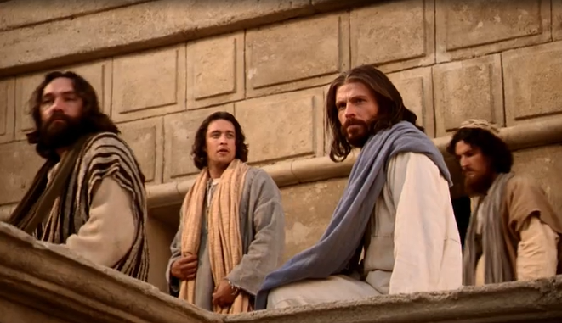
Then he said to them, “Let me tell you, this poor widow gave more than all
those people who threw many coins into the treasury. The wealthy men
gave just a small part of their riches which made no difference to them.
But the widow gave all that she had.”

Slide 8
You see, God is more interested in what is in the heart of the giver than the size of their gift.

Slide 9
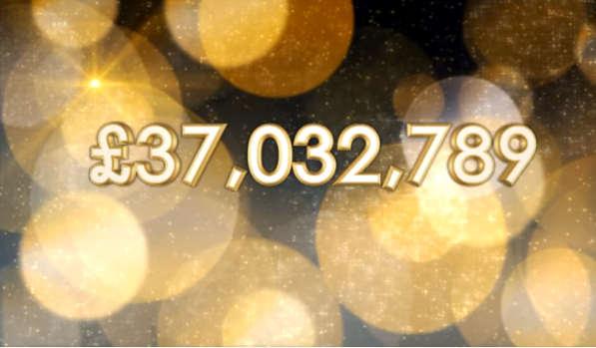

Slide 11
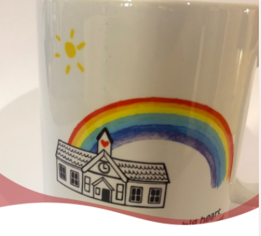
Let us pray..
Dear Lord,
teach me to be generous.
Teach me to serve you as you deserve;
to give and not to count the cost
Amen

