Slide 1
God as Creator

Slide 2
Our Bibles tell us that God created the heavens and the earth
Time to think
What is your favourite animal or plant?

Slide 3
My favourite animal is …

Slide 4
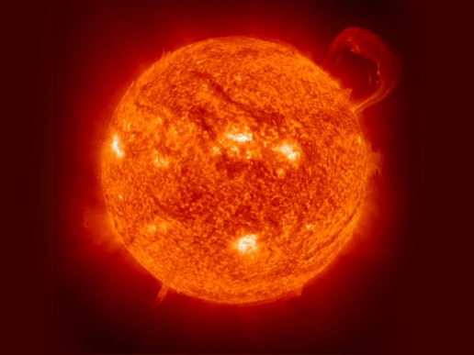

Slide 5
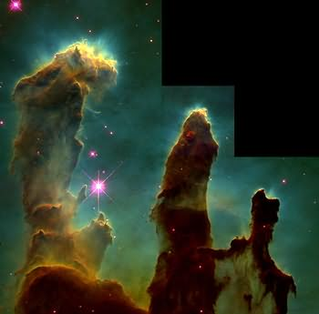

Slide 6
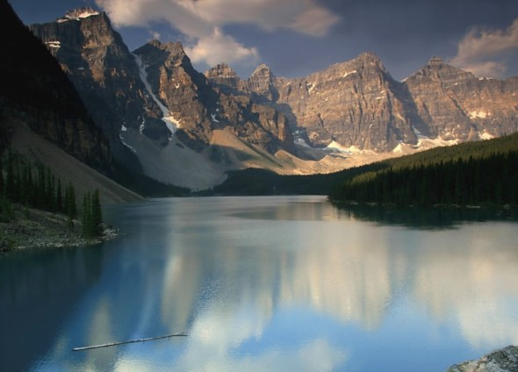

Slide 7
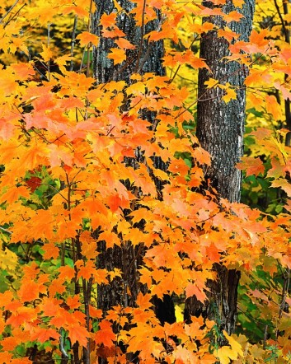

Slide 8
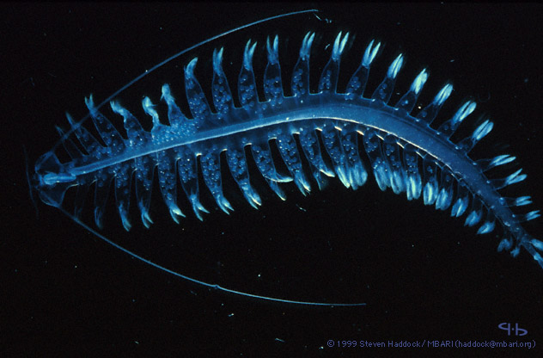

Slide 9
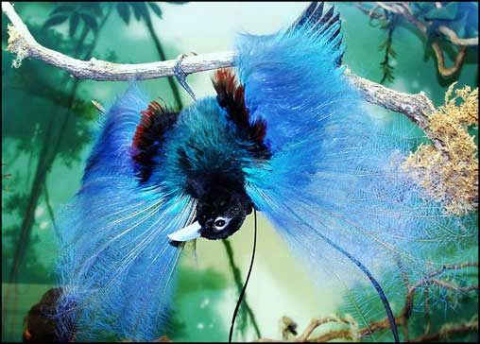

Slide 10
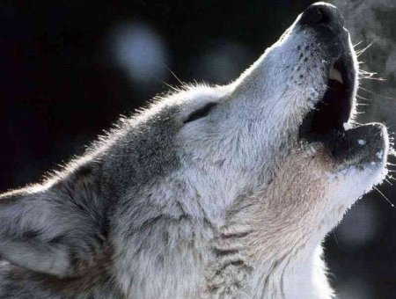

Slide 11
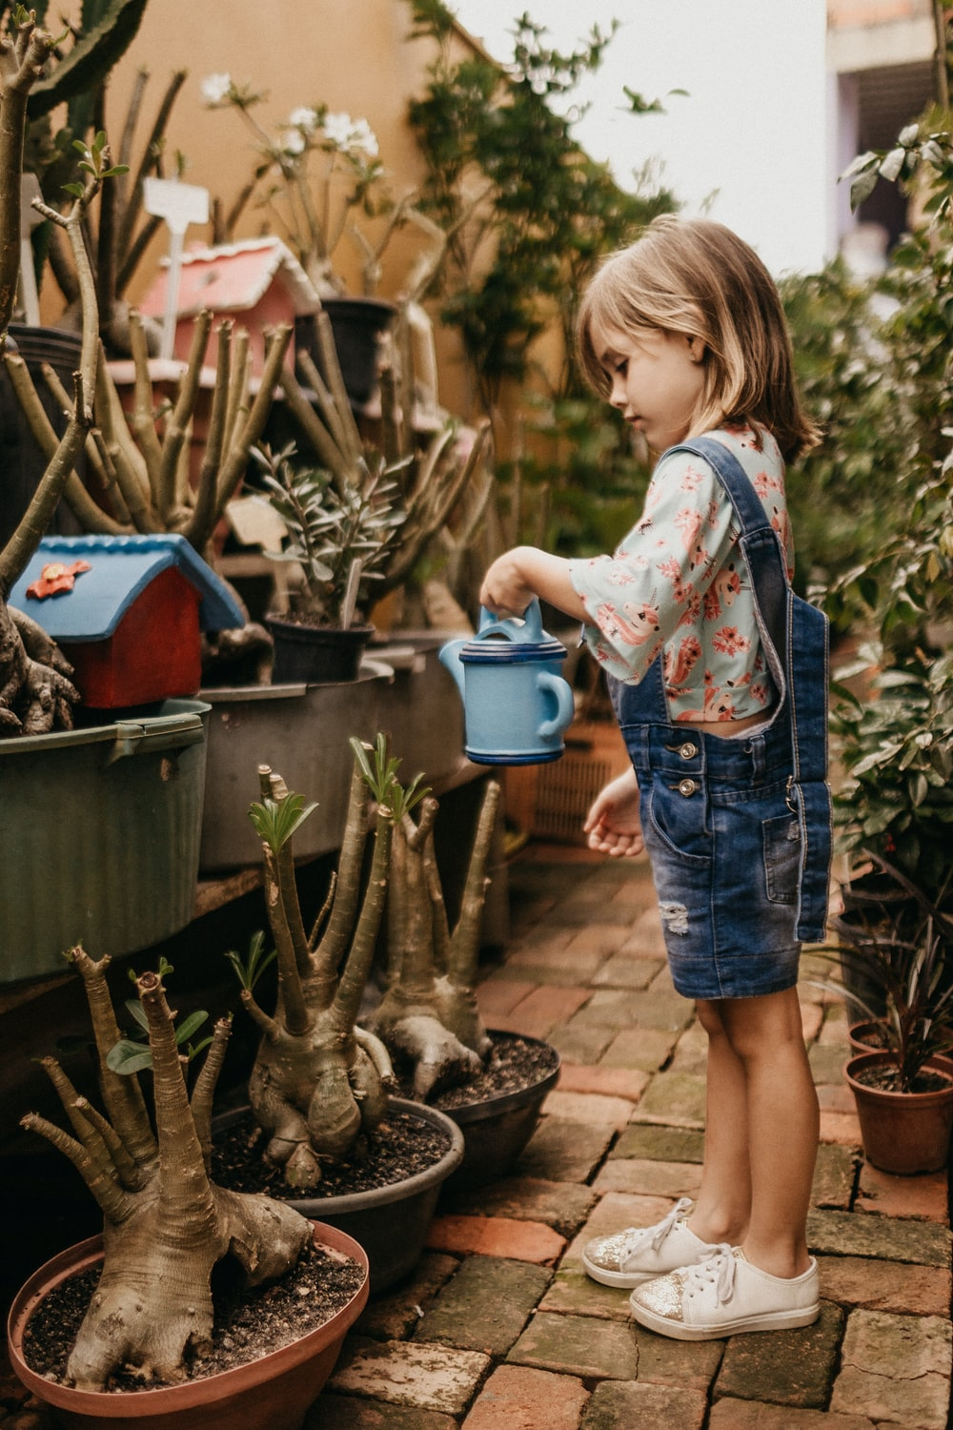
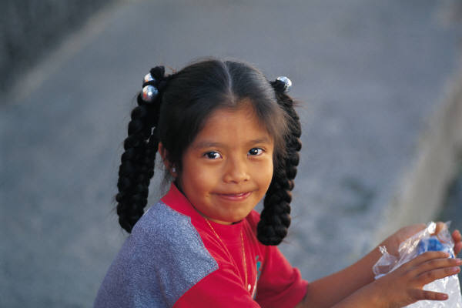
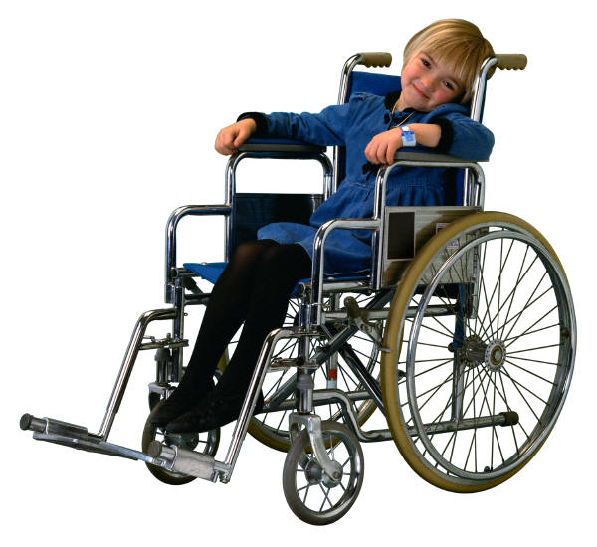
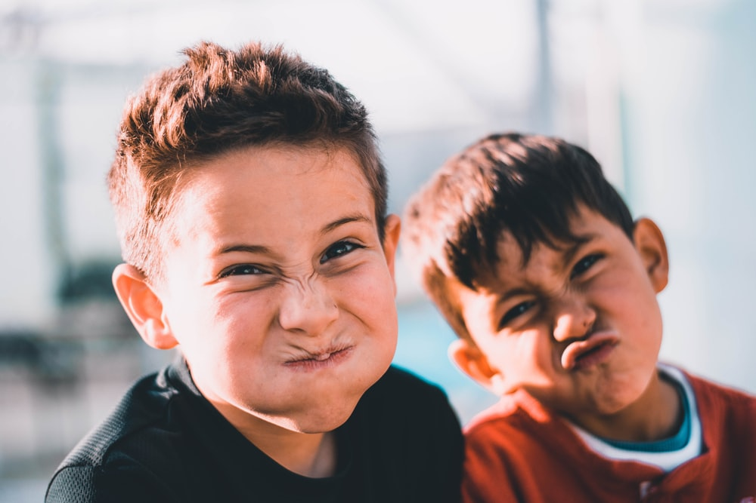
Photo by Jonathan Borba on Unsplash

Slide 12
But sometimes we spoil God’s creation

Slide 13
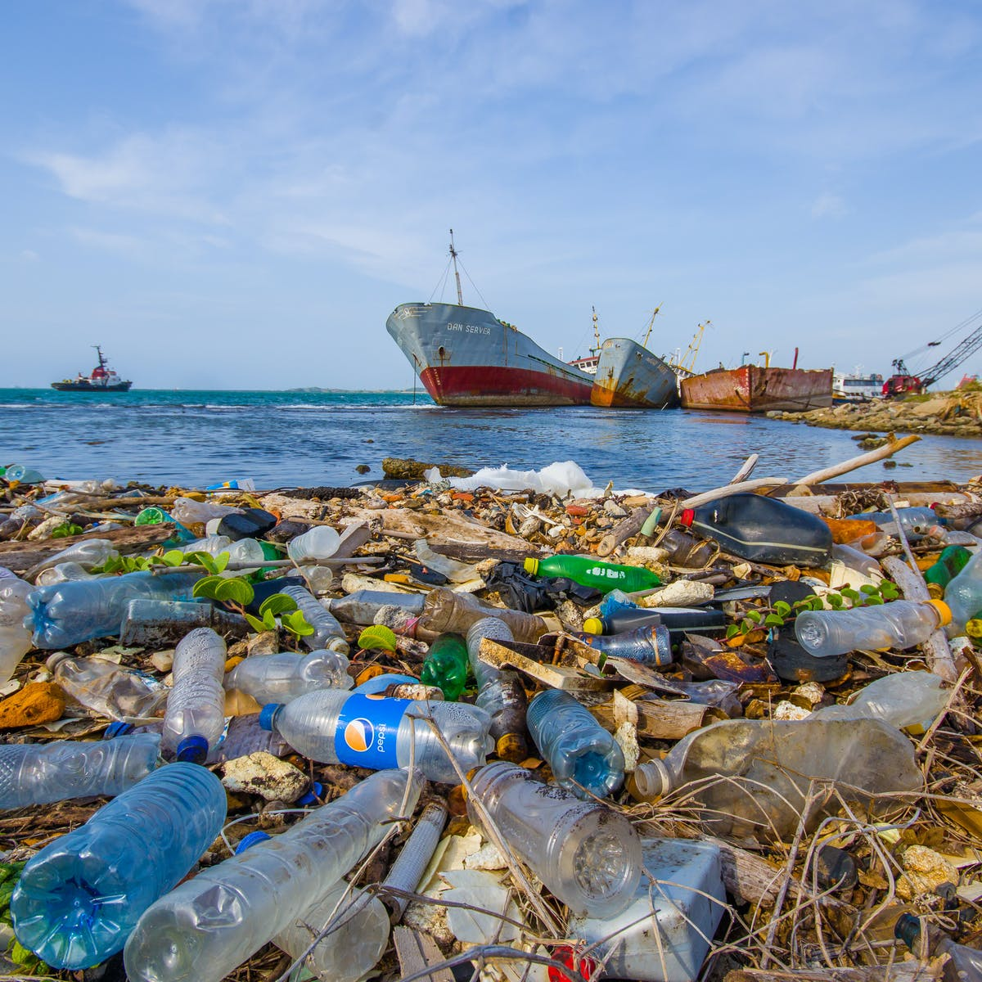

Slide 15
What can we do with all this rubbish?

Slide 16
God likes to create and we can be creative even with rubbish.

Slide 21
Time to Reflect

Slide 22
The Lord’s Prayer
The Grace

Slide 23
Image by L Lad from Pixabay
Image by jplenio on pixabay.com

