Slide 2
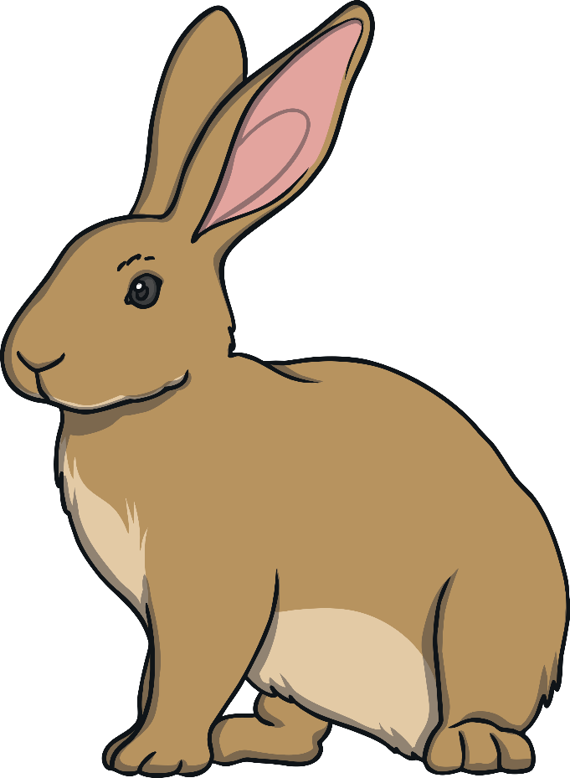
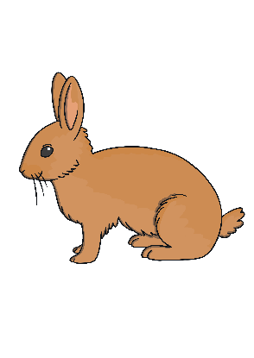
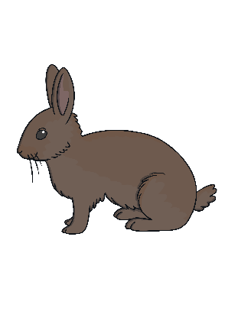
Poor Mrs Rabbit!
Can you help Mrs Rabbit?
It’s dinner time at Mrs Rabbit’s house and she needs her 10 little rabbits home for dinner.
The trouble is that the little rabbits keep hopping everywhere and she can’t count them.
next

Slide 3
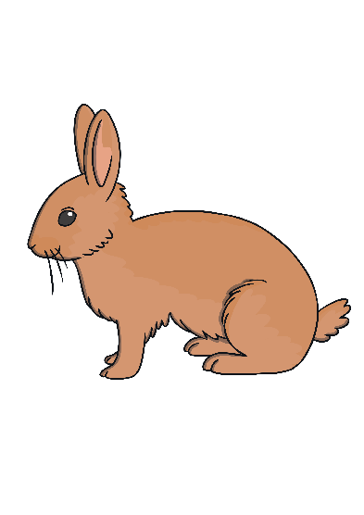
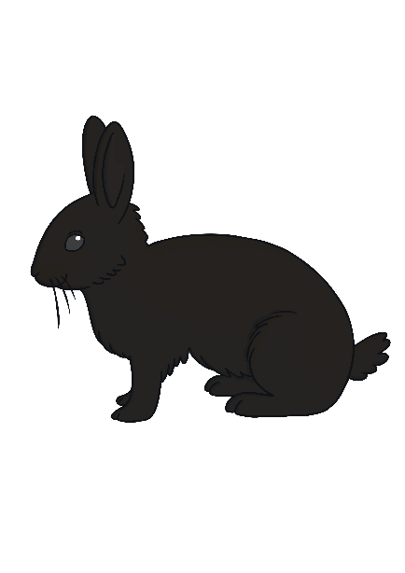
How many rabbits are at home?
next
Only 3 rabbits are at home. Let’s try again!
How many rabbits can you count?
0
1
2
3
4
5
6
7
8
9
10

Slide 4
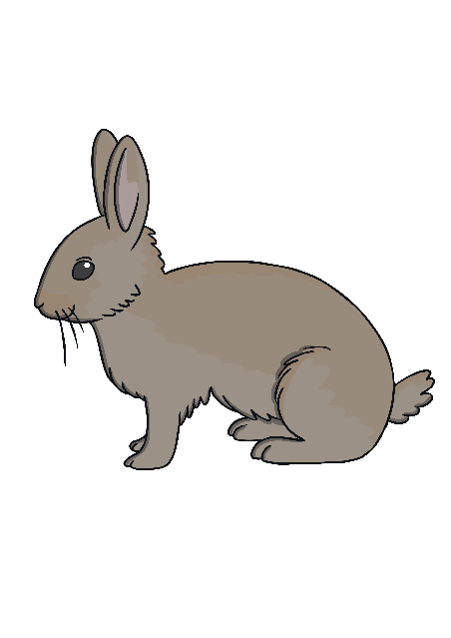
How many rabbits are at home?
next
Only 5 rabbits are at home. Where are all the little rabbits?
How many rabbits are there now?
0
1
2
3
4
5
6
7
8
9
10

Slide 5
How many rabbits are at home?
next
8 rabbits are at home but Mrs Rabbit should have 10!
Are all the rabbits at home? Count them and see.
0
1
2
3
4
5
6
7
8
9
10

Slide 6
How many rabbits are at home?
next
Oh no! Now there are 0 rabbits and it’s nearly time for dinner!
How many rabbits are at home?
0
1
2
3
4
5
6
7
8
9
10

Slide 7
How many rabbits are at home?
next
Just 2 rabbits are at home. We need to find the little rabbits!
How many rabbits are at home for dinner?
0
1
2
3
4
5
6
7
8
9
10

Slide 8
How many rabbits are at home?
next
Nearly there! There are 9 rabbits at home.
Are all of the rabbits home now? Count and click the number.
0
1
2
3
4
5
6
7
8
9
10

Slide 9
How many rabbits are at home?
next
Hurray! There are 10 little rabbits at home, just in time for dinner.
It’s nearly dinner time. I hope all the rabbits are
home now. Can you count them?
0
1
2
3
4
5
6
7
8
9
10

Slide 10
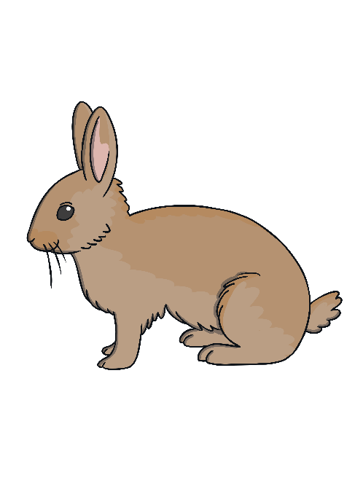
10 little rabbits are home for dinner.
10

