Slide 1
Believe and Achieve
Love.Respect.Friendship

Slide 2
The Lord is here…

Slide 3
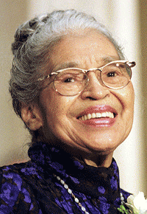
Rosa Parks
Taught us perseverance, positivity and leadership.

Slide 4
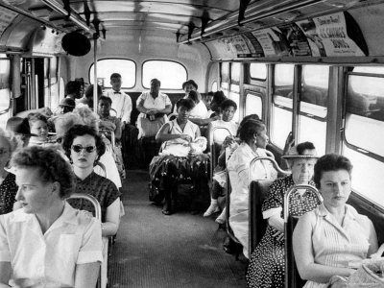

Slide 5
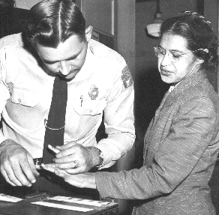
Rosa Parks believed in a world where black and white communities could live and work together

Slide 6
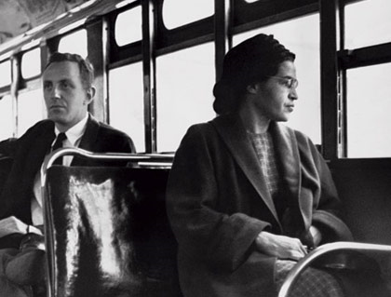
For those that
wait upon the Lord

Slide 7
Justice.
To make fair
For everything to be even.
To be equal….
Today we will look at….

Slide 8
Fairness.

Slide 9
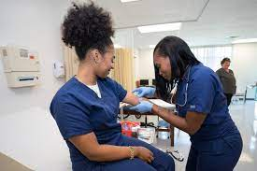

Slide 10
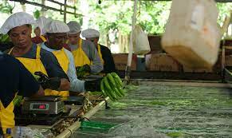

Slide 11
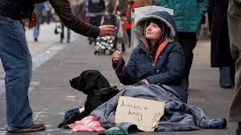

Slide 13
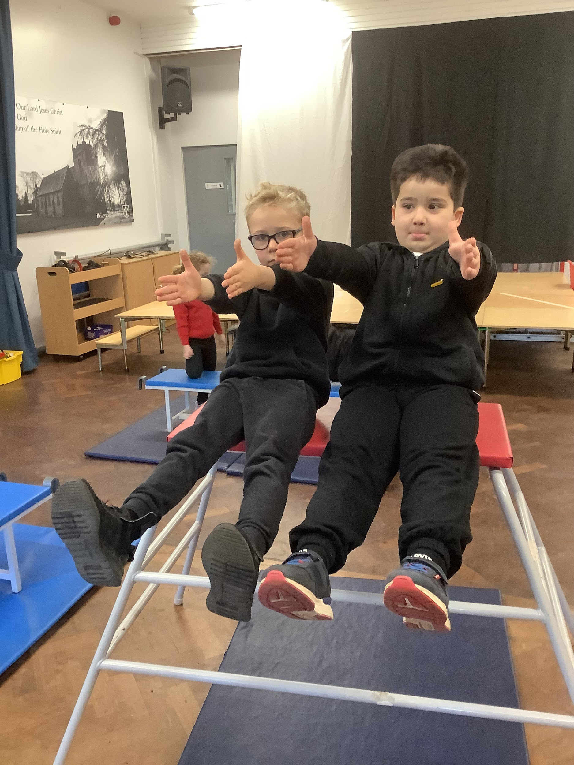
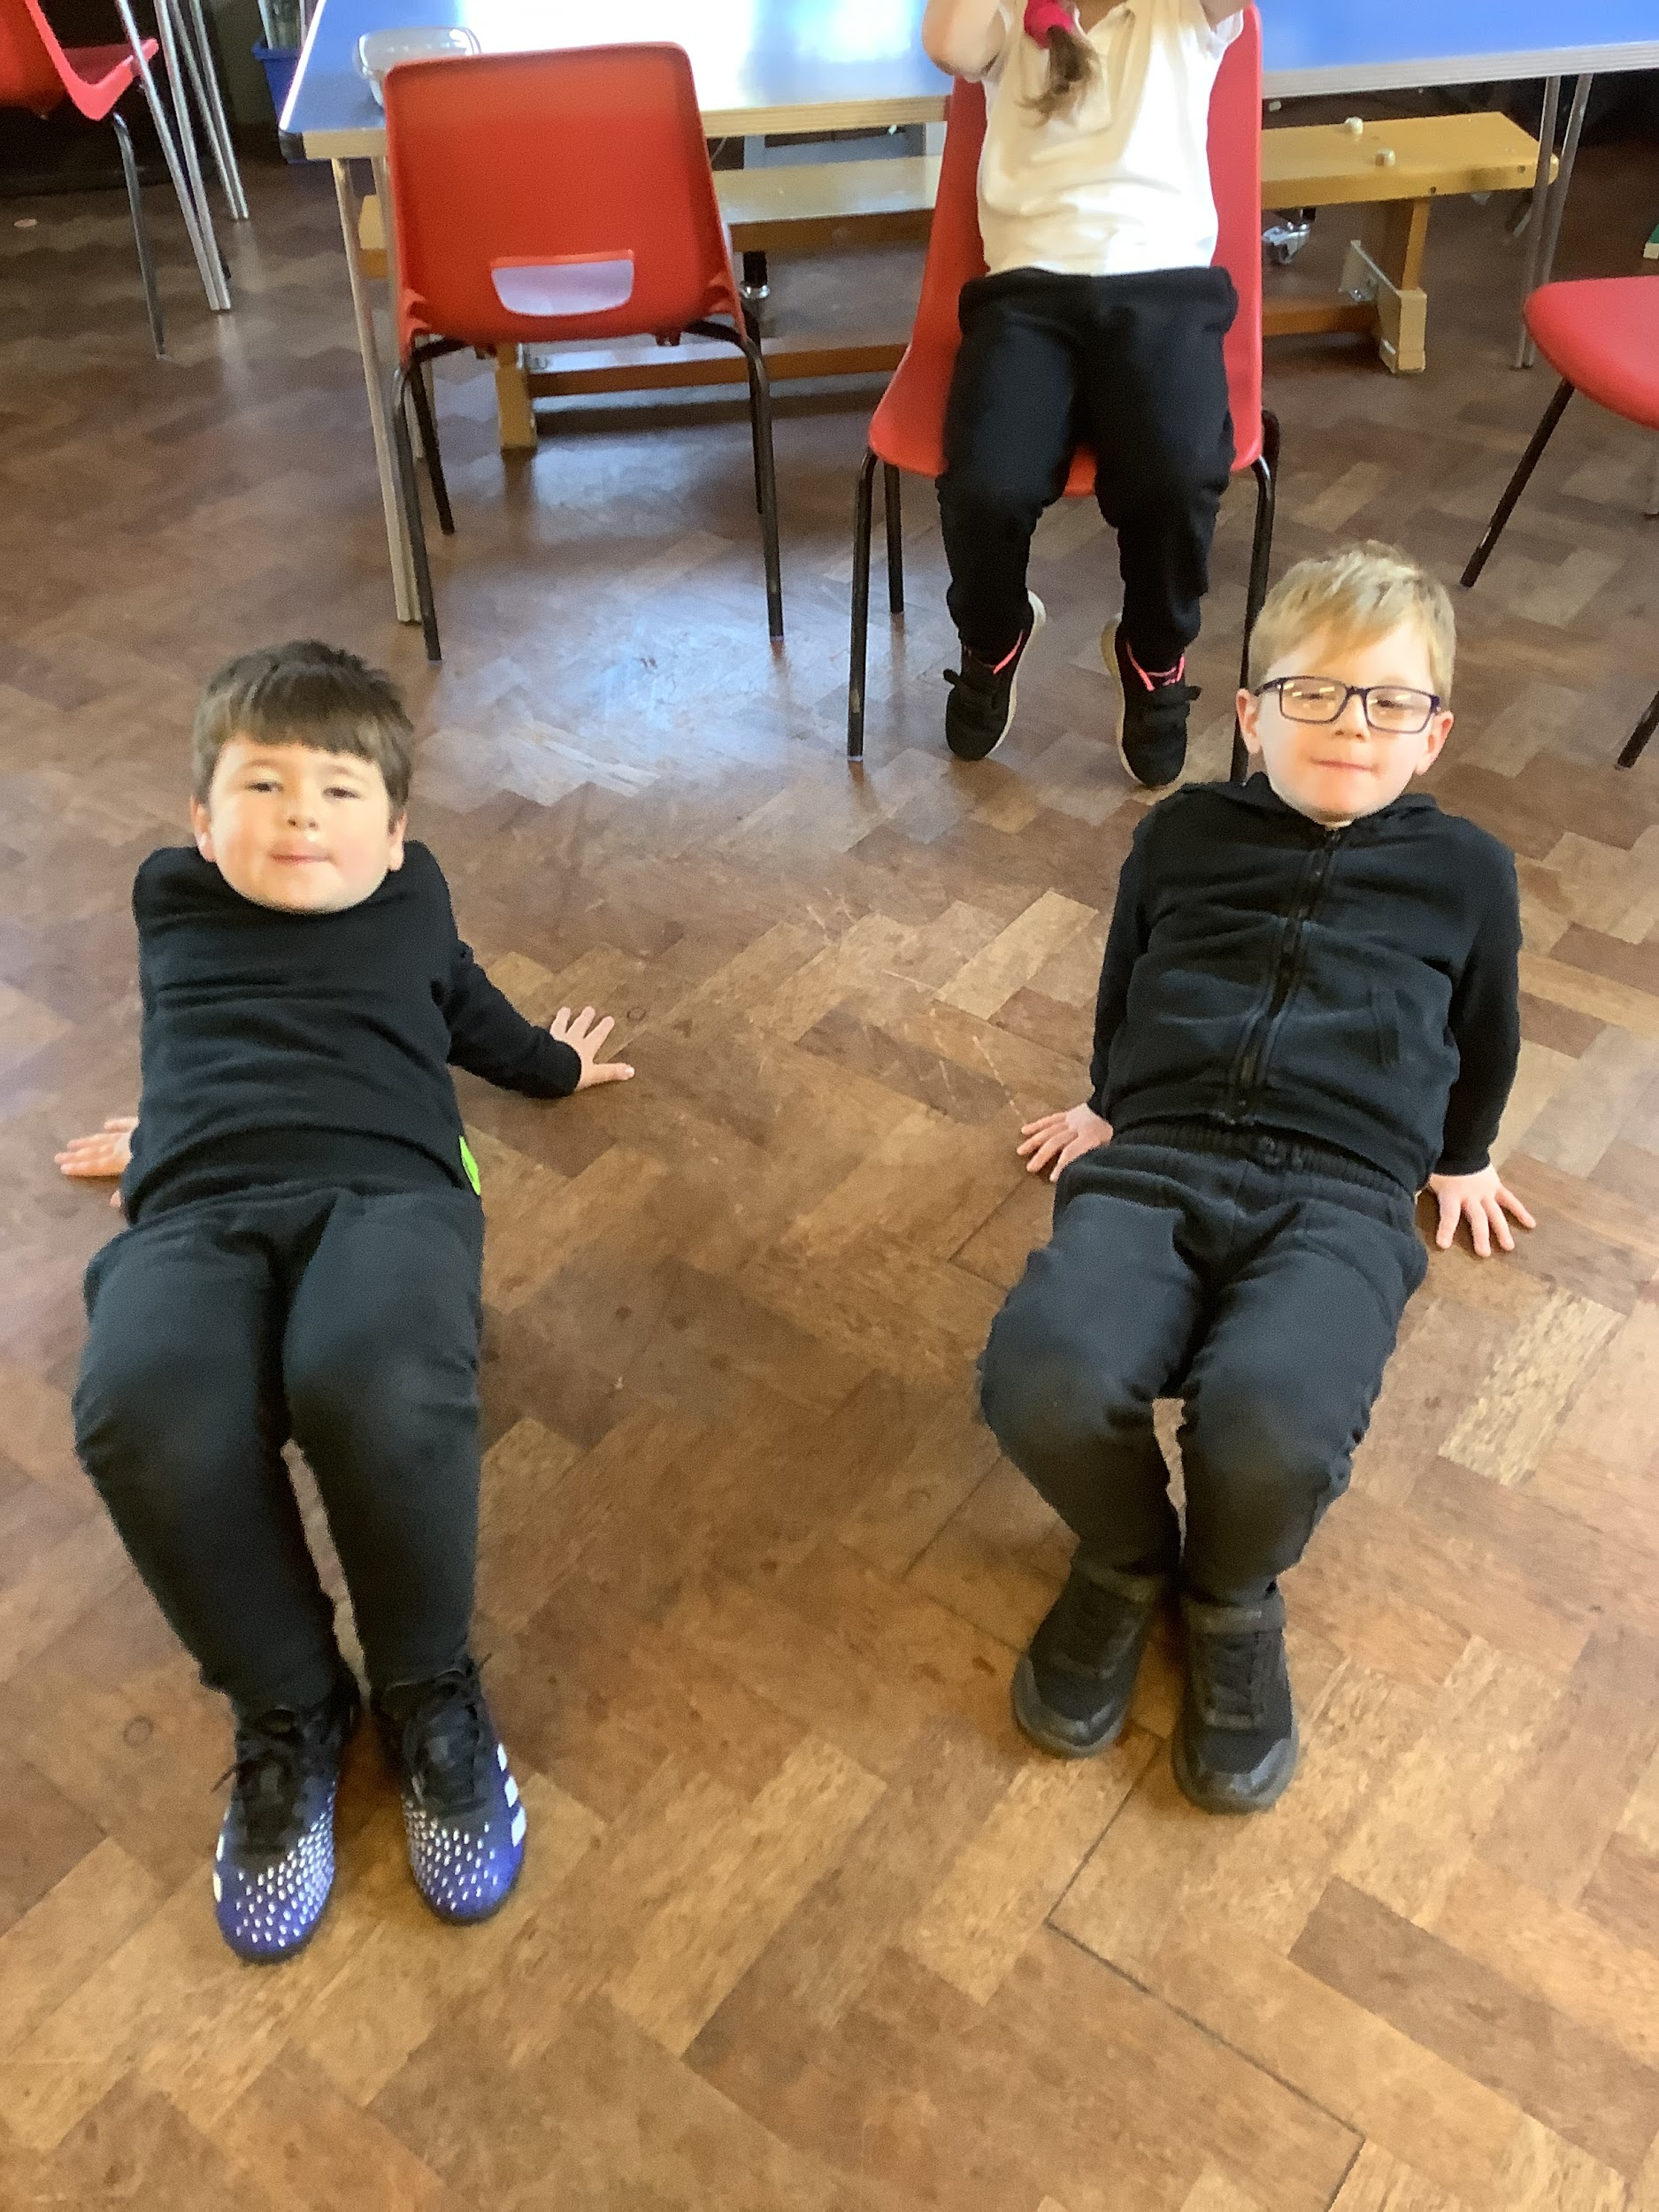
How can we make sure our school is just and fair?

