Slide 1
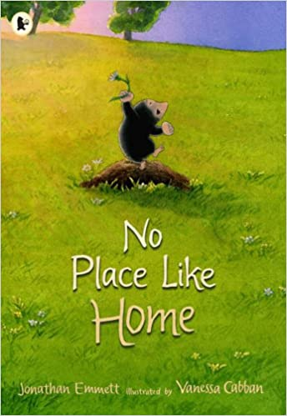
KS1 Living Things and their Habitats Knowledge Mat
Subject Specific Vocabulary |  | Interesting Books | Sticky Knowledge about habitats
dinosaur | Dinosaurs were the main animals on Earth for more than 150 million years. They were lizard-like reptiles.
 |  |  | A habitat is a place that an animal lives. It provides the animal with food, water and shelter.
indigenous | Produced, growing, living, or occurring naturally in a particular region or environment.
rivers | A river is a flowing, moving stream of water. Usually a river feeds water into an ocean, lake, pond, or even another river. |  | There are many different sorts of habitats around the world from forests to grasslands and from mountain slopes to deserts.
woodland | Woodland is a low-density forest with plenty of sunlight and limited shade.
 |  |  | Animals like cockroaches are really important in a habitat -they eat the dead plants and recycle the nutrients back into the soil.
ponds | A pond is a body of water smaller than a lake. Ponds support a very wide range of wildlife.
 |  | Important facts to know by the end of the habitats topic:
sea | A sea is part of the ocean partially enclosed by land. Seas are found on the margins of the ocean and are partially enclosed by land.
 |  | know how a specific habitat provides for the basic needs of things living there | People are causing harm to many habitats. Forests are being burnt down, lakes and rivers polluted and the polar ice caps are melting.
rainforest | Tropical rainforests are forests with tall trees, warm climates and lots of rain.
 |  | identify and name plants and animals in a range of habitats
desert | A desert is any large region that gets very little rain each year. Very few plants or animals live in desert areas.
 |  |  | Because resources like water and food may be limited, plant and animal species often compete with each other for food and water.
 |  | match living things to their habitat
species | A group of animals, plants or other living things that all share common characteristics and that are all classified as alike in some manner.
 |  | know how animals find their food
 |  | name some different sources of food for animals | Because the Earth is always changing, habitats are constantly changing.
microhabitats | Microhabitats are the small-scale physical requirements of a particular organism or a community of organisms.

Slide 2
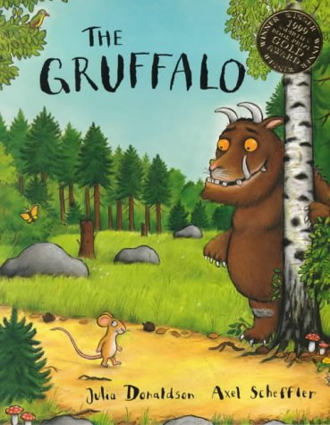
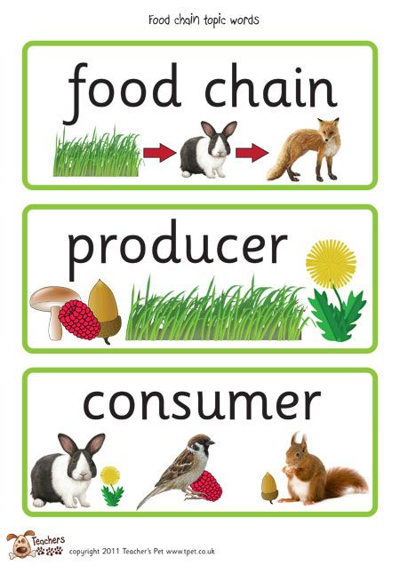
KS1 Animals including humans - Food Chains Knowledge Mat
Subject Specific Vocabulary |  | Interesting Books | Sticky Knowledge about food chains
carnivore | A carnivore is a meat-eating animal that gets its food from killing other animals.
herbivore | A herbivore eats plants. |  | Humans are omnivores.
omnivore | An omnivore eats plants and meat.
 |  |  | Plants are normally at the bottom of food chains.
predator | The top of the food chain.
 |  |  | A food chain shows how each animals gets its food.
Food chain | Shows how/where living things get food.
 |  | Important facts to know by the end of the food chains topic:
habitat | A place where someone of something lives.
 |  |  | Food chains are one of the ways animals depend on each other to survive.
survive | To live.
Producer | The bottom of the food chain.
 |  |  | Because resources like water and food may be limited, plant and animal species often compete with each other for food and water.
Food | Gives energy and nutrients.
 |  |  | Because the Earth is always changing, habitats are constantly changing.
Hunt | The process of finding food.

Slide 3
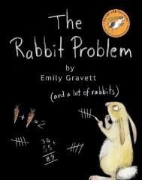
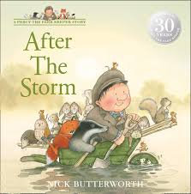
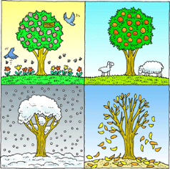
KS1 Seasonal Change Knowledge Mat
Subject Specific Vocabulary |  | Interesting Book | Sticky Knowledge about seasonal change
Autumn | The time of year between September and November. Many leaves fall off the trees.
Spring | The time of year between March and May. There is usually lots of signs of new growth in Spring.
 |  |  | In the UK we have four seasons: spring, summer, autumn and winter. Summer is the hottest season and winter the coldest.
Summer | The hottest season in the UK. It happens between June and August. The longest day is June 21st.
 |  |  | Spring starts when the day and night are the same length (usually 21st March. However, many say that Spring starts on March 1^{st)}.
Winter | The coldest season in the UK. We can have snow in this season. It occurs between December and February.
Fall | The name given to the Autumn season by Americans. It is because so many leaves fall off the trees.
 |  |  | In summer the longest day of the year is around June 21st and in winter the shortest day of the year is usually December 21st.
weather | Weather is what the sky and the air outside are like, such as cold and cloudy.
temperature | It is measurement of hot or cold that can be measured using a thermometer.
 |  |  | When we have our summer it is winter in the southern hemisphere. When we have our winter Australia has its summer.
thermometer | This is the instrument that measures the temperature.
weather symbol | These are signs used to help us understand more about our daily weather. |  | In the USA and many other countries the season ‘Autumn’ is known as the ‘Fall’. This is because so many leaves fall from the trees in Autumn.
deciduous | Deciduous trees are trees that shed their leaves once a year, usually during the season of autumn.
coniferous | Most conifers are evergreens, or trees that keep their leaves year-round. |  | Seasons change throughout the year because of the way the Earth travels around the Sun.

