Slide 2
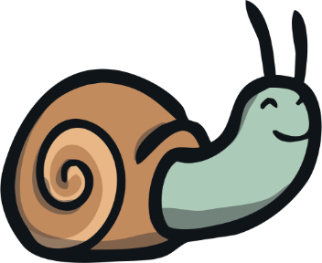
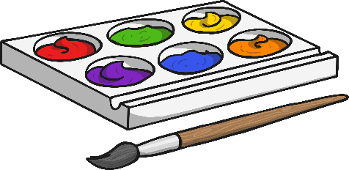
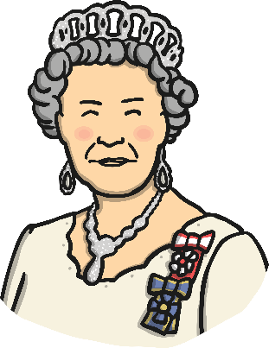
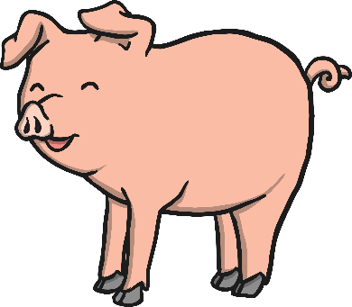
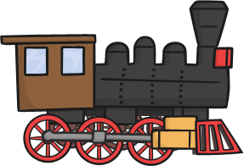
Click the pictures that contain the ‘ai’ sound to move them into the middle.
ai

Slide 3
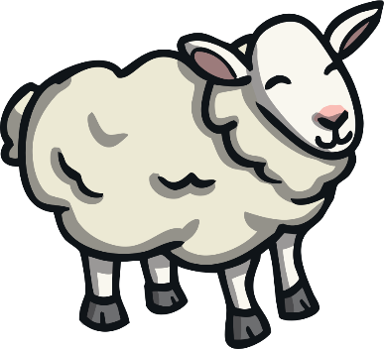
Click the pictures that contain the ‘ee’ sound to move them into the middle.
ee

Slide 4
Click the pictures that contain the ‘igh’ sound to move them into the middle.
igh

Slide 5
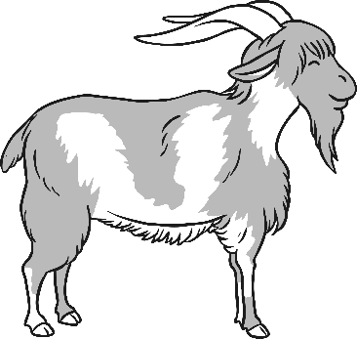
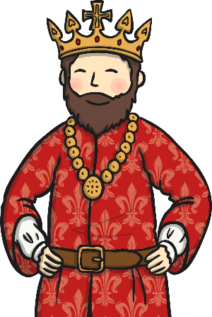
Click the pictures that contain the ‘oa’ sound to move them into the middle.
oa

Slide 6
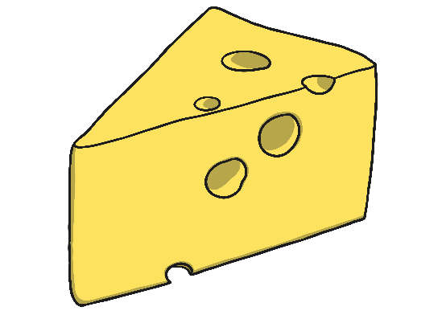
Click the pictures that contain the long or short ‘oo’ sound to move them into the middle.
oo

Slide 7
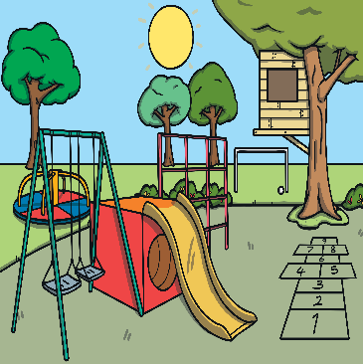
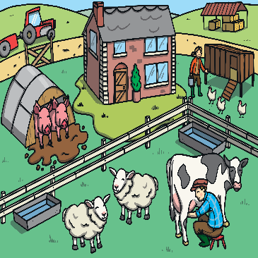
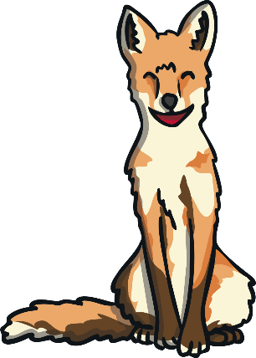
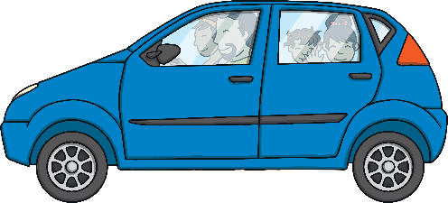
Click the pictures that contain the ‘ar’ sound to move them into the middle.
ar

Slide 8
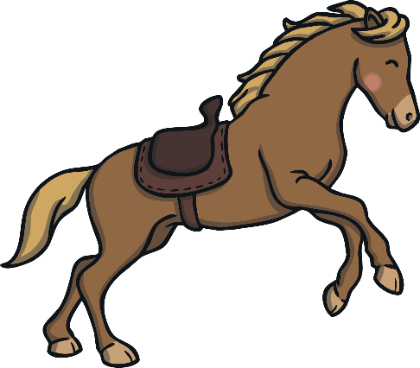
Click the pictures that contain the ‘or’ sound to move them into the middle.
or

Slide 9
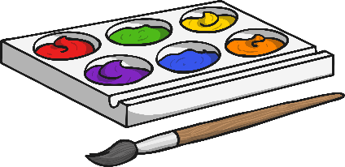
oa
igh
ee
ai
ar
or
oo

