Slide 1
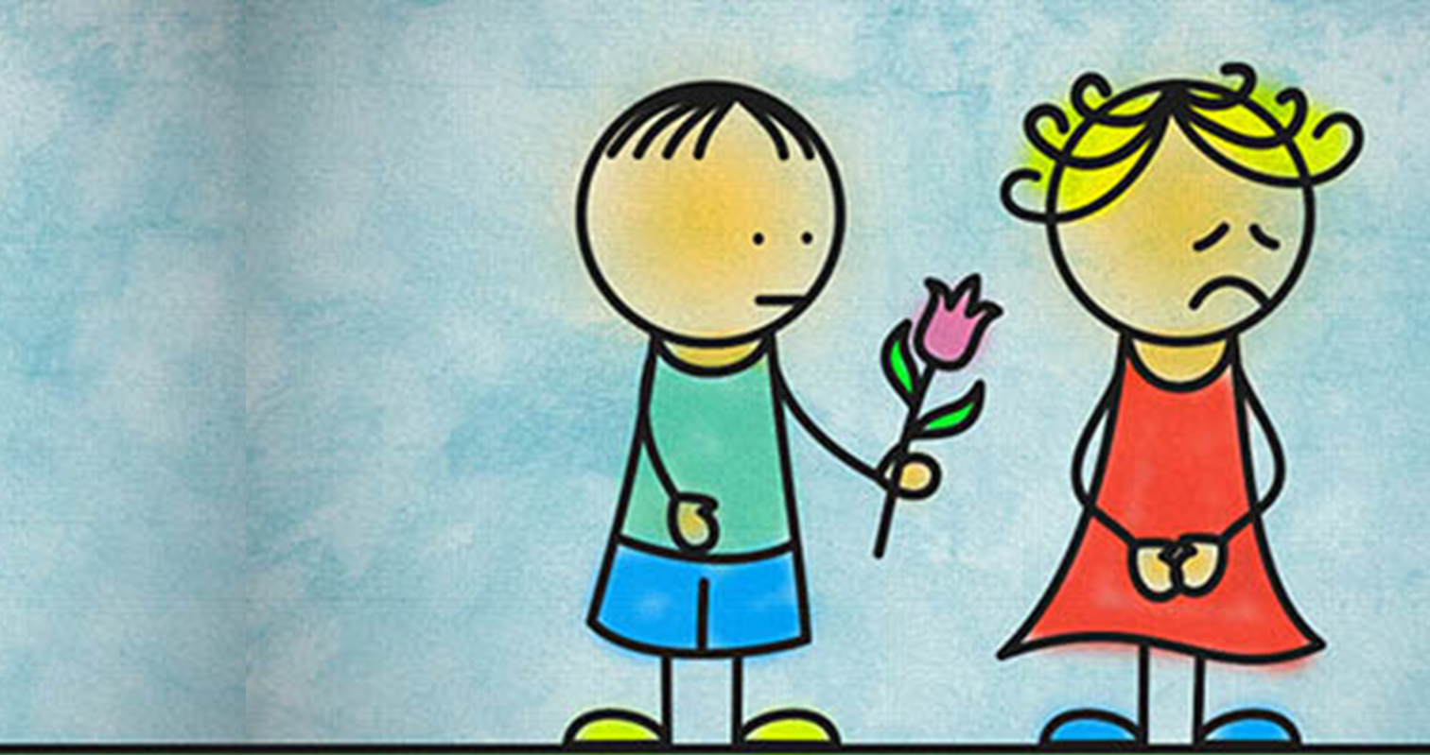
How does Jesus expect us to act with forgiveness?
Forgiveness
Collective Worship.

Slide 2
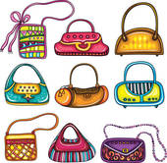
If you couldn’t find your purse with your money in, what would you do?
How would you feel?
Notes:
Decide who is going to be your partner so you can talk to them.

Slide 3
In Matthew's gospel Jesus is talking to the crowd when he says:
For if you forgive others the wrongs you have done, your heavenly Father will also forgive you; but if you do not forgive others, then your Father will not forgive the wrongs that you have done.
Matthew 6:14-15

Slide 4
On her way into school that morning Jane had shown Julie her money in a little bright red purse.
“I’ve got two pounds for after school,” she said excitedly.
“Why where are you going?”
“Granny is coming to collect me and we’re going to go to the garden centre to buy mum a plant for her birthday. It’s a big secret; we’re not going to tell her.”
Both girls smiled knowingly at each other as they waved goodbye to Jane’s mum with out saying another word about it.
But when Jane came to hang up her coat in the cloakroom the purse had vanished. Jane burst into tears.

Slide 5
“Jane take Julie and go and have a good look in all the places you’ve been in the playground,” suggested Miss Jones.
So they did. They looked by the gate; they looked by the tyres and last of all they looked down the centre of the playground where they all stood in line. But they didn’t find the purse.
“Well,” sighed Miss Jones “Please bring your coats into the classroom and we’ll check everybody’s pockets.”
There in Stephanie’s inside pocket was the red purse with the shiny two pound coin inside it.
“It’s mine; it’s for buying sweets on the way home!” Stephanie lied defiantly but no-one believed her.

Slide 6
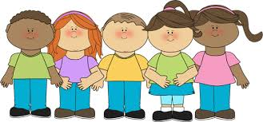
“Well Stephanie this is very serious,” said Miss Jones, “you’ll have to stay in at playtimes today and when your mum comes to collect you tonight I’ll be having a word with her.”
That made Stephanie cry too.
“Are you really sorry?” asked Miss Jones and Stephanie nodded furiously, “so what does sorry mean?”
“It means I won’t do it again,” came the stout reply.
“Then go and say you’re sorry to Jane now, ”said Miss Jones with a smile.

Slide 7
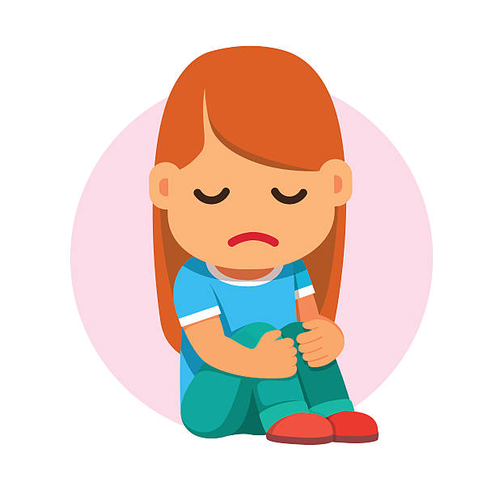
Stephanie didn’t really know why she’d taken the purse. She’d simply found it by the gate but instead of handing it in she’d put it quickly into her inside pocket. Now she sat by herself inside while everybody else played outside. Her heart was heavy and sad, she wished heartily that she hadn’t taken the purse but she couldn’t change what she’d done.
When granny picked Jane up after school, she told her all about the incident.
“Oh dear, what a muddle,” said granny “have you made friends again yet?”
“No!” said Jane indignantly “I’ll never be friends with Stephanie again!”
“Never is a long time,” said granny.

Slide 8
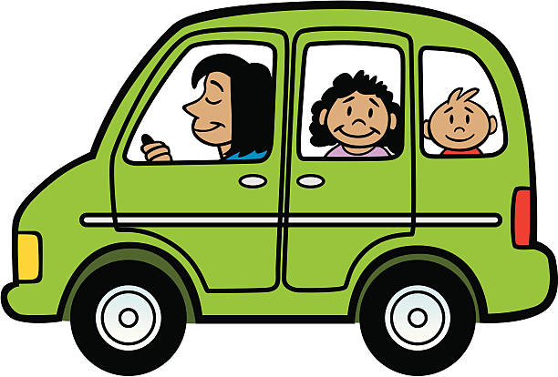
Once they were driving down the quiet country road to the garden centre granny said,
“You know Jesus expects us to forgive others even when we feel badly treated.”
Jane scowled.
“In the Lord’s prayer we ask God to forgive us the wrongs we’ve done to other people in the same way as we forgive other people the wrong things they have done to us. That means if we won’t forgive other people, God can’t forgive us our wrong things either.”

Slide 9
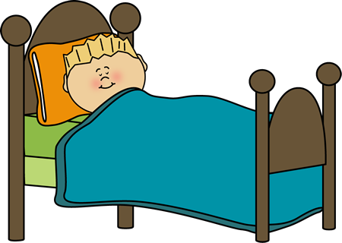
When Jane went to bed that night she still felt cross and grumpy. She tossed about from side to side and not even Mr Ted could comfort her. She kept thinking about how she hadn’t helped granny put the plants away in the greenhouse or given her a kiss when she went home. Stephanie had just spoilt her trip with granny. Now she wasn’t even sure she’d chosen something mum would like. It was all going to be spoilt.
As she was drifting off to sleep, she thought about what granny had said. Quietly she asked Jesus to help her forgive. After all she had got the money back and she had been able to go and get the present. Perhaps, she thought, tomorrow she might just be able to ask Stephanie to play with her and Julie after all

Slide 10
When God asks us to forgive other people it is just too hard to do.
Agree or disagree?
Who would God forgive, Stephanie or Jane?
Who was right in the end, Jane or Stephanie?
Should people always be punished when they hurt others?

Slide 11
Think about the last time you did something unkind to someone else, it may have been in school or it may be at home.
Why did you do it?
Was the other person really sad?
Were you sorry afterwards about it and whished you could change it?
Give it to God now so he can forgive you and it can be forgotten and you can have a new start.
Lord Jesus, help us this day to forgive those hurts we keep locked up inside us so that we can start again with gladness. Amen
Notes:
You may want some quiet music for the back ground to this.
If you’re in the classroom you may want to give each child a pebble so they can put their action onto it and then put it into a central basket as they give it to God.
Allow the children plenty of time to think about their forgiveness using the prompts.

