Slide 1
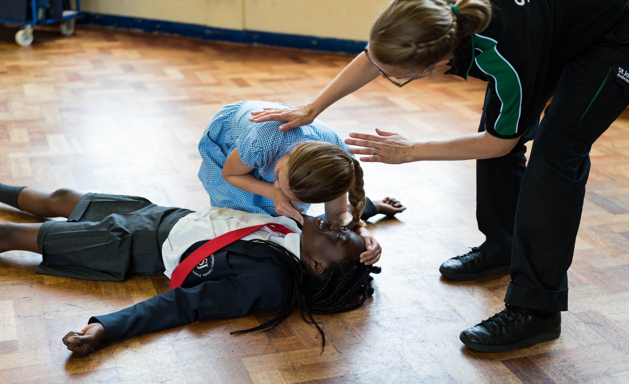

Basic life support
KS2 – Basic life support

Slide 2
Casualty care A17
There are lots of things to remember when taking care of somebody.
Which three of these casualty care actions do you think are the most important?
Remain calm
Treat the casualty with dignity and respect
Get help
Reassure the casualty
No food or drink
Communicate well
Prevent the condition from worsening
Keep the casualty warm
Notes:
ALL the answers are correct and ALL very important- answers and opinions from students will differ- use material a talking point rather than correct/ incorrect answers.
Card sorting activity can be made if preferred.

Slide 3
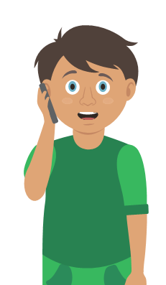
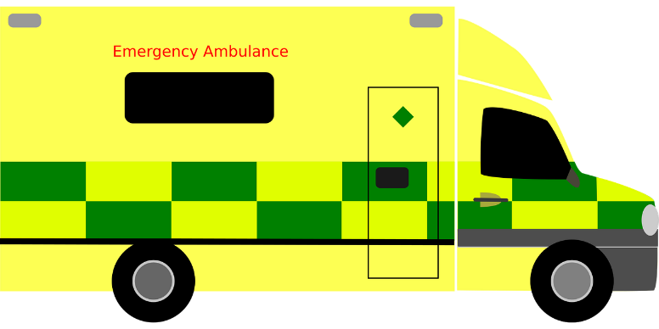
Calling for help
If there is an e_ _ _ _ _ _ _ y you can dial 999 or 112 to get the emergency services
The call operator will ask, “Which service do you require?’’ F_ _ _,
P_ _ _ _ _ or A_ _ _ _ _ _ _ _?
You will need to tell them which service you need
It is really important that you give information to help them arrive at the correct location i.e. address
KS2 - Basic Life Support
Notes:
Options: call out answer or use whiteboards or paper to write answers
Answers
Emergency
Fire, Police or Ambulance

Slide 4

Remember LIONEL
Location. Tell them where the emergency is and where you want them to arrive
Incident. Tell them what has happened
Other services. Do you need more than one?
Number of people that are involved
Extent of the injuries. What types of injuries do people have?
Location. Repeat again where they need to arrive
Question:
Do you know the correct addresses for two or three places you often visit?
KS2 - Basic Life Support
Notes:
Explain the acronym of LIONEL and the importance of this information

Slide 5

999/112 calls
Thumbs up
if the information is
key to a 999/112 call
Thumbs down
if it is not relevant information
  What you had for tea last night
  What happened
  What football team you support
  Where you are
  What is wrong with the casualty
KS2 - Basic Life Support
Notes:
Can be stand up and sit down/ thumbs up / down if needing an energiser to focus group select what works best.
Questions:
Age and gender of the casualty?
What team you support?
Is the casualty breathing?
What’s happened?
How tall you are?
The address of the incident?
Last night’s tea?

Slide 6
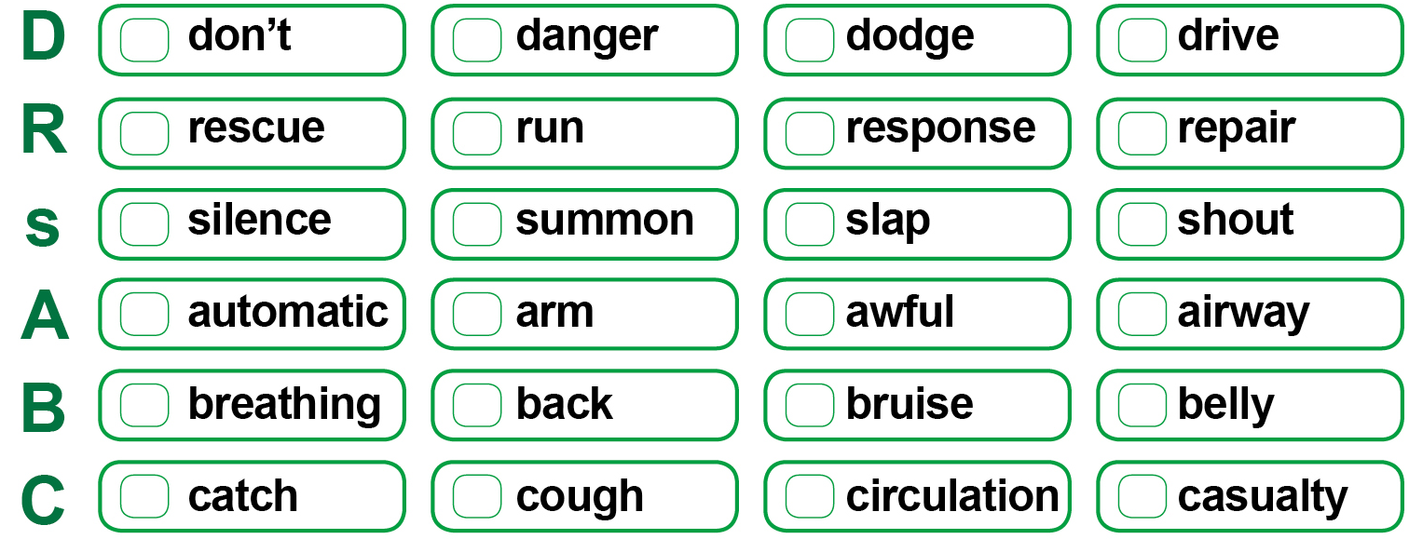
Primary survey
Choose the correct word for each part of the primary survey
Challenge: Why is it important we use DRsABC?
KS2 - Basic Life Support
Notes:
Use the DRSABC to get the students to guess the correct words for the acronym. Can be a hands up/down activity or can be used as a table top activity using A3 laminated sheets and a counters

Slide 7
Primary survey
Choose the correct word for each part of the primary survey
Challenge: Why is it important we use DRsABC?
KS2 – Basic Life Support
Notes:
Answers to previous slide

Slide 8
Watch this video
https://youtu.be/lCMhuRM0cIU
KS2 – Basic life support

Slide 9
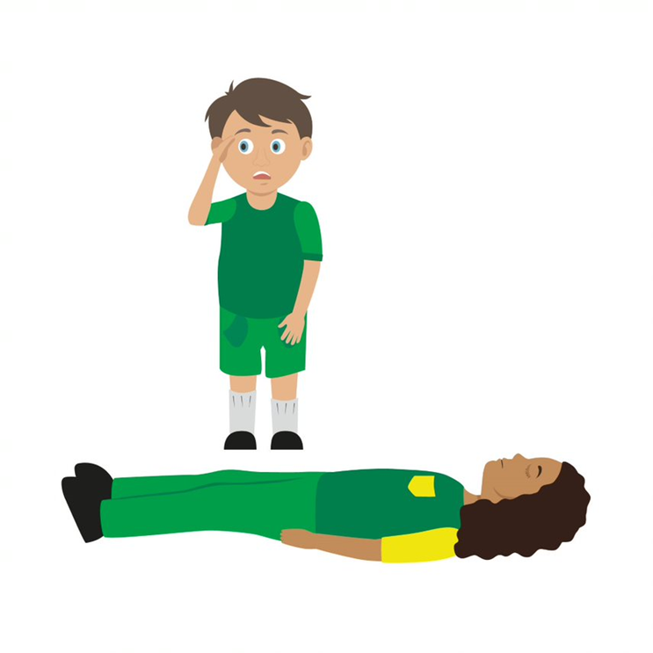

Your turn: Primary survey
1. Check for danger
Always make sure the area is safe
2. Response
Check the casualty’s response. Ask questions and gently tap shoulders. Say “open your eyes!”
3. Shout for help
Anyone nearby can assist you
4. Airway
If not clear, then open by tilting the head back, use one hand on forehead and two fingers under the chin
5. Breathing
Check for normal breathing. Use look listen and feel to check. (Remember 10 seconds!)
6. Circulation (only if breathing normally)
Check the casualty for bleeding
NB
If the casualty is not breathing normally call 999/112 then start CPR
If the casualty is breathing normally place them in the recovery position then call 999/112
KS2 – Basic Life Support
Notes:
Trainer demonstrates then gets the students to practice using either the PP slide as a prompt or the sheet in the workbook. Trainer circulate and correct as necessary

Slide 10

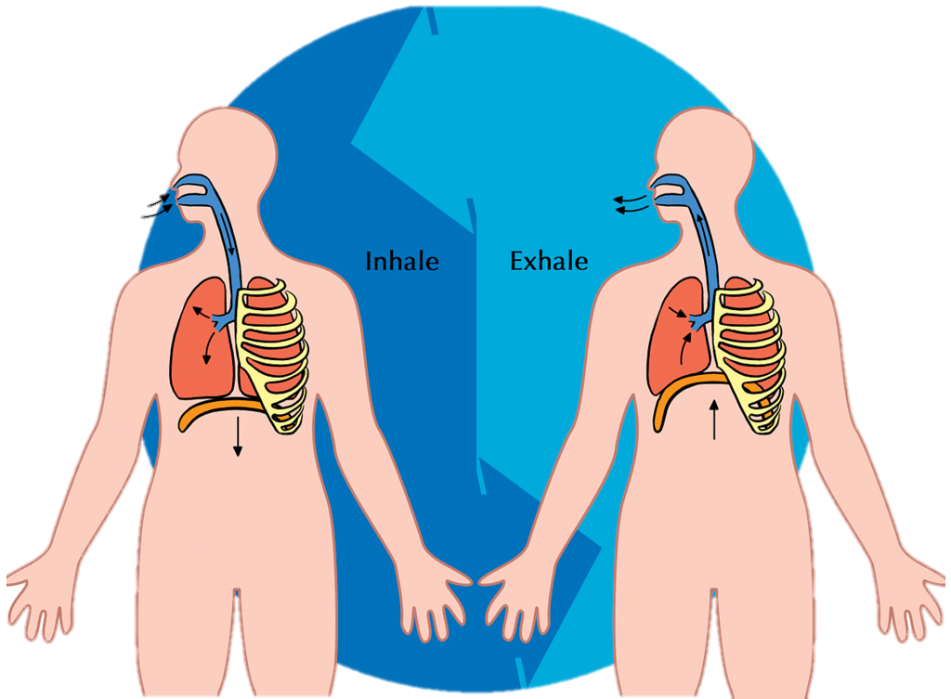
Recap
Danger
Response
Shout
Airway
Breathing
Circulation

Slide 11
Watch this video
https://youtu.be/ubbZU15-ETM
KS2 – Basic life support

Slide 12
Your turn: Recovery position
1. Kneel
By the side of your casualty
2. Angle arm
Put the arm nearest to you to make a right angle. Palm facing upwards
3. Hand to cheek
Bring the arm furthest away across the chest and place the back of their hand against the cheek nearest to you
Hold it there
4. Knee bend
With other hand, bend their far knee up so that the foot is flat on the floor
5. Knee pull
Pull on the knee to roll the casualty towards you onto their side
Adjust them as necessary
6. Ensure airway is open
Recheck breathing
Call 999/112
Stay and monitor casualty until help arrives
KS2 – Basic Life Support
Notes:
Trainer demonstrates then gets the students to practice using either the PP slide as a prompt or the sheet in the workbook. Trainer circulate and correct as necessary

Slide 13
Watch this video
https://youtu.be/zZAIA7Iqhyo
KS2 – Basic life support

Slide 14
CPR
If you are a young person , you may not be strong enough to do CPR. That’s OK, you can tell someone else what they need to do
It’s important to know that sometimes even CPR cannot help someone if they are really poorly
Anything you can do to help, even just calling for help, will be really useful
Never do CPR on someone if they are awake and breathing normally

Slide 15
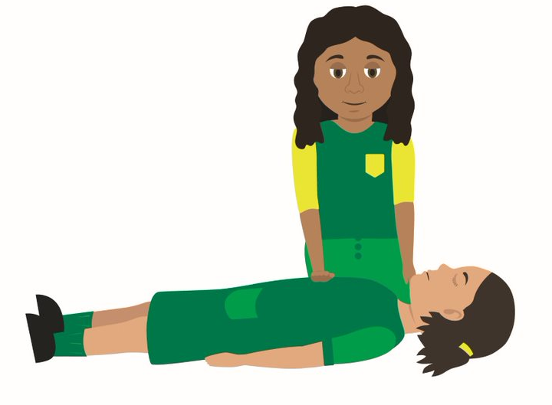
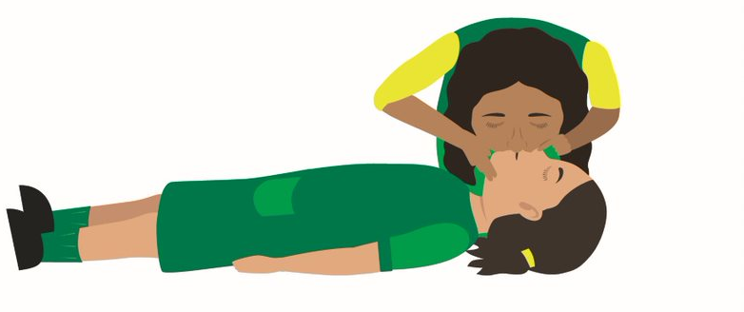
Your turn: CPR
1. Call 999/112
Kneel by the side of your casualty
Send a bystander for an AED if one is available
2. Place one hand..
On the centre of the chest
Put the heel of the other hand on top
Interlock your fingers to lift them off the chest
3. Begin chest compressions
Lean over with your arms straight
Press downwards on breastbone 30 times
4. Press down
To a depth of about 5-6cm
Release the pressure but leave hands in place
Try to press at a rate of 100-120 times per minute
5. Breathe into casualty
open the airway and pinch the nostrils together
take a breath and blow into the mouth until the chest rises
repeat to give two breaths
6. Start compressions again
repeat 30 chest compressions with two breaths until help arrives
NEVER do this on someone if they are awake!
KS2 – Basic Life Support
Notes:
Stress NOT doing this on someone who is breathing normally
Consider W6 sorting table top activity if space ltd or not enough mannequins.

