Slide 1
Believe and Achieve
Love.Respect.Friendship

Slide 2
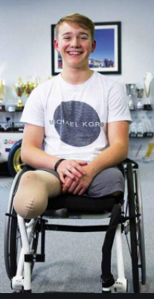
Last week Billy Monger
taught us how to fly
like an eagle with his…
Positivity
and Resilience

Slide 3
This week
Rosa Parks
Will fly like an eagle…..

Slide 4
America in the 1950’s
The black community are segregated from the white.

Slide 5
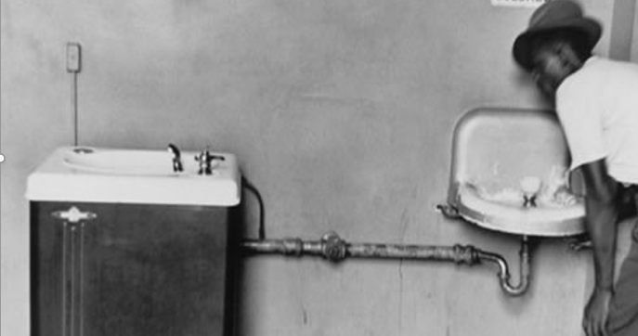

Slide 8
Whilst the white
took the four rows
at the front
of the bus
On the buses, black people were made to sit in the back rows
x

Slide 9
But if the front rows were full
The black passengers were expected to give up their seats
x

Slide 10
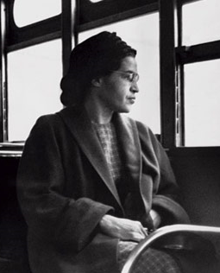
On December 1st, 1955
Rosa Parks was travelling home on the buses from a day at her work as a seamstress

Slide 11
She took her seat…
x
Rosa’s seat

Slide 12
After a few stops, the seats
began to fill

Slide 13
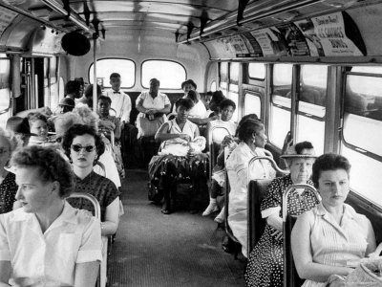

Slide 14
And when a white man entered the bus, the driver insisted that Rosa and the three other passengers on her row
give up their seats for him.

Slide 15
Rosa refused

Slide 16
Which of our learning tools or values did Rosa use that day?
Notes:
Positivity, resilience, leadership, optimism, team work, creativity
Courage

Slide 17
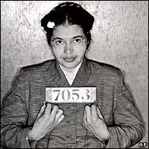

Slide 18
She was arrested. How does this make you feel?

Slide 19
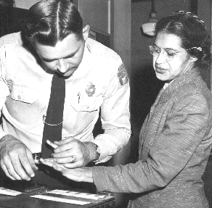
Rosa Parks believed in a world where black and white communities could live and work together

Slide 20
She was later named the ‘Mother of the Civil Right’s Movement’
for her refusal on that day

Slide 21
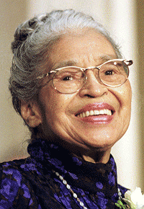

Slide 22
"My message to the world is that we must
come together and live as one"

Slide 23
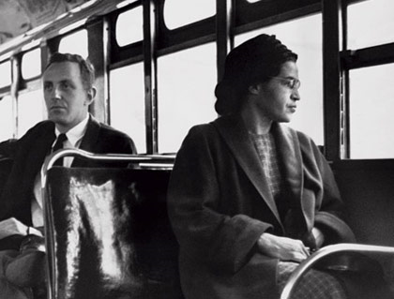
For those that
wait upon the Lord

