Slide 1
Coming up this week…
This assembly will cover:
Thought of the Week: What kind thing will you do this week?
Be informed: What does kindness look like?
Be curious: How does a feeling spread?
Be heard: What will you do?
Making your voice heard!
Please Note:
This assembly is a modified version of our original assembly from February 2020, in case it looks familiar!
Videos:
N/A
Notes:
Images
iStock

Slide 3
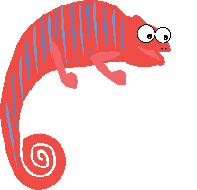
Thought of the Week…
What kind thing will you do this week?
Notes:
Images
iStock

Slide 4
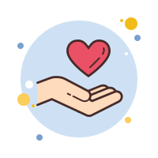
Be informed: What does kindness look like?
If the Coronavirus pandemic has taught us anything, it’s that kindness goes a long way, and is very important for strengthening our bonds with people – whether they are families, friends or even neighbours!
But being kind doesn’t need to be a big action; it can be as small as helping a parent or carer with some chores, paying a friend a compliment, or even just letting someone you love know that you are there for them.
Since everyone needs a little bit of kindness now and again, this assembly is going to show you the effect kindness has and why it’s important we all do what we can to bring a smile to someone’s face (and that others bring one to ours!).
Notes:
Images
Icons8

Slide 5
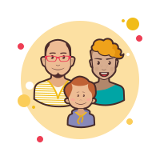
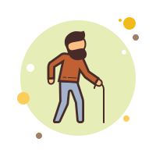
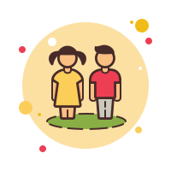
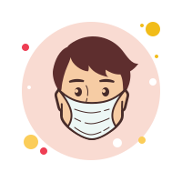
Be curious: How does a feeling spread?
Scientists in the USA have found out that one person’s happiness can spread to at least six other people!
This means that how you make another person feel can influence others too – this could be with kind words or a nice gesture.
The “ripple” effect!
Take a look at the diagram on the right. If your kind action is in the middle, who could the happy feeling you give someone eventually spread to? Use the ideas below to help you.
Your kind action
Close family
Wider family
School friends
Teachers & helpers
Friends of friends
Key workers
Notes:
Images
Icons8
References
https://www.weforum.org/agenda/2015/10/why-happiness-is-contagious/

Slide 6
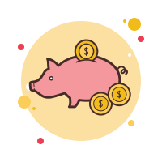
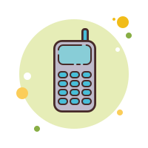
Be heard: What will you do?
Being kind from a distance!
It might feel impossible to think of kind acts you can do while everyone is at home. But it’s not impossible! Below are some ideas of things you could do to make the world a better place. For each action, put your hands up if you would like to do it, and put both hands up if you have done it before!
Challenge:
Imagine that everyone in your class did at least one kind thing this week. How many acts of kindness would that be?
Smile at anyone you see outside
Give someone a compliment
Say thank you to a key worker
Save up to make a donation to charity
Help with chores without being asked
Call a friend or family member
Send someone a letter or a card
Recommend a book or a film
Notes:
Images
Icons8

Slide 7
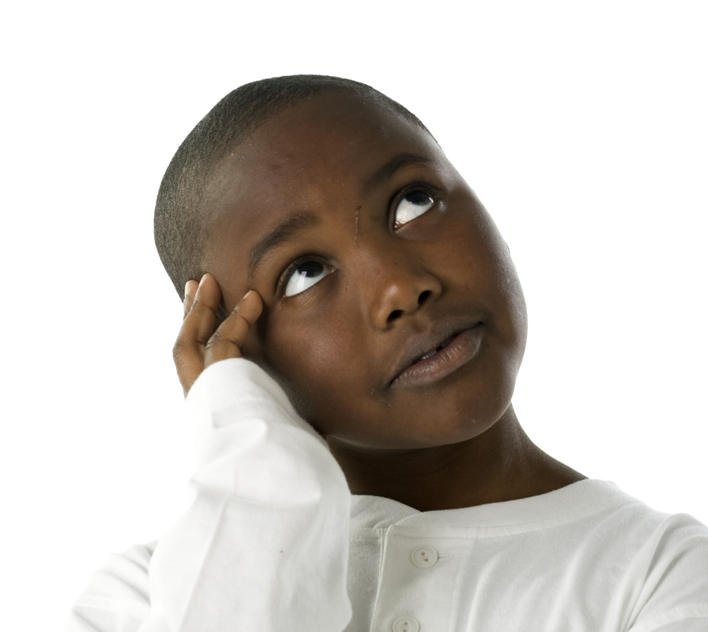
How do I make sure my voice is heard?
Cast your vote at the end of each lesson!
Voice your opinions during your VotesforSchools lessons!
Let us know any future VoteTopics you would like to see!
Send your thoughts and comments on the VoteTopic to us.
Even though you might be at home at the moment, you can still vote using our special SurveyMonkey link or email us!
Notes:
Images:
iStock
Icons8

